Slide 1
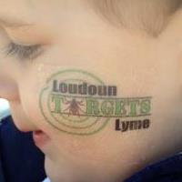
Lyme Prevention/Control at the Local Level
David Goodfriend, MD, MPH
Health Director, Loudoun Health District lyme@loudoun.gov

Slide 2
Lyme Disease - Early Surveillance

Slide 3
2006 Study
Objective:
  To determine risk factors for contracting Lyme disease in Loudoun County
Sample:
  371 Loudoun County Lyme disease cases reported between January 2003 and February 2006
Method:
  Surveys were mailed to all 371 people
Returns:
  184 valid responses (50.6%) were returned

Slide 4
Study Results
Notes:
Those between 11 and 50 were less likely to report a known tick bite
Those over 65 were more likely to believe they were infected on their own property

Slide 5
Notes:
Those between 36 and 50 were more likely to have a delay in diagnosis

Slide 6
Notes:
Those between 18 and 50 were less likely to remember a rash
Those between 36 and 64 were most likely to remain symptomatic after treatment

Slide 7
Intervention
Based on these findings, the Health Department conducted targeted outreach with education on steps people can take to:
  Keep ticks off themselves
  Keep ticks off their property
  Be aware of early signs and symptoms of Lyme disease
  Be aware that a bulls eye rash or tick may not be noted
  Seek medical attention quickly should signs or symptoms occur

Slide 8
Results of Intervention

Slide 9
2012
New Loudoun County Board of Supervisors elected
Candidates heard from many people with Lyme disease during their election
On March 20, Board passed a 10-Point Plan to Mitigate Lyme Disease in Loudoun County

Slide 10
10-Point Plan
Create a Lyme Disease Commission
Create a follow-up Lyme disease survey
Create high profile link to County’s Lyme web page
Develop educational materials
Organize education forums
Place information in local newspapers
Provide list of doctors knowledgeable about Lyme
Develop information on spraying for ticks
Provide education to County campers
Study feasibility of spraying county property and use of 4-poster deer feeders

Slide 11
2012 Follow-up Study
Sample:
  673 Loudoun County Lyme disease cases were reported between January 2009 and December 2011
Method:
  Surveys were mailed to the 668 of these cases who had complete mailing addresses
Returns:
  314 valid responses (47%) were returned

Slide 12
Comparison with 2006 Survey
2012 respondents were more likely to:
be diagnosed within a month of symptom onset (60% versus 46%)
check for ticks (85% versus 66%)
use pesticide on their property (19% versus 4%)
remove brush or leaf litter (33% versus 9%)

Slide 13
Comparison with 2006 Survey
2012 respondents were less likely to:
wear long sleeved shirts, pants and long socks (24% versus 48%)
tuck their pants into their socks (6% versus 17%)
wear light-colored clothing (13% versus 58%)

Slide 14
Next Step:
Should Loudoun Expend the Effort to Engage in A Broad Based Community Awareness Program?

Slide 15
No: Prevention is Easy,
Focused Outreach is Not Needed
Ticks don’t fly…person has to brush against tick to come in contact
Ticks take a while to transmit infection…in most cases tick must be on for 36 hours to transmit infection
Ticks are gross…people are already motivated to keep them off

Slide 16
No: Prevention is Hard,
Focused Outreach Won’t Work
Previous efforts have not reduced the number of new cases
Many people are coming in contact with ticks every day on their own property, requiring continuous active behavior change to prevent infection
Environmental changes to reduce tick habitats and rodent harborage won’t be done
Counties that have struggled with Lyme disease for 30 years still have high case counts

Slide 17
Yes: This Could be the Best
Time to Affect Change
The recently completed survey provides the most up to date guidance on areas to target
The community understands this is a significant issue in Loudoun County
The County and Town governments see this as a priority
The newly formed Loudoun Lyme Commission is an independent voice for change

Slide 18

Campaign Creation
Loudoun created a planning team comprised of the Health Department, Parks & Recreation, PIO, Lyme Commission, Loudoun Health Council and National Capital Lyme
Branded campaign through
both a name the campaign
competition and a create a
logo competition
Campaign to take place
April through June 2013

Slide 19
Campaign Approach
Target different populations
Target people at each stage of change
Repetition
Multiple Modes

Slide 20
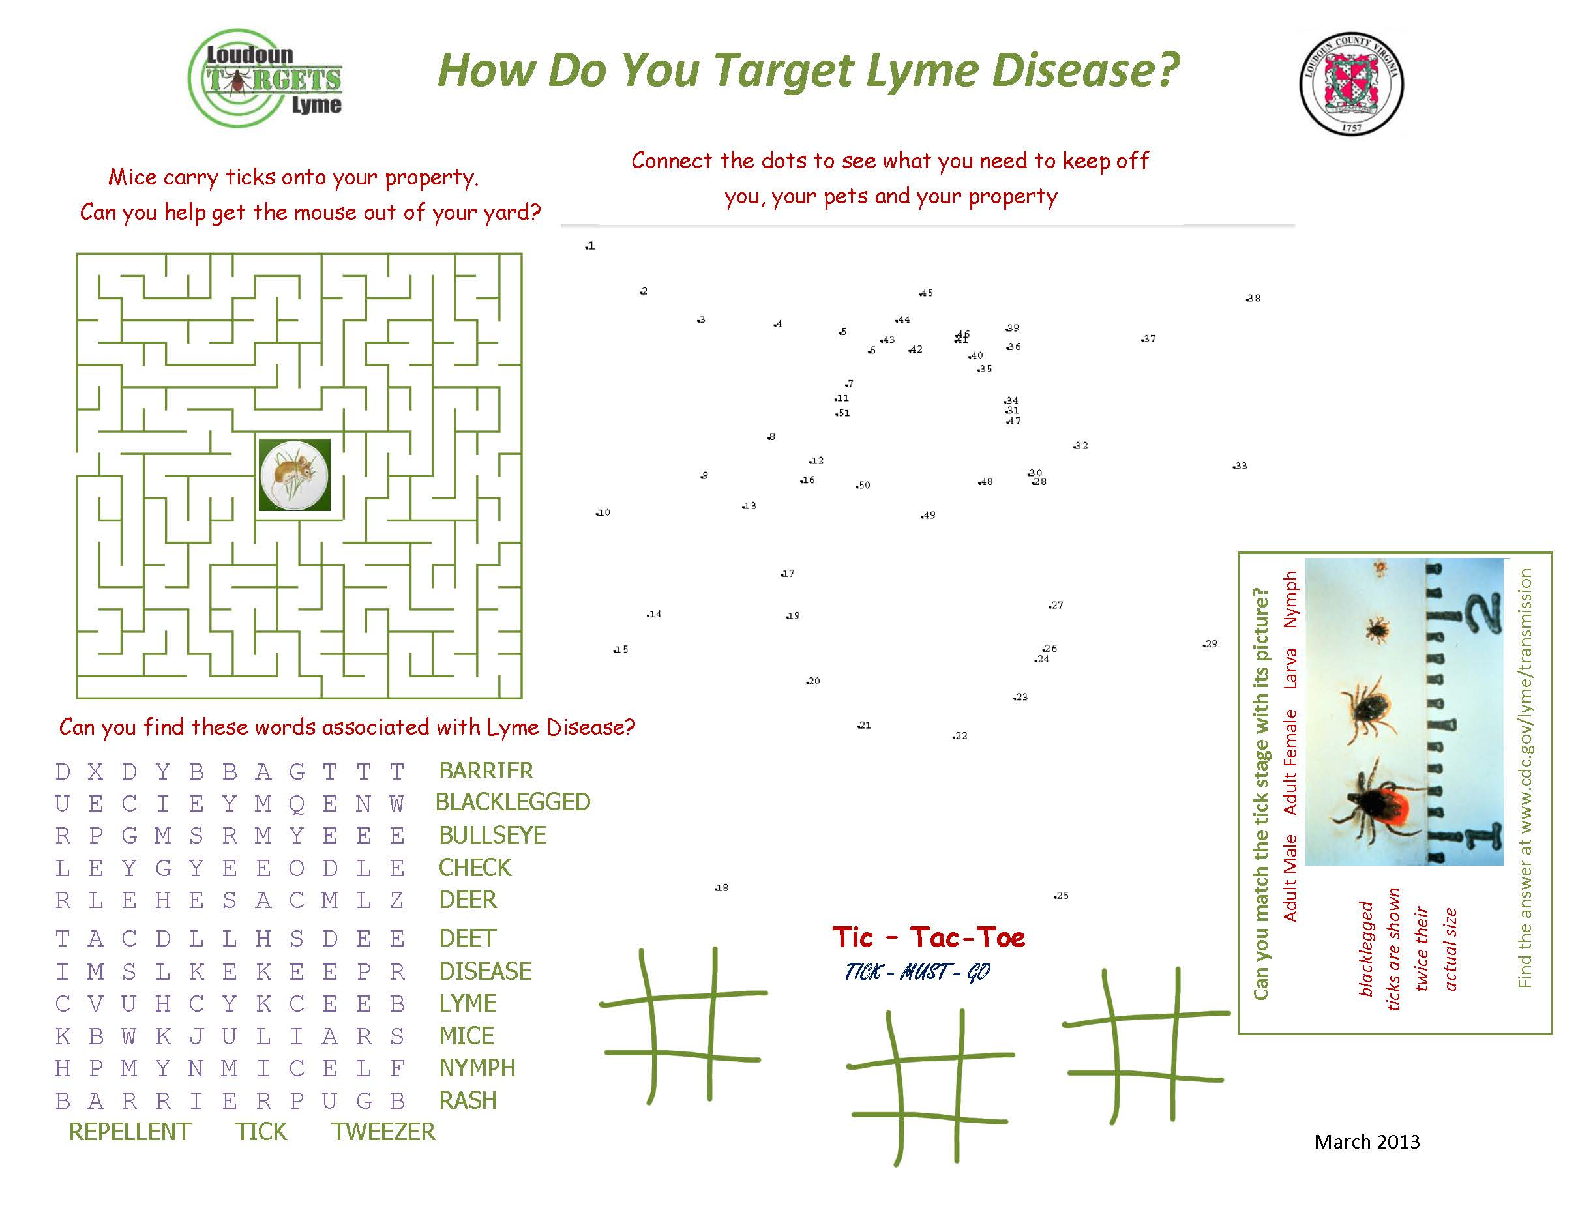

Slide 21
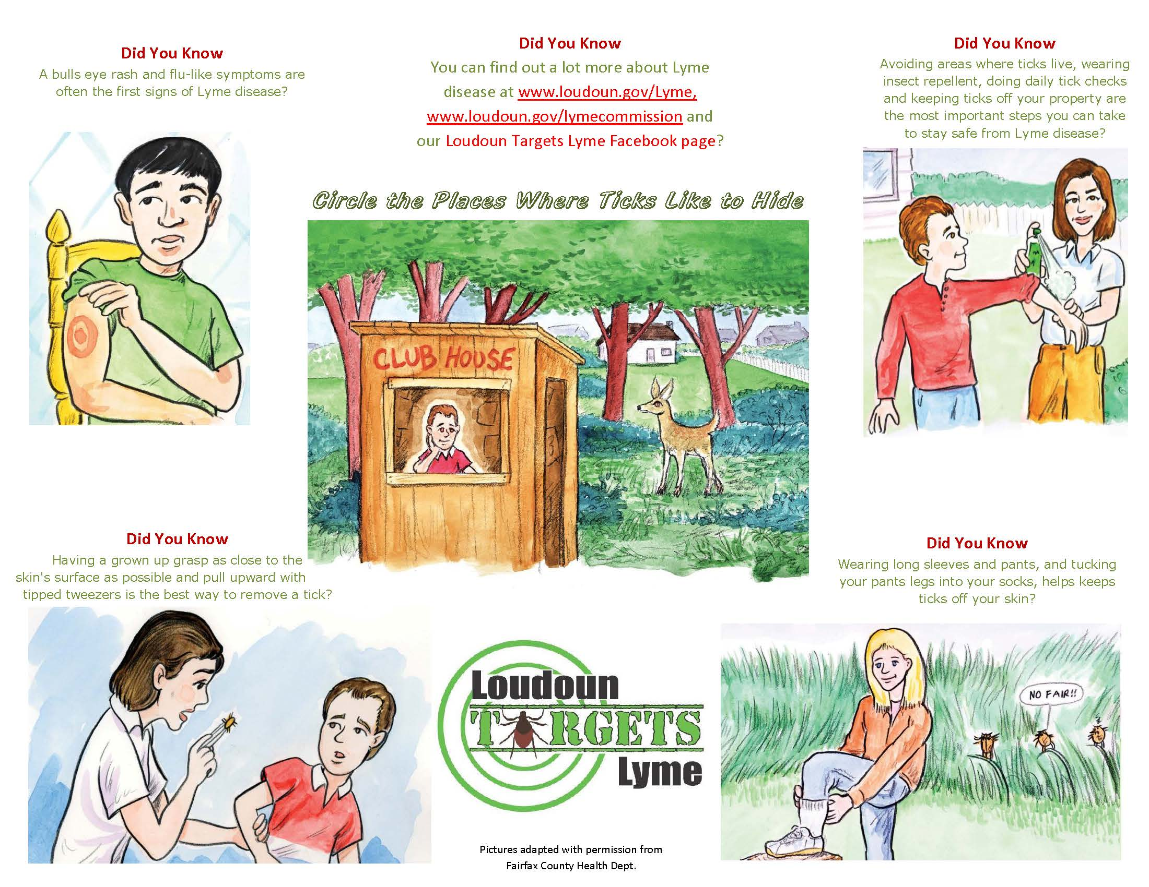

Slide 22
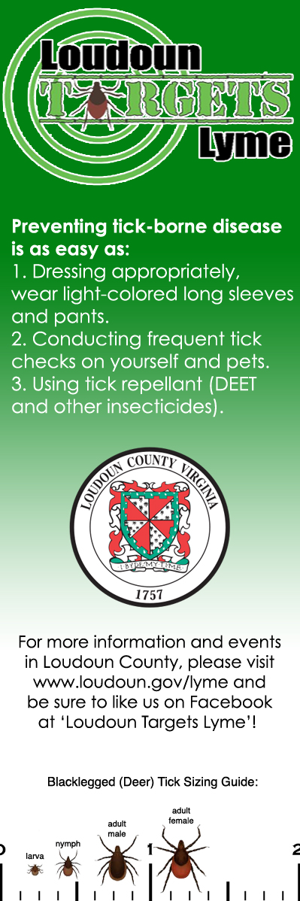


Slide 23
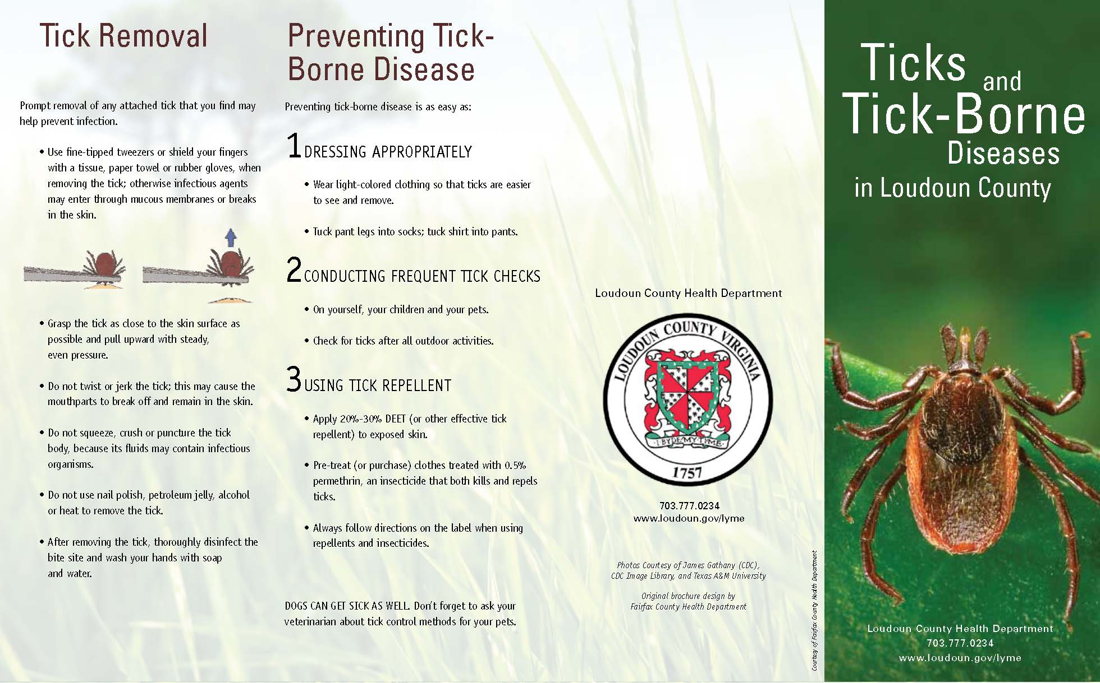

Slide 24
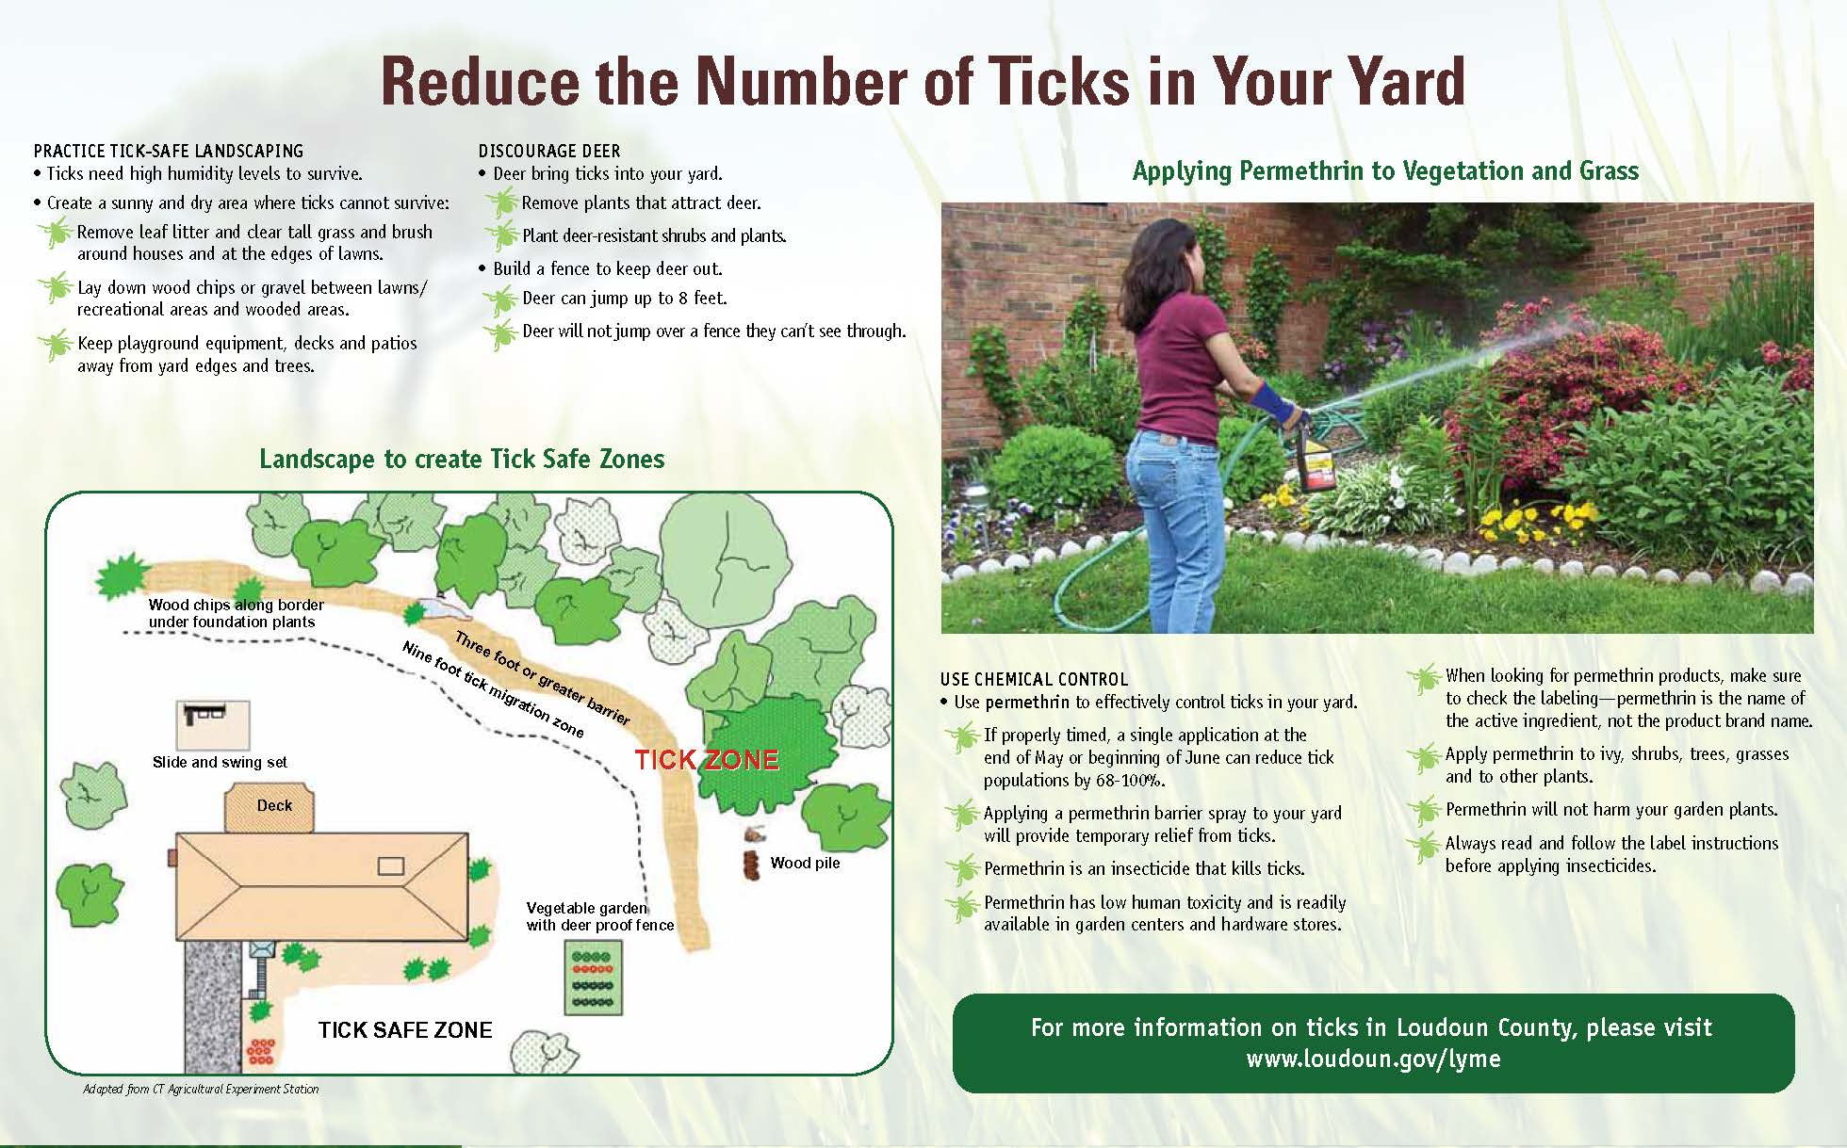

Slide 25
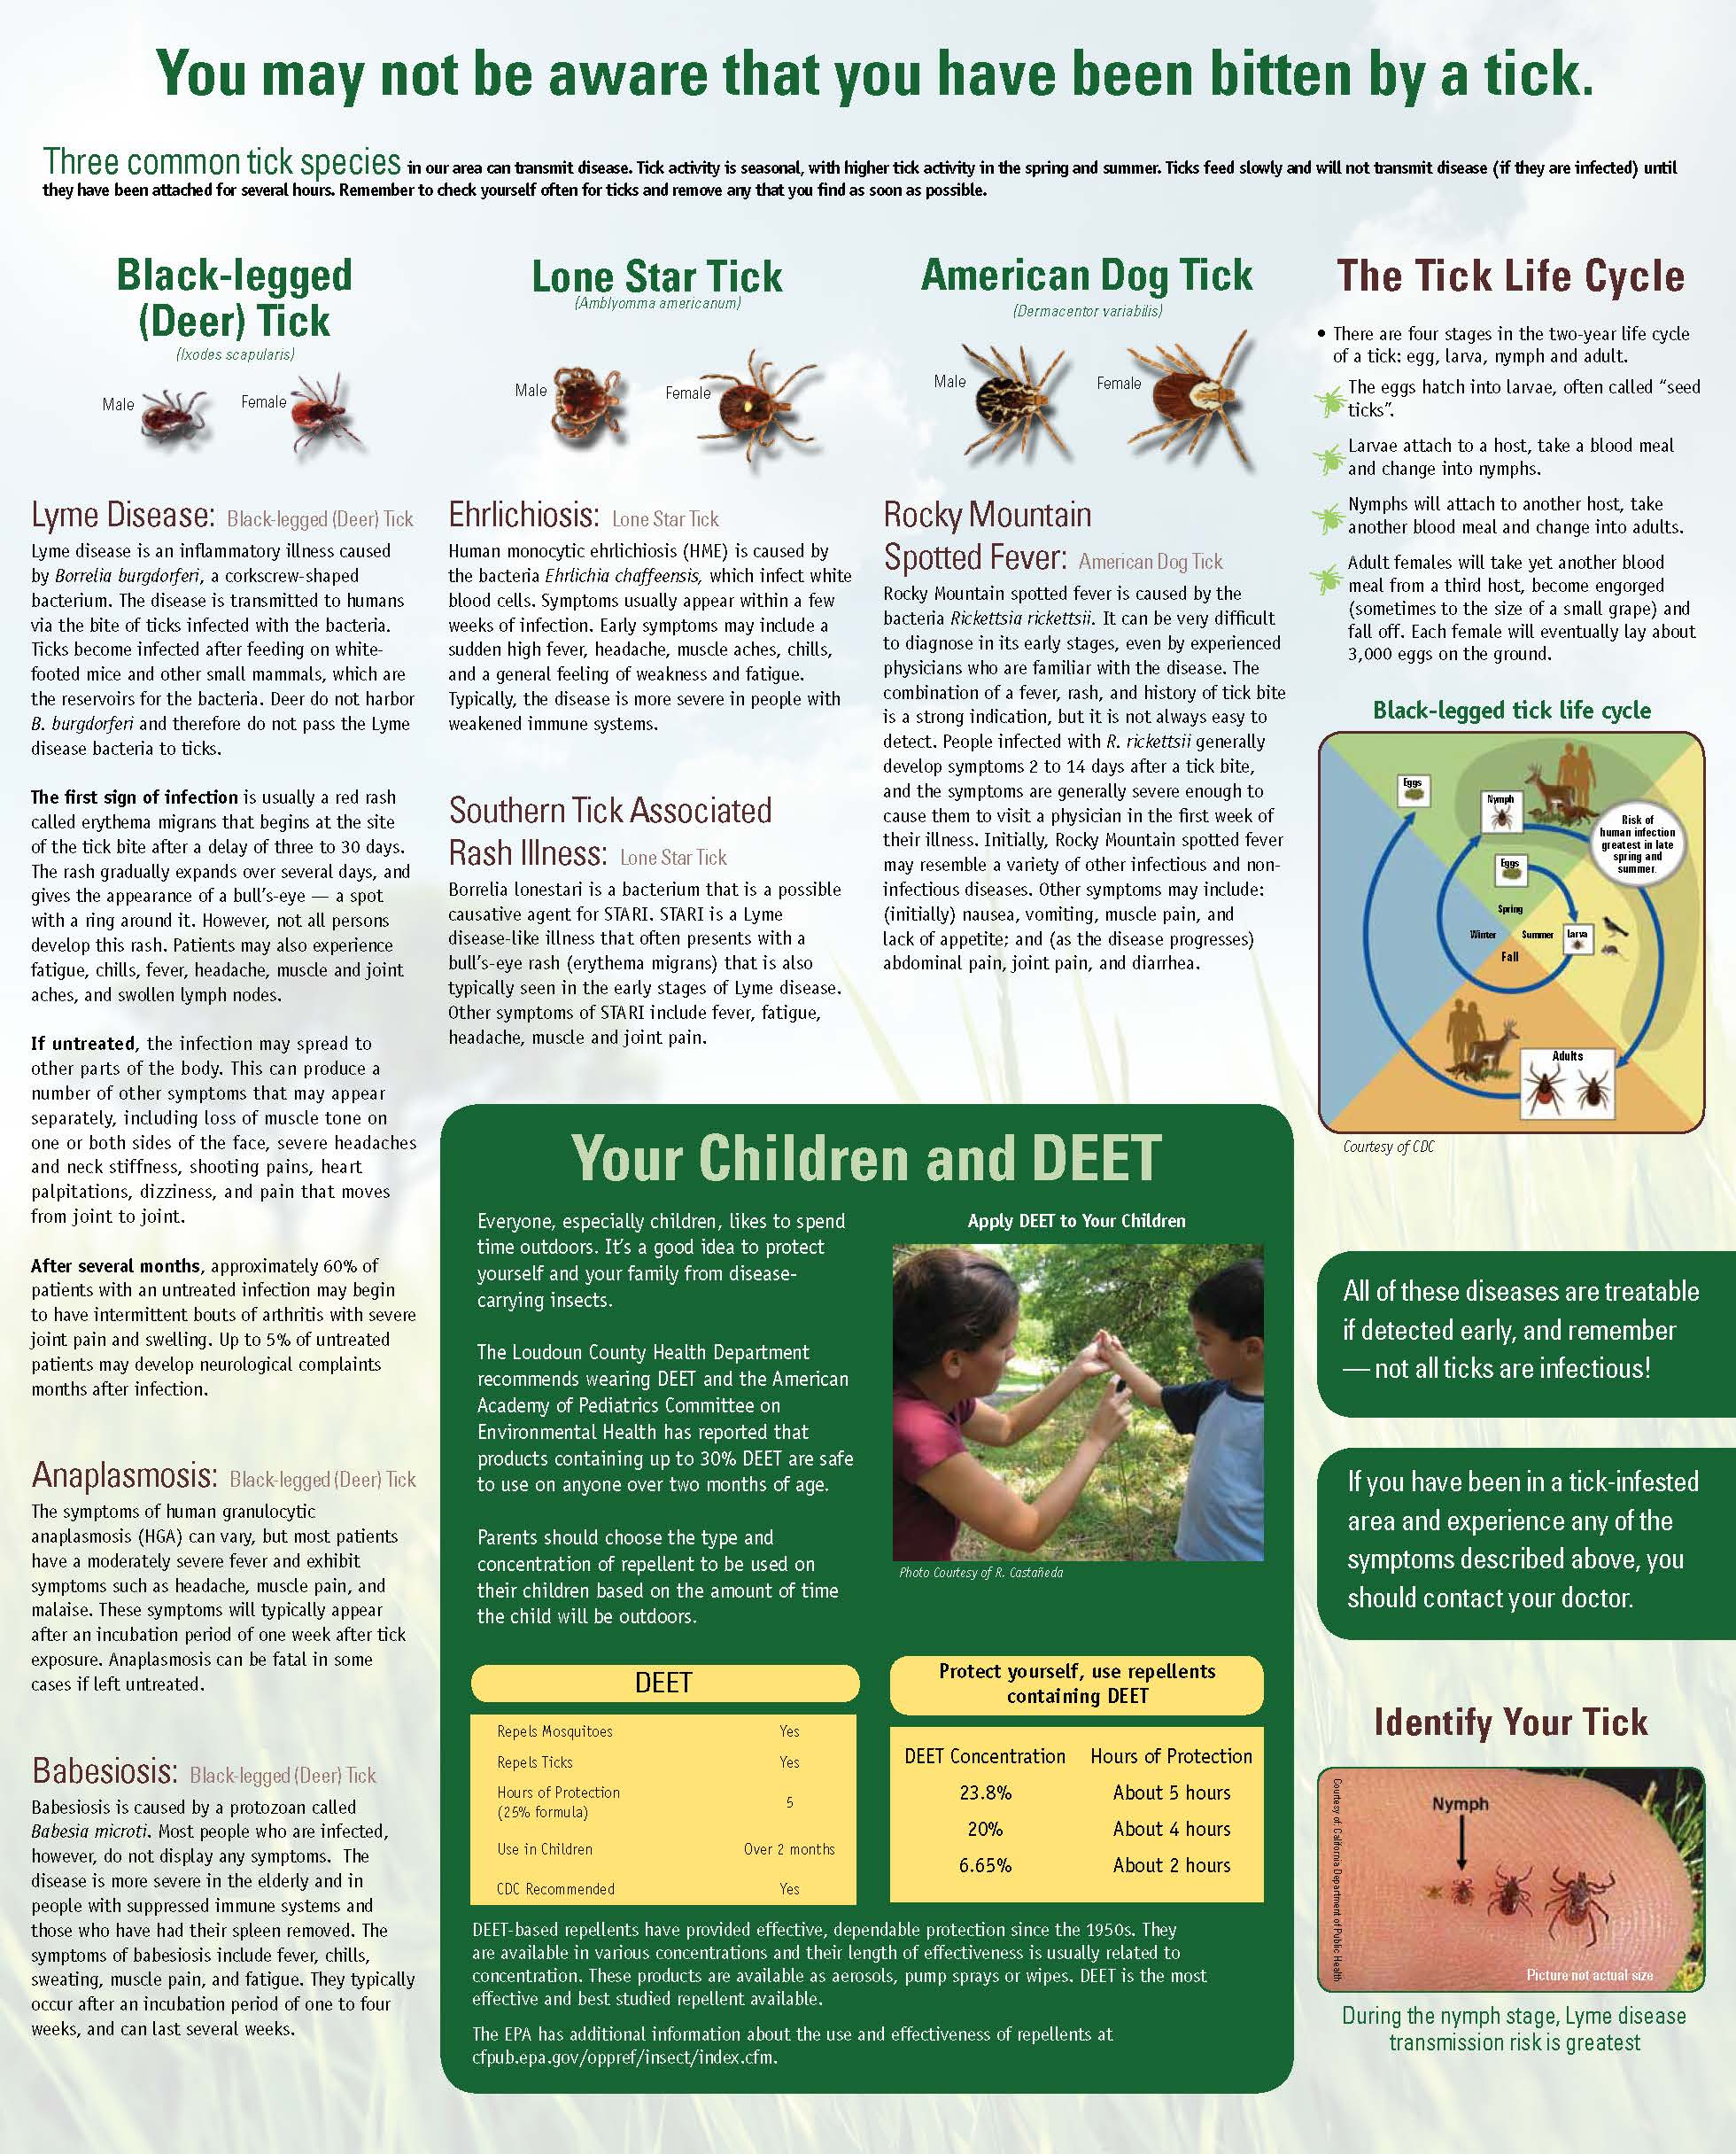

Slide 26
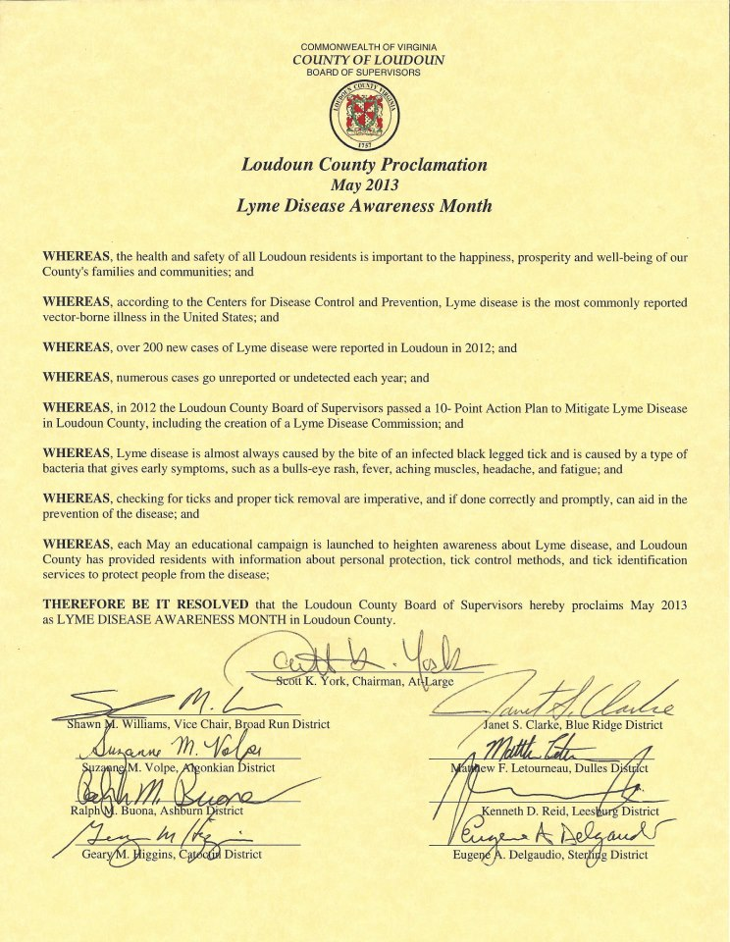

Slide 27
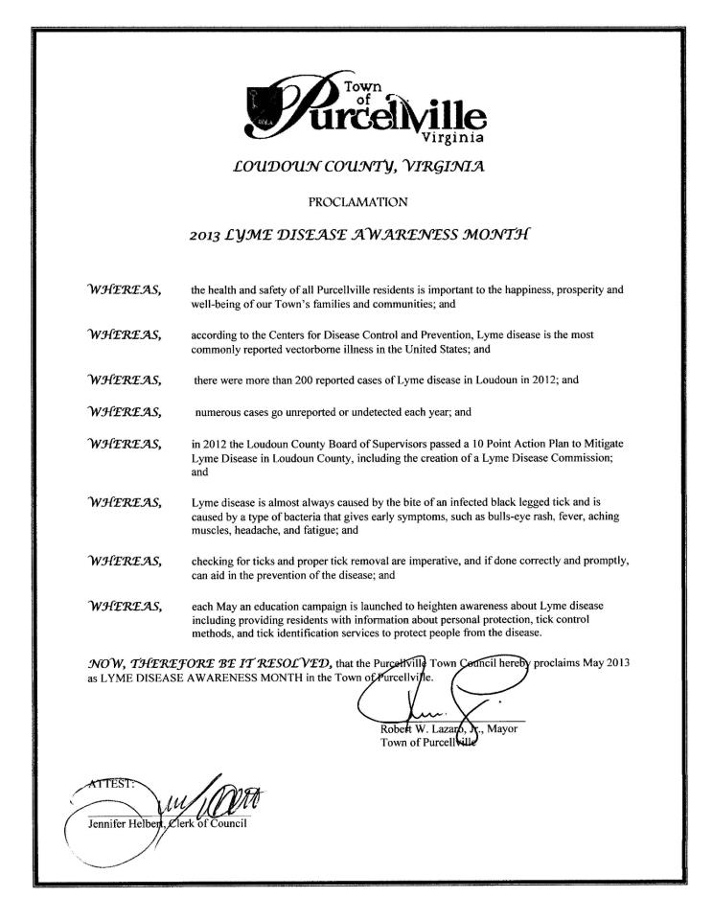

Slide 28
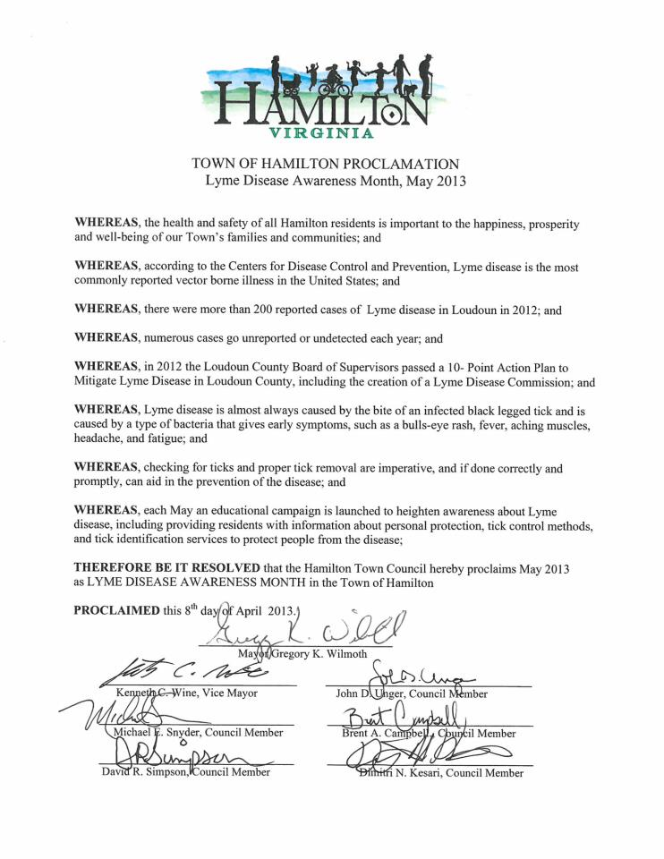

Slide 29
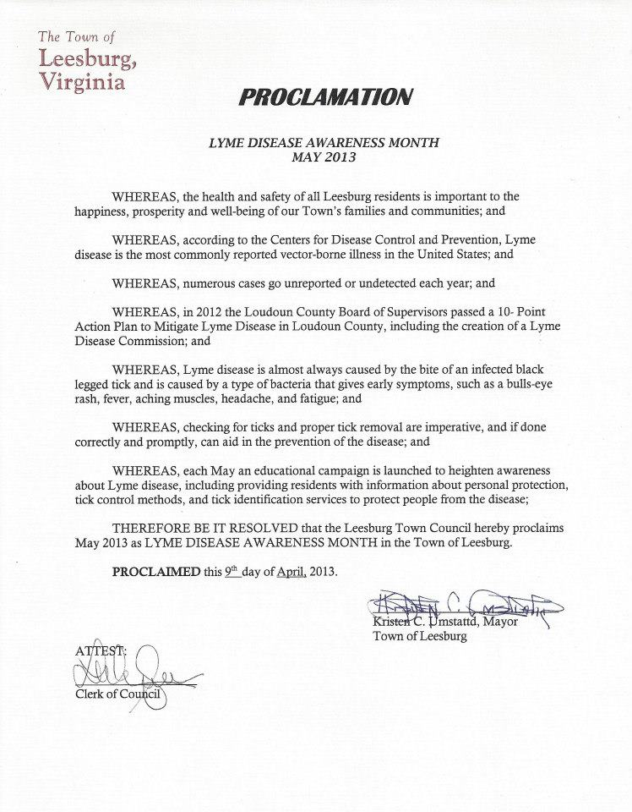

Slide 30
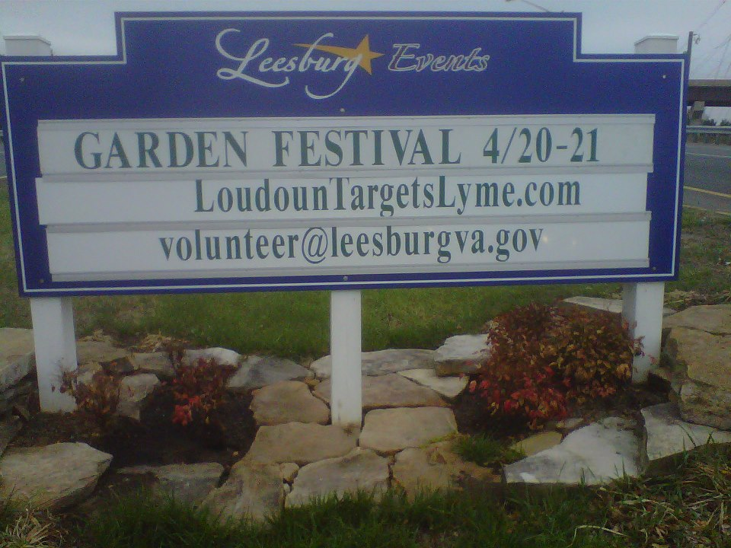

Slide 31
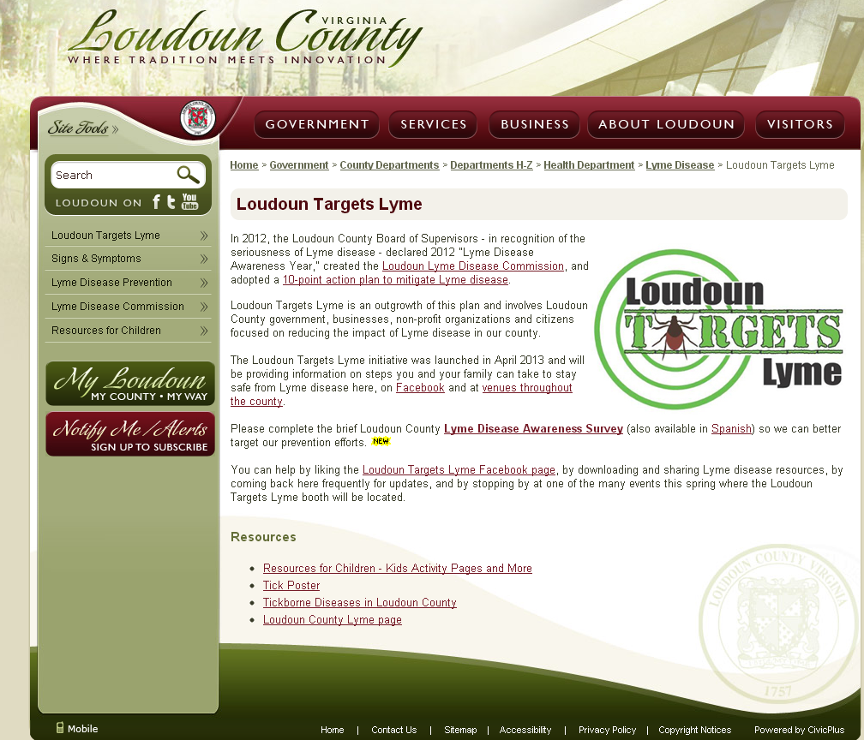
Notes:
10 thousand page views

Slide 32
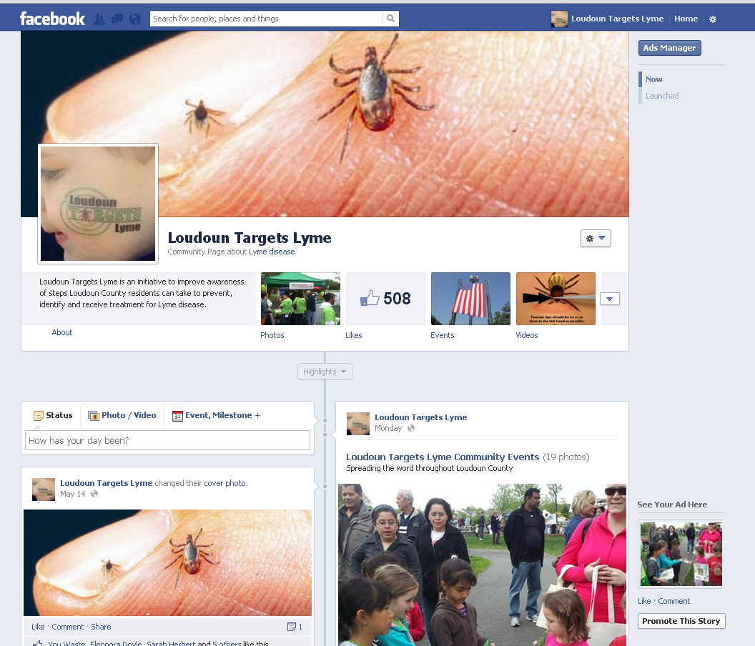

Slide 33
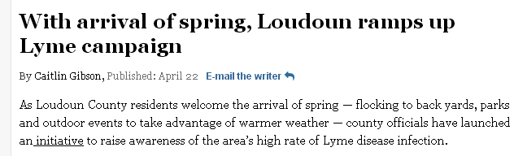
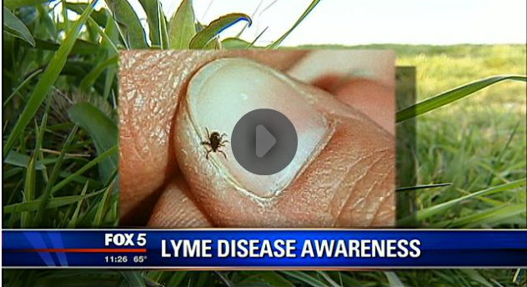

Slide 34
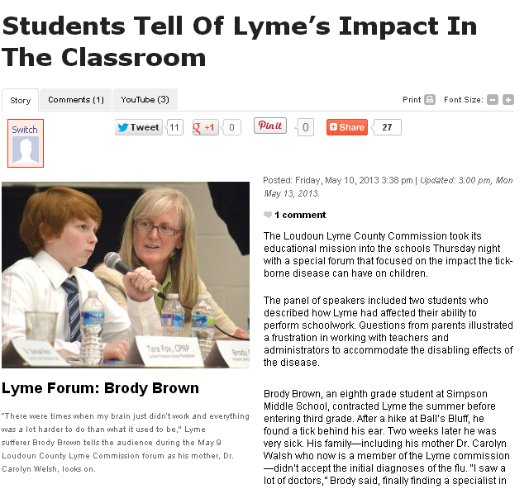

Slide 35
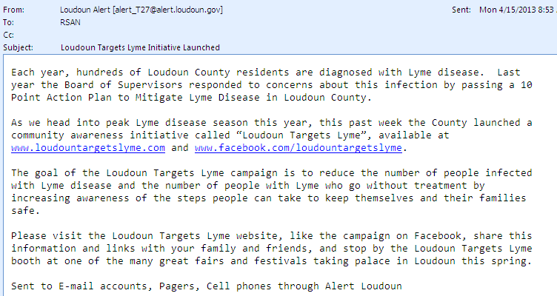

Slide 36
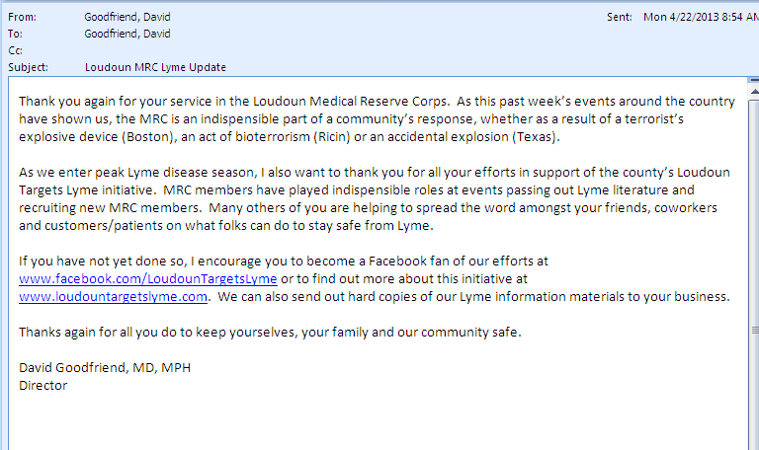

Slide 37
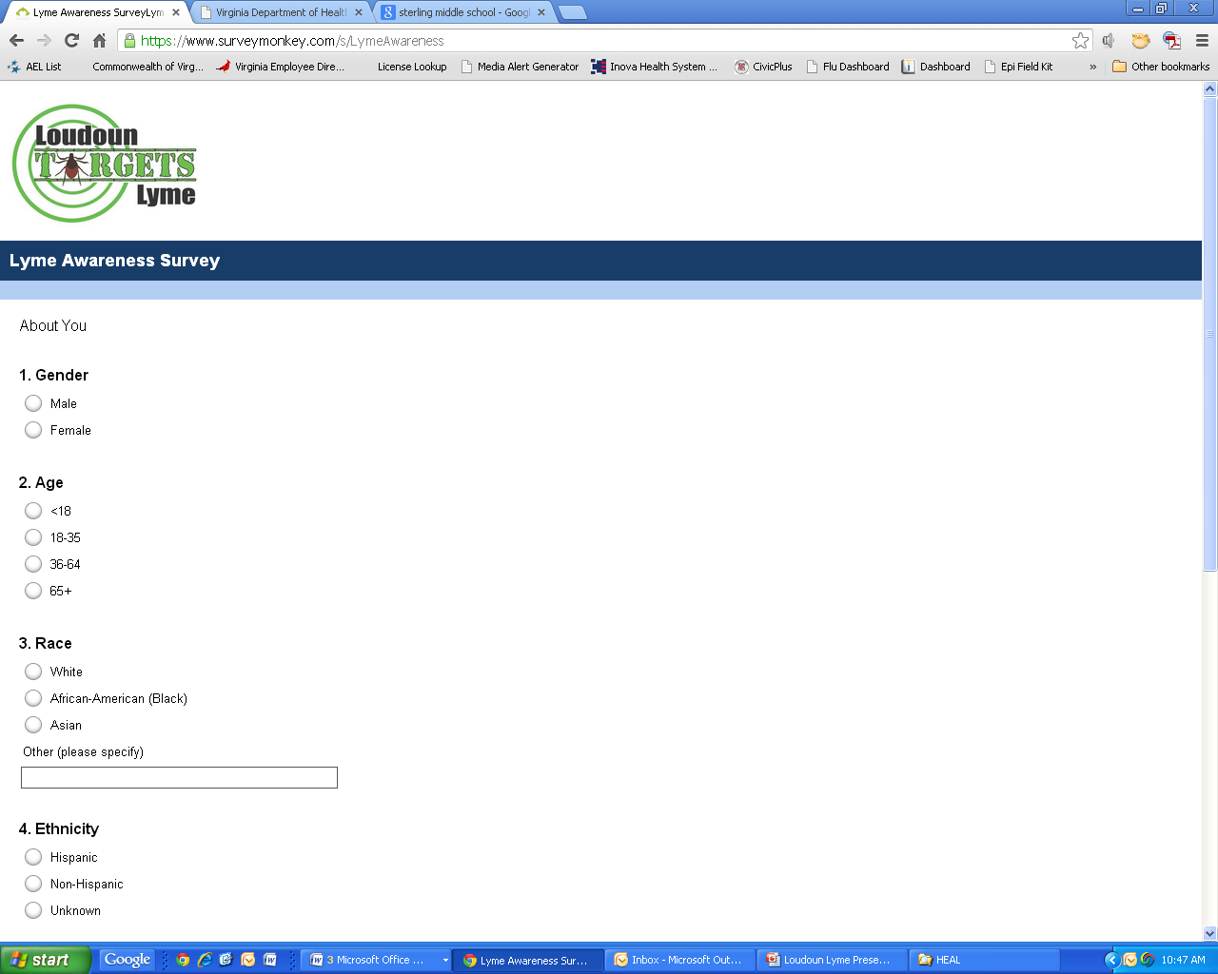

Slide 38
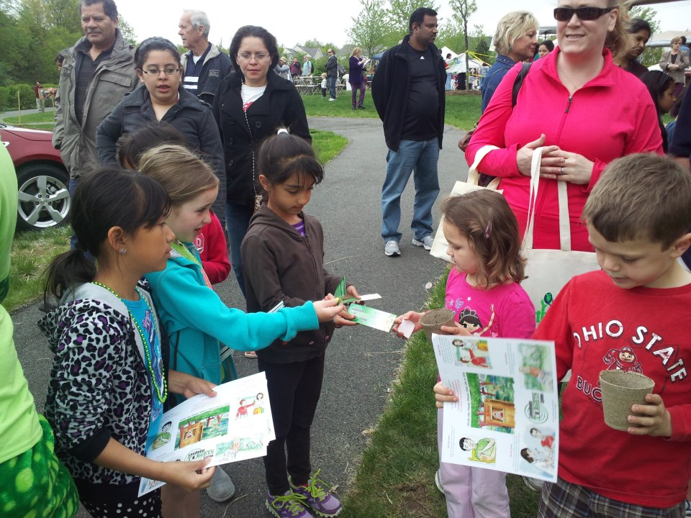

Slide 39
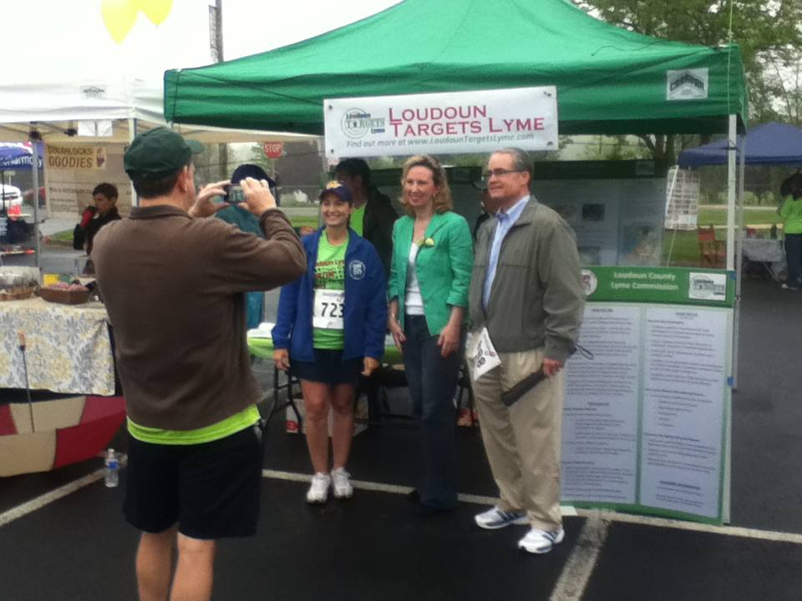
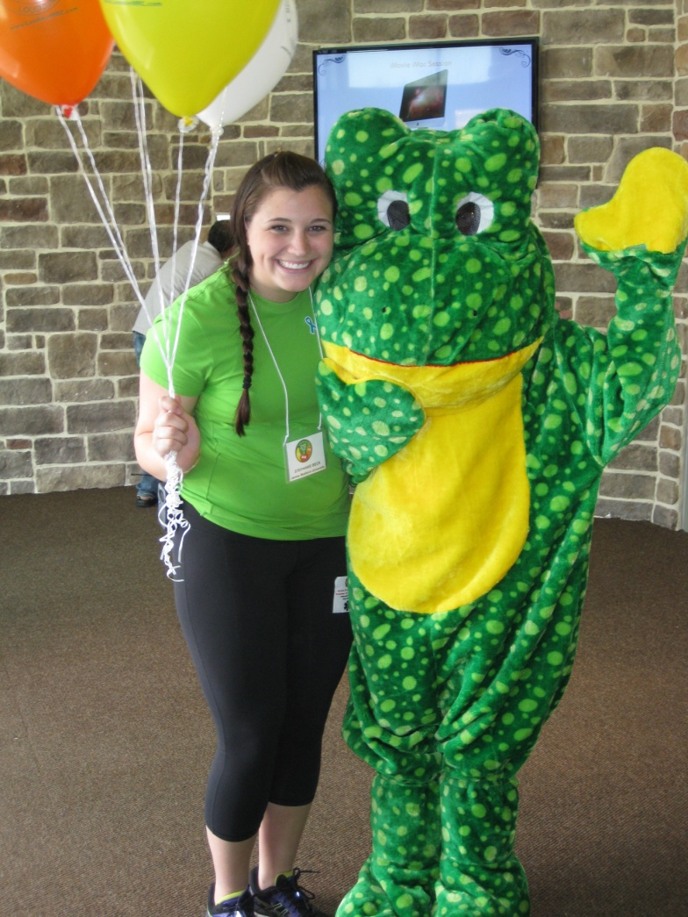

Slide 40
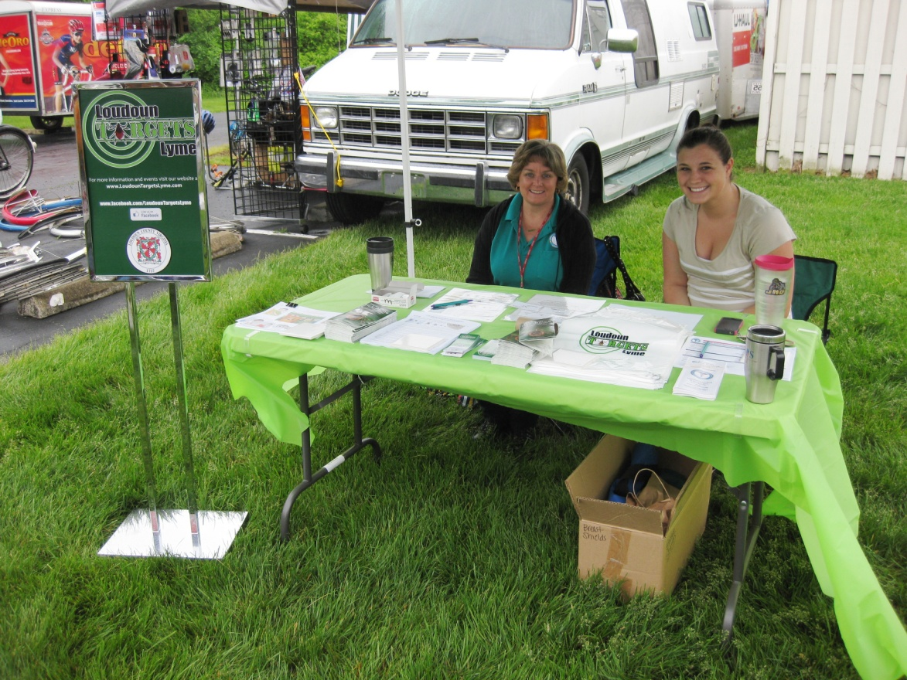
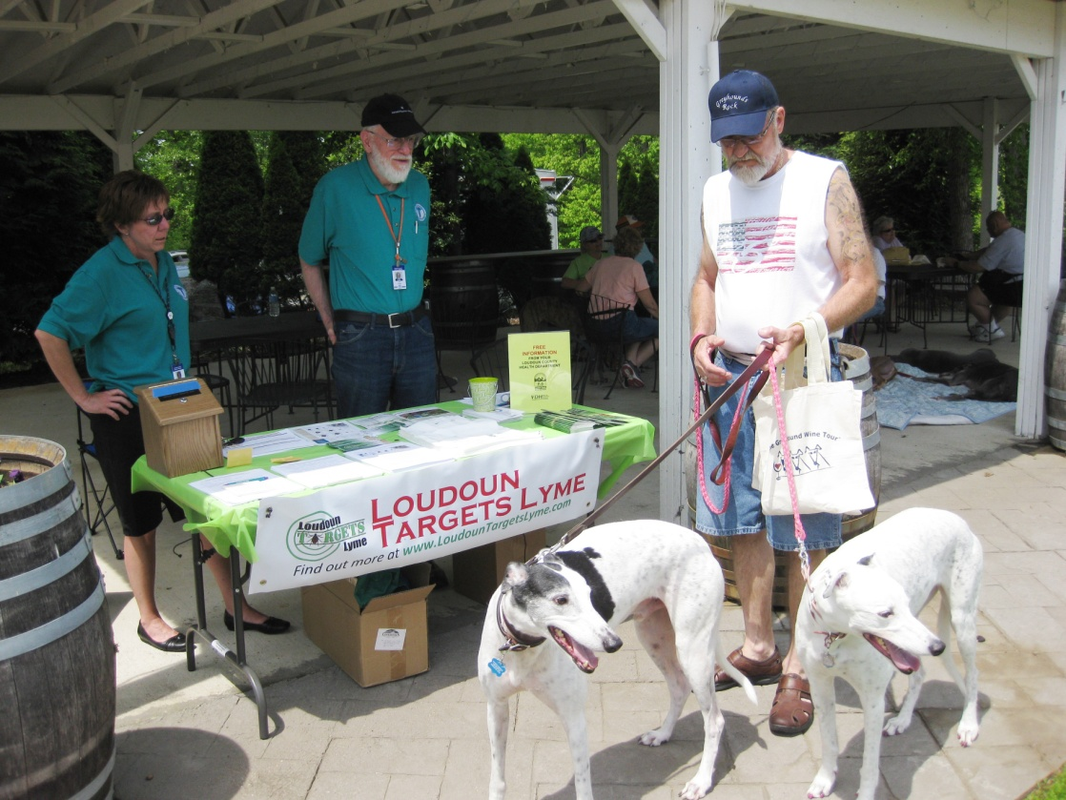

Slide 41
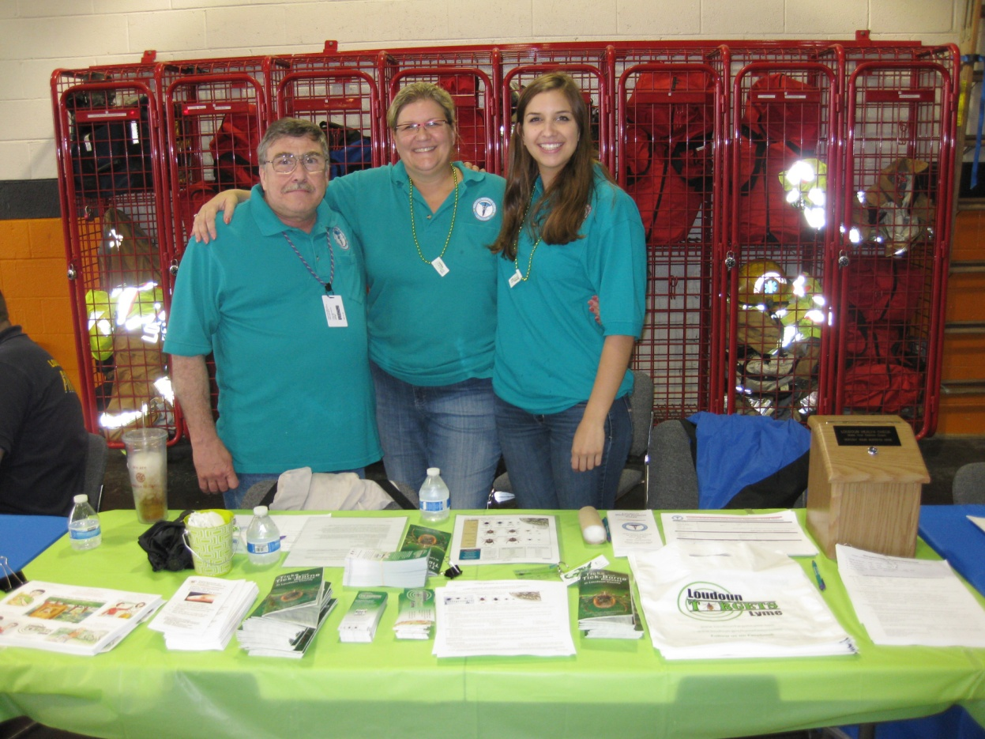
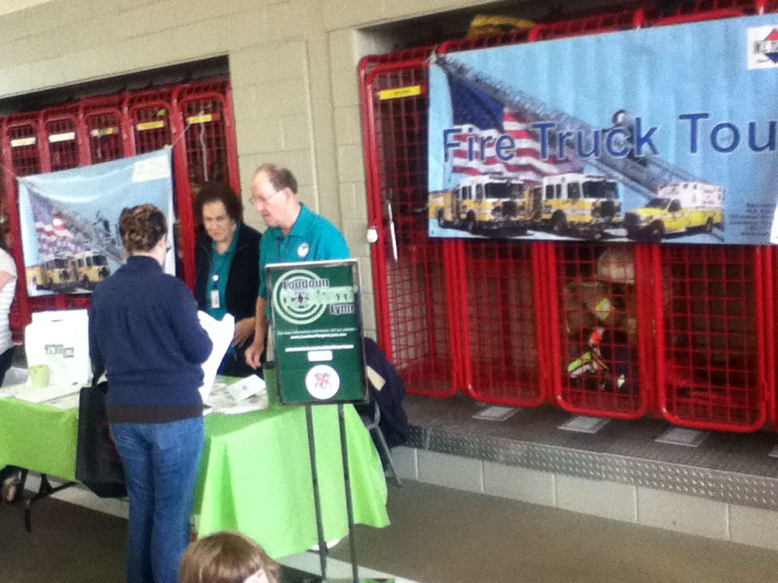

Slide 42
Measuring Success
Great participation and reception at events
Over 100,000 pieces of material distributed
Thousands reached electronically
Many residents reported hearing about Lyme from multiple sources

Slide 43
Big Question
Are fewer being becoming infected and are those infected more likely to seek care early?
  If so, how do we measure that?
  How do we build on these efforts?

Slide 44
Thank You

