Slide 1



Building a Business Case for Infection Prevention
Thomas M Kerkering, MD, FACP, FIDSA
Professor of Medicine and Chief,
Section of Infectious Diseases,
Medical director, Infection Control
Virginia Tech Carilion School of Medicine and Carilion Clinic

Slide 2
Reasons for a Business Case
ALTRUISM: Wish to prevent suffering & death
- necessary & laudable goal, but does not pay the bills
REALISM: Life’s circumstances do not allow you to work for free
PRAGMATISM: You need the resources to carry out an effective Infection Control Program

Slide 3
Number One Reason for a Business Case
MARKET FORCES!!
Perhaps a bit cynical, but nevertheless true
The driving force behind the “Epidemic of Infection
Prevention” is the decision by CMS to NOT REIMBURSE
for potentially preventable events
Infection Prevention has now not only become necessary
for the survival of the patient, but also for the survival of
the facility

Slide 4
“While society would benefit from a reduced incidence of nosocomial infections, there is currently no direct reimbursement to hospitals for the purpose of infection control, which forces healthcare institutions to make economic decisions about funding infection control activities. Demonstrating value to administrators is an increasingly important function of the hospital epidemiologist because healthcare executives are faced with many demands and shrinking budgets.”
Raising Standards While Watching the Bottom Line: Making a Business Case for Infection Control: Eli N. Perencevich, MD, MS; Patricia W. Stone, PhD, MPH, RN; Sharon B. Wright, MD, MPH; Yehuda Carmeli, MD, MPH; David N. Fisman, MD, MPH, FRCP(C); Sara E. Cosgrove, MD, MS
Infect Control Hosp Epidemiol 2007; 28:1121-1133

Slide 5
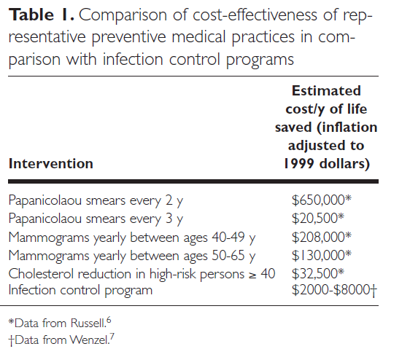
Quiz: Find the one item in the Table below that is different from all of the others.
The business of health care epidemiology: Creating a vision for service excellence
Victoria J. Fraser, MD, Margaret A. Olsen, PhD, MPH, St Louis, Missouri
AJIC: 30:2, April 2002
Notes:
This table shows a comparison of cost-effectiveness of various preventive medical practices compared to infection prevention programs. Infection control programs are far less costly per year of life saved ($2000-8000) compared to tens or hundreds of thousands of dollars for screening programs or cholesterol reduction programs.

Slide 6
Basic Premise of an ICP Business Plan
Infection Control Programs are not REVENUE PRODUCERS
Infection Control Programs cost money
The basis, or theme, of an Infection Control Business Plan
is to demonstrate cost efficiency
That is, an Infection Control Program will save more money than it
costs to fund the Program.

Slide 7
A business case “exists if the entity that invests in the intervention realizes a financial return on its investment in a reasonable time frame.” The reasonable return can occur through profit, reduction in losses, or cost avoidance.*
* Leatherman S, Berwick D, Iles D, et al. The business case for quality:
case studies and an analysis. Health Aff (Millwood) 2003; 22:17-30.

Slide 8
Necessary Data for Initial Business Plan
Number and type of HAIs over period of time (in-house)
Attributable cost for each type of HAI (in- house or literature)
Payor mix
Listing of what CMS & other third party payors will not reimburse
Personnel costs
Equipment
- computers
- copiers
- fax
Software programs
Space
Supplies
Communications
Education (CME)

Slide 9
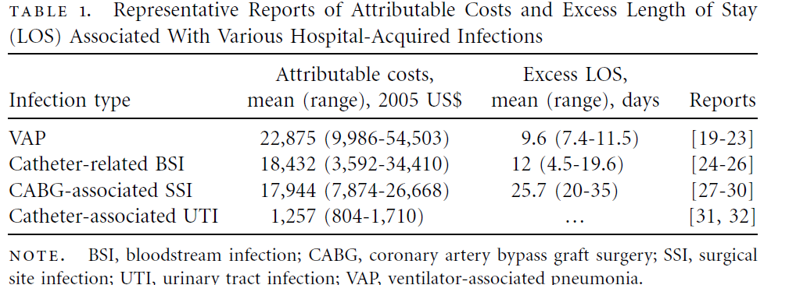
Attributable Cost
Be forthright in explaining how you obtained (assumed) the attributable cost.
Perform the calculations using the mean and the high and low ends of the range.
Provide the literature.
Notes:
The table in this slide shows the average attributable cost and excess length of stay associated with four HAIs – ventilator-associated pneumonia (VAP), catheter-related bloodstream infection (CRBSI), surgical site infection following coronary artery bypass graft surgery (CABG SSI), and catheter-associated urinary tract infection (CAUTI). VAP costs nearly $23,000 on average and an excess length of stay of nearly 10 days. CRBSI costs more than $18,000 on average and has an excess length of stay of 12 days. CABG SSIs cost nearly $18,000 and have an excess length of stay of over 25 days. CAUTI’s attributable costs are more than $1,000 per infection.

Slide 10
References for Previous Table
Dietrich ES, Demmler M, Schulgen G, et al. Nosocomial pneumonia: a cost-of-illness analysis. Infection 2002; 30:61-67.
Hugonnet S, Eggimann P, Borst F, Maricot P, Chevrolet JC, Pittet D. Impact of ventilator-associated pneumonia on resource
utilization and patient outcome. Infect Control Hosp Epidemiol 2004; 25:1090-1096.
Warren DK, Shukla SJ, Olsen MA, et al. Outcome and attributable cost of ventilator-associated pneumonia among intensive
care unit patients in a suburban medical center. Crit Care Med 2003; 31:1312-1317.
Rello J, Ollendorf DA, Oster G, et al. Epidemiology and outcomes of ventilator-associated pneumonia in a large US database. Chest 2002; 122:2115-2121.
Safdar N, Dezfulian C, Collard HR, Saint S. Clinical and economic con- sequences of ventilator-associated pneumonia: a
systematic review. Crit Care Med 2005; 33:2184-2193.
Blot SI, Depuydt P, Annemans L, et al. Clinical and economic outcomes in critically ill patients with nosocomial catheter-
related bloodstream infections. Clin Infect Dis 2005; 41:1591-1598.
Digiovine B, Chenoweth C, Watts C, Higgins M. The attributable mortality and costs of primary nosocomial bloodstream
infections in the intensive care unit. Am J Respir Crit Care Med 1999; 160:976-981.
Rello J, Ochagavia A, Sabanes E, et al. Evaluation of outcome of intra-venous catheter–related infections in critically ill patients.
Am J Respir Crit Care Med 2000; 162:1027-1030.
Coello R, Charlett A, Wilson J, Ward V, Pearson A, Borriello P. Adverse impact of surgical site infections in English hospitals. J
Hosp Infect 2005; 60:93-103.
Coskun D, Aytac J, Aydinli A, Bayer A. Mortality rate, length of stay and extra cost of sternal surgical site infections following
coronary artery bypass grafting in a private medical centre in Turkey. J Hosp Infect 2005;60:176-179.
Hollenbeak CS, Murphy DM, Koenig S, Woodward RS, Dunagan WC, Fraser VJ. The clinical and economic impact of deep chest
surgical site infections following coronary artery bypass graft surgery. Chest 2000; 118:397-402.
Jenney AW, Harrington GA, Russo PL, Spelman DW. Cost of surgical site infections following coronary artery bypass surgery.
ANZ J Surg 2001; 71:662-664.
Tambyah PA, Knasinski V, Maki DG. The direct costs of nosocomial catheter-associated urinary tract infection in the era of
managed care.Infect Control Hosp Epidemiol 2002; 23:27-31.
Lai KK, Fontecchio SA. Use of silver-hydrogel urinary catheters on the incidence of catheter-associated urinary tract infections
in hospitalized patients. Am J Infect Control 2002; 30:221-225.

Slide 11

http://www.cdc.gov/HAI/burden.html
Notes:
The picture on this slide is a screenshot of the cover of an important publication on direct medical costs of HAIs in US hospitals written by R. Douglas Scott. It is available on the CDC website on the slide (www.cdc.gov/HAI/burden.html)

Slide 12

Infection Control
Device Related Infections
- Ventilators (VAP)
- Central Lines (CLABSI)
- Urinary Catheters (CAUTI)
Multi Drug Resistant Organisms (MDRO)
- MRSA
- VRE
- C diff
- Gram negative bacilli
Surgical Site Infections (SSI)

Slide 13
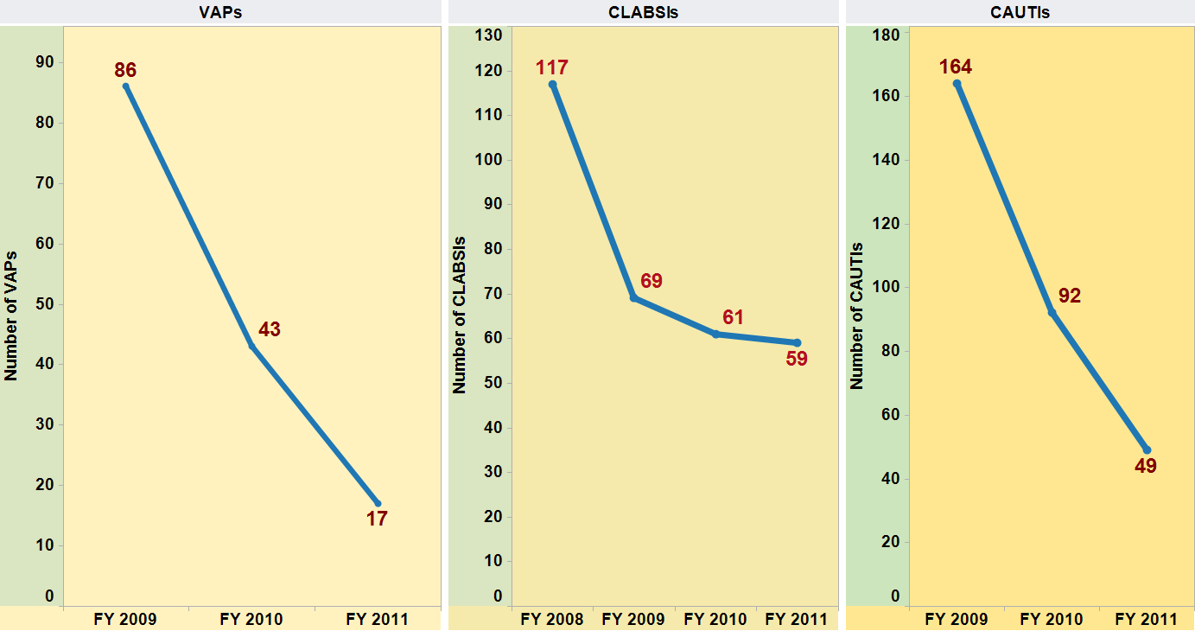
Notes:
These 3 line graphs shows the number of specified HAIs per fiscal year between 2008 (when available) and 2011. In 2009 there were 86 ventilator-associated pneumonias (VAPs), which decreased to 43 VAPs in 2010, which continued to decrease to 17 VAPs in 2011. In 2008, 117 central line-associated bloodstream infections (CLABSIs) were reported, dropped to 69 in 2009, 61 in 2010, and 59 in 2011. In 2009, 164 catheter-associated urinary tract infections (CAUTIs) were reported, dropping to 92 in 2010 and 49 in 2011.

Slide 14
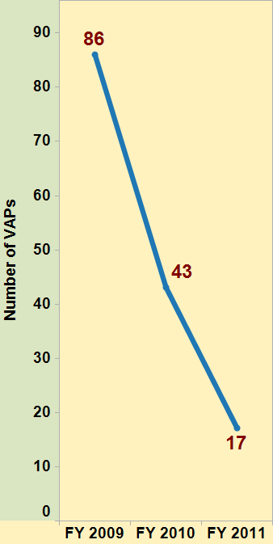
VAPs
Hospital Wide
Adult ICUs only
Rate = (# VAPs / # ventilator days) X 1,000
Notes:
Hospital-wide, in 2009 there were 86 VAPs, which decreased to 43 VAPs in 2010, which continued to decrease to 17 VAPs in 2011. However, it is important to include a denominator to demonstrate trends in rates. Therefore, the VAP rate is calculated as the number of new VAPs divided by the number of ventilator days, multiplied by 1000. The annual VAP rate per 1000 ventilator days was calculated between 2008 and 2011 in adult ICUs only: 10.8 in 2008, 10.1 in 2009, 4.9 in 2010, and 1.3 in 2011.

Slide 15
Notes:
The total VAP costs also decreased. $1,967,052 was spent on total VAP costs in 2008, $1,967,052 in 2009, $1,026,288 in 2010, and down to $342,096 in 2011.

Slide 16
Year | Attributable VAP Deaths | Amount Saved from Prior Year
FY2008 VAP | 34 (69)
FY2009 VAP | 34 (69) | 0
FY2010 VAP | 18 (36) | 16
FY2011 VAP | 6 (12) | 12
Potential Lives Saved |  | 28
Notes:
The chart on this slide shows the number of attributable VAP deaths per fiscal year and the amount of deaths saved from the prior year to show the total number of potential lives saved.

Slide 17
Year | Total FY VAP Costs | Amount Saved from Prior Year
FY2008 VAP | $1,967,052
FY2009 VAP | $1,967,052 | 0
FY2010 VAP | $1,026,288 | $940,764
FY2011 VAP | $342,096 | $684,192
Total Savings |  | $1,624,956
Notes:
The chart on this slide shows the VAP costs for each fiscal year and the amount of money saved for each year by preventing VAPs. To get the amount of money saved, the VAP costs from the current year was subtracted by the VAP costs from the previous year. In all, there was nearly $1.6 million dollars of cost savings from fiscal year 2008 to fiscal year 2011.

Slide 18
Year | Total FY CLABSI Costs | Amount Saved from Prior Year
FY2008 CLABSI | $1,224,552
FY2009 CLABSI | $670,588 | $553,964
FY2010 CLABSI | $728,900 | ($58,312)
FY2011 CLABSI | $699,744 | $29,156
Total Savings |  | $524,808
Notes:
The chart on this slide shows the CLABSI costs for each fiscal year and the amount of money saved for each year by preventing CLABSIs. To get the amount of money saved, the CLABSI costs from the current year was subtracted by the VAP costs from the previous year. In all, there was more than $500,000 of cost savings from fiscal year 2008 to fiscal year 2011.

Slide 19
Year | Total FY CAUTI Costs | Amount Saved from Prior Year
FY2008 CAUTI | $106,742 - $173,204
FY2009 CAUTI | $51,357 | $55,385
FY2010 CAUTI | $29,203 | $22,154
FY2011 CAUTI | $10,070 | $19,133
Total Savings |  | $96,672
Notes:
The chart on this slide shows the CAUTI costs for each fiscal year and the amount of money saved for each year by preventing CAUTIs. To get the amount of money saved, the CAUTI costs from the current year was subtracted by the CAUTI costs from the previous year. In all, there was nearly $100,000 of cost savings from fiscal year 2008 to fiscal year 2011.

Slide 20
Devices | Savings over 3 Yr. Period
VAPs | $1,624,956
CLABSIs | $524,808
CAUTIs | $96,672
Sub total | $2,246,436
MDROs
MRSA
VRE
C diff
Gram negative bacilli
Sub total
SSIs
CABG
Colon
KNPRO
HPRO
HYST
Sub total
GRAND TOTAL
Notes:
The chart on this slide shows how you would display cost savings over a three year time period for all of the types of infections that your infection control program targets. VAP, CLABSI, and CAUTI line items are filled in the “device-associated” section with the numbers from the previous three slides. You could do the same calculations for various types of multidrug-resistant organisms such as MRSA and gram negative bacilli and for surgical site infections following different surgeries such as colon procedures, or knee replacements, or hysterectomies. Then you can total all of the cost savings for all of the infection types.

Slide 21
Item | Each | Number | Cost/year | 3 Year Cost
Personnel Costs (Salary + Benefits) | $82,280 | 6 | $493,680 | $1,481,040
Equipment
Computers | $1,100 | 6 |  | $6,600
Copier/Fax (rent with maintenance agreement) |  | 1 | $1,750 | $1,750
Software License |  | 2 | $60,000 | $180,000
Space (rent) |  |  | $36,000 | $108,000
Supplies |  |  | $5,000 | $15,000
Communications (telephone, beepers, postage) |  |  | $6,000 | $18,000
Education (CME, Dues, Journals) |  |  | $8,000 | $24,000
TOTAL |  |  |  | $1,834,390
Notes:
This slide shows a chart with the infection control program’s costs such as personnel, equipment (including infection prevention software), space, supplies, communications (phone, pagers, postage), and education (continuing education, dues, journal subscriptions). Putting education into your budget is critical!

Slide 22
Device Savings | $2,246,436
Program Costs | $1,834,390
Net Gain | $412,046
Assume 3 year Savings
MDROs | $150,000
SSIs | $200,000
Total 3 Year Net Gain | $762,046
Program Costs already incorporated for MDRO’s & SSI’s
Notes:
This slide shows a sample 3-year net gain for an infection control program. The program’s costs are deducted from the amount the program is projected to save by preventing device-associated infections, MDROs, and surgical site infections.

Slide 23
STEPS FOR DEVELOPING A BUSINESS CASE/PLAN

Slide 24
1. Develop a Mission Statement
Improve patient morbidity and mortality by reducing hospital acquired infections through (cost effective) evidence based practices
- make sure it is in line with the mission of the facility - keep it simple and defensible
- it becomes your “Constitution”
- one can always refer to the Mission Statement to keep the program on track

Slide 25
2. Frame the Problem and Develop a Hypothesis About Potential Solutions
The problem is HAIs and their economic costs to the facility
Use your data (shown in previous slides) to demonstrate the costs
Determine which interventions would be necessary to reduce HAIs
Determine the resources needed
Develop a budget based on this

Slide 26
3. Meet With Key Administrators
Director of Quality Improvement, Chief Medical Officer, Chief Financial Officer
- Obtain agreement that this is of institutional concern & has the support of hospital leadership
- Learn from this meeting who else within the facility are key players and who should be included in developing the business plan
- Learn of other costs to consider in the plan

Slide 27
4. Determine the Annual Costs
Personnel costs
Equipment
- computers
- copiers
- fax
Software programs
Space
Supplies
Communications
Education (CME)

Slide 28
5. Determine What Costs Can Be Avoided Through Reduced Infection Rates
From your surveillance data determine the number of infections you are experiencing
in each of the categories surveyed (devices,
MDROs, SSIs)
Decide what you are going to target

Slide 29
6. Determine the Costs Associated With the Infection of Interest at Your Hospital
If your institution can do this, determine the costs associated with each device infection, SSI and MDRO
Otherwise, use the literature (which to choose?)
Some software can do this for a price (Med Mined)
The number reduced X the associated cost =
the savings in that period of time (not really)

Slide 30
This is where it gets tricky:
One has to use attributable costs
If, for an example, the cost of a particular HAI is $10,000, the hospital does not necessarily lose $10,000 for each of these HAIs
The reason is because a certain percentage of these costs are still reimbursed by 3rd Party Payors.
Factoring in the Payor mix and the percentage reimbursed leads to the attributable cost

Slide 31
EXAMPLE
Assume that the cost of a CLABSI is $25,000
In your plan you have decided that you will prevent 10 CLABSIs.
The bad logic is the calculation that 10 X $25,000 = $250,000
& since you cost $80,000 you saved the hospital $170,000.
The finance people will say, “Not so fast”
If the profit from a patient with a central line is $10,000, but with an
identical patient with a CLABSI this falls to $1,000 (because of a
mix of reimbursements), the savings per CLABSI prevented is $9,000,
not $25,000. The total amount for 10 patients is $90,000. You cost $80,000.
The real savings for the hospital is $10,000
STAY TUNED

Slide 32
7. Now Calculate the Financial Impact
Do it for each type of HAI you are trying to prevent
Calculate three ways using the mean, low end and high end attributable cost.
The result will be a range
Subtracting the costs of the Program
The result is the anticipated savings

Slide 33
8. Include all Financial Benefits
Do it for each type of HAI you are trying to prevent
- Devices (CAUTI, CLABSI, VAP
- SSIs (KPRO, HPRO, CABG, Colon, Hyst, etc.)
- MDROs (MRSA, VRE, C diff, gram negative
bacilli

Slide 34
9. Make Your Case
Do not immediately take your plan to the “highest of the high”
Discuss it with unit managers, various vice-presidents, department managers, etc.
Tweak, build consensus
Get ideas for the implementation plan
Now you are ready
Dooley RS, Fryxell GE, Judge WQ. Belaboring the not-so-obvious: consensus, commitment, and strategy implementation speed and success. J Management 2000; 26:1237-1257.

Slide 35
10. Never Stop Collecting Cost & Outcome Data
Imperative to show what has occurred after an intervention
Once HAIs become low, rate of savings return lessens
Administrators may think of cutting budget
Use this data to show what could happen without a continued program

Slide 36
Cost-effectiveness analysis. Cost-effectiveness analysis compares
interventions or products that have different costs and different levels of effectiveness. The benefits of an intervention are measured, such as the number of lives saved or infections prevented. Programs are then compared in terms of cost per unit (e.g., dollars per life-year gained or dollars per infection prevented).
Cost-utility analysis. The benefits of a specific intervention are adjusted by health preference scores or are utility weighted. In this type of analysis, programs are compared in terms of quality-adjusted life-years (QALYs) gained.
Cost-benefit analysis. One in which all aspects of the analysis, including the consequences of the intervention, are valued in monetary or dollar terms. If an intervention’s benefits measured in dollars exceed its costs, then this analysis considers it worthwhile. The major impediment to the use of cost-benefit analysis in healthcare decision making is the requirement to set a monetary value on human life or health benefits.
Drummond MF, Sculpher MJ, Torrance GW, O’Brien BJ, Stoddart GL. Methods for the Economic Evaluation of Health Care Programmes. 7th ed. Oxford: Oxford University Press; 2005.

Slide 37
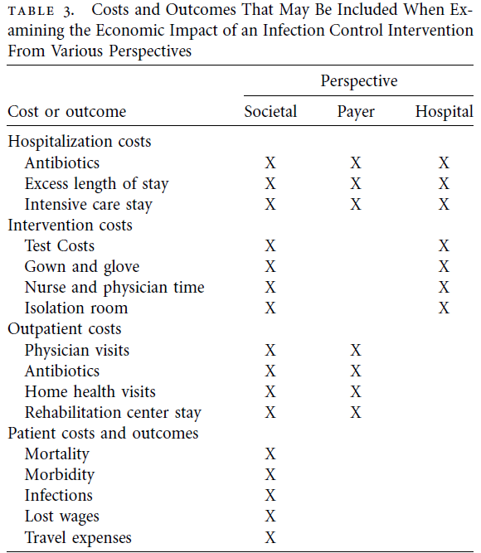
Raising Standards While Watching the Bottom Line: Making a Business Case for Infection Control: Eli N. Perencevich, MD, MS; Patricia W. Stone, PhD, MPH, RN; Sharon B. Wright, MD, MPH; Yehuda Carmeli, MD, MPH; David N. Fisman, MD, MPH, FRCP(C); Sara E. Cosgrove, MD, MS Infect Control Hosp Epidemiol 2007; 28:1121-1133
Notes:
This table shows the costs and outcomes that may be included when examining the economic impact of an infection control intervention from various perspectives (societal, payer, and hospital). Costs/outcomes are grouped into 4 categories – hospitalization costs, intervention costs, outpatient costs, and patient costs and outcomes. All of these costs may be included from a societal perspective but payers and hospitals consider different items in their economic impact assessments. Hospitals are more concerned with hospitalization costs (antibiotics, excess length of stay, and intensive care stay) and intervention costs (test costs, gown and glove costs, nurse and physician time, isolation room costs). Payers are also concerned with hospitalization costs as well as outpatient costs (physician visits, antibiotics, home health visits, rehab center stays). Patient costs and outcomes (morbidity, mortality, infections, lost wages, and travel expenses) are only of concern to the societal perspective.

Slide 38
More on Attributable Costs
Measure it for your institution
E.g., MRSA SSI:
- Cases with MRSA SSI
- Cases without MRSA SSI
- Minimum match
- prior length of stay
- co-morbid conditions
- severity of illness
This is a Cohort Study

Slide 39
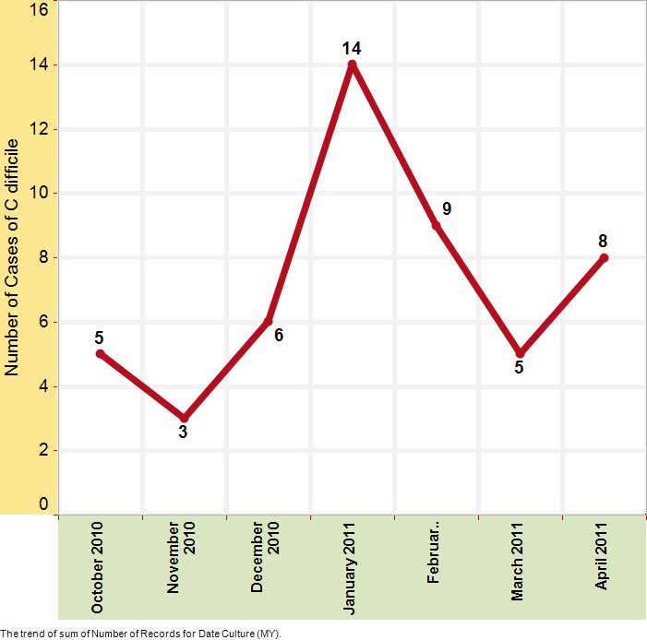
Cases of HFOHFA
C difficile at
Hospital X
October 2010
through
April 2011
= 50
Notes:
This graph shows the number of cases of Clostridium difficile per month between October 2010 and April 2011. October = 5, November = 3, December = 6, January = 14, February = 9, March = 5, April = 8 with a total of 50 C. difficile cases in the 7 month period.

Slide 40
Group | Controls | Cases
Mean | 1.5700 | 3.0000
SD | 1.4100 | 1.7800
SEM | 0.2940 | 0.3712
N | 23 | 23
P value and statistical significance:
The two-tailed P value equals 0.0042
Confidence interval:
The mean of Controls minus Cases equals -1.4300
95% confidence interval of this difference: From -2.3843 to
-0.4757
Intermediate values used in calculations:
t = 3.0201
df = 44
standard error of difference = 0.473
Notes:
SD = standard deviation
SEM = standard error of the mean
N = the number in the sample
T = t-score
DF = degrees of freedom

Slide 41
Summary
Your Infection Control Program Needs to have built a business case
Simply stating, “We do good work by reducing infections and saving lives” will not generate resources
Prove it with your data and the literature

Slide 42
Necessary Data for Initial Business Plan
Number and type of HAIs over period of time (in-house)
Attributable cost for each type of HAI (in- house or literature)
Payor mix
Listing of what CMS & other third party payors will not reimburse
Personnel costs
Equipment
- computers
- copiers
- fax
Software programs
Space
Supplies
Communications
Education (CME)

Slide 43
Summary
Patience
Knowledge of how to use a spreadsheet
Ask for help
- finance administrator
- epidemiologist/statistician/economist

Slide 44
PRACTICE

Slide 45
Summary
With today’s climate and emphasis on safety, quality, and cost containment Infection Control has come of age.
It is an exciting time!

Slide 46
THANK YOU

