Slide 1
SIR 201: Calculating the Measure, Generating Reports, and Presenting the Data
Dana Burshell, MPH, CPH, CIC
HAI Epidemiologist
Virginia Department of Health
Notes:
Good afternoon and welcome to the SIR 201: Calculating the Measure, Generating Reports, and Presenting the Data webinar brought to you by the Virginia Department of Health’s Healthcare-Associated Infections Program. My name is Dana Burshell and I am the HAI Team’s Epidemiologist. I am happy to speak with you about the standardized infection ratio, also referred to as the SIR.

Slide 2
SIR 101 available online
SIR 101: Interpretation and public reporting
  April 19th, 2012
  Reviewed basic SIR calculation and interpretation
  Introduced publicly available SIR reports
    NHSN, Hospital Compare, Virginia Department of Health
Archived and available at: http://www.vdh.virginia.gov/epidemiology/ surveillance/hai/communication.htm
Notes:
Two weeks ago, we held the SIR 101: Interpretation and public reporting webinar. This webinar reviewed the calculation of the SIR and its interpretation. In addition, I shared examples of how the National Healthcare Safety Network (NHSN), the Centers for Medicare and Medicaid Services (CMS), and the Virginia Department of Health (VDH) have incorporated the SIR into their reports. Bonita Allen from Parham Doctors’ Hospital shared her experience and success in starting to educate and expose her staff to the SIR.
An audio of this webinar and slides have been archived and are available on the VDH HAI website at http://www.vdh.virginia.gov/epidemiology/surveillance/hai/communication.htm where this webinar will also be stored.

Slide 3
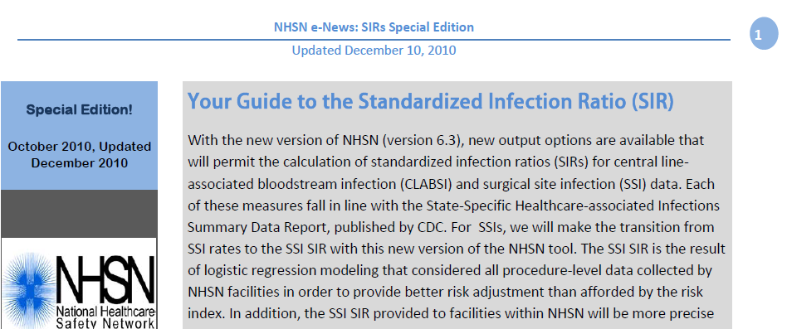
NHSN’s Guide to the Standardized Infection Ratio (SIR)
http://www.cdc.gov/nhsn/PDFs/Newsletters/NHSN_NL_OCT_2010SE_final.pdf
Notes:
Let us return to the NHSN e-News: SIR Special Edition published in October of 2010 and updated it in December 2010. A link to the document online is found at the bottom of the slide. I highly suggest you print out and keep this document in your files because it reviews the SIR definition, benefits of the metric, how it is calculated for a central line-associated bloodstream infections (CLABSIs) and surgical site infections (SSI), how to interpret it, and what SIR options are available in NHSN reports. I have used this document to help frame the conversation and some of the examples will be found throughout the presentation. As we did with SIR 101, let’s begin with a review of the definition.

Slide 4
What is a standardized infection ratio?
The standardized infection ratio (SIR) is a summary measure used to track healthcare-associated infections (HAIs) at a national, state, or local level over time. The SIR adjusts for patients of varying risk within each facility.
- The National Healthcare Safety Network (NHSN)
Notes:
The standardized infection ratio (SIR) is a summary measure used to track healthcare-associated infections (HAIs) at a national, state, or local level over time. The SIR adjusts for patients of varying risk within each facility.

Slide 5
The SIR calculation
Indirect standardization method
In HAI data analysis, the SIR compares the actual number of HAIs reported (observed) with the baseline U.S. experience (predicted) adjusting for several risk factors that have been found to be significantly associated with differences in infection incidence.
SIR is a ratio that is a comparison of two values
CLABSI SIR = number of observed CLABSIs
number of predicted CLABSIs
Notes:
The SIR is an indirect standardization method. An indirect standardization method for HAIs uses infection rates from a standard population to derive what is expected or predicted in the population under analysis.
In HAI data analysis, the SIR compares the actual number of HAIs observed with the baseline U.S. experience (predicted) adjusting for several risk factors that have been found to be significantly associated with differences in infection incidence.
2006-2008 NHSN aggregate data are used as the standard population and considered to be the baseline U.S. experience for the SIR calculations.
NHSN baseline data are used to calculate the predicted number of HAIs adjusting for the identified risk factors.

Slide 6

Benefits of using the SIR
Single metric
  One number that can be used to make comparisons
Scalable
  National, regional, facility-wide, location-specific, by surgeon for SSIs, etc.
  Can combine the SIR values at any level of aggregation
  Can perform more detailed comparisons within any individual risk group
Risk-adjusted
  Adjusts for factors known to be associated with differences in HAI rates
  Risk-adjustment differs between types of HAIs and types of surgical procedures
- HHS HAI Action Plan - http://www.hhs.gov/ash/initiatives/hai/appendices.html#appendix_g_comparison
Notes:
The HHS HAI Action Plan succinctly summarizes the benefits of using the SIR. First of all, it is a single metric where one number can be used to make comparisons. Because the SIR is always compared to 1, it is relatively easy to assess performance.
Secondly, the SIR is scalable because the SIR values at any level can be combined. It can be calculated at the national, regional, facility-wide, or location-specific levels. It can be calculated by surgeon or by procedure for surgical site infections. Even within each group, you can perform more detailed comparisons – a function that is made easier by using NHSN Reports.
The SIR is risk-adjusted for factors known to be associated with differences in HAI rates. The risk-adjustment may differ between types of surgical procedures, and the SIR remains flexible to any future changes to risk adjustment. We will talk more about the benefits of risk adjustment as it pertains to SSIs later in the presentation.

Slide 7
How is the predicted # calculated?
CLABSI, CAUTI, and SSI
  Baseline period
    CLABSI and SSI – 2006-2008 NHSN aggregate data from December 2009 AJIC report
    CAUTI – 2009 NHSN aggregate data from June 2011 AJIC report
  Calculated
    CLABSI and SSI data in 2009 and forward
    CAUTI in 2010 and forward
  SIR calculated only if the number of predicted HAIs is greater than or equal to 1.
CLABSI and CAUTI | SSI
Derived from baseline aggregate data | Derived from a logistic regression model using a baseline time period
Notes:
You may be wondering how the predicted number of the SIR is calculated and where the data originated. Let us focus on CLABSI, CAUTI, and SSI since they are currently required by CMS to receive incentive payments. The baseline period for both CLABSI and SSI are based on 2006-2008 NHSN data which can be found in the December 2009 AJIC report. Therefore, CLABSI and SSI SIRs can be calculated for 2009 and forward. The baseline period for CAUTI is based on 2009 NHSN aggregate data from the June 2011 AJIC report. Therefore, CAUTI SIRs can be calculated for 2010 and forward.
When the number of predicted HAIs is less than one, this indicates that the denominator (for example, central line days for CLABSI or catheter days for CAUTI) in your facility or location is too low to calculate a precise SIR and comparative statistics. An SIR is not populated by NHSN. When this is the case, you may wish to group your data for a longer time period to permit the SIR to be calculated by NHSN.
Both CLABSI and CAUTI SIRs are derived from baseline aggregate data. SSI SIRs, on the other hand, are derived from a logistic regression model using the baseline time period. We will review how both types of calculations are derived by focusing on CLABSI and SSI SIRs.

Slide 8
CLABSI
Central line-associated bloodstream infection
Notes:
Although I will be using CLABSI examples in this next section, I want to reiterate that the analyses and processes are very similar for the CLABSI SIR and the CAUTI SIR. If you start using the CAUTI reports in NHSN and run into difficulty, feel free to contact us with your questions.

Slide 9
Using the 2006-2008 NHSN data
From the 2006-2008 NHSN data, we can obtain the CLABSI pooled mean rates for each unit type.
For example, the CLABSI pooled mean rate for medical cardiac units is 2.0.
A facility has 380 central line days (cl days) in the medical cardiac unit:
  Predicted = (2.0/1,000 cl days) X (380 cl days) = 0.76
NHSN predicted
Facility’s cl days
Facility’s predicted # of CLABSIs in that unit for that time period
Notes:
From the 2006-2008 NHSN report, we can obtain the CLABSI pooled mean rates for each unit type.
For example, the CLABSI pooled mean rate for medical cardiac units is 2.0, which is read as 2 CLABSI infections per 1000 central line days. This is what is used as the baseline for the CLABSI SIR. We predict that for every 1000 central line-days, we will see 2 CLABSIs.
But what does this mean for a facility? Let us take a facility that has 380 central line days in the medical cardiac unit. We can calculate the facility’s predicted number of CLABSIs in the medical cardiac unit for that time period. We multiply the what was predicted by NHSN, which was 2 CLABSIs per 1000 central line days in the medical cardiac unit, by the number of central line days in that unit for that time period, which is 380 cl days. Therefore, we would predict that there would be 0.76 infections predicted in the medical cardiac ICU if there were 380 central line days.

Slide 10
Deriving the CLABSI SIR
Predicted CLABSI (#) = NHSN CLABSI rate x central line days
1000
Location type | CLABSI (#) | Central line days (#) | NHSN CLABSI rate | Predicted CLABSIs (#)
Medical cardiac | 2 | 380 | 2.0 | 0.76
Medical | 1 | 257 | 2.6 | 0.67
Med/Surg | 3 | 627 | 1.5 | 0.94
Neurosurg | 2 | 712 | 2.5 | 1.78
Total | 8 |  | ------ | 4.15
Overall CLABSI SIR = observed = 8 = 1.93
predicted 4.15
Notes:
This table provides an example of how a facility’s CLABSI data from four different locations can be “rolled up” into a single risk-adjusted summary statistic, the SIR. This is also how bedsize, state, and national SIRs are calculated.
As seen in this table, to calculate a “rolled up” SIR, one only needs the number of observed CLABSIs and central line days in each unit and the NHSN CLABSI rate for each unit. The overall observed number of CLABSIs would be the sum of all of the CLABSIs in each unit you want to include in the SIR. In this example it is 8 CLABSIs in the 4 units of interest – this is the numerator. To calculate the predicted number of CLABSIs for all units of interest, like in the previous example, you start by multiplying the NHSN CLABSI rate by the number of central line days in each unit. Then you sum all of the predicted number of CLABSIs. This number becomes your denominator for the overall SIR across these locations – 4.15.
Therefore, in this example for this time period, the SIR for the medical cardiac, medical, medical/surgical, and neurosurgical ICUs is 1.93 and is derived by dividing the observed (8) by the predicted (4.15).

Slide 11
How do I interpret the SIR?
Facility name | CLABSI (#) | Central line days (#) | Predicted CLABSIs (#) | SIR | SIR p-value | SIR 95% CI
Hospital X | 8 | 1,976 | 4.15 | 1.93 | 0.06 | 0.83, 3.80
During 2009, there were 8 CLABSIs identified and 1,976 central line days observed in Hospital X’s intensive care units.
Based on the NHSN 2006-2008 baseline data and the composition of locations in Hospital X, 4.15 CLABSIs were predicted.
This results in an SIR of 1.93 (O/P= 8/4.15), signifying that during this time period, Hospital X identified 93% more CLABSIs than predicted.
The p-value (0.06) and 95% confidence interval (CI) (0.83, 3.80) indicate that the number of observed CLABSIs is not statistically significantly higher than the number of predicted CLABSIs. (Reminder: If the p-value is less than 0.05 and the 95% CI does not cross 1, the SIR is statistically significantly different than 1.)
Notes:
Building upon this example, we can interpret the SIR with the help of using NHSN reports. NHSN Reports calculates the SIR, the SIR p-value, and the SIR 95% confidence interval for you. With this information, we can show that:
During 2009, there were 8 CLABSIs identified and 1,976 central line days observed in Hospital X’s intensive care units.
Based on the NHSN 2006-2008 baseline data and the composition of locations in Hospital X, 4.15 CLABSIs were predicted.
This results in an SIR of 1.93 (O/P= 8/4.15), signifying that during this time period, this hospital identified 93% more CLABSIs than predicted.
This seems high, doesn’t it? However, the p-value (0.06) and 95% confidence interval (0.83, 3.80) indicate that the number of observed CLABSIs is not statistically significantly higher than the number of predicted CLABSIs. (Reminder: If the p-value is less than 0.05 and the 95% CI does not cross 1, the SIR is statistically significantly different than 1.)

Slide 12
Data quality for CLABSI
Incomplete/missing
  Box will pop-up upon log-in of NHSN (if you have not turned it off)
  On the navigation bar
    Event > Incomplete
    Summary Data > Incomplete
  Embedded within the SIR report at the end
    Months with 0 or missing device days
Notes:
We cannot discuss the SIR nuts and bolts without talking about data quality and missing data. Even if you have entered all of your CLABSI events, if you do not enter the summary data, your CLABSI SIR will not be calculated and the data for your facility will be incorrect.
There are a number of methods to identify if you are missing or have incomplete data for the device-associated module.
If someone with access to NHSN has not turned off the incomplete/missing box, this pop-up box will appear upon log-in of NHSN if there are any data that NHSN considers missing or incomplete.
You can also get to this same information through the blue navigation bar on the left side of the NHSN screen. You can click event, then click incomplete or click summary data, then click incomplete.
When using NHSN Reports, the incomplete data will be at the end of the SIR report and will include months with zero device days or missing device days.

Slide 13
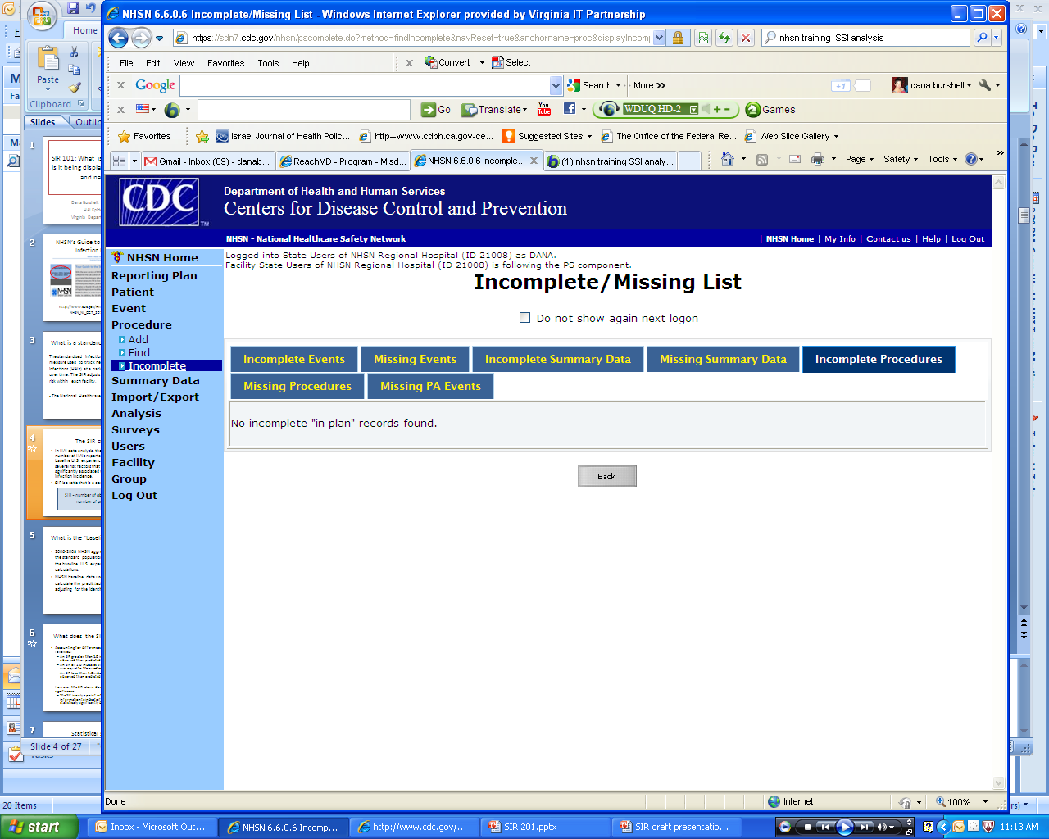
NHSN alerts to ensure data quality
Further explanation in NHSN Help
Notes:
Here is the Incomplete/Missing list that I was referring to. If it pops up every time you open NHSN and you no longer want that function, you can check the box next to “Do not show again next logon”. Circled are all of the incomplete/missing areas that apply to CLABSI and CAUTI: incomplete events, missing events, incomplete summary data, and missing summary data. Click on each tab to identify if there are any areas that need your attention. Otherwise, for the tabs with no missing or incomplete data, it will read “No incomplete ‘in plan’ records found”.
For further explanation, use NHSN Help which is located on the top right bar when you are logged into NHSN and is called “Help”.

Slide 14
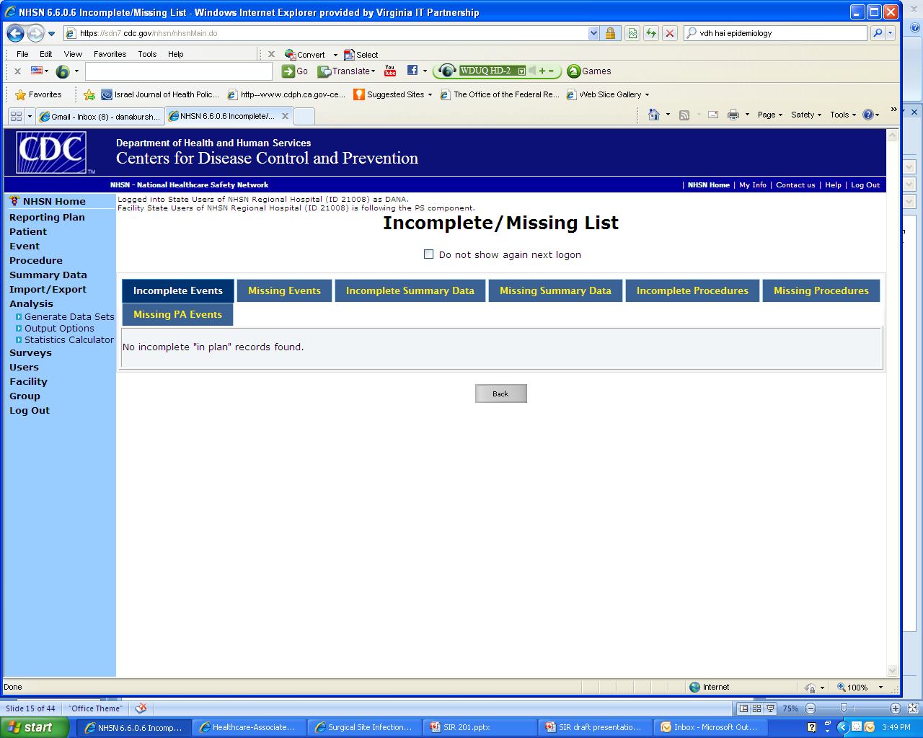
NHSN reports
NHSN reports offer over 50 CDC-designed reports that are modifiable plus you can create your own reports!
The only way to really become proficient in using NHSN reports is practice.
Experiment using NHSN reports
  You will not and cannot alter the input data when generating any report.
Generate data sets!
  It is the first step in performing NHSN analysis.
  Only way to capture the most recent data in an analysis.
Notes:
NHSN reports offers over 50 CDC-designed reports that are modifiable. In addition, you can create your own reports and save them so they will be easy to run in the future.
The only way to really become proficient in using NHSN reports is practice.
Experiment using the NHSN reports functionality: You will not and cannot alter the input data when generating any report; therefore, there is nothing to fear by practicing.
Generate data sets: It is the first step in performing NHSN analysis and is the only way to capture the most recent data in an analysis. If you do not generate data sets, you will be viewing data from the last time you generated data sets.

Slide 15
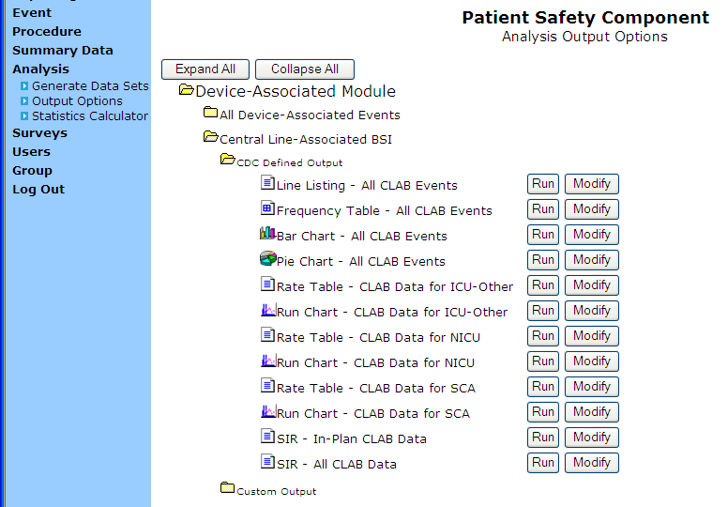
Generating an NHSN CLABSI SIR Report
Notes:
Once you have generated data sets, go back to the blue navigation bar and click “Output options”. In this example we want CLABSI SIR results. Therefore, we will first click on “Device-Associated Module”, then “Central Line-Associated BSI”. Because we want to use a report already created by CDC, we click “CDC Defined Output”. There are two options for the SIR report: “In-Plan CLAB Data” and “All CLAB Data”. The “In-plan” report will contain all of the information available according to your monthly reporting plan. “All CLAB Data” will include any custom procedures that cannot be included in the Monthly Reporting Plan or data from any units in which you conduct surveillance and enter the data into NHSN but the units are not included in your Monthly Reporting Plan.
You choose to either click “Run” or “Modify”. Run generates a default output that pops up in another window. If you would like the results in another format or if you would like to modify the output in any way, click “Modify”.

Slide 16
Monthly reporting plans
The Patient Safety Monthly Reporting Plan Form (CDC 57.106) is used by NHSN institutions to inform CDC which Patient Safety modules are used during a given month. This allows CDC to select the data that should be included in the aggregate data pool for analysis. Each participating institution must enter a monthly Plan to indicate the module used, if any, and the events, locations and/or procedures they monitored.
Notes:
Remember that the patient safety monthly reporting plan is used by NHSN to inform CDC which Patient Safety modules are used during a given month. Each participating institution must enter a monthly reporting plan to indicate the module used, if any, and the events, location(s), and/or procedures they monitor.

Slide 17
Output sections
Sections in each output
  Grouped by location
    Overall
    OrgID – facility
    Location Type (ex. ICU-Other)
    CDC Location Code - how facility is mapped to CDC’s location codes
    By Location - name designated by your NHSN administrator
  Months with Missing or 0 Device Days
Modifiable outputs
  Examples: by month/quarter/half-year/year, by locations
Notes:
The output has multiple sections grouping the information by various locations. Let’s take an example of a hospital with 4 different types of ICUs. The CLABSI SIR output first gives the overall CLABSI SIR for the 4 ICUs combined. It then provides the information by OrgID, which is more useful if you were looking at data from multiple hospitals. Next are the CLABSI SIRs by Location Type. Again, this may populate the same information if you only conduct surveillance for locations that fall under the “ICU-Other” category. Next are the CLABSI SIRs by CDC Location Code. This is where the 4 ICUs are separated and an SIR is calculated for each type of ICU. (Note that if you had two med/surg ICUs, for example, only 1 SIR would be calculated). Finally are the CLABSI SIRs by your facility’s location name. At the very end of the report are outputs summarizing what NHSN has identified as months with missing or zero device days. These areas should be resolved.
I mentioned that you can modify outputs. Although NHSN’s default is to group the SIR by half year, you may want to look at it by a different time period. From the screen I showed you before, you would click “Modify”, scroll to the bottom of the screen, and choose the time period you would like to “Group By”. This is one of the many ways you can modify your output.

Slide 18
NHSN CLABSI & CAUTI SIR output for CMS IPPS
  Displays data being submitted to the Centers for Medicare and Medicaid Services (CMS) by NHSN on behalf of facilities participating in the Inpatient Quality Reporting Program
  “SIR – CLAB Data for CMS IPPS”
  “SIR – CAUTI Data for CMS IPPS”
Navigation instructions:
  “Analysis” > “Output Options” > “Advanced” > “Summary Level Data” > “CDC-Defined Output”
  More information available at www.cdc.gov/nhsn/library.html
Notes:
NHSN has created special output analyses for users to know what data was shared with the Centers for Medicare and Medicaid Services. These outputs display data being submitted to CMS by NHSN on behalf of facilities participating in the Inpatient Quality Reporting Program. The two device-associated reports are “SIR – CLAB Data for CMS IPPS” and “SIR – CAUTI Data for CMS IPPS”.
In order to navigate to these outputs, generate data sets, click on “Analysis” on the blue navigation bar, click “Output Options”. On the main screen, click “Advanced” then “Summary Level Data” and then “CDC-Defined Output”. From there you can select the specific output you would like. Additional information is available on the NHSN website in their online library. Under CMS Reporting, there are 2 documents for CMS assistance.
Helpful Tips for CLABSI Reporting for the Centers for Medicare and Medicaid Services’ Hospital Inpatient Quality Reporting Programs
Using the “SIR - CLAB Data for CMS IPPS” Output Option

Slide 19
SSI
Surgical site infections
Notes:
Now that we have reviewed how the CLABSI SIR is calculated and briefly introduced you to NHSN Reports to help you generate SIR data, let us move to surgical site infections. The calculation of the SSI SIR is more complicated and I will be using some statistical terms that all of you may not be familiar with. It is not essential for you to be able to follow every step; however, I want to help introduce the concepts to you to increase your comfort with the SSI SIR.

Slide 20
Deriving the SSI SIR: Improved risk adjustment
No longer based on the basic risk index
  Therefore, recent risk-stratified SSI rates not published
New method uses an improved risk adjustment calculated through logistic regression modeling.
  Used for prediction of the probability of occurrence of an event by fitting data
  Allows specified risk factors to be considered
  Allows risk factors to be procedure-specific
  Allows each factor’s contribution to vary according to its association with risk
Notes:
The SIR provides improved risk adjustment as compared to the previously used risk index. The risk index relied on 3 risk factors only, and these same risk factors determined the risk for all types of procedures. Also, in the risk index, the relative contribution of each of these factors are constrained to be equal and treated equally in the analysis. The SSI SIR is no longer based on the risk index; therefore, the risk-stratified SSI rates are no longer published.
The SIR, on the other hand, allows specified factors to be considered, allows the set of risk factors to be procedure-specific, and allows each factor’s contribution to vary according to its significant association with risk. To further improve risk adjustment, NHSN is now using logistic regression models for surgical site infection SIR analysis.
Logistic regression is used to determine how one or more independent variables (like gender or ASA score) are related to the probability of the occurrence of one of two possible outcomes (in this case – SSI or no SSI). What this means is that there are mathematical equations that take into account specific risk factors and can generate the predicted number of SSIs for a specific procedure over a certain time period. These models are procedure-specific and allows risk factors to be procedure-specific.

Slide 21
Using logistic regression model to calculate SSI risk for 1 hypothetical patient
Risk Factor* (X1-X4) | Parameter Estimate (β1 –β4) | Odds Ratio | p-value
Intercept | -5.448 | --- | ---
Age (≤44* vs >44) | 0.520 | 1.659 | <0.001
ASA (3/4/5* vs 1/2) | 0.425 | 1.529 | 0.041
Duration (>100 mins* vs ≤100 mins) | 0.501 | 1.650 | 0.002
Med school affiliation (Y*/N) | 1.069 | 2.912 | <0.001
Hypothetical patient
40 years old, ASA score of 4, duration of 117 minutes, medical school affiliated
logit (p) = α + β1X1 + β2X2 + β3X3 + β4X4
logit (p) = -5.448 + 0.520(1*) + 0.425(1*) + 0.501(1*) + 1.069(1*)
= 0.05 (individual patient’s risk)
* Does not include all risk factors for SSIs and is only a model
Notes:
This model was developed by NHSN for teaching purposes to show how a SSI SIR is derived – this example should not be used to calculate a patient’s risk of SSI in your facility.
This table lists some of the risk factors found to be significant for NHSN operative procedure categories. For the purposes of this webinar, let’s assume these are all of the significant SSI risk factors for the type of procedure this patient had. Note that each risk factor’s contribution varies, as represented by the parameter estimate (β) for each factor. These parameter estimates can be plugged into the formula above for each β, and either a 0 or 1 will be plugged into each x. For the risk factors with an asterisk, if present for that patient, x=1, if not x=0.
In this example with hypothetical patient #1 who is 40 years old, has an ASA score of 4, the operation duration was 117 minutes, and the hospital is medical school affiliated, we can see that each risk factor is considered present, and 1 should replace each x in the equation. Once each x is plugged in, the equation can be calculated. For this patient, the probability of an SSI using this logistic regression model is 0.05, which can be interpreted as a 5% risk of infection for patient #1.

Slide 22
SSI SIR incorporating many patients
Patient | Age | ASA score | Duration | Medical school affiliation | SSI observed | Probability of SSI
1 | 40 | 4 | 117 | Y | 0 | 0.050
2 | 53 | 2 | 95 | N | 0 | 0.004
3 | 30 | 2 | 107 | Y | 1 | 0.033
. | . | . | . | . | . | .
100 | 37 | 4 | 128 | Y | 1 | 0.050
TOTAL | --- | --- | --- | --- | 3 | 2.91
SIR = number of observed SSIs = 3 = 1.03
number of predicted SSIs 2.91
* Does not include all risk factors for SSIs
Notes:
The probability is calculated for each patient and then summed to give the predicted number of SSIs for this population. This table represents a partial list of 100 hypothetical patients who have undergone this particular procedure and the significant risk factors present for each.
There were 3 SSIs observed for this particular procedure for the identified period of time. 2.91 SSIs were predicted by using this logistic regression model. To calculate the SIR, you divide 3 (observed) by 2.91 (predicted), for an SIR of 1.03.

Slide 23
Risk factors for COLO and HYST
NHSN operative procedures (2 examples) | Risk factors included in SIR logistic regression model*
Colon surgery (COLO) | Age, anesthesia, ASA, duration, endoscope, medical school affiliation, location bed size, wound class
Abdominal hysterectomy (HYST) | Age, anesthesia, ASA, duration, endoscope, location bed size
http://www.cdc.gov/nhsn/PDFs/pscManual/SSI_ModelPaper.pdf
* As of April of 2012
**Taken from the annual facility survey
Notes:
Here are the risk factors included in the SIR logistic regression model for the two NHSN operative procedures that are required by CMS for their incentive program: colon surgery and abdominal hysterectomy. This is as of April of 2012 and are based on the findings of the Society for Healthcare Epidemiology of America (SHEA) paper, “Improving Risk-Adjusted Measures of Surgical Site Infection for the National Healthcare Safety Network”. For colon surgery, the risk factors include: age, anesthesia, ASA, duration, endoscope, medical school affiliation, location bed size, and wound class. Abdominal hysterectomy risk factors include: age, anesthesia, ASA score, duration, endoscope, and location bed size.

Slide 24
Definition tips
Inpatient – admission and discharge dates are on different calendar days
Outpatient – admission and discharge dates are on the same calendar day
Endoscope (Y) – entire procedure was performed using a laparoscope/robotic assist
  If more than one becomes infected, report only one (the deeper SSI)
Emergency (Y) – procedure was non-elective and unscheduled
Trauma (Y) - operation was done because of blunt or penetrating trauma
Implant (Y) – no longer has to be permanent
Notes:
In order to complete forms correctly, it is essential that you are familiar with NHSN’s definition of each term. The following includes some definition tips that may help you more confidently fill out NHSN forms.

Slide 25
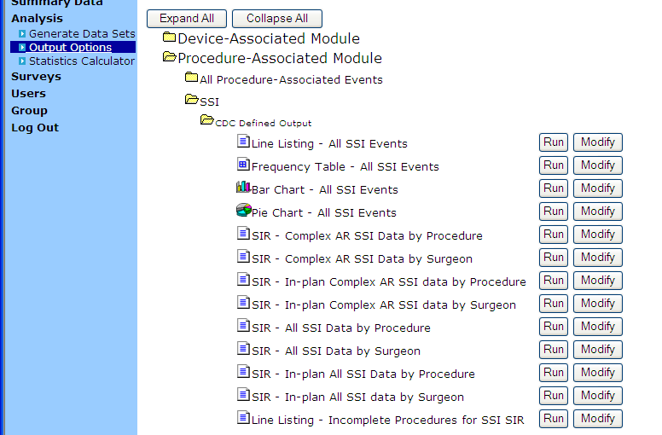
NHSN generated reports by procedure or by surgeon
Complex AR– only includes inpatient deep
incisional and organ/space infections
identified on admission (A) and
readmission (R)
In-plan – only includes what is identified in
the monthly reporting plan
All SSI – includes inpatient and outpatient superficial, deep, and organ/space identified on
admit/readmit/post-discharge; includes primary only and excludes secondary SSIs.
Notes:
To get to the SSI SIR Output, first generate data sets, then click “Output Options” on the blue navigation bar under “Analysis”. On the main screen, click “Procedure-Associated Module”, then click “SSI”, followed by “CDC Defined Output”. As you can see, there are many CDC defined outputs for the SSI SIR – 8 to be exact, and a separate line list report at the bottom to identify incomplete procedures.
In order to choose the correct report for your purposes, it is important to understand the distinctions between each output. Learning the vocabulary of in-plan, complex, and AR will be helpful. In-plan, like for CLABSI, only includes what is identified in the monthly reporting plan. Complex includes only deep incisional and organ/space infections (not superficial). AR only includes inpatient SSIs identified on admission and readmission (not post-discharge). Therefore, complex AR SSI Data includes deep incisional and organ/space infections identified on admission or readmission (and does not include superficial incisional infection or those identified post-discharge).
“All SSI SIRs” include inpatient and outpatient superficial incisional primary (SIP), deep incisional primary (DIP), and organ/space SSIs, SSIs detected during admission, readmission, or post-discharge. The only exclusions are: secondary SSIs (SIS, DIS), incomplete procedures, and custom procedures.
The line listing of “Incomplete Procedures for SSI SIR” provides a detailed list of all non-custom excluded procedures that meet the exclusion criteria.
You will still be able to obtain SSI rates using the legacy basic risk index, within NHSN analysis but they have been moved to the “Advanced” section of the output options. Note that while these options are available, you will be able to obtain only YOUR facility’s SSI rates; comparison to the previously-published NHSN SSI pooled means will no longer be available.

Slide 26
Enter a form for each procedure
Complete a denominator form for each procedure that is referenced in your monthly reporting plan
  Even if two procedures are done through the same incision
  Record operative procedures with more than one incision only one time
Notes:
To reiterate, an SIR will only include data from the procedures that were collected and entered correctly. Therefore, you need to complete a denominator form for each and every procedure that is referenced in your monthly reporting plan. Even if two procedures are done through the same incision, each procedure needs a separate denominator form completed and entered. On the other hand, if a procedure required more than one incision, it is still counted and entered as only one procedure.

Slide 27
SSI SIR exclusions
Any SSI if its corresponding procedure is excluded from the SIR
All custom procedures
All secondary SSIs
  Superficial incisional secondary (SIS) and deep incisional secondary (DIS)
Any procedure record that meets the exclusion criteria
Incomplete/missing
Notes:
When NHSN calculates the SSI SIR, it will exclude any SSI if its corresponding procedure had not been appropriately entered into NHSN. In addition, SSI SIR exclusions include all customized procedures, all secondary SSIs, and any procedure record that is incomplete or missing or meets any of the exclusion criteria.

Slide 28
Exclusion criteria
Missing one or more of the risk factors
Procedure date is ≤ patient date of birth
Patient’s age at procedure is ≥ 109 years
Wound class = U (unknown)
Procedure duration is < 5 minutes or > 5 times the interquartile range above the 75th percentile.
  List of the extreme outlier cut-offs available for each NHSN Operative Procedure in Appendix E of the NHSN e-News: SIRs Special Edition
Additional exclusions apply for FUSN and RFUSN
Notes:
Procedures will be excluded from the SIR if they meet any of the following exclusion criteria, as written in Appendix C of the SIR e-newsletter: missing one or more of the risk factors, procedure date is less than or equal to the patient date of birth, patient’s age at procedure is greater than or equal to 109 years, wound class is unknown, or procedure duration is less than 5 minutes or greater than five times the interquartile range above the 75th percentile. There are additional exclusions for fusion and refusion (FUSN and RFUSN) procedures located in Appendix C.
See Appendix E of the NHSN e-News: SIRs Special Edition for a list of the extreme outlier cut-off values for each NHSN Operative Procedure, also known as greater than five times the interquartile range above the 75th percentile. While it is not essential for you to understand how the interquartile range is calculated, I will briefly go through an example for those of you who are interested in this example. If the interquartile range, the difference between the upper and lower quartiles, is 30 minutes, and the 75th percentile is 100 minutes, then fives times the interquartile range above the 75th percentile would be 100 + (5*30) = 250 minutes.

Slide 29
NHSN SSI SIR report output
Several sections
  Overall SIR
  SIR for each procedure
  SIR for each procedure, by outpatient (Y or N)
  Incomplete and Custom Procedures not included in SIR
Modify to answer your question
  Examples: all joint replacement SSIs, M/Q/H/Y
Notes:
Once you generated new data sets and selected a CDC SSI SIR Output, there will be 4 sections of tables available in each output. The first table represents an overall SIR for those locations and those operative procedures for which SSIs were monitored in your facility, during the specified time period. The default time period for SIRs is a half year.
The second table provides an SIR by NHSN operative procedure category. The SIRs that appear in this table will group inpatient and outpatient procedures within each category.
The third table provides an SIR by NHSN operative procedure category and outpatient status, as well as the time period specified. Note that this table will be available only in the “All SSI SIR” output option since it is the only option that includes outpatient data.
The fourth table provides a count of the number of procedures and SSIs that were excluded from the SIRs in the previous tables, although this list will only include those procedures that were excluded from the SIR due to the exclusion criteria mentioned on the previous slide.
Remember that you can modify your output to suit your needs, such as to change the time period, or group the procedures together in a certain way (such as if you were tracking the SIR for all joint replacement procedures).

Slide 30
Data quality
To ensure the data are correct before you start making your graphs and compiling your report
  Check incomplete/missing alert tabs and/or run the line list for “Incomplete procedures for SSI SIR”
  Check data quality line lists in “Advanced” section of the Output Analysis
Notes:
To ensure the data are correct before you start making your graphs and compiling your report
Check incomplete/missing alert tabs and/or run the line list for “Incomplete procedures for SSI SIR”
Check data quality line lists in “Advanced” section of the Output Analysis
Let us look into these options a little more to gain some familiarity.

Slide 31
NHSN alerts to ensure data quality
Further explanation in NHSN Help
Notes:
Here is that same Incomplete/Missing list that I was referring to for CLABSIs. You can also get to it by clicking “Procedure” on the blue navigation bar on the left, then clicking “Incomplete”. Circled are all of the incomplete/missing areas that apply to SSIs and procedures: incomplete procedures, missing procedures, and missing procedure-associated (PA) events. Click on each tab to identify if there are any areas that need your attention. Otherwise, for the tabs with no missing or incomplete data, it will read “No complete ‘in plan’ records found”.
For further explanation, use NHSN Help which is located on the top right bar when you are logged into NHSN and is called “Help”.

Slide 32
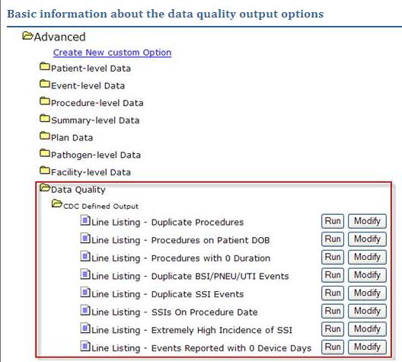
NHSN-generated line lists to ensure data quality
Duplicate events and procedures
Procedures with duration = 0
Procedures on patient date of birth
SSI on procedure date
Extremely high incidence of SSI
Events reported with 0 device days
Further explanation in NHSN Help
Notes:
There are additional ways to identify SSI data quality issues. Click “Output Options” on the blue navigation bar on the left, click “Advanced”, then click “Data Quality” and “CDC Defined Output”. There are multiple outputs that you can run which include: duplicate events and procedures, procedures with a duration of 0, procedures on patient date of birth, SSI on procedure date, extremely high incidence of SSI, and events reported with 0 device days.
If there are records identified in these reports that need to be modified, go back to the appropriate record and make the correction. To ensure the records were fixed, regenerate datasets and rerun the report. In instances where you are unable to edit an existing record because the application does not allow it or the data needed to make the record correct are no longer available, you must remove the event(s) from your monthly reporting plan for the affected month(s), since such records are out of compliance with the protocol. If this is the case, careful consideration should be given to your state’s HAI reporting mandate and CMS IPPS reporting requirements, if applicable. It is important to remember that removing events from your monthly reporting plan could make your facility non-compliant with state or CMS reporting requirements.
For further explanation of these outputs, search NHSN Help.

Slide 33
New NHSN SSI SIR Report for CMS IPPS
“SIR – Complex 30-Day SSI Data for CMS IPPS”
  Displays data being submitted to CMS by NHSN on behalf of facilities participating in the Inpatient Quality Reporting Program
  Available in NHSN v6.6.1 (April 2012)
  Navigation instructions: “Analysis” > “Output Options” > “Advanced” > “Summary Level Data” > “CDC-Defined Output”
  More information available at www.cdc.gov/nhsn/library.html
Notes:
NHSN has created special output analyses for users to know what data was shared with the Centers for Medicare and Medicaid Services. These outputs display data being submitted to CMS by NHSN on behalf of facilities participating in the Inpatient Quality Reporting Program. The SSI SIR report is “SIR – Complex 30-Day Data for CMS IPPS” and became available in the April 2012 release of version 6.6.1.
In order to navigate to these outputs, generate data sets, click on “Analysis” on the blue navigation bar, click “Output Options”. On the main screen, click “Advanced” then “Summary Level Data” and then “CDC-Defined Output”. From there you can select the specific output you would like. Additional information is available on the NHSN website in their online library. More information will be available at www.cdc.gov/nhsn/library.html.

Slide 34
Calculating your own SIR
NHSN location rates are published and available on the NHSN website for CLABSI and CAUTI
  SSI risk index data no longer published
We recommend that you use the 2006-2008 baseline rates
  To be consistent with NHSN’s SIR calculation
  To be able to have meaningful trended data over time
Use the NHSN statistics calculator to determine:
  If the SIR is statistically significant
  If the difference between two SIRs is statistically significant
Notes:
It is possible to calculate SIRs by hand, especially for CLABSIs and CAUTIs. However, if you already enter the data into NHSN, we recommend that you simply use NHSN reports to generate the necessary SIR data. If you need to calculate an SIR, NHSN CLABSI and CAUTI location rates are published and available on the NHSN website. Remember that the SSI risk index data are no longer being published, and the SSI SIR would be much more difficult to derive manually. We recommend that you use the 2006-2008 baseline rates in order 1) to be consistent with NHSN’s SIR calculation and 2) to have meaningful trended data over time.
Because statistical significance is important in SIR interpretation, the NHSN statistics calculator will be useful to help determine if the SIR is statistically significant. In addition, the NHSN statistics calculator can determine if the difference between two SIRs is statistically significant.

Slide 35
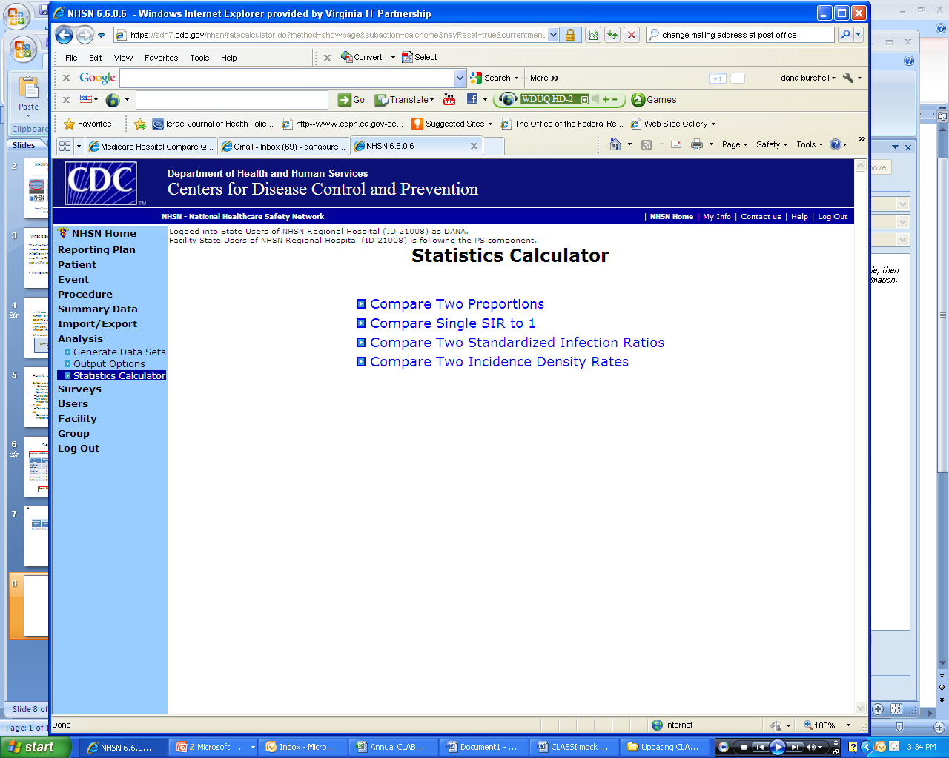
The NHSN statistics calculator:
Your friend
Notes:
To get to the NHSN Statistics Calculator, click “Analysis” from the blue navigation bar on the left, then click “Statistics Calculator”. As you can see there are 4 types of calculations available through NHSN, two of which refer to the SIR: Compare Single SIR to 1 and Compare Two Standardized Infection Ratios.

Slide 36
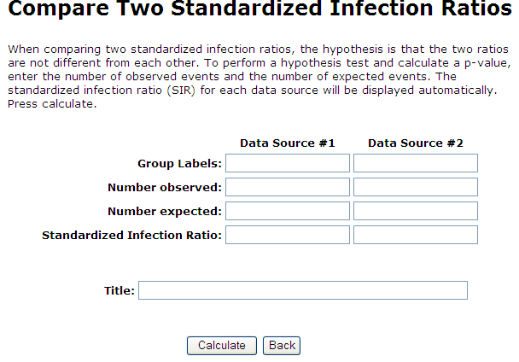
NHSN statistics calculator
Calculates the SIR, the p-value, and the 95% confidence interval.
Notes:
Here is the screen that appears if I click “Compare Two Standardized Infection Ratios.” You input the labels you would like to use, the number of observed HAIs, and the number of expected HAIs. Remember that on slides 10 and 11 of this presentation, we gave an example of how to calculate the expected (or predicted) number of infections. By clicking “Calculate”, the SIR, p-value (one-tailed and two-tailed), and the 95% confidence interval are generated.

Slide 37
Seven steps to success
Generate data sets
Do data quality checks to ensure data are complete
Choose an NHSN analysis output option
Modify analysis (time period, ICUs, etc.)
Export in friendly file type (CSV, Excel)
Use data to create targeted reports for audience via your own methods (Excel, Word, PowerPoint)
Contact the VDH HAI Program or NHSN with Qs
Notes:
We reviewed a significant amount of information today, and it may seem a bit overwhelming. But, let us break it down into steps to make this process a little more manageable.
Generate data sets
Conduct data quality checks to ensure data are complete and accurate (If you make changes, re-generate data sets.)
Choose an NHSN analysis output option to run
If necessary, modify the analysis by time period, etc.
If desired, export the NHSN output in a file type most useful for you
Use data to create targeted reports for your audience through Excel, Word, PowerPoint or any other method that you are comfortable with
If you have any questions, contact the VDH HAI Program, NHSN, or your fellow IPs

Slide 38
Things to remember about the SIR
The default SIR output option will produce SIRs by half-year for 2009 and forward, however, you can change this by modifying the output
SIR will not be calculated for the current time period, as the time period is not yet complete
If the number of predicted HAIs < 1, NHSN will not calculate the SIR – the comparison is too unstable
  Consider using a longer time frame for your calculation to increase the # of central line days (for CLABSI) or urinary catheter days (for CAUTI)
If the number of observed HAIs = 0, the lower bound of the 95% CI will not be calculated
Incomplete and custom procedures not included in SIR
Notes:
A few things to remember about the SIR:
The default SIR output option will produce SIRs by half-year for 2009 and forward for CLABSIs and SSIs and 2010 and forward for CAUTIs; however, you can change the time period the SIR is grouped by by modifying the output
The SIR will not be calculated for the current time period, as the time period is not yet complete
If the number of predicted HAIs is less than 1, NHSN will not calculate the SIR because the comparison is too unstable
Consider using a longer time frame for your calculation to increase the # of central line days or catheter days
If the number of observed HAI is 0, the lower bound of the 95% confidence interval will not be calculated
Incomplete and custom procedures are not included in the SIR

Slide 39
Common errors and missed steps that may lead to CMS noncompliance
Has not completed 2011 facility survey
Has not completed a monthly reporting plan for each month for CLABSIs, CAUTIs, and SSIs
Did not indicate appropriately
  0 events, procedures, or device days
  Remember, without your direct indication, these months will be considered incomplete and will not be included in the SIR nor will you be in compliance with CMS
Notes:
There are common errors and missed steps that may lead your facility to not be in compliance with CMS. The following must be completed to be in compliance:
Your 2011 facility survey must be completed. You may have difficulty entering data beyond February 2012 if you have not yet completed the 2011 facility survey.
You must complete a monthly reporting plan for each month
You must appropriately indicate that there were 0 events, 0 procedures, or 0 device days. Remember, without your direct indication, these months will be considered incomplete and will not be included in the SIR nor will you be in compliance with CMS. Refer to the Nov-Dec 2011 VDH HAI newsletter, Synergy under the NHSN Q&A to learn how to check the appropriate “No Events” boxes.

Slide 40
SIR data presentation: Components to consider
Presented data
# infections
Format
Table
Stratification type and time period
Aggregate by
Hospital
Adult/PICU and NICU
Unit
Interpretation
Time period
# CL days
SIR
# predicted
p-value
95% CI
Comparison
Historical data
Cues
Color
Symbols
Words
SIR Language
Order
National
State
Hospital
Considerations
No infections
<1 predicted
Quarterly
Semi-annual
Annual
Bedsize
Graph
Always customize for your audience whenever possible.
Notes:
During the Nov 10th conference, we talked about data presentation, and we wanted to reemphasize customizing your data whenever possible. In SIR 101, you saw how NHSN, CMS, and VDH chose to display SIR data. There is no right way and it should always be customized for the audience whenever possible. This slide is a reminder of components to consider when presenting SIR data. What type of data would be most important to your audience, do you need comparison or historical data? Which format - table or graph - would be the most impactful and easy to understand for your audience? How do you want to stratify and group your data? By unit, quarterly or annually, etc? And of course, what words, symbols or colors are you going to use to help your audience easily follow the data?

Slide 41
Resources
SIR and surveillance
  NHSN e-News: SIRs Special Edition
    http://www.cdc.gov/nhsn/PDFs/Newsletters/NHSN_NL_OCT_2010SE_final.pdf
  VDH HAI website – surveillance
    http://www.vdh.virginia.gov/Epidemiology/Surveillance/HAI/SurveillanceReporting.htm
Guidance for CMS and data quality
  Alerts Guide to identify missing/incomplete data
    http://www.cdc.gov/nhsn/PDFs/pscManual/NHSN-Alerts_6_5.pdf
  NHSN library - http://www.cdc.gov/nhsn/library.html
    Helpful Tips for CLABSI Reporting for the Centers for Medicare and Medicaid Services’ Hospital Inpatient Quality Reporting Program
    Using the “SIR - CLAB Data for CMS IPPS” Output Option
    Operational Guidance for Acute Care Hospitals to Report Data to CDC’s NHSN for the Purpose of Fulfilling CMS’s Hospital Inpatient Quality Reporting Requirements
Notes:
There are a variety of resources pertaining to the SIR. I hope you will be able to take some time to investigate and become more comfortable with this new metric.

Slide 42

Thank you!
Dana.Burshell@vdh.virginia.gov 804-864-7550
Andrea.Alvarez@vdh.virginia.gov 804-864-8097

Slide 43
Duration rules
The time between skin incision and skin closure.
Does not include anesthesia time.
If more than one NHSN operative procedure is done through the same incision during the same trip to the OR, use the total time for each record.
If the patient goes to the OR more than once during the same admission, report only one procedure combining the durations of both.
For bilateral operative procedures, track duration separately or divide the total time for both by 2.
Notes:
Extra slides

Slide 44
Other tips and tricks
For bilateral operative procedures, two separate Denominator for Procedure records must be completed.
Wound class should be assigned by a person directly involved in performing the operation.

