Slide 1
Zika Virus and Virginia
Briefing for the General Assembly
Marissa J. Levine, MD, MPH, FAAFP
State Health Commissioner
March 7, 2016

Slide 2
Outline
The Basics: Zika Virus Disease
  Epidemiology
  Transmission
  Special circumstances
Prevention
  Travel related
  Mosquito Control
State Actions
  VDH
  Zika Task Force

Slide 3
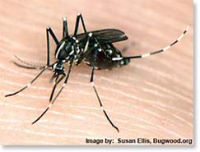
Zika Virus Disease – The Basics
Spread to people primarily through bite of
infected mosquitoes (Aedes species)
1 of 5 infected persons get sick
  Fever, rash, joint pain and conjunctivitis are most common symptoms – usually a mild illness
  Illness lasts several days to 1 week
No vaccine or medications are available to prevent or treat Zika infections
Notes:
Zika virus infection is primarily spread through the bite of an infected mosquito. Of those that are infected with the virus, 1 out of every 5 will become sick. The most commonly reported symptoms are fever, rash, joint pain and conjunctivitis. The illness is typically mild, lasting approximately 1 week. There are some reports of more lengthy or more serious illness, but those are much less common. 80% of those who are infected will NOT become ill.
The treatment for Zika virus infection is what is known as “supportive care”, that is, there are no specific medications to treat the infection. The illness is treated by managing the symptoms, which can include fluids, rest, and medications such as tylenol to reduce fever. There is currently no vaccine to prevent zika virus infection.
4 of 5 infected persons are asymptomatic – not sick

Slide 4
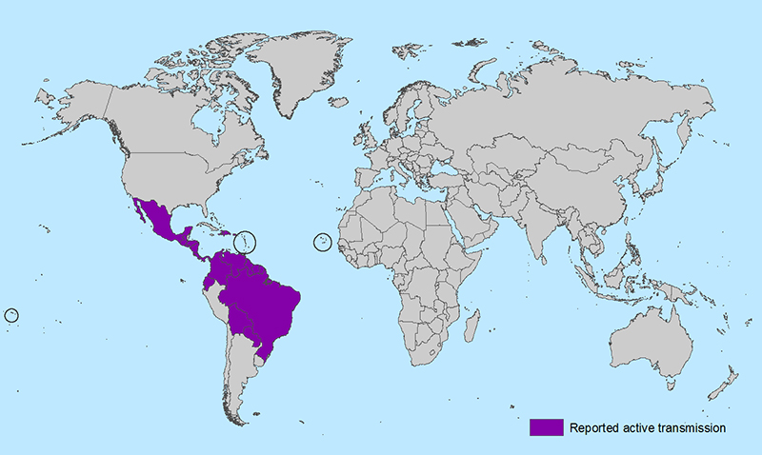
2015–2016 Outbreak in Americas
1st case of locally-spread Zika virus disease in Brazil confirmed in May 2015
  Since then, outbreaks occurring in many countries
  Number of cases among travelers visiting or returning to US will increase
*Maps were developed by CDC using currently available information as of February 2, 2016
Notes:
The first case of locally spread Zika virus was confirmed and reported from Brazil in May of 2015. The virus has long circulated in Africa and parts of Asia but it is new to the Western Hemisphere. It is thought that 1.5 million people in Brazil have been infected with the virus, and the virus has spread throughout countries in Latin America and the Caribbean.
Due to the mobile nature of our society, we expect that numbers of imported cases , or cases that are identified in travelers visiting or returning to the US from these areas of the world, to increase over time.

Slide 5
Populations at Risk for Zika Infection
Current – Anyone living in or traveling to area with active transmission, including pregnant women
  Potential – During mosquito season, parts of US, including Virginia, have mosquitoes that could spread virus if they bite an infected person
Notes:
Persons who have not traveled to affected country are not currently at risk of getting Zika from mosquito bites in the United States
Risk of local transmission of Zika virus is currently low because it is not mosquito season in Virginia
The main population at risk includes those individuals who are living in or traveling to areas with ongoing transmission of Zika virus infection, including pregnant women. Transmission via the bite of a mosquito remains the primary mode of transmission; persons who have not traveled to these areas are not currently at any significant level of risk. There is potential for local transmission to take places in parts of the United States, including Virginia that are mosquitoes that are capable of spreading zika virus. Right now, because it is not mosquito season in Virginia, the risk of local transmission here is very low.

Slide 6
Zika Virus Disease in Virginia
As of March 3, 2016, VDH has reported five (5) cases of Zika virus disease in adult residents of Virginia to the Centers for Disease Control and Prevention (CDC)
All are travel associated
Additional cases will be reported as healthcare providers evaluate ill returning travelers, consider Zika, and work with public health to obtain testing
Notes:
2 in Northwest Region
1 in Northern Region
1 in Eastern Region
1 in Central Region

Slide 7
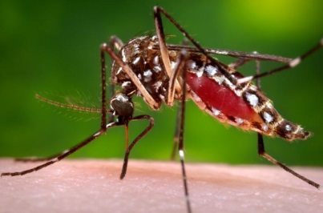
Transmission
Zika virus primarily transmitted by:
  Mainly Aedes aegypti (Yellow fever mosquito)
  Also by Aedes albopictus (Asian tiger mosquito)
    Both also transmit dengue and chikungunya viruses
  Both circulate in VA, especially the Asian tiger mosquito
  Mosquitoes become infected by feeding on infected persons
  Zika virus remains in an infected person’s blood for about one (1) week
CDC Public Health Image Library
Notes:
The mosquitos that can transmit zika virus are those that also are capable of transmitting other viruses called Dengue and chikungunya. The main species involved in transmission of Zika is the Aedes aegypti or yellow fever mosquito. The Aedes Albopictus mosquito while common in Virginia, is a capable but less common vector for the virus.
Mosquitoes become infected by biting an infected persons. That is, if a mosquito bites an infected human being while that person is infectious (so during their first week of illness), it then becomes an infected mosquito, and can go on to bite another human being, which is how the virus spreads.
As explained earlier, the virus remains in an infected person’s blood for approximately 1 week.
No animal reservoir is known to be involved in Zika transmission in the Americas

Slide 8
Transmission
  Transmitted from mother to child, during pregnancy or at the time of delivery
Sexual transmission
Rarely, transmitted by blood
    Spread through blood transfusion has been reported
    Food and Drug Administration (FDA) has recommended deferral of blood donation from individuals who were recent travelers to Zika-affected areas
Notes:
While mosquito transmission is the main mode of transmission of the virus, there are other documented routes of transmission which are less common.
Maternal-fetal transmission , which is the spread of an infection from a mother to her baby during pregnancy or birth, has been documented.
It is also thought that although rare, the virus can be transmitted through blood transfusion. Some blood donation agencies have requested that recent travelers defer donating their blood.
There is growing evidence (recent reports from CDC if published by time of this presentation) that transmission via sexual contact is more common than previously reported. To date, all reported instances of sexual transmission involve transmission from a male partner.
Sexual transmission from infected women to their sex partners has not been documented, nor has transmission from persons who are asymptomatically infected.
It is unclear whether sexual transmission poses a greater risk of poor pregnancy outcomes than mosquito-borne transmission.

Slide 9
Special Concerns for Pregnant Women and Zika
There have been reports of microcephaly (smaller than normal head size) and other poor pregnancy outcomes in babies of mothers who were infected with Zika virus while pregnant
Link between Zika infection and these outcomes is not understood fully, but is under investigation
Notes:
Maternal-fetal transmission, which is the spread of an infection from a mother to her baby during pregnancy or birth, has been documented for Zika virus. Experts suspect that if a woman is infected while she is pregnant, the virus could cause adverse impacts to her baby, including a condition known as microcephaly. Microcephaly is the presence of an unusually small head and can impact brain development. There have been reports of microcephaly and other outcomes in babies of mothers who were infected with Zika while pregnant. Brazil has reported an increase in the number of cases of microcephaly; researchers are trying to determine the accurate number of those cases, and any potential connection to Zika. Links between zika infection and these concerning birth outcomes are suspected, but not well understood and these questions are under investigation.
Sources: http://www.cdc.gov/zika/pregnancy/index.html, http://wwwnc.cdc.gov/travel/notices/alert/zika-virus-pacific-islands

Slide 10
Special Concerns for Pregnant Women and Zika
At this time, CDC advises that pregnant women avoid travel to Zika-affected countries
If travel unavoidable, protect against mosquito bites
No evidence that, after the virus is cleared from the body, Zika virus affects future pregnancies
Notes:
If symptoms start within 2 weeks of travel, see healthcare provider and consider testing
If no symptoms, see healthcare provider after return, consider testing, consider ultrasound evaluations
Virus will not cause infections in a baby conceived after virus cleared from blood

Slide 11
Zika Prevention Strategies: Travel
On January 15, 2016, CDC issued travel alert for people traveling to regions where transmission is ongoing
Until more is known, CDC recommends special precautions for pregnant women and women trying to become pregnant
    Pregnant women in any trimester should consider postponing travel to affected area
    Women trying to become pregnant should consult with healthcare provider before traveling to affected area
Notes:
CDC’s travel alert is Level 2 (Practice Enhanced Precautions).
CDC currently recommends that, if pregnant women must travel to one of these regions, they strictly adhere to guidelines regarding avoiding mosquito bites during their trip.
For an up-to-date list of countries and regions that have been issued a level 2 travel notice, visit http://wwwnc.cdc.gov/travel/notices
Level 2-Practice Enhanced Precautions: means that there is an increased risk in defined settings or associated with specific risk factors; certain high-risk populations may wish to delay travel to these destinations
1/15/16: CDC media release http://www.cdc.gov/media/releases/2016/s0315-zika-virus-travel.html

Slide 12
Zika Prevention Strategies:
Avoid Mosquito Bites
All travelers, especially pregnant women, should take steps to avoid mosquito bites
  Choose an EPA-registered insect repellant and use according to product label
    http://www.epa.gov/insect-repellents/find-insect-repellent-right-you
  Use permethrin-treated clothing
  Cover exposed skin by wearing long sleeves, pants, and hats
  Sleep indoors in rooms with screened windows or air-conditioning, or use bed net if sleep in room exposed to outdoors

Slide 13
Zika Prevention Strategies:
Sexual Transmission
Until we know more:
Men who reside in or have traveled to an area of active Zika virus transmission who have a pregnant partner should abstain from sexual activity or consistently and correctly use condoms during sex with their pregnant partner for the duration of the pregnancy
Recommendations will be revised as more information becomes available

Slide 14
Mosquito Control & Surveillance in Virginia
Mosquito control in Virginia - locally funded and limited to some densely populated counties and cities:
Most efforts focus on surveillance and control of nuisance mosquitoes and mosquitoes that transmit West Nile or Eastern Equine Encephalitis viruses
Asian tiger mosquito control methods require house-to-house inspections and treatments
Notes:
Generally use truck-mounted aerosol spraying on public streets and/or treat water catchments/storm drains on public lands
Most mosquito control programs in Virginia do not have the resources or legal authority to conduct inspections or control efforts on private land

Slide 15
VDH’s Initial Response
Coordinate with public and private partners
Raise awareness among clinicians and general public
  https://www.vdh.virginia.gov/epidemiology/Zika/
Expand lab testing capability at State Lab: DCLS
  DCLS currently facilitates testing at CDC
  DCLS expects to get Zika virus lab testing
Notes:
Sent two ‘Dear Colleague’ Letters
Established VDH websites for healthcare providers and general public
Developing additional resources for websites, brochure for pregnant women, fact sheets, presentations for local health districts, etc.
What is Virginia doing in response to Zika virus outbreak?
Coordinate with partners, including
Working with healthcare providers to answer questions, receive reports of suspected cases, facilitate testing
Working with DCLS for laboratory testing
Working with CDC on issues for disease investigation, surveillance, and testing
Raise awareness among clinicians and general public
Dear Colleague letter on Zika, Influenza and Noro sent out 1/26/16 (http://www.vdh.virginia.gov/clinicians/; note that dissemination was delayed because of winter storm)
VDH Zika fact sheet (posted 1/21/16)
VDH Zika websites for general public and healthcare providers (http://www.vdh.virginia.gov/epidemiology/Zika/index.htm, live 1/26/16 and will be updated as needed)
VDH brochure for pregnant women (1/29/16)
Expand laboratory testing capabilities at DCLS
DCLS is in discussion with CDC about the opportunity to expand lab testing in Virginia

Slide 16
VDH’s Initial Response
Conduct disease surveillance
All suspected and confirmed cases are required to be reported to local health department
Local health departments can provide consultation and facilitate lab testing if needed
Lab testing is focused on pregnant women who traveled to affected area; other suspect cases may be tested if testing criteria are met
VDH and DCLS are pursuing funding opportunities to enhance mosquito surveillance and preparedness
Notes:
What is Virginia doing in response to Zika virus outbreak?
Conducting disease surveillance in Virginia
Develop guidance, procedures and training for VDH staff
Statewide guidance available through the disease control manual for staff (1/21/16 with updates as needed, http://vdhweb/epi/DCM_guidelines.asp)
Epi call with districts 1/27/16
Pursue funding opportunities
With funding available from CDC for Ebola response, VDH plans to pursue funding opportunities for Zika surveillance, laboratory testing
The focus of public health actions related to Zika virus in Virginia will be to identify and test pregnant women who may be infected. These test results will guide additional recommendations for her pregnancy. A pregnant woman will be offered testing by public health if:
she traveled to a Zika-affected area within the past 12 weeks (even if she does not have signs of illness);
she traveled to a Zika-affected area at any point during pregnancy and an ultrasound identifies microcephaly or intracranial calcifications in her fetus;
she traveled to a Zika-affected area at any point during pregnancy and she experiences fetal loss or has an infant born with microcephaly
she has a sexual partner who has been diagnosed with Zika.
In addition to pregnant women, individuals who fall into one of the following groups may also be tested for Zika:
Testing and further clinical evaluation is recommended for infants who have symptoms of Zika in the first 2 weeks of life or are diagnosed with microcephaly or intracranial calcifications and are born to a woman who traveled to or resided in a Zika-affected area.
Infants born to a mother with positive or inconclusive test results for Zika virus infection.
Men who traveled to or resided in a Zika-affected area and who developed symptoms compatible with Zika during or within 2 weeks of travel and have a pregnant sexual partner
Men who traveled to or resided in a Zika-affected area and who developed symptoms compatible with Zika during or within 2 weeks of travel and have a sexual partner with symptoms of Zika.
Men or women who did not travel to a Zika-affected area, but have symptoms of Zika and who had a sexual partner who traveled to a Zika-affected area and had symptoms of Zika during or within 2 weeks of travel.

Slide 17
Virginia’s Coordinated Preparation and Response
Initial briefings
Interagency – February 4
Cabinet – February 8
Local emergency managers/health directors – February 10
Governor’s direction: Establish Statewide Zika Task Force
Led by VDH Commissioner
Inaugural Task Force Meeting – February 26

Slide 18
Task Force Members
Deputy Chief of Staff, Office of the Governor
Department of Emergency Management
Department of Health
Department of Health Professionals
Department of Behavioral Health & Developmental Services
Department of Agriculture and Consumer Services
Department of Environmental Quality
Department of General Services - Division of Consolidated Laboratory Services
Department of Conservation and Recreation
Department of Game and Inland Fisheries
Virginia Hospital and Healthcare Association / 6 regional coalitions
Medical Society of Virginia
City, Town and County Governments
  Virginia Municipal League
  Virginia Association of Counties
American Red Cross and Virginia Blood Services
Others, situationally dependent, as required

Slide 19
  Task Force Activities
Agreed on action plan & milestones
Defined agency & organization roles
Established task groups
  Mosquito Control
  Blood Supply Security
  External Communications
Established requirements for sharing/reporting
  Overall situational awareness
  Task assignments & tracking
Next meeting – week of March 14
Notes:
CDC Recommended (funded) Activities:
Human surveillance & epidemiological investigations
Amplified vector surveillance & control activities
ArboNET reporting coordination
Screening & monitoring of travelers or local transmission cases
Clinician outreach enhancements
Risk communications support
Management of mosquito abatement districts
Clinical lab specimen transport
Laboratory testing, diagnostics, supplies, training
Biosafety & security enhancements
Coordination of partnerships with maternal/fetal & birth defects organizations

Slide 20
Action Plan & Milestones
Item | Due Date | Assignee
Complete Draft VDH Zika Human and Mosquito Surveillance and Investigation Plans | 3/31/16 | VDH Office of Epidemiology
Establish Zika Mosquito Control Task Group | 3/4/16 | Mosquito Control Association; Lead
Complete Draft Mosquito Mitigation Plan | 3/24/16 | Mosquito Control Task Group
Establish Blood Supply Security Task Group | 3/4/16 | American Red Cross & Virginia Blood Services, Lead
Complete Draft Blood Supply Security Plan | 3/24/16 | Blood Supply Security Task Group
Establish External Communications Task Group | 3/4/16 | VDH Communications, Lead
Complete Draft Communications Plan | 3/24/16 | External Communications Task Group
Validate TF Member Agency Roles and Responsibilities | 3/4/16 | VDH Emergency Preparedness
Develop/Publish Situational Awareness Battle Rhythm (SitReps, Leadership Briefs, TF Meeting Schedule) | 2/26/16 | VDH Emergency Preparedness
Develop Pre-scripted Zika Messaging | 3/24/16 | Communications Task Group
Complete State Zika Plan | 3/31/16 | VDH Emergency Preparedness
Develop Zika Exercise-in-a-Box for use at local, regional, state levels | 3/31/16 | VDH Training

Slide 21
Potential Funding Sources
Refocused CDC Ebola Funding
Reorientation of state-allocated Ebola support funding
State sum-sufficient funding

Slide 22
What Your Constituents Can Do
Pay attention to travel advisories regarding Zika-affected areas
  CDC Travelers’ Health Page
    http://wwwnc.cdc.gov/Travel
If traveling to Zika-affected areas, take steps to avoid mosquito bites

Slide 23

What to do… (continued)
When mosquito season begins in Virginia
  Take steps to avoid mosquito bites
  Stop mosquitoes from living and multiplying around home or business
    Drain standing water from all containers
    Discard containers that can hold water
    Empty and clean birdbaths and pet water bowls once or twice a week
Follow us on Twitter!
@VDHgov @VDHCommissioner

Slide 24
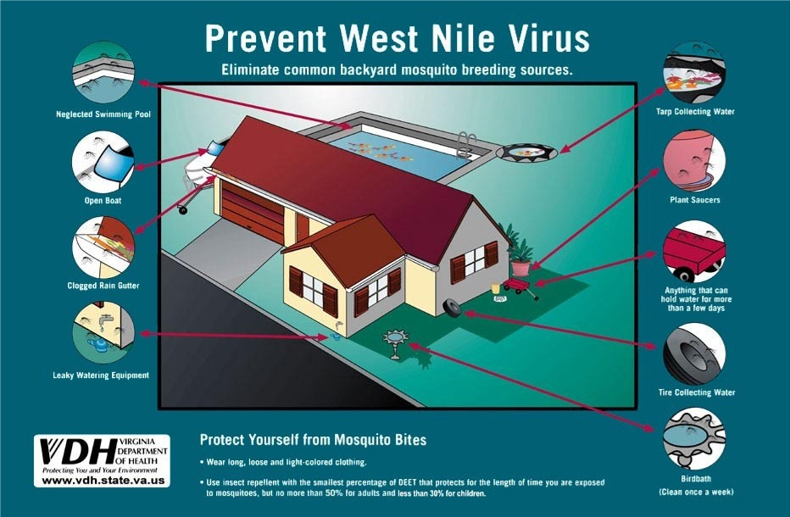

Slide 25

http://www.vdh.virginia.gov/Administration/VPfWB/

Slide 26
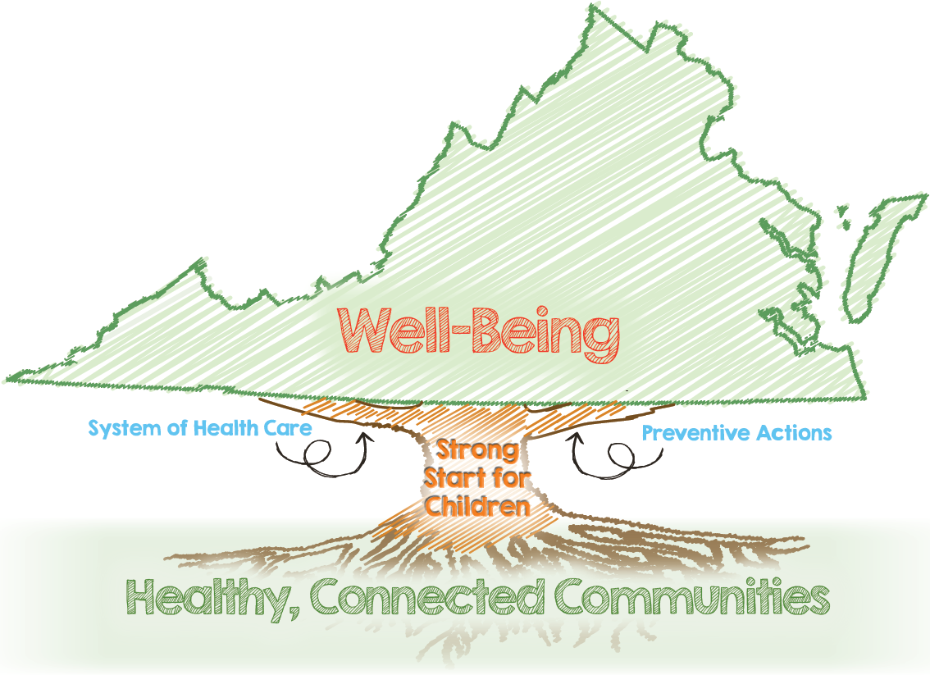

Slide 27
Zika Information & Resources
http://www.vdh.virginia.gov/
https://www.vdh.virginia.gov/clinicians/
https://www.vdh.virginia.gov/epidemiology/zika/index.htm
http://wwwnc.cdc.gov/travel/notices
http://www.cdc.gov/zika/geo/united-states.html

Slide 28
Thank You!
Questions?

