Slide 1
Child Meal Patterns
Guidance for Institutions Participating in the Child and Adult Care Food Program (CACFP)

Slide 2

Training Objectives
Successfully determine whether a child’s meal contains all of the meal pattern components requirements
Develop two months’ worth of
menus that include all of the CACFP
meal pattern components and can be
cycled throughout the year.
Submit invoices for CACFP meals
that are fully reimbursable

Slide 3
Meal Pattern Requirements
CACFP meal pattern requirements assist the menu planner in providing well-balanced meals and snacks for children that:
Meet nutritional needs of children
Are consistent with the Dietary Guidelines for Americans
Taste appetizing and contain a variety of food items (rotating foods)
Notes:
*Handout – Meal Pattern requirements
-Any questions about credible/noncredible food items?

Slide 4

Child Meal Pattern: Breakfast
ALL 3 Components Required for Reimbursement:
Milk (1)
Fluid milk (low/nonfat for children over 2)
Fruits/Vegetables (1)
100% fruit juice, fruit and/or vegetable
Grain/Bread (1)
Bread
Cornbread, biscuit, roll, muffin
Cold dry or hot cooked cereal
Pasta, noodles, grains
Notes:
Required portion sizes vary by age.
Children age 12 and older may be served larger portions based on their greater food needs. They may not be served less than the minimum quantities listed for those ages 6-12.
Fruit or vegetable juice must be full-strength.
Breads and grains must be made from whole-grain or enriched meal or flour. Cereal must be whole-grain enriched or fortified.

Slide 5
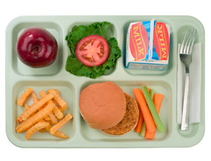
Child Meal Pattern: Lunch or Supper
ALL 5 Components Required for Reimbursement:
Milk (1)
Fluid milk (low/nonfat for children over 2)
Fruits/Vegetables (2)
100% fruit juice, fruit and/or
vegetable
Grain/Bread (1)
Bread
Cornbread, biscuit, roll, muffin
Cold dry or hot cooked cereal
Pasta, noodles, grains

Slide 6
Child Meal Pattern: Lunch or Supper
ALL 5 Components Required for Reimbursement (cont):
Meat/Meat Alternate (1)
Meat, poultry, fish, or alternate protein product
Cheese
Egg
Cooked dry beans or peas
Peanut, other nut or seed butters, nuts and/or seeds
Yogurt
Notes:
Children age 12 and older may be served larger portions based on their greater food needs. They may not be served less than the minimum quantities listed for those ages 6-12.
Fruit or vegetable juice must be full-strength.
Breads and grains must be made from whole-grain or enriched meal or flour. Cereal must be whole-grain enriched or fortified.
A serving (as listed on the handout) consists of the edible portion of cooked lean meat or poultry or fish.
Nuts and seeds may meet only one-half of the total meat/meat alternate serving and must be combined with another meat/meat alternate to fulfill the lunch or supper requirement.
Yogurt may be plain or flavored, unsweetened or sweetened.

Slide 7
Child Meal Pattern: Snack
2:4 Components Required for Reimbursement (cont):
Milk (1)
Fluid milk (low/nonfat for children over 2)
Fruits/Vegetables (1)
100% fruit juice, fruit and/or vegetable
Grain/Bread (1)
Bread
Cornbread, biscuit, roll, muffin
Cold dry or hot cooked cereal
Pasta, noodles, grains
Notes:
Children age 12 and older may be served larger portions based on their greater food needs. They may not be served less than the minimum quantities listed for those ages 6-12.
Fruit or vegetable juice must be full-strength.
Breads and grains must be made from whole-grain or enriched meal or flour. Cereal must be whole-grain enriched or fortified.
A serving (as listed on the handout) consists of the edible portion of cooked lean meat or poultry or fish.
Nuts and seeds may meet only one-half of the total meat/meat alternate serving and must be combined with another meat/meat alternate to fulfill the lunch or supper requirement.
Yogurt may be plain or flavored, unsweetened or sweetened.

Slide 8
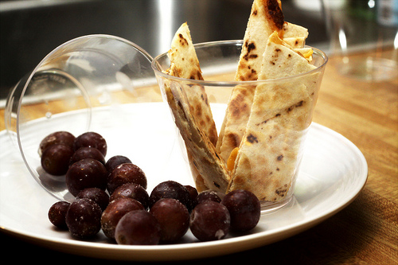
Child Meal Pattern: Snack
2:4 Components Required for Reimbursement (cont):
Meat/Meat Alternate (1)
Meat, poultry, fish, or alternate
protein product
Cheese
Egg
Cooked dry beans or peas
Peanut, other nut or seed butters, nuts and/or seeds
Yogurt
Notes:
Children age 12 and older may be served larger portions based on their greater food needs. They may not be served less than the minimum quantities listed for those ages 6-12.
Fruit or vegetable juice must be full-strength.
Breads and grains must be made from whole-grain or enriched meal or flour. Cereal must be whole-grain enriched or fortified.
A serving (as listed on the handout) consists of the edible portion of cooked lean meat or poultry or fish.
One-half egg meets the required minimum amount (one ounce or less) of meat alternate.
Yogurt may be plain or flavored, unsweetened or sweetened.

Slide 9
Required Meal Components
Meat and Meat Alternates
Beef, chicken, fish, ham, pork, turkey and eggs
Cheese
Dry beans and peas
Peanut butter, almond, and other nut butters (**Caution: Allergies and Choking Hazard**)
Walnuts, peanuts, almonds, soy nuts, other nuts, and seeds (**Caution: Allergies and Choking Hazard**)
Yogurt
Alternate Protein Product (APP)
Notes:
Cheese: Swiss, ricotta, part-skim mozzarella, cottage cheese, American, cheddar, and other cheeses
Dry Beans and Peas: Lentils, navy beans, black beans, kidney beans, pinto beans, black-eyed peas, refried beans, chickpeas and soy nut
**May also count as a vegetable, but not if they are meetings the meat requirement in the same meal
Peanut butter, almond an other nut butters
**Children under 4 are at the highest risk for choking and should not be fed a spoonful or chunks of peanut butter or other nut butters. Instead, the USDA recommends that peanut butter and nut butters should only be spread thinly on bread or crackers.
Walnuts, peanuts, almonds, soy nuts, other nuts, and seeds:
**Nuts and/or sees served to children should be ground or finely chopped in prepared food.
Yogurt: Commercially produced yogurt, plain or flavored, unsweetened or sweetened
Alternate Protein Product (APP): An ingredient mixed/made into foods such as ground beef patties, meat loaf, tuna salad, chicken nuggets, pizza toppings, etc.
**Tofu is NOT a creditable APP b/c there is no standard of identity for tofu.
Reference the Food Buying Guide and the Crediting Guide for the CACFP (http://www.fns.usda.gov/sites/default/files/CACFP_creditinghandbook.pdf) for additional guidance.

Slide 10
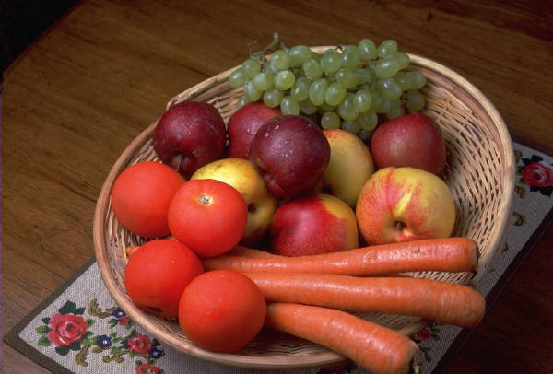
Required Meal Components
Vegetables and Fruits
Mixtures (fruit salad, veg medley)=1 serving
Mixed dishes with ¾ cup or more each different fruit/veg + meat/meat alternate=2 servings
Notes:
To align with the most current Dietary Guidelines, centers are encouraged to serve more vegetables from the dark green, deep orange and red, and dry beans and peas categories for optimal nutrition. Serving fresh fruit ensures that a variety of fruit will be offered since many fruits are only available in their fresh form.
Handouts re: Better Choices?

Slide 11

Required Meal Components
Fruit Juice Guidelines
Must be full strength (100%)
Must be pasteurized
Should not be served as snack if fluid milk
is the only other component being served
During lunch/supper, no more than half
of the vegetable/fruit component can be met with fruit juice

Slide 12
Required Meal Components
Grains and Breads:
Required component of all meals
Must be made primarily of whole-grain, enriched or “fortified” flour or meal (first ingredient listed on package)
Includes:
Enriched breads, cereals, and pasta such as white bread and corn tortillas
Whole Grain breads, cereals and pasta such as whole-wheat bread and ready-to-eat cereal
Notes:
To determine if a product is whole-grain, look for the word “whole” (whole wheat, whole corn, etc.) in the first ingredient listed on the food package.
Handouts re: Better Choices?
*Discuss CN Labels - prepared foods (such as chicken nuggets and fish sticks) and combination items (such as pizza)
*Also, recipes are needed for any homemade dishes (lasagna and sandwiches)

Slide 13

Required Meal Components
Milk: Required component of all meals except for snack.
May be served as a component of snack when the other component is not juice
Not considered a serving when used as an ingredient in cooked meals

Slide 14
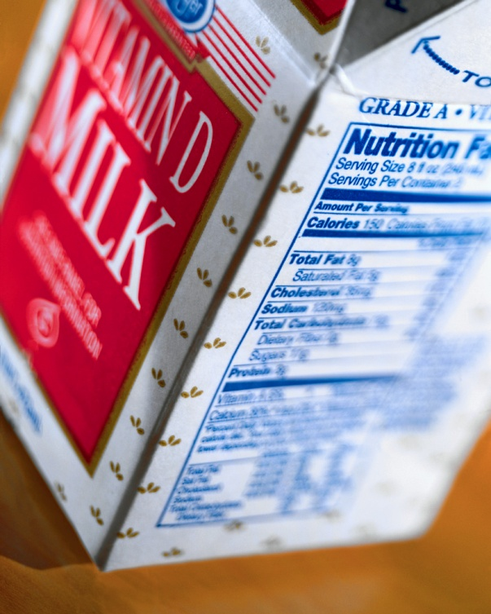
Required Meal Components
Milk: Guidance for Children < 2:
Children < 12 months may only be served IFIF or breast milk. If a completed medical statement is on file, they may be served milk that is 2% or less.
For children 12-23 months, whole milk is recommended but not required.
Notes:
Children < 12 months can only drink 2% milk with a medical statement because it is medically recommended which states that infants should receive breast milk or formula for the first year.
Handout on benefits of whole milk for children 12-23 months would be helpful to offer participants education and guidance around the recommendation.
This could also be a point of discussion and/or test question (VDH could not cite a center for serving 1% to children under the age of 2, but could cite them for serving 2% to children > over the age of 2).

Slide 15
Milk in the CACFP
Allowable types for participants > 2
Low fat (1% or fat free)
Lactose-reduced or lactose free, buttermilk or acidified milk
Unflavored or flavored, including chocolate or strawberry
Goat’s milk (only if pasteurized)
USDA-approved non-dairy milk substitutes products (e.g. some brands of soy milk) at the parent/guardian’s request as long as it is nutritionally equivalent to cow’s milk.

Slide 16

Milk in the CACFP: Substitutions
Medical or Other Special Dietary Need
If a participant cannot consume fluid milk due to medical or other special dietary needs (e.g. vegetarian), non-dairy beverages may be served in lieu of milk
If the substitute is not nutritionally equivalent to milk (e.g. juice, water), a signed medical statement is required for the meal to be claimed.
Notes:
For Additional Information, see FNS Instruction 783-2 Accommodating Children with Special Dietary Needs, and CACFP 2102911 Revised Child-Nutrition Reauthorization 2010: Nutrition Requirements for Fluid Milk and Fluid Milk Substitutions, September 15, 2011.

Slide 17
Milk in the CACFP: Substitutions
Disability
If a disability directly affects a child’s ability to consume milk and a signed medical statement is on file, the facility must purchase and can claim alternatives that do not conform to the meal pattern. Statement must include:
Participant’s disability and why it restricts participant’s diet
Major life activity affected by the disability
Food(s) to be omitted from the participant’s diet; and
Appropriate substitutions
Notes:
This guidance is unchanged from last issued in 2011.

Slide 18
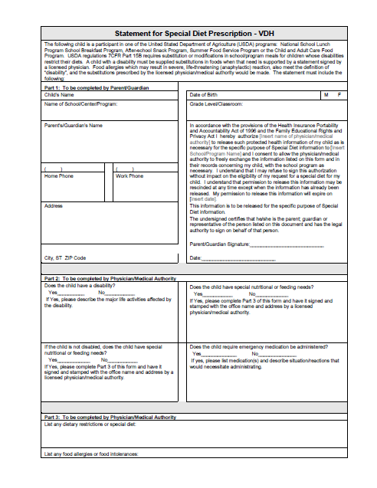
Meal Components: Substitutions
Special Dietary Needs
If a child has special dietary needs (e.g. vegetarian), the parent/guardian may request substitutions by submitting a written statement that includes the child’s medical condition or special dietary need,
listing food to be omitted and
substitutions.
In order to receive credit for foods
outside of the meal pattern requirements,
a signed medical statement must be on
file.
Notes:
Medical Statement form/template to be disseminated.
For Additional Information, see FNS Instruction 783-2 Accommodating Children with Special Dietary Needs, and CACFP 2102911 Revised Child-Nutrition Reauthorization 2010: Nutrition Requirements for Fluid Milk and Fluid Milk Substitutions, September 15, 2011.

Slide 19
Meal Components: Substitutions
Special Dietary Needs
Whether, due to a medical condition or parent preference, a substitution is needed and/or requested , the institution is not required to purchase/provide it.
However, if the institution does not purchase the substitution, then they cannot claim the meal. With the exception of infants, a meal can only be claimed when:
It meets meal pattern component requirements or there is a medical statement with substitutions AND
The institution purchases and provides all components and/or substitutions.

Slide 20
Meal Components: Substitutions
Disability
If a disability affects what kinds of foods a child can consume (liquid and/or non-liquid) and a signed medical statement is on file, the facility must purchase and can claim alternatives that do not conform to the meal pattern. Statement must include:
Child’s disability and why it restricts child’s diet
Major life activity affected by the disability
Food(s) to be omitted from the child’s diet; and
Appropriate substitutions

Slide 21

Family Style Meal Service
Meals served in a family style setting where foods are placed on a table in serving dishes and participants serve themselves.

Slide 22
Family Style Meal Service
Meals are able to be claimed so long as:
The amount of food on table provides full required portions of each component for all participants and any supervisors
Every participant is offered and encouraged to take full portion of each required meal component
When a component is refused or full portion size is not taken, a supervisor actively encourages taking a full portion, or offers a 2nd helping

Slide 23
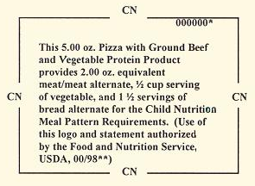
Child Nutrition (CN) Labels
Certain foods served require additional documentation to ensure they meet the minimum component portion size requirements.
Commercially processed foods used to meet the meat/meat alternate requirement
Combination dishes/dishes
containing more than one
component
**CN labels are NOT the same thing as Nutritional Facts
Notes:
Disseminate and discuss Appendix

Slide 24
Child Nutrition (CN) Labels
Institutions that prepare main dishes on-site must maintain documentation of:
Recipes used
Amount of each ingredient used in preparing the dish and estimated contribution toward meeting the component requirements
Number of participants that the recipe serves
**Resources:
http://www.fns.usda.gov/tn/resources/foodbuyingguide.html
http://www.fns.usda.gov/cnlabeling/child-nutrition-cn-labeling-program

Slide 25
Resource:
Crediting handbook for the
Child and Adult Care Food Program
http://www.fns.usda.gov/sites/default/files/CACFP_creditinghandbook.pdf

Slide 26
Questions?

