Slide 1
Requirements for Serving Infants on the Child and Adult Care Food Program (CACFP)

Slide 2
Infants on the CACFP
Training Objectives
List meal components for each stage of infancy
Describe requirements regarding the Infant Formula Choice Form
Define how the term "developmentally ready" is applicable to the infant meal pattern
Know which conditions must be met in order to claim for infant meals

Slide 3
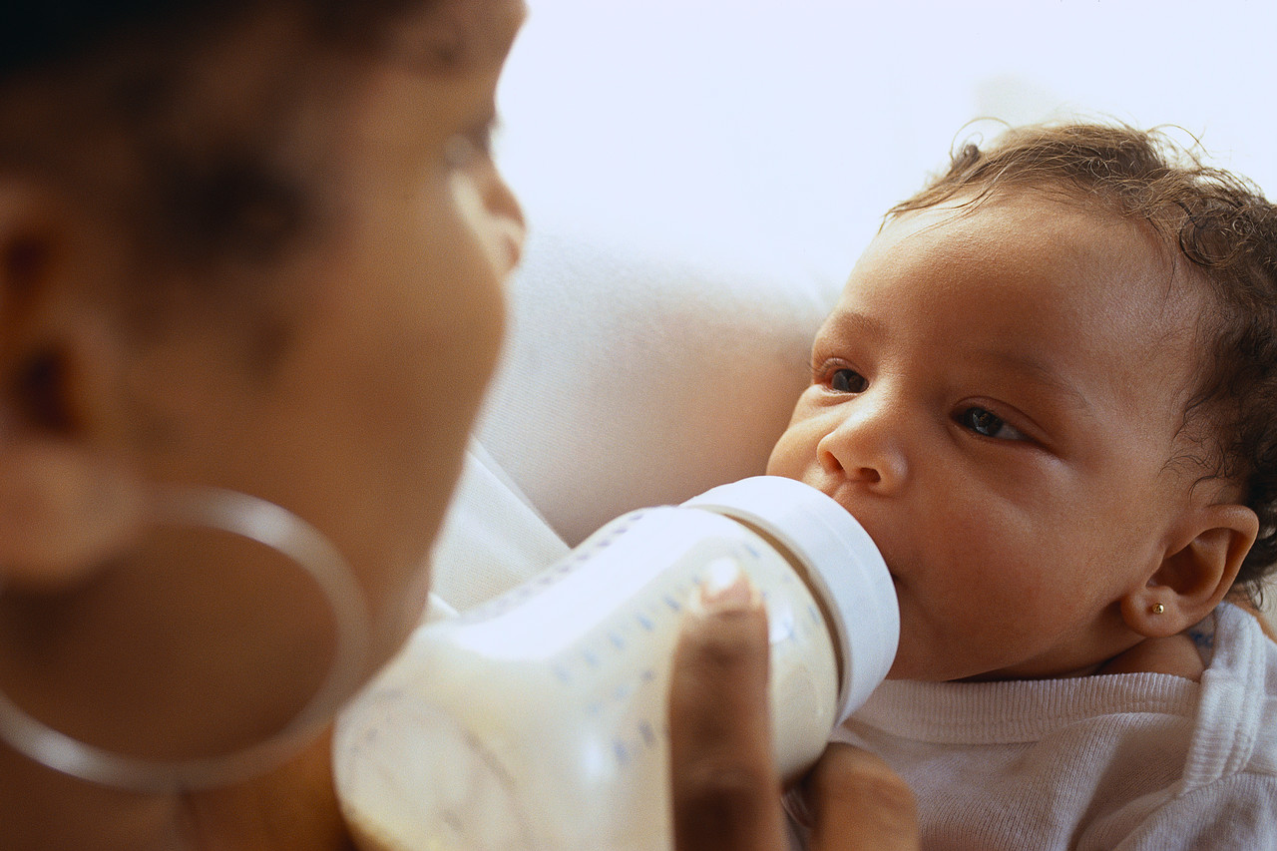
Infants on the CACFP
Definitions
Infant: A baby from birth
through 11 months (any child less than one year of age)
Infant Formula: Any iron fortified infant formula (IFIF), including soy-based, intended for dietary use solely as a food for normal, health infants served in liquid state according to manufacturer’s recommended dilution
**To serve/claim reimbursement for formulas that do not meet this definition, a medical statement is required.
Notes:
Special/low iron formulas:
Formula labeled low iron or those specifically formulated for infants with inborn errors of metabolism or digestive or absorptive problems do not meet the infant meal pattern requirement.
A medical statement is required in order for the center to serve/claim reimbursement for infant formulas that do not meet this definition.

Slide 4
Infants on the CACFP
Definitions
Infant Cereal: Any iron-fortified infant cereal (IFIC) specially formulated for and generally recognized as cereal for infants that is routinely mixed with breast milk or iron-fortified formula prior to consumption.
Developmentally Ready: An infant’s developmental readiness determines which foods should be fed, what texture the food should be and which feeding styles to use.
Infants develop at varying rates
When an infant is developmentally ready, new foods must be offered to them
Notes:
Although age and size often correspond with developmental readiness, these should not be used as sole considerations for deciding what and how to feed infants. It is important to be aware of infants rapidly developing mouth patterns and hand and body control so you know the appropriate food and texture to serve them and the appropriate feeding style to use at each stage of their development. On the Infant Meal Pattern for ages 4 through 11 months, you will see foods listed under the category When Developmentally Ready. If an infant is developmentally ready, and the parents want you to serve the foods to the infant, then you must offer these foods to the infant.

Slide 5
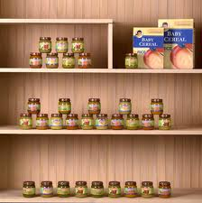
Infants on the CACFP
Requirements
If the center serves infants, infant meals MUST be offered.
At least one type of iron-fortified infant formula must be offered.
Iron-fortified infant cereal and other developmentally appropriate foods for infants (fruits/vegetables and meat/meat alternatives) must be offered.

Slide 6
Infants on the CACFP
Infant Formula Choice Form
A center must inform parents in writing that an iron-fortified infant formula (including the specific name) and foods for infants are provided.
Parent or legal guardian may accept or decline formula and/or infant foods provided. A signed Infant Formula Choice Form indicating their decision must be kept on file.
VDH approved formulas: http://www.vahealth.org/DCN/Publications/Files/PDFs/Approved%20Formulas.pdf
Notes:
Disseminate Infant Formula Choice Form
The list of VDH approved formulas is very long, so reference the link where they can go online and find the most updated list.
**TIP: It is recommended that parent choice forms should be re-done as developmental changes demand different needs.

Slide 7
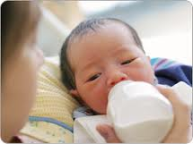
Infants on the CACFP
Infant Meal Pattern: Birth-3 Months
Through 3 months, the only meal component that is required is breast milk or iron-fortified infant formula (4-6 ounces)
Infant meal times may vary depending on the individual infant, and they should be fed on demand
Parent/guardian can provide IFIF or breast milk and the center can claim the meal
Notes:
Because of the extensive requirements that vary depending on the age of the infant, it is recommended to make a file/chart to document each child’s feeding patterns rather than trying to compile them into a single document.
Disseminate Infant Meal Pattern Chart(s) (http://www.fns.usda.gov/sites/default/files/Child_Meals.pdf) and Infant Meal Flow Chart (http://fns.dpi.wi.gov/files/fns/pdf/infant_meal_flow_chart.pdf)

Slide 8
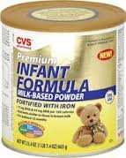
Infants on the CACFP
Infant Meal Pattern: 4-7 Months
Breakfast
4-8 fl oz IFIF or breast milk
0-3 T Iron-fortified Infant Cereal (IFIC)—
“when developmentally ready”
Lunch/Supper
4-8 fl oz IFIF or breast milk
0-3 T IFIC and 0-3 T fruit and/or vegetable—when developmentally ready
Snack
4-6 fl oz IFIF or breast milk
Notes:
The decision to begin offering an infant solid foods should be made by the infant’s parent or guardian in consultation with the infant’s doctor.
When the infant is 4 through 7 months old, is developmentally ready for solid foods, and the parents want you to serve the solid foods, those foods listed on the Infant Meal Pattern under “When Developmentally Ready” must be served to the infant.
For example, you may have a 5-month old infant that is only drinking breast milk, and is not receiving any foods yet. For this child, you would only be required to serve the breas tmilk.
In another example, you may have another 5-month old infant who is drinking breast milk and eating iron-fortified infant cereal. Then your center would be required to offer both the breast milk and infant cereal at the meals.

Slide 9
Infants on the CACFP
Infant Meal Pattern: 4-7 Months
If, according to the parent/guardian, the infant is not “developmentally ready” to receive IFIC, the center can still claim for the meal (even when the parent/guardian is providing the breast milk or IFIF).
If the parent thinks that the child is “developmentally ready” to start receiving solid foods, then the center must provide them in order to claim the meal.
Notes:
The decision to begin offering an infant solid foods should be made by the infant’s parent or guardian in consultation with the infant’s doctor.
When the infant is 4 through 7 months old, is developmentally ready for solid foods, and the parents want you to serve the solid foods, those foods listed on the Infant Meal Pattern under “When Developmentally Ready” must be served to the infant.
For example, you may have a 5-month old infant that is only drinking breast milk, and is not receiving any foods yet. For this child, you would only be required to serve the breast milk.
In another example, you may have another 5-month old infant who is drinking breast milk and eating iron-fortified infant cereal. Then your center would be required to offer both the breast milk and infant cereal at the meals.

Slide 10
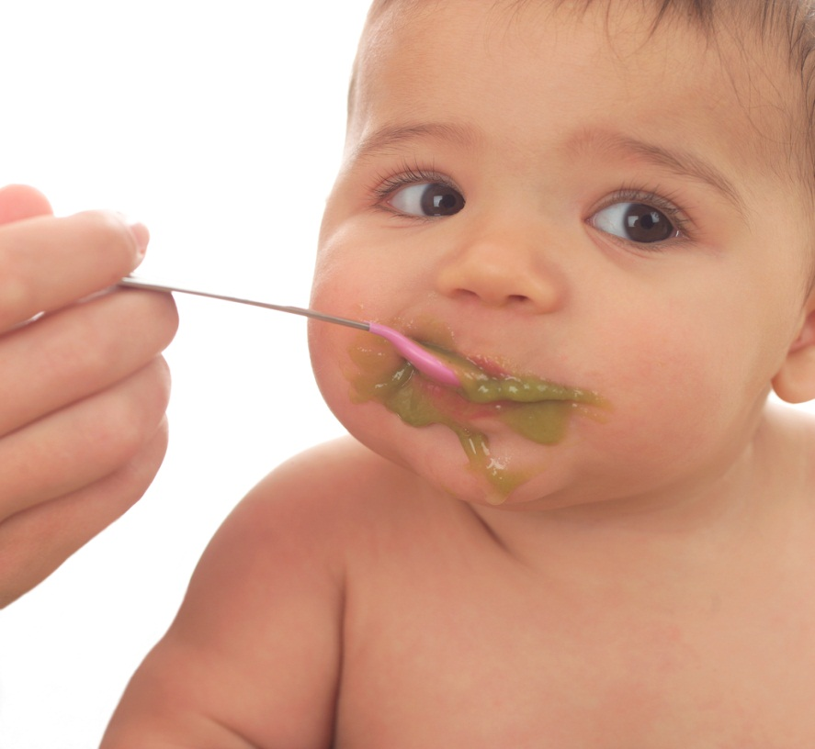
Infants on the CACFP
Infant Meal Pattern: 8-11 Months
Breakfast
6-8 fl oz IFIF or breast milk
2-4 T Iron-fortified Infant Cereal
1-4 T fruit and/or vegetable
Lunch/Supper
6-8 fl oz IFIF or breast milk
1-4 T fruit and/or vegetable
2-4 T Iron-fortified Infant Cereal and/or
meat alternate
Notes:
A current list of creditable foods may be found at: http://www.fns.usda.gov/sites/default/files/CACFP_creditinghandbook.pdf

Slide 11

Infants on the CACFP
Infant Meal Pattern: 8-11 Months (cont.)
Snack
2-4 fl oz IFIF, breast milk or 100% fruit juice
Bread and/or crackers--when developmentally ready
Notes:
Institutions do not need to have something in writing indicating when a child is “developmentally ready.”
Bread and/or crackers:
For a list of what qualifies as a bread or cracker for this age group, please refer to the handout “Creditable and Non-creditable Infant foods” (need most current version)

Slide 12
Infants on the CACFP
Important Tips on Juice
Full strength (100%) juice is reimbursable only as a snack for 8-11 month old infants
Juice cannot be diluted or watered down
Juice should only be served to infants when they are able to drink it from a cup
No fruit drinks, fruit punch, soda or sweetened drinks are reimbursable

Slide 13

Infants on the CACFP
Infants 8-11 months Not Eating IFIC: Options
Talk with parents and ask permission to offer IFIC at breakfast since it is required
Do not claim reimbursement for the child’s breakfast
Request a medical statement stating the child is eating all table foods and that it is appropriate
Notes:
Some older infants may be eating table foods and may not want to eat baby cereal anymore and/or parents may request that you not serve it to their child. However, in order to claim meals for reimbursement, all components are required to be served to infants who are 8- 11 months old (including iron-fortified infant cereal at breakfast). The options presented in this slide should be explored in these situations.

Slide 14
Infants on the CACFP
Infants 8-11 Months Not Eating IFIC
When a medical statement indicating appropriateness of all table foods is available:
The infant may be counted in regular meal counts and production records.
Infant meal records need not be completed; however
The complete meal pattern must be met for each meal that is to be claimed (as for any child ages 1-12 on CACFP)

Slide 15
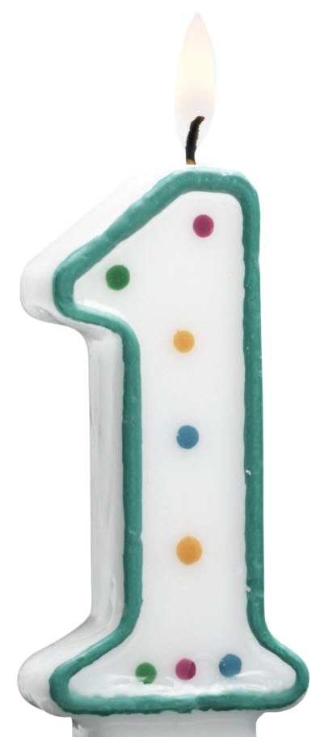
Infants on the CACFP
Transitioning from IFIF to Whole Milk
Typically, infants transition from formula
to whole milk at 12-13 months
After 13 months of age, IFIF is no
longer a reimbursable component of
CACFP unless there is a medical
statement on file

Slide 16
Questions?

