Slide 1
Corrective Actions
Not a punishment – but an opportunity to improve operation of the CACFP!
For all participating organizations
Notes:
CAPs! (ugh HUH) What are they good for? Absolutely everything.
(say) Hello and welcome to the “Corrective Actions in the Virginia CACFP” training session! This training is geared towards organizations that could receive a corrective action plan in the CACFP, which is all participating organizations.
(say) My name is ______________________________, a Special Nutrition Program Specialist with VDH, and I will be leading the discussion on corrective action plans. In today’s session we are going to discuss the purpose and components of a corrective action plan. We will determine the root causes of the issues that result in the need for corrective action. We will also discuss the details of a corrective action plan and possible outcomes. Hopefully by the end of this training, you’ll view corrective actions as an opportunity to improve your organization’s operation of the CACFP, and not as a punishment!
[Slide]

Slide 2
Step(s) in the Right Direction Activity
15 minutes
2
Notes:
(say) Before jumping into the presentation, I’d like to start off with an activity.
(In-Person): We will split the room into Group 1 and Group 2. Both groups will receive a notecard with something to have the other group create. The catch is, the other group CAN NOT know what it is ahead of time, so it is important to keep this hidden from the other group until the time comes to present. As a group, they will have 5 minutes to come up with a procedure (and document on the easel) for a volunteer from the other group to create (from start to finish). The groups are responsible for picking their volunteer, scribe, and announcer during those 5 minutes as well. After splitting the room, the trainer will let the audience know when the five minutes begin and end. At the end of the five minutes, we’ll have a question to decide which group presents their procedure first, and which group creates first. Then we will switch. Again, the volunteer that is creating from the other group can not know what they are making, so the easel with the corresponding procedure on it can not be shown. One person from the procedure group will read their step-by-step procedure to the volunteer to help them create their item.
-------- Follow steps for In-person activity noted below
(End of Activity): Okay, so let’s discuss what just happened.
(ask) What was something you found to be the most difficult? [audience feedback]
(ask) Why was it difficult? [audience feedback]
(ask) What is something that could have made it better? [audience feedback]
(ask) What elements from this activity did you find were important when thinking about corrective actions? [audience feedback]
This activity and feedback leads us into our topic of corrective actions. When a Program deficiency is found, the corrective action must demonstrate how the organization will fully and permanently correct it.
[Slide]
Webinar Activity idea: write a corrective action for a scenario deficiency (meal counts do not match what is in CHAAMPS) and have participants hold onto them until the end of the training. To finish the training, we’ll present the same scenario and have the participants do it all over again. Compare their corrective actions and discuss which is more beneficial and why.
Materials: piece of paper with written scenario. Pen.
In person activity: PB&J or Ants on a Log procedure demo.
Materials: loaf of bread, jar of peanut butter, jar of jelly, celery, raisins or chocolate chips, plates, napkins, knives, spoons, two cardboard boxes or cabinets (one labeled refrigerator, one labeled pantry) easels, easel markers, notecards, envelopes, sharpie
Steps:
(ahead of time) Place loaf of bread, jar of peanut butter, plates, napkins, and knives into the “pantry” box
(ahead of time) Place jelly, in the “refrigerator” box
(ahead of time) write “Ants on a Log” on one notecard, and “Peanut Butter and Jelly” on another note card
(ahead of time) place one notecard in an envelope then label it “Group 1”, place the other notecard in another envelope and label it “Group 2”
(ahead of time) Place envelopes on easels with easel markers accessible
(ahead of time) Place “pantry” and “refrigerator” somewhere accessible in the room
Set up easels on each side of the room facing toward each other.
Instruct the attendees that we will be doing an activity in which we will split the room into Group 1 and Group 2. Both groups will receive a notecard with something to have the other group create. The catch is, the other group CAN NOT know what it is ahead of time, so it is important to keep this hidden from the other group until the time comes to present. As a group, they will have 5 minutes to come up with a procedure (and document on the easel) for a volunteer from the other group to create (from start to finish). The groups are responsible for picking their volunteer, scribe, and announcer during those 5 minutes as well. After splitting the room, the trainer will let the audience know when the five minutes begin and end. At the end of the five minutes, there will be an assessment to decide which group goes first. group presents their procedure first, and which group creates first. Then we will switch. Again, the volunteer that is creating from the other group can not know what they are making, so the easel with the corresponding procedure on it can not be shown. One person from the procedure group will read their step-by-step procedure to the volunteer to help them create their item.
The trainer splits the room into two groups (maybe do the 1-2 count off to mix up people)
The trainer instructs the audience to move to their respective sides of the room (up to the trainer of which side is Group 1 or 2, but it corresponds with the envelope placed at the easel ahead of time)
Once the groups are in place, the trainer looks at the clock and says “begin”. Noting the time on the clock, the trainer will wait until 5 minutes have elapsed until saying “stop”. During the creation time, the associate trainer can be going around the room to answer questions or helping to keep the items secret.
After stopping, the trainer will instruct the audience that the group that goes first is the group whose volunteer has a birthday closest to the date of the training. The trainer will ask for the volunteer from Group 1, and ask their birthday. Repeat with Group 2. Whichever has the closest birthday, their group will choose whether to present or create first. Whichever they choose, they will do the opposite in the next round.
Whichever the winning group chooses, the trainer will guide the other group through instructing the volunteer on how to make their creation. The trainer will instruct the volunteers they can ONLY do what the group guiding them says and make NO assumptions. Pretend as if they are a brand new staff.
Key potential areas of confusion: indicating WHO from the other group will be making the item (the procedure should state the volunteer will be doing so), WHERE will the volunteer get the materials from (did the group mention the “refrigerator” or “pantry” in their procedure), WHAT will the volunteer be using to make their creation (did they include a knife? A plate?), HOW will the volunteer be making the creation (will they spread the peanut butter onto the bread or dip the celery in the peanut butter?), WHEN do each of these steps take place (are they in an order that makes sense to make the item).
After completing, switch and have the opposite group present their procedure.
Have associate trainer help with cleaning up plates and items (after first group uses them, putting back into the respective box, cleaning up after both groups have gone, etc.)
Once both groups have presented, ask one member to move the easels out of the way, and then return to their respective seats.
Facilitate discussion on what the audience noticed, what did they think was hard or easy, why were each of the steps important?

Slide 3
https://zippy.gfycat.com/OilySleepyCassowary.webm. May 14 2019.
Raise your hand if….
Notes:
(say) Thank you all for the enthusiasm in that activity. Before we dive into today’s “Learning Objectives”, let’s take a quick poll of the room. Raise your hand if you’ve had experience with corrective actions or noncompliance in the CACFP? Yeah, if you look around you’ll see that just about everyone, if not every one, has encountered a corrective action plan at some point in their Program participation. By the end of this session, you’ll be able to ….
[Slide]

Slide 4
Purpose
Root Causes
1
CAPs
2
Learning
Outcomes
Components
3
Evaluate
4
CHAAMPS
5
6
Notes:
(say) (click) 1. Explain the purpose of corrective action.
(click) 2. Analyze the root cause of the noncompliance which is resulting in the required corrective action.
(click) 3. Understand the relationship between the corrective action and the corrective action plan (also known as a CAP).
(click) 4. Identify the key components of a successful CAP.
(click) 5. Evaluate the effectiveness of a CAP, along with a few best practices.
(click) 6. Finally, we’ll go over where CAPs can be found in CHAAMPS and what to do if you’ve received one.
And as an unofficial outcome, I hope that by the end of this session you’ll be able to see how corrective actions can be an opportunity to improve your organization’s CACFP operation and not just feel like we’ve asked them as a punishment. As a reviewer myself, I can promise you they are meant to sustainably resolve areas of Program non-compliance, not just create extra work.
[Slide]

Slide 5
Single Program Audit
State Agency Review of Sponsor
Sponsor Review of Facilities
Corrective Action
Purpose
Notes:
(say) Let’s begin with discussing why corrective actions are required. (click) Corrective action is required to address program findings and to maintain program compliance.
(say) As a sponsoring organization, what are some instances where you would be required to provide a corrective action? [audience feedback]
As a sponsoring organization:
(click) 1. You are required to provide corrective action as a result of findings cited to you by your State agency during a Program review, when requesting a 36 month claim exception, or as a result of your organization being declared seriously deficient by the State agency.
(click) 2. You are required to provide corrective action as a result of findings from a Single audit. (if one is required).
(click) 3. If you are a sponsoring organization of multiple centers or day care homes, you are required to obtain corrective action from homes or centers for findings cited during a monitoring review or part of the serious deficiency process for sponsored family day care homes.
[Slide]

Slide 6
Program Noncompliance
New or improved processes or procedures.
Corrective Action
The action the facility will take within a specific timeframe to address the finding(s) of non-compliance and to prevent it from recurring.
2 CFR 200.26
How the individuals impacted by the updated processes and procedures are informed.
Finding
Implemented within a specific time frame.
Identifies who is responsible for implementation.
Corrective Action
Expected to resolve the condition that resulted in noncompliance
Expected to prevent recurrence.
Where the corrective action documentation is retained.
Purpose
Notes:
(say) Each institution accepts final administrative and financial responsibility for Program operations. If your organization sponsors multiple facilities (be it centers or homes), your organization accepts final administrative and financial responsibility for the food-service operations in sponsored facilities.
Part of this responsibility is monitoring facility operations to ensure compliance with CACFP regulations, State policy, and internal organizational requirements. For sponsors of multiple facilities, it is required this follow specific monitoring requirements that include documentation. While independent sponsors are not required to document their facility monitoring, they are required to periodically perform self-evaluations to identify and fix potential areas of noncompliance.
(click) Sponsoring organizations of multiple facilities and State agencies share similar responsibilities when it comes to noncompliance, when noncompliance is identified, (click) it must be cited, and the State agency (and the sponsoring organizations) must require corrective action. (click)
In other words, citing findings and requiring corrective action from participating organizations and facilities of sponsoring organizations is not optional. Corrective action is required to maintain Program compliance. (click)
(click) So, then what is a corrective action?
(ask audience member to read definition) “A corrective action is the action the facility will take within a specific time frame to address the finding(s) of noncompliance and to prevent it from recurring.
A corrective action is not an appealable action. It is a description of a new or improved process or procedure that will address the cited noncompliance. It is expected, when implemented, that the corrective action will resolve the condition that resulted in noncompliance and prevent recurrence. (click)
So, how does a corrective action work?
(click) A corrective action works by implementing new or improved processes or procedures, (click) within a specific time frame – not to exceed 90 days – (click), and it is expected to resolve the noncompliance (click) and prevent it from recurring.
(click) Also, the corrective action must identify who is responsible for implementing and maintaining the new processes or procedures (click), where the corrective action documentation is retained, and how the individuals impacted by the updated process or procedures will be informed.
[Slide]

Slide 7
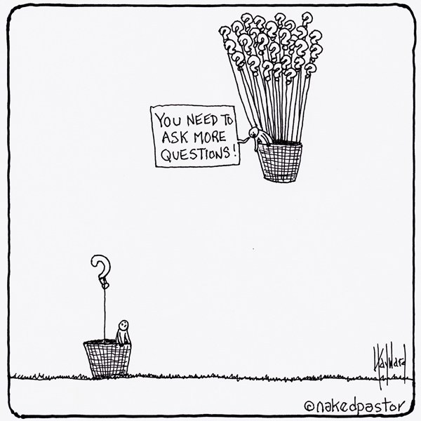
Root Cause
Why ask WHY?
The 5 Whys
Why?
Why?
Why?
Why?
Why!
Root – Cause Analysis
Notes:
(say) The word “why” is very important in the corrective action process. In order to successfully implement a corrective action, you must first understand what caused the finding of noncompliance. (click)
If your organization is cited a finding of noncompliance, it’s important to understand the root-cause. The same principle is important for sponsored facilities that are cited findings by their sponsoring organization. The cause of the finding is documented in the finding description.
When completing a corrective action, you must identify the causes. To ensure the deficiency is fully and permanently corrected, you want to not only address the deficiency itself but more importantly address what caused the issue. The best way to do this is to ask the question “Why?”.
(click) A root-cause analysis is necessary to get to the bottom of the issue.
(click) The 5 Whys is a method that will help you determine the root cause of an issue.
(click) The key is to ask “Why?” as many times as needed to uncover the true cause of the problem. Asking “Why?” 5 times is a gauge, not an absolute. Ask “Why?” as many or as few times as necessary to uncover the root-cause of the problem.
[Slide]

Slide 8
Root Cause
Why?
Why?
Why?
Why?
Why!
Finding: Failure to maintain compliance with meal-pattern requirements [§226.20(c)]
You are the sponsor of a childcare center under review by the State agency. During the on-site meal observation, the reviewer notices that orange drink is served for the milk component at breakfast. The reviewer questions the cook, who indicated that whole, skim, or fat-free milk (depending on age-level) is listed on the posted menu for the day. However, there is no milk available. All the center has is orange drink, 100% apple juice, and water. In order to provide something to drink for the children in care, the cook decided to serve orange drink because it has vitamin C and the kids like it. The cook said she did not know that orange drink does not meet meal-pattern requirements. Therefore, the State agency cites the center for failure to meet the meal-pattern requirements noted in 7 CFR 226.20(c).
SCENARIO
5 minutes
Notes:
(Do) Demonstrate the 5 Whys method.
(say) So, let’s put the 5 Whys method to the test with a practice scenario. The scenario itself is up on the screen (click) and in your participant’s guide.
(say) Let’s say your organization is a childcare center that is being reviewed by the State agency. During the on-site meal observation, the reviewer notices that an orange beverage is served for the milk component at breakfast. The reviewer questions the cook, who indicates that whole, skim, or fat-free (depending on age level) milk is listed on the posted menu for that day. However, no milk is available. All the center has is an orange beverage, 100% apple juice, and water. In order to provide something to drink for the children in care, the cook decided to serve an orange beverage because it has vitamin C and the kids like it. The cook said she did not know that the orange beverage does not meet meal-pattern requirements. Therefore, the State agency cites the center for failure to meet meal pattern requirements noted in 7 CFR 226.20(c).
(Do – in advance) Set up easel with flipchart paper and a poster marker to the side at the front of the room. After reading the scenario, required action, and first model question write “Why” responses on the flipchart as the conversation progresses along.
(say) The required action is: Centers must comply with 7 CFR 226.20(c). Each meal claimed for reimbursement must have a corresponding menu that lists all required components. Only credible meals and food items should be served and claimed for CACFP reimbursement.
(say) I’ll model the first question and answer, then I want you to help me build on that question to find out the root-case of the finding.
(ask/say) Why was the meal not reimbursable? {(Do) Write “not reimbursable” on flip chart}
(answer/say) Because the meal failed to meet meal-pattern requirements {(Do) write “not meal-pattern compliant” on flip chart}
(say) See that I asked why and led my answer with “because”. Now it’s your turn. Start with the question “Why?”.
(ask) Who wants to tell us our next question? {(Do) write questions/answers on flip chart}
Possible responses:
Why did the cook not serve milk for breakfast? Because the only available drinks were 100% apple juice, orange drink and water.
Why did the meal not meet meal-pattern requirements? Because the milk component was not served.
Why did the cook select orange drink? Because the cook knew the kids liked it//wanted to serve something to drink.
Why isn’t orange drink an acceptable substitution? Because it is not the nutritional equivalent of cow’s milk and/or it doesn’t meet meal-pattern requirements because it isn’t a credible food item.
Why didn’t the cook know this wasn’t an acceptable substitution? Because the cook wasn’t trained effectively.
Why wasn’t the cook trained effectively? Because the center/monitors didn’t exhibit sufficient oversight.
(say) So, what did we determine is the root-cause? (possible answer: lack of training/oversight)
(Do) Summarize the root-cause for the finding (example: “the failure to maintain compliance with meal-pattern requirements was because the center did not properly train staff”)
(ask) How did this model help us understand the reason for the finding of noncompliance?
(say) If we’d stopped asking “Why?” around question 2 or 3, we might not have uncovered the root-cause of the deficiency. Once you’ve explored all viable reasons for the deficiency, you can stop asking why. At this point we’ve established a root-cause and gained a clearer idea of the issue, which will help with the next step of the corrective action process.
(say) The 5 Whys is helpful independent centers or sponsoring organizations and the facilities they oversee. Including this in annual trainings for staff can help in the event a finding is cited during a monitoring visit. That way, when the deficiency is cited, the facility staff can also go through this process to determine root-causes and fully correct the finding.
(ask) What are your questions before we move onto the next topic?
[Slide]

Slide 9
Corrective
Corrective Action Plans
Action
PLAN
A written response that details the specific action the facility will take within a specified time frame to permanently correct the noncompliance. [2 CFR 200.511(c)]
Step-by-step actions
Prevent recurrence
Consistent with regulations
“what, who, when, where, how”
Root-cause resolution
Root-cause
Notes:
(say) So, we’ve identified the need for corrective action and have an understanding of the how to determine the root-cause (click) of the problem. Now what?
(say) A corrective action is required and can be documented in the form of a corrective (click) action plan.
(click) (say) What is a corrective action plan?
(ask) Can an audience member read the definition of a corrective action plan to the group? -> “A written response that details the specific action the facility will take within a specified time frame to permanently correct the noncompliance.”
(say) For sponsoring organizations, the goal of the corrective action requirement is to document the actions it will take to fully correct the deficiencies noted. The same goal applies to organizations with multiple facilities, documenting the actions that the center or home has taken to fully correct any deficiencies noted.
(say) Now, aside from serious deficiencies for day care home providers, it is up to the sponsoring organization to create and implement its own corrective action plan process for the facilities it oversees. However, as we covered earlier, the sponsoring organization must require corrective action when noncompliance is cited at any of its facilities. Submission of written documentation by the sponsored facility or home for a corrective action plan is only required for sponsors implementing the serious deficiency process for a day care home provider.
(say) That being said, as a State agency, VDH requires an organization demonstrate full implementation of their corrective action by providing a written response (with supplemental documentation) that demonstrates a full understanding of the regulations and policies related to the requirement that was not followed. It’s beneficial to also submit documentation showing the deficiencies were corrected.
(click) (say) The correct action plan must contain certain requirements, such as:
(ask) Audience member to volunteer to read requirements
Detailed step-by-step actions.
Must include the “what, who, when, where, how”.
Actions must prevent recurrence.
Process and procedures must be consistent with federal regulations, State policy, and organizational requirements.
(say) As we just went over, corrective action plans are required to contain certain elements. So, for those in the audience that will be training additional staff, be it at the institution level or a sponsored facility, think about how you train them to develop these steps. Across the board, it increases the likelihood of an organization following their written CAP if they understand the requirements.
(say) Recap so far: we’ve defined corrective action, explored how to determine the root-cause, and reviewed the requirements of a CAP. (ask) Before moving onto developing a CAP, what are your questions?
[Slide]

Slide 10
Components
W
What processes and procedures will be implemented to correct the finding?
Who is ultimately responsible for implementing the processes and internal controls?
W
Developing the CAP
How will the facility ensure the processes and procedures are followed consistently to prevent recurrence?
H
W
When will the processes and procedures be implemented and at what frequency?
Where will the documentation be retained?
W
Notes:
(say) Let’s take a look at how to develop a corrective action plan.
(ask) Can I have another volunteer read the explanation for each required component?
(volunteer) What processes and procedures will be implemented to correct the finding? (click)
(say) The “what” is identifying the problem and addresses the process(es) that will correct the problem. It is important to ensure that the process communicated will directly address the problem. It should be easy to follow. Whether it’s the State agency or a sponsoring organization evaluating the “what”, the steps should clearly demonstrate the actions taken to correct the deficiency.
(ask) May I have another volunteer read the second one?
(volunteer) Who is ultimately responsible for implementing the process and internal controls? (click)
(say) The “who” identifies the positions (by position/title) that are ultimately responsible for ensuring the policies and procedures are implemented. Personnel in these positions must have the skill set and be adequately trained to fulfill this responsibility. They must also be empowered with the authority and support necessary to successfully manage this responsibility. Decide who should be involved, and assign specific tasks. The “who” is not just identifying the over-arching individual responsible for ensuring the entire corrective action plan is implemented, but also clearly identifying each person in each step and what their roles/responsibilities are.
(ask) May I have a volunteer read the third one?
(volunteer) How will the facility ensure the processes and procedures are followed consistently to prevent recurrence? How will staff be notified and/or trained? (click)
(say) The key factors of “how” are policies and internal controls. The “how” represents the rules. It speaks to “what and why” something is done. The “how” addresses several factors, including:
What controls exists to ensure that the process is followed?
What actions are required to prevent recurrence?
(say) The “how” must communicate how compliance with the policies and processes will be monitored and the frequency. It must also detail how and when the policies are communicated to all pertinent staff who have responsibility in adhering to the policy and implementing the process. For example, will there be an updated handbook made, training held, worksheets updated, etc.
(ask) May I have another volunteer read the fourth one?
(volunteer) When will the processes and procedures be implemented and at what frequency? (click)
(say) The “when” identifies the date that the corrective action will be fully implemented. The severity of the deficiency will guide the implementation date. The more severe the deficiency, the sooner the implementation of the corrective action. The implementation date must be an actual date and not a general period of time. Ideally, these corrective actions should be started as soon as the State agency or sponsor monitor has made the center or provider aware.
(ask) May I have a volunteer to read the last component?
(volunteer) Where will the documentation be retained?
(say) If applicable, the “where” identifies the location of records or any information that supports the implementation of the corrective action.
(say) This developmental process might look familiar to some of you from the corrective action plan training and worksheet previously used. That resource will still be good to use to in addition to this training. What questions do you have about developing a corrective action plan?
[Slide]

Slide 11
Supporting Documentation
Components
Staff training documentation
Site monitoring reports
Menus
Child Nutrition (CN) labels/manufacturers’ product analysis sheets
Recipes
Updated forms
Notes:
(say) Additional supporting documentation must be submitted with the CAP, with some required supporting documentation specified by the State agency. This supporting documentation must demonstrate the problems identified were fully and permanently corrected.
(say) Supporting documents might include copies of:
(click) Staff training documents. For example, a State agency reviewer determines missing, incomplete, or inaccurate enrollment forms to be a deficiency from a Program review of your organization. In addition to updating the process for how enrollment forms are collected, the staff involved in the process will need to be re-trained prior to implementation. Simply saying “the director will fix the enrollment forms moving forward” doesn’t address what actions have been taken to correct the deficiency at the root cause (the how).
(ask) Can anyone think of other types of supporting documents? [audience feedback]
(say) It’s important to remember that supporting documentation is only one factor that assists with supporting an organization or facility’s corrective action plan. It is not necessarily the only factor, and the list on screen or in your participants’ guide is not all inclusive. Supporting documentation is very dependent on the noncompliance issue.
[Slide]

Slide 12
Evalutating a CAP
✓
Required elements
✓
Addresses noncompliance
✓
Prevents recurrence
✓
Fully implemented
Notes:
(say) The State agency and sponsoring organizations of multiple facilities have the same responsibility for evaluating corrective action plans. Whether you’re submitting or evaluating a facility’s CAP, it’s helpful to understand what items contribute to the State agency deciding if your CAP is acceptable or not.
(click) (say) The State agency’s main objective of evaluating a corrective actin plan is to determine if the documented plan has all required elements (4W’s ad 1 H).
(click) (say) The CAP must ensure all actions will fully and permanently correct the noncompliance and that the plan (click) provides reasonable assurance that the noncompliance will not recur.
(say) Submission of an acceptable CAP helps determine if there are internal controls in place to ensure accountability. (click)
(say) So far, we’ve defined corrective action, explained the elements of a CAP, and how to evaluate those elements. We’re going to put what we’ve reviewed into practice.
(ask) Before applying this information, what are your questions?
[Slide]

Slide 13
CAP Analysis
15 minutes
2
Notes:
(ACTIVITY)
(say) We are going to step in the shoes of the State agency and sponsoring organizations of multiple sites and practice evaluating a CAP response to determine if it meets the criteria for acceptance. Please take the next two minutes and read the Corrective Action Plan scenario listed in your participant’s guide. We’ll debrief the elements from this scenario once you’ve finished reviewing it.
(Do) Give the audience two minutes to read the CAP Scenario (presenter should have copy of participant’s guide to follow along with reading)
2 minutes pass
(say) We’ll do a high-level overview of what you have read. You have a CAP scenario that lists the finding and required corrective action.
(ask) What was the document finding for this story? [audience feedback]
(ask) As a result, what is the required corrective action [audience feedback]
(say) On the next page in your participant’s guide, you’ll see an example of the 5 Whys method for the root-cause analysis. For the purposes of this activity, we have determined the root-cause for you.
(ask) What did we determine was the root-cause? [lack of system checks and balances]
(say) As you can see, in this example, it did not take 5 times to determine why. There is a response to the finding on page _____ of your participant’s guide. We’ve also created and inserted a template CAP Evaluation Checklist in your training packets to use.
(say) Using the CAP Evaluation Checklist, you will work with your partner [assigned or audience picked] to determine if this is an acceptable CAP. We’ll discuss your evaluations afterwards.
(ask) What are your questions about the instructions? If there are no questions, you may begin. You’ll have 10 minutes to complete the activity.
[Slide]

Slide 14
W
What processes and procedures will be implemented to correct the finding?
W
Who is ultimately responsible for implementing the processes and internal controls?
Developing the CAP
H
How will the facility ensure the processes and procedures are followed consistently to prevent recurrence?
W
When will the processes and procedures be implemented and at what frequency?
W
Where will the documentation be retained?
14
Notes:
(Do) Keep this slide up until completion of the CAP Analysis Activity.
--- After 10 minutes -----
(ask) Who would like to share their decisions?
(ask) Are there other procedures you would put in place or follow to make sure this is does not happen again?
(say) Did you find it challenging to determine if the CAP was acceptable? Why or why not?
[Slide]

Slide 15
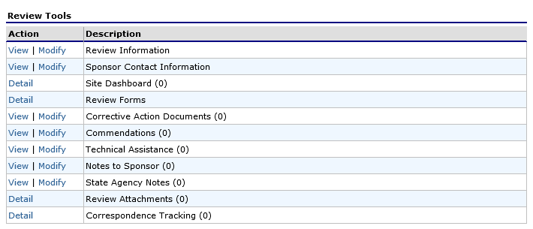
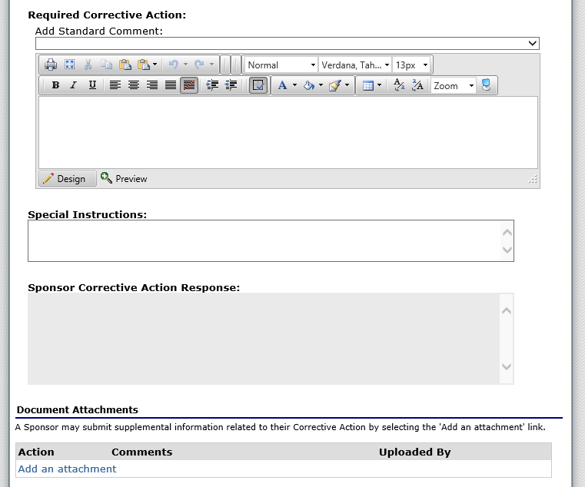
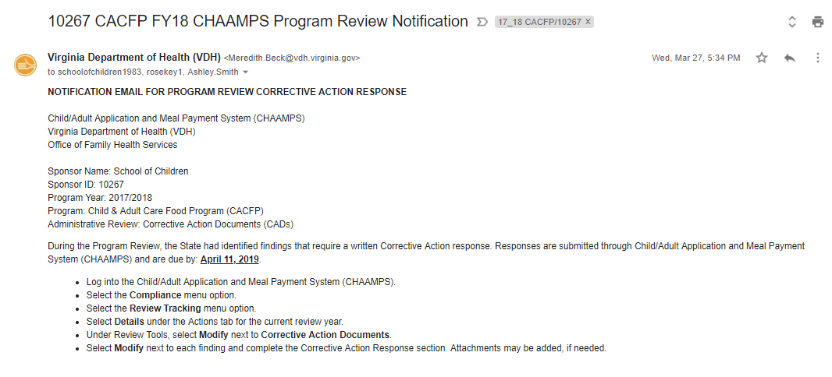
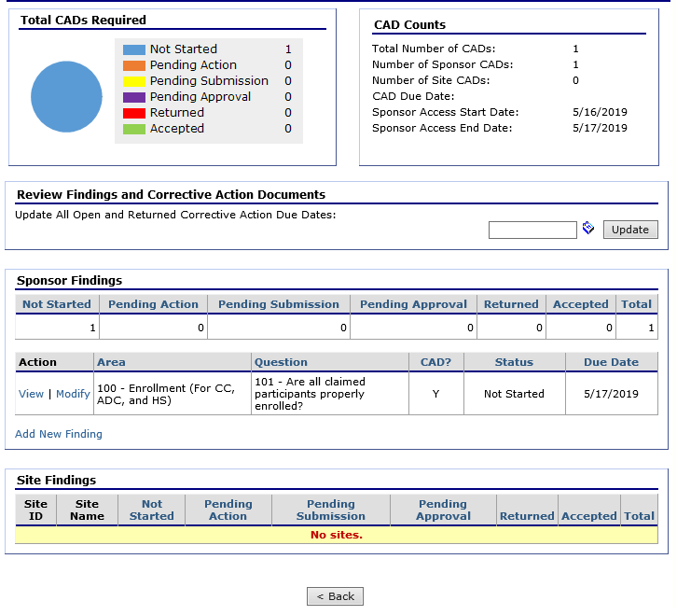
CHAAMPS Compliance
Notes:
(say) Before wrapping up corrective actions today, we’re going to do a quick walk-through of how to address required corrective actions in CHAAMPS. In an effort to move towards administering the Program electronically, all documents from a Program review will be located within the “Compliance” section of CHAAMPS, regardless of whether there are findings.
(click) For this walk-through, let’s assume your organization has had a Program review and receives a finding. After the on-site portion, the State agency reviewer will enter all of the review documentation into CHAAMPS and your organization’s RPI’s and Program Contact will receive an email notification that looks similar to the one on the screen.
(say) This email provides the directions of the (click) date the corrective action plan is due and (click) how to access the required corrective actions in CHAAMPS.
(click) (say) Now, once you log into CHAAMPS you’ll go to the “Compliance” section. (click) Even if you don’t have any review findings, this section will have all of the technical assistance, resources, and documents from your Program Review. If this section is grayed out, that means you do not have access and will need to contact your Program reviewer.
(click) In the “Compliance” section, you’ll see the “Review Tools”. For this example on the screen there aren’t values next to the specific tools, however once completed by the reviewer the documented numbers will go up. All of the documentation from the review (your entrance conference, scheduling letters, supporting documentation, etc.) will be housed here (click) in “Review Attachments”. Technical assistance and resource documentation from your review, will be housed here (click) in the Technical assistance section of “Review Tools”. And finally, to address the finding received during a Program review, you’ll go here (click) to “Corrective Action Documents”.
(say) Let’s zoom into the Corrective Action Documents and examine what that section looks like and how to address findings within. (click) Again, for this example, it looks a little different than it would if you were accessing the Corrective Action Documents with active findings. (click) In the upper left hand corner, you’ll see a progress diagram. The status of all required CAPs is captured here. If a CAP is waiting to be addressed, it will be yellow. If you’ve addressed the CAP and submitted it, it will be purple, and so on. One the right hand side (click) is another demonstration of CAP statuses as well as the due date and dates that your organization will have access to modify and submit them.
(click) Down here, under Sponsor Findings, is where both the sponsor and site level findings are listed with statuses and due dates. To view a finding or submit a CAP, you’ll click “Modify” next to the finding you’d like to address.
(click) In the Review Findings Detail, there will be a description of the finding, similar to what was in the review letters. Further down the page, you will see the required corrective action (or actions), any special instructions from the reviewer, document attachments – this can be resources from the reviewer or when you submit your corrective action plan where to upload supporting documentation – and finally the section where you may type in the corrective action plan. Now if you prefer to type the corrective action plan on your organization’s letter head, that is okay – you can attach it in the document attachments on this screen. Once completed, remember to “Submit for Acceptance”.
(ask) What are you questions regarding the CHAAMPS CAP process?
[Slide]

Slide 16
ReCAP
Purpose of corrective action
Root-cause analysis
Corrective action plan requirements
CAP Components and evaluating effectiveness
CHAAMPS Compliance Section
Notes:
(say) Let’s recap what we’ve covered today:
We discussed the purpose of corrective action and that corrective action is required when there is a finding of noncompliance
We used a tool to determine the root cause of a finding of noncompliance, and we experience how root-cause analysis supports effective corrective action.
(ask) Who remembers the name of this tool? [5 Whys method]
We discussed the requirements of a corrective action plan and that the CAP should address the root-cause of the noncompliance and prevent recurrence.
We discussed the components of a CAP and how to evaluate the effectiveness of the CAP.
We reviewed the CHAAMPS Corrective Action process and how to see Program review documentation in the “Compliance” section.
(ask) What questions do you have from our discussion?
[Slide]

Slide 17
References
Requirements
Code of Federal Regulations (7 CFR 226)
§226.6(c) – participating organizations
§226.16(l) – FDCH providers
USDA Policy Memos
CACFP 14-2012, Child and Adult Care Food Program Guidance on Serious Deficiency Process and Acceptable Corrective Action Plans, National Disqualified List Procedures and Debt Collections, May 1, 2012.
USDA Handbooks
Serious Deficiency, Suspension, & Appeals for State Agencies & Sponsoring Organizations, USDA (February 2015).
Resources
Handouts
Corrective Actions Participant’s Guide
CAP Evaluation Checklist
CAP Development Template
Training and Resources from VDH http://www.vdh.virginia.gov/child-and-adult-care-food-program/
This training and participant guide were adapted from the March 2019 CACFP Operational Resources and Education “Corrective Action” training by MH Miles Company.
Presentation template by SlidesCarnival // Photographs by Unsplash

Slide 18
Questions? Contact Us!
CACFP@VDH.Virginia.Gov
(877) 618- 7282
Virginia Department of Health
Division of Community Nutrition
Special Nutrition Programs
109 Governors Street, 8th Floor
Richmond, Virginia 23219
This institution is an equal opportunity provider.

