Slide 1
Preparing for a Program Review
Guidance for Institutions Participating in the Child and Adult Care Food Program

Slide 2
Purpose
1
2
Requirements
Hot Topics
3
Process
Deficiencies
Elephant in the Room
4
5
Notes:
(say) By the end of today’s session, we’ll have covered these “hot topics”….
1. Explain the purpose for Program reviews and the State agency’s responsibilities.
2. Defined the Federal requirements for Program reviews.
3. Discussed the process for a standard Program review and shared some preparation best practices.
4. Identified common findings and technical assistance noted from the prior Program review year.
5. and finally, we’ll talk about the “elephant in the room” during every Program review, the outcomes.
[Slide]

Slide 3
Purpose
Accountability
Capability
Viability
Notes:
(ask) Can a few people share what they think is the purpose of Program reviews or monitoring? Why do “we” do them?
(do) Wait for the audience to provide feedback, acknowledge and build upon it. Only allow one or two answers.
(click) (say) Monitoring includes the State agency’s processes of visiting, reviewing, and evaluating centers’ operation of the CACFP. State agencies must provide technical assistance and supervisory oversight to independent centers and sponsoring organizations to ensure effective Program operation, monitor progress towards achieving Program goals, and ensure that there is no discrimination in the Program. This assures that participants receive nutritious meals and that institutions receive proper financial reimbursement. By conducting Program reviews, the State agency is ensuring the integrity of the Program is being upheld.
(click) All potential and currently participating organizations must meet certain performance standards in order to participate. Prior to being apart of the Program, your organization will have gone through an application process ensuring it meets these specific standards. A part of Program reviews is reassessing whether your organization meets these standards and is still eligible to participate. All organizations must be (click) financially viable, administratively capable of operating the Program, and have internal controls in effect to ensure Program accountability. You’ve also heard this referred to as “being VCA”. The intent is to ensure consistency in viability, capability, and accountability from the initial application to the point of review.
[Slide]

Slide 4
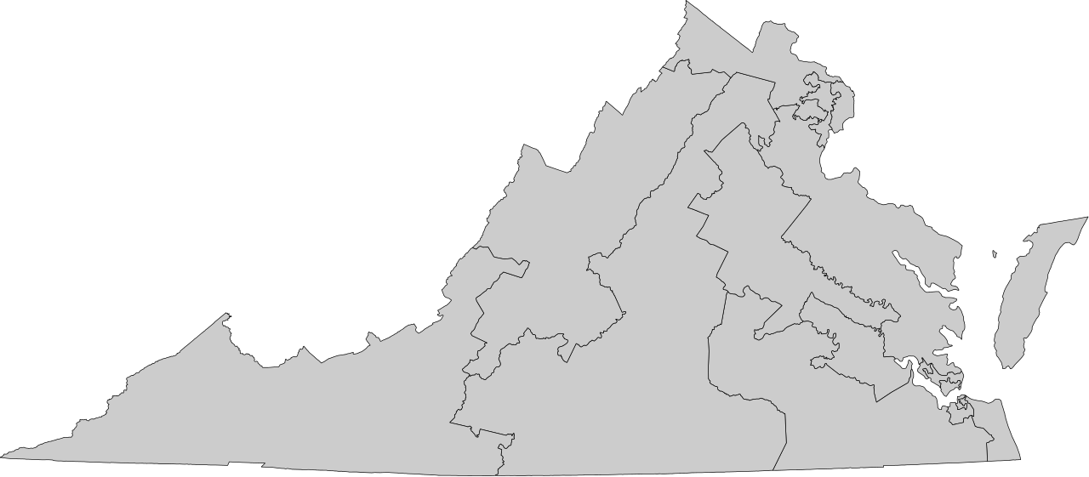
Requirements
255
87
Notes:
(say) The state agency must annually review 33.3 percent of all institutions. And each independent center or sponsoring organization of multiple facilities must be reviewed at least every three years except those larger than 100 (or 150) facilities.
(ask) Now, does that mean that if you see for a review in Spring 2016, that we are not allowed to come and do a review the following year? (do) Wait for audience response.
(say) No, you’ve signed a permanent agreement allowing the State agency to conduct on-site reviews at any time during business operating hours. These reviews can be annual or every two years, but may not exceed three years. (click) Under the administration of the Virginia Department of Health, we have approximately 255 independent and sponsoring organizations (excluding at-risk afterschool meals programs) in the CACFP across the Commonwealth. (click) This would require the SA to conduct approximately 87 Program reviews.
[Slide]

Slide 5
Requirements
Announced
Program review
Desk Program review
Unannounced
Program review
Site visits
Follow-Up Visits
Notes:
(ask) Another question – does the State agency have to tell you when they are coming out to conduct a Program review?
(do) Wait for audience responses.
(click) (say) Correct, again, you’ve signed a permanent agreement saying it’s okay for the State agency to conduct a review of your organization or facility at any point during business operating hours whether it’s scheduled or not. Typically, we will send you a scheduling letter in advance to let you know we are coming, however this may not always be the case. We call a Program review in which we’ve sent a scheduling letter to the sponsor ahead of time – announced reviews. (click) Reviews or visits that are not scheduled, are called – unannounced reviews. (click) At VDH, all of our site visits (or meal observations) are “unannounced” because we don’t pre-plan with the facility when we will be conducting the visit. (click) For today’s session, we’re going to focus more on the typical, announced Program review.
[Slide] Hello Sponsor! Thank you for updating your site application(s) and checklist item(s) with the most current license/approval information. While most of the site applications are good to go, there are items that require attention prior to approval. Please see the site application(s) that have been returned for corrections and address the items noted within the 7/11/19 notes. Once completed, please re-submit the site applications and then the overall sponsor application packet for approval. If you have any questions, please reach out. Thank you-
Onsite and/or desk reviews of independent centers’ and sponsoring organization’s operations and records allows the State agency to evaluate Program integrity. Once every three years, State agencies must assess each institution’s compliance with the requirements related to:
“The program review is designed to ensure that a sponsor’s overall program is operating according to Federal and State requirements and to provide technical assistance whenever necessary to the sponsor. These reviews are an important part of the State agency’s responsibility to ensure program integrity is maintained.”
Click and recordkeeping will appear, click again and meal counts will appear, and so forth for 4 more times.

Slide 6
Recordkeeping
Meal counts
Administrative costs
Observation of a meal service
Training and Monitoring
Applicable guidance issued by FNS, USDA, or the State
Facility licensing and approval
SD Process for FDCH
Eligibility
All other Program requirements.
Requirements
Notes:
(say) Regardless of whether the Program review is announced, on-site, a desk review, or unannounced, Federal regulations specify the State agency must assess compliance with requirements pertaining to recordkeeping, meal counts, administrative costs (this includes center disbursement, operating costs are under recordkeeping), any applicable instructions, handbooks, guidance issues by FNS/USDA/or the State agency, facility licensing/approval, if an independent center an observation of a meal service (for sponsored facilities, conducting facility visits), implementation of the serious deficiency process by family day care home sponsors, compliance with eligibility requirements, and if I hadn’t included everything yet – compliance with all other Program requirements.
[Slide]

Slide 7
Prior to On-Site: Scheduling Letter
Confirms the following:
Where?
Location from CHAAMPS Application
When?
Date and Time
Who?
Reviewer(s)
What?
Why?
Documentation for review
Purpose and intent of review
Review month
Notes:
(say) For today, we’re going to discuss from the aspect of an announced on-site review, meaning the State agency notifies the sponsoring organization about the review prior to coming out. The scheduling notification or scheduling letter confirms a few key points about the review:
Where: Details of the location are noted from the information in your organization’s CHAAMPS application
When: Date and time provided, as well as the claim month for review
Who: Specialist(s) names --- in case you have questions, concerns, etc.
What: Details what documentation needs to be available
Why: The scheduling letter details the intent and need of the Program review
[Slide]

Slide 8
Prior to On-Site: Preparation
SOP Review
Review supporting documentation for claim
Review CHAAMPS Application
Prepare copies (or process to make copies)
Organize documentation
Group documentation
Notes:
(say) What the independent or sponsoring organization should do once the scheduling letter has been received
Pull all Standard Operating Procedures (SOPs) make sure at the entrance conference the sponsor contact can detail your organizations process of getting to the claim
Ensure all application information is accurate and up to date
Go through the claim month noted in the scheduling letter to ensure all documentation supporting the claim month is accurate
Make copies of all information requested (this is a cost that can be associated to the program)
If possible organize all information in alphabetical order by site
Put all documentation specific to each participant together (IEF, AEF, IFCF, Special Dietary Prescription Form)
[Slide]

Slide 9
On-Site: Entrance Conference
1. Establish the points of contact
2. SOPs
3. Records Walkthrough
4. Logistics
5. Purpose and Outcomes
Notes:
1. Establish the points of contact
Who is available to answer questions?
Who will be available during the meal service observation to show the Specialist around?
Do we need finance at the table, do we need the cook at the table?
2.
Present information on internal policies and procedures
Present SOPs
Ask clarifying questions about any unclear areas
3.
Walk through the checklist of records
If anything is missing make it known now (if you need additional time to provide documentation)
Walk through how documentation is organized
4.
The Logistics
Provide times of operation and lunch times
Access to facilities
If possible please provide a quiet, clear work space for the Specialist
5. Purpose and Outcomes

Slide 10
On-Site: Review
Provide any additional information requested or stated during the entrance conference
Ask questions as they arise
Request technical assistance as needed
and
CHILL
Notes:
You’ve done all of the work to get you to this point, and you’ve gone through your own information at this point (with a second set of eyes). You’ve done your due diligence now is time to let the review happen and wait until its all over.

Slide 11
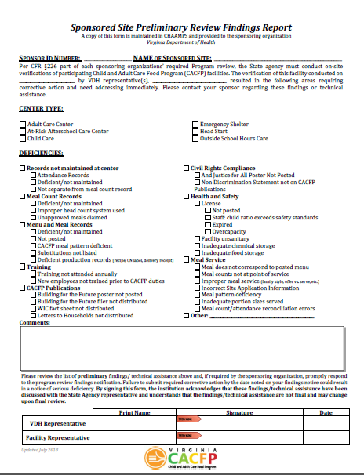
Meal Service Observation // Facility Review
Un-announced
Continue as normal
Notes:
(say) Observing a meal service at an institution provides a great opportunity for the State agency monitor to understand to what extent the CACFP is being operated in accordance with the intent of the Program. Observation of a meal service enables the State agency monitor to provide an extra level of review to ensure that the institution is in compliance with multiple Program regulations.
(click) All meal service observations are unannounced so if you request to tag along the Specialist will not let you know until right before going to the observation. We will not send emails to alert the sponsoring organization of any issues found during a meal service observation so keep up with what is being put in CHAAMPS.
(click) You’ll want to allow the meal service to continue as it normal would, even if issues are found. This is an opportunity for training either with the sponsoring organization or site staff. You want to see how the center normally operates to see how effective your organization’s internal processes and procedures are.
Also, if it is a sponsored facility, the State agency will also be verifying the Program applications, conducting five day reconciliations, and other Program requirements.
(click) Each site’s center contact will sign a preliminary findings form (same as the sponsor does) if it’s a sponsored facility, and any information, technical assistance, or findings noted during the observation will be included in CHAAMPS.
[Slide]

Slide 12
Exit Conference
Clarity
CAP
CHAAMPS
Technical Assistance
Findings
Corrective actions begin immediately.
Notes:
(say) At the end of the Program review, will be the Exit Conference. The exit conference ensures clarity. You’ll want whoever is impacted by the Program review, similar to the entrance conference, to be at the exit conference.
(click) It will be a walk through of any findings and technical assistance to resolve all that you can at the point of preliminary findings.
(click) Once the Preliminary Findings Report is signed and the specialist leaves that is the time to start creating your corrective action plan for any findings (and T.A)
(click) All items discussed (T.A., Commendations, and Findings) will be within your CHAAMPS compliance module that we will go over in the corrective action plans session.
[Slide]

Slide 13
Notes:
(say) Okay! So, we’ve gone through the standard process for a Program, we’ve covered the main requirements to be reviewed, and now we’re going to get a little interactive and dive into the most common technical assistance your State agency reviewers have reported since 2016. On the screen is a pie chart of the 687 noted technical assistance since that time, and we’re going to play a little game to break down the five most common items.
[Slide]

Slide 14
name the TOP FIVE most common technical assistance?
VDH has completed approximately
340 Program Reviews since October 2016,
X
SURVEY SAYS!
IEF Deficiencies | Non-Discrimination Statement on CACFP Documentation
AEF Deficiencies | Menu Documentation Deficiencies
Training // Training Documentation Deficiencies
XX
1
4
XXX
2
5
3
Notes:
(say) Welcome to our own little version of family feud! For the sake of time, we won’t be breaking up into teams, so it will be a group effort to make it through this round. I want you to be as specific as possible, and shout out what you think the most common types of technical assistance were from the last 3.5 years of Program reviews!
(do) poll the audience and play through.
#1: IEF Deficiencies
Excellent! The top instance of technical assistance we documented from our Program reviews were IEF Deficiencies. Most notably, instances of incomplete IEFs causing misclassifications. This was documented 47 times as technical assistance throughout our reviews.
#2: AEF Deficiencies
Yes! The second most common instance of documented, noted 40 times as technical assistance throughout our reviews, were AEF/ES Deficiencies! The most common issues were enrollment forms not being updated or collected annually for childcares, not using the most current enrollment form, and enrollment forms being incomplete rendering them incomplete and invalid.
#3: Training Documentation // Training Documentation Deficiencies
The third most common technical assistance noted was for training. Whether it was training documentation or contents of training, we document 32 instances of training deficiencies through our reviews. Notably, there were many many many instances of the training documentation not containing the signature and title of those that were in attendance.
#4: Non-Discrimination Statement on CACFP Documentation
Oh, I think I might be responsible for documenting 25 of the 31 fourth most common technical assistances. Non-Discrimination Statements missing from CACFP documentation. Can anyone guess which document in particular I’ve noted it missing from? (answer: menu)
#5: Menu Documentation Deficiencies
Okay, I think this one may surprise everyone! I know it surprised me! Coming in at number give of the most common documented technical assistance, reported 27 times, are menu documentation deficiencies. Now, there wasn’t one stand out causation culprit here but it’s worth noting that ensuring menus are specific as possible and document whole-grains is something I’ve personally noted multiple times while on review.
(do) Work through the family feud game with the audience. Engage and give hints.
[Slide]

Slide 15
Notes:
(say) How much fun was that?? Enough fun that you want to look at it from the perspective of the most common findings? Let’s look into the 212 findings your State agency reviewers have reported since 2016. One the screen, we have another fabulous pie chart breaking down these findings. But instead of going into them one by one… let’s go for round two of CACFP FAMILY FEUD!!
[Slide]

Slide 16
VDH has completed approximately
340 Program Reviews since October 2016,
name the TOP FIVE findings?
X
SURVEY SAYS!
Menu Records l Food Service | Financial Management Deficiencies
AEF Deficiencies | Meal Count Deficiencies
Eligibility Deficiencies
1
4
XX
XXX
2
5
3
Notes:
(say) Alright – round 2! For the sake of time, we won’t be breaking up into teams, so it will be a group effort to make it through this round. I want you to be as specific as possible, and shout out what you think the most common types of findings were from the last 3.5 years of Program reviews!
#1: Menu Records I Food Service
Way to go! Out of the 212 findings from the last 3.5 years, 54 of these were attributed to this number one cause – menu records / food service. Serving or documenting meals that are not compliant with the meal pattern are the number one way to have meals disallowed along with invalid enrollment. Remember from recordkeeping, the documentation is the proof that your organization has done what they said they were going to in their permanent agreement, without this documentation then the State agency can’t verify that you’ve complied with regulations. Menus should be specific and detail all of the components that were served. More so, you’ll want to pay attention to your recipes – verify the component portions, verify the amount of milk that is served, verify verify verify.
#2: AEF Deficiencies
Yes! The second most common instance of documented, ironically noted 40 times as technical assistance and 40 times as a finding throughout our reviews, were AEF/ES Deficiencies! The most common issues were enrollment forms not being updated or collected annually for childcares, not using the most current enrollment form, and enrollment forms being incomplete rendering them incomplete and invalid.
#3: Eligibility Deficiencies
The third most common technical assistance noted was for eligibility deficiencies. These deficiencies are specific to income eligibility forms and enrollment totals. Enrollment totals are based off of the income eligibility documentation and like we covered in the documentation session, an incorrect or inaccurate monthly enrollment total creates issues with the claim percentage and can cause either your monthly claim for reimbursement to be too high or too low. Both of which are findings.
#4: Financial Management Deficiencies
Number four on the top five, coming in at a documented 36 times, are Financial Management Deficiencies. These findings relate to inaccurate cost documentation, (ask) how many in the room have ever had a finding or issue related to milk receipts?, using reimbursement for unallowable items, or not properly allocating a cost in your budget.
#5: Meal Count Deficiencies
Coming in at number five, we have meal count deficiencies. I’ve mainly seen these related to inaccurate counting or transcription errors, meaning the summation wasn’t reported correctly in CHAAMPS based on what you calculated. Another very common issue I’ve noted with meal counts are meals being claimed for participants that are not marked as being in attendance. For my centers, maintain staff:child ratio is important, right? Making sure that the child isn’t counted in both rooms. There should be a very strict process and procedure for performing edit checks and determining meal counts each month.
(do) Work through the family feud game with the audience. Engage and give hints.
(say) That was fantastic, way to go! If I had a pile of cash or a new car to give to all of you for winning – I would, but I don’t – the only thing I have left for all you champions is the rest of this presentation so I hope that will do. Did anyone else notice a main theme in each of these deficiencies? The importance of proper standard operating procedures and edit check systems? Honestly, with a lot of things in life not just with this Program, a lot of these deficiencies could be prevented by having a great double checking process or a process period in place.
Let’s move onto something a little more uplifting --- let’s get into the potential outcomes of Program reviews, shall we?
[Slide]

Slide 17
Post Review
Preliminary Review Report
No Findings/Closure Letter
Possibility 1
Possibility 2
Preliminary Review Report
Closure Letter
Corrective Action Plan
Implementation
Review Letter
Notes:
(say) Now, there are a few outcomes from Program reviews…..
(click) “Possibility 1” flies in
(click) “Possibility 1” fades away
(click) “Possibility 2” flies in
(click) “Possibility 2” fades away
**walk through each step, portion.
But what I want to get into with y’all is Possibility #2…
[Slide]

Slide 18
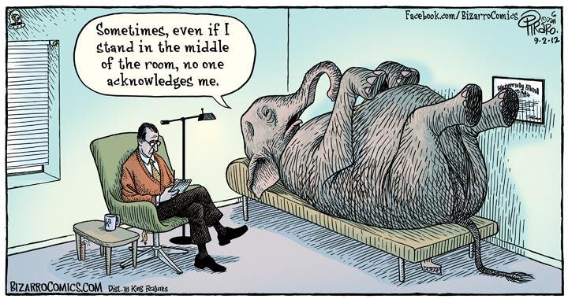
Elephant in the Room
Serious Deficiencies
Insufficient Corrective Actions
Quantity of Findings
Fraudulent Claiming/ Records
Health and Safety
Serious Deficiency
CAPs
Ask for help!
There is still an opportunity for corrective action.
What do
we do?
Notes:
(say) Let’s talk about the elephant that is in the room at every Program review I’ve conducted. What happens if the State agency determines your organization to be “seriously deficient in its operations of the Child and Adult Care Food Program”? I can promise it’s not the end of the world, and as anyone who’s ever had a review with me or my poor teammates in the back there have heard a million times, short of you feeding a participant glass or cashing your reimbursement check for wild weekends in Tijuana – there is always an opportunity for corrective action and to right the deficiency (ies). (click) (click)
Ok, so what causes a serious deficiency determination? Serious Deficiencies are due to things such as (but not limited to) (click) repeat findings, (click) a significant amount of findings, (click) health and safety issues, (click) fraudulent claiming practices, fraudulent documentation, etc. The intent of a seriously deficient determination is to correct the findings that are egregious or repeated. A specific plan has to be put in place to correct and ensure those items do not happen again. There is opportunity for corrective action at this point, but whatever corrective action is submitted and approved must be implemented. In cases where Program deficiencies are not corrected or the deficiency pertains to an immediate threat to health and safety, the serious deficiency or deficiency will rise to the level of Program termination. Once terminated for noncompliance, an organization, or day care home provider, and its responsible principals and individuals will go onto the National Disqualified List. Once on the NDL, the organization, RPIs, or FDCH provider are ineligible for participation in any other child nutrition programs for seven years and all debts are repaid if there are debts along with the termination.
(say) But trust me when I say, our goal is the same as your goal: not to have terminations. We want our operators to succeed, we want those in care to receive the most nutritious meals possible… so (click) what are some good tips to try to avoid heading down the SD road? (click)
Know your previous review findings and the Corrective Action Plan submitted and make sure to abide by the CAP. So often I hear – “I wasn’t trained” or “the person that was here before didn’t tell me that this was a corrective action” – at that point, I want to run into a corner, put my fingers in my ears, hum “Single Ladies” and forget those words were ever muttered in my presence. I’m kidding, but, I do want to reiterate… your organization has signed a permanent agreement stating it will abide by Federal, State, and local regulations when it comes to this Program. That includes communicating, training, and ensuring that CAPs fully and permanently correct a deficiency regardless of turn over.
Now, after I just talked about running away from overly honest statements - Don’t think you’re incriminating yourself by asking for help, if you have a question or feel that a process may be noncompliant … come to us first. It’s not good to let something linger and snowball into a larger problem when it could have been nipped in the bud. It’s our job to make sure this Program is operated with integrity, we want to make sure you’re questions are answered rather than have a deficient operation.
In this Program, it’s not over till it’s over. There is still an opportunity for corrective action up until an organization has received notification for termination and disqualification. Now, that doesn’t mean that the corrective action is sufficient or that the State agency has to accept it. But just know, that it’s not the end of the road, there’s still opportunity for adequate corrective action.
[Slide]
(click)
Unannounced and/or follow-up reviews are typically required due to complaints received, serious deficiencies, and all of our meal service observations must be unannounced.

Slide 19
Unannounced and/or Follow-Up Reviews
Ensure there is always a point of contact for CACFP available
Have a 2nd set of eyes to review CACFP documentation each month for accuracy
Consistently keep documentation organized and ensure SOPs are being followed
Notes:
(say) Part of VDH’s process for determining the effectiveness of a corrective action, is to conduct unannounced follow-up reviews. This allows us to see how the organization is implementing their corrective action and access whether it is actually effective in permanently and fully correcting the deficiency.
Some tips to help ease fears of an unannounced review –
(click) Ensure there is always a point of contact for CACFP available. Technically a center or sponsored facility is operating the Program each day their serving meals unless they’ve indicated otherwise. Would it make sense to have a program operating on-site with no one who is familiar with it available?
(click) Have a second set of eyes to review CACFP documentation each month for accuracy. Having a well practiced and effective edit-check system is crucial (and required).
(click) Have a practiced and effective organization system that is known to more than just one person. And, the buzz word of the training, ensure your organization’s SOPs are being followed. Make sure they are up to date, that they didn’t become ineffective five years ago when that one person retired.
[Slide]

Slide 20
References
Requirements (not all inclusive)
Code of Federal Regulations (7 CFR 226)
§226.6(m)
FNS Instruction 796-2, Revision 4
USDA Handbooks
Guidance for Management Plans and Budgets Handbook. USDA (December 2013).
Monitoring Handbook for State Agencies, USDA (May 2014).
Resources
http://www.vdh.Virginia.gov/child-and-adult-care-food-program/
Training and Resources from VDH http://www.vdh.virginia.gov/child-and-adult-care-food-program/
Presentation template by SlidesCarnival // Photographs by Unsplash
This institution is an equal opportunity provider, employer, and lender.

Slide 21
Questions? Contact Us!
CACFP@VDH.Virginia.Gov
(877) 618- 7282
Virginia Department of Health
Division of Community Nutrition
Special Nutrition Programs
109 Governors Street, 8th Floor
Richmond, Virginia 23219
This institution is an equal opportunity provider, employer, and lender.
Notes:
(say) This session will now come to a close. If you have any additional questions or would like to share some resources you’ve found helpful during your operation of the CACFP, please share them at the contact information on the screen.

