Slide 1
Program Accountability
Recordkeeping, Training, and Civil Rights Requirements
For sponsoring organizations and independent institutions
July 2019
This institution is an equal opportunity provider, employer, and lender.
Notes:
Written in Training planning as “Administrative Capability”
(say) Hello! My name is _______________________ and I will be leading this session today.
***WEBINAR ONLY*** (say) If you haven’t already done so, I’d recommend printing the Participant Guide from the VDH CACFP Livewell website to follow along with. It contains valuable information that is important to this session, don’t worry just pause the webinar and I’ll wait for you here until you get back! (do) take a beat before diving into the next portion of dialogue.
(say) CACFP regulations require current sponsoring organizations to comply with the performance standards in 7 CFR 226.6 (b)(2). As part of this regulation, all organizations are required to demonstrate that they are:
Financially viable;
Administratively capable of operating the CACFP in accordance with the regulations;
and be Programmatically accountable through internal controls and management systems, which operate effectively, to ensure accountability,
We often refer to this as VCA—Viable, Capable, and Accountable. As the State agency, we must ensure that new and renewing organizations meet all three performance standards and must deny the applications of those organizations who don’t.
The CFR outlines specific criteria for State agencies to use when determining whether a participating institution has Program accountability. The institution must document that it meets these criteria in the following areas:
Program oversight,
Fiscal accountability,
Recordkeeping,
Sponsoring organization operations and,
Meal service and other operational requirements.
To give adequate time to all of the criteria, we have broken out trainings that apply to Program accountability into multiple sessions. This session will focus on recordkeeping, portions of sponsoring organization operations, and portions of other operational requirements. It is designed for participating sponsoring organizations and independent institutions in the Child and Adult Care Food Program. However, it is our goal that this session will assist you in navigating the requirements for your organization and/or sponsored facilities.
[Slide]

Slide 2
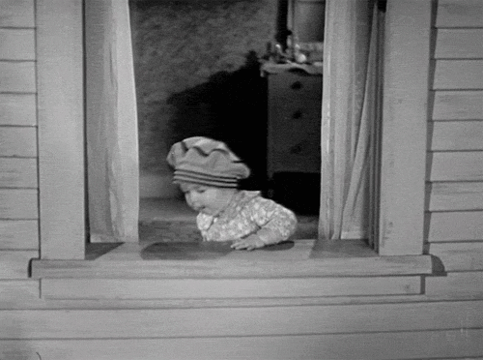
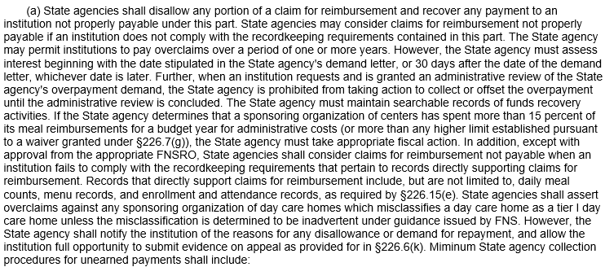
Let’s Imagine….
You cannot return or exchange ripped Spring Summer 2019 Runway Collection blouses without a receipt.
Notes:
(say) Before we get started, I want you to use your imagination.
(click) Let’s imagine that you just purchased this beautiful Dolce & Gabbana Spring Summer 2019 Runway Collection blouse to wear to an event next Saturday. You loved the way this top looked so much, that you willingly pay the sale price of $1,377.00. ---what a steal, right?--.
(say) You are on your lunch break and in a rush, so you don’t try it on at the store. Later that day, you take it home, remove the tags, and proudly hang it in your closet. (click) On Saturday, you try it on and discover that it is ripped in the back. You realize that you’ve thrown the tags away and cannot find the receipt.
(ask) What do you say to yourself at that moment? What do you do? (Pause for reactions).
(click) (say) You take it back to Dolce and Gabbana and explain the situation. The sales clerk is sympathetic but explains that you can not return or exchange it without a receipt. This is the store’s policy.
(ask) Knowing how expensive this shirt was, and there is no way to get your money back, how do you feel? What do you do now?
(do) Poll the room for 2-3 reactions. Acknowledge their responses, then move on.
(click) (say) Well, guess what? As independent institution or sponsoring organization, this is an example of what might happen to your center or those you sponsor if there are not accurate records and the claims submission process isn’t followed correctly.
(click) (say) In the Child and Adult Care Food Program (CACFP), the receipt from this example is the same thing as your records. The attempt to get a refund on the blouse is similar to supporting and submitting a claim for reimbursement. While recordkeeping and claims go hand in hand, we will not be covering claims in this session. Bee will lead an in-depth claiming discussion later on.
(say) With that, welcome to Program Accountability, focusing on recordkeeping, training, and civil rights requirements!
[Slide]

Slide 3
Purpose
1
2
Common Issues
3
Requirements
Retention
Learning
Outcomes
4
Best Practices
5
Notes:
(say) By the end of today’s session, you’ll be able to….
(click) 1. Explain the purpose and importance of maintaining accurate records.
(click) 2. Define and explore basic requirements for recordkeeping, training, and civil rights.
(click) 3. Identify common issues associated with recordkeeping
(click) 4. Share information regarding records maintenance and management
(click) 5. and finally, evaluate best practices related to recordkeeping.
[Slide]

Slide 4
Record (noun)
A thing constituting a piece of evidence about the past, especially an account of an act or occurrence kept in writing or some other permanent form.
Synonyms:
account(s)
document(s)
documentation
data
file(s)
Notes:
(say) To ensure that we all have the same understanding of the term “record”, could I have someone read the following definition aloud for us all to agree on.
(do) Ask a participant to read the slide aloud, thank them by name.
(ask) Is that a definition we can all agree on? Great, let’s move on.
[Slide]

Slide 5
Overview
Independent institutions and sponsoring organizations must establish and consistently follow procedures for collecting, maintaining, and retrieving records for their center or sponsored facilities. Records can be both electronic and in paper form.
7 CFR 226.15(e)
7 CFR 226.16 (e)
For sponsoring organizations of multiple facilities, these standard operating procedures (SOP) must be in writing and included in the management plan.
This includes written policies and procedures for both the sponsoring organizations and their facilities.
Notes:
(say) Let’s look at an overview of recordkeeping,
(click) (ask) may I have a volunteer to read the information on the slide?
(do) Once the volunteer has read the 1st sentence, click and pull up the second sentence.
(click) (say) Thank you, may I have someone else read the next statement?
(do) Once the volunteer has read the 2nd statement, click and pull up the last statement.
(click) (say) Thank you, and the last one?
(say) Thank you, <name>!
(say) The CFR also states that for independent institutions, sponsoring organizations, and sponsored facilities that failure to maintain records will be grounds for the denial of reimbursement for meals served by the records in questions and for the denial of reimbursement for costs associated with such records.
[Slide]
**FOR THE WEBINAR***
Just read each point instead of asking for a volunteer to read.

Slide 6
Sustainability
Sustainability
Proof
Proof
Correct Reimbursement
Correct Reimbursement
Purpose &
Importance
Notes:
(say) Now that we have a high-level overview of recordkeeping, let’s discuss the purpose and importance of keeping records.
(click) (say)
To receive accurate reimbursement from the CACFP, having accurate records are vital for success.
(click) (say)
These records provide the necessary proof to show that meals were served to enrolled participants and that the funds received were actually used as expected and in support of the CACFP. They support the validity of claims and ensure Program requirements are met.
(click) (say)
Records ensure Program sustainability by providing organizations with Program historical information that can be used for future Program planning and budgeting.
(click) (ask) Given what you know so far, would you agree with these statements?
(ask) If records are so important, why do some organizations and facilities struggle with keeping their records straight?
(do) Promote brainstorming and dialogue, acknowledge each participants input. Possible responses:
Multi-tasking
Not in child-care to maintain CACFP meal records
Lack of processes and procedures/internal controls
(say) Thank you, these were all great responses. Most facility owners start their businesses because they really care about helping people. Keeping track of records, while certainly important, may not always be at the top of the “to-do” list.
[Slide]
***FOR WEBINAR***
Do not include thanks for the responses, simply start at “most facility…”.

Slide 7
Impacts of Poor Recordkeeping
1. Cost documentation is not appropriately maintained.
Serious Deficiency
2. Inaccurate and disorganized meal service records.
Denial of application or claims
Fiscal action
3. Insufficient edit check processes.
Termination
4. Required records are not maintained.
Records Road
5. Inadequate staff training.
Notes:
(say) During the course of my career, my colleagues and I have seen many preventable issues with it comes to record keeping. (click) These issues include but aren’t limited to:
(click) Receipts are completely disorganized, not maintained, or randomly maintained in a way that the reviewer can tell it is probably impossible for the organization to reconcile them each month.
(say) For example, cost documentation shouldn’t be stored in shoe box.
(click) Meal service records are inaccurate or disorganized to the point that the reviewer can not determine how the organization arrived at the number of creditable meals served for the time period being reviewed.
(say) For example, if we’re on a review and it would be easier for us to decipher hieroglyphics than understand the names, markings, or structure of the meal counts or menus, how can we confidently assess that the organization is capable of accurately reporting meals served to claim for reimbursement?
(click) Meal counts are not taken at point of service or the “edit check” system in place is inadequate in catching common errors (such as transcription, participants claimed for meals when they are absent, meals claimed for meals that don’t meet meal pattern, etc.).
(click) Records are unavailable, non-existent, or staff haven’t received adequate training on the organization’s processes and procedures for maintaining records so they are unsure of how the records are kept.
(say) We love come to do site visits and when asking the center staff for their meals counts we get a blank look, followed by, “what a meal count?” or when we introduce ourselves to staff on a review and the Program we’re affiliated with and the staff has no idea what Program we’re talking about.
“It’s too much”. Believe it or not, at the State agency we do understand that there is a healthy amount of documentation associated with this Program. We are very conscious of adding any additional requirements onto what is Federally required and understand that the spirit of this Program is not an exploration into the tediousness of paperwork, but to provide reimbursement so the participating organizations can provide healthier meals to those they care for. Part of our job, a big part of our job, is making sure each infant, child, or adult is actually receiving the benefits of these reimbursements and organizations are not misappropriating or misusing the public funds they receive. As we discussed earlier, the recordkeeping is the way the State agency is able to validate your organization is operating with integrity.
(click)(ask) What other challenges can you think of?
(do) Listen and acknowledge a few responses from the crowd.
(say) Some of us laughed because the examples seem far-fetched. But these are actual situations we’ve discovered during reviews and site visits.
(click) (say) As you can imagine, there are Program consequences associated with poor recordkeeping. They include but are not limited to:
(click) (say) The determination that your organization is seriously deficient in its Program operations.
(click) (say) The denial of the application or claims for reimbursement.
(click) (say) Mandate to repay prior reimbursements.
(click)(say) And in a worse case scenario, termination from the Program.
(say) Maintaining accurate records will help you avoid getting into hot water. Let’s look at the types of records that should be kept.
[Slide]

Slide 8
Sponsoring Organizations + Facilities are responsible for maintaining and tracking TWO types of records.
Program
Records that demonstrate the successful operations of the CACFP
Financial
Records that demonstrate the financial compliance of the CACFP.
Application
Administration
Operation
Application
Administration
Operation
Notes:
(say) There are two types of records that you, as an independent institution or sponsoring organization and your facilities, must maintain to be in compliance with CACFP requirements.
(say) Additionally, there are certain records within each record type that are required to demonstrate compliance on the application level and the operation/administration level.
(say) As a reminder to sponsoring organizations of multiple facilities, as the sponsoring organization, you are accountable to the State agency for records. For example, if you have a center that is supposed to maintain a certain type of record but isn’t complying, you are ultimately responsible. The same oversight is for ensuring forms are completed correctly. An independent institution is equally responsible for ensuring the required records are maintained and completed correctly, however the independent institution reports directly to the State agency as opposed to the sponsored center which reports to the sponsoring organization which reports to the State agency.
(say) What questions do you have about this topic?
(do) Acknowledge and answer any questions. Simultaneously, bring easel (with blank page) to the front of the room. Set easel up with marker in hand ready to move into the next portion of this section. Once you’ve answered enough questions, draw the attention back to you and the easel.
(say) Thank you for your questions. Alright, instead of walking through each record by type (don’t worry, we’ll still touch on specific records required) we’re going to try a different exercise.
(do) Move easel into the center/front of the room so the attendees can see as you are writing.
(ask) What are some examples of records that you (as a sponsoring organization or independent institution) and your facilities are required to maintain.
(do) Poll the room and write the responses on the flip chart. Solicit a few responses and write them on the flip chart. Up to you to decide whether to have a separate page for sponsors/independent institutions/facilities and type.
(ask) When someone responds, ask, “Would you say that this is a Program record or a financial record?”
(say) Thanks! These are great responses. Now, let’s test your knowledge….
[Slide]
**FOR THE WEBINAR***
Adapt this exercise to be more interactive -> Language change as follows + additional slide:
(say) There are two types of records that you, as an independent institution or sponsoring organization and your facilities, must maintain to be in compliance with CACFP requirements. Additionally, there are certain records within each record type that are required to demonstrate compliance on the application level and the operation/administration level.
(say) As a reminder to sponsoring organizations of multiple facilities, as the sponsoring organization, you are accountable to the State agency for records. For example, if you have a center that is supposed to maintain a certain type of record but isn’t complying, you are ultimately responsible. The same oversight is for ensuring forms are completed correctly. An independent institution is equally responsible for ensuring the required records are maintained and completed correctly, however the independent institution reports directly to the State agency as opposed to the sponsored center which reports to the sponsoring organization which reports to the State agency.
(say) Alright, instead of walking through each record by type (don’t worry, we’ll still touch on specific records required) we’re going to try a different exercise.
[Slide]

Slide 9
Name That Program Record
Debrief
15 minutes
Notes:
Activity: Name That Program Record (15 minutes)
Materials: (prior to session, or with the help of the other presenter during the first part of the presentation, set up posters around the room with enough space in between for each group to work but not on top of another group)
10 copies of “Name That Program Record” posters (1 copy per group)
10 packs of Post-Its (one pack per group)
Writing Instruments (enough per group)
Program records worksheet (one per person, should be in Participant Guide)
Program records answer sheet (one per person, should be passed out after activity)
Tape (to hang charts on walls at the end)
(say) We are going to conduct an activity called “Name That Record”. We know some organizations might have slightly different names for various records. However, the information on the record, regardless of what the record is called, is the same.
(say) Turn to page XXX in your Participant’s Guide.
(say) You will work independently, reviewing the blank Program Records chart on page XXXX to familiarize yourself with this activity. Based on your current knowledge, name as many Program records as you can in the time allotted. Write the type of record on a sticky note and the corresponding requirements on another sticky note. Then, determine the applicable entity who maintains the record. Complete your sticky notes and place them on the “Name That Program Record Chart” on the wall (or on the desk in front of you) that is closest to you.
(say) You will have 8 minutes to document as many Program records and requirements as you can. Look on page XXX to help get you started.
(do) Assist attendees in sorting into their applicable chart areas, ensure each group has Post-Its and pens.
(say) Alright, remember to paste your sticky notes on the chart as quickly as you can. It is okay to brainstorm with those around you that are posting on the same chart. Your time starts…now! Go!
(do) Monitor the time, only give 8 minutes. It’s okay if the groups do not get all of the answers.
(click) (say) Time’s up!! Let’s review your results!
(do) Have each area tape their chart up around the walls of the room and then sit back down. Walk around the room to each chart on the wall, pull a few sticky notes from the chart (maybe 12-14 total), and read them one at a time. Poll the room for feedback on the Program records, the requirements, and the entities (agreement/disagreement).
(say) That was a great job! Now let’s look over some of the answers.
[Slide]
***WEBINAR ADAPTATION*****
(say) We are going to conduct an activity called “Name That Record”. We know some organizations might have slightly different names for various records. However, the information on the record, regardless of what the record is called, is the same.
(say) Turn to page XXX in your Participant’s Guide.
(say) You will work independently, reviewing the blank Program Records chart on page XXXX to familiarize yourself with this activity. Based on your current knowledge, name as many Program records as you can in the time allotted. Write the type of record on and the corresponding requirements on the blank Program Records chart. Then, determine the applicable entity who maintains the record.
(say) You will have 8 minutes to document as many Program records and requirements as you can. Look on page XXX to help get you started.
(say) Alright, remember to fill it out as quickly as you can. It is okay to brainstorm with those around you if you are watching this webinar together. Your time starts…now! Go!
(do) Mute the audio recording for the next 8 minutes. Monitor the time, only give 8 minutes. It’s okay if they don’t get all of the answers.
(click) (say) Time’s up!! Let’s review your results! When looking over the records you’ve written, can you see any that might be considered financial records? Do you have any that are classified in the wrong section? How many were you able to get!
(say) I’m sure you did a great job! Now let’s look over some of the answers.
[Slide]

Slide 10
Name That Program Record
Who Maintains
Type of Program Record | Requirements | Sponsor | Center | DCH Provider | Exempt Facilities
Meal Counts | Time of service (end of day for DCH)* By meal type By participant (except for ES, OSHC) Dated Separate from attendance | X | ADC CC EMS HS OSHC | X | * Meal counts for OSHC and EMS are not required to be at POS; must keep record of the number of meals prepared, meals served, and number of participants in attendance for each meal served.
Meal Counts – Adults Performing Labor to Program | Daily Time of service By meal type Not claimed for reimbursement Costs of meals can be part of reported food costs | X | ADC CC EMS HS OSHC
Attendance | Daily Number of participants in attendance Separate from meal counts | X | ADC CC EMS HS OSHC | X
Notes:
(say) Let’s turn to page XXXX in your Participant’s Guide.
(do) Review the Slide. Be sure to mention any relevant point (records, requirements or who maintains the records) that the groups did not mention during the exercise.
(say) Let’s take a look at a few records on the slide:
Meal Counts – review requirements and who maintains the record. Ask about exemptions.
VDH uses the blended rate computation method, so only a total # of meals served by type must be recorded
No more than 3 meals per participant, per day can be claimed
For more information on the different types of meal counting systems, as well as unallowable methods of meal counting, refer to VDH’s Child or Adult Meal Pattern Training presentation (we’ll cover that in a later session).
For the family style meal service, MC must be taken while the participants are actually eating
The State agency must be notified of all field trips away from the independent center during meal service times
Attendance – review requirements and who maintains the records.
[Slide]

Slide 11
Name That Program Record
Who Maintains
Type of Program Record | Requirements | Sponsor | Center | DCH Provider | Exempt Facilities
Menus | Daily Dated (Month, Day, Year) Details Food Items Served Indicate Serving Sizes Note Substitutions Contains Nondiscrimination Statement Prominent Location Separate if Serving Infants | X | ADC CC EMS HS OSHC | X
Special Dietary Prescription Form | Updated as necessary Required for participants with a disability if the food substitution does not meet the meal pattern requirements Details information about the participant’s disability and lists alternate foods Signed by a State licensed medical professional | X | ADC CC EMS HS OSHC | X
Infant Parent Choice Form | “Infant Formula Choice Form” Required for all enrolled infants Updated as necessary to reflect developmental changes (readiness) of the infant Signed by parent/guardian |  | CC EMS HS | X | ADC, OSHC
Notes:
(do) Review the Slide. Be sure to mention any relevant point (records, requirements or who maintains the records) that the groups did not mention during the exercise.
(say) Let’s look at the records on this slide
Menu
Menus must be kept daily and maintained by the facility as well as the sponsoring organization.
Menus must include the month, date, and year of the meals served.
They must include the specific food items served in each meal type and note the milk fat content and juice type to show compliance with the CACFP meal patterns. Be specific when in the description of the item.
For example: for breakfast instead of writing “grain” or “toast” detail “whole wheat bagel”. Instead of listing “vegetable” list “carrots”.
If the center creates the menu ahead of time or has changes, that’s okay! It is required that the substitution be posted on the menu.
The specification requirement is important for multiple reasons. Most importantly, it let’s the parents/guardians or participants know what exactly is being served. It’s also a record of what items were served to verify that your organization or facility met the CACFP meal pattern requirement.
Should note the whole wheat item served each day.
It’s a best practice to indicate the offered serving sizes for each food item.
If your center or organization serves infants, they must have separate menus. As a reminder, centers and day care homes will need to vary the foods served to each infant based on the infant’s developmental readiness. All infants must be served breastmilk or infant formula, but not all infants should be served solid foods unless they are developmentally ready. An option for demonstrating the various foods these infants are served is to have a standard menu for all infants in cared and adapt a menu for each infant based on what that infant is offered.
There is more information regarding infant menus in the Breast Feeding Friendly training session.
As always, the nondiscrimination statement should be included on all CACFP documentation, including your menus.
[Slide]

Slide 12
Name That Program Record
Who Maintains
Type of Program Record | Requirements | Sponsor | Center | DCH Provider | Exempt Facilities
Child Nutrition (CN) Label, Recipes, & Meal Production Records | Updated as necessary Commercially processed combination dishes: CN label or manufacturer’s product analysis sheet required Homemade dishes: recipe required Quantity of each component Total servings , serving sizes |  | ADC CC EMS HS OSHC | X
Enrollment | Annual: CC, HS, FDCH At enrollment, updated as necessary: ADC Participant’s full name Age, DOB Normal hours/days of care Signed by parent/guardian (child) Signed by guardian/participant (adult) Newest State agency form | X | ADC CC HS | X | EMS, OSHC
Income Eligibility Form | Annual Household income Number of members in household Signed by parent/guardian (child) Signed by guardian/participant (adult) Indication of categorical eligibility Last four digits of SSN | X | ADC CC OSHC | X | EMS, HS
Notes:
(do) Review the Slide. Be sure to mention any relevant point (records, requirements or who maintains the records) that the groups did not mention during the exercise.
(say) Let’s look at the records on this slide
Child Nutrition Label, Recipes, and Meal Production Records
Institutions must have documentation on file to ensure meal served to participants meet the meal pattern requirements. These include CN labels for commercially prepared products when the product counts towards one or more components (for example: chicken nuggets).
Homemade dishes comprised of more than one component must have a recipe on file. This recipe must contain the quantity of each component in the dish, the total servings yielded from the recipe, and the serving sizes. As a best practice, I’d encourage you to include the breakdown of the meal pattern contributions on the recipe as well. The Recipe Analysis Workbook from the electronic Food Buying Guide is a great tool to use when evaluating the meal pattern contribution from your recipe.
We’ll go more in depth on CN Labels, Recipes, and Meal Production Records during the meal pattern training.
Enrollment
There is a separate session specifically on enrollment documentation that will go more in depth. Please keep in mind this is an overview of the record.
[Slide]

Slide 13
Name That Program Record
Who Maintains
Type of Program Record | Requirements | Sponsor | Center | DCH Provider | Exempt Facilities
Tiering Documentation | Tier 1 classification documentation Tier II classification documentation | X |  | X | ADC, CC, EMS, HS, OSHC
Master Enrollment List | Best practice Updated monthly Currently enrolled participants Classification | X | ADC CC EMS HS OSHC | X
Training | Date Annual (unless new staff/facility) Location Topics Name(s), signature(s), position(s) of attendees Support documentation | X | ADC CC EMS HS OSHC | X
Physical Inventory | Monthly/Yearly Calculation of “cost of food used” |  | ADC CC EMS HS OSHC |  | DCH providers
Notes:
(do) Review the Slide. Be sure to mention any relevant point (records, requirements or who maintains the records) that the groups did not mention during the exercise.
(say) Let’s look at the records on this slide
Tiering
We’re in the process of making in depth family day care home specific trainings, and as with the rest of this information this is an overview. We’ll announce these trainings when they are ready, but for now this information is just reflected in this overview of Program records table.
And why we’re all here….(click)Training
Independent institutions and sponsoring organizations MUST train their staff annually. And with the new VDH memo, independent institutions and sponsoring organizations’ RPIs must attend VDH’s training annually.
Sponsoring organizations are also required to train the staff at their sponsored facilities annually.
And don’t forget, whether at an independent institution, sponsoring organization, or sponsored facility… new staff must be trained PRIOR to beginning any CACFP duties. We will ask on a review whether you’ve had any new staff or sites since your last review and to produce the training documentation showing they were trained prior to beginning operation or job duties.
The training documentation, whether its for your center staff or the staff at a sponsored facility, must include:
An agenda that records the date/time of the training, the location of the training, who gave the training, specific training topics.
Remember, training must include instruction, appropriate to the level of staff experience and duties, on the Program’s meal pattern, meal counts, claims submission and claim review procedures, recordkeeping requirements, and an explanation of the Program’s reimbursement system. Perfect example, if you’re a sponsoring organization training your monitoring staff, the training must include instruction on monitoring.
It’s best practice to also have supportive documentation of the training topics you’ve covered if you’re developing your own outside of the State agency trainings.
Documentation must also include a dated sign-in sheet that includes the names, signatures, and position titles of those in attendance. VDH has an example of a training sign in sheet and record under Download Forms in CHAAMPS. THIS IS NOT THE SAME AS THE ANNUAL TRAINING CERTIFICATION FORM!
Sponsored facilities should also retain documentation that they attended training.
[Slide]

Slide 14
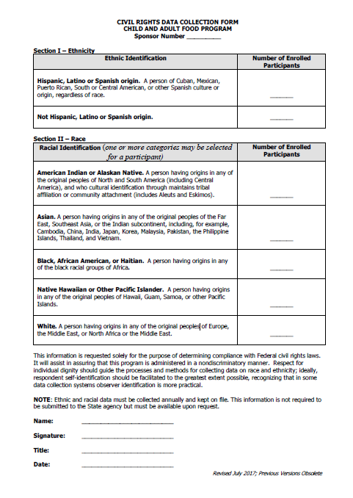
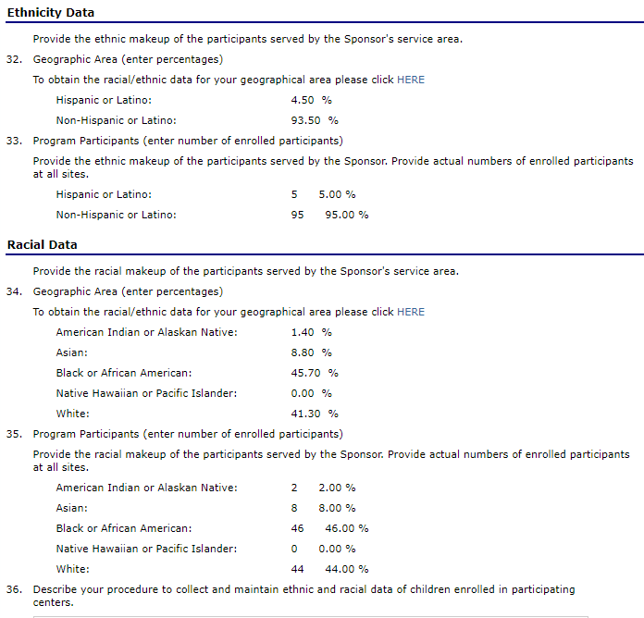
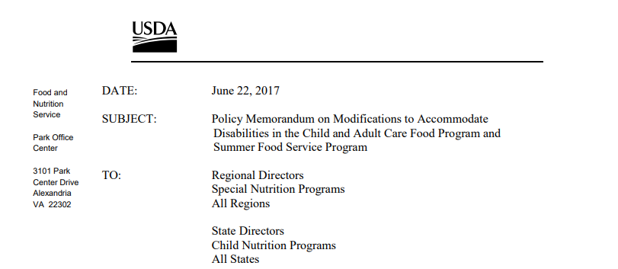
Name That Program Record
Who Maintains
Type of Program Record | Requirements | Sponsor | Center | DCH Provider | Exempt Facilities
Monitoring | Pre-Approval Visits Location, Date Announced/Unannounced Five Day Reconciliation Meal Pattern Compliance Licensing or Approval compliance Attendance at training verification Recordkeeping verification Meal service Problems noted Corrective action prescribed and effectiveness Signature of Monitor and Center Rep. | X | ADC CC EMS HS OSHC | X
Application Documentation | See application training(s) Agreement(s) Management Plan Civil Rights Data Collection Licenses/Approval Field Trip Notification | X | ADC CC EMS HS OSHC | X
*This list is not all inclusive. Please see 7 CFR 226., USDA and State agency Policy Memos, USDA Handbooks, 7 CFR 200, 796-2 Rev. 4, and other State agency or USDA materials for all requirements.
Notes:
(do) Review the Slide. Be sure to mention any relevant point (records, requirements or who maintains the records) that the groups did not mention during the exercise.
(say) Let’s look at the records on this slide
Monitoring
An in-depth webinar focusing solely on monitoring and monitoring requirements is in the works. We will announce it when it is ready, but until then please ensure that sponsoring organizations and sponsored faculties are retaining copies of their monitoring and corrective action documentation.
Application Documentation
It should be noted that sponsored facilities should have copies (or originals if applicable) of their documentation on site as well as with the sponsoring organization. We realize that a lot of this information is held in CHAAMPS now, however the original paper documentation should be retained for required time.
More specifically, (click) I’d like to quickly highlight Civil Rights. Bee will go more in-depth on Civil Rights requirements in he VDH Civil Rights training presentation, however we’re going to focus on the recordkeeping aspect.
In addition to including the nondiscrimination statement on all public CACFP documentation, independent institutions and sponsoring organizations for their sponsored facilities are required to complete the Civil Rights Data Collection Form (click) as well as report this information in the CHAAMPS application packet (click).
This form and information is requested solely for the purpose of determining compliance with Federal civil rights laws. It will assist in assuring the institution’s Program is administered in a nondiscriminatory manner. Respect for individual dignity should guide the processes and methods for collecting data on race and ethnicity. Ideally, a respondent self-identification should be facilitated to the greatest extent possible, however we do recognize that in some data collection processes the observer’s identification is more practical.
Additionally, a civil rights complaint log must be kept which should store all CACFP-related civil rights complaints made against the participating institution or its employees. For more information on the Section 504 grievance requirements, please see (click) USDA’s June 22, 2017 memo in addition to 7 CFR 226. (click)
It is not a requirement to use the Civil Rights Data Collection Form above, which is located in CHAAMPS under Download Forms, but the form your organization uses should collect the same information listed on VDH’s form. (click)
(say) Whew! Alright, that’s a lot of records. However we do realize that this is a major overview and not necessarily an all-inclusive list. For any additional records and requirements not covered in this summary chart, please refer to the Federal regulations, USDA memos, USDA resources, and State agency memos.
[Slide]

Slide 15
Name That Financial Record
Debrief
15 minutes
Notes:
Activity: Name That Financial Record (15 minutes)
Materials: (prior to session, or with the help of the other presenter during the first part of the presentation, set up posters around the room with enough space in between for each group to work but not on top of another group)
10 copies of “Name That Financial Record” posters (1 copy per group)
10 packs of Post-Its (one pack per group)
Writing Instruments (enough per group)
Program records worksheet (one per person, should be in Participant Guide)
Program records answer sheet (one per person, should be passed out after activity)
Tape (to hang charts on walls at the end)
(say) We are now going to perform the same activity, but this time we are going to focus on Financial records! Turn to page XXXX in your participant’s guide.
(say) Turn to page XXX in your Participant’s Guide.
(say) You will have 8 minutes to document as many financial records as you can. Look at page XXX to help get you started but PLEASE do not jump ahead!
(say) Now, grab your pen and a few more sticky notes. Paste your sticky notes on the chart as quickly as you can. Your time starts now, Go!
(do) Monitor the time, only give 8 minutes. It’s okay if the groups do not get all of the answers.
(click) (say) Time’s up!! Let’s review your results!
(do) Have each area tape their chart up around the walls of the room and then sit back down. Walk around the room to each chart on the wall, pull a few sticky notes from the chart (maybe 12-14 total), and read them one at a time. Poll the room for feedback on the Program records, the requirements, and the entities (agreement/disagreement).
(say) That was a great job! Now let’s look over some of the answers.
[Slide]
***WEBINAR ADAPTATION*****
(say) We are now going to perform the same activity, but this time we are going to focus on Financial records! Turn to page XXXX in your participant’s guide.
(say) Turn to page XXX in your Participant’s Guide.
(say) You will have 8 minutes to document as many financial records as you can. Look at page XXX to help get you started but PLEASE do not jump ahead!
(say) You will have 8 minutes to document as many Program records and requirements as you can. Look on page XXX to help get you started.
(say) Alright, remember to fill it out as quickly as you can. It is okay to brainstorm with those around you if you are watching this webinar together. Your time starts…now! Go!
(do) Mute the audio recording for the next 8 minutes. Monitor the time, only give 8 minutes. It’s okay if they don’t get all of the answers.
(click) (say) Time’s up!! Let’s review your results! When looking over the records you’ve written, can you see any that might be considered financial records? Do you have any that are classified in the wrong section? How many were you able to get!
(say) I’m sure you did a great job! Now let’s look over some of the answers.
[Slide]

Slide 16
Name That Financial Record
Who Maintains
Type of Financial Record | Requirements | Sponsor | Center | DCH Provider | Exempt Facilities
Bank Statements/ Cancelled Checks | To document non-profit food service Payroll verification Reimbursement distribution verification | X | ADC CC EMS HS OSHC
Itemized Receipts/ Invoices | Merchant’s name Date Items purchased Price of each item Total amount of bill Method of payment Donation receipts | X | ADC CC EMS HS OSHC
Compensation Plan | Rates of pay Hours of work Policy and schedule for regular compensation, overtime, etc. Requirements of US Dept. of Labor FLSA | X | ADC CC EMS HS OSHC
Notes:
(say) Let’s turn to page 9 in your Participant’s Guide.
(do) Review the Slide. Be sure to mention any relevant point (records, requirements or who maintains the records) that the groups did not mention during the exercise. As with the Program records, remember this is not an all inclusive list. Bee will be discussing Financial Viability in another session that will be much more thorough and specific.
(say) Regardless, let’s take a look at a few records on the slide:
Bank statements– review requirements and who maintains the record. Ask about exemptions.
Itemized Receipts/Invoices
When documenting costs for the CACFP, it’s required to maintain receipts and/or documentation (for example: documentation for a milk donation). This is to ensure the organization is financially viable and accounting for all Program reimbursements received from VDH.
Receipts must be itemized with the date, merchant’s name, method of payment, etc.
Please remember, it’s important to go through a receipt and allocate what is allowable vs. unallowable and what category the item is attributable to. For example: Is the item a non-food?
You’ll also want to remember to when we were discussing physical inventories, this is another type of cost documentation that can be used to reconcile your monthly reimbursement.
[Slide]

Slide 17
Name That Financial Record
Who Maintains
Type of Financial Record | Requirements | Sponsor | Center | DCH Provider | Exempt Facilities
Payroll | Employee’s name//Identification number Rate of pay Hours worked Benefits earned Reduction or increase to base pay Gross pay Net pay Date of payment Method of payment Verification that employee has been paid | X | ADC CC EMS HS OSHC
Time Distribution Log | Date//Dates worked Employee name// ID number Rate of pay Total pay Total hours worked Hours (by day) in food service/administrative duties Signature by employee and supervisor | X | ADC CC EMS HS OSHC
Notes:
(say) Let’s turn to page XXXX in your Participant’s Guide.
(do) Review the Slide. Be sure to mention any relevant point (records, requirements or who maintains the records) that the groups did not mention during the exercise.
(say) As with the Program records, remember this is not an all inclusive list. Bee will be discussing Financial Viability in another session that will be much more thorough and specific.
Regardless, let’s take a look at a few records on the slide:
Payroll – Can anyone tell me why it’s important for your organization to keep documentation of the payroll as well as the “Time Distribution Log”?
Time Distribution Log for employees performing CACFP related tasks
We’ve included a template as a hand out (walk through the requirements)
Can anyone tell me why it’s important to maintain documentation of the employee’s hours worked in food service or administrative hours?
[Slide]

Slide 18
Name That Financial Record
Who Maintains
Type of Financial Record | Requirements | Sponsor | Center | DCH Provider | Exempt Facilities
Facility Funds Integrity (Reimbursement Documentation) | Name of facility Facility’s CHAAMPS ID number Meal counts and cost data identified with the date the information was received Reimbursement claimed on behalf of the facility Amount and date of the reimbursement payment Income to the Program from all sources | X | ADC CC EMS HS OSHC
Procurement | Procedures that reflect State, local, and tribal laws and regulations Written standards of conduct Rationale for procurement method Selection contract Contractor selection//rejection Procedures for transactions For sealed bids: firm fixed price contract issued to the lowest bidder
*This list is not all inclusive. Please see 7 CFR 226., USDA and State agency Policy Memos, USDA Handbooks, 7 CFR 200, 796-2 Rev. 4, and other State agency or USDA materials for all requirements.
Notes:
(say) Let’s turn to page XXXX in your Participant’s Guide.
(do) Review the Slide. Be sure to mention any relevant point (records, requirements or who maintains the records) that the groups did not mention during the exercise.
(say) let’s take a look at a few records on the slide:
Facility Funds Integrity
This is also the claim and reimbursement documentation.
Remember for a sponsoring organization, you have five days to distribute reimbursement funds once you’ve received them from the State agency.
A portion of this information is maintained in CHAAMPS and it is not expected to also print that information.
Procurement
We have a whole separate session regarding Procurement and the necessary documentation and requirements. I won’t touch on it at this time other than to say: check out that session!
And it’s ultra important… all of these costs should be anticipated and reconciled (best practice is monthly) in your (click) CHAAMPS BUDGET!!! We do compare your budget and your actual costs on a Program review, which is exactly what you should be doing. As I said before, this list is not all inclusive. There may be additional records or requirements that we haven’t covered. For more information on the cost documentation, tune into the Financial Viability session as well as USDA’s Guidance for Management Plans and Budgets Handbook and FNS Instruction
(ask) Before moving on, what did you notice that I different about financial records?
Answer: Correct! Day Care Homes are not required to maintain any financial records!
(say) If you have any questions about particular records, please write them down on a post-it and add them to the parking lot. We’ll review all of these specific questions and answer them all together at the end of the training!
(say) Great job! Let’s discuss records management.
[Slide]

Slide 19
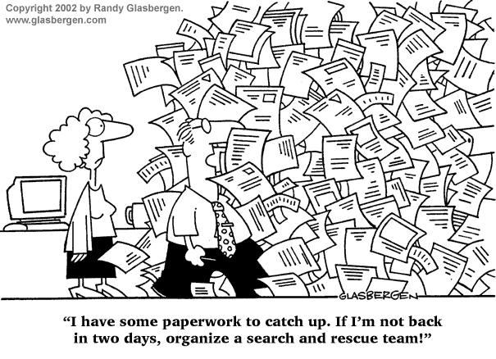
Records Management
Why are good records important when demonstrating how your CACFP reimbursements are being utilized?
Bottom line…
“If it’s not documented, it did not happen.”
Notes:
(click) So, now you must be asking yourself if management all of these records is really necessary. Let’s talk through it.
(click) (ask) Why are good records important when demonstrating how your CACFP reimbursements are utilized?
(do) Poll the room for 2-3 answers and thank each person for his or her reply.
(click) (say) Have you ever head the old saying, “If it’s not written down, it did not happen?” So in essence, if you do not have accurate records to show that meals were served and funds were spent on allowable costs, your reimbursements will be denied or disallowed.
[Slide]

Slide 20
Records Management
Retention
Records should be kept for a period of three years plus the current fiscal year, unless there is an audit exception.
Retrieval
Records must be readily available for retrieval and access upon request.
Notes:
(say) A big part of effectively managing records has to do with maintaining these records and being able to provide access to them when requested.
(ask) By a show of hands, how many of you have received an unannounced review?
(ask) Now, by a show of hands how many of you, regardless of if you’ve had an unannounced review, how many of you feel that if an unannounced review occurred without you present, that another staff member with your organization would be able to pull all of the required review information without issue?
(click) (say) Independent institutions, sponsoring organizations are responsible and accountable to the State agency for records maintenance. With that said, if your center or facilities your organization sponsors do not have records or is unable to retrieve records when requested, who is ultimately responsible?
Records should be maintained for 3 years plus the current fiscal year, unless there is an audit finding or a delinquent Program debt – then the records must be maintained until the audit finding and debt are resolved.
Records must be readily available for retrieval and access, upon request.
If records are maintained onsite, online, or in the cloud, then your staff should be able to access them within one hour. If they are maintained in paper form and stored offsite, you should be able to retrieve them within 48 hours.
(say) A point to note is that simply having electronic/automated records does not necessarily equate to compliance. The software could be inadequate, or if the computer crashes, you still have no records. Additionally, terminated sponsoring organizations and facilities are required to maintain records according to the requirements. Because a sponsoring organization or facility terminates its agreement, it does not relive it of the recordkeeping requirements.
[Slide]

Slide 21
Month & Vendor Organization
Periodic Check
Best Practices
Staff access
Current month + previous 12 on site
Confidential Off-site
Notes:
(say) Let’s take a look at some best practices for recordkeeping. These are not requirements – just recommendations for you to consider and share with your organization and facilities:
(click) Keep records organized, by month and vendor.
(click) Check your files periodically to ensure that the records are still accurate and complete.
(click) Ensure that your staff has access to paper and electronic records.
Having electronic records does not necessarily mean that you’re in compliance.
(click) For independent institutions, sponsoring organizations and their facilities, maintaining the current month plus the previous 12 months onsite. As a reminder, day care home providers are required to maintain the current months plus the previous 12 months on site.
(click) Store offsite records in a safe place, and keep them confidential.
(click) Produce records, when requested, in a reasonable time frame:
Current year = within 1 hour
Prior years = within 48 hours
(click)
(ask) What additional best practices would you recommend?
[Slide]

Slide 22
Recap
Purpose of Recordkeeping
Record Availability
Impact of Non-compliance
Record Variety
Notes:
(say) Before we wrap up this session, let’s recap what we’ve covered in recordkeeping:
We emphasized that maintaining accurate, completed records is vital for the Program’s success.
As a reminder, the sponsoring organization is responsible and accountable for the records, no matter where they are stored and maintained.
We discussed the various types of records that should be maintained.
We discussed that records should be accessible and available for review, upon request.
We discussed that not maintaining appropriate records will have a negative impact on the success of your Program.

Slide 23
References
Continued
Requirements (not all inclusive)
Code of Federal Regulations (7 CFR 226)
§226.6(b) – Overview
§226.15(e) – Institution provisions
§226.16 – Sponsoring organization provisions
§226.17-19 – Specifics by site type
§226.20– Meal Pattern Requirements
§226.15(e) – Institution provisions
§226.23 – Eligibility requirements
FNS Instruction 796-2, Revision 4
CACFP 14-2012
CACFP 03-2009
CACFP 01-2008
CACFP 09-2007
CACFP 01-2007
CACFP 2000-03-14
USDA Handbooks
Guidance for Management Plans and Budgets Handbook. USDA (December 2013).
Monitoring Handbook for State Agencies, USDA (May 2014).
Resources
Handouts
Recordkeeping Participant’s Guide
Program Record Handout
Financial Record Handout
USDA Policy Memos
CACFP 15-2013
CACFP 14-2013
CACFP 13-2013
CACFP 02-2018
CACFP 17-2017
CACFP 14-2017
Training and Resources from VDH http://www.vdh.virginia.gov/child-and-adult-care-food-program/
This training and participant guide were adapted from the March 2019 CACP Operational Resources and Education “Recordkeeping & Claiming” training by MH Miles Company.
Presentation template by SlidesCarnival // Photographs by Unsplash
This institution is an equal opportunity provider, employer, and lender.

Slide 24
Questions? Contact Us!
CACFP@VDH.Virginia.Gov
(877) 618- 7282
Virginia Department of Health
Division of Community Nutrition
Special Nutrition Programs
109 Governors Street, 8th Floor
Richmond, Virginia 23219
This institution is an equal opportunity provider, employer, and lender.

