Slide 1
Community Themes & Strengths Assessment
survey results
Thomas Jefferson Health District
MAPP 2 Health 2016

Slide 2
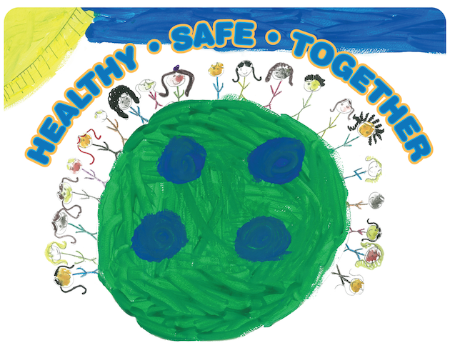

Slide 3
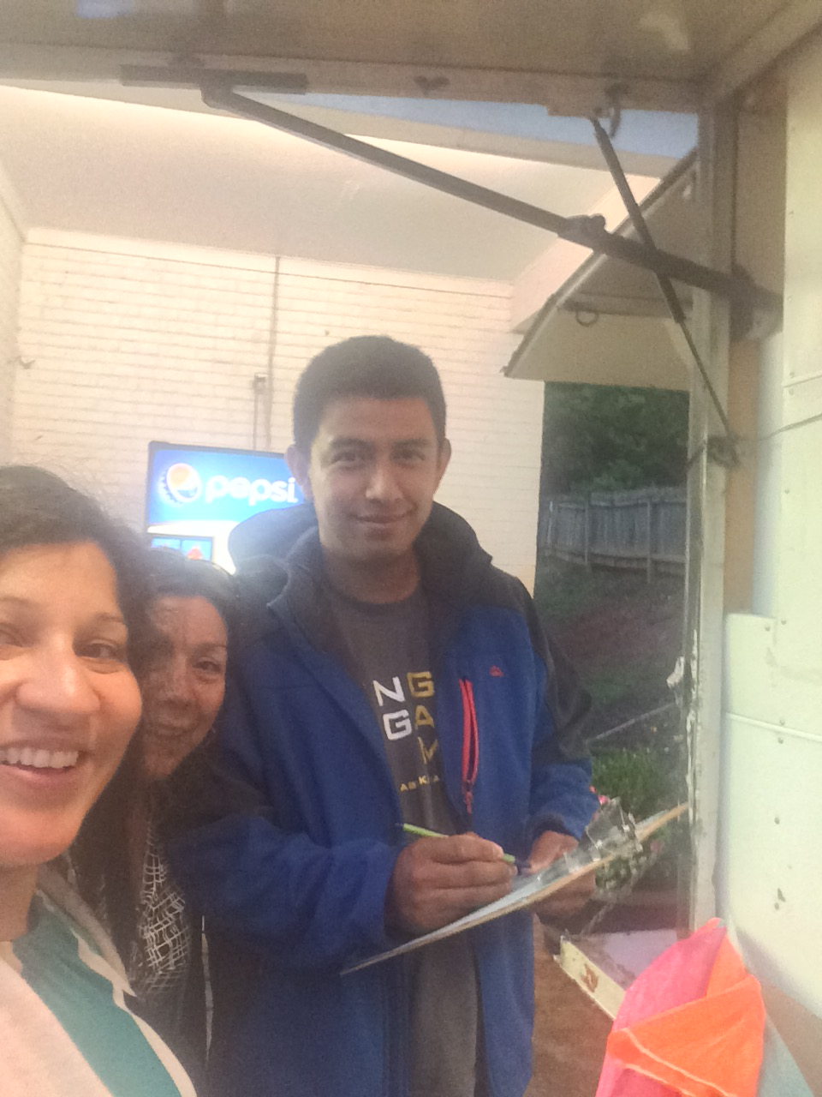
Tako Nako
Promotoras de Salud
(Community Health Workers – CHWs)
Lili Guzman &
Consuelo Canon

Slide 4
CTSA Background
“The Community Themes and Strengths Assessment answers the questions:
‘What is important to our community?’
‘How is quality of life perceived in our community?’
‘What assets do we have that can be used to improve community health?’
This assessment results in a strong understanding of community issues and concerns, perceptions about quality of life, and a map of community assets.”
-National Association of County & City Health Officials (NACCHO)
http://archived.naccho.org/topics/infrastructure/mapp/framework/phase3ctsa.cfm

Slide 5
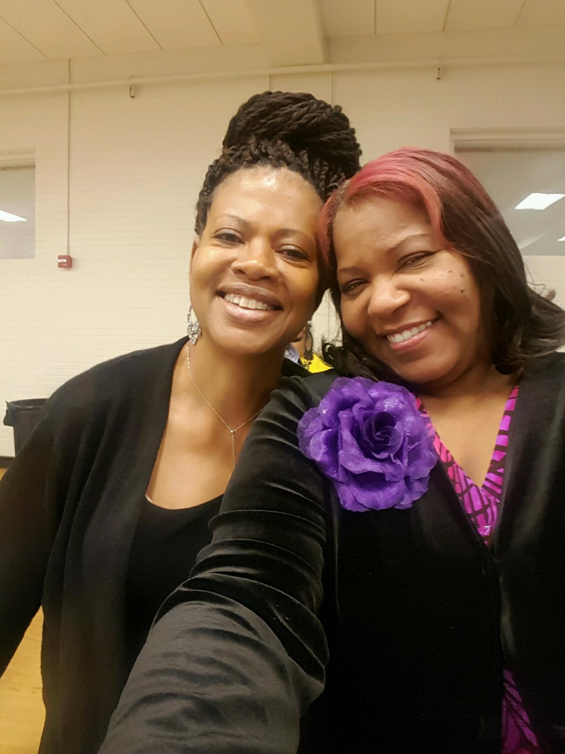
City of Promise Community Dinner
CHW Wendy Cooper
and
MAPP Core Group member Jackie Martin (SMJH)

Slide 6
Recap: Survey Questions
Where do you live?
What makes your community a healthy place to live?
What should your community improve?

Slide 7
Additional Areas By Locality
Greene
  Dental Care
  Jobs
  Transportation
  Housing
Fluvanna
  Aging
  Education
  Housing
  Transportation

Slide 8
Recap: Survey Methods
In-person (paper survey) at community events and gatherings
Partner locations (paper survey) such as clinics, non-profit offices
Online (electronic survey) via SurveyMonkey

Slide 9
Recap: Survey Methods
The survey was available in the following languages:
Paper survey: English, Spanish, Arabic, Dari, and Nepali
Online survey: English and Spanish

Slide 10
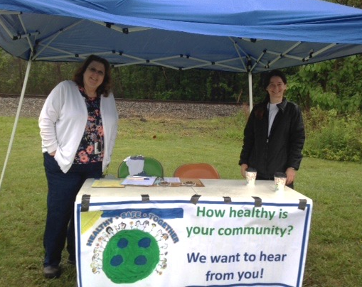
Mineral Farmers’ Market
TJHD staff members
Keila Rader & Jillian Regan

Slide 11
In-person Surveys at Community Events
Timeline: Saturday, May 7th – Sunday, June 12th
Events attended by survey team: 36
Surveys collected: 1,198
Notes:
++ of these how many in spanish?

Slide 12
Community Events, Gatherings, Meetings
Albemarle
Southwood May Market
Scottsville Farmers’ Market
Christian Salon
Super Amanecer
Church of the Incarnation
Tako Nako
Latino Market
Charlottesville
Charlottesville City Market
Reid’s Super Saver
City of Promise Community Dinner
Pilgrim Baptist Church Bible Study
El Tío Variedades
Mí Canton
Fluvanna
Old Farm Day
Fluvanna County Employee Wellness Fair
Fluvanna County Sunday School Union
Fluvanna Farmers’ Market
Greene
Greene Lions Club
Greene Strawberry Festival
Tuesday’s Table
Louisa
Mineral Farmers’ Market
Louisa County Resource Council
Community Extravaganza
Nelson
Community Breakfast at the RVCC
Unity in Community Luncheon
Nelson County Pantry
Nelson Farmers’ Market

Slide 13
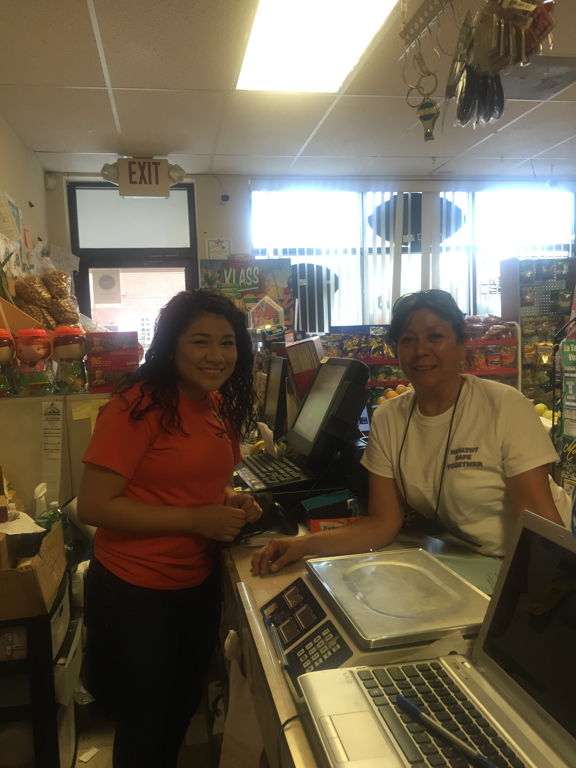
Super Amanecer
CHW Consuelo Canon

Slide 14
Surveys Collected from Partner Locations
Timeline: May 23, 2016 - June 15, 2016
Partner Locations: 35
Surveys collected: 494

Slide 15
Partner Locations
Albemarle
Albemarle DSS
Jefferson Area Board for the Aging (JABA) – Esmont, Scottsville
Jefferson Area Children’s Health Improvement Program (CHiP)
Martha Jefferson Medical Group (MJMG) – multiple sites
Charlottesville
Albemarle/Charlottesville Health Department
Charlottesville DSS
JA CHiP
JABA
Neighborhood Family Health Center (CVHS)
Sin Barreras
Fluvanna
Fluvanna County Library
Fluvanna DSS
Fluvanna Health Department
JA CHiP
JABA
Region Ten
Union Baptist Church
Greene
Emmanuel Christian Center
Feeding Greene
Greene Care Clinic
Greene County DSS
Greene Health Department
Region Ten
Louisa
Health & Wellness Center (CVHS)
JA CHiP
JABA
Louisa County Department of Human Services
Louisa Health Department
MJMG – Spring Creek Family Medicine
Vets of Louisa
Nelson
Blue Ridge Medical Center (BRMC)
MJMG - Afton Family Medicine
Nelson Health Department
Region Ten

Slide 16
Online Survey
Timeline: May 18, 2016 - June 12, 2016
Respondents: 1,193

Slide 17
Participation

Slide 18
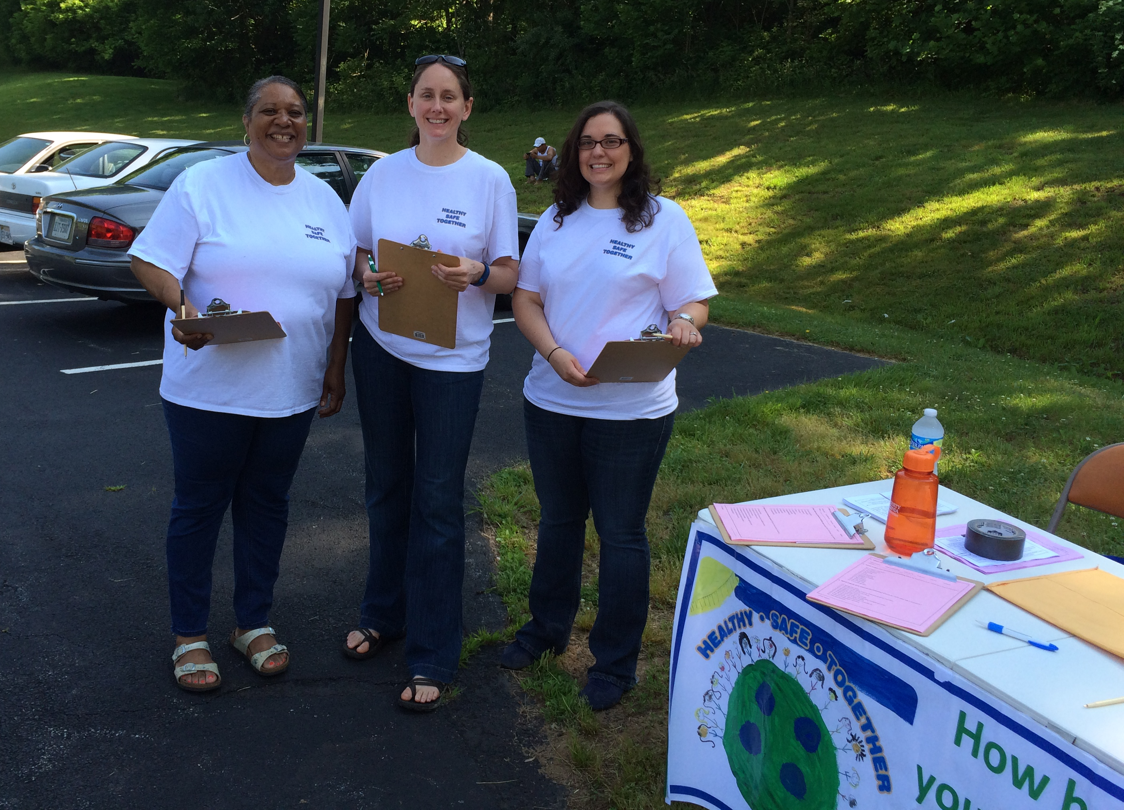
Nelson County Pantry
CHW Deborah Chesley,
TJHD staff member April Carman, and
Volunteer Sylvia Coffee of Afton Family Medicine (MJMG)

Slide 19
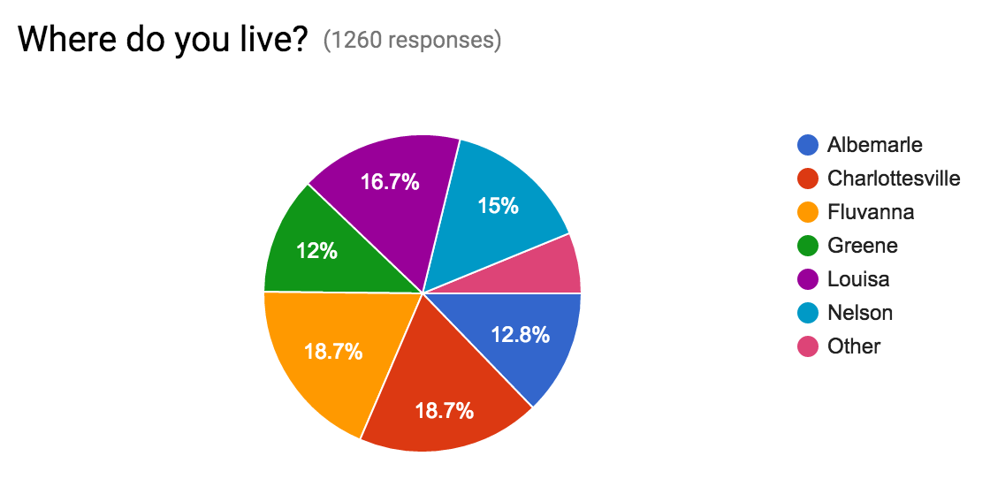
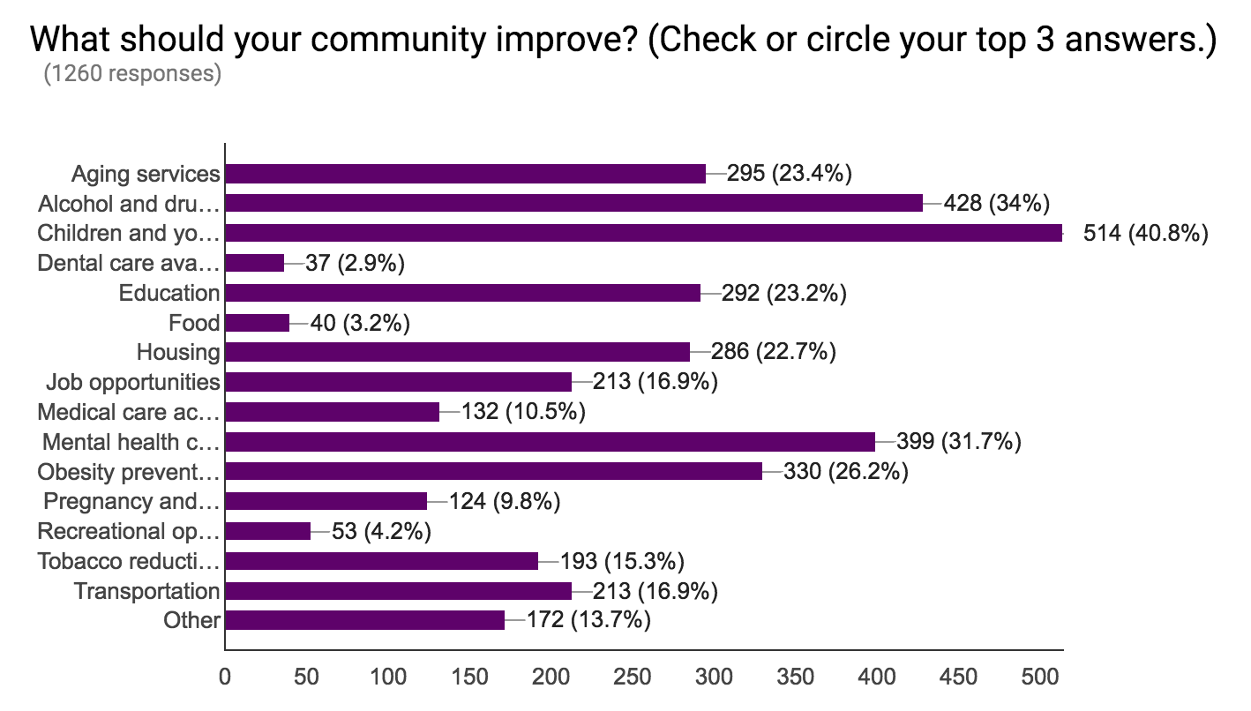
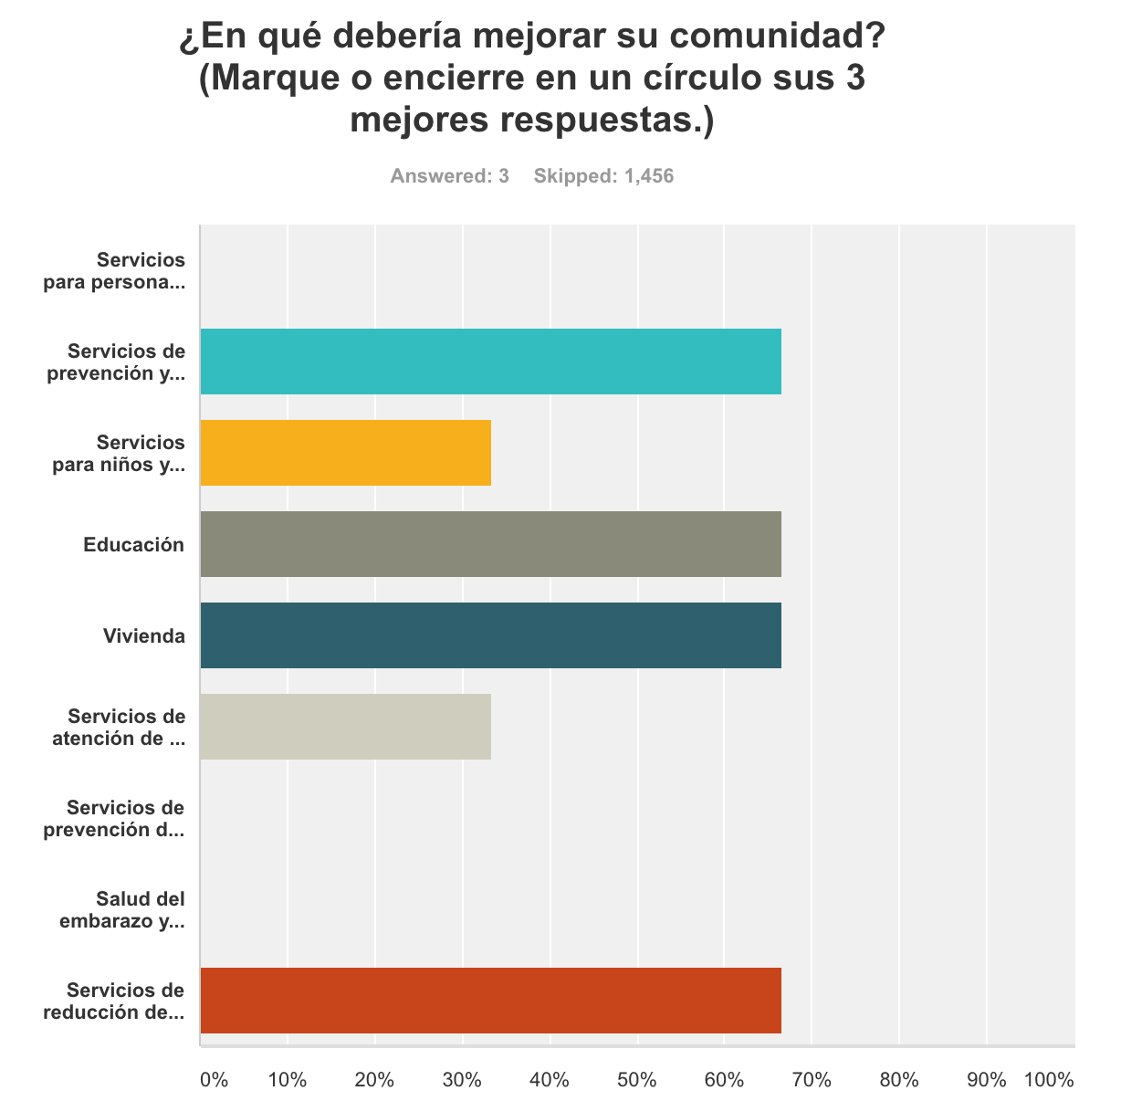
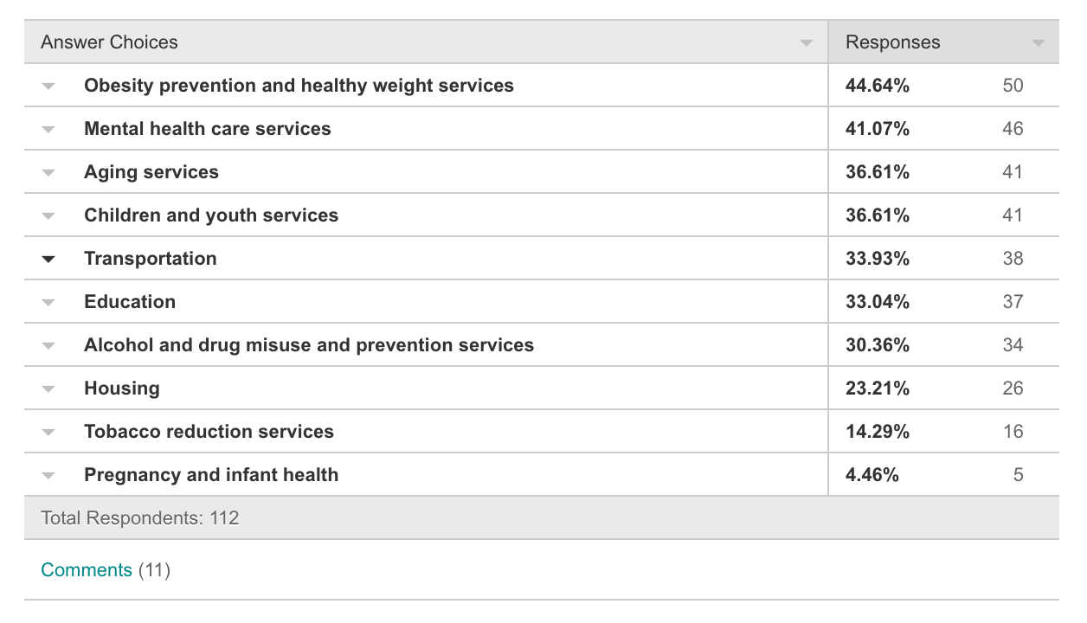
Results
Notes:
We looked at the answer choices by locality and ranked the most commonly chosen answer choices for each locality.
Google Forms, Survey Monkey

Slide 20
Commonalities Across TJHD
Q2 - What makes your community a healthy place to live?
 | Albemarle | Charlottesville | Fluvanna | Louisa | Nelson | Greene
1 | Healthcare | Healthcare | Outdoors | Outdoors | Outdoors | Local schools
2 | Outdoors | Food options | Recreation | Spiritual Life | Healthcare | Outdoors
3 | Food options | Outdoors | Spiritual Life | Healthcare | Recreation | Spiritual Life
4 | Recreation | Safe Streets | Local schools | Local schools | Food options | Healthcare
5 | Culture and arts | Culture and Arts | Healthcare | Recreation | Local Schools | Safe Streets
 |  |  |  |  | Spiritual Life
Notes:
Again, it’s a lot to take in. Consider using animation to show top five district wide commonalities in order - healthcare, outdoors, recreation, spiritual life…
# of Localities the Sector Ranks within Top Five
Outdoors 6
Healthcare 6
Recreation 4
Spiritual life 4
Food options 3
Local schools 3
Culture and arts 2
Safe streets 2

Slide 21
Q2 – Healthy Strengths
Healthcare (6)
Outdoors (6)
Recreation (4)
Spiritual life (4)
Food options (3)
Local schools (3)

Slide 22
Commonalities Across TJHD
Q3 - What should your community improve?
 | Albemarle | Charlottesville | Fluvanna | Greene | Louisa | Nelson
1 | Mental health | Mental health | Children and youth | Jobs | Jobs | Children and youth
2 | Obesity | Housing | Aging | Children and youth | Children and youth | Aging
3 | Children and youth | Alcohol and drug | Transportation | Alcohol and drug | Alcohol and drug | Transportation
4 | Aging | Children and youth | Mental health | Obesity | Medical care access | Alcohol and drug
5 | Alcohol and drug | Education | Obesity | Mental health | Mental health | Medical care access
Notes:
Again, it’s a lot to take in. Consider using animation to show top five district wide commonalities in order – children and youth, mental health, alcohol and drug, aging, obesity
Sector # of Localities the Sector is Ranked within Top Five
Children and youth 6
Mental health 5
Alcohol and drug 5
Aging 3
Obesity 3
Transportation 2
Jobs 2
Medical care access 2
Housing 1
Education 1

Slide 23
Q3 – Needs Improvement
Children and youth (6)
Mental health (5)
Alcohol and drug (5)
Aging (3)
Obesity (3)

Slide 24
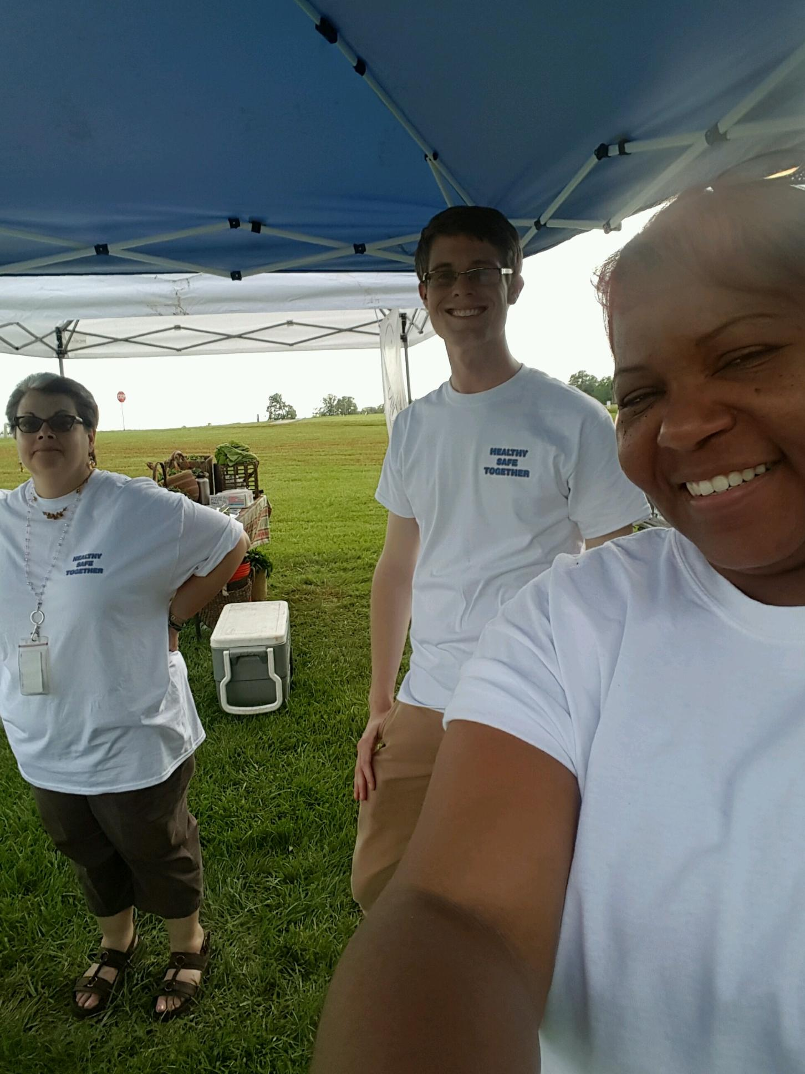
Fluvanna Farmers’ Market
CHW Wendy Cooper and
TJHD staff members
Erin Callas & Owen Yancey

Slide 25
Thank you to our Partners Sites!
Fluvanna County Library
Fluvanna DSS
Fluvanna Health Department
JA CHiP
JABA
Region Ten
Union Baptist Church
Old Farm Day
Fluvanna County Employee Wellness Fair
Fluvanna County Sunday School Union
Fluvanna Farmers’ Market

Slide 26
CTSA Background
“The Community Themes and Strengths Assessment answers the questions:
‘What is important to our community?’
‘How is quality of life perceived in our community?’
‘What assets do we have that can be used to improve community health?’
This assessment results in a strong understanding of community issues and concerns, perceptions about quality of life, and a map of community assets.”
-National Association of County & City Health Officials (NACCHO)
http://archived.naccho.org/topics/infrastructure/mapp/framework/phase3ctsa.cfm
Notes:
+ how this information can be used with our other district quantitative data
+ don’t forget this also highlights community members’ perceptions of positive things in our communities, our CHA councils should consider how those strengths might be used to improve what needs improving
Q2 – healthy strengths
# of Localities the Sector Ranks within Top Five
Outdoors 6
Healthcare 6
Recreation 4
Spiritual life 4
Food options 3
Local schools 3
Culture and arts 2
Safe streets 2

Slide 27

CTSA 2016
strengths & what we can improve next time
Notes:
+feedback forms in your packets

Slide 28
Questions?
Notes:
How do we want to conclude? Q and A with the audience and Core Group? Instructions on giving feedback for improvements/additional survey events/partners for future rounds?

