Slide 1
Improving Community Health through Planning and Partnerships
Greene
Community Health Council
Notes:
Improving Community Health

Slide 2
Things to keep in mind…
Feel free to ask questions as we go along
We are presenting the most recent data we have
(From the past 4 – 5 years)
This is the last part of Section 3 data

Slide 3
Today
Updates/Highlights from Section 3, Part 2 covered at last meeting
Section 3, Part 2
Unintentional Injury Deaths
Violent Deaths
Ambulatory Care Sensitive Conditions / Prevention Quality Indicator Hospitalizations

Slide 4
Updates Maternal & Child Health

Slide 5
Infant Mortality by Race
The rate is nearly twice as high for blacks in Greene than it is for whites, though it had been decreasing
Source: Virginia Department of Health. Division of Health Statistics

Slide 6
Neonatal Death
The percentage is slightly higher in Greene than the state-wide average and much lower than in Nelson.
Source: Virginia Department of Health. Division of Health Statistics

Slide 7
SIDS Deaths
There were fewer deaths from SIDS from ’09-’14 then there
were from ‘04-’08. There were none in 2012.
Source: Virginia Department of Health. Division of Health Statistics

Slide 8
Pregnant Women with Prenatal Care
A lower percentage of newborns were given prenatal care within the first 13-weeks in Greene than in Nelson, but both are higher than the Healthy People 2020 goal
Source: Virginia Department of Health. Division of Health Statistics

Slide 9
Ten or More Prenatal Care Visits
Fewer mothers in Greene get at least 10 prenatal care visits than in Nelson or the state as a whole
Source: Virginia Department of Health. Division of Health Statistics

Slide 10
Mothers with < 12th Grade Education
The percent of births to mothers with less than a 12th grade education is decreasing in Greene and lower in Greene than in Nelson and VA
Source: Virginia Department of Health. Division of Health Statistics

Slide 11
Smoking During Pregnancy
The percent of mothers smoking while pregnant in Greene is higher than the state-wide average and higher than the Healthy People 2020 target
Source: Virginia Department of Health. Division of Health Statistics

Slide 12
Updates Mental Health-More details about MH emergency services

Slide 13
Mental Health Outcomes
2,543
Total MH Emergency Service Evaluations
in 2015
Source: Region 10

Slide 14
Mental Health Outcomes
891
of the 1,836 pre-screened for hospitalization by Region in 2015 went on to a hospitalization (were admitted to hospital)
More Detailed Breakdown:
Type | Number
TDO’s | 676
Recommitments | 133
Voluntary Admissions | 220
WRC | 337
Safety Plan | 290
Released | 116
Referred | 152
Other | 152
Yes, there can be some duplication in these types, such as someone who was released and referred is counted for both of those
Source: Region 10
Notes:
(can be some duplication in dispositions below, e.g., someone who was released and referred)

Slide 15
Section 3: What is Our Health Status?
Unintentional Injury Deaths
Violent Deaths
Ambulatory Care Sensitive Conditions / Prevention Quality Indicator Hospitalizations

Slide 16
Unintentional Injury Deaths

Slide 17
Unintentional Injury Deaths
The rate of unintentional injury deaths is lower in Greene than
Nelson but above VA and the Healthy People 2020 goal
Source: Virginia Department of Health, Division of Health Statistics

Slide 18
Unintentional Injury Deaths by Race
There are racial disparities in with the rate currently being higher for
white Virginians than black Virginians
Source: Virginia Department of Health, Division of Health Statistics for years 2000-2012. Centers for Disease Control and Prevention, National Center for Health Statistics. CDC Online WONDER database for years 2013.

Slide 19
Suicide & Homicide

Slide 20
Violent Deaths
*Note: 2014 data is preliminary and subject to change
The rate of violent deaths in our health district
are very close to the state-side average
Source: Virginia Violent Death Reporting System, Office of the Chief Medical Examiner, Virginia Department of Health

Slide 21
Suicide
The suicide rate in Greene has reached the Healthy People 2020 goal
Source: Virginia Department of Health, Division of Health Statistics

Slide 22
Youth Suicide
The youth suicide rate in our district is lower than the state-wide average
Source: Virginia Department of Health, Virginia Online Injury Reporting System

Slide 23
Youth Suicide
The suicide rate among Virginian youths has increased since 1999
Source: Virginia Department of Health, Virginia Online Injury Reporting System

Slide 24
Youth Suicide
The suicide rate among white youths is nearly double the
rate of black youths
Source: Virginia Department of Health, Virginia Online Injury Reporting System

Slide 25
Homicide
Greene has not had any homicides recently.
The homicide rates in Nelson and Virginia as a whole fall just under Healthy People 2020 goals.
Source: Virginia Department of Health, Virginia Online Injury Reporting System

Slide 26
Ambulatory Care Sensitive / Prevention Quality Indicator Hospital Discharges

Slide 27
Prevention Quality Indicator (PQI) Hospital Discharges
Greene’s rate is lower than Nelson’s and the state-wide average, all of which are lower than the national standard
Source: Virginia Atlas of Community Health. Behavioral Health Hospital Discharge Profile (January 1-December 21, 2012). Accessed at www.AtlasVA.org.
Notes:
The PQI definitions are detailed in their specification of ICD-9 diagnosis codes and procedure codes. Not every hospital admission for congestive heart failure, bacterial pneumonia, etc. is included in the PQI definition; only those meeting the detailed specifications. Low birth weight is one of the PQI indicators, but for the purpose of this report, low birth weight is included in the Maternal and Infant Health Profile. Also, there are four diabetes-related PQI indicators which have been combined into one for the report. For more information, visit the AHRQ website at www.qualityindicators.ahrq.gov/pqi_overview.htm
Source for AHRQ PQI National Benchmarks: US Dept of Health and Human Services. Agency for Healthcare Research and Quality (AHRQ). Prevention Quality Indicators v5.0 Benchmark Data Tables. March 2015.
http://www.qualityindicators.ahrq.gov/Modules/PQI_TechSpec.aspx

Slide 28
Prevention Quality Indicator (PQI) Hospital Discharges
The rate in Greene is almost identical to the state-wide average
and slightly lower than in Nelson, all of which are under the
national standard
Source: Virginia Atlas of Community Health. Behavioral Health Hospital Discharge Profile (January 1-December 21, 2012). Accessed at www.AtlasVA.org.

Slide 29
Prevention Quality Indicator (PQI) Hospital Discharges
The rates in Nelson and Virginia are both well below the national standard
Source: Virginia Atlas of Community Health. Behavioral Health Hospital Discharge Profile (January 1-December 21, 2012). Accessed at www.AtlasVA.org.

Slide 30
Prevention Quality Indicator (PQI) Hospital Discharges
Greene’s rate is slightly higher than the state-wide average,
lower than Nelson’s, and below the national standard
Source: Virginia Atlas of Community Health. Behavioral Health Hospital Discharge Profile (January 1-December 21, 2012). Accessed at www.AtlasVA.org.

Slide 31
Prevention Quality Indicator (PQI) Hospital Discharges
The district and state discharge rates are both well below the
national standard
Source: Virginia Atlas of Community Health. Behavioral Health Hospital Discharge Profile (January 1-December 21, 2012). Accessed at www.AtlasVA.org.

Slide 32
Prevention Quality Indicator (PQI) Hospital Discharges
The rate in Greene is higher than in Nelson and both are
higher than the state-wide average
Source: Virginia Atlas of Community Health. Behavioral Health Hospital Discharge Profile (January 1-December 21, 2012). Accessed at www.AtlasVA.org.

Slide 33
Prevention Quality Indicator (PQI) Hospital Discharges
Virginia’s rate is much lower than the nationwide standard, and the district’s average is lower than the state’s
Source: Virginia Atlas of Community Health. Behavioral Health Hospital Discharge Profile (January 1-December 21, 2012). Accessed at www.AtlasVA.org.

Slide 34
Prevention Quality Indicator (PQI) Hospital Discharges
Virginia’s rate is much lower than the nationwide standard
Source: Virginia Atlas of Community Health. Behavioral Health Hospital Discharge Profile (January 1-December 21, 2012). Accessed at www.AtlasVA.org.

Slide 35
Prevention Quality Indicator (PQI) Hospital Discharges
Virginia’s rate is much lower than the nationwide standard
Source: Virginia Atlas of Community Health. Behavioral Health Hospital Discharge Profile (January 1-December 21, 2012). Accessed at www.AtlasVA.org.

Slide 36
Ambulatory Care Sensitive Hospitalizations

Slide 37
ACS Hospitalizations in Older Adults
Greene has a higher rate than the district and the state, but it is lower than the nationwide average
Source: Community Commons CHNA Report for TJHD Localities. Dartmouth College Institute for Health Policy & Clinical Practice, Dartmouth Atlas of Health Care. 2012. Source geography: County

Slide 38
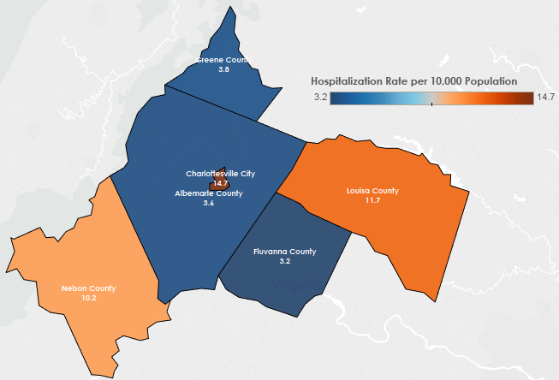
ACS Hospitalizations Asthma Hospitalization Rate per 10,000 Population, 2013
Source: Virginia Department of Health, Division of Population Health.

Slide 39
ACS Hospitalizations Asthma
Greene’s rate has been dropping since 2010, and is lower than the state’s and district’s averages, which are lower than the rate in Nelson
Source: Virginia Department of Health, Division of Population Health.

Slide 40
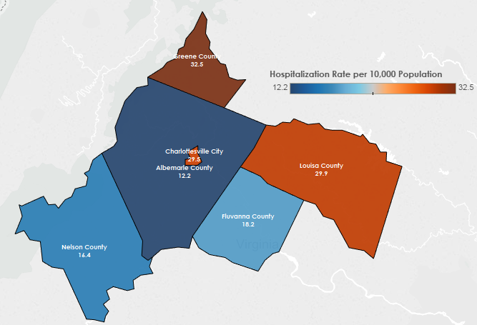
ACS Hospitalizations Diabetes (Type 2) Hospitalization Rate per 10,000 Population, 2013
Source: Virginia Department of Health, Division of Population Health.

Slide 41
ACS Hospitalizations Diabetes (Type 2)
Greene’s rate has increased over the last few years while Nelson’s decreased. Greene has a higher rate than the district’s and the state’s averages
Source: Virginia Department of Health, Division of Population Health.

Slide 42
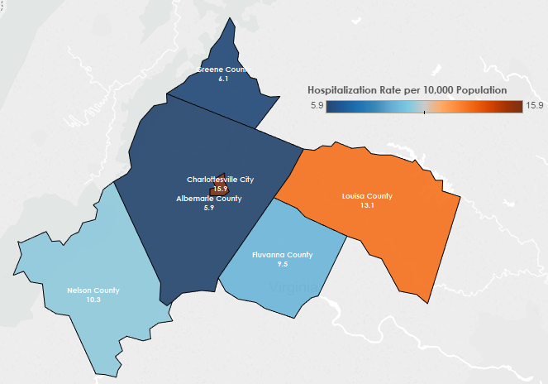
ACS Hospitalizations Hypertension Hospitalization Rate per 10,000 Population, 2013
Source: Virginia Department of Health, Division of Population Health.

Slide 43
ACS Hospitalizations Hypertension
Greene’s rate has risen since 2010, and is now higher than Nelson’s, but it is still lower than the district’s and state’s averages
Source: Virginia Department of Health, Division of Population Health.

Slide 44
Questions ?
Contact Info:
Jillian Regan, MPH
Jillian.Regan@vdh.virginia.gov

