Slide 2
Improving Community Health through Planning and Partnerships
Together we support equitable access to resources for a healthy, safe community.
MAPP 2 Health Leadership Council Meeting
5-18-2016
Notes:
Improving Community Health

Slide 3
Things to keep in mind…
You may ask questions as we go along
We are presenting data that stood out in each of the locality council meetings (since March)
We are presenting the most recent data we have
(From the past 4 – 5 years)

Slide 4
Healthy People 2020: Eliminate health disparities to achieve health equity
Health disparities
Health outcomes differences among different groups of people
Also differences in underlying factors and behaviors that can affect health outcomes
Source: Centers for Disease Control and Prevention (CDC). Health Disparities and Inequalities Report-Strategies for Reducing Health Disparities, 2016.

Slide 5
Sections Two & Three:
Strengths, Risks, and Health Outcomes

Slide 6
Tobacco Use and Lung Cancer

Slide 7
Source: County Health Rankings.
Notes:
Measure calculation changed for 2016
­ For the 2016 County Health Rankings, the CDC produced 2014 county estimates using single-year 2014 BRFSS data and a multilevel modeling approach based on respondent answers and their age, sex and race/ethnicity, combined with county-level poverty and county and state level contextual effects¹.
To produce estimates for those counties where there was no or limited data, the modeling approach borrowed information from the entire BRFSS sample as well as Census Vintage 2014 population estimates. CDC used a parametric bootstrapping method to produce standard errors and confidence intervals for those point estimates. This estimation methodology was validated for all U.S. counties, including those with no or small (<50 respondents) samples (2). Prior to the 2016 County Health Rankings, up to seven survey years of landline only BRFSS data were aggregated to produce county estimates However, even with multiple years of data, these did not provide reliable estimates for all counties, particularly those with smaller respondent samples.

Slide 8
Cigarette Expenditures, 2014
 | % of Food-at-Home Expenditures | Average Expenditures (USD)
TJHD | 1.5% | $877.76
VA | 1.4% | $823.43
U.S. | 1.6% | $822.70
Source: Community Commons. Community Health Needs Assessment Report. Nielsen, Nielsen SiteReports. 2014. Source geography: Tract.

Slide 9
HP 2020 Goal = 21%
Source: Centers for Disease Control & Prevention (CDC). Youth Risk Behavior Surveillance System (YRBSS), 2013

Slide 10
Source: Centers for Disease Control & Prevention (CDC). Youth Risk Behavior Surveillance System (YRBSS), 2013

Slide 11
Source: Virginia Department of Health. Division of Health Statistics

Slide 12
Source: Virginia Department of Health. Division of Health Statistics

Slide 13
Source: Virginia Department of Health. Virginia Cancer Registry.

Slide 14
Source: Virginia Department of Health. Virginia Cancer Registry.

Slide 15
Source: Virginia Department of Health. Virginia Cancer Registry.

Slide 16
Source: Virginia Department of Health. Division of Health Statistics.

Slide 17
Cancer Screening Behaviors, Incidence, and Mortality

Slide 18
HP 2020 Goal = 81.1%
Source: Community Commons Community Health Needs Assessment for TJHD localities-Clinical Care Report. Dartmouth College Institute for Health Policy & Clinical Practice, Dartmouth Atlas of Health Care. 2008-12. Source geography: County

Slide 19
Breast Cancer Incidence
Source: Virginia Department of Health. Virginia Cancer Registry. University of Virginia, Department of Public Health Sciences.

Slide 20
Breast Cancer Mortality
Source: Virginia Department of Health, Division of Health Statistics

Slide 21
Prostate Cancer: Screening
Source: Virginia Department of Health. Centers for Disease Control & Prevention, Behavioral Risk Factor Surveillance System (BRFSS).

Slide 22
Prostate Cancer Incidence
Source: Virginia Department of Health. Virginia Cancer Registry. University of Virginia, Department of Public Health Sciences.

Slide 23
Prostate Cancer Mortality
Source: Virginia Department of Health, Division of Health Statistics

Slide 24
Cervical Cancer: Screening
Source: Community Commons Community Health Needs Assessment for TJHD localities-Clinical Care Report. Centers for Disease Control & Prevention, Behavioral Risk Factor Surveillance System (BRFSS). Accessed via the Health Indicators Warehouse. US Department of Health & Human Services. 2006-12. Source geography: County

Slide 25
Cervical Cancer Incidence
Source: Virginia Department of Health. Virginia Cancer Registry. University of Virginia, Department of Public Health Sciences

Slide 26
Cervical Cancer Mortality
Source: Virginia Department of Health, Division of Health Statistics

Slide 27
Cervical Cancer Mortality-Racial Disparity
Source: Virginia Department of Health, Division of Health Statistics

Slide 28
Colorectal Cancer: Screening
Source: Community Commons Community Health Needs Assessment for TJHD localities-Clinical Care Report. enters for Disease Control & Prevention, Behavioral Risk Factor Surveillance System (BRFSS). Accessed via the Health Indicators Warehouse. US Department of Health & Human Services. 2006-12. Source geography: County

Slide 29
Colorectal Cancer Incidence
Source: Virginia Department of Health. Virginia Cancer Registry. University of Virginia, Department of Public Health Sciences

Slide 30
Colorectal Cancer Mortality
Source: Virginia Department of Health, Division of Health Statistics

Slide 31
Physical Activity, Diet, and Obesity

Slide 32
Percent of Adults (Age 20+ Years) Reporting No Leisure Time Physical Activity, 2011-14
Source: US County Healthy Rankings

Slide 33
Percent of Adults (Age 20+ Years) Reporting No Leisure Time Physical Activity, 2011-14
Source: US County Healthy Rankings

Slide 34
Physical Activity in High School Students in VA and the U.S., 2011-13
Gender Differences in VA
More females (65%) than males (46%) report NOT being physically active for at least 1 hour per day on 5 or more days in the past 7 days
More females (53%) than males (43%) did NOT attend a PE class on at least 1 day in an average school week
Lower in VA(48%) than US (52%)
Source: Centers for Disease Control & Prevention (CDC). Youth Risk Behavior Surveillance System (YRBSS)
Notes:
Physical Activity Guidelines for Children & Adolescents Guidelines for children & adolescents = at least 1 hr of physical activity every day - most of the 1 hr should be either moderate/vigorous intensity aerobic physical activity & include vigorous-intensity at least 3 days a week muscle strengthening (such as climbing trees, using playground, or lifting weights) at least 3 days a week bone-strengthening (such as running or jumping rope) at least 3 days a week Source: US Dept of Health & Human Services, Office of Disease Prevention & Health Promotion. Physical Activity Guidelines. http://health.gov/paguidelines/guidelines/children.aspx Website updated 2/24/2016 website visited 2/24/2016

Slide 35
Screen Time Behavior Among High School Students in VA and the US, 2011 - 2013
VA vs U.S.
Percent who played video/computer games OR used a computer (for something other than schoolwork) for 3 or more hours per day increased in both VA (29% to 38%) & the US (31%-41%)
VA lower (38%) than the US (41%)
Percent who watched TV for 3 or more hours per day slightly decreased in VA (31% to 28%) while remained similar in US (33% & 32%)
Source: Centers for Disease Control & Prevention (CDC). Youth Risk Behavior Surveillance System (YRBSS)
Notes:
Physical Activity Guidelines for Children & Adolescents Guidelines for children & adolescents = at least 1 hr of physical activity every day - most of the 1 hr should be either moderate/vigorous intensity aerobic physical activity & include vigorous-intensity at least 3 days a week muscle strengthening (such as climbing trees, using playground, or lifting weights) at least 3 days a week bone-strengthening (such as running or jumping rope) at least 3 days a week Source: US Dept of Health & Human Services, Office of Disease Prevention & Health Promotion. Physical Activity Guidelines. http://health.gov/paguidelines/guidelines/children.aspx Website updated 2/24/2016 website visited 2/24/2016

Slide 36
Soda Expenditures, 2014
 | % of Food-at-Home Expenditures | Average Expenditures (USD)
TJHD | 4.3% | $252.94
VA | 4.1% | $238.29
U.S. | 4.0% | $236.04
Source: Community Commons. Community Health Needs Assessment Report. Nielsen, Nielsen Site Reports. 2014. Source geography: Tract.

Slide 37
Fruit and Vegetable Expenditures, 2014
 | % of Food-at-Home Expenditures | Average Expenditures (USD)
TJHD | 12.1% | $714.63
VA | 12.4% | $729.71
U.S. | 12.7% | $744.71
Source: Community Commons. Community Health Needs Assessment Report. Nielsen, Nielsen SiteReports. 2014. Source geography: Tract.

Slide 38
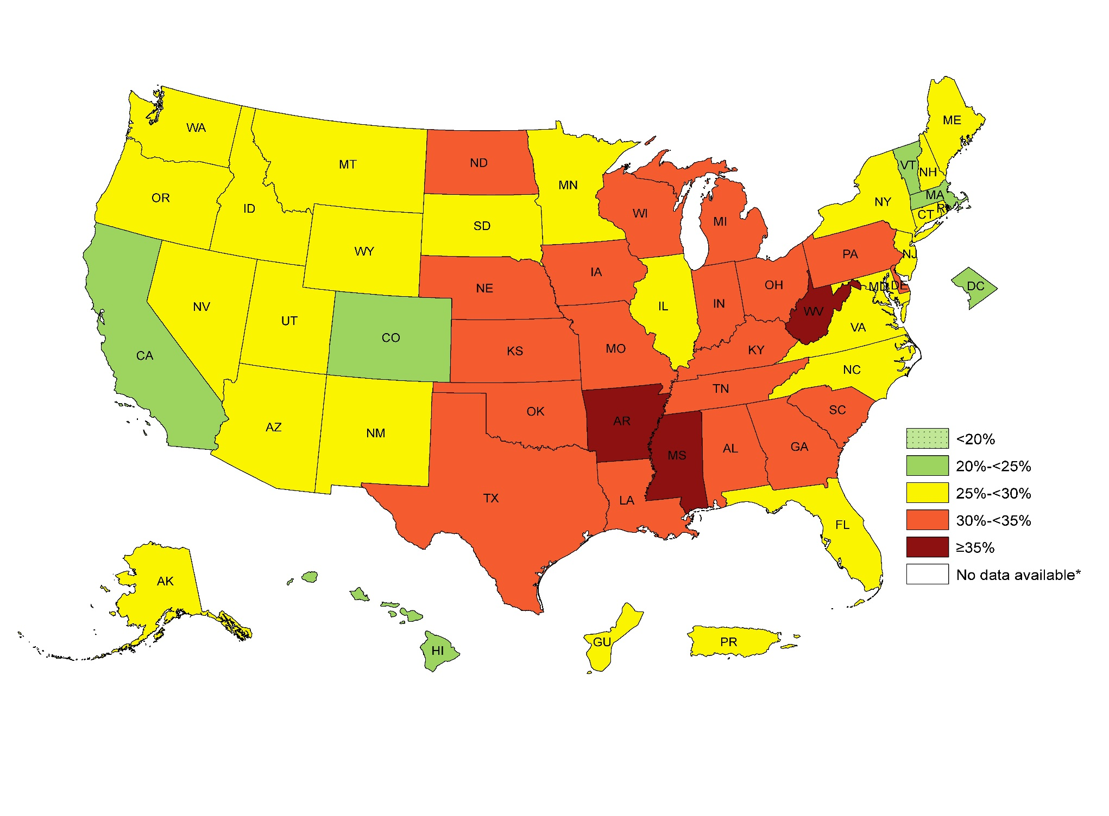
Obesity Trends Among U.S. Adults, 2014
¶ Prevalence estimates reflect BRFSS methodological changes started in 2011. These estimates should not be compared to prevalence estimates before 2011.
Source: Behavioral Risk Factor Surveillance System, Centers for Disease Control and Prevention
Notes:
2011 and forward data can not be combined with 2010 & earlier due to changes in BRFSS sampling & methodology
-they also decided to change the colors on the map (to remind us to not combine with 2010 & earlier data
Summary
No state had a prevalence of obesity less than 20%.
5 states and the District of Columbia had a prevalence of obesity between 20% and <25%.
23 states, Puerto Rico, and Guam had a prevalence of obesity between 25% and <30%.
19 states had a prevalence of obesity between 30% and <35%.
3 states (Arkansas, Mississippi and West Virginia) had a prevalence of obesity of 35% or greater.

Slide 39
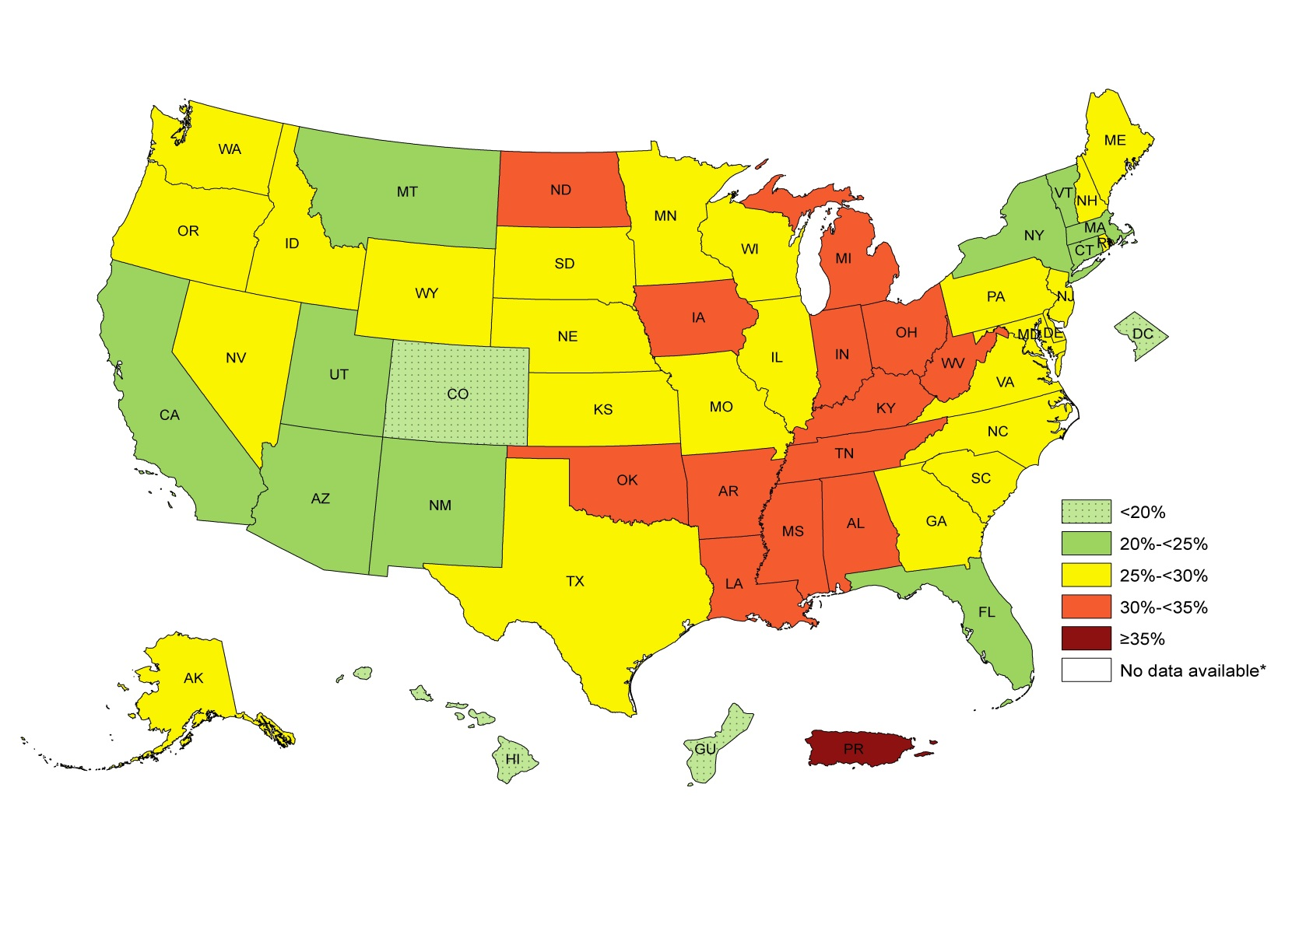
Obesity Trends Among US White (Non-Hispanic Adults), 2012-14
VA = 26%
95% CI = (25.2, 26.9)
¶ Prevalence estimates reflect BRFSS methodological changes started in 2011. These estimates should not be compared to prevalence estimates before 2011.
Source: Behavioral Risk Factor Surveillance System, Centers for Disease Control and Prevention
Notes:
Summary
2 states (Colorado and Hawaii) and the District of
Columbia and Guam had a prevalence of obesity less than 20%.
10 states had a prevalence of obesity between 20% and <25%.
25 states had a prevalence of obesity between 25% and <30%.
13 states had a prevalence of obesity between 30% and <35%.
Puerto Rico had a prevalence of obesity of 35% or greater.

Slide 40
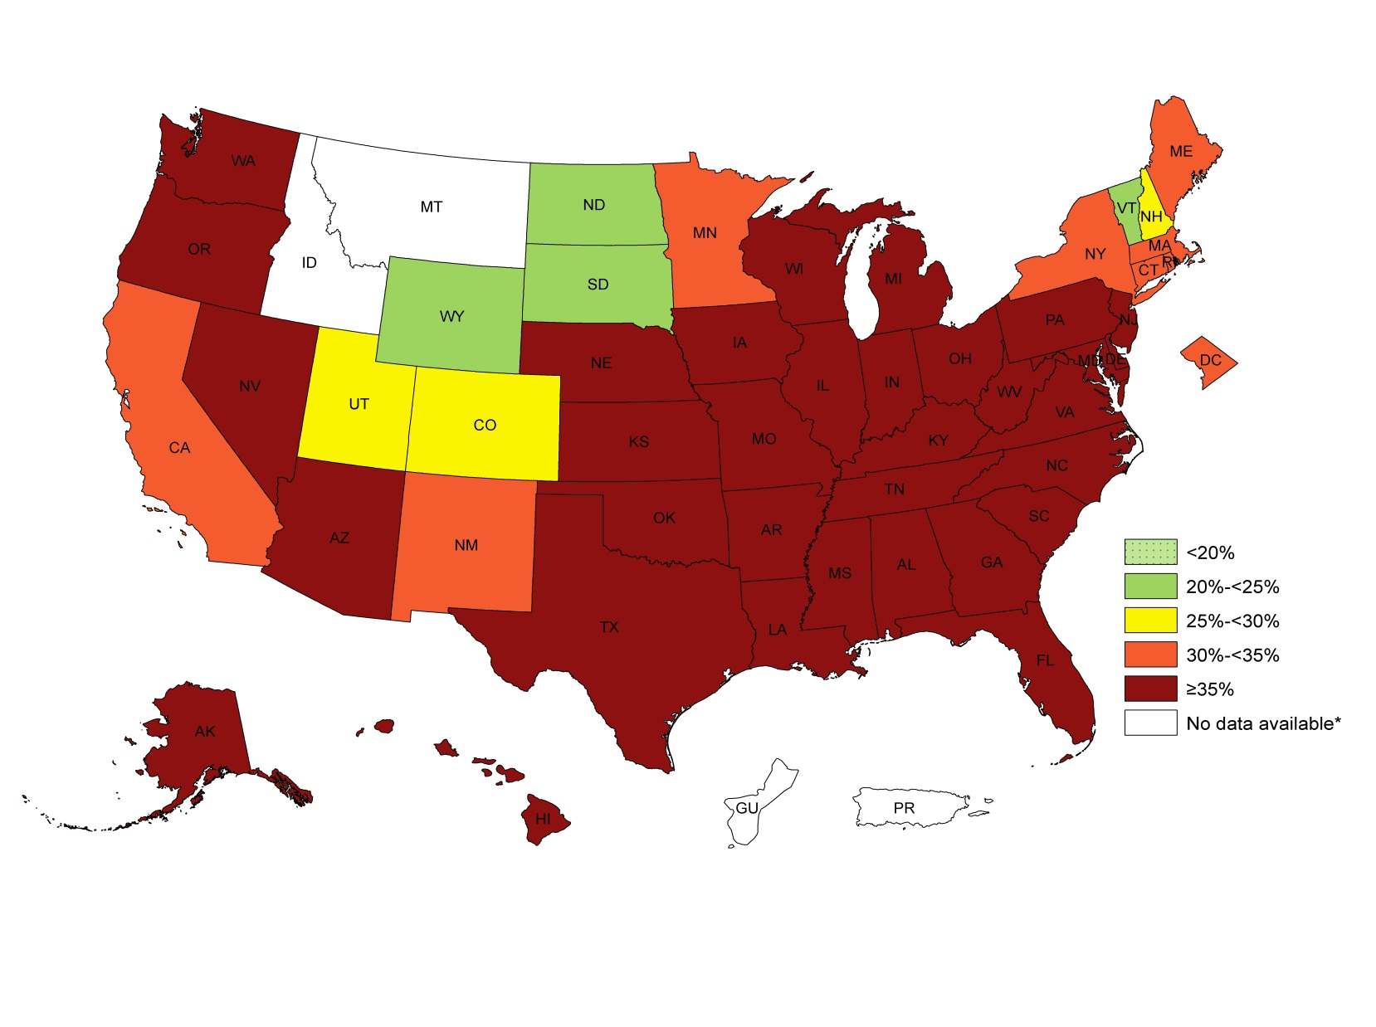
Obesity Trends Among U.S. Black (NH) Adults, 2012-14
VA = 39%
95% CI = (36.8, 41.0)
¶ Prevalence estimates reflect BRFSS methodological changes started in 2011. These estimates should not be compared to prevalence estimates before 2011.
Source: Behavioral Risk Factor Surveillance System, Centers for Disease Control and Prevention
Notes:
Summary
No state had a prevalence of obesity less than 20%.
4 states had a prevalence of obesity between 20% and <25%.
3 states had a prevalence of obesity between 25% and <30%.
8 states and the District of Columbia had a prevalence of obesity between 30% and <35%.
33 states had a prevalence of obesity of 35% or greater.

Slide 41
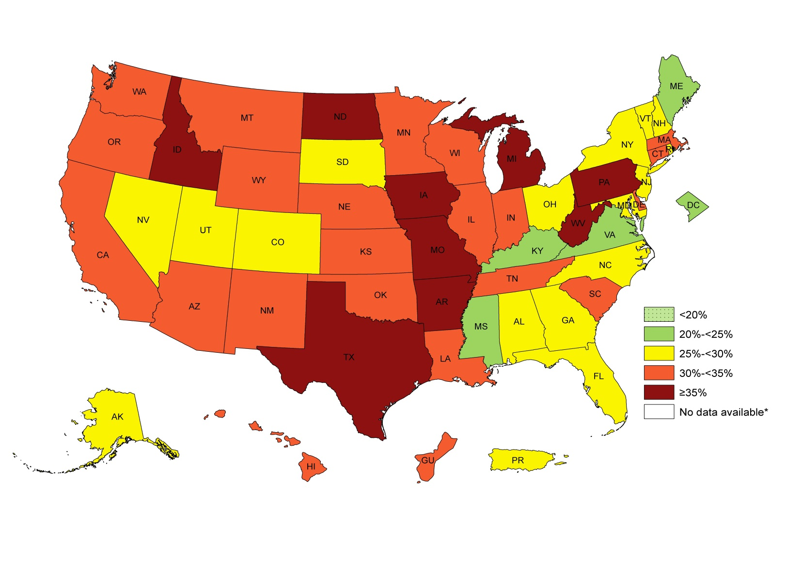
Obesity Trends Among U.S. Hispanic Adults,
2012-14
VA = 25%
95% CI = (21.2, 28.2)
¶ Prevalence estimates reflect BRFSS methodological changes started in 2011. These estimates should not be compared to prevalence estimates before 2011.
Source: Behavioral Risk Factor Surveillance System, Centers for Disease Control and Prevention
Notes:
Summary
No state had a prevalence of obesity less than 20%.
4 states and the District of Columbia had a prevalence of obesity between 20% and <25%.
16 states and Puerto Rico had a prevalence of obesity between 25% and <30%.
21 states and Guam had a prevalence of obesity between 30% and <35%.
9 states had a prevalence of obesity of 35% or greater.

Slide 42
Percentage of Adults Who are Obese, 3 Year Rolling Averages, 2000-13
Source: Virginia Department of Health. Behavioral Risk Factor Surveillance Survey

Slide 43
Albemarle & Charlottesville Fifth Grade Students Who are Overweight or Obese, 2004-2014
Source: Charlottesville and Albemarle Public School Systems, 2015.

Slide 44
Leading Causes of Death

Slide 45
Leading Causes in Virginia
Source: Virginia Department of Health, Division of Health Statistics
Notes:
Septicemia = serious life threatening infection that is often fatal (the infection in blood can lead to organ damage, septic shock, then death) (from WebMD)

Slide 46
Leading Causes of Death-TJHD
Source: Virginia Department of Health, Division of Health Statistics
Notes:
*Note: Diabetes Mellitus is #11 for TJHD with rate of 11.0 per 100,000 population

Slide 47
Hypertension & Heart Disease

Slide 48
Adults with Hypertension
Source: Community Commons Community Health Needs Assessment Report for TJHD Localities-Health Outcomes. Centers for Disease Control and Prevention (CDC), Behavioral Risk Factor Surveillance Survey (BRFSS). Additional data analysis by CARES. 2006-2012. Source geography: County

Slide 49
Hypertension-Older Adults (Adults aged 65+ years)
Sources: Community Commons Community Health Needs Assessment Report for TJHD Localities-Health Outcomes. Centers for Medicare and Medicaid Services. 2012. Source geography: County
Notes:
Note

Slide 50
Adults with Heart Disease
Source: Community Commons Community Health Needs Assessment Report for TJHD Localities-Health Outcomes. Centers for Disease Control and Prevention (CDC), Behavioral Risk Factor Surveillance Survey (BRFSS). Additional data analysis by CARES. 2011-2012. Source geography: County.

Slide 51
Heart Disease-Older Adults (Adults Age 65+ years)
Source: Community Commons Community Health Needs Assessment Report for TJHD Localities-Health Outcomes. Centers for Medicare and Medicaid Services. 2012. Source geography: County

Slide 52
Heart Disease Deaths
Source: Virginia Department of Health, Division of Health Statistics

Slide 53
Heart Disease Deaths
Source: Virginia Department of Health, Division of Health Statistics

Slide 54
Heart Disease Deaths by Race
Source: Virginia Department of Health, Division of Health Statistics for years 2000-2010. Centers for Disease Control and Prevention, National Center for Health Statistics. CDC Online WONDER database for years 2011-13.

Slide 55
Stroke (Cerebrovascular Disease)

Slide 56
Source: Virginia Department of Health, Division of Health Statistics
Notes:
Last 10 years.
Charlottesville has a higer poverty perencage than all other locales.

Slide 57
Stroke-Related Deaths by Race
Source: Virginia Department of Health, Division of Health Statistics for years 2000-2010. Centers for Disease Control and Prevention, National Center for Health Statistics. CDC Online WONDER database for years 2011-13.

Slide 58
Diabetes

Slide 59
Source: Community Commons Community Health Needs Assessment Report for TJHD Localities-Health Outcomes. Centers for Disease Control and Prevention (CDC), National Center for Chronic Disease Prevention and Health. 2012. Source geography: County.
Notes:
Last 10 years.
Charlottesville has a higer poverty perencage than all other locales.

Slide 60
Diabetes in Older Adults (Age 65+ Years)
Source: Community Commons Community Health Needs Assessment Report for TJHD Localities-Health Outcomes. Centers for Medicare and Medicaid Services. 2012. Source geography: County.
Notes:
Last 10 years.
Charlottesville has a higer poverty perencage than all other locales.

Slide 61
Diabetes-Related Deaths
Source: Virginia Department of Health, Division of Health Statistics
Notes:
Last 10 years.
Charlottesville has a higer poverty perencage than all other locales.

Slide 62
Diabetes-Related Deaths by Race
Source: Virginia Department of Health, Division of Health Statistics for years 2000-2010. Centers for Disease Control and Prevention, National Center for Health Statistics. CDC Online WONDER database for years 2011-13.

Slide 63
Chronic Lower Respiratory Diseases (COPD & Asthma)

Slide 64
Chronic Obstructive Pulmonary Disease -Deaths
Source: Virginia Department of Health. Division of Health Statistics.

Slide 65
Asthma
Source: Community Commons Community Health Needs Assessment Report for TJHD Localities-Health Outcomes. Centers for Disease Control and Prevention (CDC), Behavioral Risk Factor Surveillance Survey (BRFSS). Additional data analysis by CARES. 2011-2012. Source geography: County.

Slide 66
COPD + Asthma Deaths
Source: Virginia Department of Health, Division of Health Statistics for years 2000-2010. Centers for Disease Control and Prevention, National Center for Health Statistics. CDC Online WONDER database for years 2011-13.

Slide 67
Communicable Diseases

Slide 68
New HIV Infections by Race
Source: Virginia Department of Health. Office of Epidemiology. Tables of Selected Reportable Diseases in Virginia by Year of Report. Table 4 for each year.

Slide 69
Lyme Disease Infections
Source: Virginia Department of Health. Office of Epidemiology. Reportable Disease Surveillance in Virginia Annual Reports.

Slide 70
Unintentional Injuries

Slide 71
Unintentional Injury Hospitalizations
Source: Virginia Department of Health Online Injury Reporting System

Slide 72
Unintentional Injury Deaths
Source: Virginia Department of Health. Division of Health Statistics

Slide 73
Unintentional Injury Deaths by Race
Source: Virginia Department of Health, Division of Health Statistics for years 2000-2012. Centers for Disease Control and Prevention, National Center for Health Statistics. CDC Online WONDER database for years 2013.

Slide 74
Unintentional Injuries: Falls
Source: Virginia Department of Health Online Injury Reporting System

Slide 75
Unintentional Injuries: Motor Vehicle Crashes
Source: Virginia Department of Motor Vehicles

Slide 76
Unintentional Injuries: Motor Vehicle Crashes
Source: Virginia Department of Motor Vehicles

Slide 77
Percent of Motor Vehicle Crashes That
Were Alcohol-Related, 3 Year Rolling Averages, 2000 – 14
Source: Virginia Department of Motor Vehicles
Notes:
Alcohol-related crash = Crash where a driver, bicyclist or pedestrian is listed on the police report as drinking before the crash. BAC data (0.01 or greater) is used in addition to police reports to determine alcohol-related status

Slide 78
Percent of Motor Vehicle Crash Fatalities
That Were Alcohol-Related, 3 Year Rolling Averages, 2000-2014
Source: Virginia Department of Motor Vehicles
Notes:
Alcohol-related fatality = Person who dies within 30 days as a result of a traffic crash involving alcohol

Slide 79
Teen Pregnancy: Ages 15-17 Years
Source: Virginia Department of Health. Division of Health Statistics

Slide 80
Maternal & Child Health

Slide 81
Infant Mortality by Race
Source: Virginia Department of Health. Division of Health Statistics

Slide 82
Low Birth Weight by Race
Source: Virginia Department of Health. Division of Health Statistics

Slide 83
Pregnant Women with Prenatal Care
Source: Virginia Department of Health. Division of Health Statistics

Slide 84
Mental Health

Slide 85
Mental Health Diagnoses
Source: Region 10

Slide 86
Adolescent Mental Health-Suicide Attempts in High School Students (Grades 9-12) by Gender, 2011-13
Source: Centers for Disease Control & Prevention (CDC). Youth Risk Behavior Survey (YRBS)

