Slide 1
Improving Community Health through Planning and Partnerships
Planning District 10/Thomas Jefferson Health District
Leadership Council
3-16-2016
Notes:
Improving Community Health

Slide 2
Things to keep in mind…
Ask questions as we go along
We are presenting the most recent data we have
(From the past 4 – 5 years)

Slide 3
Today’s Plan:
Section 1
Demographics
Socioeconomic
Section 2
Environmental Health
Community Resources
Community Safety

Slide 4
Section One: Who are we and what do we bring to the table?
1.1 Demographic Indicators
1.2 Socioeconomic Indicators
1.3 Health Resource Availability

Slide 5
Demographics

Slide 6
Percent Change in Population, 2010-14
TJHD
234,712 in 2010
TJHD
244,403 in 2014
Source: US Census Bureau

Slide 7
TJHD Population by Race, 2014
Source: US Census Bureau
Notes:
American Indian and Alaska native less than 1%

Slide 8
Population with Disabilities, Adults (2013) & Children (School Year 2013-14)
TJHD
(3.7%)
VA
(4.4%)
Children (7.6%)
Children (7.7%)
Sources: Social Security Administration (All Ages, 2013) and the Virginia Department of Education Special Education Child Count Reports (Children, 2014-15 School Year)
Notes:
Note

Slide 9
Population Served by Region 10 CSB, FY 2015
Source: Region 10 FY 2015 Report

Slide 10
School Readiness, School Years 2010-11 to 2014-15
Source: Kids Count
Notes:
Percent of Kindergarteners not ready to enter Kindergarten according to the Pals-K score.
Nelson and Charlottesville, Greene, percentage above the HP 2020 and VA Plan for Well-Being Goals.

Slide 11
Socioeconomics

Slide 12
Source: US Census Bureau Small Area Income and Poverty Estimates: SAIPE Interactive Data Tool
Notes:
Last 10 years.
Charlottesville has a higer poverty perencage than all other locales.

Slide 13
Self-Sufficiency (Orange Dot) Year
To be added once we get the students results from the other localities
Source:

Slide 14
Median Household Income, 2010-14
Source: US Census Bureau. Small Area Income and Poverty Estimates: SAIPE Interactive Data Tool

Slide 15
Health Resource Availability

Slide 17
Source: US County Health Rankings

Slide 18
Source: Community Commons Community Health Needs Assessment-Clinical Care report for TJHD Localities. Centers for Disease Control & Prevention, Behavioral Risk Factor Surveillance System (BRFSS). Additional Data Analysis by CARES. 2011-12 Source geography: County
Notes:
Self reported data –
Cville, Greene, Louisa, TJ all are above the HP and VA PLAN goals.

Slide 19
Source: Community Commons Community Health Needs Assessment-Clinical Care report for TJHD Localities. Centers for Disease Control & Prevention, Behavioral Risk Factor Surveillance System (BRFSS). Additional Data Analysis by CARES. 2006-10 Source geography: County

Slide 20
Percent of Adults with no Health Insurance, 2005-13
Source: US Census Bureau. Small Area Health Insurance Estimates

Slide 21
Percent of Children with No Health Insurance, 2006-13
Source: US Census Bureau. Small Area Health Insurance Estimates

Slide 22
Percent of Children with No Health Insurance, 2006-13
Source: US Census Bureau. Small Area Health Insurance Estimates

Slide 23
Percent Children Ages 0-17 Years, Enrolled in Medicaid, FY 2015
Source: Virginia Department of Social Services. Local DSS FY 2015 Profile

Slide 24
Percent Adults Ages 18-64 Years Enrolled in Medicaid by Age Group, FY 2015
Source: Virginia Department of Social Services. Local DSS FY 2015 Profile

Slide 25
Percent Adults Aged 65+ Years Enrolled in Medicaid, FY 2015
Source: Virginia Department of Social Services. Local DSS FY 2015 Profile

Slide 26
Section Two: Strengths and Risks in Our Community
Community Resources
Community Safety
Environmental Health Indicators

Slide 27
Percent Vacant Housing Units, TJHD, 2009-13
Source: Community Commons Community Health Needs Assessment Report-Physical Environment for TJHD localities. US Census Bureau, American Community Survey, 2009-13. Source geography: Tract
Notes:
A housing unit is considered vacant by the American Community Survey if no one is living in it at the time of interview. Units occupied at the time of interview entirely by persons who are staying two months or less and who have a more permanent residence elsewhere are considered to be temporarily occupied, and are classified as “vacant.”

Slide 28
Rate per 10,000 HUD Assisted Housing Units, 2013
Source: Community Commons Community Health Needs Assessment Report-Physical Environment for TJHD localities. US Department of Housing and Urban Development. 2013. Source geography: County
Notes:
Define HUD - Dept of Housing and Urban Development

Slide 29
Homelessness in TJHD, 2015
Homeless Persons in 2015
185
70%
Had at least 1 trip to the emergency room
Of homeless females experienced domestic violence
58%
Source: Thomas Jefferson Area Coalition for the Homeless and FCG Consulting. 2015 Point in Time Comprehensive Survey Analysis

Slide 30
Homelessness in TJHD By Age Group, 2015
Source: Thomas Jefferson Area Coalition for the Homeless and FCG Consulting. 2015 Point in Time Comprehensive Survey Analysis

Slide 31
Length of Time Experiencing Homelessness, 2015
Source: Thomas Jefferson Area Coalition for the Homeless and FCG Consulting. 2015 Point in Time Comprehensive Survey Analysis

Slide 32
TJHD Food Stores by Type per 1,000 Population, 2007-12
Source: US Department of Agriculture (USDA) Food Environment Atlas

Slide 33
SNAP and WIC Authorized Stores per 1,000 Population in TJHD, 2008-12
Source: US Department of Agriculture (USDA) Food Environment Atlas

Slide 34
Low Access
Number of people in a county living more than:
1 mile from a supermarket, supercenter or large grocery store if in an urban area,
or more than 10 miles from a supermarket or large grocery store if in a rural area.
Source: US Department of Agriculture (USDA) Food Environment Atlas

Slide 35
Population with Low Access to Store, 2010
No
Data
Source: US Department of Agriculture (USDA) Food Environment Atlas
Notes:
Define low access

Slide 36
Food Insecurity, 2012 & 2013
Source: County Health Rankings
Notes:
Food insecurity estimates the percentage of the population who did not have access to a reliable source of food during the past year.
A 2-stage fixed effect model was created using information from the Community Population Survey, Bureau of Labor Statistics, and American Community Survey.

Slide 37
Food Environment Index, 2012 & 2013
Source: County Health Rankings
Notes:
The Food Environment Index ranges from 0 (worst) to 10 (best) and equally weights two indicators of the food environment.
Limited access to healthy foods estimates the percentage of the population who are low income and do not live close to a grocery store.
Living close to a grocery store is defined differently in rural and nonrural areas; in rural areas, it means living less than 10 miles from a grocery store whereas in nonrural areas, it means less than 1 mile.
Low income is defined as having an annual family income of less than or equal to 200 percent of the federal poverty threshold for the family size.
Food insecurity estimates the percentage of the population who did not have access to a reliable source of food during the past year.
A 2-stage fixed effect model was created using information from the Community Population Survey, Bureau of Labor Statistics, and American Community Survey.

Slide 38
Community Resources

Slide 39
Child Care
There is more available child care for children under 5 years than 0-12 year old children in licensed day care centers and licensed home day cares.
Sources: Virginia Department of Social Services and U.S. Census Bureau

Slide 40
Percent of Population with Adequate Access to Locations for Physical Activity, 2013-14
Source: County Health Rankings
Notes:
What is adequate access

Slide 41
JAUNT, Number of Passengers by Type of Ride, FY 2010-15
Source: JAUNT Ridership Reports

Slide 42
Community Safety

Slide 43
Reported Crime Incidents per 100,000 Population, TJHD, 2000-14
Source: Department of State Police. Virginia Uniform Crime Reporting Program. Crime in Virginia
Notes:
Overall, it looks like reported crime incidence decreased over the last 10 years.

Slide 44
DUI Arrests per 100,000 Population, 2004-14
Source: Department of State Police. Virginia Uniform Crime Reporting Program. Crime in Virginia

Slide 45
DUI Arrests per 100,000 Population, 2004-14
Source: Department of State Police. Virginia Uniform Crime Reporting Program. Crime in Virginia
Notes:
2004-2006 thru 12-14

Slide 46
Drug / Narcotic Arrests per 100,000 Population, 2004-14
Source: Department of State Police. Virginia Uniform Crime Reporting Program. Crime in Virginia

Slide 47
Drug / Narcotic Arrests per 100,000 Population, 2004-14
Source: Department of State Police. Virginia Uniform Crime Reporting Program. Crime in Virginia

Slide 48
School Violence, Incidence by Type per 1,000 Students, 2008-12
Source: Virginia Department of Education. School Climate Reports

Slide 49
2016 County Health Rankings Just Released Today
Albemarle ranks as one of the 5 healthiest localities in VA (#4) in health outcomes
The rankings align with VA’s Plan for Well-Being
At TJHD we have been strategically working to improve health through coalitions and health education outreach programs
Notes:
Health Outcomes overall rankings:
Charlottesville = 55th
Fluvanna = 29th
Greene = 31st
Louisa = 50th
Nelson = 75th
Health Factors Overall rankings:
Albemarle = 10th
Charlottesville =47th
Fluvanna = 23rd
Greene = 34th
Louisa = 63rd
Nelson = 53rd

Slide 50
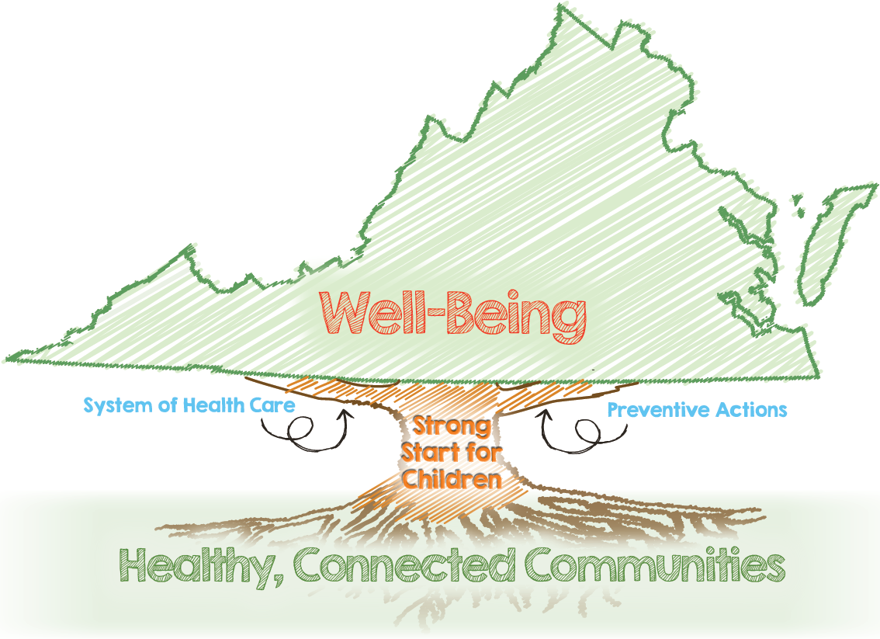

Slide 51
Metrics
Percent of Adults Who Report Positive Well-Being
HEALTHY, CONNECTED COMMUNITIES H.S. Grads Enrolled in Higher Ed Cost-Burdened Households Consumer Opportunity Index Economic Opportunity Index Districts with Collaborative Improvement Processes PREVENTIVE ACTIONS Adults Not Participating In Physical Activity Adults Who Are Overweight or Obese Households That Are Food Insecure Adults Using Tobacco Adults Vaccinated Against Influenza Adolescents Vaccinated Against HPV Adults Screened for Colorectal Cancer Percent of Adults With Adverse Childhood Experiences Disability-free Life Expectancy | STRONG START FOR CHILDREN Teen Pregnancy Rate Kindergarteners Not Meeting PALS-K Benchmark Third Graders Passing Reading SOL Infant Mortality Rate by Race SYSTEMS OF HEALTH CARE Adults With A Regular Health-care Provider Avoidable Cardiovascular Disease Deaths Mental Health and Substance Abuse Hospitalizations Avoidable Hospital Stays Adults Whose Poor Health Kept Them from Usual Activities Providers With Electronic Health Records Health Districts With EHRs Entities Connected to the Health Information Exchange Hospitals Meeting State Goal for Prevention of C. difficile Infections

Slide 52
Isolated Health Improvement Activities
Aligned Efforts and Resources

Slide 53
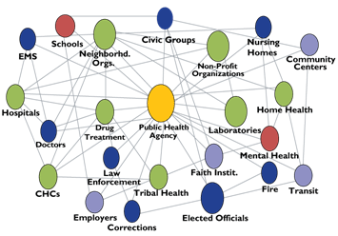

Slide 54
Strategies
Establish collaborative health assessment and strategic health improvement planning processes throughout the Commonwealth that include public health, health care systems, and community partners
Align health system community benefit programs with community health improvement plans
Enhance data systems and public health information technology to collect, manage, track, analyze, and report state and county-level data for use in health assessments

Slide 55
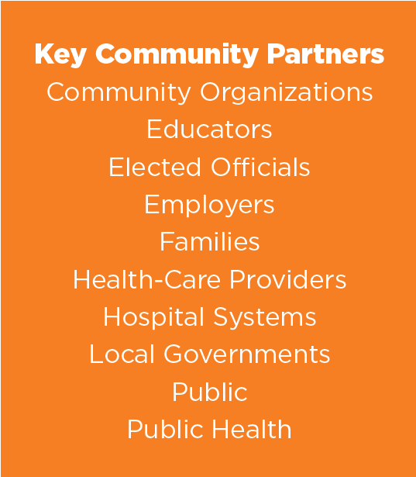

Slide 56
Questions ?
Contact Info:
Elizabeth Beasley, MPH
Elizabeth.Beasley@vdh.virginia.gov

