Slide 1
Implementing a community health assessment via MAPP
The Community Drives the Process…
Elizabeth D. Beasley, MPH
Sr. Health Promotions Consultant

Slide 2

Brainstorming Activity
What do the following words mean to you?
Community
Public Health
Local Health Department

Slide 3


What is MAPP?
Mobilizing for Action Through Planning & Partnerships

Slide 4

A strategic approach to…
Community Health Improvement
Notes:
Community ownership is the fundamental component of MAPP. The community’s strengths, needs, and desires drive the process.

Slide 5
MAPP OVERVIEW
Notes:
There are four assessments within the MAPP framework.
Once the assessments are complete, issues are identified, and goals and strategies are developed.
The last step is implementation.
Since 2012, we have been implementing MAPP2Health, the district-wide community health improvement plan, which prioritized addressing obesity, access to mental health services, pregnancy outcomes, and tobacco use above the HP 2020 goal.

Slide 6
Organize for Success/Partnership Development
Two interrelated activities occur during this phase:
  Organize for Success – Undertake MAPP
  Partnership Development – Identify and recruit participants for a MAPP committee
Notes:
Success – Determine the necessity of understanding the MAPP Process – gain a clear understanding of why such a process is needed.
Helps focus planning efforts and assists in the recruitement and sustained involvment of participants
Participants should consider the benefits they hope to gain from the process
Why do you think it’s important to conduct community health assessments?
Six Steps!
1. Identify and Organize participants –
2. Design the planning process - What will the process entail? How long will it take? What results are we seeking? Who will do the work?
3. Develop a timeline and workplan that meets the community’s needs.
4. Assess resource needs and secure commitment. – Aside from staff time and energy, meeting space, refreshments, report production and printing, costs associated with info. gathering and data collection. ID resources and sources for meeting those needs. Consider whether in-kind donations are possible.
5. Conduct a readiness assessment – The information collected in the previous four steps should provide a clear picture
6. Manage the process – the final step in organizing the MAPP process is to consider how the process will be managed as it moves forward.

Slide 7

Visioning
Notes:
Phase II:
Guides the community through a collaborative and creative process that leads to a shared community vision and common values.
Vision and values statements provide focus, purpose, and direction to the MAPP process so that participants collectively achieve a shared vision of the future.
Done at the beginning of the MAPP to provide a useful mechanism for convening the community and building enthusiasm for the process, setting the stage for planning, and providing a common framework throughout subsequent phases.
On November 30th, we will hold a vision reception for the third MAPP kickoff. We hope that at least one of you will represent the Nelson IAC.

Slide 8
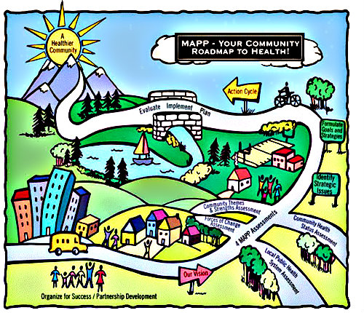

Slide 9
Mobilizing for Action through Planning and Partnerships (MAPP)
In 2007-08, TJHD completed an assessment/strategic planning process called MAPP
Limited to Charlottesville-Albemarle
Involved four assessments
Looks at the entire LPHS,
not just the health
department

Slide 10
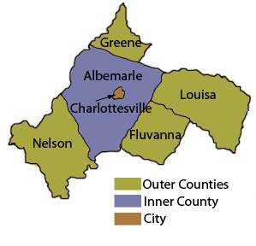
TJHD is part of the Local Public Health System (LPHS)
Schools
Civic Groups
Nursing Homes
EMS
Neighborhd.
Orgs.
Community Centers
Non-Profit
Organizations
Hospitals
Home Health
Drug Treatment
Laboratories
Doctors
Mental Health
Law Enforcement
Faith Instit.
CHCs
Health
Fire
Transit
Chamber of Comm.
Elected Officials
Corrections

Slide 11
Community Health Improvement Process
Community Health Assessment:
  Process to systematically collect and analyze qualitative and quantitative data from a variety of sources within a specific community.
  Engages with community members and Local Public Health System partners

Slide 12
Community Health Improvement Process
Community Health Improvement Plan:
  Action-oriented plan
  Details how community health priorities (based on Community Health Assessment findings and community/LPHS input) will be addressed

Slide 13

VA Planning District 10:
Thomas Jefferson Health District
Community Health Improvement Plan
Mobilizing for Action through Planning and Partnerships

Slide 14
Locality CHA Councils
Review, discuss and determine need for additional quantitative and qualitative data
Prioritize health issues
Albemarle
Charlottesville
Fluvanna
Greene
Louisa
Nelson
Local government/schools
Community agencies
Local health care providers
TJHD CHIP Committee
Decide health questions for PD 10 phone survey
Conduct Forces of Change assessment
Complete Community Health Improvement Plan for PD 10
Two reps per CHA locality council
District-wide agencies serving PD10
Notes:
CHA
Meet with locality groups within PD 10 for buy-in
Collect, present, discuss and get feedback regarding local data for each locality
Create written Community Health Profile(s)
Have locality groups prioritize local health issues and conduct Forces of Change assessment
CHIP
Funnel data/priorities to district-wide group
Develop district-wide, action-oriented CHIP using evidence-based strategies

Slide 15
TJHD Community Health Improvement Draft Process Timeline
 | Sept '15 | Oct '15 | Nov '15 | Dec '15 | Jan '16 | Feb '16 | Mar '16 | Apr '16 | May '16 | June '16 | July '16 | Aug '16 | Sept '16 | Oct '16 | Nov '16 | Dec '16
Hold NACCHO MAPP training
Hold initial locality council meetings
Continue locality CHA meetings
Collect/present quantitative data
Plan for qualitative research
Conduct qualitative research
Determine health priorities
Write community profile(s)
Hold TJHD CHIP meetings
Complete CHIP
Disseminate profile and CHIP
Notes:
Mobilizing for Action through Planning and Partnerships (MAPP) is a community-driven strategic planning process for improving community health. Facilitated by public health leaders, this framework helps communities apply strategic thinking to prioritize public health issues and identify resources to address them. MAPP is not an agency-focused assessment process; rather, it is an interactive process that can improve the efficiency, effectiveness, and ultimately the performance of local public health systems.

Slide 16
Next Steps
What additional partner organizations should be invited to participate?
Attend 6-8 meetings to review community health assessment data
Appoint two Nelson IAC representatives to join MAPP Leadership Council
Recommend priorities to MAPP Leadership Council
Begin data review in January
Notes:
So, who is missing at the table? Who else should we invite?
If you can’t make it (if you miss a meeting), is there someone from your organization who can attend in your place?

