Slide 1
Improving Community Health through Planning and Partnerships
Charlottesville-Albemarle
Community Health Assessment Council
Notes:
Improving Community Health

Slide 2
Today
Brief Data Review
CTSA Survey Results
Selecting priorities

Slide 3
Topics that Stood Out:
Socioeconomics: poverty in Charlottesville & how college students impact poverty in Charlottesville
Healthcare access indicators
Housing & Homelessness
Alcohol related MV crashes / fatalities
Depression-in youth and the gender difference
911 calls and mental health issues (frequent callers having mental health not medical issues )
Chicken pox / vaccine preventable disease rates higher in Charlottesville & Albemarle compared to VA
HIV incidence-racial disparity
Cancer disparities
Heroin/opioid use
PQI rates higher in Charlottesville than Albemarle
HIV incidence-racial disparity
Cancer disparities
Heroin/Opioid Use
PQI Rates higher in Charlottesville than Albemarle
Diabetes ACS rate in Charlottesville

Slide 4
Socioeconomics- Poverty in Charlottesville and how students impact poverty in Charlottesville

Slide 5
Healthcare access indicators

Slide 6
Housing & Homelessness

Slide 7
Median Year Housing Units Were Built
Albemarle
1988
Charlottesville 1966
Percent of Housing Units Built in Each Time Period,
before 1960-after 2010
Source: Community Commons Community Health Assessment Indicators Report: Physical Environment

Slide 8
HUD-Assisted Housing Units,
Rate per 10,000 Housing Units, 2013
Albemarle
(160)
Charlottesville (881)
Source: Community Commons Community Health Assessment Indicators Report: Physical Environment
Notes:
Note: percentages do not add up to 100% b/c there are vacant housing units (so owner-occ. + renter-occ. + vacant = 100%)

Slide 9
Substandard Housing Units,
Percent Occupied Housing Units with One or More Substandard Conditions, 2009-13
Albemarle
(30%)
Charlottesville (39%)
Source: Community Commons Community Health Assessment Indicators Report: Physical Environment
Notes:
Number and percentage of owner- and renter-occupied housing units having at least one of the following conditions:
lacking complete plumbing facilities,
2) lacking complete kitchen facilities,
3) with 1.01 or more occupants per room,
4) selected monthly owner costs as a percentage of household income greater than 30 percent, and
5) gross rent as a percentage of household income greater than 30 percent.

Slide 10
Albemarle & Charlottesville National Citizen Survey Results
(Reports the percent rating each positively (good/often, etc.)
Sources: Albemarle County. City of Charlottesville. National Research Center, Inc., International City/County Management Association. The National Citizen Surveys for Charlottesville and Albemarle, 2011-15

Slide 11
Homelessness in TJHD, 2004-15
Source: Thomas Jefferson Area Coalition for the Homeless (TJACH)
Notes:
TJAC is doing a survey of homelessness near end of January 2016-check with them near end of Feb/beginning of March for results

Slide 12
Homelessness in TJHD, 2015
Source: Thomas Jefferson Area Coalition for the Homeless (TJACH)

Slide 13
Homelessness in TJHD, 2015
Source: Thomas Jefferson Area Coalition for the Homeless (TJACH)

Slide 14
Alcohol-related car crashes & fatalities

Slide 15
Percent of Motor Vehicle Crashes that were Alcohol-Related by Place of Occurrence, 3 Year Averages, 2000-13
Source: Virginia Department of Motor Vehicles-Virginia Crash Facts

Slide 16
Percent of Motor Vehicle Fatalities that were Alcohol-Related by Place of Occurrence, 3 Year Averages, 2000-13
Source: Virginia Department of Motor Vehicles-Virginia Crash Facts

Slide 17
Depression- In youth and the gender difference

Slide 18
Adolescent Mental Health- in High School Students (Grades 9-12) Feeling Sad or Hopeless, 2011-13
Source: Centers for Disease Control & Prevention (CDC). Youth Risk Behavior Survey (YRBS)

Slide 19
Adolescent Mental Health-Depression in High School Students (Grades 9-12) Feeling Sad or Hopeless by Gender, 2011-13
Source: Centers for Disease Control & Prevention (CDC). Youth Risk Behavior Survey (YRBS)

Slide 20
Chicken pox / vaccine preventable disease rates higher in Charlottesville & Albemarle compared to VA

Slide 21
Vaccine Preventable Infectious Diseases
Source: Virginia Department of Health. Office of Epidemiology. Reportable Disease Surveillance in Virginia Annual Reports.

Slide 22
HIV incidence-racial disparity

Slide 23
HIV by Race
Source: Virginia Department of Health. Office of Epidemiology. Tables of Selected Reportable Diseases in Virginia by Year of Report. Table 4 for each year.

Slide 24
HIV by Race
Source: Virginia Department of Health. Office of Epidemiology. Tables of Selected Reportable Diseases in Virginia by Year of Report. Table 4 for each year.

Slide 25
Cancer Disparities

Slide 26
Breast Cancer Incidence by Race
Sources: Virginia Department of Health. Virginia Cancer Registry. University of Virginia, Department of Public Health Sciences.

Slide 27
Prostate Cancer Incidence by Race
Sources: Virginia Department of Health. Virginia Cancer Registry. University of Virginia, Department of Public Health Sciences.

Slide 28
Lung Cancer Incidence by Race
Sources: Virginia Department of Health. Virginia Cancer Registry. University of Virginia, Department of Public Health Sciences.

Slide 29
Cervical Cancer Incidence
Sources: Virginia Department of Health. Virginia Cancer Registry. University of Virginia, Department of Public Health Sciences.

Slide 30
Skin Cancer (Melanoma) Incidence
Data suppressed
Sources: Virginia Department of Health. Virginia Cancer Registry. University of Virginia, Department of Public Health Sciences.

Slide 31
Cancer-Related Deaths by Race
Source: Virginia Department of Health, Division of Health Statistics for years 2000-2010. Centers for Disease Control and Prevention, National Center for Health Statistics. CDC Online WONDER database for years 2011-13.
Notes:
The prevalence by county was estimated using data from CDC's Behavioral Risk Factor Surveillance System (BRFSS) and data from the U.S. Census Bureau’s Population Estimates Program.¹

Slide 32
Heroin / Opioid Use

Slide 33
Slide from CMHWC Presentation

Slide 34
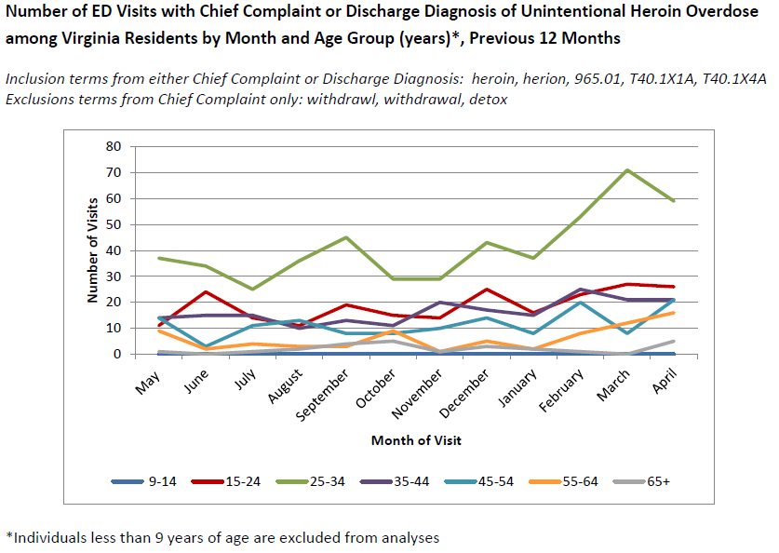
Source: Virginia Department of Health, Division of Surveillance and Investigation, Enhanced Surveillance Monthly Report

Slide 35
Source: Virginia Department of Health, Division of Surveillance and Investigation, Enhanced Surveillance Monthly Report

Slide 36
Slide from CMHWC Presentation on 5-26-16

Slide 37
Prescription Drug Misuse is Prevalent
1 in 6
High School youth in Region 10
reported
taking prescription drugs without a doctor’s prescription
Slide from CMHWC Presentation on 5-26-16
Source: VACSB Atlas, 2014 Youth BRFSS

Slide 38
PQI Rates- Higher in Charlottesville than Albemarle

Slide 39
Prevention Quality Indicator (PQI) Hospital Discharges
Source: Virginia Atlas of Community Health. Behavioral Health Hospital Discharge Profile (January 1-December 21, 2012). Accessed at www.AtlasVA.org.
Notes:
The PQI definitions are detailed in their specification of ICD-9 diagnosis codes and procedure codes. Not every hospital admission for congestive heart failure, bacterial pneumonia, etc. is included in the PQI definition; only those meeting the detailed specifications. Low birth weight is one of the PQI indicators, but for the purpose of this report, low birth weight is included in the Maternal and Infant Health Profile. Also, there are four diabetes-related PQI indicators which have been combined into one for the report. For more information, visit the AHRQ website at www.qualityindicators.ahrq.gov/pqi_overview.htm
Source for AHRQ PQI National Benchmarks: US Dept of Health and Human Services. Agency for Healthcare Research and Quality (AHRQ). Prevention Quality Indicators v5.0 Benchmark Data Tables. March 2015.
http://www.qualityindicators.ahrq.gov/Modules/PQI_TechSpec.aspx

Slide 40
Diabetes ACS Rate in Charlottesville

Slide 41
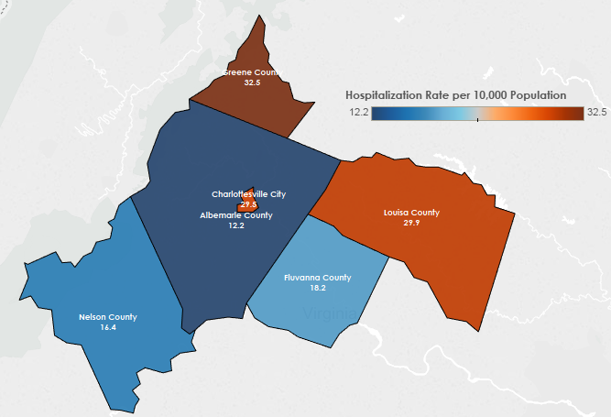
ACS Hospitalizations Diabetes (Type 2) Hospitalization Rate per 10,000 Population, 2013
Source: Virginia Department of Health, Division of Population Health.

Slide 42
Questions ?
Contact Info:
Jillian Regan, MPH
Jillian.Regan@vdh.virginia.gov

