Slide 1
Improving Community Health through Planning and Partnerships
Albemarle and Charlottesville
Community Health Council
Notes:
Improving Community Health

Slide 2
Things to keep in mind…
Feel free to ask questions as we go along
We are presenting the most recent data we have
(From the past 4 – 5 years)
This is Section 2 data
In the next section in March we will cover:
Section 3: What is our Health Status?

Slide 3
Today we will discuss:
Section 1 Updates
Section 2
Community Resources
Transportation
Child Care
Access to Exercise Opportunities
Community Safety
Crime
Domestic Violence
Environmental Health Indicators
Air quality
Watershed water quality
Food safety
Lead
Housing & Homelessness
Rabies

Slide 4
Updates for Section 1 Data

Slide 5
U.S. Census Data
College students are counted where they live while they go to college
2 month rule
Counted where living / plan to live for at least 2 consecutive months of the year
Children attending boarding school or summer camps are counted at their parents residence
For more details on survey methods for Census & American Community Survey:
http://census.gov/programs-surveys/acs/methodology.html

Slide 6
Adult Literacy Adults served by Literacy Volunteers of Charlottesville & Albemarle , State FY 2015
361
(0.2% of population)
Adults served in
Charlottesville & Albemarle
48% were Hispanic / Latino(a)
More females (62%) than males (38%)
Most had less than a 12th grade education (55%)
Source: Literacy Volunteers of Charlottesville and Albemarle: Who We Served in 2014-15 Infographic

Slide 7
Poverty & Self Sufficiency Cost Analysis of Living and Working in Charlottesville, 2013
 | Single Householder + 2 Kids (1 Toddler)
 | Annual
Costs of Survival
Food | $ 5,831.28
Clothing | $ 1,056.11
Shelter | $11,124.00
Utilities | $ 2,645.22
Necessary Costs | $ 4,131.32
Total Survival Income | $24,787.94
Costs of Working
Transportation | $ 240.00
Childcare | $ 9,936.00
Total Working Income | $34,963.94
Source: Greater Charlottesville Area Development Corporation / Charlottesville Works Initiative. Orange Dot 2.0 Report. Published 9-29-2015

Slide 8
Poverty & Self Sufficiency Percent of families that do not earn enough income to be self-sufficient, 2013
Albemarle (16%)
Charlottesville
(25%)
Source: Greater Charlottesville Area Development Corporation / Charlottesville Works Initiative. Orange Dot 2.0 Report. Published 9-29-2015
Notes:
In Charlottesville in 2010 it was 20%
(The 2011 report did not include Albemarle)

Slide 9
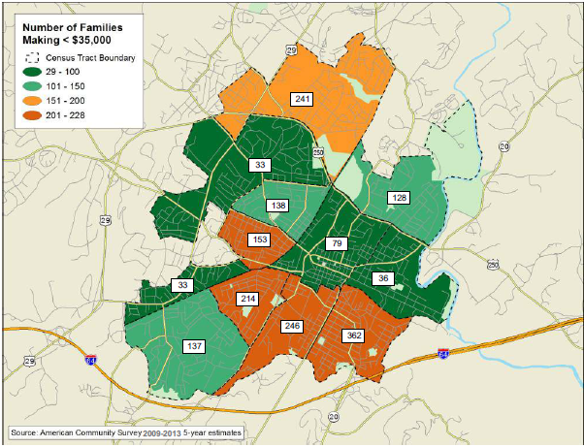
Poverty Orange Dot Project/Charlottesville Works Initiative, Charlottesville, 2012
Source: Greater Charlottesville Area Development Corporation / Charlottesville Works Initiative. Orange Dot 2.0 Report. Published 9-29-2015

Slide 10
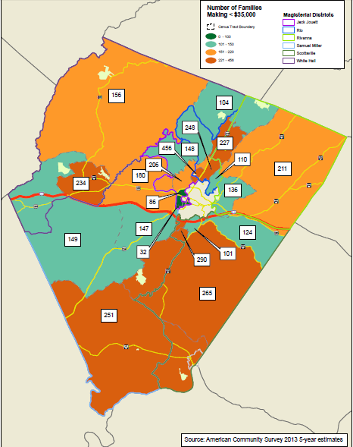
Poverty Orange Dot Project/Charlottesville Works Initiative, Albemarle, 2013
Source: Greater Charlottesville Area Development Corporation / Charlottesville Works Initiative. Orange Dot 2.0 Report. Published 9-29-2015

Slide 11
Medicaid Enrollment Percent of Population Enrolled, State FY 2015
Source: DSS. Local DSS FY 2015 Profile

Slide 12
Section Two: Strengths and Risks in Our Community
Community Resources
Community Safety
Environmental Health Indicators
Behavioral Risk Factors

Slide 13
Community Resources

Slide 14
Public Transportation by the Numbers
127,083
JAUNT Riders in Albemarle in FY 14
103,821
JAUNT Riders
in Charlottesville in FY 14
11
Bus routes Charlottesville Area Transit (CAT)
14
Vehicles operated by
Greene County Transit on demand-response basis
9
Bus routes
UVA’s University Transit Service (UTS)
Sources: CAT, UTS, JAUNT, & Greene County Transit
Notes:
CAT has 11 bus routes serving Charlottesville and parts of Albemarle County
UVA’s UTS has 9 bus routes serving the university and areas of Charlottesville and Albemarle surrounding the university
Greene County Transit serves Greene County residents, bringing them to Albemarle and Charlottesville if that is their destination and operates 14 vehicles and works on a demand-response system

Slide 15
Transportation-RideShare 2016
11
Rideshare Park & Ride lots in Albemarle
1
Rideshare Park & Ride lot in Charlottesville

Slide 16
JAUNT Riders Albemarle & Charlottesville, FY 2008-14
Source: Jaunt Ridership Reports

Slide 17
JAUNT Riders by Type TJHD, FY 2008-14
Source: Jaunt Ridership Reports

Slide 18
Percent of Workers Driving Alone to Work 5-Year Averages, 2005-13
Source: U.S. County Health Rankings
Notes:
US County Health Rankings got this data from ACS 5-Year Estimates
Why this is a health factor: The transportation choices that communities and individuals make have important impacts on health through active living, air quality, and traffic crashes.

Slide 19
Percent of Workers Who Drive Alone to Work Who Have a Long Commute ( > or = 30 minutes) 5-Year Averages, 2008-13
Source: U.S. County Health Rankings
Notes:
US County Health Rankings got this data from ACS 5-Year Estimates
Why this is a health factor: The transportation choices that communities and individuals make have important impacts on health through active living, air quality, and traffic crashes.

Slide 20
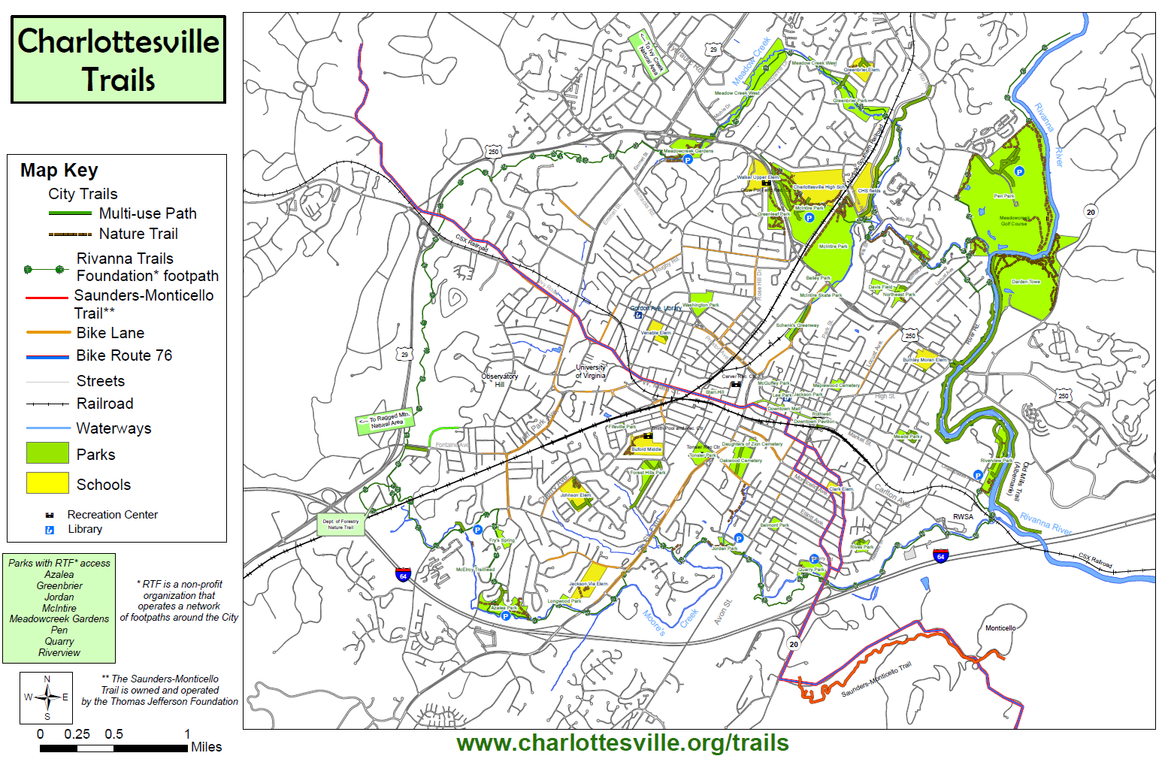
Map of Bike and Pedestrian Trails, Paths, & Bike Lanes in Charlottesville, 2013
Source: City of Charlottesville, Parks and Recreation

Slide 21
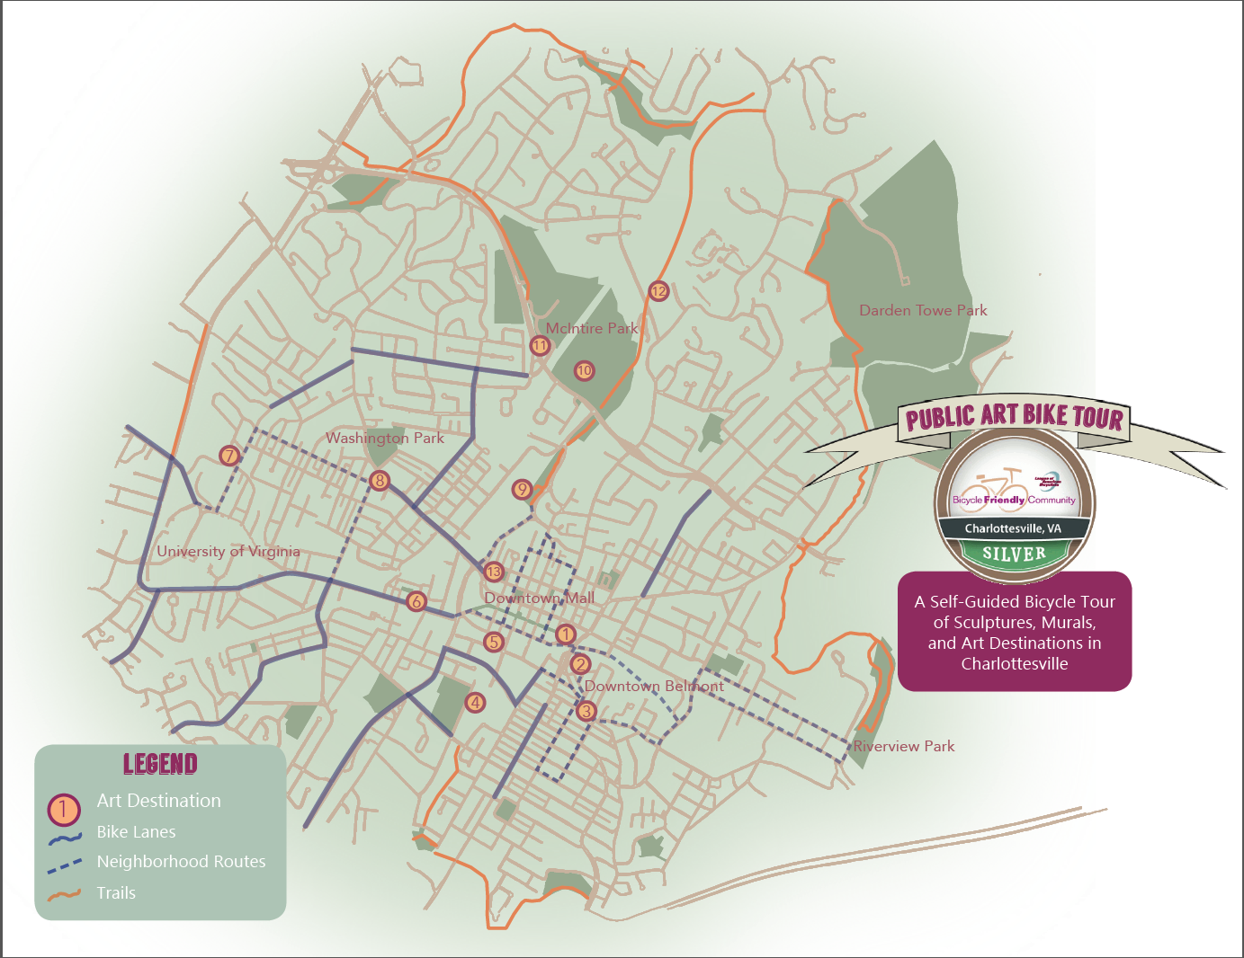
Map of Self-Guided Public Art Bike Tour in Charlottesville, 2013
Source: City of Charlottesville

Slide 22
Child Care Albemarle and Charlottesville, 2012-14
19,988
Population Aged 0-12 Years in 2014
Sources: Virginia Department of Social Services and U.S. Census Bureau

Slide 23
Percent of Population with Adequate Access to Exercise Opportunities, 1 Year Average, 2012-13
Source: U.S. County Health Rankings
Notes:
Population considered to have adequate access to opportunities for physical activity are those who:
Reside in a census block within a half mile of a park or
in urban areas: reside within one mile of a recreational facility
in rural areas: reside within three miles of a recreational facility
Where & How County Health Rankings Gets This Data from:
OneSource Global Business Browser, Delorme map data, ESRI, & US Census Tigerline Files
These data files are combined in ArcGIS to create the measure.
The OneSource Global Business Browser, for a fee, provides access to robust, integrated business intelligence, including corporate families, industries, key executives and financial data.
The DeLorme Map Mart and ESRI public use GIS data provide geocoded, projected data on parks at the local, state and national level across the US.
US Census Tigerline files are spatial extracts from the Census Bureau's MAF/TIGER database, containing features such as roads, railroads, rivers, as well as legal and statistical geographic areas.

Slide 24
Percent of Population Living within ½ mile of a park, 2010
Albemarle (12%)
Charlottesville
(72%)
Source: CDC. National Environmental Public Health Tracking Network
Notes:
Having access to places for physical activity, like parks, encourages people to get active and do so more often. The closer you live to a park, the more likely you are to walk or bike there. Walking and biking to parks can decrease air pollution and car crashes, which in turn, can reduce chronic disease rates and traffic-related injuries.

Slide 25
Community Safety

Slide 26
Reported Crime Incidents Per 100,000 Population, 2000-10
Source: Crime in Virginia, Virginia Uniform Crime Reporting Program, Department of State Police

Slide 27
Child Abuse & Neglect (Founded Reports), Rates Per 1,000 Children, 5 Year Averages, 2000-13
Source: Virginia Department of Social Services
Notes:
Founded means that “a review of the facts shows by a preponderance of the evidence that child abuse and/or neglect has occurred.” (Department of Social Services)
“Abuse and Neglect” includes:
Medical neglect
Mental abuse/neglect
Physical abuse
Physical neglect
Sexual abuse
Substance exposed infants
Failure to thrive
Invalid

Slide 28
Adult Abuse & Neglect (Founded Reports), Rates Per 1,000 Adults, 3 Year Averages, 2006-13
Source: Virginia Department of Social Services. Adult Services Program Report
Notes:
Founded means that “a review of the facts shows by a preponderance of the evidence that child abuse and/or neglect has occurred.” (Department of Social Services)
“Abuse and Neglect” includes:
Medical neglect
Mental abuse/neglect
Physical abuse
Physical neglect
Sexual abuse
Substance exposed infants
Failure to thrive
Invalid

Slide 29
Violence in Schools Rates per 1,000 Students, 4-Year Averages, 2007-12
Source: Virginia Department of Education. School Climate Reports
Notes:
An incident is an event that may involve one or more offenses. An incident also may involve one or more students and may result in one or more disciplinary outcomes. An offense is the problem behavior exhibited by the student(s). Nearly 130 offense codes are used to report different behaviors. Each offense has a unique code and a specific definition.
The process of collecting and reporting DCV data begins within individual schools when incidents occur that violate the local code of student conduct. It is the responsibility of the school administrator to determine the appropriate offense code to be reported, based on the offense definition. Information is recorded about the incident, the student offenders, and the disciplinary outcomes. The school division is responsible for reporting DCV data to the VDOE. School divisions choose to submit DCV data using one of two available methods: (1) submission of a tab delimited electronic file, or (2) use of a Web-based data submission application. School divisions using the first method collect and maintain discipline data in their own information systems and upload an electronic file to the VDOE. School divisions using the second method may enter school division and school level data manually and directly into the VDOE database using the Web-based data collection application. A school division may select and use only one of the two methods available for data submission.
Altercations: Confrontation, tussle, or verbal/physical aggression that does not result in injury
Battery against a Student without a weapon: an actual offensive and intentional touching or striking of a student against his or her will, or mutual participation in a fight that intentionally causes bodily harm without the use of a firearm or weapon
Bullying: Using repeated negative behaviors intended to frighten or cause harm. These may include, but are not limited to, verbal or written threats or physical harm
Drug Violations: Includes: Schedule I & II, Anabolic Steroid, Marijuana Use/Possession (Violation of laws or ordinances prohibiting the manufacture, transportation, possession or consumption of marijuana, schedule I & II drugs, and anabolic Steroid-Use. Suspicion of being under the influence of marijuana may be included), Look-alikes Use/Possession (Unlawfully using, cultivating, manufacturing, purchasing, possessing, transporting, or importing any substances represented as drug look-alikes), Inhalants (Unlawfully using, cultivating, manufacturing, purchasing, possessing, transporting, or importing any inhalants), Prescription Theft/Attempted Theft (Unlawfully possessing or attempting to take possession of drugs prescribed for another), Schedule I & II, Anabolic Steroid, Marijuana Sale/Distribution (Unlawfully possessing with the intent to distribute, sell or solicit any Schedule I or II drug, marijuana or anabolic steroid), Schedule III-IV Use/Possession/Sale/Distribution/Paraphernalia Possession (Unlawfully using or possessing with the intent to distribute, sell or solicit any controlled drug or narcotic substance not specified in previous drug categories. Having equipment (paraphernalia) for use in consuming illegal drugs in one’s pocket, bag, car or locker
Fighting Without Injury: Mutual participation in a fight involving physical violence, where there are no or minor injuries. These may include, but not be limited to, the following: scrape on the body (e.g., knee, elbow, hand) or minor bruising
Gang Activity: Street gang means any ongoing organization, association, or group of three or more persons, whether formal or informal, that has as one of its primary objectives or activities to commit one or more criminal or non-criminal gang activities. This includes articles of clothing that symbolize association, rituals or activities identified by groups of students.
Harassment: Repeatedly annoying or attacking a student or a group of students or other personnel which creates an intimidating or hostile educational or work environment
Offensive Sexual Touching/All: Improper physical contact against a staff/student that is offensive, undesirable and/or unwanted as determined by the victim
Other Weapons, and Explosive Devices: Includes: Weapon 3 (Expels a Projectile – Possessing or bringing to school or a school-sponsored event any weapon designed to expel a projectile or that may readily be converted or modified manufactured guns to expel a projectile by the action of an explosive device), Weapon 4 (Knife – Possessing or bringing to school or a school-sponsored event any sharp-edged instrument that is classified as a knife with a blade of three-inches or more), Weapon 5 (Other Firearms - Possessing or bringing any other weapon that will, is designed to, expel a projectile by the action of an explosive to school or a school event. This includes firearms not mentioned in other categories (operable or inoperable, loaded or unloaded) such as, but not limited to a zip or starter gun), Weapon 6 (Other Weapon – Possessing or bringing any weapon, instrument, or object that is designed to or may readily be converted to inflict harm on another person to school or a school event – i.e. golf club, baseball bat, chains, nunchakus, or Billy club), Pneumatic weapon (Possessing or bringing any pneumatic gun or rifle that is air powered to school or a school event. A pneumatic gun or rifle includes a BB, paint ball or pellet gun), Explosive Device (Possessing or representing any weapon that explodes or is designed to or may readily be converted to explode)
Threat: Unlawfully placing a staff member/student in fear of bodily harm through physical, verbal, written or electronic threats without displaying a weapon or subjecting the person to actual physical attack. Considers age, developmentally appropriate behavior and disability status before use
Vandalism: Willfully and/or maliciously destroying, damaging or defacing public or private property without the consent of the owner or the person having custody or control of it. This category includes graffiti.

Slide 30
Domestic Violence Arrest Rate per 1,000 Population 2000-2010
Source: CCF-Stepping Stones Report
Notes:
(the 2012 stepping stones report is most recent available & the most recent data it has is 2010)

Slide 31
Family and Intimate Partner Homicide Rate per 100,000 Population, 7-Year Rolling Averages, 1999-2013
Source: Office of the Chief Medical Examiner. Family & Intimate Partner Homicide in VA's Cities & Counties, 1999-2013

Slide 32
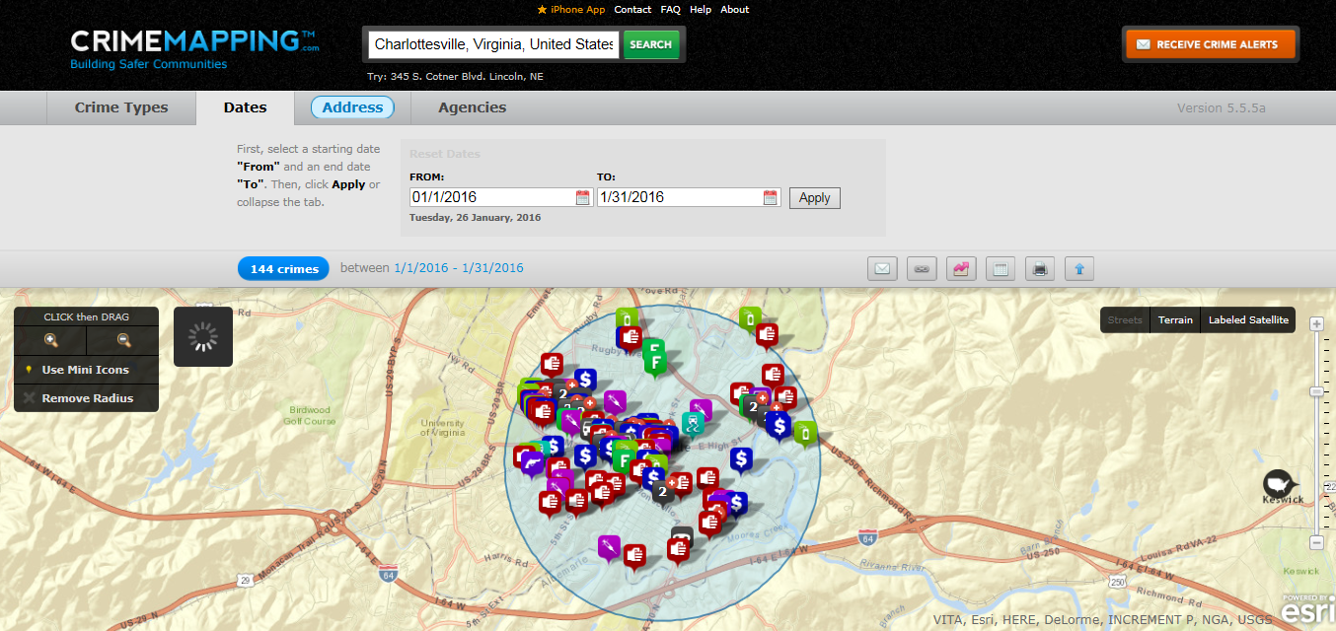
Interactive crime map available, http://www.charlottesville.org/departments-and-services/departments-h-z/police-department/crime-statistics
Source: City Of Charlottesville / Charlottesville Police Department.
Notes:
Go to the link and click on Crime Mapping

Slide 33
Environmental Health Indicators

Slide 34
Air Quality, Air Quality Ratings, Charlottesville, 2011-14
332 days ranked Good in 2014
32 days ranked Moderate in 2014
0 days ranked Unhealthy in 2014
Source: Environmental Protection Agency

Slide 35
Percent of Population Living within 150 Meters of a Highway, 2010
Albemarle (6%)
Charlottesville
(5%)
Note: 150 meters is approximately 2 blocks
Source: CDC. National Environmental Public Health Tracking Network
Notes:
Traffic-related air pollution is a major cause of unhealthy air quality, especially in urban areas. Many health problems have been linked to exposure to traffic-related air pollution. The closer your home or school is to a major highway, the more likely you and your family are to be exposed to traffic-related air pollution.

Slide 36
Percent of Public Elementary Schools within 150 meters of a highway, 2010
Albemarle (4%)
Charlottesville
(8%)
Note: 150 meters is approximately 2 blocks
Source: CDC. National Environmental Public Health Tracking Network
Notes:
Traffic-related air pollution is a major cause of unhealthy air quality, especially in urban areas. Many health problems have been linked to exposure to traffic-related air pollution. The closer your home or school is to a major highway, the more likely you and your family are to be exposed to traffic-related air pollution.

Slide 37
Air Quality, Number of Days with Ozone Levels Exceeding Standards, 2008
0.09
0.00
Air Quality, Number of Days with PM 2.5 Levels Exceeding Standards, 2008
0.9
1.0
Source: Community Commons Community Health Assessment Indicators Report: Physical Environment
Notes:
VA ozone # days exceed = 1.97
US ozone # days exceed = 1.59
VA PM2.5 # days exceed = 1.35
US PM2.5 # days exceed = 4.17

Slide 38
Watersheds In and around Albemarle & Charlottesville
Rapidan – Upper Rappahannock
South Fork Shenandoah
Rivanna
Pamunkey
Middle James - Buffalo
Albemarle County
Source: Environmental Protection Agency – EnviroMapper for Water

Slide 39
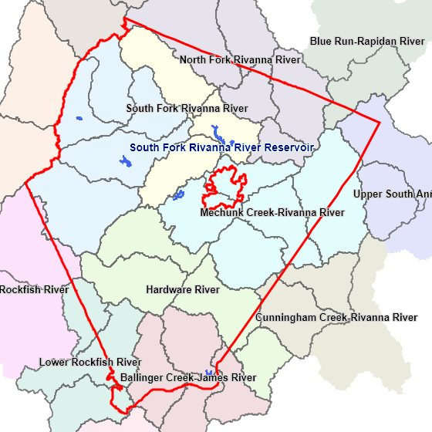
Watersheds & Reservoirs Albemarle & Charlottesville
Source: Albemarle County Service Authority
Notes:
Colors correspond to the watershed for the river listed
Reservoirs are shown in blue

Slide 40
Numbers of Good & Impaired Streams in Watersheds in TJHD, 2010
Source: Environmental Protection Agency

Slide 41
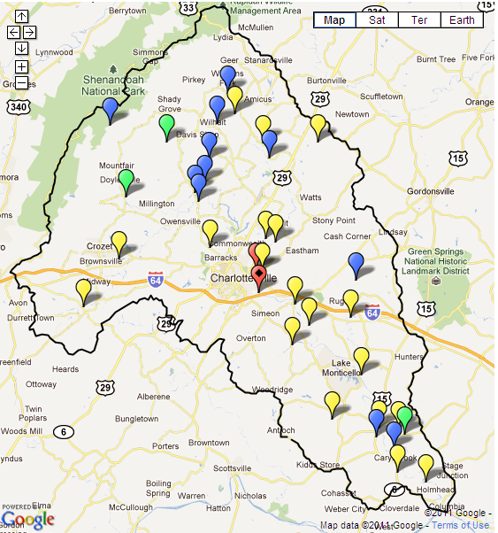
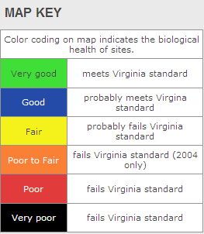
Rivanna Basin, Year
Source: StreamWatch

Slide 42
Water Quality in Public Water Systems, 2014
No water quality violations in 2014
In Albemarle or in Charlottesville
Sources: City of Charlottesville 2014 Water Quality Report & Albemarle County Service Authority
Notes:
Link to Cville’s reports http://www.charlottesville.org/home/showdocument?id=33231
Link to Albe reports http://www.serviceauthority.org/watersupply.html

Slide 43
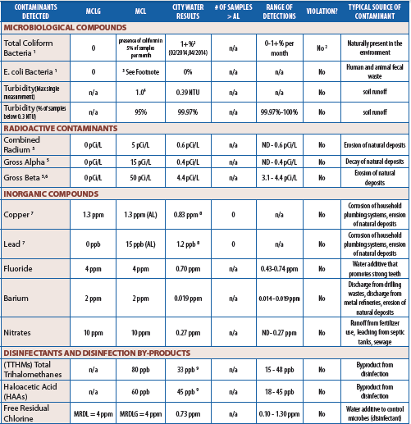
Water Quality in Public Water Systems, Charlottesville 2014
0 water quality violations in 2014
In Albemarle and Charlottesville
Sources: City of Charlottesville 2014 Water Quality Report
Notes:
Link to Cville’s reports http://www.charlottesville.org/home/showdocument?id=33231
Link to Albe reports http://www.serviceauthority.org/watersupply.html

Slide 44
Fluoridation in Public Water, Percent of population served by Fluoridated Public Water Systems 2015
Albemarle
71%
Charlottesville
Approximately 100%
Source: CDC. Division of Oral Health: My Water's Fluoride web application & U.S. Census Bureau
Notes:
CDC definition of a public water system: “A system that provides piped water to the public for human consumption and is regulated under the Safe Drinking Water Act.
Such a system must have at least 15 service connections or regularly serve at least 25 persons daily for at least 60 days per year.
Each public water system is further classified as either a community water system or a non-community water system”

Slide 45
Onsite Wells / Sewage

Slide 46
Food Safety
Any vendor who plans to serve food to the public is required to apply for a permit from the health department.
The health department follows regulations to reduce risks, starting with reviewing the permit application and the following areas:
Source: Virginia Department of Health
Notes:
Staff handwashing including:
approved water sources, waste water and sewage disposal, handwashing stations, use of proper utensils, dress standards, etc.
Equipment sanitation, cleaning, and storage
Safety including the facility, grills, overhead protection, keeping the public at a safe distance from food preparation, etc.
Checking the food source, cooking/reheating/keeping hot food hot, cooling/cold storage, ice storage, food transportation, thermometers, etc.

Slide 47
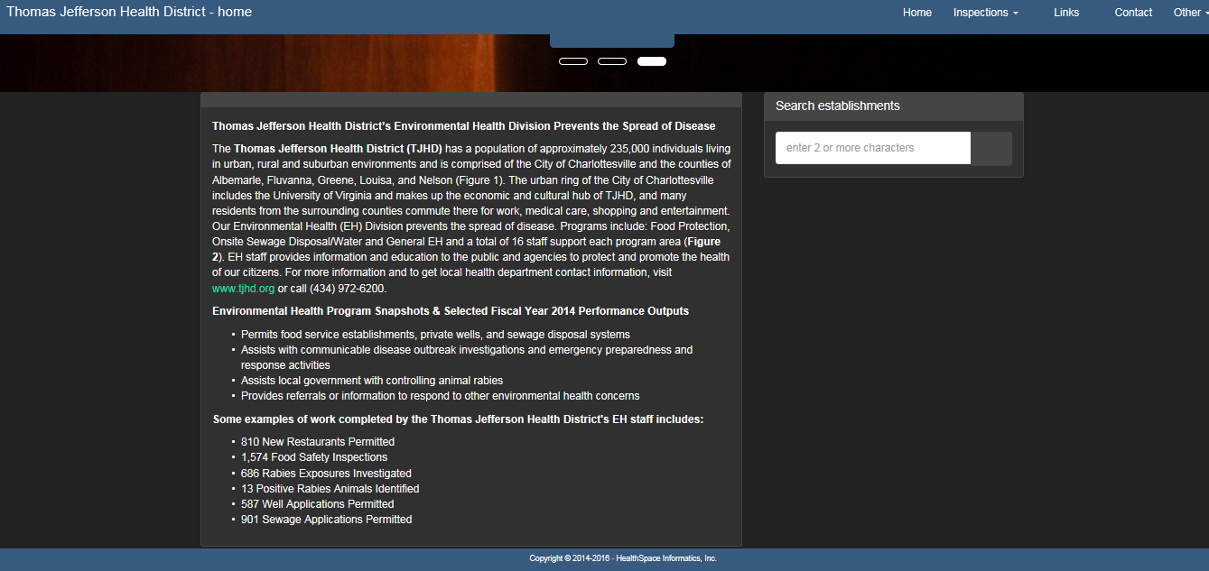
Food Safety-Restaurant Inspection Reports
Link: http://healthspace.com/Clients/VDH/TJefferson/web.nsf/home.xsp
Source: Virginia Department of Health

Slide 48
Food Safety
Source: Virginia Department of Health

Slide 49
Food Safety
Source: Virginia Department of Health

Slide 50
Food Environment Index
Albemarle
8.8
Charlottesville
7.1
Source: County Health Rankings
Notes:
The Food Environment Index ranges from 0 (worst) to 10 (best) and equally weights two indicators of the food environment.
Limited access to healthy foods estimates the percentage of the population who are low income and do not live close to a grocery store.
Living close to a grocery store is defined differently in rural and nonrural areas; in rural areas, it means living less than 10 miles from a grocery store whereas in nonrural areas, it means less than 1 mile.
Low income is defined as having an annual family income of less than or equal to 200 percent of the federal poverty threshold for the family size.
Food insecurity estimates the percentage of the population who did not have access to a reliable source of food during the past year.
A 2-stage fixed effect model was created using information from the Community Population Survey, Bureau of Labor Statistics, and American Community Survey.

Slide 51
Food Stores by Type, 2012
Source: US Department of Agriculture-Food Environment Atlas

Slide 52
Lead Exposure
Lead interferes with normal brain development and is associated with permanently reduced IQ, learning disabilities and behavioral disorders.
The primary source of lead exposure is dust from lead-based paint in homes built before 1978.
Local zip codes with >27% of housing built before 1950 and/or an increased prevalence of children with elevated blood lead levels are:
22903 | 22947 (Keswick)
22901 | 22959 (North Garden)
22931 (Covesville) | 22943 (Greenwood)
22937 (Esmont) | 24590 (Scottsville)
Source:
Notes:
VA = 42%
TJHD = 38%
General Program Requirements
In order to qualify for this benefit program, you must be a resident of the state of Virginia and a parent or primary caregiver responsible for a child(ren) who attends school (high school or under). Household Size*Maximum Income Level (Per Year) 1 $21,7752

Slide 53
Percent of Child Population under 72 months of age with Elevated Blood Lead Levels, 2008-13
Source: Virginia Department of Health, Lead Safe Virginia Program

Slide 54
Housing & Homelessness

Slide 55
Median Year Housing Units Were Built
Albemarle
1988
Charlottesville 1966
Percent of Housing Units Built in Each Time Period,
before 1960-after 2010
Source: Community Commons Community Health Assessment Indicators Report: Physical Environment

Slide 56
Owner-Occupied Housing Units, 2009-13
Albemarle
(59%)
Charlottesville (37%)
Renter-Occupied Housing Units, 2009-13
Albemarle
(30%)
Charlottesville (54%)
Source: Community Commons Community Health Assessment Indicators Report: Physical Environment
Notes:
Note: percentages do not add up to 100% b/c there are vacant housing units (so owner-occ. + renter-occ. + vacant = 100%)
Also %’s were rounded to nearest whole #

Slide 57
Vacant Housing Units, 2009-13
Albemarle
(11%)
Charlottesville (10%)
Source: Community Commons Community Health Assessment Indicators Report: Physical Environment
Notes:
Note: percentages do not add up to 100% b/c there are vacant housing units (so owner-occ. + renter-occ. + vacant = 100%)

Slide 58
HUD-Assisted Housing Units,
Rate per 10,000 Housing Units, 2013
Albemarle
(160)
Charlottesville (881)
Source: Community Commons Community Health Assessment Indicators Report: Physical Environment
Notes:
Note: percentages do not add up to 100% b/c there are vacant housing units (so owner-occ. + renter-occ. + vacant = 100%)

Slide 59
Substandard Housing Units,
Percent Occupied Housing Units with One or More Substandard Conditions, 2009-13
Albemarle
(30%)
Charlottesville (39%)
Source: Community Commons Community Health Assessment Indicators Report: Physical Environment
Notes:
Number and percentage of owner- and renter-occupied housing units having at least one of the following conditions:
lacking complete plumbing facilities,
2) lacking complete kitchen facilities,
3) with 1.01 or more occupants per room,
4) selected monthly owner costs as a percentage of household income greater than 30 percent, and
5) gross rent as a percentage of household income greater than 30 percent.

Slide 60
Homelessness in TJHD, 2004-12
Source: Thomas Jefferson Area Coalition for the Homeless (TJACH)
Notes:
TJAC is doing a survey of homelessness near end of January 2016-check with them near end of Feb/beginning of March for results

Slide 61
Homelessness in TJHD, 2012
Source: Thomas Jefferson Area Coalition for the Homeless (TJACH)
Notes:
TJAC is doing a survey of homelessness near end of January 2016-check with them near end of Feb/beginning of March for results

Slide 62
Homelessness in TJHD, 2012
Source: Thomas Jefferson Area Coalition for the Homeless (TJACH)
Notes:
TJAC is doing a survey of homelessness near end of January 2016-check with them near end of Feb/beginning of March for results

Slide 63
Rabies
What is it?
A viral disease that affects the nervous system of mammals
How could you catch it?
Through a bite
Or by getting saliva or brain tissue from an infected mammal in a wound / in the eye /mouth.
Source: Virginia Department of Health, Department of Environmental Epidemiology

Slide 64
Rabies
What you can do to help control Rabies:
Vaccinate pets and livestock.
If your pet is attacked or bitten by a wild animal, report it to the local health or animal control authorities.
Do not leave garbage or pet food outside. It may attract wild or stray animals.
Enjoy all wild animals from a distance, even if they seem friendly.
A rabid animal sometimes acts tame.
If you see an animal acting strangely, report it to your local animal control department and do not go near it yourself.
Source: Virginia Department of Health, Department of Environmental Epidemiology

Slide 65
Rabies
What to do if you get bitten by an animal:
Wash the wound thoroughly with soap and lots of water.
Give first aid as you would for any wound.
If possible, capture the animal under a large box or can, or at least identify it before it runs away.
Don't try to pick the animal up.
Call an animal control or law enforcement officer to come get it.
Notify your family doctor immediately and explain how you got the bite.
Your doctor will want to know if the animal has been captured.
If necessary, your doctor will give the anti-rabies treatment recommended by the United States Public Health Service.
Report the bite to the local health department.
Source: Virginia Department of Health, Department of Environmental Epidemiology

Slide 66
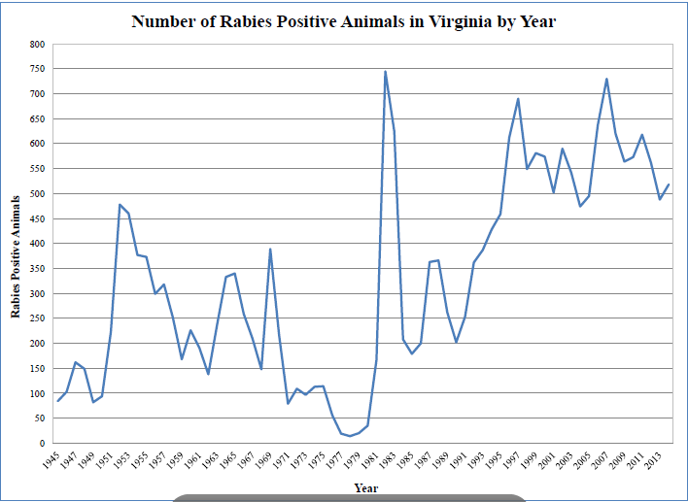
Rabies Positive Animals in VA, 1945-2013
Source: Virginia Department of Health, Department of Environmental Epidemiology

Slide 67
Rabies Positive Animals, 2010-15
Source: Virginia Department of Health, Department of Environmental Epidemiology

Slide 68
Type of Animal Positive for Rabies, 2015
Source: Virginia Department of Health, Department of Environmental Epidemiology

Slide 69
Rabies in Humans
Most recent case of rabies in a human in Virginia was in 2009 in Fairfax County.
It was fatal
Human contracted rabies from encounter with dog while traveling in India & did not receive PEP when returned to U.S.
For more information on this case:
http://www.cdc.gov/mmwr/preview/mmwrhtml/mm5938a3.htm?s_cid=mm5938a3_w
Source: Virginia Department of Health, Department of Environmental Epidemiology
Notes:
2003-human rabies case also in northern VA-first documented case of human rabies associated with a raccoon rabies virus variant in the United States
http://www.cdc.gov/mmwr/preview/mmwrhtml/mm5245a4.htm
1998-human rabies case in Richmond, VA-bat rabies
http://www.cdc.gov/mmwr/preview/mmwrhtml/00056456.htm

Slide 70
Questions ?
Contact Info:
Jillian Regan, MPH
Jillian.Regan@vdh.virginia.gov

