Slide 1

2019 MAPP2Health

Slide 2
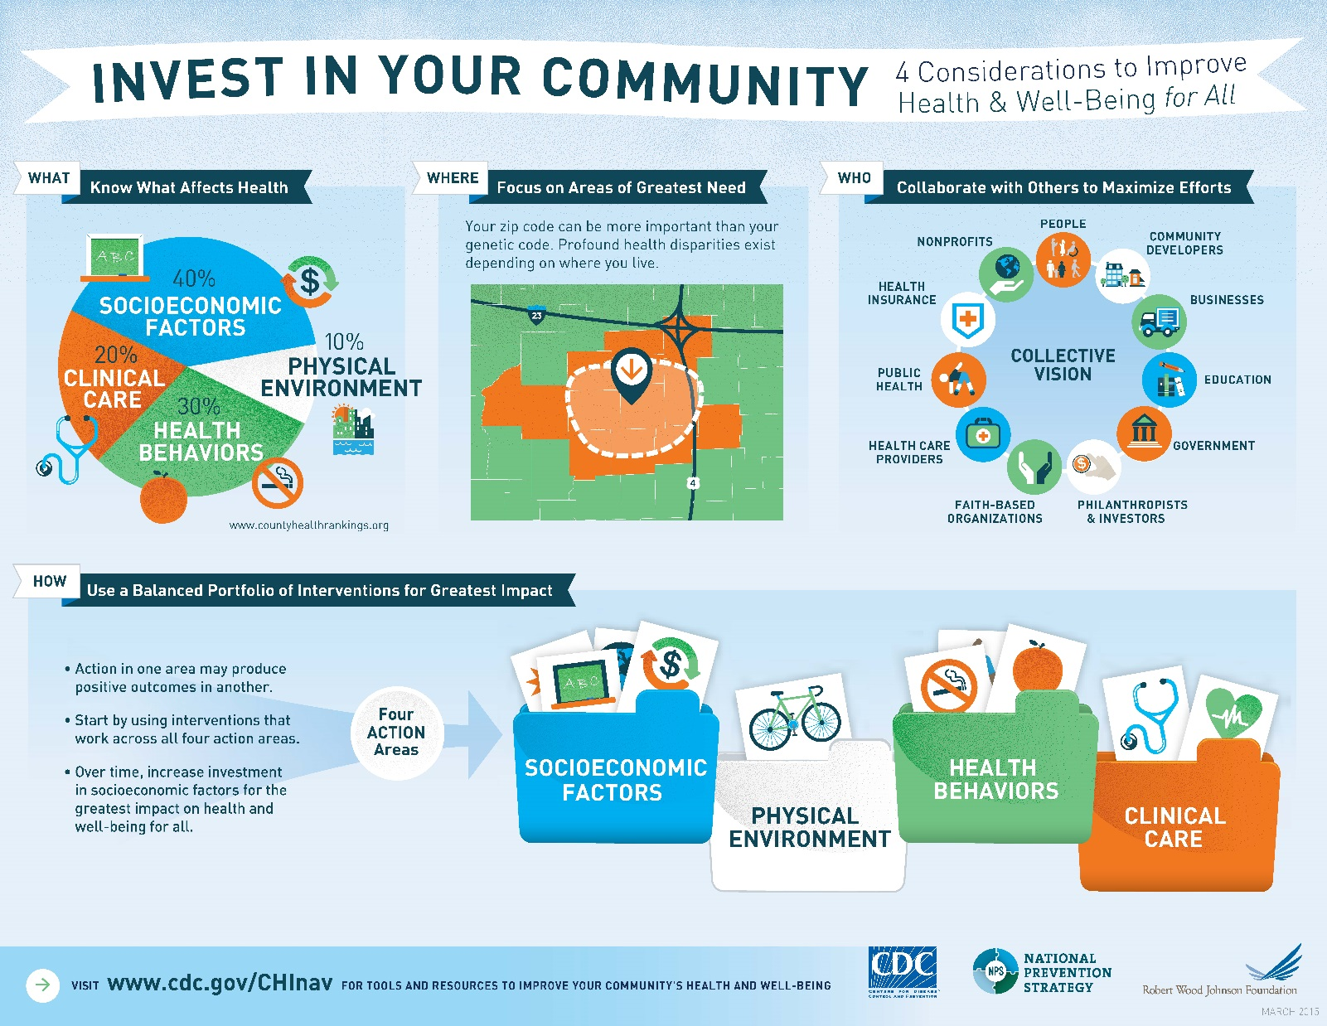
The Big Picture: How to Assess and Improve Community Health
Notes:
Great infographic from CDC’s Community Health Improvement Navigator on the process. I find it is the most succinct way of explaining the and understanding the idea of improving health and well-being for all.
WHAT? Not just clinical!
WHERE? Should be targeted to areas of greatest need, based on data
WHO? Must be collaborative
HOW? After assessment, interventions should have a balanced portfolio for the greatest impact (just like your stock portfolio, right?) It’s interventions related to health behaviors, clinical care, social determinants of health, and more!

Slide 3
2016 MAPP included participation from
105 community partners and
10 community coalitions
Mobilizing for Action through Planning and Partnerships (MAPP)
MAPP2Health History & Framework
Cville/Albe
2008
Health District
2012
Health District
2016
Health District
2019
Notes:
(NACCHO)
The MAPP framework includes four assessments (arrows around the outside) where community partners gather to assess data, understand community needs, identify issues or priorities, formulate goals and strategies to address them, and then implement the plan.
community-wide strategic plan for health and well-being.
In the middle of the arrows are the steps involved from beginning (partnering) to end (developing, implementing, and evaluating your plan)
Has been used as the framework for our local process since the first assessment; we continue to use this framework and adjust as needed to fit the local process.
Bringing health systems, community agencies and organizations, and community representatives together to:
Better understand the health of our community by reviewing data and having discussions
Identify key health priorities to address together in order to improve the health and well-being for all members of our community
Mobilizing for Action through Planning and Partnerships (MAPP) is a strategic framework to engage community stakeholders, key organizations, and citizens to come together to review health indicators and determine community health priorities for focus and improvement. In the 2016 MAPP process, 105 community partners and 10 community coalitions reviewed and discussed quantitative and qualitative data and 2,885 community members provided feedback on strengths and areas for improvement. These discussions led to the adoption of four priorities, described in the 2016 MAPP2Health Report:
• Promote Healthy Eating and Active Living
• Address Mental Health and Substance Use
• Reduce Health Disparities and Improve Access to Care
• Foster a Healthy and Connected Community for All Ages

Slide 4
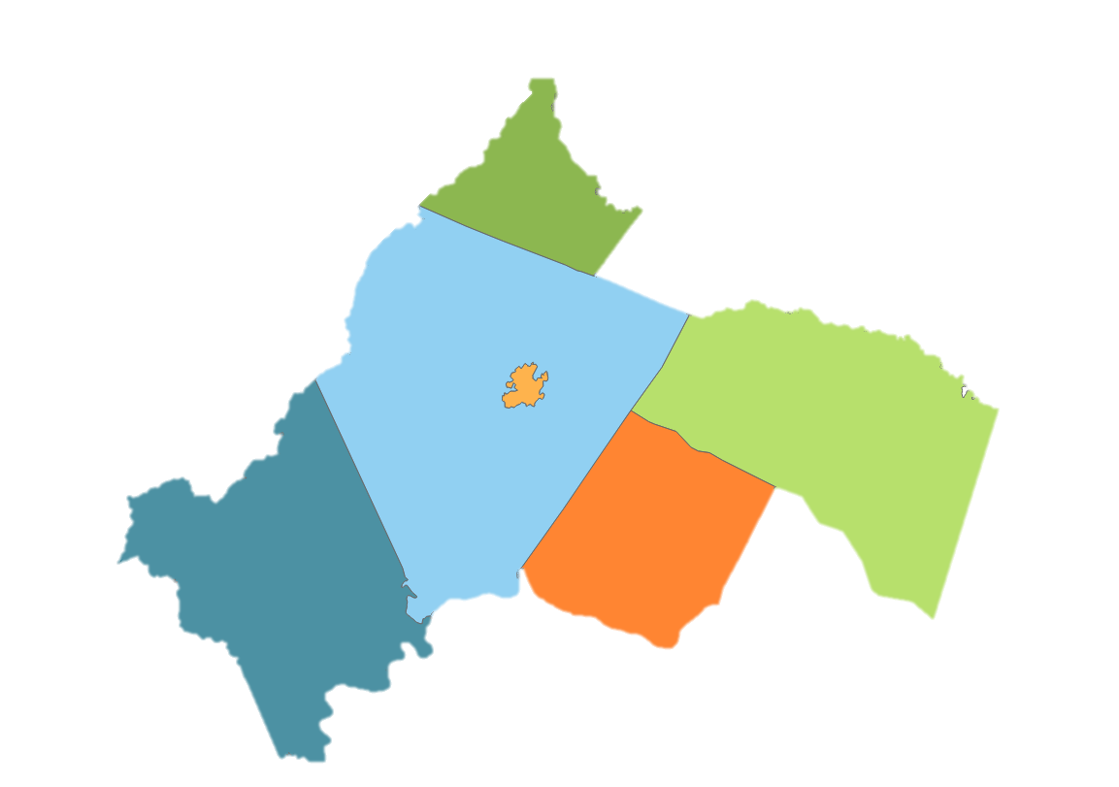
Planning District 10 / Thomas Jefferson Health District
Locality | Population
Albemarle County | 107,697
Charlottesville City | 49,132
Louisa County | 35,035
Fluvanna County | 26,467
Greene County | 19,985
Nelson County | 14,858
TJHD | 253,174
Greene
Albemarle
Louisa
Charlottesville
Nelson
Fluvanna
Notes:
For MAPP purposes, how is the community defined?
Per online resident training:
“members of a community have some characteristics in common; usually where they live”
--Duke Community and Family Medicine, Community Health Training: Partnering with the Community to Improve Health
The Thomas Jefferson Health District (TJHD) is the same as Planning District 10 (PD10) and the Region Ten Community Services Board area (R10)
Albemarle, Fluvanna, Greene, Louisa, and Nelson counties
City of Charlottesville
Administrative geographic area
Also the same area as the Thomas Jefferson Planning District Commission (TJPDC), Jefferson Area Board for Aging (JABA), and others

Slide 5
2016 Community Themes and Strength Responses
2,885 survey responses
Notes:
This is information from the 2016 process but I wanted to share as it has informed planning for the 2019 process.
Survey was simple and non-identifiable. Two main questions: healthy strengths and areas for improvement to assist with the prioritization process.

Slide 6
2016 MAPP2Health Priorities & RoadMAPP
Promoting Healthy Eating and Active Living
Addressing Mental Health and Substance Use
Reducing Health Disparities and Improving Access to Care
Fostering a Healthy and Connected Community across the Lifespan
Community Coalitions
MAPP Partners and Organizations
Community Groups (businesses, churches)
Community Members
MAPP Core Group + County Councils

Slide 7
2019 MAPP Structure
Core Group
NEW Data & Eval. Committee
Leadership & Interagency Councils
NEW Best Practices Work Group
Community input and engagement (projects, surveys, presentations)
4 Priorities through the lens of health equity
Leadership Council*
Charlottesville/Albemarle MAPP Council
Fluvanna Interagency Council
Greene Agencies Coming Together
Nelson Interagency Council
Louisa Interagency Council
Notes:
Community engagement and input builds on the 2016 process. Last time, we got input from almost 3,000 residents on areas of strength and areas in need of improvement to help with prioritization.
For 2019 process, look for more in-depth information on areas of strength and community + cultural assets (Photovoice)
Photovoice projects
TJHD Community Health Survey (~1,000 respondents) + updated data indicators for each priority to better understand each priority
Under health disparities, had a work group. Diabetes is one of selected health disparities. Putting together a community-based Diabetes Steering Committee with people of color (African American + Latino) to provide input and guide organizational response.

Slide 8
2019 MAPP2 Health: What’s New
3 meetings per Council
2019 Meeting Schedule
January 21: MAPP Overview, Unnatural Causes & Equity Discussion, Photovoice
March 19: Nelson County Data Profile + Equity Discussion
May 20: Photovoice Results, Strategy Selection, & Grant Planning

Slide 9
2019 MAPP2 Health: What’s New
Data and Evaluation Committee
Best Practices Work Group
Notes:
The MAPP2Health Best Practices Work Group will convene subject matter experts across the four (4) MAPP priorities and related social determinants of health to review current MAPP2Health strategies by priority, research evidence-based best practices, and recommend a variety of strategies to address each MAPP priority.
The MAPP2Health Data and Evaluation Committee will convene data partners to review current MAPP2Health community indicators, strengthen local data partnerships, and provide evaluation support and planning for the strategies contained in the MAPP2Health Report.

Slide 10
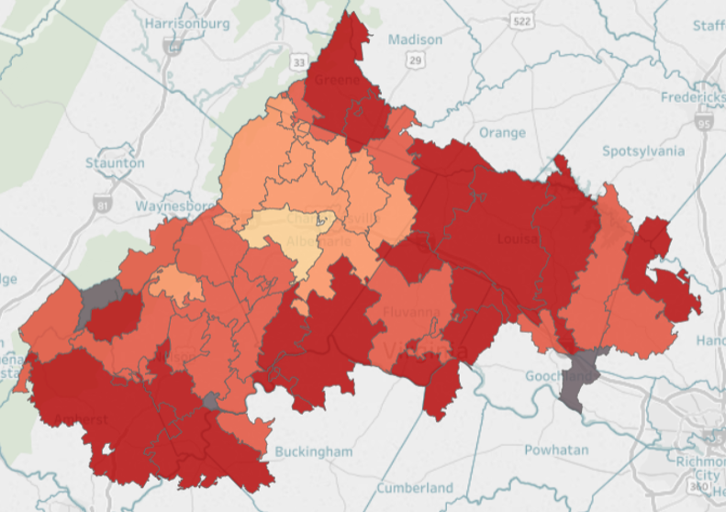
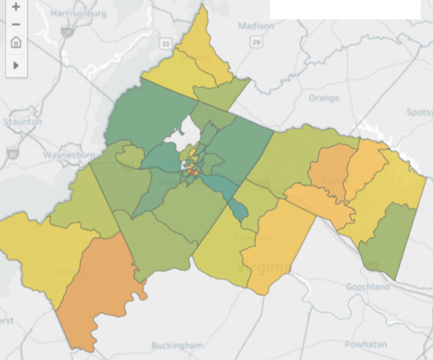
Local Data: Priority Indicators Available Online
https://public.tableau.com/profile/thomas.jefferson.health.district#!/
Mapping the Prevalence of Obesity in TJHD (2014-2016)
Life Expectancy Estimates at Birth by Census Tract (2008-2012)
Notes:
5 indicators per priority available on TJHD’s Tableau Public page.

Slide 11
2019 MAPP2 Health: What’s New
Photovoice Projects
Funding for Localities
Notes:
Photovoice is meant to give people who typically don’t have a voice, one through photography. Intended to identify cultural and community assets that organizations can build on to improve health equity. IACs need to start thinking about a group in their community that they feel will best represent health inequities. For example, older adults, mothers, the homeless, rural residents, faith communities, etc.
Funding details still being worked out but there will be a grant(s) available for organizations/agencies within in each locality to implement one or more selected strategies.

Slide 12
2019 MAPP2Health
Putnam Ivey, Healthy Communities Coordinator
Thomas Jefferson Health District
434-972-6241
putnam.ivey@vdh.virginia.gov
Questions?

