Slide 1
HUMAINS
High Utilizer Management And Integrating Needed Systems

Slide 2
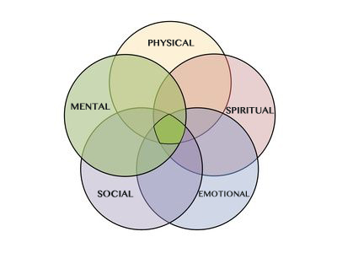
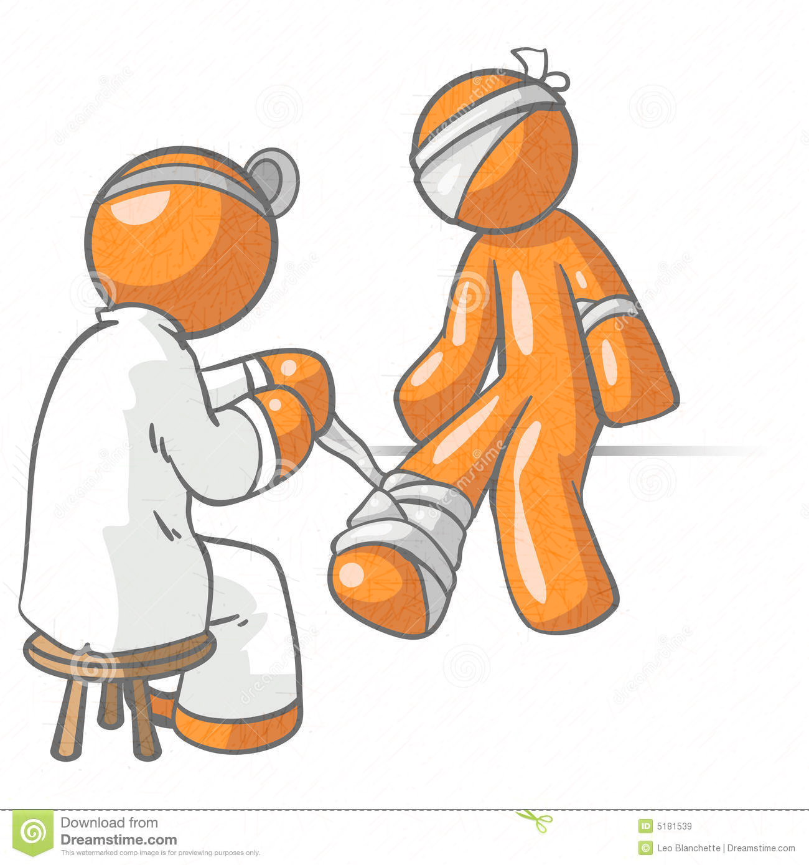
What is HUMAINS?
HOLISTIC VIEW
We have recognized a problem, that not one agency can solve alone.
Nor can that “problem” be linked to one specific issue. It is affected by multiple factors.
HUMAINS recognizes this and promotes a holistic view of the communities health by effecting change in multiple areas by collaborating together, breaking down “silos” and working to create a patient centered care model.

Slide 3

30,000 Ft View
HUMAINS (High Utilizer Management And Integrating Needed Systems) is a system developed from agencies within the Albemarle County which can be expanded to the TJEMS (Thomas Jefferson Emergency Medical Services) region that work collaboratively to provide resources to resident that do not have access to quality, effective/efficient healthcare, by creating a safe and healthy community for all residents.

Slide 4



Mission / Vision
Utilizing Community Risk Reduction (CRR) principles to limit threats faced by our residents. To improve access and remove barriers, to ultimately create: effective / efficient quality healthcare for every resident through increased compliance/adherence with healthcare provider directives while providing social determinacies of healthcare.

Slide 5
Goals of HUMAINS
Removing Barriers
Compliance / Adherence
By focusing on:
Education
Engineering
Enforcement
Engagement
Evaluation

Slide 6
Players
Albemarle County Fire and Rescue
JABA
DSS/APS
Region 10
Virginia Department of Health
University of Virginia

Slide 7

Covering the community
HUMAINS

Slide 8
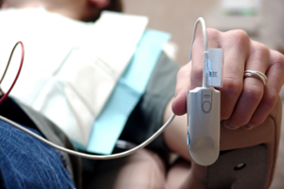
“Trying to ensure the Patient receives the right care, by the right provider at the right place at the right time and at the right cost.”

Slide 9
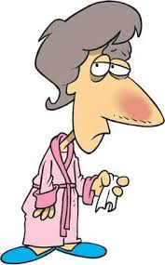
Lets think of the Patient
For this purpose with will assume EMS in the first contact with the health care for an individual.

Slide 10

Lets think of the Patient
When the Patient is at home, they make a choice, call 911 for transport to the hospital, Drive themselves to the hospital, or wait till the clinic is open.

Slide 11
Lets think of the Patient
Depending on the time of day, day of the week, and other factors this could determine what choice they make.
Most clinics are only open 9-5
Can someone take off work?
Financial impact on going to the clinic (copay, Loss of income, Loss of job)
How am I going to get there?

Slide 12

Lets think of the Patient
They decide to call 911 due to one of those circumstances…
Emergency rooms are open…
I don’t have a primary care provider…
I can get in quicker...

Slide 13
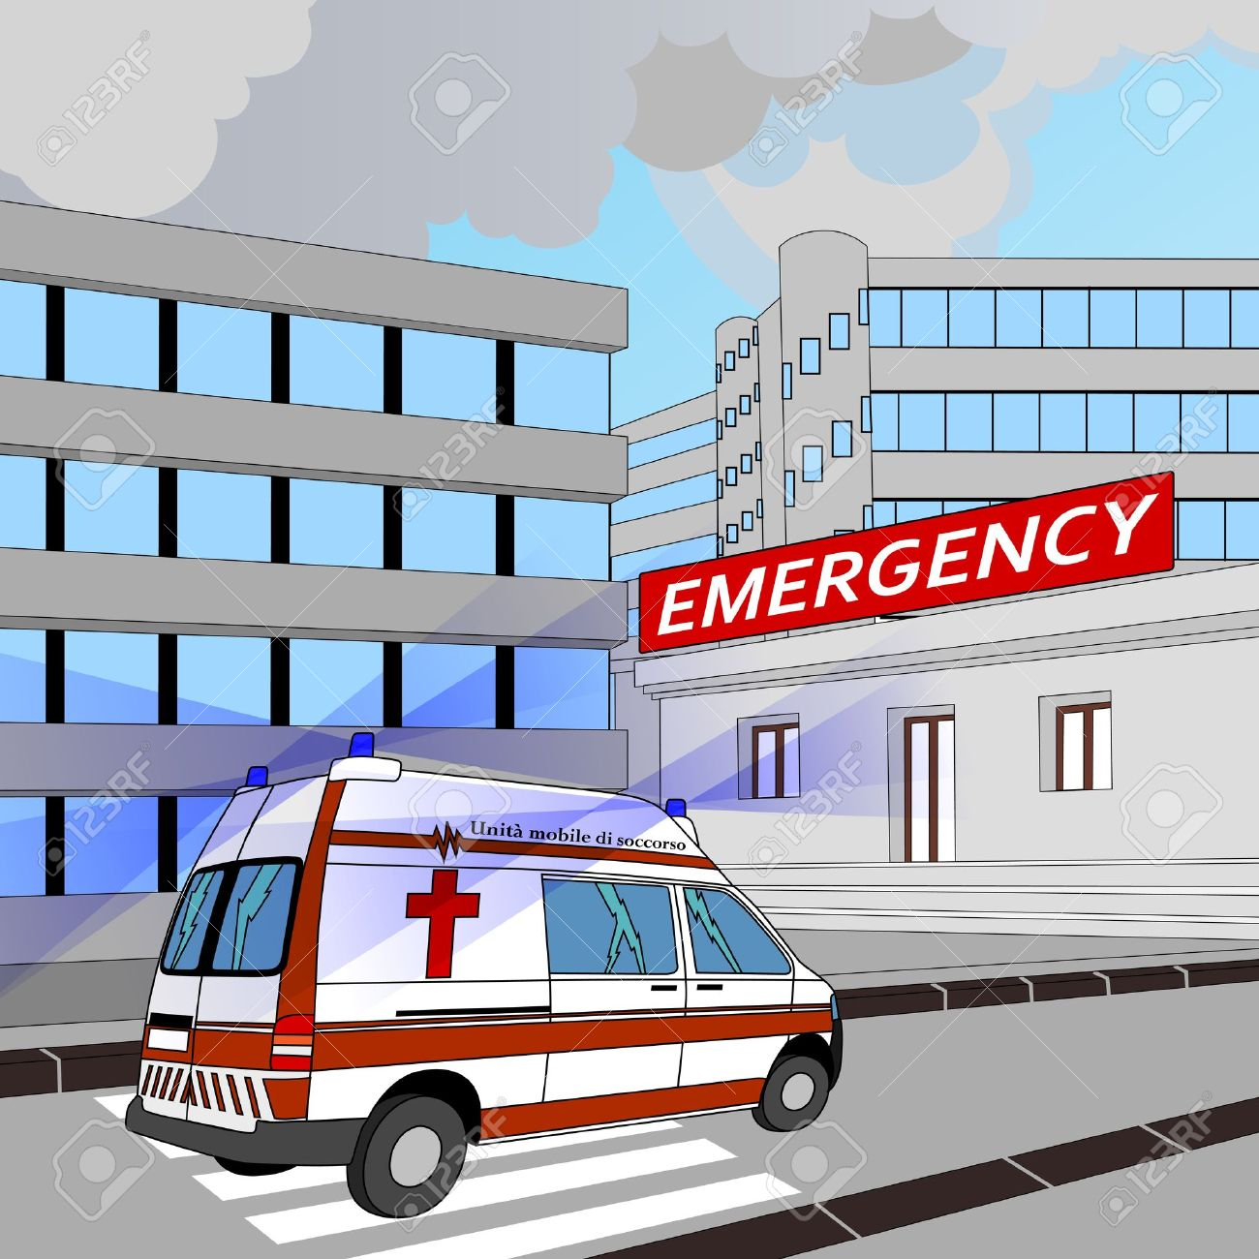
Lets think of the Patient
How many patients are discharged home ?
How many are admitted?
How many return?

Slide 14

Lets think of the Patient
This is where the story begins…
The patient eventually goes home and can take several paths…
How many of those individuals understand the discharge instructions. Or have followed up with PMD?

Slide 15
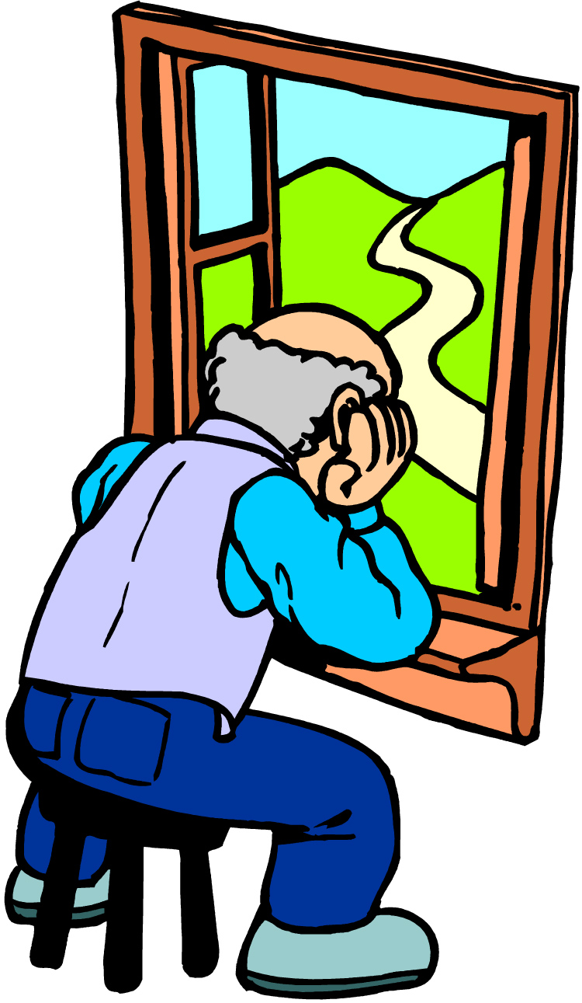
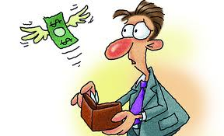

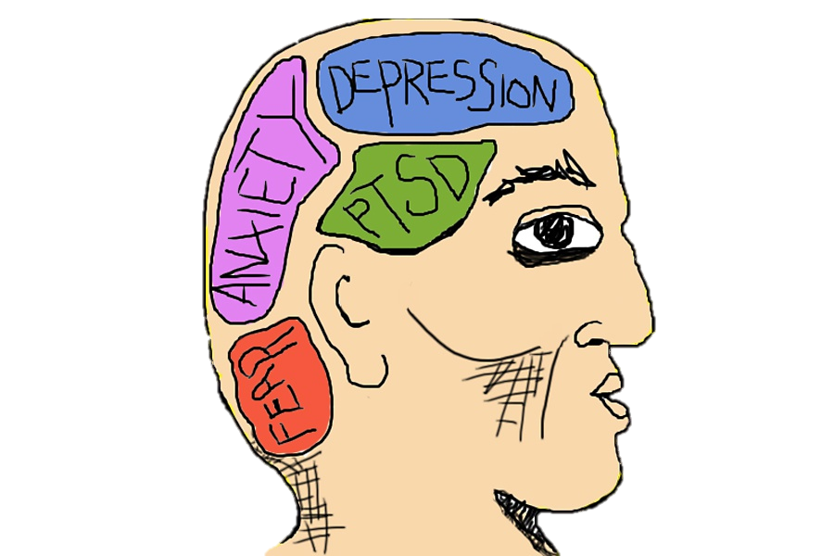
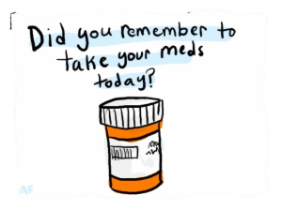
Lets think of the Patient
This is where the story begins…
The patient eventually goes home and can take several paths…
How many of those individuals understand the discharge instructions. Or have followed up with PMD?
Are they isolated?
Have they even taken the medications?
If financial problems took them to the ED…

Slide 16

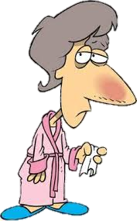

Lets think of the Patient
They end up going back…
Things have not gotten better…
We have not solved the underlying problem…
We have just recycled…

Slide 17
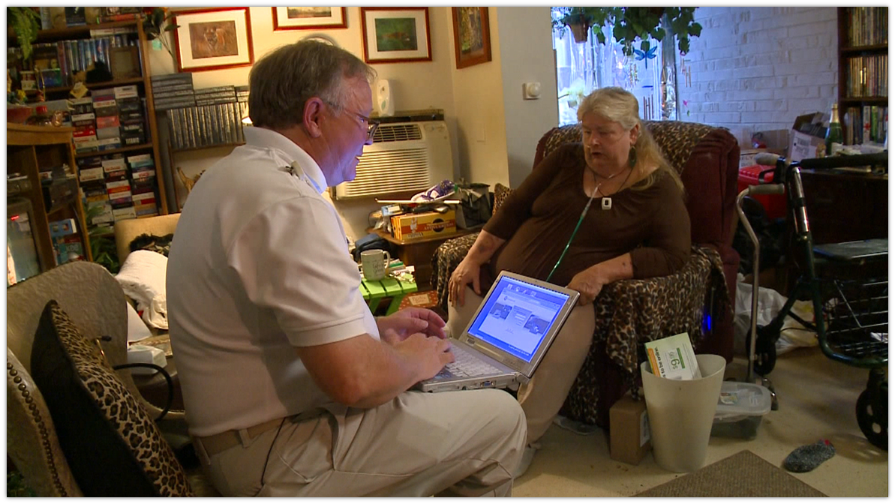
Lets Practice Prevention
Preventing the deterioration of chronically ill patients and making sure they receive intervention before emergency care is needed.

Slide 18

Lets look at where…

Slide 19
Lets look where…
Heat mapping shows the concentration of our calls…
Hot spots…

Slide 20
Lets look where…
Heat mapping shows the concentration of our calls…
Hot spots…
The more EMS calls…can lead to more fires.

Slide 21
Lets look where…
Heat mapping shows the concentration of our calls…
Hot spots…
The more EMS calls…can lead to more fires.
We can also look at Narcan use in the area…

Slide 22
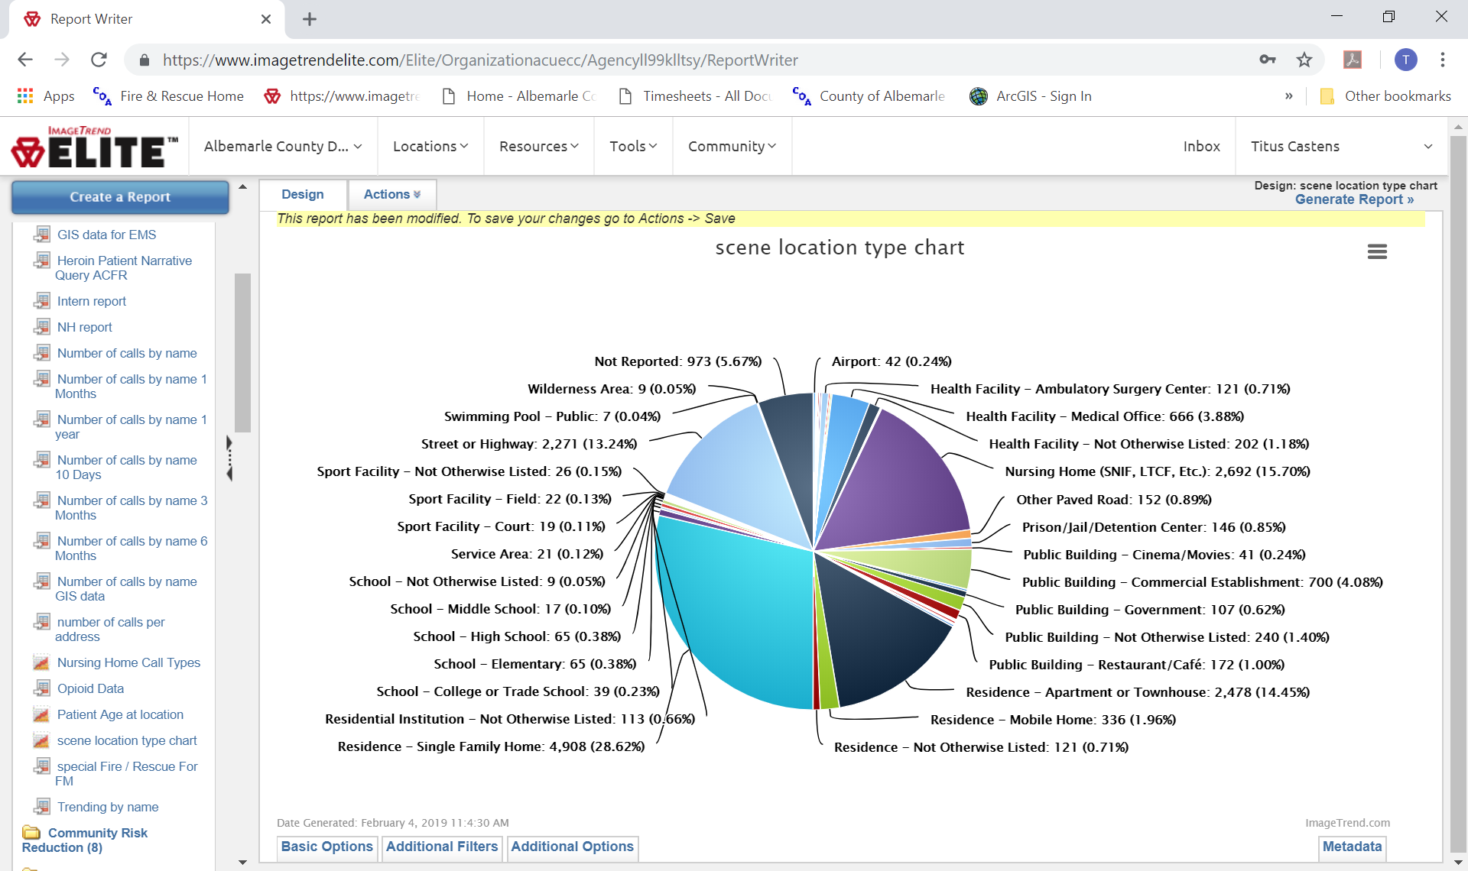
Data, Data, Data…

Slide 23
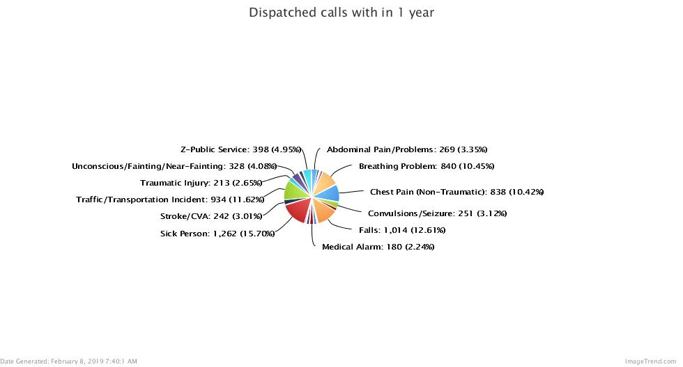

Slide 24
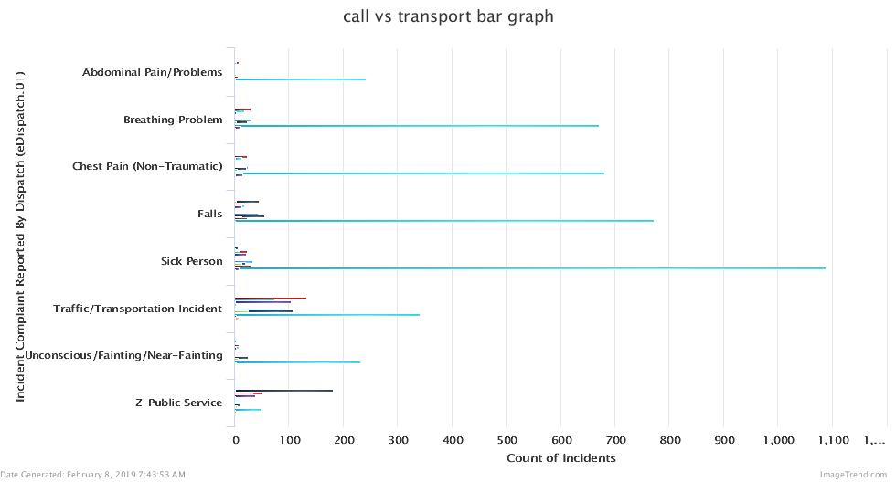

Slide 25
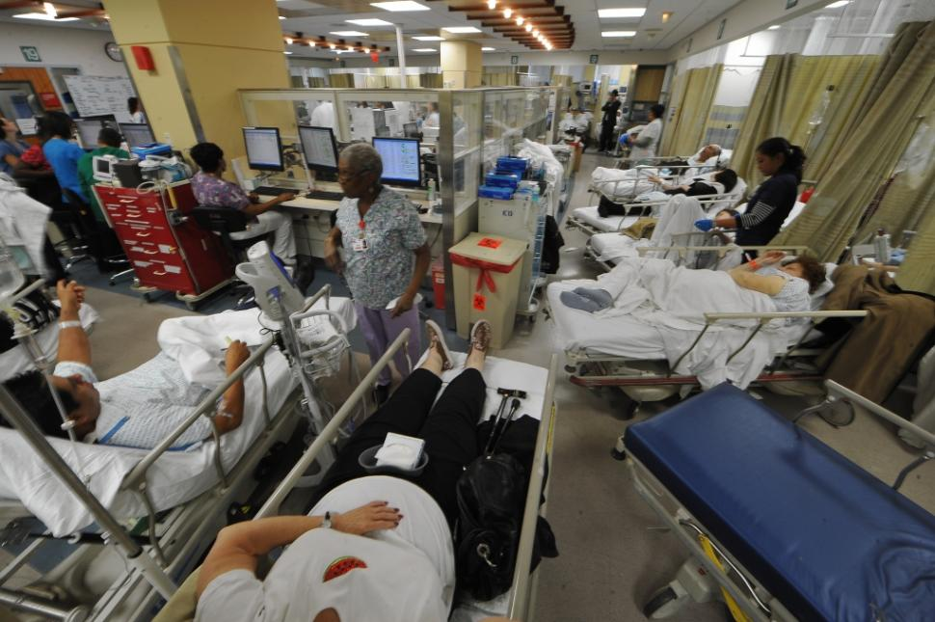
Why is this important?
By utilizing the resources already available, for the appropriate reasons, at the right time, we can eliminate overuse and misuse of the system….
Does this look familiar?

Slide 26

The whole system is Taxed
EMS is transporting non-emergent patients to the hospital
Could we be transporting elsewhere or treating in the field?
EMS tends to be the “First Alert” of a possible problem on the horizon.
We can intervene prior to EMS services being utilized

Slide 27
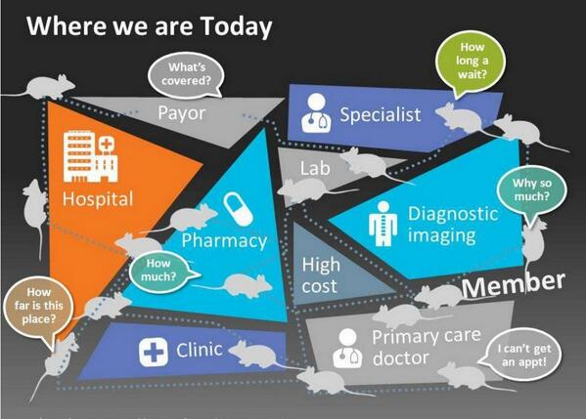
Brings all the players together
Past case studies have shown that by removing silos, communicating and working collaboratively together we can decrease duplication of work and effort.

Slide 28
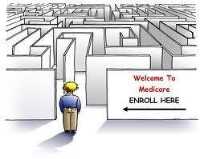
Allows for better navigation

Slide 29

Streamline the system
This has shown to provide a faster response form the services already established
Become more efficient and effective.
Reduction in duplication or overlapping services.

Slide 30
So where are we now?

Slide 31
Flow of the program

Slide 32
Slowly enrolling Pt’s
2018-0001APS | 2018-00006951 |  | Female | APS
2018-0002APS | 2018-00006845 |  | Male | APS
2018-0003APS | 2018-00007025 |  | Female | APS
2018-0004APS | 2018-00006533 |  | Male | APS
2018-0005APS | 2018-00007539 |  | Male | APS
2018-0006APS | 2018-00009367 |  | Female | APS
2018-0007APS | 2018-00008938 |  | Male | APS
2018-0008APS | 2018-00009633 |  | Female | APS
2018-0009APS | 2018-00009787 |  | Male | APS
2018-0010APS | 2018-00010082 |  | Female | APS

Slide 33
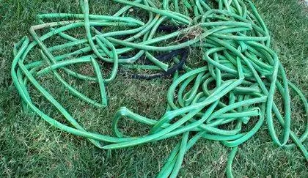
Working out the kinks…
We have found, through trial and error that there are some Kinks in the system.
As we go we are resolving those issues.
Enrollment, Tracking, and data sharing are several major obsticals which we are trying to address.
This plays a part in the formation of KPI’s and proving project effectiveness.

Slide 34
5 E’s
Each agency will use the 5 E’s approach when creating plans to reach the objectives.
As a HUMAINS group we will review the proposal and make sure that it meets one of the objectives set forth.

Slide 35
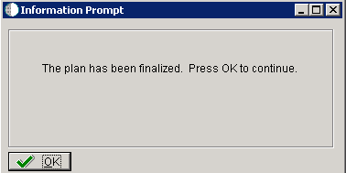
Strategic plan Finalization…

Slide 36

Signed off by each agency

Slide 37
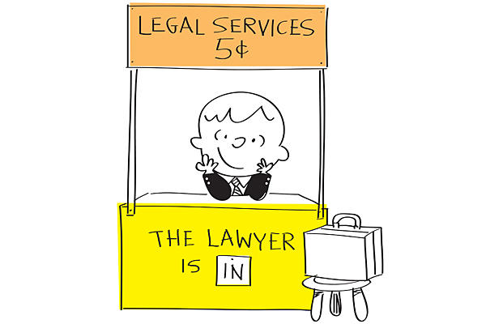
Vetted by legal
Both documents will be vetted by each agencies legal department to make sure that HUMAINS is inline with each respective agency.
After which each agencies management team would sign off on the project.

Slide 38

Go Live ?
Hopefully if we stay on task and with in the timeline, we should be able to go live April 1st
There is some flexibility in this due to the fact of Inservice training for agencies as well as the need for a Public Relations Push.
We would also suggest presentations of the HUMAINS program to each agency if requested as well as a town hall meeting for the public.

Slide 39
FUTURE Ideas
Community Health Workers
Yancey School Occupancy.
After the program is fully established the establishment of a Community Health Worker Program would be sought.
Leveraging the “high risk” communities.
Using Yancey School as a southern HUB of CHW as well as CP.
Could be utilized as a mobile clinic and resource staging.
Help with the access to care that is needed in the south due to economic and transportation factors.

Slide 40
FUTURE Ideas
Telemedicine
Utilizing grants we could proceed with the implementation of telemedicine for assessments and communication with Primary, Secondary and Tertiary care.
Could be used in field, or in location such as Yancey, Scottsville Rescue, etc.

