Slide 1
MAPP2Health Louisa County Data Profile
Notes:
Who has heard of MAPP before?
Who has participated directly in MAPP groups before?
IAC—interagency council

Slide 2
What do you see?
Spend 5-7 minutes walking around and looking at the data posters. Add your stars:
Blue = What stands out to you?
Green = Do you see any differences in the data (better/worse outcomes) by geography, race, age, gender, etc.?
Yellow = Is there a topic where you’d like to see more data or have more discussion?

Slide 3
MAPP Data Available Online: https://public.tableau.com/profile/thomas.jefferson.health.district#!/
Mapping the Prevalence of Obesity in TJHD (2014-2016)
Life Expectancy Estimates at Birth by Census Tract (2008-2012)
Notes:
5

Slide 4
Promote Heathy Eating and Active Living

Slide 5
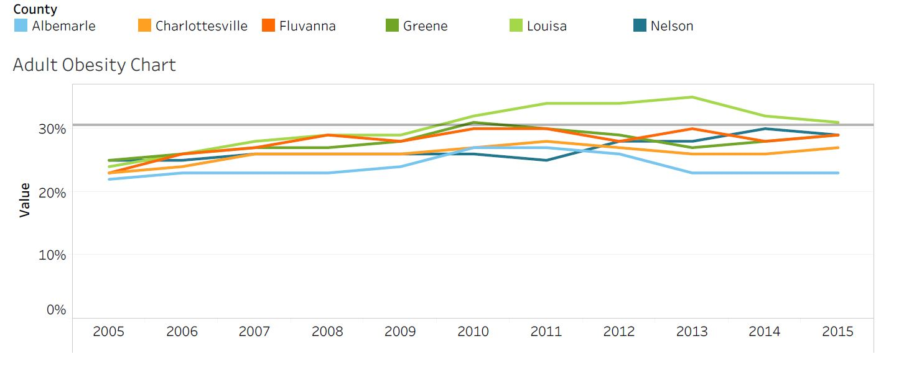
Percent of Obese Adults by TJHD Locality, 2005-2015.
Source: Robert Wood Johnson Foundation (RWJF), County Health Rankings, 2018.
Healthy People 2020 Benchmark = 30.5%
Notes:
Louisa has been increasing since 2005.
Increased from 24% to 31% and has been as high as 35%.
Went above the HP benchmark early 2010

Slide 6
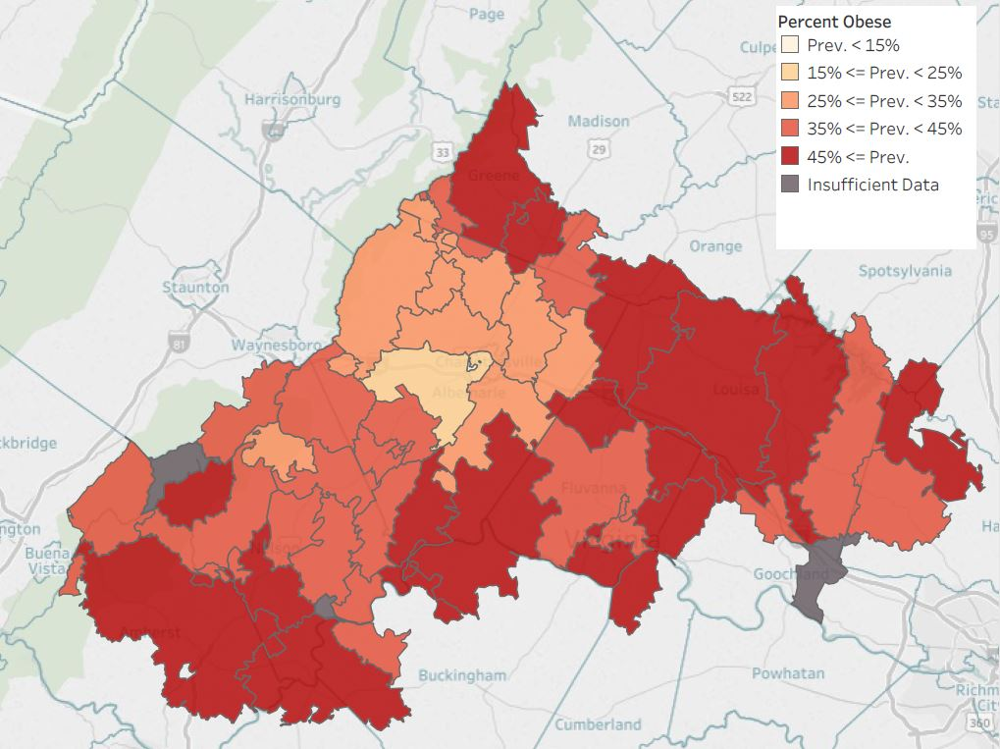
Percent of Obese Adults
by TJHD Zip Code Tabulation Area, 2016.
Source: Translational Health Research Institute of Virginia (UVA Clinical Data Repository), 2017.
Notes:
Mapping obesity across the district. Darker red = higher prevalence of obesity (45%+) and yellow-white is the lower (less than 15%). Louisa is almost half dark red.
LIMITATION: UVA outpatient data only; so doesn’t necessarily reflect the entire population (but it has an n of ~200,000 versus the County Health Rankings/BRFSS data n for the district is in the hundreds)
Note: these are mapped by Zip Code Tabulation Area (ZCTAs) which sometimes cross county lines.

Slide 7
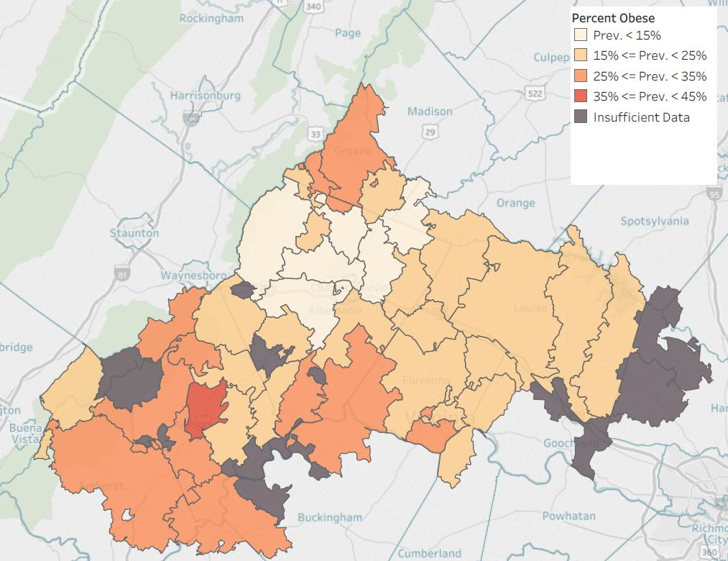
Percent of Obese Children
by TJHD Zip Code Tabulation Area, 2016.
Source: Translational Health Research Institute of Virginia (UVA Clinical Data Repository), 2017.
Notes:
Mapping obesity across the district. This is for children instead of adults. As you can see from the dark gray areas, not enough data for several areas (that is, less children seen at UVA outpatient clinics across the district)

Slide 8
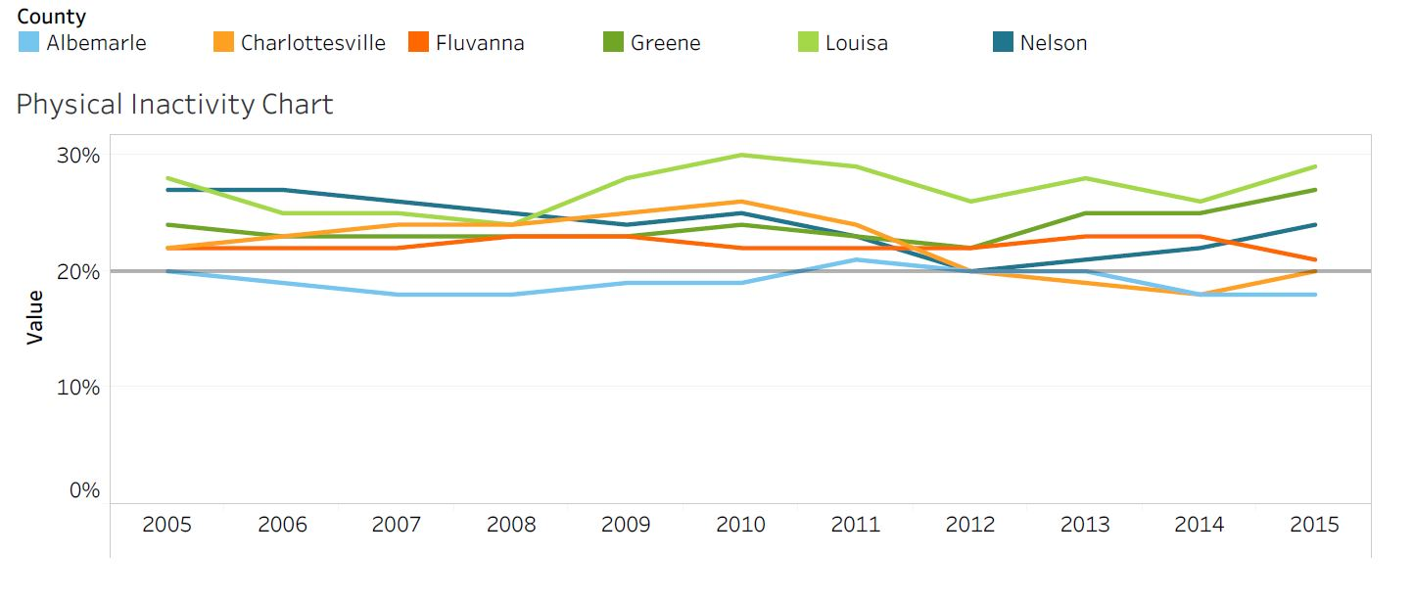
Percent of Adult Physical Inactivity, by TJHD Locality, 2005-2015.
Source: Robert Wood Johnson Foundation (RWJF), County Health Rankings, 2018.
VA Plan for Well-Being Target = 20%
Notes:
Louisa has the highest percent of adult physical inactivity in the district in 2016, at 28%
Not within the target for VA plan for well-being

Slide 9
What Prevents You from Exercising, by TJHD Locality, 2018.
Source: UVA Center for Survey Research and the Thomas Jefferson Health District, Community Health Survey, 2019.
Notes:
Top two reasons for Louisa County are no time and no sidewalks/parks
*note: not enough responses from localities so Fluvanna and Louisa were merged

Slide 10
Access to Exercise Opportunities, by TJHD Locality, 2014 & 2016.
Source: Robert Wood Johnson Foundation (RWJF), County Health Rankings, 2018.
Notes:
Since 2014, Louisa has seen a decrease in access to exercise opportunities
Question: do you all know if a new park or community center or YMCA that has closed since 2014

Slide 11
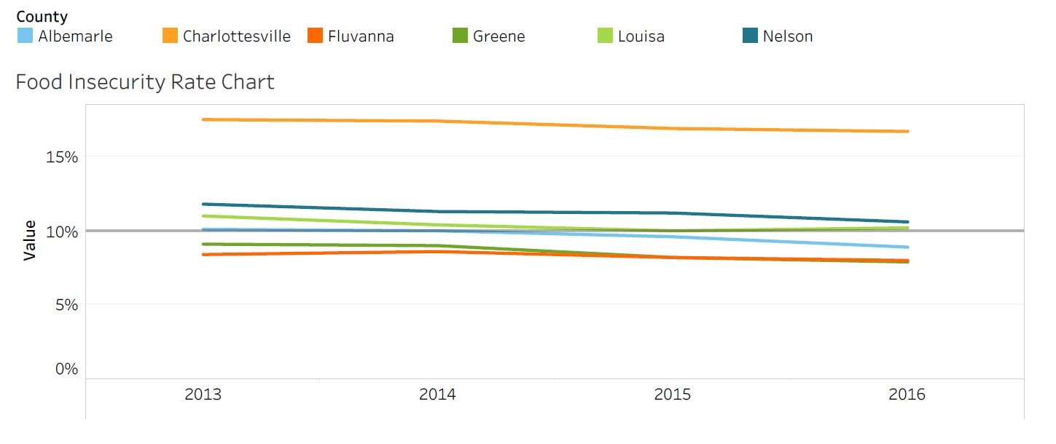
Food Insecurity, by TJHD Locality, 2013-2016. Source: Map the Meal Gap, Feeding America, 2018.
VA Plan for Well-Being Target = 10%
Notes:
Within this 3 year timeframe, Louisa has stayed right on the target for VA plan for well-being
~10% of adults experience food insecurity
Food insecurity: lack of access, at times, to enough food for an active, healthy life for all household members and limited or uncertain availability of nutritionally adequate foods. May not always experience food insecurity—may also reflect a households need to make trade-off’s between important basic needs, such as housing or medical bills, and purchasing nutritionally adequate foods.

Slide 12
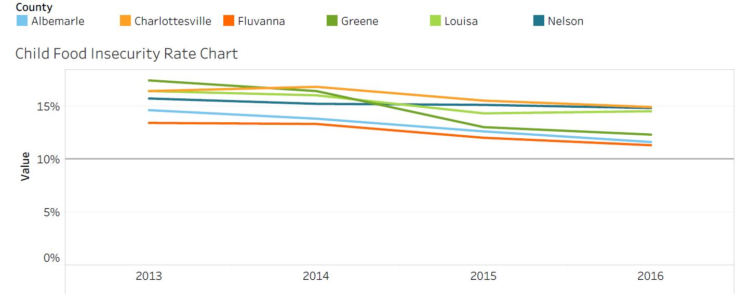
Child Food Insecurity, by TJHD Locality, 2013-2016. Source: Map the Meal Gap, Feeding America, 2018.
VA Plan for Well-Being Target = 10%
Notes:
Louisa has stayed around 14-16% of children experiencing food insecurity—much higher than the target for VA plan for well-being

Slide 13
Address Mental Health & Substance Use

Slide 14
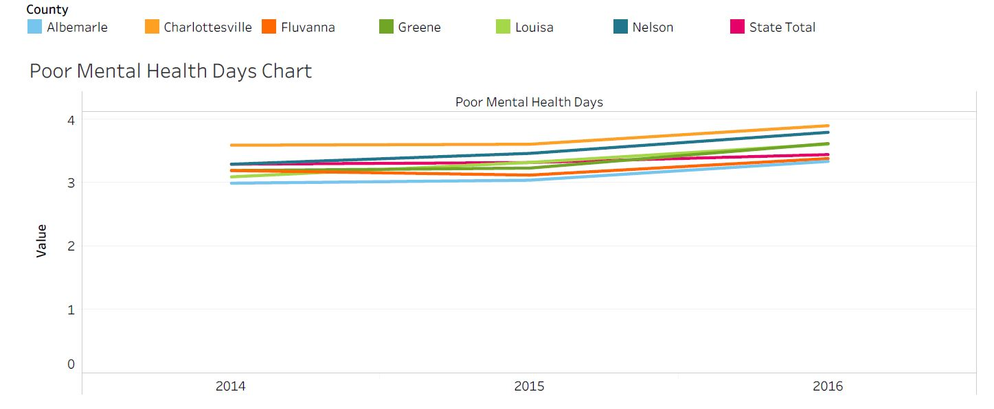
Poor Mental Health Days, by TJHD Locality, 2014-2016. Source: County Health Rankings, 2018.
Notes:
Important measure because an increase in poor mental health days increases risk for development of depression—includes reporting days where mental health isn’t good, including stress and problems with emotions
The number of poor mental health days in Louisa has been steadily increasing
Louisa is higher than the state
https://www.ncbi.nlm.nih.gov/pmc/articles/PMC3133938/

Slide 15
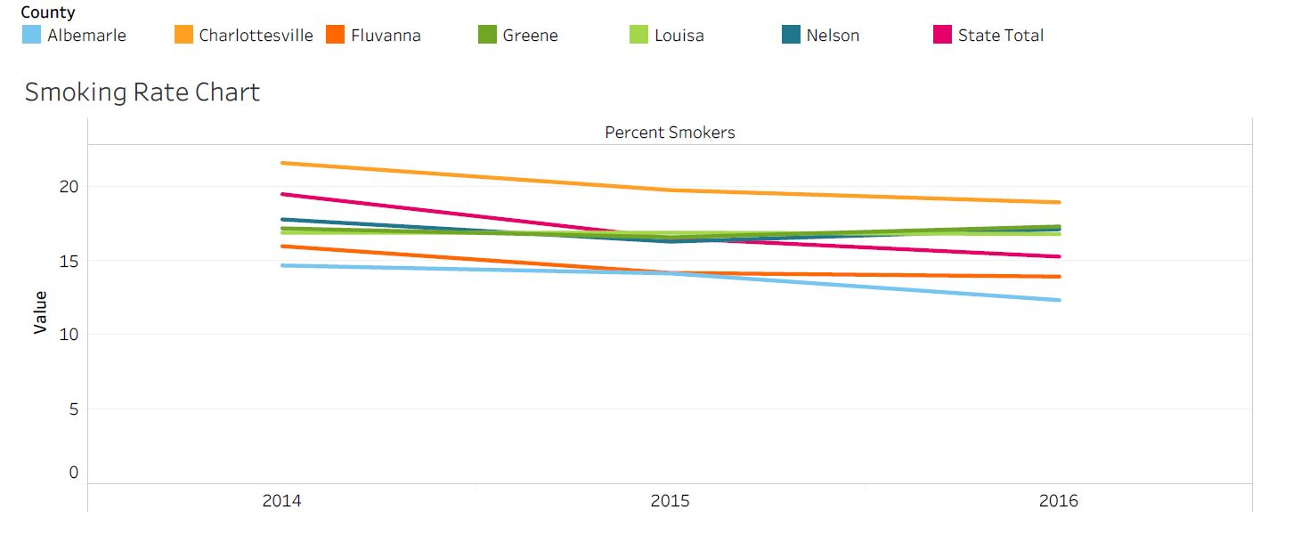
Percent of Adults Smokers, by TJHD Locality, 2014-2016. Source: County Health Rankings, 2018.
Notes:
Louisa smoking rates have remained ~16%--3rd highest rate in the district following Charlottesville, Nelson and Greene

Slide 16
TJHD Overdose Mortality Rates (per 100,000 residents), TJHD and TJHD Localities, 2011-2017 & 2017. Source: Virginia Department of Health, Opioid Addiction Dashboard, 2018 (http://www.vdh.virginia.gov/data/opioid-overdose).
Louisa Overdose Mortality Rate, 2011-2017
TJHD Overdose Mortality Rates, by TJHD Locality, 2017
Louisa NAS Rate, 2011-2017
Notes:
Fentanyl/Heroin overdose rate is higher than the opioid overdose rate…8.5 compared to 5.7
NAS—group of conditions caused when a baby withdraws from certain drugs he’s exposed to in the womb before birth—most often caused by opioids
Louisa has experienced a very SIGNIFICANT increase in NAS rates…2.7 to 15.5—this is also significantly higher than the state NAS rate being 6.7

Slide 17
Louisa Rate Summary by Age Groups, Rates per 100,000 Residents, 2017. Source: Virginia Department of Health, Opioid Addiction Dashboard, 2018 (http://www.vdh.virginia.gov/data/opioid-overdose).
Overdose Deaths |  |  | ED Visits for Overdose
Age Group | Fentanyl and/or Heroin Overdose | Prescription Opioid Overdose | ED Heroin Overdose | ED Opioid Overdose
0–14 | 0.0 | 0.0 | 0.0 | 66.0
15–24 | 27.5 | 27.5 | 54.9 | 329.7
25–34 | 0.0 | 25.2 | 226.5 | 528.6
35–44 | 25.2 | 0.0 | 75.5 | 352.4
45–54 | 0.0 | 0.0 | 75.8 | 132.7
55–64 | 17.4 | 0.0 | 0.0 | 52.2
65+ | 0.0 | 0.0 | 0.0 | 45.7
All Ages | 8.5 | 5.7 | 51.1 | 181.6
Notes:
Age groups most at risk for overdose deaths AND ED visits are between the ages 15 and 54 years old
Highest ED Heroin Overdose rate in the district: ~51 per 100,000 persons
Also highest ED opioid overdose rate in the district (following Charlottesville at ~128): being ~182 per 100,000 persons

Slide 18
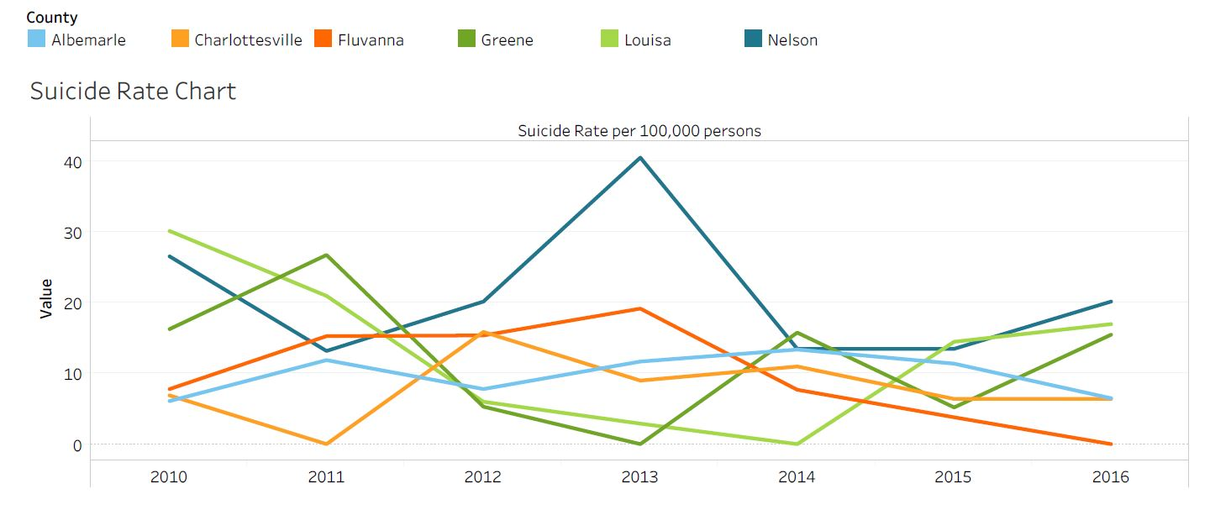
Suicide Rate per 100,000 population, by TJHD Locality, 2010-2016. Source: Office of the Chief Medical Examiner, Virginia Department of Health, 2018.
Notes:
Louisa experienced a significant decrease in suicide rates from 2010 to 2014; from rate of 30 to rate of 0
BUT then suicide rates jumped in 2014 and Louisa has the second highest suicide rate in the district following Nelson County with a rate of 17 per 100,000 people

Slide 19
Increase Access to Care and Reduce Health Disparities

Slide 20
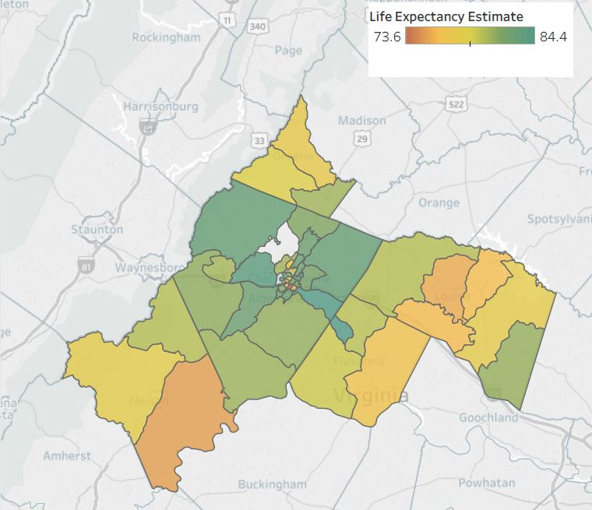
Life Expectancy Estimates at Birth by TJHD Census Tract, 2008-2012. Source: Virginia Department of Health, Office of Vital Records, 2018 and U.S. Census Bureau, 2010 Population Counts, 2018.
Notes:
The highest life expectancy in Louisa is ~80 years, which relative to the district is fairly low—the Albemarle, Charlottesville, and Fluvanna all have life expectancy estimates that are higher
→the darker green regions
The lowest life expectancy is ~75 years which is second lowest life expectancy after a neighborhood in Charlottesville
→the middle regions in Louisa all range from ~75-78 years

Slide 21
Percent of Families Below the Federal Poverty Level, by TJHD Locality, 2008-2016. Source: U.S. Census Bureau, American Community Survey 5-year Estimates, 2018.
Notes:
Since 2008, Louisa has experienced an increase in the % of families below the federal poverty level and is third highest in the district following Charlottesville and nelson county
Federal poverty level
1 individual: $12,140
Family of 4: $20,780

Slide 22
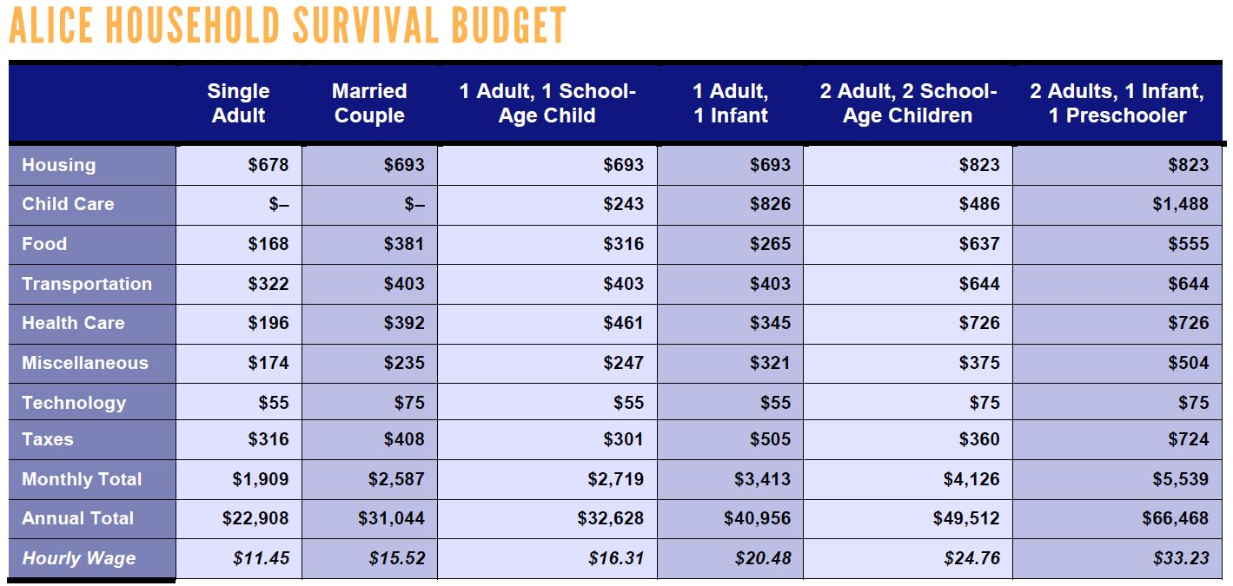
ALICE Cost of Living Estimates, Louisa County Survival Budgets, 2016. (ALICE = Asset Limited, Income Restrained, Employed) Source: United Way, 2018 ALICE Report.
Notes:
The ALICE population represents individuals and families who earn more than the official Federal Poverty Level but less than the basic cost of living. The measure has estimates for housing, childcare, food, transportation, healthcare, tax, and a miscellaneous category. There are estimates for different household and family compositions; there is an estimate for a basic "Survival" budget and a larger "Stability" budget.

Slide 23
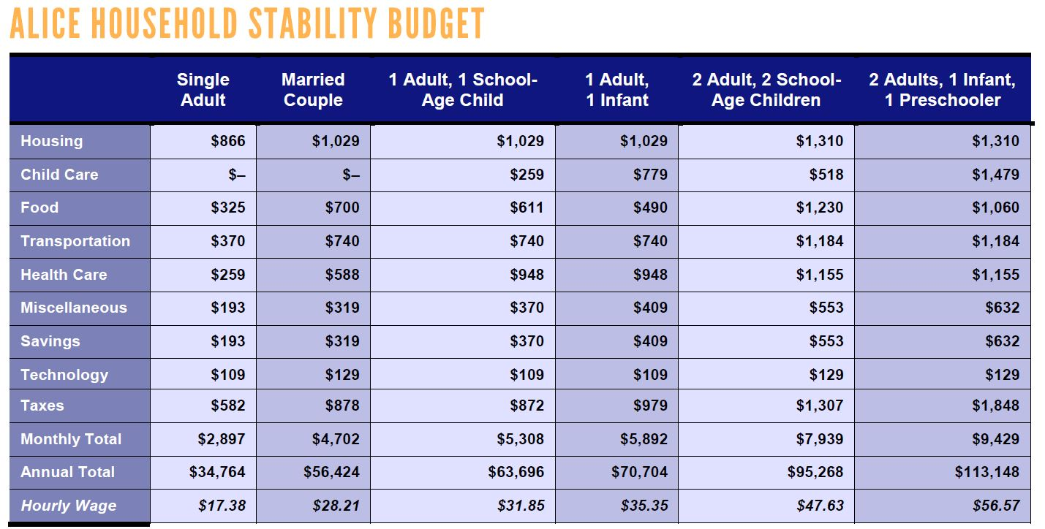
ALICE Cost of Living Estimates, Louisa County Stability Budgets, 2016. (ALICE = Asset Limited, Income Restrained, Employed) Source: United Way, 2018 ALICE Report.
Notes:
The ALICE population represents individuals and families who earn more than the official Federal Poverty Level but less than the basic cost of living. The measure has estimates for housing, childcare, food, transportation, healthcare, tax, and a miscellaneous category. There are estimates for different household and family compositions; there is an estimate for a basic "Survival" budget and a larger "Stability" budget.

Slide 24
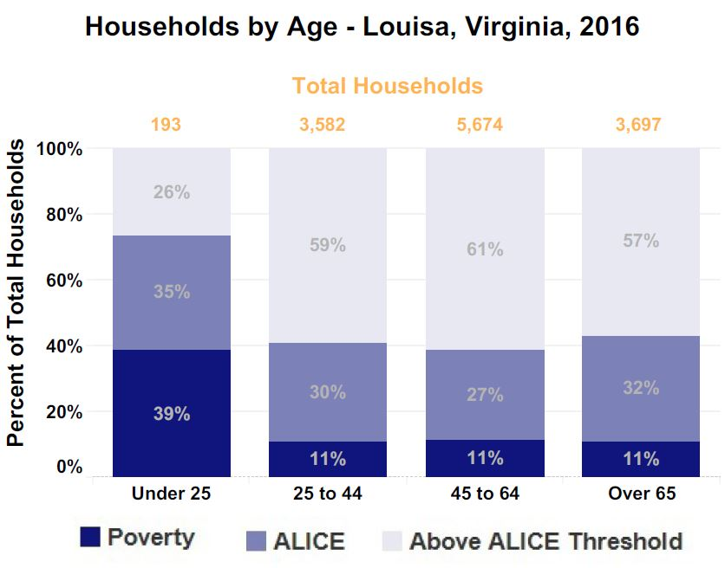
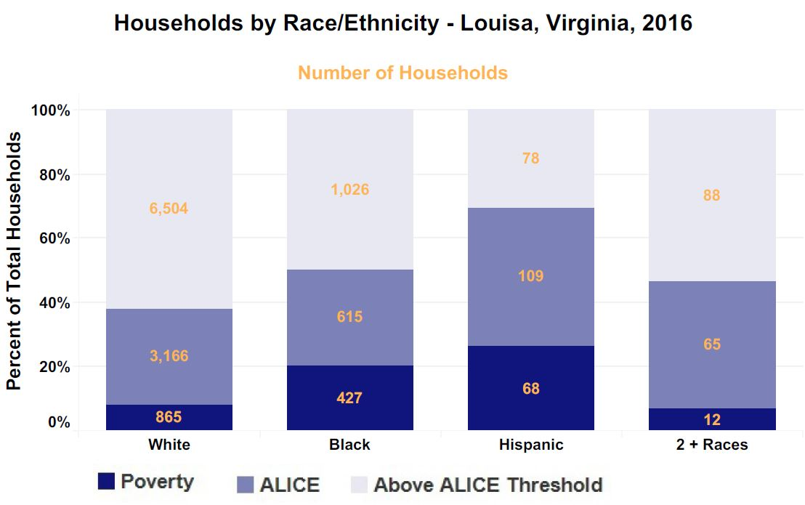
ALICE Cost of Living Estimates, Louisa County Households by Age and Race/Ethnicity, 2016. Source: United Way, 2018 ALICE Report.
Notes:
The majority of households living in poverty are under 25 years of age
Even with smaller population sizes, Hispanic residents have the highest percent of households experiencing poverty followed by black residents.

Slide 25
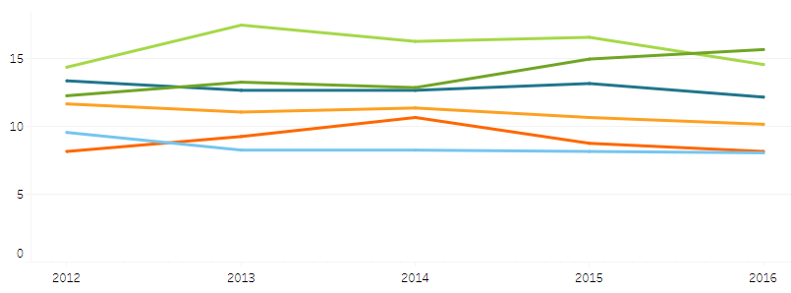
Percent Uninsured, by TJHD Locality, 2012-2016. Source: U.S. Census Bureau, American Community Survey 5-year Estimates, 2018.
Notes:
Louisa was consistently the locality with the highest percent of persons uninsured, but in 2016, there was a slight decrease in % and Greene county is now the highest in the district
Note: we expect these numbers will change once data are available for post-Medicaid expansion (2019)

Slide 26
Louisa Low Birth Weight, by Race. 2008-2016. Source: Virginia Department of Health, Division of Health Statistics, 2018.
Total Low Birth Weight
Black Low Birth Weight
White Low Birth Weight
Notes:
Compared to 2008, in 2016 black low birth weights are almost 3% higher. However there has been great fluctuation in black low birth weights, with spikes in 2010 and steep decline from 2012 to 2014
White low births have experienced a slight decrease since 2008.
Black low births are around 4% higher in 2016 compared to white low birth weights.

Slide 27
Foster a Healthy and Connected Community for All Ages

Slide 28
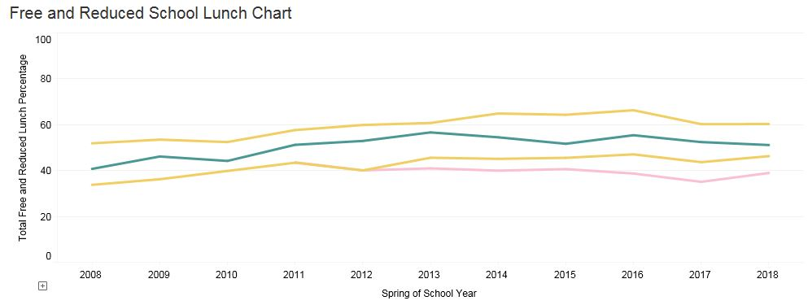
Percent Free and Reduced School Lunch, Louisa County Public Elementary Schools, 2008-2018. Source: Virginia Department of Education, 2018.

Slide 29
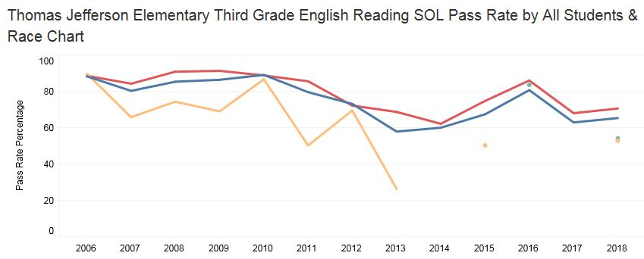
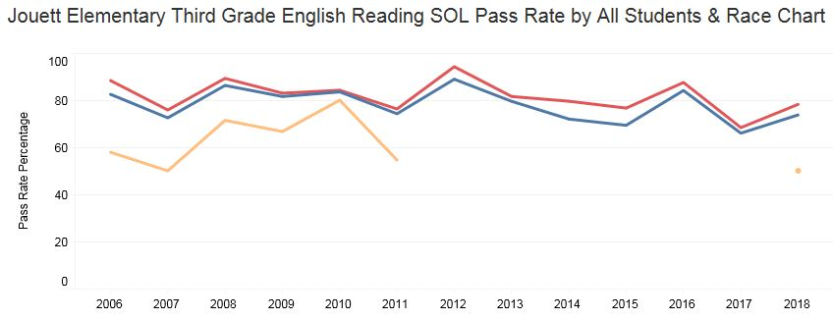
Third Grade English Reading SOL Pass Rate,2008-2018 Class Year. Source: Virginia Department of Education, 2018.
Notes:
After 2013, both TJ and Jouett elementary lost the majority of nonwhite students. But where there are students of color, they consistently have much lower pass rates.

Slide 30
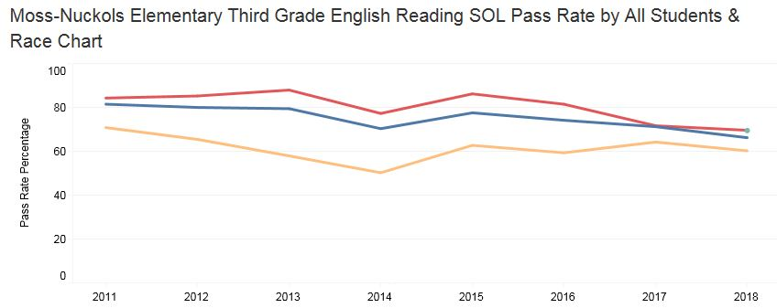
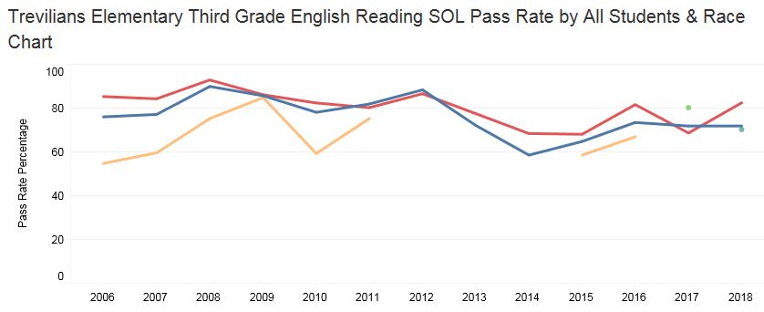
Third Grade English Reading SOL Pass Rate,2008-2018 Class Year. Source: Virginia Department of Education, 2018.
Notes:
Black students at Moss-Nuckols consistently have lower SOL pass rates than white students—overall performance has been decreasing
Same with Trevilians Elementary

Slide 31
2019 MAPP2Health
Questions?
Guleer Shahab, Data Analyst
Thomas Jefferson Health District
434-422-3214
guleer.shahab@vdh.virginia.gov

