Slide 1
MAPP2Health Meeting 1 Recap
Notes:
In the first meeting, we discussed a variety of public and community health frameworks intended to frame community health improvement work and community health programming. In addition to the frameworks presented in the first meeting, wanted to share several more frameworks provided by members of this group.

Slide 2
Notes:
Pyramid of optimal mix of services for mental health. Framework provided by the World Health Organization. Thanks to Rebecca Kendall of the Community Health and Wellness Coalition for sharing.

Slide 3
TedTalk
How Childhood Trauma affects Health across a Lifetime
Nadine Burke Harris
Notes:
In first meeting, talked about the importance of trauma-informed care. Pyramid depicting the impact of adverse childhood experiences (ACEs). In addition, highly encouraged to watch this excellent TedTalk by Dr. Burke Harris on ACEs. Thanks to Alicia Lenahan of the Trauma Informed Community Network (TICN) for sharing.

Slide 4
Group Activity Recap from 1st Meeting
Spend 15 minutes walking around and looking at the posters. Add your stars:
Would like to learn more about this
Likely to have a greater impact on health equity
Top consideration for action/implementation (OK to include items that would be difficult to implement if likely to have a greater impact)
Notes:
In the first meeting, we broke into smaller groups arranged by MAPP priority (+ a social determinants of health category) to brainstorm current practices (community programming, activities, and initiatives) and where they might fall on the health impact pyramid. Then, brainstormed best practices (either currently occurring here/elsewhere and/or promising practices) that are either policy, systems, or environmental changes. Posters are wall reflect the work from the work meeting. Walk around and review the work from each group and use the dots to highlight the three categories (pink, green, yellow).

Slide 5
MAPP2Health Incorporating Health Equity

Slide 6
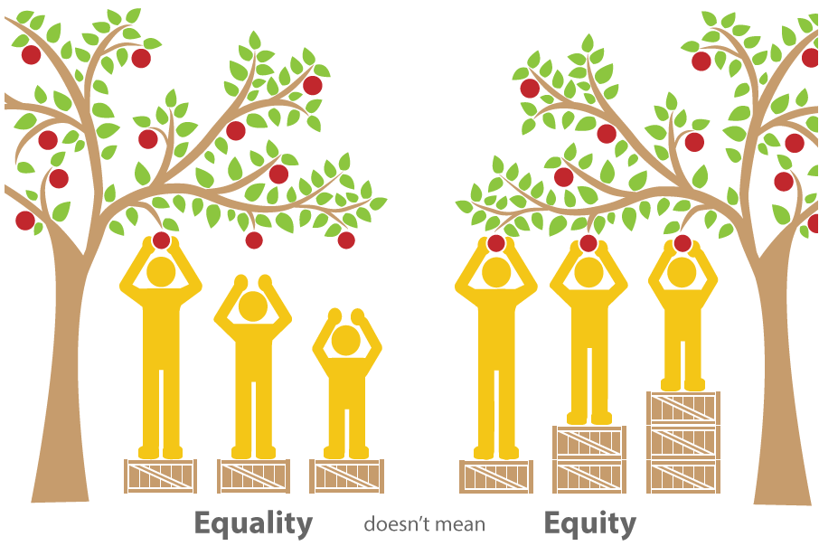
What is Health Equity?

Slide 7
Incorporating Health Equity Activity
Conventional Approach
Health Equity Approach
What types of services and resources do we need to improve health?
What programs and services do we need to address health disparities?
Which government officials, expert researchers, or media personalities best understand the issue?
What fundamental policy changes do we need?
What kind of collective action and structural social changes do we need to tackle health inequities?
Which community members and grassroots organizations can best define the issue?
Notes:
(30 minutes) As a group, review the MAPP handout from NACCHO’s MAPP user handbook (p.88a) “Identifying Strategic Issues to Address Health Equity.” In the context of your group’s priority/topic, discuss the following questions. You can take notes on the paper at your table, if you’d like.

Slide 8
MAPP2Health Best Practices Planning Tools

Slide 9
CDC’s Community Health Improvement Navigator:
the Who, What, Where, and How of Improving Community Health
Notes:
Goal of this work group is to recommend best practices for use by MAPP Councils in each locality that will positively affect health in our district’s communities through a “balanced” portfolio of interventions as suggested by this CDC framework we reviewed in the first meeting.

Slide 10
Unnatural Causes Documentary
Diabetes Among Native Americans – Genes or Environment?

Slide 11
Policy, Systems, and Environmental Change
Change Policies
Change Systems and How They Work
Change the Environment around You
Policies at the legislative or organizational level | Changes made to the rules within an organization; often focuses on changing infrastructure or instituting processes or procedures | Change made to the physical environment (or social / economic factors)
Ex 1: locality cigarette tax (P) or organizational tobacco-free policy (p). Ex 2: policy on no soda in vending machines, at school events. | Ex 1: creating a certification process for school bake sales to ensure they are in line with school wellness policy. Ex 2: school switches procurement and cooking systems to fresh from scratch foods. | Ex 1: installing bike signage for bike routes or sidewalk installation and pedestrian friendly intersections to promote walking and biking. Ex 2: installing school gardens (expose students to fresh produce, teach about how food grown)
Notes:
11
Traditional approach: education and counseling for individual behavior change. Per RWJF, policy, systems and environmental change approaches seek to go beyond programming and into the systems that create the structures in which we work, live and play. These approaches often work hand‐in‐hand where, for example, an environmental change may be furthered by a policy or system change. Similarly a policy could be put in place that results in additional environmental changes. The process is not linear. At the end of the day, an effective PSE approach should seek to reach populations and uncover strategies for impact that are sustainable. Efforts may accelerate the adoption or implementation of effective interventions by effectively integrating approaches into existing infrastructures. Such approaches often include advocates, decision and policy makers. Characteristics:
Ongoing
Foundational: often produces behavior change over time
Community/Population level
Part of an ongoing plan
Long term
Sustaining

Slide 12
SPHERES OF INFLUENCE APPROACHES | INDIVIDUALS | ORGANIZATIONS & INSTITUTIONS | COMMUNITY (neighborhoods, municipalities, counties, or state)
PROGRAMS Activities focused on increasing knowledge about health issues.
POLICY CHANGE Policies, rules, ordinances & laws that support healthy practices.
SYSTEMS CHANGE Change that impacts social norms of an organization, institution, or system.
ENVIRONMENTAL CHANGE Physical aspects of the environment that support healthy or discourage unhealthy behaviors.
Notes:
The intervention planning matrix helps you consider the range of possible approaches that could be used to address your identified health issue at the individual, organization/institution, and community levels. Some approaches may fit more than one box, just decide which is the best fit. The goal isn’t to fill out every box.
This tool can help you brainstorm strategies and work toward the “sweet spot” of policy changes with greater impact
Consider
Will the strategies you’re considering have the impact you’re hoping for?
Are the strategies you’re considering programmatic or are they on the policy spectrum?
Developed by the Healthy Wisconsin Leadership Institute
Download the tool here: http://www.countyhealthrankings.org/intervention-planning-matrix

Slide 13
Best Practices Tool Activity
(5 min) As a group, compile your homework (research on best practices). Write each item down on a separate sticky note.
(15 min) Share information on the best practices you brought (already happening in Cville? National recommendation? Something promising happening in another state/city/county/country? How/where did you hear about it? Do you know how it’s funded?)
(15 min) As a group, discuss and place sticky notes on the matrix. Do you have any gaps? Too many in one part and not enough elsewhere?

Slide 14
Homework
Consult community:
Which community members and grassroots organizations can best define the issue [your priority]?
What might work in your/our community? Who in the community has been consulted (consider conversations, community meetings, surveys, focus groups, Photovoice projects, etc.)
What has already been tried? What are people excited about? Where is there energy and momentum?
Come back in March ready to discuss and share.

Slide 15
2019 MAPP2Health
Putnam Ivey, Healthy Communities Coordinator
Thomas Jefferson Health District
434-972-6241
putnam.ivey@vdh.virginia.gov
Questions?

