Slide 1
2019 MAPP2Health

Slide 2
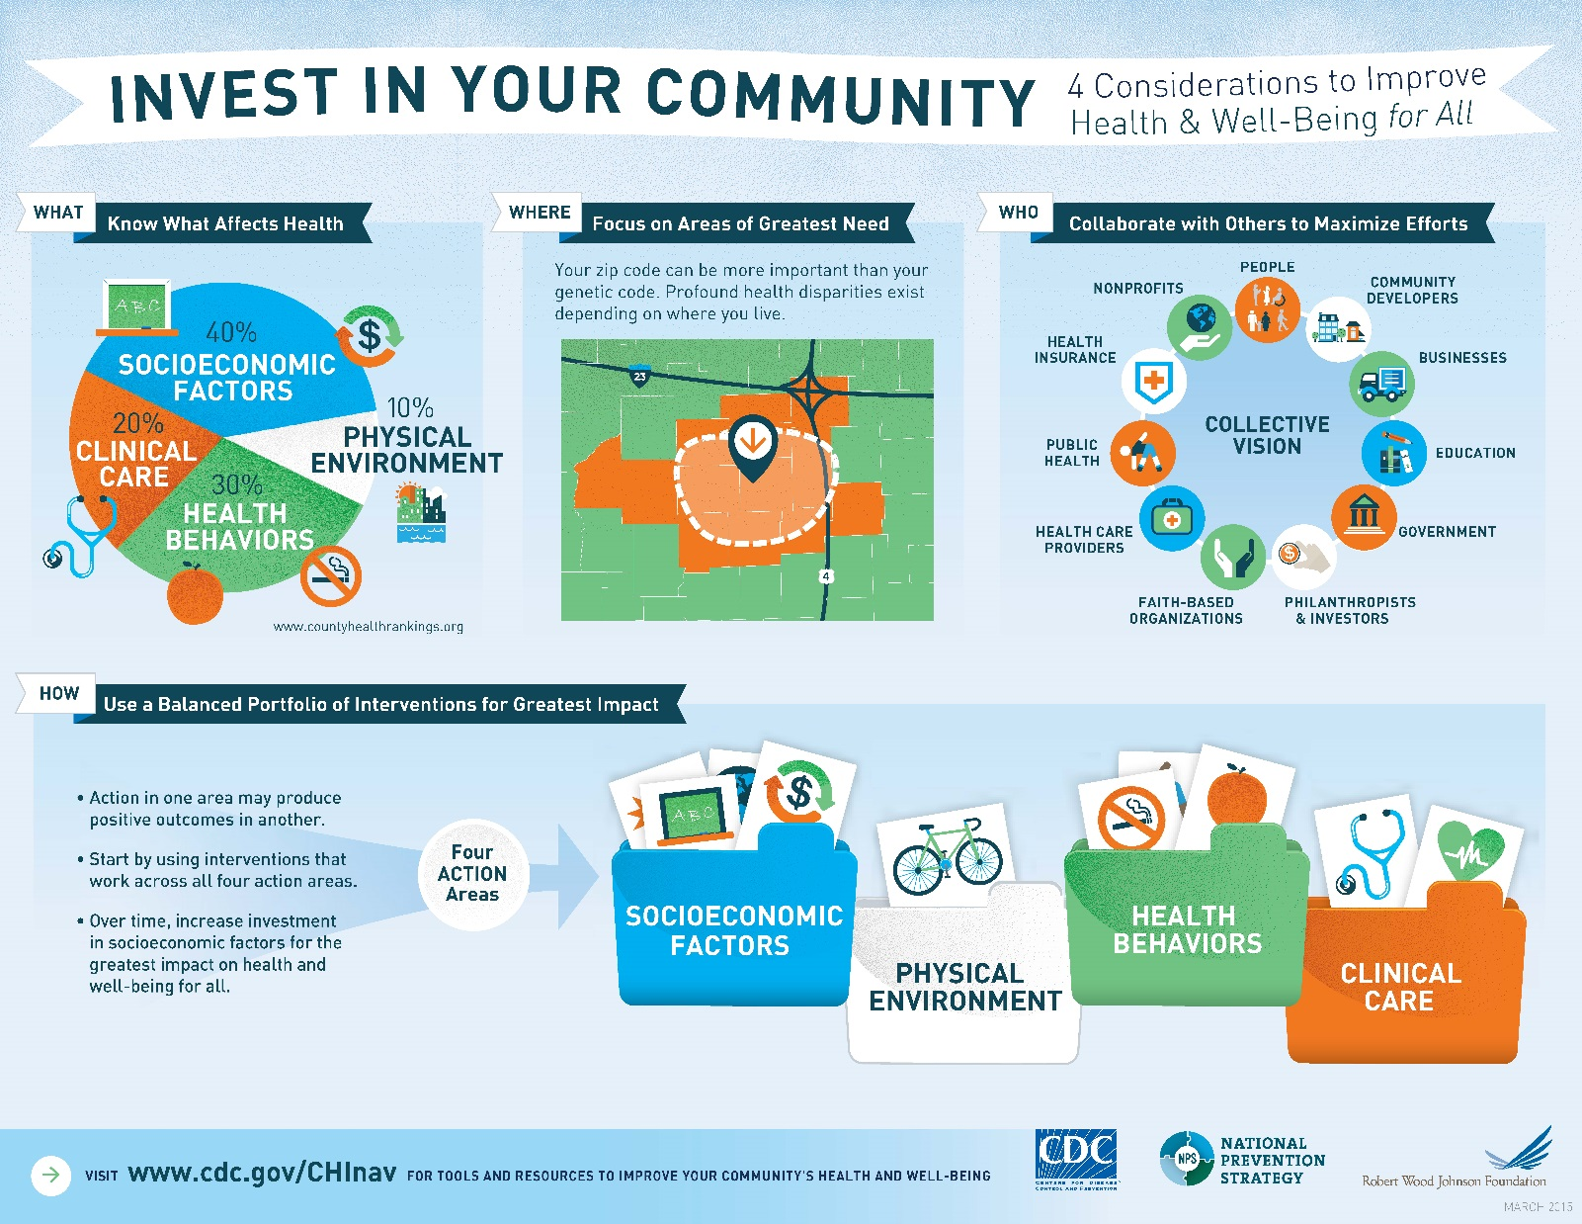
The Big Picture: How to Assess and Improve Community Health
We’re here!
Notes:
Great infographic from CDC’s Community Health Improvement Navigator on the process. I find it is the most succinct way of explaining the and understanding the idea of improving health and well-being for all.
WHAT? Not just clinical!
WHERE? Should be targeted to areas of greatest need, based on data
WHO? Must be collaborative
HOW? After assessment, interventions should have a balanced portfolio for the greatest impact (just like your stock portfolio, right?) It’s interventions related to health behaviors, clinical care, social determinants of health, and more!

Slide 3
The Other 50%
Clinical care (20%)
Health behaviors (30%)
Where you live, work, play, and pray affects your health and well-being
(Social Determinants of Health)
Notes:
Basically, the recognition that genetics and access to care/your healthcare (going to the doctor) aren’t the only factors that influence your health. Most of health occurs outside the walls of your healthcare provider and are influenced by things such as where you live (next to a polluting factory or in a neighborhood with leafy green trees) … access to and quality of education [like we saw with the health literacy slides] … your job - do you work in dangerous conditions around dangerous chemicals that irritate your asthma or do you work somewhere with wellness policies and ergonomic desks/chairs? Do you make enough money to support yourself/your family? Do you have paid sick and vacation leave? What about paid maternity/paternity leave? … what kinds of opportunities for physical activity and recreation are around you both as a child and as an adult … as you age, do you have a healthy support network or are you socially isolated? Can you access opportunities for social interaction, physical activity, fun activities, etc.
How does what you see in this picture affect your health?

Slide 4
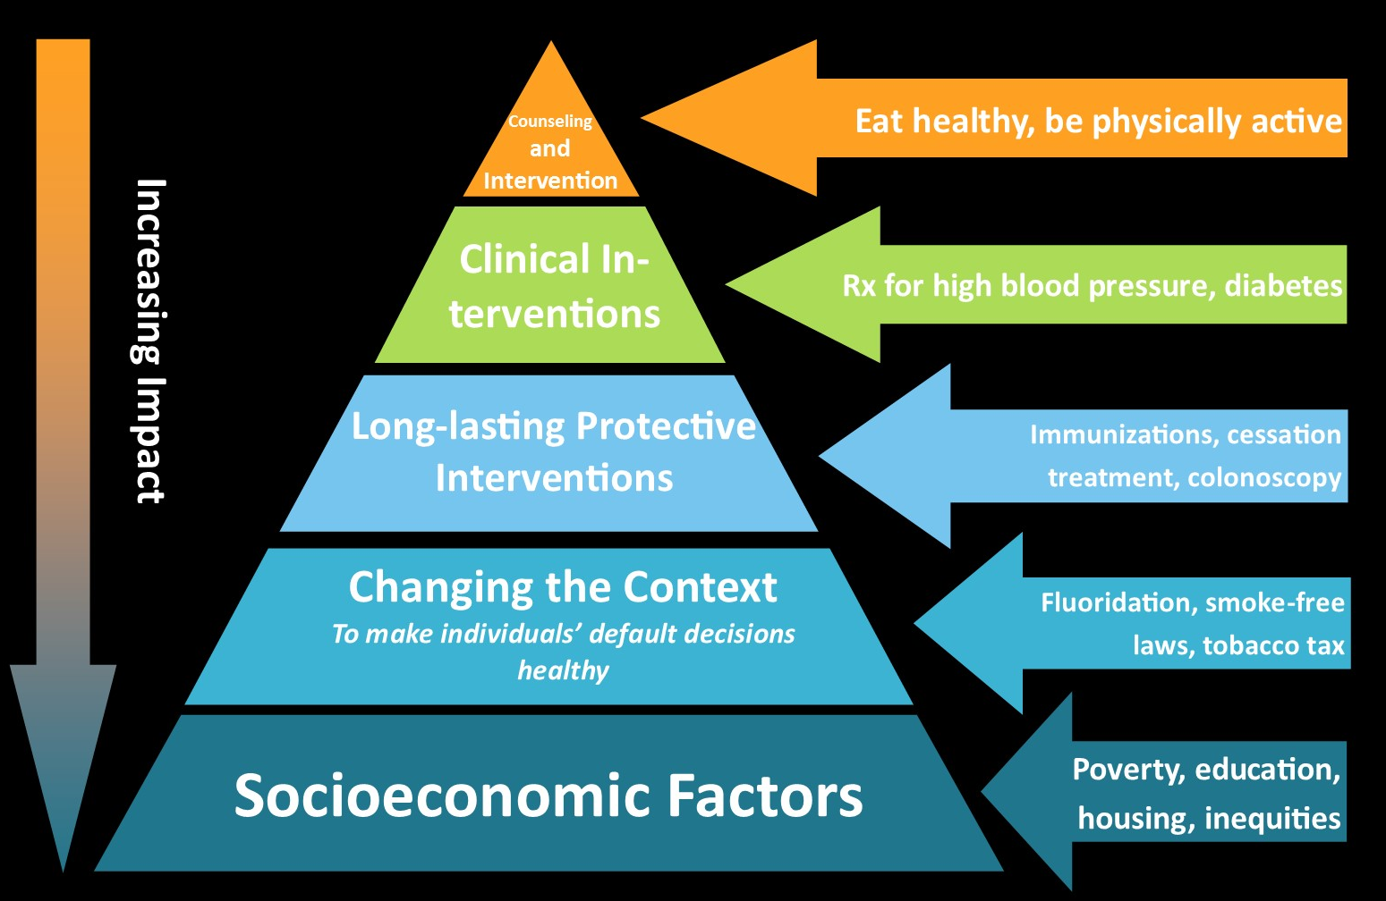
How Do We Impact Health?
Source: CDC, Frieden, T. A Framework for Public Heath Action: The Health Impact Pyramid. Am J Public Health. 2010; April; 100(4): 590–595.
Notes:
4
“A 5-tier pyramid best describes the impact of different types of public health interventions and provides a framework to improve health. At the base of this pyramid, indicating interventions with the greatest potential impact, are efforts to address socioeconomic determinants of health. In ascending order are interventions that change the context to make individuals' default decisions healthy, clinical interventions that require limited contact but confer long-term protection, ongoing direct clinical care, and health education and counseling.
Interventions focusing on lower levels of the pyramid tend to be more effective because they reach broader segments of society and require less individual effort. Implementing interventions at each of the levels can achieve the maximum possible sustained public health benefit.”

Slide 5
How do we impact health?
Change Policies
Change Systems and How They Work
Change the Environment around You
Notes:
5
What is Policy Change? Policy change includes policies at the legislative or organizational level. For example, institutionalizing new rules or procedures as well as passing laws, ordinances, resolutions, mandates, regulations, are all examples of policy change efforts. Government bodies (federal, state, local level), school districts and schools, park districts, healthcare organizations (hospitals, health systems), worksites, and other community institutions (jails, daycare centers, senior living centers, faith institutions) all have and make policies.
Examples include: • Establishing healthy concession stand policies in local parks or recreation facilities
What is Systems Change? Systems change involves change made to the rules within an organization. Systems change and policy change often work hand‐in‐hand. Often systems change focuses on changing infrastructure within a school, park, worksite, or health setting or instituting processes or procedures at the system level that ensure a healthier workplace. Examples are: • Screening for Hunger in Hospitals and developing ongoing mechanisms to refer hungry residents to food • Far
What is Environmental Change? Environmental change is change made to the physical environment. Physical (Structural changes or programs or service), social (a positive change in attitudes or behavior about policies that promote health or an increase in supportive attitudes regarding a health practice), and economic factors (presence of financial disincentives or incentives to encourage a desired behavior) influence people’s practices and behaviors. While related to the environment, such changes are not isolated to a few households or individuals, but instead reflect a population‐ focused effort. Examples of changes to the environment might include: • Incorporating sidewalks, paths, pedestrian friendly intersections, and recreation areas into community design (complete streets policy). • Installing signage on already established walking or biking routes. • Availability of healthy food choices in restaurants or cafeterias. • Increase in acceptance of limiting candy as rewards in classrooms across a school district. • Charging higher prices for less healthy products to decrease their use.
http://healthtrust.org/wp-content/uploads/2013/11/2012-12-28-Policy_Systems_and_Environmental_Change.pdf

Slide 6
A Recommended Best Practice(s)
An Identified Community Asset (Photovoice)
Strategy to Improve Health Equity

Slide 7
Example 1
Recommended Best Practices
Jobs-Plus program that combines employment, training services, and neighbor-to-neighbor outreach.
Provide a living wage for contract and non-contract staff.
Develop an agency job pathway for high schools, trade schools and/or Associates degrees.
Photovoice Assets
Asset #1: Our families. You can improve health equity by helping to strengthen our families, especially Moms and Dads through opportunities for stable housing, jobs, and education.

Slide 8
Example 2
Recommended Best Practices
Home-based visiting programs for children and families.
Youth development and advocacy programs.
Expand program-driven community gardens that include an educational component such as nutrition education, cooking classes, and tastings.
Photovoice Assets
Asset #3: Community programming. Charlottesville has lots of programs. You can build on health equity by making sure more kids are exposed to programming to build and encourage friendship and community.

Slide 9
Example 3
Recommended Best Practices
Community Health Worker models
Peer support services / peer navigators
Develop a peer network for all peer educators, including continuing education
Youth development opportunities
Social support groups
Photovoice Assets
Asset #5: Community leaders. You can build on health equity by developing more role models and mentors in our communities and especially in schools where we sometimes feel ignored.

Slide 10
Small Group Activity
Break into small groups
Take 20 minutes to review some of the recommended best practices and cultural and community assets identified in the Photovoice project
How could you combine a best practice + asset into an actionable strategy to improve community health and health equity in Greene County?
Remember to consider areas of greatest need

Slide 11
Keep in Mind
Who would your idea serve?
How does your idea or strategy serve those in greatest need? (based on data, community conversations, identified assets, historically underserved, etc.)
How could this become the foundation for a MAPP implementation grant? Who would be partner agencies? Have community members expressed a need that your idea would fill?

Slide 12
2019 MAPP2Health
Putnam Ivey
Healthy Communities Coordinator
Thomas Jefferson Health District
434-972-6241
putnam.ivey@vdh.virginia.gov
Questions?

