Slide 1

Virginia Department of Health
Medical Monitoring Project
Stakeholder Meeting
Monday, April 20, 2015
10-11:30am

Slide 2
Introduction
Presenters
  Anne Rhodes, PhD; Director of HIV Surveillance
  Lauren Yerkes, MPH; HIV Epidemiologist
  Kristen Kreisel, PhD; MMP Project Coordinator
  Jennifer Kienzle, PhD; MMP Data Manager
  Celestine Buyu, MPH, MHSA; MMP Principal Investigator
  Mark Freedman, DVM, MPH; CDC MMP Project Officer for Virginia
Hold questions for discussion sections
Chat feature for questions
Notes:
I wanted to start off by introducing myself. My name is Kristen Kreisel, and I am the Project Coordinator for the Medical Monitoring Project at the Virginia Department of Health.
We really wanted to thank all of you for taking the time out of your busy schedules to join us today.
Many of you may be wondering why you’ve been invited to this webinar, especially if you have not been involved in the Medical Monitoring Project before or even know what it is. If you don’t know what the Medical Monitoring Project, or MMP, is, we’ll provide all of the information you need to know today. The purpose of this webinar is to inform all of the HIV care providers around Virginia about some upcoming changes to the protocol for MMP and illicit your feedback. As a HIV care provider, HIV patients receiving care at your facility could be sampled in the next cycle of MMP, so we want to hear what you have to say about these upcoming changes to the sampling methodology. You’re our partners and without your involvement, MMP really isn’t possible.
With that being said, there are a handful of people presenting on today’s call, so I’ve listed all of the presenters in order of presentation. Everyone presenting today is involved with MMP in one way or another, and we also have our MMP Project Officer with us today as a representative for CDC.
Just a few housekeeping items:
We have quite a bit of information to go over and anticipate that there could be a fair bit of discussion. Please hold your questions for discussion sections that we have placed throughout the presentation.
We encourage the use of the chat feature in the Genesys webinar software. If you should have any questions that you don’t want to forget, please feel free to type your questions as we go and we will address them during the discussion sections.

Slide 3
Webinar Agenda
Introduction
Overview of the HIV Surveillance Program at VDH
HIV Epidemiology in Virginia
What is MMP?
MMP data overview
DISCUSSION
New Case Surveillance Based Sampling (CSBS) Methodology for MMP 2015
Reasons for Change to New Design
DISCUSSION
CSBS Pilot Study
Change in Facility Involvement with CSBS
CSBS Challenges and Benefits
DISCUSSION

Slide 4
HIV Surveillance at VDH
Collect data on Persons Living with HIV
Work with providers and other stakeholders to improve data quality and understand needs
Disseminate information on HIV data, trends, rates to monitor the epidemic

Slide 5
Division of Disease Prevention
Includes HIV Prevention, HIV Care (Ryan White grant), TB Control and Newcomer Health, and STD Surveillance and Field Operations
Part of the Office of Epidemiology
Webpage:
  http://www.vdh.virginia.gov/epidemiology/DiseasePrevention/
  Facebook Page:
  https://www.facebook.com/DiseasePreventionHotline

Slide 6
HIV Case Surveillance
Collect data on newly identified cases of HIV
Collect ongoing data on labs for persons living with HIV
Data utilized as base for Ryan White and HIV Prevention funding
Base for HIV Continuum of Care and assessing epidemic in VA

Slide 7
HIV Incidence Surveillance
Purpose
Provides estimates of the number of new HIV infections over a certain period of time.
Definition
Incidence refers to persons newly infected with HIV in a specified time period, whereas a person newly diagnosed with HIV may have been infected for years before being diagnosed.
Usages
Important for prevention evaluation and planning, public health policy development, resource allocation and to identify disease trends.

Slide 8
Molecular HIV Surveillance
Collection
All HIV nucleotide sequence data from laboratories that perform HIV genotypic drug resistance testing;
Have data for 2013-2014 from one site, working to bring other labs on board and change regulation
Analysis
Assess HIV drug resistance, evaluate HIV genetic diversity, and describe HIV transmission patterns
Disseminate findings to physicians, HIV planning groups

Slide 9
Newly Diagnosed HIV Disease Cases in Virginia, 2004-2013
7.8%
Data as of December 2014; Accessed March 2015, HIV Surveillance, Virginia Department of Health

Slide 10
New HIV Diagnoses by Region, 2013
 | Central (N= 207) | Eastern (N= 343) | Northern (N= 279) | Northwest (N= 87) | Southwest (N = 90)
Sex | 79.2% male 20.8% female | 81.6% male 18.4% female | 81.0% male 19.0% female | 82.8% male 17.2% female | 77.8% male 22.2% female
Race | 75.9% Black, NH 20.8% White, NH 2.4% Hispanic | 72.0% Black, NH 21.9% White, NH 4.4% Hispanic | 44.4% Black, NH 42.5% White, NH 18.6% Hispanic | 44.8% Black, NH 42.5% White, NH 11.5% Hispanic | 44.4% Black, NH 51.1% White, NH 3.3% Hispanic
Age at Dx | 34.8% 15-24 28.0% 25-34 13.5% 35-44 13.0% 45-54 10.6% 55+ | 30.0% 15-24 31.5% 25-34 15.7% 35-44 12.0% 45-54 9.6% 55+ | 13.6% 15-24 29.4% 25-34 25.5% 35-44 21.9% 45-54 9.0% 55+ | 24.1% 15-24 20.7% 25-34 14.9% 35-44 24.1% 45-54 16.1% 55+ | 23.3% 15-24 23.3% 25-34 20.0% 35-44 18.9% 45-54 11.1% 55+
Risk
Data as of December 2014; Accessed March 2015, HIV Surveillance, Virginia Department of Health
MSM- Men who have sex with men/ male-to-male sexual contact
IDU- Injection drug use
NRR/NIR- No reported or identified risk
HC- Heterosexual contact
Notes:
IDU includes MSM-IDU as well
Northwest has more newly diagnosed male cases than other regions
Central and Eastern have more predominance in newly diagnosed cases among 15-34 year olds. Northern, Northwest, and Southwest, have a little more even distribution among the age groups. Northern has a high percentage of 35-54 year olds than other regions.
Northern and Northwest have the most newly diagnosed cases attributed to Hispanics; Northern (19%) and Northwest (12.6%) Southwest has more White new diagnoses than Black or Hispanic
Eastern has the highest percentage of cases attributed to MSM transmission; Northwest has highest percentage of IDU out of all the regions. Southwest has the highest percentage of cases attributed to heterosexual transmission. Risk percentages are only calculated for those who DID report or identify a risk. Those that were NIR/NRR were excluded from the pie charts. Also did not include pediatric cases or cases attributed to receipt of blood transfusion/organ transplant

Slide 11
Summary of Persons Living with HIV Disease in Virginia as of December 31, 2013
Transmission Risk | Percent of PLWHA
Men who have sex with men (MSM) | 46.4%
No reported or identified risk | 19.2%
Heterosexual contact | 19.1%
Injection drug use | 9.7%
MSM-IDU | 4.0%
Other (pediatric and receipt of blood products) | 1.7%
White, non-Hispanic
(30.0%)
Black,
non-Hispanic (59.4%)
Hispanic (7.8%)
Other (1.7%)
Asian/Hawaiian/PI (1.2%)
Hispanic (7.4%)
Data as of December 2014; Accessed March 2015, HIV Surveillance, Virginia Department of Health
Notes:
Females: a little over ¼ of persons living with HIV; Males approximately ¾
Black, non-Hispanics: almost 60% of all prevalent cases, White, NH (30.2%), Hispanics 7.4%
Age at diagnosis: greatest percentage is among those 25-34, followed by 35-44; current age: greatest percentage is those 45-54, followed by 55+
Percent of PLWHA: denominator only includes those who did report or identify a risk for transmission

Slide 12
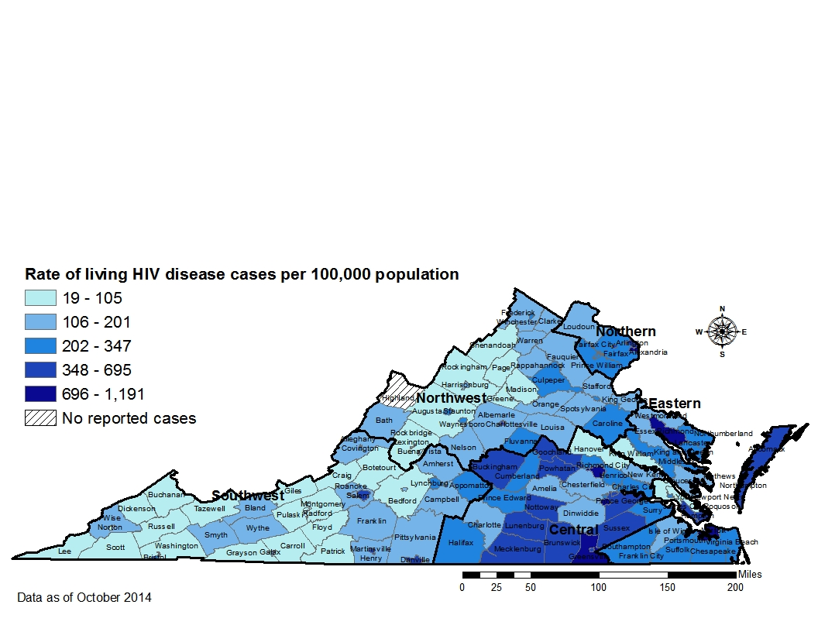
Persons Living with HIV Disease as of December 31, 2013 by Locality in Virginia

Slide 13
What is the HIV Continuum of Care?
A model used to assess health outcomes of persons living with HIV/AIDS (PLWHA)
A surveillance tool used to:
  Evaluate program effectiveness
  Identify potential gaps in services to facilitate better outcomes among subpopulations most in need
  Assist PLWHA to engage in and receive continuous care
  Aid PLWHA in achieving progress through the stages of engagement with the goal of viral suppression

Slide 14
Defining the HIV Continuum of Care
What’s considered a care marker?
CD4 test
Viral load test
HIV medical care visit
ART prescription
Linkage
Retention
Viral Suppression
Evidence of a care marker within 90 days of initial HIV diagnosis
2 or more care markers in 12 months at least 3 months apart
Last viral load <200 copies/mL in the time period being measured
Notes:
The Centers for Disease Control (CDC) currently uses two markers of care to collect care continuum information, either a viral load test or a CD4 test. Since both surveillance and care data sources are integrated together, we also have information on HIV medical care visits from VACRS and ART prescriptions from ADAP which enables us to use more than the two care markers (CD4 count or viral load) to determine a person’s progress through the continuum. We define a care marker as evidence of a HIV medical care visit date, a CD4 count and test date, a viral load value and test date, and/or an antiretroviral medication prescription and date.
What are the definitions of linkage to care, retention in care, and viral suppression? They are typically defined in these ways here, but there are many different definitions of the care continuum as of this point. Linkage to care is defined as evidence of a care marker within 90 days of initial HIV diagnosis, retention is defined as 2 or more care markers in a 12-month timeframe, at least 3 months apart, and viral suppression is the last viral load that was measured is <200 copies/ml.

Slide 15
Data derived from eHARS, ADAP, VACRS, Medicaid as of December 2014; Accessed March 2015, HIV Surveillance,
Virginia Department of Health

Slide 16
Data derived from eHARS, ADAP, VACRS, Medicaid as of December 2014; Accessed March 2015, HIV Surveillance,
Virginia Department of Health

Slide 17

What is the Medical Monitoring Project (MMP)?
Ongoing supplemental surveillance system assessing behaviors and clinical characteristics of persons living with HIV/AIDS (PLWHA) who have received outpatient HIV medical care
To learn more about the experiences and needs of people who are receiving care for HIV
Funded by Centers for Disease Control and Prevention (CDC)
Conducted by state and local health departments
Notes:
HIV surveillance programs collect a core set of information on persons with a diagnosis of HIV infection, persons who are living with HIV infection, and persons who have died from HIV infection
MMP is a supplemental surveillance system that can collect information in addition to what core surveillance can collect regarding the clinical outcomes and behaviors of HIV-infected persons
MMP is designed to produce nationally representative data on the HIV population in care in the US with respect to seeking medical care, access to and utilization of health care services, and ongoing risk behaviors.
The program grew out of experience with previous supplemental surveillance programs, and is funded by the CDC and conducted by state and local health departments.

Slide 18
Goals of MMP
  Behaviors and clinical outcomes
  Access to/
  Use of Prevention Services
HIV-related
Co-morbidities
Support Services
Met/Unmet Needs
HIV Care
Notes:
The aims of MMP are to provide nationally and locally representative data to:
describe behaviors and clinical outcomes of persons in care for HIV
describe the prevalence of co-morbidities related to HIV disease
to determine the prevalence of ongoing risk behaviors and access to, and use of, prevention services among persons living with HIV
describe HIV care and support services received and the quality of such services
identify met and unmet needs for HIV care and prevention services to inform prevention and care planning groups, health care providers, and other stakeholders

Slide 19
Significance of MMP
MMP is the most comprehensive project of its kind.
MMP can provide valuable local and national estimates regarding health care utilization, quality of care, and met and unmet needs of PLWHA.
Because of a nationally representative sample, information gathered from MMP can be used for care, prevention, and funding planning purposes groups by a wide variety of groups with different initiatives.
Notes:
MMP is unique in that it provides comprehensive information from patient samples carefully selected to represent everyone receiving medical care for HIV in the U.S.
Because MMP’s national estimates are representative, information gathered from MMP may be used by HIV prevention community planning groups, Ryan White planning councils, HIV care providers , policy makers and service planners, and people living with HIV/AIDS to highlight disparities in care and services and advocate for additional resources.
For a program to be effective, it must meet the needs of the population it serves. MMP data provide information on prevention, care-seeking, treatment, and risk behaviors that can assist in designing, and more importantly improving, HIV programs.

Slide 20
Current MMP Sampling Methods:
3-Stage Sampling Design
State Level
Health Care Facility Level
Patient Level
23 Project Areas
Sample of HIV medical care facilities from each state (small, medium, and large)
Sampling frame reconstructed every 2 years
Sample of patients from each facility selected to participate
Behavioral and clinical information to represent HIV+ patients in HIV medical care
16 states, 1 U.S. territory, 6 separately funded cities
25-50 facilities from each project area
400 sampled for Virginia; 100-800 for other project areas
Notes:
MMP uses a 3-stage sampling design.
During the first stage of sampling, which is conducted at the state level, project areas are selected from across the nation to participate. All 50 states, the District of Columbia, and Puerto Rico are eligible for inclusion in MMP. Project areas are selected using a geographically stratified random sampling where the probability of selection is proportional to the prevalence of AIDS in each project area. Sites are selected to represent low, medium, and high prevalence areas of the country. In the 2014 data collection cycle, there are 23 project areas, consisting of 16 states, 6 independent cities, and 1 outlying US territory (Puerto Rico). The project areas selected are estimated to include over 80% of the total HIV/AIDS cases in the US.
During the second stage of sampling, which is conducted at the facility level, project areas construct a facility sampling frame, which is a complete list of all of the facilities that provide outpatient HIV medical care in the project area’s jurisdiction. For the purposes of creating this facility sampling frame, facilities are eligible to participate if they order CD4 and/or HIV viral load tests or prescribe antiretroviral medications in the context of treating and managing HIV. From this list of all facilities that provide HIV care, the MMP staff from VDH recruit to determine which facilities agree to participate. Facility participation is very important, because those that participate represent those not selected to participate.
During the third stage of sampling, which is conducted at the patient level, a sample of 400 patients is selected each year from participating HIV care facilities. Patients must be at least 18 years old, diagnosed with HIV, and receiving care. The total resulting population from all project areas combined is approximately 10,000 patients per data collection cycle nationwide.
Patients who are selected are then asked to participate in an interview and answer questions about their HIV care.

Slide 21


MMP Data Collection - Interviews
Telephone Interviews
In-person Interviews
OR
Notes:
There are 2 methods of data collection for MMP – interview and medical record abstractions
Interviews are performed with patients who provide consent, and are either performed over the phone or in-person in a private location, such as in the clinic or at the patient’s home
Interviews are arranged to accommodate patient’s schedule and are performed by trained interviewers in either English or Spanish
The interviews take approximately 45-60 minutes to complete and participants are reimbursed with a $40 Walmart gift card for their participation
There are 13 modules in the interview that covers information such as HIV treatment and adherence, sexual behaviors, and access to health care.

Slide 22

MMP Data Collection – Medical Record Abstractions (MRA)
Diagnosis of opportunistic illnesses and other HIV-related conditions
Non-HIV associated comorbid conditions
Preventive care received
Prescription of antiretroviral and other medications
Laboratory results
Health services utilization
Notes:
Patients’ medical records are abstracted after the interview is completed using a web-based application provided by the CDC.
The observation period during which medical record data is abstracted is a 2-year period. For patients participating in the interview, medical record data for 2 years prior to the interview date are abstracted.
For example, if a participant was interviewed today, their medical record would be abstracted for information back through April 20, 2013
The information abstracted from medical records includes: 1) diagnosis of opportunistic infections, 2) non-HIV associated comorbidities, 3) preventive care received, 4) ARV and other medications prescribed, 5) lab results, and 6) health services utilization

Slide 23
Uses of MMP Data for Current Issues
Contribution of MMP data to the HIV continuum of care
  Can provide nationally and locally representative data to evaluate each stage of the HIV continuum of care, especially the “Prescribed ART”
    Diagnosis, linked to care, retained in care, prescribed ART, virally suppressed
MMP data can provide information on how the Affordable Care Act (ACA) is affecting the National HIV/AIDS Strategy (NHAS)
  Insurance status, met/unmet needs
Notes:
The data collected from MMP can be used to evaluate a number of current issues
One example is the contribution of MMP data to the HIV continuum of care previously discussed by Lauren Yerkes
All MMP participants are HIV infected, so the diagnosis portion is already addressed
However, other information collected in the MMP interview and medical record abstraction provide data to satisfy the other stages of the care continuum.
Of particular use are the data that can evaluate the percentage of HIV patients prescribed ART, as those data are not collected through core surveillance efforts
MMP data can also be used to evaluate the impact of the Affordable Care Act on the National HIV/AIDS Strategy
There are data points collected in the MMP interview and medical record abstraction regarding insurance status and met/unmet needs
These data can be used to evaluate the changes HIV-infected patients are experiencing with regards to service needs, as well as healthcare access and costs, with the introduction of ACA

Slide 24
Enhancing HIV Surveillance
Sociodemographics
Access to and utilization of care
HIV treatment and adherence
Insurance/ health coverage
Substance use
Mental health
Met/unmet need for ancillary services
Prevention activities
Health Conditions and preventive therapy
Sex behaviors
Women’s health
Notes:
Data collected via the medical monitoring project supplements our core and incidence surveillance programs by providing a more complete picture of what our in-care population looks like, in terms of behavioral and clinical characteristics.
In addition, data can be used to inform partner stakeholders within VDH, such as HIV care services and HIV prevention; as well as our external stakeholder partners via factsheets, presentations, abstracts, and papers.
As can be seen on this slide, data are collected for several domains.
At VDH, we are currently working on abstracts/papers looking at the influence of mental health on the likelihood someone has an undetectable viral load; predictors for ART treatment adherence (or non-adherence we may say) and factors that may influence ART taking behaviors and beliefs.
Reports can be found on our website. Check back often, as we hope to publish on the website frequently. For example, we are working on a summary report of clinical and behavioral characteristics of patients who participated in MMP in 2010, with 2011 coming out close after. We will publish this summary report each year.

Slide 25
Participation by Year and Region
100
90
80
70
60
Number of participants
50
40
30
20
10
0
2009
(n=125)
2010
(n=200)
2011
(n=217)
2012
(n=228)
2013
(n=210)
2014 †
(n=220)
MMP cycle year
Central
Eastern
Northern
Northwest
Southwest
† Participant count, to-date.
Notes:
The data collected from MMP can be used to evaluate a number of current issues
This slide shows the number of participants that participate each year; as well as participation by region.
Between regions, we see a discrepancy in numbers, due to population density and site participation rates.
But, for the most part, across time, we’ve seen an increase in participation in MMP. This is important, as it allows us to apply statistical weights to our final data that then enables us to produce findings that are representative of all HIV-positive patients in Virginia.
For the next few slides, I’d like to show you some of the ways we can use data from MMP.
Data utilized in the examples are from the unweighted data from the MMP 2013 data collection cycle. This includes individuals receiving care at a HIV medical care provider from January through April 2013.
Please keep in mind these data are considered preliminary and because statistical weights are not yet incorporated, findings may not representative of the in-care population as a whole.

Slide 26
Selected Sociodemographic Characteristics, 2013†
High school diploma/GED or higher
76%
Living above 2013 FPL
63%
Any public health coverage
42%
No health coverage
19%
Homeless in past 12 months
10%
0
20
40
60
80
100
Percentage of Respondents
† Preliminary data.
Notes:
This slide illustrates what MMP collects beyond the standard demographics of sex at birth, gender, age, race, etc.
Once data weights are applied, these enhanced sociodemographics provide a clearer picture of what the in-care population looks like in terms of education, income, housing and even health care access.

Slide 27
Unmet Need for Ancillary Services, 2013†
Most frequently reported unmet needs for ancillary services*
100
35
31%
30
Percentage
25
20
15
13%
12%
11%
10%
10
5
0
Dental care
Meals/food
assistance
Transportation
Public
assistance
Housing/shelter
assistance
*Percentages calculated from entire 2013 study population (n=210);
categories are not mutually exclusive.
† Preliminary data.
Notes:
MMP data can provide data support for resource planning and allocation for our partner units, such as HIV care services and HIV prevention services.
MMP collects met and unmet need data from patient interviews.
This slide shows the top 5 most frequently reported unmet need in 2013, for ancillary services needed, but not received in the prior 12 months.

Slide 28
Treatment Adherence, 2013 †
If medication has special instructions, how often did you follow all special instructions in the past 3 days?
How closely did you follow your specific medication schedule during the past 3 days?
100
90
79%
80
71%
70
Always
60
Percentage
Not always
50
40
21%
29%
30
20
10
0
† Preliminary data.
Notes:
We also collect data on treatment adherence.
These two items use a 3-day window to assess more recent ART adherence.

Slide 29
Treatment Adherence, 2013 †
When was the last time you missed any of your antiretroviral medicines?
100
45
40
38%
35
30
Percentage
25%
25
20
17%
15
10
8%
9%
5
4%
0
Never
> 3 mo.
1-3 mo.
3-4 wks
1-2 wks
Within
past week
† Preliminary data; Numbers do not add up to 100%, as 9% of respondents skipped this item.
Notes:
This is the third treatment adherence item; and it collects data on a more open ended time retrospective time frame.

Slide 30
Substance Use and Mental Health, 2013 †
Substance use within the past 12 months
Depression symptoms present (PHQ-8 score ≥ 10)?
100
60
55%
50
29%
Percentage
40
30
20%
20
15%
14%
71%
10
1%
0
Daily
smoking
Non-IDU
Marijuana
use
Binge
drinking*
IDU
Yes
No
† Preliminary data.
* Binge drinking refers to alcohol use in the past 30 days.
Notes:
Finally, for the last MMP data example we have for you today, we collect interview and medical record information on substance use and mental health symptoms/diagnoses.
For substance use, we see that 55% of our study population in 2013 reported smoking cigarettes on a daily basis. This is consistent with what we’ve seen in previous data collection cycles; and higher than what is seen with the general population (around 21%). As for non-IDU, 20% of the population reported use in the past 12 months. Most reported marijuana use only. Binge drinking was self-reported at 14%, and calculated by current gender. A couple of patients reported IDU.
In the interview, we administer the Patient Health Questionnaire- 8, or PHQ-8. The PHQ-8 is considered the gold standard for assessing the presence and severity of behavioral symptoms associated with depression. Patient that score a 10 or higher are considered to report moderate to severe depression symptoms. In 2013, almost 30% of participants scored a 10 or higher.
Please keep in mind that that these examples were just a few of the types of data we can pull from MMP. If you have any questions after the webinar, my email address will be shared at the end of the webinar. We’re about to enter a discussion section of the webinar, so I’m going to hand the webinar back to Kristen and if there are any pressing questions I can answer now, just let me know. Thank you for your time.

Slide 31
Discussion/Questions
Notes:
Possible questions for discussion:
Any questions in chat feature of Genesys software?
Providers’ current experience with MMP?
More explanation for those providers who have not participated in the past?

Slide 32
New Sampling Methodology for
MMP 2015
New methods will transition to a Case Surveillance Based Sampling (CSBS) method
MMP population of inference will now include all HIV-diagnosed persons (in and out of care)
Data will be representative of full HIV population
Will assist in addressing issues related to linkage and retention in care, as well as early initiation of antiretroviral therapy (ART)
Notes:
In 2015, new sampling methods will be implemented switching to a Case Surveillance Based Sampling method, or CSBS.
This change in methodology will expand the MMP population of inference to include all HIV-diagnosed persons both receiving and not receiving HIV care.
This will result in the data that is collected being generalizable to all HIV infected adults in the US, no longer just those in care, which will allow for a direct estimation of the proportion of HIV-diagnosed persons who have not been linked to or retained in HIV care.
For those not engaged in care, the data collected will assist in addressing barriers to engagement in care, which subsequently impacts early initiation of antiretroviral therapy. In addition, these data can help to identify demographic or behavioral factors that predict linkage or retention.

Slide 33
MMP 2015 Sampling Method:
2-Stage Sampling Design
State Level
Patient Level
Up to 26 Project Areas possible, contingent on resource availability
Sample of patients selected to participate from HIV Surveillance database for Virginia (eHARS)
Same 16 states, 1 U.S. territory, 6 separately funded cities as 2014
400 sampled for Virginia; 100-800 for other project areas
Potential for 3 additional states
Notes:
With the change in methodology to using case surveillance based sampling, starting in June, the MMP 2015 protocol will use a 2-stage sampling design.
The first stage of sampling will remain the same, where the project areas are selected at the state level using the same probability proportional to size sampling strategy as before. If resources allow, there will be an additional 3 states added as project areas, but the other project areas will remain the same as 2014
However, now, with the new sampling methods being implemented, instead of requesting lists of HIV patients that have received care at facilities around the state, we will be selecting our sample directly out of the HIV surveillance database for Virginia. This means less work for the facilities!
Virginia will still have an annual sample of 400 patients and participants must be at least 18 years old and diagnosed with HIV, but receiving care is no longer a criteria for eligibility. Patients who are selected will still then be asked to participate in an interview and medical record abstraction.

Slide 34
Inclusion Criteria for Sampling Frame
Sampling Frame
Present in the national HIV case surveillance dataset
Meet the HIV case surveillance definition
Diagnosed with HIV as of 12/31/2014
Age ≥ 18 years as of 12/31/2014
Most recently reported address in VA
No death documented as of 12/31/2014
Notes:
To be included in the sampling frame, persons must meet the following inclusion criteria:
1. Present in the national HIV case surveillance dataset
2. Meet the HIV case surveillance definition
3. Diagnosed with HIV as of the sampling date of December 31, 2014
4. Age ≥ 18 years on December 31, 2014
5. Most recently reported address is within VA
6. No death documented as of December 31, 2014

Slide 35
Why the Change in Methodology??
Supplemental HIV Surveillance:
The Back Story
Notes:
To better understand the reasons for the changes in the methodology, I will present some background information in the next two slides.

Slide 36
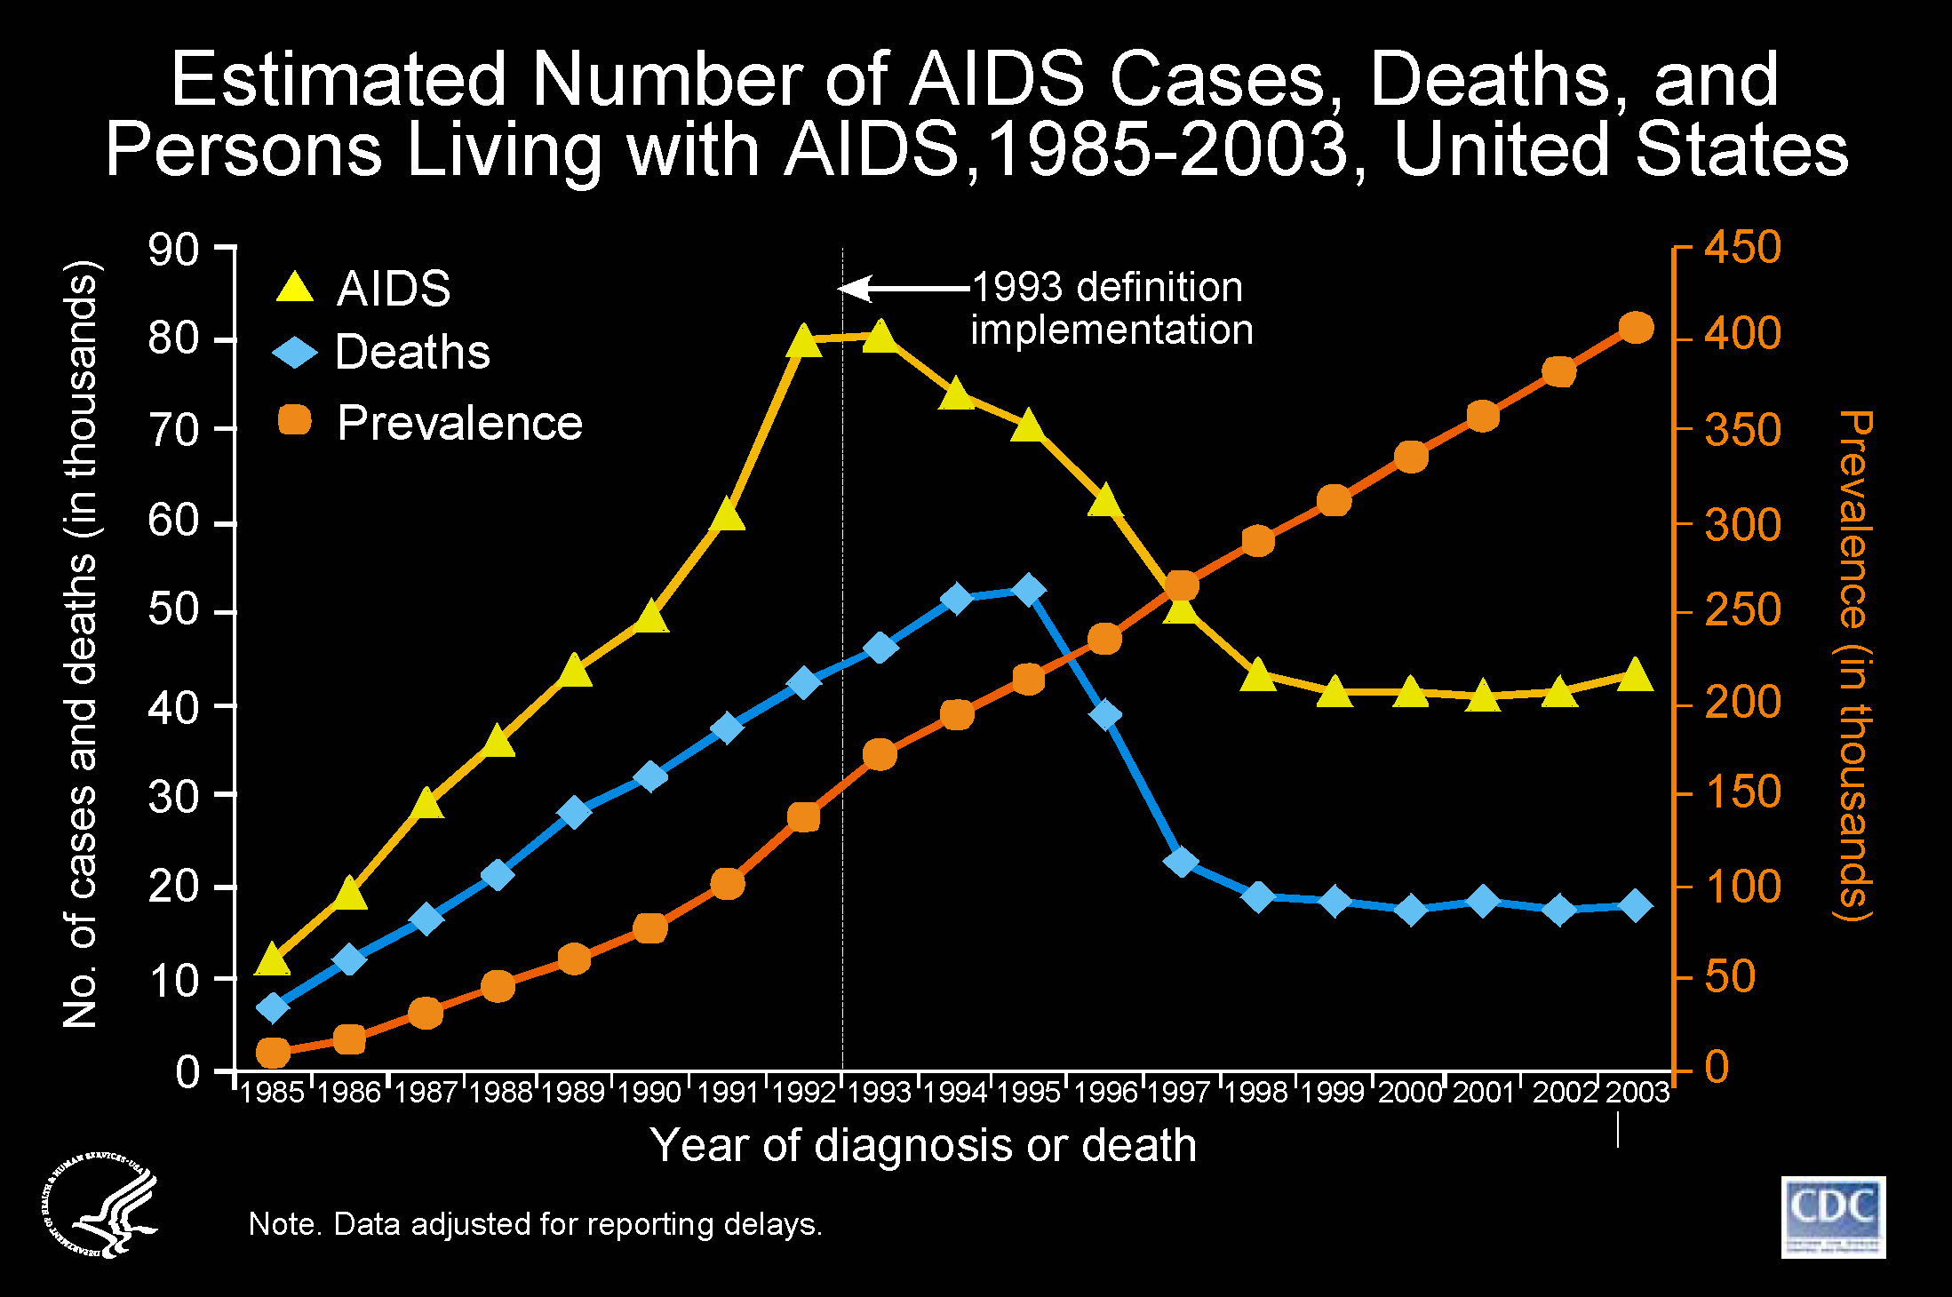
HAART
Notes:
This chart shows data from AIDS case reporting in the US between 1985 and 2003; from the mid 80s to the early 90s, the number of AIDS cases and deaths increased. In 1993 a new case definition was implemented and with the introduction of HAART in the mid 90s, the number of AIDS cases and deaths continued on the downward trend.
But around 1998/1999, number of AIDS cases started leveling off and at that time the reasons for the leveling were thought to include resistance, late presentation to care or late initiation of ART, poor adherence to ART or treatment failure.
Case surveillance, the core HIV surveillance program provides a core set of data that has over the years characterized the HIV epidemic nationally and locally, case surveillance can describe these trends, but supplemental surveillance programs were needed to explore the reasons for the trends and so in the mid 2000s, CDC implemented supplemental HIV surveillance programs. The Medical Monitoring Project was implemented in 2005 following pilot studies conducted in 2004. Other supplemental HIV surveillance programs implemented included: HIV Incidence Surveillance which focuses on new/recent cases as opposed to long term newly diagnosed cases; Molecular HIV Surveillance which collects sequence data and uses molecular epidemiology techniques to characterize the disease and the National HIV Behavioral Surveillance program which focuses on those at high risk for HIV infection.

Slide 37
Backstory (Continued)
Comprehensive rosters of HIV-infected persons did not exist in 2004
Name-based reporting was not legally mandated in all jurisdictions
Facility-based sampling allowed for the collection of interview and medical record data
The importance of ART for HIV was very clear but the role of ART in HIV prevention was not yet firmly established
Notes:
The goals and objectives of MMP have been mentioned by Kristen and at the implementation of MMP, a comprehensive roster of HIV-infected persons did not exist.
The national HIV registry included both name and non-name based jurisdictions
Although Virginia has had mandated name based reporting since 1989, not all reporting jurisdictions in the US legally required name-based reporting. States that did not mandate name reporting used unique identifiers to report their cases.
Based on the need to gather additional information, sampling patients from HIV-care facilities not only allowed for the creation of lists of those in care for HIV but for the collection of data through a linked patient interview and medical records data.
At this time, HAART had been clearly demonstrated to be an effective treatment regimen and the importance of ART was clear however, the role of ART in HIV prevention was not yet firmly established when MMP was first proposed.

Slide 38
Why the Change to CSBS?
Address information gaps regarding progress with linkage and retention in care and enhance the value of the data collected
Strong evidence has emerged showing that a reduction of HIV to undetectable levels through ART can sharply reduce the transmission of HIV
Notes:
Just like the implementation of supplemental surveillance projects were needed to provide more in-depth information about persons with HIV and AIDS, such as disease progression, clinical outcomes, risk and health-related behaviors, and issues surrounding access to care, there is a need to change the MMP methodology to better address information gaps regarding progress with linkage and retention in care and to enhance the value of the data collected.
In recent years, strong evidence has emerged that by reducing the amount of HIV in the blood to undetectable levels, ART can sharply reduce the transmission of HIV, and that the reduction of HIV to undetectable levels can sharply decrease HIV transmission rates.

Slide 39
Why the Change to CSBS? (Continued)
Expand the target population to all HIV-diagnosed persons regardless of their care status
IOM recommendation
NHAS – Increasing access to care
Increase MMP’s capacity to monitor and guide efforts to prevent HIV infection
Notes:
As of 2008, all HIV reporting jurisdictions in the United States have been required to include names in their local registries which facilitates the de-duplication of cases allowing for the expansion of the target population to include all HIV diagnosed persons regardless of their care status.
Additionally, in a review of national data systems including the National HIV Surveillance System, the institute of medicine further recommended that MMP take steps to either make its population more representative of the national population of people living with HIV.
This meant including all HIV diagnosed individuals regardless of their care status
With the requirement that as of 2008, all jurisdictions move to name based reporting, it is now possible sample from the national system
The 2010 National HIV AIDS Strategy – Increasing access to care.
As a national system, the current methodology does not provide any information on those who are not in care
Increase MMP’s capacity to monitor and guide efforts to prevent HIV infection.
MMP is the only HIV surveillance system that collects data on ART.
With the increased focus on the role of ART in HIV prevention, it is imperative that the methodology changes

Slide 40
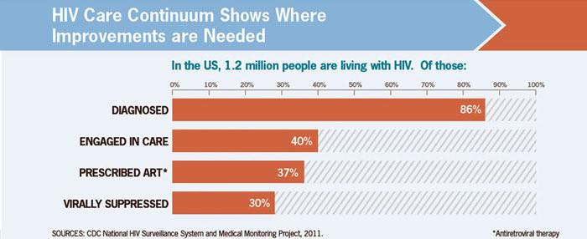
National HIV Care Continuum Indicators
Notes:
The HIV care continuum is being used as tool in HIV prevention and MMP currently provides data needed to determine those engaged in care, prescribed ART and virally suppressed. Changing the methodology will provide information on those diagnosed but not linked to care or engaged in care, barriers in accessing care or staying engaged in care.

Slide 41
Discussion/Questions
Notes:
Possible questions for discussion:
Any questions in chat feature of Genesys software?
Questions about new design?
How does this affect providers? Facilities?
How does this affect/benefit the patients?
What do we need from the providers?
How does this change affect facilities with an IRB determination?
Release of information form for MRA’s? Separate for each facility?
Still possible to perform interviews at facilities if requested by patient?
MMP staff will contact facilities for updated contact info for patients
Updated consent forms

Slide 42
The Case-Surveillance-Based Sampling Demonstration Project:
Methods to Include those Not Receiving HIV
Care in the Medical Monitoring Project
Mark Freedman, DVM, MPH
Virginia MMP Project Officer
Virginia MMP Stakeholder Webinar
April 20, 2014

Slide 43
Acknowledgements
HICSB
  Mi Chen
  Irene Hall
  Alexandra Oster
  Tian Tang
MMP
  Demi Adedinsewo
  Jeanne Bertolli
  Lauren Messina
  Margaret Nyaku
  Mabel Padilla
  Joseph Prejean
  McKaylee Robertson
  Luke Shouse
  Jacek Skarbinski
  Sandra Stockwell
Los Angeles
  Nouran Mahmoud
  Judy Tejero
  Amy Wohl
Mississippi
  Kendra Johnson
  Leandro Mena
  Tiffany McDonald
New York City
  Chi-Chi Udeagu
  Chris Williams
San Francisco
  Allison Hughes
  Maree Kay Parisi
  Susan Scheer
Washington
  Susan Buskin
  Julia Hood
  Tom Jaenicke
  Jennifer Reuer
Georgia MMP
  Jane Kelly
  Eugene Pennisi
  Pascale Whortley
Notes:
First I’d like to acknowledge all the people both at CDC and in the project areas who have contributed to the CSBS pilot—not all of whom could be fit on this slide. In particular, I’d like to acknowledge our five CSBS project areas—Los Angeles, Mississippi, New York City, San Francisco, and Washington
Also, Stan Wei (PI for project) for the slides

Slide 44
Caveats
Unpublished data: please do not distribute
Findings and conclusions are those of the speaker
  Not formally cleared
Notes:
A couple caveats. I will be showing a lot of unpublished data from the pilot, so please do not distribute without checking with me, and because this is an internal presentation the determination was made that it need not be cleared, so the findings and conclusions are mine alone and should not reflect poorly on anyone else.

Slide 45
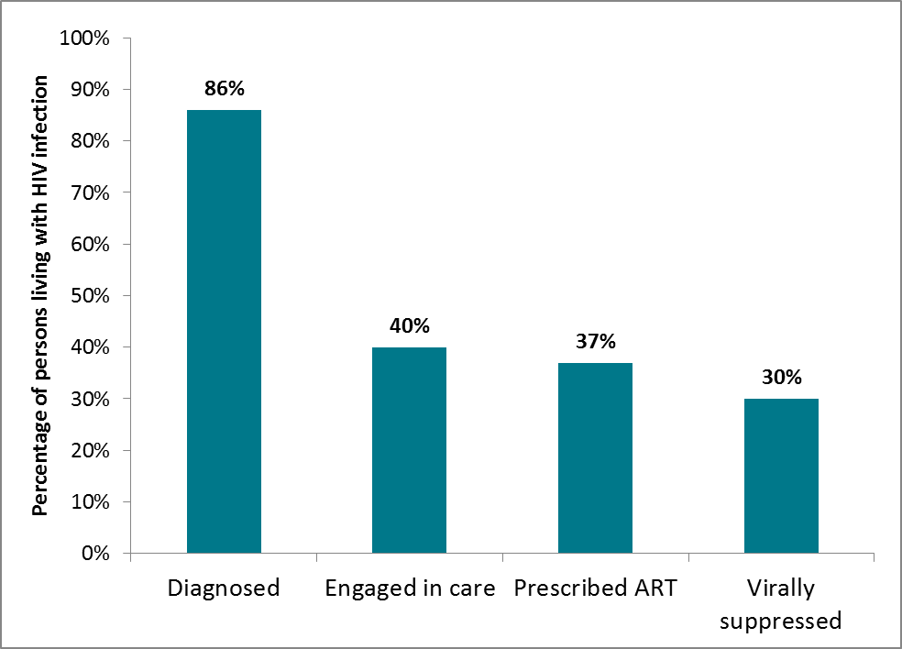
Continuum of HIV Care:
MMP’s Current Role
Current Facility-based MMP
MMWR, Vital Signs, 2014
Notes:
As currently designed, MMP conducts facility-based sampling. That is, we sample participants off of patient lists obtained from HIV facilities. By its nature, only those who are in some sense retained in care are eligible for participation. In this figure, you see the full continuum of HIV care from HIV-infected to virally suppressed. MMP currently captures about 40% of the HIV-infected population.

Slide 46
MMP Misses Persons Not in Care
Diagnosed but not in care
MMWR, Vital Signs, 2014
Notes:
The CSBS demonstration project is an effort to develop methods to expand its reference population from the 40% of HIV infected who are retained in care to the 86% who are diagnosed with HIV, capturing this additional 46% made up of persons diagnosed but not receiving HIV care.

Slide 47
Basic CSBS Procedures
Persons sampled out of national case surveillance data
  All living HIV-diagnosed adults are eligible
  Oversampling of recently diagnosed persons
Persons located through public health and other available data systems
Like MMP, interview, medical record abstraction, and linked case surveillance data collected and weighted
Notes:
We sample from among all living HIV-diagnosed adults in national case surveillance data, oversampling the recently diagnosed (won’t be done for MMP 2015). Then we locate and enroll those sampled persons through public health and other available data systems. Like MMP, we collect and weight interview and medical record abstraction data. We also export linked data from the HIV case surveillance system.

Slide 48
Key Outcomes
Interview response rate
Inclusion of new population
Notes:
In this pilot project, we wanted to know two key things: 1. could you use this sampling strategy to successfully locate and interview HIV-diagnosed persons and 2. were we getting at that out of care population that is needed to guide HIV prevention efforts.

Slide 49
Decision to Incorporate
CSBS Methods into MMP
Promising pilot experience
  Comparable overall response rate
  About ¼ of CSBS participants less engaged in care than MMP participants
Compelling public health data needs
MMP to adopt CSBS methods in 2015
Notes:
Overall, the Division of HIV/AIDS prevention at CDC has judged the CSBS pilot to be promising. The overall response rate for CSBS has been comparable to the MMP overall response rate and about ¼ of CSBS participants are less engaged in care than MMP participants. Based on these encouraging findings and on the compelling public health data needs, the Division of HIV/AIDS prevention has decided that MMP will adopt CSBS methods in its 2015 data collection cycle (to begin in June of 2015). So those are the core findings from the pilot. We sampled people, we found them, we interviewed them, and it went well enough that we’re going full speed ahead with national implementation in less than 4 months.

Slide 50
Changes in Facility Involvement
MMP Facility Sampling
MMP CSBS
Sampling Frame
Census of HIV-Care Facilities
Sample
Participating Facilities
Sample of Participants
Selected from participating facilities
Sampling Frame
Cases in eHARS
Sample of Participants
Selected from eHARS
HIV-Care Facilities
Usual place of care
Notes:
This is a schematic of how things will be changing as far as facility involvment. As previously stated, the patient sample will no longer be drawn from lists provided by HIV care facilities but from the state HIV registry. This means that we will no longer contact care facilities to obtain patient lists.

Slide 51
Changes in Provider Relationships
Census of HIV-care providers in Virginia
Reaching certain patients may require additional help from HIV-care facilities and foster a closer partnership with VDH
The patients will be different
VDH will no longer depend on facilities to get a sample of patients
Participation is patient driven
Notes:
Census of HIV-care providers in Virginia
MMP will no longer be sampling facilities, this previously require interactions with only sampled facilities. With CSBS, MMP will possibly be interacting with all HIV-care facilities
As already stated, the patient sample will include HIV positive individuals both in and out of care or not fully engaged in care and may have been to the facility on a very limited basis.

Slide 52
HIV-Care Facility Perspective
No staff time putting together list of patients seen at care facility
Large facilities may see a decrease in the number of patients associated with their facility
Initial contact most likely with patient
Work closer with VDH to link some patients to care

Slide 53
VDH Perspective
More HIV-care facilities involved
Facility of care information will come from the patient or VDH registry
Opportunity to assist with re-engagement activities
MRA?
Notes:
Currently MMP works with sampled facilities for two years, this will change as there will be no sampling of facilities

Slide 54
Challenges of Transition to CSBS
Cross-jurisdiction data collection
More “cold calling”
Identifying MRA facilities
Potential for sampled persons to be unaware of their status
Incarcerated persons more likely to be sampled
Notes:
Sampling from HIV-care facilities has almost always guaranteed that the patient will be from Virginia. Since the implementation of HIV in Virginia in 2005, there has been only one or two occasions where the sampled patient was residing in another jurisdiction at the time of their interview. CSBS will sample from the NHSS and with reporting delays, transfers from one jurisdiction to another are not normally captured

Slide 55
Benefits of Transition to CSBS
Connect with persons who are at various stages of the HIV care continuum
Adhere to the NHAS and increase the proportion of persons linked to care
Develop and build relationships with other care faciltities
Strengthen the partnership between VDH and providers of ancillary services
Participant recruitment is direct
No major changes with HIV-care facilities that are always sampled
Notes:
CSBS will provide an opportunity to possibly connect with a more varied sample of HIV-diagnosed persons thus improving the quality of the data collected.
Encounters in the recruit process will provide the health department with an additional opportunity to not only deliver messages on the importance of getting into care but also the benefits of staying in care
The new methodology requires MMP staff to actively refer patients to care – We have the benefit of CAPUS and SPNS; both have developed active referral systems that are currently in use in Virginia
Enhance the value of the data collected
Opportunity to deliver messages on the importance of regular HIV care
Linking HIV-diagnosed persons to needed service via an active referral system

Slide 56
Participant Privacy
Division of Disease Prevention Security and Confidentiality Policies and Procedures
VDH Confidentiality Policy
VDH Information Security Policy
VDH Information Security Standard
OMB approval
CDC non-research determination

Slide 57
MMP Resources
CDC MMP website: http://www.cdc.gov/hiv/statistics/systems/mmp/
VDH MMP website: http://www.vdh.virginia.gov/epidemiology/DiseasePrevention/Programs/HIV-AIDS/SurveillanceProgram/MMP.htm
Recent MMWR publication analyzing 2009 national weighted MMP data:
Behavioral and Clinical Characteristics of Persons Receiving Medical Care for HIV Infection — Medical Monitoring Project,
United States, 2009. MMWR Morb Mortal Wkly Rep, June 20, 2014. 63(SS5): p. 1-28.

Slide 58
Thank you!
  Anne Rhodes
  anne.rhodes@vdh.virginia.gov
  804-864-8013
Celestine Buyu
celestine.buyu@vdh.virginia.gov
804-864-8043
Any Questions??
Kristen Kreisel
kristen.kreisel@vdh.virginia.gov
804-864-7171
Mark Freedman
fll0@cdc.gov
404-639-6356
Jennifer Kienzle
jennifer.kienzle@vdh.virginia.gov
804-864-7926
  Lauren Yerkes
  lauren.yerkes@vdh.virginia.gov
  804-864-7988

Slide 59
Discussion/Questions
Notes:
Possible questions for discussion:
Any questions in chat feature of Genesys software?
Further input/opinions/feedback from providers?

