Slide 1
Ryan White Cross Parts Quality Measures and the National HIV/AIDS Strategy
Carrie Walker, MPH
HIV Analyst
Virginia Department of Health
February 2021
QM Summit

Slide 2
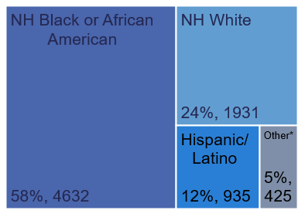
PLWH and Receiving Ryan White part B services as of December 31, 2020 (N=7,923)
Transmission Risk | % of PLWH N=7,494 [n=429 (5%) NRR/NIR]
Men who have sex with men (MSM) | 47%
Heterosexual contact | 45%
Injection drug use (IDU) | 5%
MSM-IDU | 1%
Other (pediatric or receipt of blood products) | 2%
Data current as of December 2020; accessed January 2021.
Race/Ethnicity: A/H/PI: Asian/Hawaiian/Pacific Islander; Other includes American Indian/Alaska Native and Multi-race/Unknown.
Transmission risk only includes cases who had a reported or identified risk for transmission.

Slide 3
Performance Measures: Jan 1, 2020 – Dec 31, 2020

Slide 4
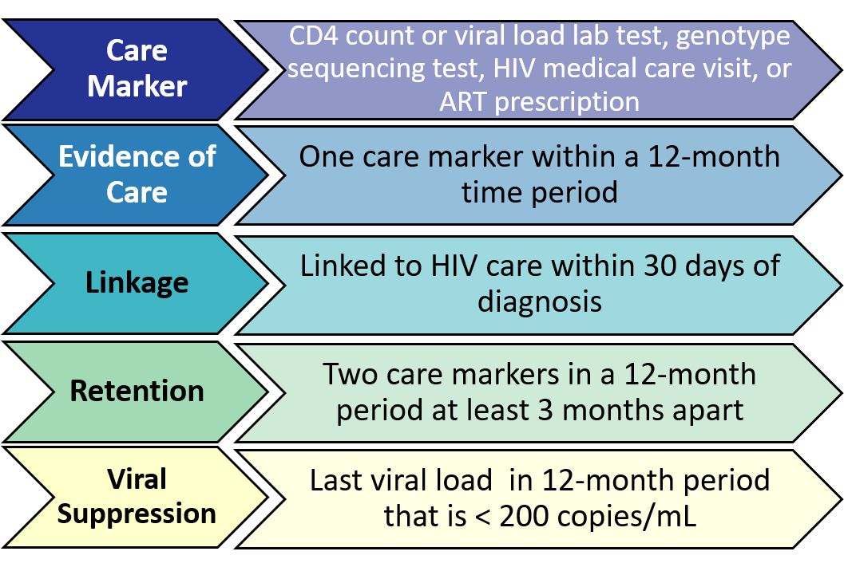
Base Definitions

Slide 5
Care Markers Database: DDP Data Integration
As of January 2019: 9 data sources
Medicaid data
Lexis Nexis® Accurint® data
Black Box/DMV data
Medical Monitoring Project (MMP) data
STD data (MAVEN/VEDSS)
HIV testing/CHARLI data (EvalWeb/RedCap)
Ryan White data (RedCap, AIDS Drug Assistance Program (ADAP) Database))
HIV Surveillance data (Enhanced HIV/AIDS Reporting System (eHARS))

Slide 6
National HIV/AIDS Strategy Goals by 2025
Linkage to HIV medical care within 30 days of diagnosis:
95%
Viral suppression:
95%
Increase Retention in HIV medical care
Notes:
**Retention indicator goal removed from strategic plan 2021-2025.

Slide 7
Ryan White Performance Measure Outcomes for all Virginia Ryan White Clients (N=7,923) vs all PLWH in Virginia (N=26,189), January 2020 – December 2020
n=346
n=865
Data reported to Virginia Department of Health as of December 2020 and accessed January 2021.
Notes:
HRSA definitions used for RW measures; CDC definitions used for all PLWH

Slide 8
Performance Measure Outcomes Among all Virginia Ryan White Clients Served in January 2020 – December 2020 (n=7,923) by Gender
Data reported to Virginia Department of Health as of December 2020 and accessed January 2021.

Slide 9
Performance Measure Outcomes Among all Virginia Ryan White Clients Served Jan 1, 2020 – Dec 31, 2020 (n=7,923) by Race/Ethnicity
*Other includes Asian, Pacific Islander, Native American, Native Hawaiian, Alaskan Native, or Multi-race. Clients with an unknown race are excluded.
Data reported to Virginia Department of Health as of December 2020 and accessed January 2021.

Slide 10
Performance Measure Outcomes Among all Virginia Ryan White Clients Served in Jan 1, 2020 – Dec 31, 2020 (n=7,923), by Age*
*Age at diagnosis is calculated for linkage to HIV care and current age as of December 31, 2020 is used for retention and viral suppression.
Data reported to Virginia Department of Health as of December 2020 and accessed January 2021.

Slide 11
Performance Measures by Timeframe

Slide 12
Linkage to HIV Care within 30 days
Those newly diagnosed with HIV in
January 2018 – December 2018
January 2019 – December 2019
January 2020 – December 2020
who had a care marker within 30 days of diagnosis date
All those newly diagnosed with HIV in
January 2018 – December 2018
January 2019 – December 2019
January 2020 – December 2020
Ineligible: Those not newly diagnosed in the specific timeframe

Slide 13
Linkage to HIV Care within 30 days of Diagnosis: RW Clients
NHAS goal=95%
Data reported to Virginia Department of Health as of December 2020 and accessed January 2021.

Slide 14
Retention in HIV Care
Those who received a Ryan White service in
January 2018 – December 2018
January 2019 – December 2019
January 2020 – December 2020
who had at least two care markers in the respective timeframe that were at least 90 days apart
Those who received a Ryan White service in
January 2018 – December 2018
January 2019 – December 2019
January 2020 – December 2020
who had at least one care marker in the respective timeframe
Ineligible: Those without a care marker in the respective timeframe or those who died during the timeframe

Slide 15
Retention in HIV Care: RW Clients
Data reported to Virginia Department of Health as of December 2020 and accessed January 2021.

Slide 16
Viral Suppression
Those who received a Ryan White service in
January 2018 – December 2018
January 2019 – December 2019
January 2020 – December 2020
whose last viral load in the respective timeframe was 200 copies/mL or less
Persons served by Ryan White in
January 2018 – December 2018
January 2019 – December 2019
January 2020 – December 2020
who had at least one care marker in the respective timeframe
Ineligible: Those without a care marker in the respective timeframe.

Slide 17
Viral Suppression in Virginia Ryan White Population
NHAS goal=95%
Data reported to Virginia Department of Health as of December 2020 and accessed January 2021.

Slide 18
Performance Measures by Region: 2019 vs 2020
Notes:
COVID impact?

Slide 19
Performance Measures for Ryan White Clients: by Region
n=346
n=865
Data reported to Virginia Department of Health as of December 2020 and accessed January 2021.

Slide 20
Performance Measures: HRSA vs CDC Definitions

Slide 21
Performance Measures for Ryan White Clients: HRSA vs CDC
n=346
n=865
Data reported to Virginia Department of Health as of December 2020 and accessed January 2021.
Notes:
Normal way for RW is HRSA definitions, while all PLWH uses CDC definitions. Here I compare RW population’s HCC measures using HRSA definitions vs CDC definitions

Slide 22
Performance Measures Summary

Slide 23
Summary
Due to updated NHAS goals, linkage to care and viral suppression measures fall below the goal of 95%
Transgender, Black/NH, and younger clients have lower rates of viral suppression
COVID19 may be impacting 2020 measures as all three have rates lower than in previous years
Truly decreased or an artifact of delay in data?
RW clients appear to have better outcomes than general PLWH population: no major differences when using CDC’s HCC definitions

Slide 24
Questions?
Carrie Walker, MPH
HIV Analyst
Carrie.Walker@vdh.virginia.gov

