Slide 1
Ryan White Cross Parts
Quality Measures and the National HIV/AIDS Strategy
Tinika McIntosh-Amouzouvi, MPH
Care Markers Data Analyst
Virginia Department of Health
8/21/2019
QMAC Meeting

Slide 2
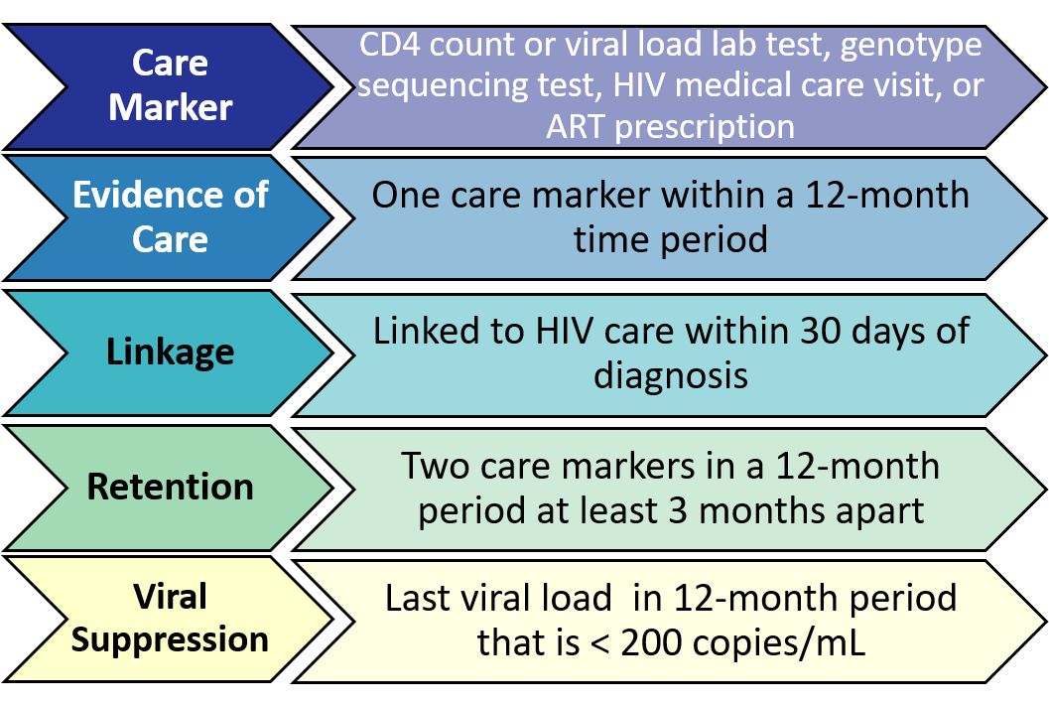
Base Definitions
Notes:
Before we get started, I wanted to go over some base definitions that will inform some of the data you will see on later slides. So first, I’m going to start with a care marker, which is defined as ….
Then we have evidence of care, which is defined as …
Next, we have linkage to HIV care, which is defined as ….
Then, we have retention, which is defined as….
And Last, we have viral suppression, which is defined as….
So with these definitions in mind, we’ll go over performance measures for linkage to HIV care, retention and viral suppression for all Ryan White agencies.

Slide 3
Care Markers Database: DDP Data Integration
As of January 2018:
9 data sources
Medicaid data
Lexis Nexis® Accurint® data
Black Box/DMV data
Medical Monitoring Project (MMP) data
STD data (STD*MIS/MAVEN)
HIV testing/CHARLI data
(e2Virginia)
Ryan White data (e2Virginia, AIDS Drug Assistance Program (ADAP) Database))
HIV Surveillance data
(Enhanced HIV/AIDS Reporting System (eHARS))
Notes:
So, before moving forward, I also wanted to go over how the data is compiled and collected for purposes of calculating performance measures. The data comes from the Care Markers database, which is housed at VDH, and has data from our surveillance system, the enhanced HIV/AIDS Reporting System (eHARS), as the base, then we combine that with Ryan White data from e2Virginia, data from the ADAP program, HIV testing and prevention and CHARLI data (which stands for Comprehensive HIV/AIDS Linkages for Inmates). We also have STD data, data from the medical monitoring project, data from a Georgetown Univesity pilot project called Black box, data from an exchange with DC and Maryland, which provides information on updated residency and out of state care markers, and th data from a public search software for Lexis Nexis (for updated address) and finally Medicaid data. So for these performance measures, we pull a list of clients served at all Ryan White agencies within a specific time period and match that with people in the Care Markers database to get care marker information. From there, we apply definitions of performance measures to calculate linkage to care, retention and viral suppression for the data you’ll see later on.
Medicaid: Client-level file received quarterly with lab and ART information on persons living with HIV (PLWH) receiving services through Medicaid
Accurint®: Annual batch match to update address and vital status information on PLWH in Virginia
Black Box: Annual match of HIV surveillance data from jurisdictions outside Virginia to update address, vital status, and lab information
DMV: Quarterly data exchange with DC and MD with address, vital status, and lab information of PLWH in Virginia receiving care in DC or MD

Slide 4
National HIV/AIDS Strategy Goals by 2020
Linkage to HIV medical care within 30 days of diagnosis:
85%
Retention in HIV medical care:
90%
Viral suppression:
80%
Notes:
So, we’ll also be going over how Ryan White cross parts measures compare to the goals set by the National HIV/AIDS Strategy for jurisdictions representing HIV positive individuals to meet by the year 2020. The three specific goals we’ll be looking at correspond to the specific performance measures we’ll be looking at, so one of the goals is
To increase linkage to HIV medical care within 30 days of diagnosis to 85%,
Increase retention in HIV medical care to 90%,
And increase viral suppression to 80%.
So with these in mind, we’ll go over these performance measures for calendar year 2017, so you get an idea of the most recent measures as well as those broken down by key demographics and then we’ll get into the measures for 3 years, broken down by demographics.

Slide 5
Performance Measures:
June 1, 2018 - May 31, 2019

Slide 6
Ryan White Performance Measure Outcomes for all Virginia Ryan White Clients (N=8,576) versus all persons living with HIV/AIDS in Virginia (N=24,793),
June 2018 - May 2019
n=346
n=865
Data reported to Virginia Department of Health as of July 2019; data for 2019 are preliminary.
Notes:
First up we have the performance measure outcomes for all of VA RW clients compared to all PLWH in VA. We see that RW clients have clear increases in all three measures, which is great. We see that overall for 2018: 80% of RW clients are linked to care within 30 days, 75% are retained in care, and 87% are virally suppressed.

Slide 7
Performance Measure Outcomes Among all Virginia Ryan White Clients Served in June 2018 - May 2019 (n=8,576) by Sex at Birth
Data reported to Virginia Department of Health as of July 2019; data for 2019 are preliminary.
Notes:
For the next few slides, we see the 2018 data broken down by gender, race, age and region. So here we have last year’s data broken down by gender, and we see that the measures are comparable between both males and females for retention and viral suppression, and linkage to care is slightly higher for females as compared to males.

Slide 8
Performance Measure Outcomes Among all Virginia Ryan White Clients Served in June 2018 - May 2019 (n=8,576), by Race/Ethnicity
*Other includes Asian, Pacific Islander, Native American, Native Hawaiian, Alaskan Native, or Multi-race.
90 clients had an unknown race at time of data access.
Data reported to Virginia Department of Health as of July 2019; data for 2019 are preliminary.
Notes:
Here we see performance measures broken down by race category, and we see that viral suppression is highest for the Other category at 92% but is lowest for Linkage to care at 70%. Hispanic/Latinos represent the highest percentage for linkage to care, but we do see high percentages across all groups for all measures as well.

Slide 9
Performance Measure Outcomes Among all Virginia Ryan White Clients Served in June 2018 - May 2019 (n=8,576), by Age*
*Age at diagnosis is calculated for linkage to HIV care and current age as of December 31, 2018 is used for retention and viral suppression.
Data reported to Virginia Department of Health as of July 2019; data for 2019 are preliminary.
Notes:
Next we have the performance measures broken down by age category, where we see the performance measures increase as age grouping increases, with clients younger than 25 having lower performance measures for linkage, retention and viral suppression, and older age groups doing better for all performance measures in general.

Slide 10
Performance Measure Outcomes Among all Virginia Ryan White Clients Served in June 2018 - May 2019 (n=8,576), by Region
Data reported to Virginia Department of Health as of July 2019; data for 2019 are preliminary.
Notes:
Here we have 2018 data broken down by region for each performance measure, with all regions close to the level of viral suppression, Northwest showing the highest percentage for retention in HIV care, and the Northern region showing the highest percentage for linkage to HIV care. We have the Southwest region having the lowest percentage for linkage to care, and Southwest and Eastern having the lowest percentage for retention in care.

Slide 11
Performance Measures by Timeframe
Notes:
So for the next few slides, we’ll go into the last 3 years’ performance measures. I’ll describe each of the performance measures and how they’re calculated in detail, and then compare the measure across the 3 years.

Slide 12
Linkage to HIV Care within 30 days
Those newly diagnosed with HIV in
June 2016 – May 2017
June 2017 – May 2018
June 2018 – May 2019
who had a care marker within 30 days of diagnosis date
All those newly diagnosed with HIV in
June 2016 – May 2017
June 2017 – May 2018
June 2018 – May 2019
Ineligible: Those not newly diagnosed in the specific timeframe
Notes:
First, we’ll start off with linkage, which is defined as those newly diagnosed with HIV and had a care marker, defined as a lab or medical visit within 30 days of diagnosis date over all those newly diagnosed with HIV in CY 2016, CY 2017 or CY 2018 and who had received a Ryan White service and had been diagnosed in the same timeframe. Those ineligible are Ryan White clients who were not newly diagnosed in the respective time period.

Slide 13
Linkage to HIV care within 30 days in Virginia Ryan White Population
NHAS goal=85%
Data reported to Virginia Department of Health as of July 2019; data for 2019 are preliminary.
Notes:
Here we have linkage to HIV care over the last 3 years, and we see an improvement in linkage to care from 2016 to 2018, and we see that we are only 5% away from the National HIV/AIDS strategy goal for linkage to care of 85%, so we are heading in the right direction, and getting closer to the goal to reach by 2020.

Slide 14
Retention in HIV Care
Those who received a Ryan White service in
June 2016 – May 2017
June 2017 – May 2018
June 2018 – May 2019
who had at least two care markers in the respective timeframe that were at least 90 days apart
Those who received a Ryan White service in
June 2016 – May 2017
June 2017 – May 2018
June 2018 – May 2019
who had at least one care marker in the respective timeframe
Ineligible: Those without a care marker in the respective timeframe or those newly diagnosed with HIV during the respective timeframe
Notes:
Another measure we use to measure quality of care is 12-month retention, which is calculated here as those who received a Ryan White service in the three timeframes who had at least 2 caremarkers in the respective timeframe that were at least 90 days apart OVER those who received a Ryan White service in those time periods who had at least one caremarker during the time periods. Those who are ineligible were patients without a care marker in either of those periods or who were newly diagnosed during the respective timeframe.

Slide 15
Retention in HIV Care in Virginia Ryan White Population
NHAS goal=90%
Data reported to Virginia Department of Health as of July 2019; data for 2019 are preliminary.
Notes:
Here we see retention in care slightly decreased from 2016 to 2018, but we recognize that 2018 data is preliminary so we can expect that measure to increase in a few months as more labs and data come in. The measure is about 15% on average lower than the national goal of 90% to reach by the year 2020, so this could be an area of improvement.

Slide 16
Viral Suppression
Those who received a Ryan White service in
June 2016 – May 2017
June 2017 – May 2018
June 2018 – May 2019
whose last viral load in the respective timeframe was 200 copies/mL or less
Persons served by Ryan White in
June 2016 – May 2017
June 2017 – May 2018
June 2018 – May 2019
who had at least one viral load test care marker in the respective timeframe
Ineligible: Those without a care marker in the respective timeframe.
Notes:
We also have viral suppression measures for Ryan White clients in the three grant years. Clients are virally suppressed if their last viral load in the time period of interest was 200 copies per milliliter or less, OVER persons served by Ryan White in those time periods who had a caremarker in those time periods. Again, those who are ineligible in this calculation are Ryan White patients without a caremarker in those time periods.

Slide 17
Viral Suppression in Virginia Ryan White Population
NHAS goal=80%
Data reported to Virginia Department of Health as of July 2019; data for 2019 are preliminary.
Notes:
Here we see that viral suppression has increased overall from 2016 to 2018, and that all measures from the last 3 years have surpassed the national goal for viral suppression of 80% by 2020, so that’s good news, and we anticipate that this will continue to increase.

Slide 18
Performance Measures by sex at birth
Notes:
In the next few slides, we’ll show trends seen over the last 3 years’, first we will look at trends seen by sex at birth.

Slide 19
Linkage to HIV Care within 30 Days by Sex at Birth in Virginia Ryan White Population
Jun 2016 – May 2017
Male= 341
Female=91
Jun 2017 – May 2018
Male= 324
Female=90
Jun 2018 – May 2019
Male= 261
Female=76
Data reported to Virginia Department of Health as of July 2019; data for 2019 are preliminary.
Notes:
So first, we’ll start with linkage to care. We see here at linkage to care is higher in females, but has slightly improved for both sexes.
The next few slides I’ll be showing gender and race disparities across retention and suppression for all three grant years. First, I’m showing retention by gender in the Ryan White population across the last three grant years. We see a decrease in retention across time within each gender category, but overall, retention is increasing in the state. We see that on average, females have the highest retention rates followed by males and then the transgender population. Overall there isn’t much difference between males and females with respect to retention, but there is a large disparity between outcomes for the transgender population and males and females.

Slide 20
Retention by Sex at Birth in Virginia Ryan White Population
Jun 2016 – May 2017
Male= 6,044
Female=2,800
Jun 2017 – May 2018
Male= 5,561
Female=2,637
Jun 2018 – May 2019
Male= 5,553
Female=2,551
Data reported to Virginia Department of Health as of July 2019; data for 2019 are preliminary.
Notes:
Here we see retention broken down by sex for the last 3 years, and we see that retention was pretty consistent for 2016 and 2017, but has slightly decreased for both sexes during 2018, Hopefully 2018 data will increase a bit in the next few months.

Slide 21
Viral Suppression by Sex at Birth in Virginia Ryan White Population
Jun 2016 – May 2017
Male= 6,374
Female=2,886
Jun 2017 – May 2018
Male= 5,877
Female=2,726
Jun 2018 – May 2019
Male=5,808
Female=2,624
Data reported to Virginia Department of Health as of July 2019; data for 2019 are preliminary.
Notes:
Here we see overall increases in viral suppression for both males and females from 2016 to 2018, and that the changes in both groups over the last 3 years are comparable to each other.

Slide 22
Performance Measures by race/ethnicity
Notes:
For the next few slides, we’ll see how race and ethnicity differ among the performance measures.

Slide 23
Linkage to HIV care within 30 days by Race/Ethnicity in
Virginia Ryan White Population
White=114
Black=244
Hispanic/Latino=56
Other=18
White=80
Black=258
Hispanic/Latino=59
Other=17
White=74
Black=199
Hispanic/Latino=53
Other=13
Jun 2016 – May 2017
Jun 2017 – May 2018
Jun 2018 – May 2019
Data reported to Virginia Department of Health as of July 2019; data for 2019 are preliminary.
Notes:
first we’ll start with linkage to care. We see great improvements among Hispanics and Latinos. And smaller, but consistent, improvements among Black, non-Hispanic clients. Some fluctuation among White clients and clients in the “other” category, which includes Asians, Pacific Islanders, Native Americans or American Indians, and clients of multi-racial descent

Slide 24
Retention by Race/Ethnicity in Virginia Ryan White Population
White=2,114
Black=5,725
Hispanic/Latino=789
Other=228
Jun 2017 – May 2018
White=2,063
Black=5,167
Hispanic/Latino=819
Other=214
White=1,965
Black=5,117
Hispanic/Latino=846
Other=224
Jun 2016 – May 2017
Jun 2018 – May 2019
Data reported to Virginia Department of Health as of July 2019; data for 2019 are preliminary.
Notes:
Next we have Retention to care broken down by race and ethnicity. Here we see decreases in retention for all groups aside from the “other” category, with the greatest decline among white, non-Hispanic clients. Overall, however, there are high percentages for all groups.

Slide 25
Viral Suppression by Race/Ethnicity in Virginia Ryan White Population
Jun 2016 – May 2017
White=2,222
Black=5,312
Hispanic/Latino=844
Other=246
Jun 2017 – May 2018
White=2,113
Black=5,420
Hispanic/Latino=684
Other=231
Jun 2018 – May 2019
White=2,037
Black=5,960
Hispanic/Latino=834
Other=236
Data reported to Virginia Department of Health as of July 2019; data for 2019 are preliminary.
Notes:
Next we have viral suppression for race and ethnicity, and we see overall high measures across all race/ethnicities. All groups had a decline in suppression in 2017, and saw a subsequent increase in 2018, with Hispanic/Latino, Other, and black non-Hispanic clients having substantial increases in 2018 compared to 2017. And white, non-Hispanic clients being mostly consistent across the 3 year time span.

Slide 26
Performance Measures by age grouping

Slide 27
Linkage to HIV care within 30 days by Age at Diagnosis in
Virginia Ryan White Population
Jun 2016 – May 2017
<25=92
25-44=253
45+=96
Jun 2017 – May 2018
<25=89
25-44=241
45+=90
Jun 2018 – May 2019
<25=58
25-44=218
45+=70
Data reported to Virginia Department of Health as of July 2019; data for 2019 are preliminary.
Notes:
We see that linkage to care numbers increase as age group increases, with the 45+ group having overall higher percentages than the <25 and 25-44 groups, but all groups showed an increase from 2017 to 2018.

Slide 28
Retention by Current Age in Virginia Ryan White Population
Jun 2016 – May 2017
<25=300
25-44=3,369
45+=5,282
Jun 2017 – May 2018
<25=226
25-44=3,074
45+=5,019
Jun 2018 – May 2019
<25=219
25-44=3,017
45+=4,995
Data reported to Virginia Department of Health as of July 2019; data for 2019 are preliminary.
Notes:
Here is retention to care by age grouping. We see a similar pattern as we did with Linkage to Care here, with measures increasing as age group increases. 45+ have consistently higher measures for all 3 years when compared to the younger two groups, with <25 having the lowest measures.

Slide 29
Viral Suppression by Current Age in Virginia Ryan White Population
Jun 2016 – May 2017
<25=388
25-44=3,615
45+=5,373
Jun 2017 – May 2018
<25=313
25-44=3,309
45+=5,108
Jun 2018 – May 2019
<25=274
25-44=3,230
45+=5,064
Data reported to Virginia Department of Health as of July 2019; data for 2019 are preliminary.
Notes:
We see Viral suppression following suite here with measures being consistently, and substantially, higher for 45+ than the other two age groups, being as wide as 14 points higher than <25 in 2018.

Slide 30
Performance Measures by Region
Notes:
For the last few slides we’ll go over how each performance measure differs regionally, again going first through linkage to care, retention, and then viral suppression.

Slide 31
Linkage to HIV Care within 30 days by Health Region in
Virginia Ryan White Population
Jun 2016 – May 2017
Northwest=39
Northern=101
Southwest=47
Central=108
Eastern=146
Jun 2017 – May 2018
Northwest=40
Northern=116
Southwest=43
Central=61
Eastern=160
Jun 2018 – May 2019
Northwest=49
Northern=107
Southwest=39
Central=59
Eastern=92
Data reported to Virginia Department of Health as of July 2019; data for 2019 are preliminary.
Notes:
Here we see improvements in linkage to care from 2016 to 2018 overall for all regions except Southwest and Central region, where we saw a pretty large decline in Southwest and leveling off in Central. We do see large improvements in Northwest, Northern and eastern, and expect Southwest & Central to improve slightly as more 2018 data comes in.
***UPDATED 8/7/19- we are not receiving data from a large player in Central, so the 2019 low numbers for Central are likely due to us not receiving caremarkers

Slide 32
Retention by Health Region in Virginia Ryan White Population
Jun 2016 – May 2017
Northwest=1,004
Northern=1,956
Southwest=1,092
Central=2,053
Eastern=2,846
Jun 2017 – May 2018
Northwest=999
Northern=2,079
Southwest=1,160
Central=1,132
Eastern=2,949
Jun 2018 – May 2019
Northwest=1,071
Northern=2,082
Southwest=1,206
Central=1,235
Eastern=2,637
Data reported to Virginia Department of Health as of July 2019; data for 2019 are preliminary.
Notes:
Next we’re showing retention in HIV care for the last 3 years, and we see consistent improvements in retention for all regions from 2016 to 2018, with the Eastern region showing the greatest improvement, followed by Southwest and Northern.

Slide 33
Viral Suppression by Region in Virginia Ryan White Population
Jun 2016 – May 2017
Northwest=1,042
Northern=2,055
Southwest=1,139
Central=2,156
Eastern=2,984
Jun 2016 – May 2017
Northwest=1,039
Northern=2,194
Southwest=1,203
Central=1,192
Eastern=3,102
Jun 2016 – May 2017
Northwest=1,118
Northern=2,187
Southwest=1,243
Central=1,293
Eastern=2,727
Data reported to Virginia Department of Health as of July 2019; data for 2019 are preliminary.
Notes:
Lastly, we have viral suppression by region, and we see that Eastern and Southwest have consistently improved over the 3 year time frame, while Northwest, Northern, and Central regions have fluctuated. However, all 5 regions do have high percentages for viral suppression and are heading in the right direction as of 2018.

Slide 34
Performance Measures
Summary

Slide 35
Summary of Cross-Parts Measures
Linkage to care within 30 days and viral suppression are continuing to increase and have passed the NHAS goal.
Retention in care still an area for improvement, but numbers are expected to increase slightly for 2019 as data is received
Disparities among race/ethnicity, gender, and age show improvement, but there are still areas to work on:
  Black clients have much lower viral suppression rates that are trending downwards
  Younger clients are have lower viral suppression rates, linkage rates, and retention rates
Notes:
On the whole, we continue to see high percentages across the board, but we see greater improvements for linkage to HIV care and viral suppression over time, with rates of viral suppression already surpassing the national goal of 80% for 2018 for all races/ethnicities.
But we also see that retention has maintained similar rates over the last 3 years, dropping by 1 point in 2018. Hopefully as data is received, this measure will increase slightly. Efforts targeted towards younger clients for linkage to care & retention in care may help in improving these measures. However, we do also see that disparities in race, gender, and age are showing greater improvement than that of the national estimates, which continues to reflect the great success of Ryan White program efforts in the state, and we anticipate that these disparities will continue to improve with better data reporting and integration of data sources.

Slide 36
REDCap Tidbits
CareWare-only agencies do not use RedCap system, will send files via sFTP
Enter data into REDCap currently, until new system gets up & going.
Monthly aggregated reports will be available from REDCap data, but any other reports or needs for client-level data will require an electronic request submission
Resources and training recordings are located on website
Notes:
Watch for funding source as we know you didn’t have to enter this in e2 & there will be funding sources you aren’t funded by included in the drop down

Slide 37
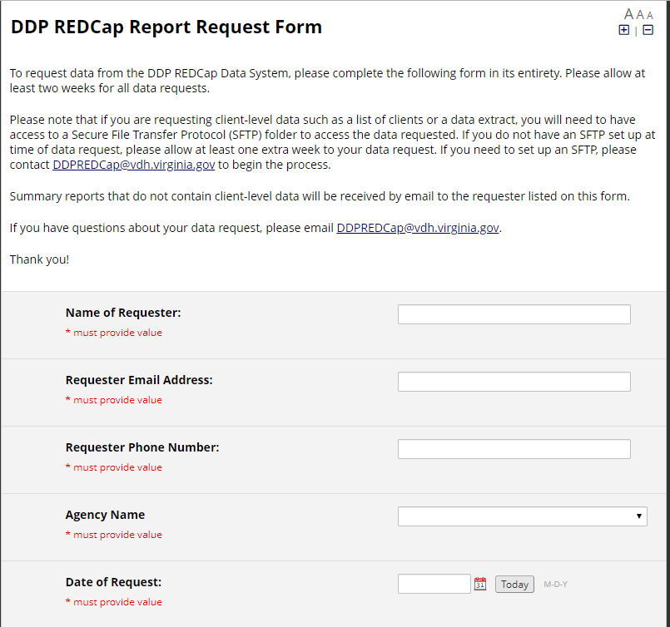
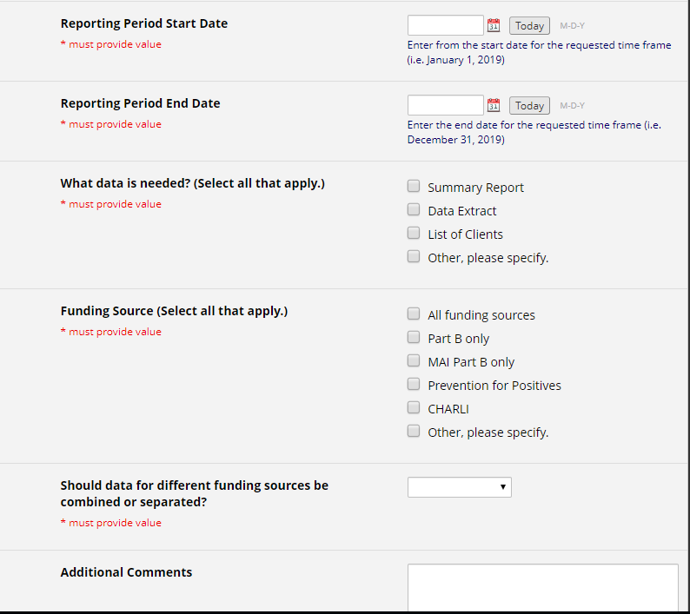
REDCap Electronic Data/Report Request

Slide 38
REDCap Contact Information
Webpage: http://www.vdh.virginia.gov/disease-prevention/redcap/
Report Request: https://redcap.vdh.virginia.gov/redcap/surveys/index.php?s=MCLCM93E8J
Email: DDPRedCap@vdh.virginia.gov
Phone: 804-441-4194

Slide 39
Questions?
Carrie Walker
HIV Care Services Analyst
Virginia Department of Health
Carrie.Walker@vdh.virginia.gov
804-864-7972
Tinika McIntosh-Amouzouvi
Care Markers Data Analyst
Virginia Department of Health
Tinika.McIntosh@vdh.virginia.gov
804-864-7334
Anne Rhodes
Deputy Director
Division of Disease Prevention
Virginia Department of Health
anne.rhodes@vdh.virginia.gov
804-864-8013

