Slide 1
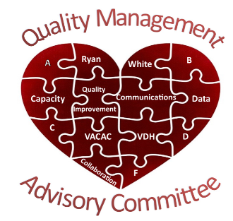
QMAC Orientation Training Beverly Franklin Ashley Yocum Camellia Espinal
May 19, 2021
Notes:
Thank you for joining us for our QMAC New Member Orientation! I am Beverly Franklin, the co-chair for the QMAC capacity-building subcommittee. I am joined today by VDH staff member Ashley Yocum, and TWO MORE SPEAKERS. Through the Orientation, we’ll take turns speaking and sharing. We are all looking forward to working with you through QMAC in the coming years!
PERSONAL INTRODUCTIONS – each trainer provides: NAME, AGENCY, ROLE AT AGENCY, TIME INVOLVED IN RWHAP IN VA
We will provide more programmatic context as individuals following this training.

Slide 2
Welcome to the Virginia Ryan White HIV/AIDS Program Cross-Parts Collaborative Quality Management Advisory Committee

Slide 3
Where did QMAC come from?
QMAC History and Background
Notes:
This section provides history and background on QMAC. It is drawn from SECTION 1 of your QMAC manuals

Slide 4
RWHAP Cross-Part Collaborative History
In 2008, Virginia was one of only five states nationwide selected to participate in the initial HRSA Cross-Parts pilot QM Collaborative (Connecticut, New Jersey, Pennsylvania, Virginia, and Texas)
The Collaborative actively worked to assess and improve the quality of care for persons living with HIV/AIDS
The Collaborative selected a standard set of care quality measures across the various parts and/or funding streams.
QMAC came out of the collaborative as a way to sustain collaborative activities
Notes:
First lets provide some context on where we have been so you have a better sense of where we are at now and where we can go in the future. More than 10 years ago, Virginia was voluntold by the Health Resources and Services Administration (HRSA) that we would be participating in a novel multi-state learning collaborative designed to improve HIV quality of care. The other states selected to participate were CT, NJ, PA, and TX. The initiative was called cross-parts collaborative, because it brought all RWHAP funded providers in a state together, regardless of Part funding, to complete QI projects. As the source funder of all RWHAP services, HRSA was able to coax the state network (Part B), its large urban area networks (Part A), and its directly funded Part C and D hospitals and health centers to participate.
As a part of this new Cross-Parts Collaborative, each state was asked to form a Response Team to organize the QI work related to the initiative. This included collection of standard HIV care quality measures, completion of QI tools, and setting up lines of communication.
QMAC came out of the Cross-Parts Collaborative as a way to sustain learning collaborative activities once HRSA transitioned it to a sustaining phase. The collaborative Response Team morphed into QMAC leadership and mechanisms were put in place for all funded subrecpients to participate in QMAC.

Slide 5
Cross-Part Collaborative (and QMAC!) Aims
Reinforce partnerships across Ryan White Parts (A, B, C, D, and F) in the Commonwealth of Virginia
Maintain a portfolio of performance measures that are routinely collected for strategic planning and quality improvement projects
Plan and implement at least one joint quality improvement project by all RWHAP recipients and subrecipients in the Old Dominion
Notes:
The Cross-Part Collaborative, and subsequently QMAC, has several aims.
First, to ensure strong working relationships across all RWHAP funded entities across VA
Second, to maintain a culture of performance measurement across VA’s RWHAP funded providers pertaining to strategic planning and QI projects
Third, to complete at least one statewide/joint QI project for all RWHAP funded providers to participate in.

Slide 6
Funding Sources
Within the Health Resources and Services Administration (HRSA), the HIV/AIDS Bureau (HAB)administers the Ryan White HIV/AIDS Program (RWHAP)
Virginia Department of Health (VDH) administers the RWHAP Part B Program, under the HIV Care Services (HCS) unit within the Division of Disease Prevention (DDP).
VDH formally collaborates with Part A agencies in its area through an initiative started in 2018.
https://hab.hrsa.gov/sites/default/files/hab/clinical-quality-management/clinicalqualitymanagementpcn.pdf
Notes:
(HRSA) is an agency of the U.S. Department of Health and Human Services that serves the uninsured, isolated or medically vulnerable. HRSA is made up of several bureaus that focus on everything from the National Health Service Corps to the Federally Qualified Health Center Program. The HIV/AIDS Bureau oversees the RWHAP.
The RWHAP is the largest federal program focused exclusively on HIV/AIDS care and treatment. The RWHAP serves those who do not have sufficient health care coverage or financial resources for coping with HIV disease. You will hear many times that RWHAP is the payer of last resort.
In VA, the Part B program is administered by the Virginia Department of Health within the HIV Care Services unit in the Division of Disease Prevention.
Beyond QMAC, the VA Part B program formally collaborates with Part A entities in its region (the DC EMA, which accounts for northern VA and the Norfolk TGA, which accounts for about half of Eastern VA).

Slide 7
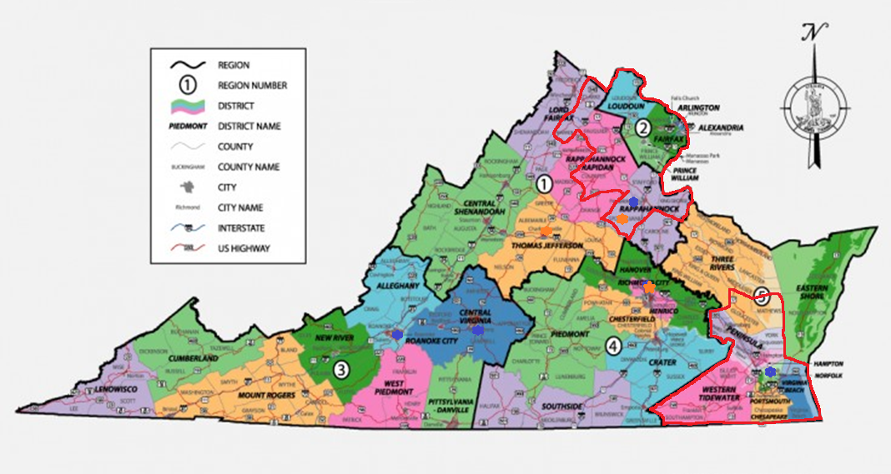
Ryan White Funded Areas in Virginia
Notes:
This map is divided into the state’s 5 health regions – 1 is NW, 2 is N, 3 is SW, 4 is Central, and 5 is Eastern.
Part A: Funding for both core medical and support services go to Eligible Metropolitan Areas (EMAS) & Transitional Grant Areas (TGA) that are most severely impacted by the HIV epidemic. For an EMA, the area must have reported at least 2,000 AIDS cases in the most recent five years and have a population of at least 50,000. For a TGA, the area must have reported 1,000 to 1,999 AIDS cases in the most recent five years and have a population of at least 50,000.
Part A Recipients: District of Colombia Eligible Metropolitan Area: Covers 6 cities & 11 counties in VA (As well as all of DC, 5 counties in MD, & 2 in WV); Norfolk Transitional Grant Area: Covers 9 cities & 5 counties in VA (& 1 in NC). The part A network areas are highlighted in red on the map above.
Part B: Grants to States and Territories to improve the quality, availability, and organization of HIV health care and support services for PLWH. Funding can support AIDS Drug Assistance Programs (ADAP – In VA the name was recently changed to Medication Assistance Program/MAP); Minority AIDS Initiatives which is funding for education and outreach to improve minority access to medication assistance programs such as ADAP, Medicaid, etc.).
Part B Recipients: VDH currently contracts with thirty subrecipients. Twenty-One agencies provide core medical/support direct services to clients, 2 pharmacies, 5 work with VDH to address training needs and the activities within the Integrated Care & Services Plan, and 2 work with our VA MAP clients in enrolled and paying for ACA Marketplace Plan Premiums/Medication Co-Pays.
Part C: Grant funding to local community-based organizations to support outpatient ambulatory health service and support services through Early Intervention Services (EIS) program grants.
Part C Recipients: University of VA (Charlottesville), Mary Washington Hospital (Fredericksburg), EVMS (Norfolk), Community Access Network (Lynchburg), Virginia Commonwealth University (Richmond), Carilion Clinic (Roanoke), & Inova Juniper (Springfield)
Part D: Grants to provide outpatient ambulatory family-centered primary and specialty medical care and support services for women, infants, children, and youth living with HIV
Part D Recipients: UVA, VCU, & Inova
Part F: Contains two aspects: the HIV Dental Program and the AIDS Education and Training Centers (AETC) Program. The HIV Dental Program offers reimbursement The AETC program supports a network of eight regional centers (and more than 130 local affiliated sites) and two national centers that conduct focused, multidisciplinary education and training programs for health care providers treating people living with HIV.
Part F AETC Recipients: VCU, & Inova
Part F Dental Program Participants: None

Slide 8
Purpose of Ryan White Part B
Since 1991, VDH has administered Ryan White Part B funding for HIV care services to persons living with HIV/AIDS
Core Medical Services, Support Services
Funds the Virginia AIDS Drug Assistance Program
Ryan White funding is the payer of last resort.
Notes:
Part B funds are provided by HRSA-HAB to all US states and territories.
A major part of Part B funding is for the AIDS Drug Assistance Program (ADAP) to provide medications for low-income, uninsured individuals with HIV/AIDS. The remaining funds provide HIV care services, targeted to deliver medical care and support services to eligible individuals living with HIV/AIDS. For information on what is a core medical versus supportive service please refer to HRSA Policy Clarification Notice 16-02
Again we want to emphasize that RWHAP funding is the payer of last resort.

Slide 9
VDH Quality Vision and Mission
Vision:
VDH envisions optimal health and medication access for all PLWH, supported by a health care system that assures ready access to comprehensive, competent, and quality care.
Mission Statement:
The RWHAP Part B Quality Management Program exists to ensure the highest quality core medical care and supportive services for PLWH in Virginia, as well as to provide medication access to them through statewide leadership and stakeholder collaboration
Notes:
Just read this slide verbatim and ask the participants what these mean to them?
Context is king!

Slide 10
VDH Quality Values
Values:
VDH believes in creating HIV services that inspire and promote quality, parity, cost effectiveness, client centered, stakeholder input, and teamwork.
Notes:
Read this slide verbatim and then ask participants what it means to them.

Slide 11
VDH Annual Quality Goals
Goals of the Virginia Part B CQM Program:
Assess quality management needs and build capacity within RWHAP Part B funded agencies statewide;
Improve existing databases, data management practices, needs assessment and client satisfaction data to document quality of care and service delivery; and
Enhance the HIV service delivery system.
Notes:
VDH updates its annual quality goals every year. The quality goals are distilled from emerging needs and cross-cutting trends in light of the vision, mission, and values discussed on previous slides.
This year, VDH is focused on all operational goals
Assessment of training needs across the network
Enhancing data collection systems at the state level
Improving the HIV service delivery system
Sometimes VDH includes clinical goals around a specific performance measurement area tied to the HIV Care Continuum.

Slide 12
VDH CQM Program Purpose
The purpose of the RWHAP Part B Clinical Quality Management Program is to continuously improve the quality of HIV care and services, and to be compliant with all applicable service standards such as:
Department of Health and Human Services Public Health Service Guidelines
National priorities
Health Resources and Services Administration Policy Clarification Notices 15-02 and 16-02 and
Promising practices that are evidence-informed
Notes:
The purpose of the CQM Program is to continuously improve the quality of HIV care while maintaining compliance with applicable service standards.
This will be accomplished by:
Developing and implementing a statewide Quality Management Plan;
Monitoring core selected performance measures across Ryan White recipients and sub-recipients;
Providing training and technical assistance related to quality improvement; and
Participating in national quality management collaborative projects.

Slide 13
What is QMAC?
A deeper dive into QMAC
Notes:
This section provides more meat on WHAT IS QMAC? It is drawn from SECTION 2 of your QMAC manuals

Slide 14
Virginia QMAC Overview
The QMAC was integrated into Virginia’s Ryan White Part B infrastructure in 2009 as part of the initial 5-state cross-parts collaborative activities.
In 2011 QMAC was extended to absorb the full Virginia Ryan White HIV/AIDS Program (RWHAP) Cross-Parts Collaborative, which had been led by its own “Response Team” from 2008-2011.
In 2018 the QMAC Executive Committee was formed by convening its subcommittee co-chairs in monthly QMAC steering discussions.
In 2018 the Virginia Quality in care Consumer Advisory Committee (VACAC) was brought in as one of the five QMAC subcommittees.
Notes:
As we’ve already discussed QMAC did not evolve out of a vacuum. It came out of the initial HRSA cross-parts collaborative convened by HRSA in 2008 and was formalized as a part of the VDH infrastructure in 2009.
By the time the HRSA collaborative was ending in 2011, the QMAC took over for the response team in leading statewide cross-parts work.
For 7 years QMAC was able to operate based on VDH leadership and the efforts of subcommittee chairs. in 2018, key stakeholder interviews with QMAC members and subcommittee chairs noted that more steady and consistent steering was needed. The Executive Committee was created that year to provide the consistent guidance and direction that QMAC was needing. This was particularly important in helping subcommittees understand where the role of one subcommittee ends and another begins.
In that same year, 2018, the Virginia Consumer Advisory Committee, which had operated independently 2015-2018 was brought into QMAC as a formal subcommittee as well.

Slide 15
Virginia HIV Care Services
Virginia HIV Service Providers
Virginia People Living with HIV
Consultants
Virginia HIV Environment
VACAC Leadership
QMAC Members
VCU/AETC
QMAC Executive
Regional VACAC
Notes:
Welcome to the BRAIN that is the Virginia HIV Service System and how it functions in the broader Virginia HIV Service Environment.
The three primary stakeholder groups included in this framework are:
People Living with HIV (PLWH) in Virginia
HIV Service Providers in Virginia
The Virginia Department of Health, HIV Care Services Unit (VDH)
In addition, there are supportive stakeholders whose sole purpose is to support the three primary stakeholder groups. These include consultant groups like Organizational Ideas and the Virginia Commonwealth University as the lead AIDS Education and Training Center in Virginia and logistical coordinator for the Virginia HIV Quality Management Advisory Committee (QMAC).
The Virginia Consumer Advisory Committee (VACAC) is an autonomous community program supported by VDH. VACAC operates on two levels to advance the interests of PLWH in Virginia. At the regional level, VACAC supports PLWH in their engagement with regional HIV provider organizations. This is focused on quality of care, customer service, and community engagement efforts by HIV provider organizations. At the statewide level, VACAC supports PLWH in their engagement with VDH. This is focused on consumer involvement in co-designing the Virginia HIV service system, particularly in elevating activities and concerns from the regional level for statewide action.
QMAC is primarily VDH’s mechanism to include the Virginia’s HIV service providers in the HIV service system planning and evaluation. QMAC is led by an Executive Committee, which also includes the VACAC Executive Leadership to ensure Virginia’s overall HIV service system is steered by competent and capable representatives of all its stakeholders.

Slide 16
Virginia QMAC Mission
The QMAC provides a mechanism for stakeholder input on objectives, evaluation, and continuing improvement of HIV care and support services in Virginia and facilitates RWHAP Cross-Parts dialogue.
Notes:
Read the slide verbatim and ask the audience what it means to them.

Slide 17
Virginia QMAC Objectives
Promote promising practices used across RWHAP-funded agencies (A, B, C, D and F)
Enhance the ability of PLWH to equitably access high quality services across the Old Dominion
Advise VDH on statewide RWHAP Part B QM plan and associated activities
Review CQM performance measurement data and assess implications of trends and program changes that have an impact on statewide HIV services
Provide a vehicle for statewide QI projects
Notes:
Our objectives, plain and simple, are to bring together all our stakeholders to discuss data and participate in QI projects. Our goal is to improve the HIV health outcomes of all PLWH across VA using evidence-informed and promising practices. This includes ensuring equitable improvement and enhancement of performance, being the vehicle for statewide QI projects and activities, and advising on the Part B QM Plan.

Slide 18
Virginia QMAC Membership
All RWHAP Part B sub-recipients funded by VDH are required to have representation in QMAC but membership is intended to include the full spectrum of the HIV care system including:
VDH staff
RWHAP recipients and sub-recipients of all Parts funding (A, B, C, D, F)
Data Managers
Clinical Providers
HIV Program Administrators
QM Coordinators from local sites
Others
Consumers from all 5 Health Districts in Virginia
Notes:
In Virginia, all RWHAP funded entities are contractually obligated to identify an ongoing participant in QMAC AND an alternate. Non-participation results in non-compliance with grant/contract expectation and could affect future funding. You are here because your agency believes you are the best fit for this work and your agency is counting on you to be an excellent representative of their needs, concerns, and successes. Some subrecipient agencies send their quality managers, while others send clinical providers. Some send their data managers and some send their program administrators. It is up to the subrecipient agency whom is the best fit to patriciate in QMAC, but consistency is participation in required. Again we recommend agencies have an alternate named in case the primary member is unavailable for any reason (no excuses will be entertained for ongoing non-participation).
Beyond subrecipients, VDH has a strong role and presence in QMAC. Consumers also have a prominent role in QMAC.

Slide 19
What Happens at QMAC Meetings?
Meetings open with VDH updated and words of welcome by key VDH program leaders
consumer moments to frame the meeting theme with community perspective
Training on an important topic tied to the meeting theme
QMAC-wide performance measurement and QI Project updates
Breakout discussion groups to drill down on the meeting theme
Subcommittee and cross-parts reports out
Meetings close with clinical presentations tying together community, programmatic, and provider perspectives related to the overall theme
Notes:
Registration is required for all meetings. Last minute registration may result in VCU’s inability to house you in the hotel (if eligible).
Meetings are designed to have themes around key topics drawn from changes in our state HIV epidemic and emerging science and approaches to HIV care.

Slide 20
Virginia QMAC Meeting Schedule
QMAC uses both face-to-face and virtual meetings/teleconferences to implement the QMAC activities
Quarterly Face-to-face meetings, one of which is the QM Summit
Periodic Virtual meetings
Minutes are taken and attendance, all recommendations, requests and action items are recorded
Notes:
Face-to-face meetings occur quarterly at various locations across Virginia. Meeting dates and locations are announced 3-4 months in advance to facilitate member planning and include a full-day and overnight accommodations for members traveling more than 50 miles to the meeting. VDH makes a concerted effort to make all QMAC meetings face to face, but sometimes its not possible.
Virtual meetings – usually notified at least 2 months in advance and utilizing a platform that allows for the use of webcams
Minutes are taken and attendance, all recommendations, requests and action items are recorded

Slide 21
QMAC vs QM Summit
QMAC meetings take place 3 quarters out of the year and the 4th quarter is reserved for the QM Summit.
Many of the same people participate in the QM Summit as QMAC, but the QM Summit is broader in scope and participation than QMAC.
As with the QMAC meetings, VDH funded RWHAP subrecipients are contractually required to participate in the QMS
The QM Summit is intended to focus statewide conversation around emerging trends and cross-cutting issues OUTSIDE of the statewide QI project.
Many times these discussions are a reflection back on past QI projects and an outlining of what possible QI projects could be coming down the pipeline.
Notes:
QMAC doesn’t actually meet every quarter – it only meets 3 out of every 4 quarters. The other quarter is reserved for the statewide QM summit. It’s easy to get these two meetings confused, but the main difference is that the QM Summit is bigger/broader than QMAC. All funded subrecipients must participate in both, but its common for agencies to send more than 1 person to the QM Summit and the audiences can be different. While QMAC is focused on planning, implementing and evaluating statewide QI activities, QMS looks at QI activities and potential outside the current statewide project.

Slide 22
Virginia QMAC Organizational Structure
Work of the QMAC is carried out through
Executive Committee
Subcommittees
Capacity Building
Communication
Data
Quality Improvement
Virginia Quality of Care Consumer Advisory Committee (VACAC)**
Notes:
The subcommittees are tied together through the QMAC executive committee. QMAC’s primary interface with VDH is through the Executive Committee
VACAC is a subcommittee of QMAC, but operates on dual levels. It’s members are also members of their other four subcommittees to allow for comprehensive and substantial consumer input and involvement at all levels of QMAC. VACAC meetings occur monthly and serve as a clearinghouse of consumer-based questions to VDH and to provide mechanisms for statewide efforts to be routinely communicated back to communities through VACAC members

Slide 23
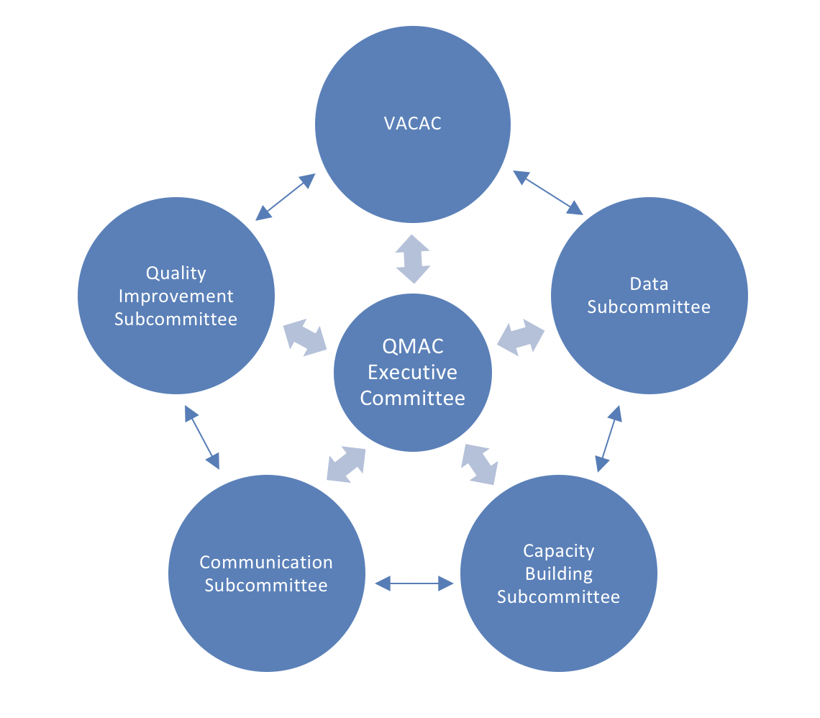
Virginia QMAC Organizational Structure
Notes:
ALL QMAC members are assigned a subcommittee and their attendance at subcommittee meetings is tracked. Individuals that do not fulfill the expectations for participation will result in VDH contacting their employer to make sure the individual is the right fit. Participation in QMAC and its subcommittees is a contractual obligating for all RWHAP funded entities in VA. If subcommittee members cannot attend a meeting, it is their responsibility to let the co-chairs know BEFORE the start of the meeting.

Slide 24
How does QMAC do its work?
A look at QMAC subcommittees and QMAC member roles
Notes:
This section is about QMAC subcommittees and member roles. It is drawn from SECTION 3 of your QMAC manuals
As a reminder, VACAC was founded in 2015 and was brought into QMAC as one of its subcommittees in 2018.

Slide 25
Executive Committee Responsibilities
Define the QMAC structure and process for statewide QM activities;
Oversee the implementation of subcommittee and overall QMAC work plans;
In conjunction with VDH, coordinate QMAC and subcommittee work;
Curate a menu of annual QIPs for QMAC member consideration;
Identify key considerations related to performance measurement, service standards, or other core QM activities for discussion at the QMAC meetings;
Make decisions on new member candidates;
Make decisions related to member terminations;
Provide encouragement and enthusiasm for the QMAC membership;
Oversee QMAC data analysis and reporting activities;
Participate in planning and implementing quarterly QMAC meetings; and
Participate in planning and implementing the annual QM Summit.
VIDEO
Notes:
As we’ve already stated, the executive committee was formed in 2018 to bring together the subcommittee chairs and serve as the primary interface with VDH. This group steers the overall QMAC workplan and takes the lead in planning QMAC meetings.
The Executive Committee includes VDH staff, the QMAC chair, the chairs of each of the other five subcommittees, and a RWHAP funded program representative to ensure geographic representation from the five Virginia health regions. The Executive Committee provides oversight and support to the QMAC and works with QMAC members to set goals, determine priorities and provide technical support necessary to implement identified quality initiatives.
The executive committee is used as a sounding board for suggestions/questions to be forwarded to VDH in addition to communication to subrecipients through the QMAC newsletter.

Slide 26
Executive Committee Activities
Notes:
The organizational structure demonstrates the oversight activities of the QMAC Executive Committee

Slide 27
Capacity Building Subcommittee Responsibilities
Develop and implement an onboarding process for all new members, including a mentor program;
As needed, collaborate with VDH to develop teachable moments and other special training content and resources based on requests sent directly to VDH
Report to Executive Committee and coordinate with QMAC Subcommittees.
VIDEO
Notes:
The Capacity Building Subcommittee supports cross-parts quality activities identifying training and technical assistance needs of all stakeholders. The subcommittee is composed of members who have expressed an interest in assisting with training and capacity building activities.

Slide 28
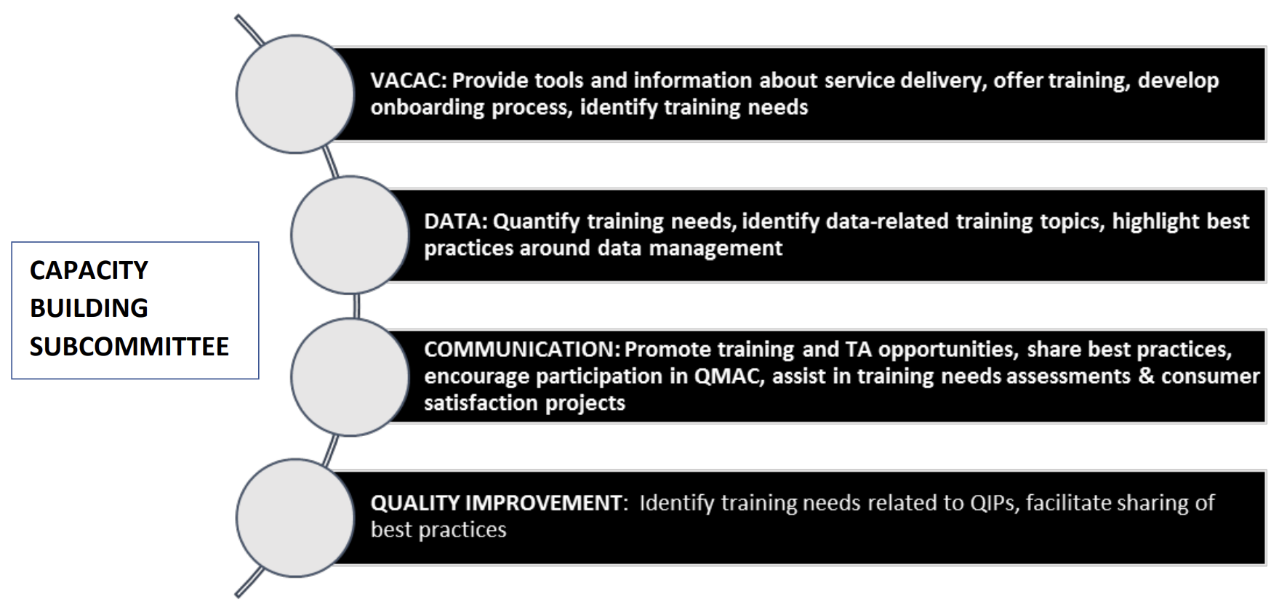
Capacity Building Subcommittee Activities

Slide 29
Communications Subcommittee Responsibilities
Provide information and opportunities to expand QM knowledge and contacts through several modes of communication to QMAC and stakeholders;
Create QMAC quarterly newsletters including provider and client perspectives to disseminate, including synopsis of subcommittee activities;
Report to Executive Committee and coordinate with QMAC Subcommittees.
VIDEO
Notes:
The Communication Subcommittee sends variety of official communications and makes recommendations to the QMAC and stakeholders, regarding QI activities. This subcommittee is composed of members who have experience or interest in utilizing various communication modalities targeted to a range of stakeholders.

Slide 30
Communications Subcommittee Activities

Slide 31
Data Subcommittee Responsibilities
Help determine how to use data in conjunction with QI activities to develop strategies for improving care;
Identify and explore issues related to specific identified data management systems (CAREWare and other VDH Data systems);
Report to and coordinate with the Executive Committee and QMAC subcommittees about data management activities/projects as they are reviewed and considered;
Identify best practices around data QM.
VIDEO
Notes:
The Data Subcommittee provides overall guidance on applying data to QI and QM initiatives. This subcommittee is composed of members from the QMAC who have expressed an interest in assisting with data related activities.

Slide 32
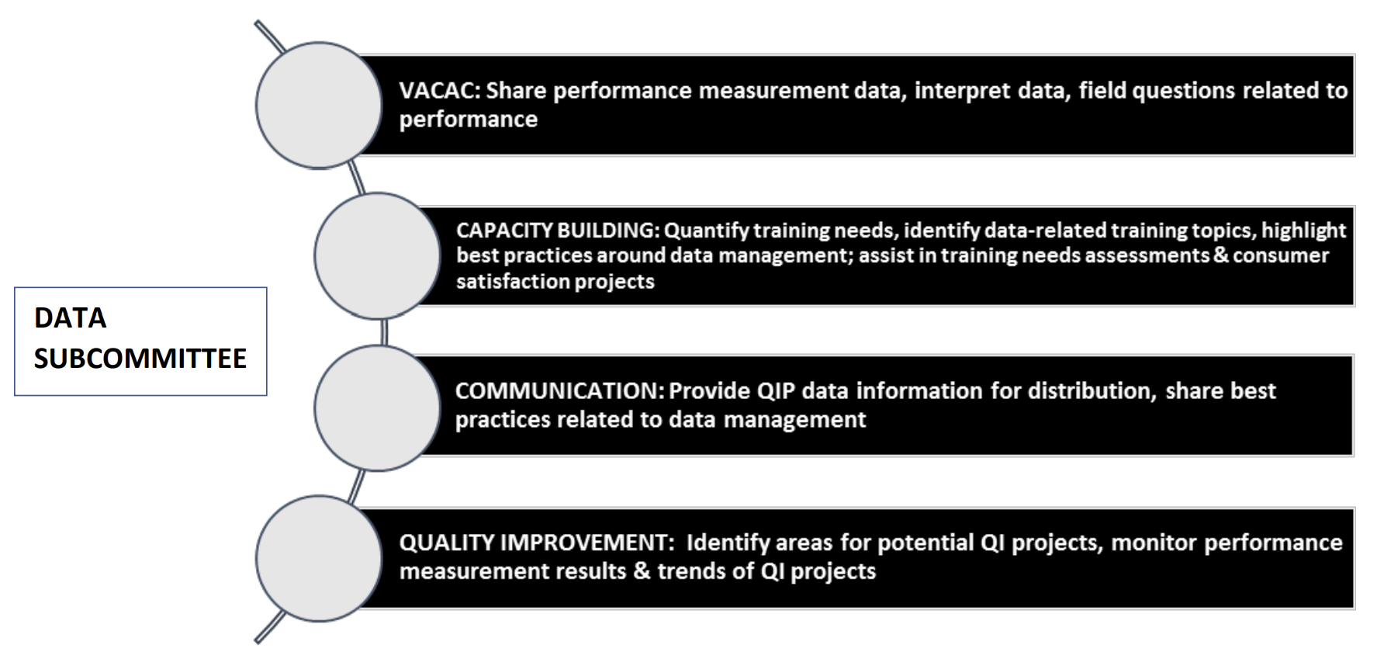
Data Subcommittee Activities

Slide 33
QI Subcommittee Responsibilities
Facilitate a dialogue around QI activities;
Provide reports on QI activities for distribution to stakeholders;
Assess progress and status of QI program, review results, identify cross-cutting issues and best practices of QIPs;
Report to Executive Committee and coordinate with QMAC Subcommittees
VIDEO
Notes:
The QI Subcommittee assists the QMAC with the development of reports, recommendations and best practices related to QI initiatives. This subcommittee is composed of members from the QMAC who have expressed an interest in assisting with QI activities.

Slide 34
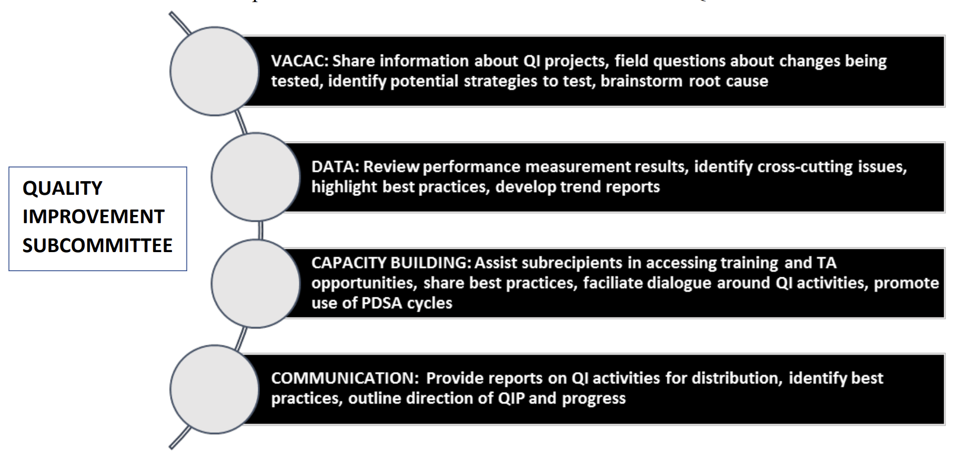
QI Subcommittee Activities

Slide 35
VACAC Responsibilities
Act as liaison between consumers, VDH and service providers;
Engage, educate, and bring together consumers through a variety of activities that support health promotion and quality of life;
Assess VACAC membership yearly to ensure appropriate special subpopulation representatives are included;
Provide input on the VDH planning and Quality of Care program; including, but not limited to, performance measurement, needs assessment, QIPs, quality infrastructure requirements, and targeted consumer initiatives;
Participate actively in HIV provider organization CQM activities in regions; and
Report to Executive Committee and coordinate with QMAC Subcommittees.
VIDEO
Notes:
VACAC’s role in QMAC is to be the consumer involvement mechanism. VACAC serves as the interface between people living with HIV, HIV service providers in VA, and VDH. There is a heavy training and support component in order to meaningfully engage people with HIV in statewide QI activities. Each year, the VACAC examines itself to ensure it is reflective of the state’s HIV epidemic and all key populations are represented.

Slide 36
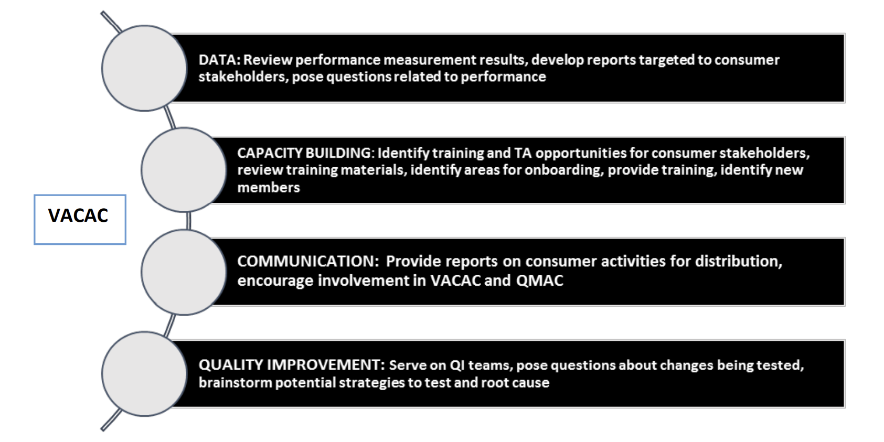
VACAC Activities

Slide 37
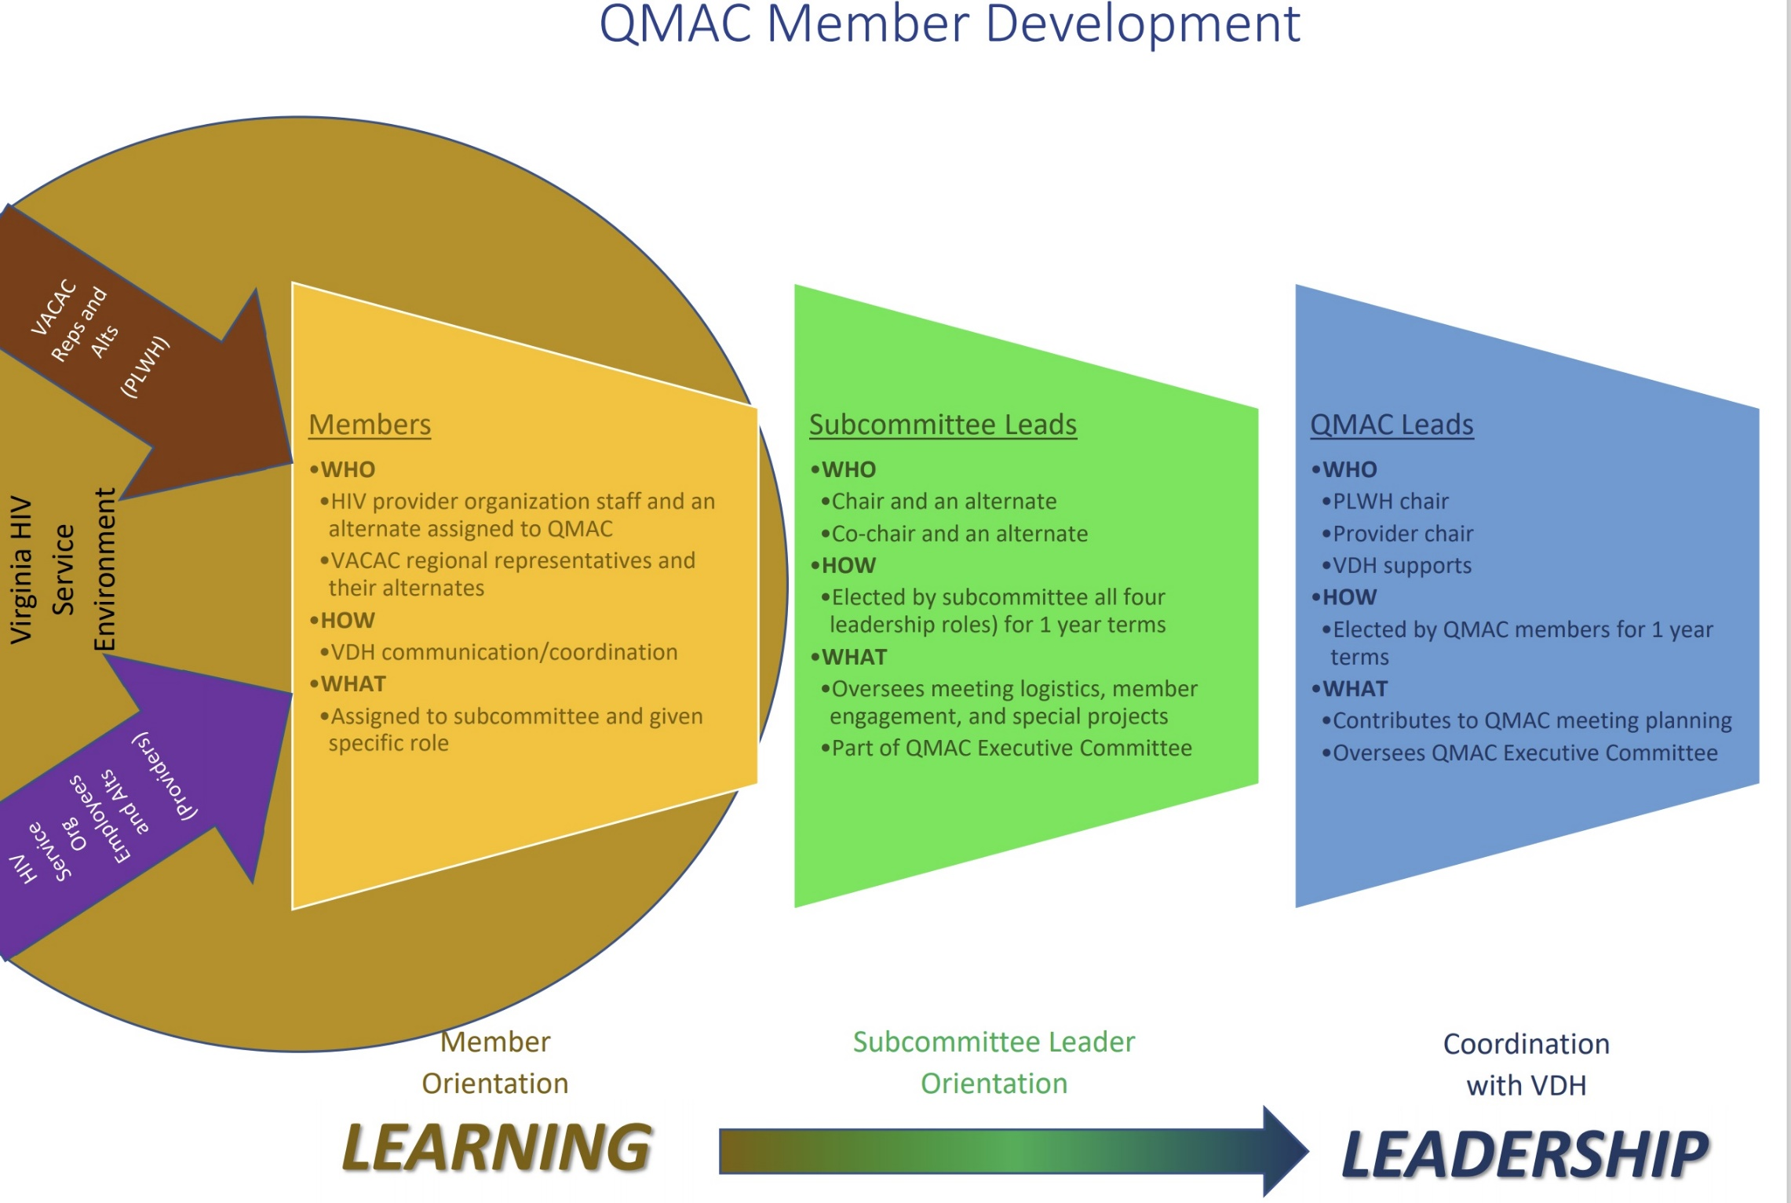

Slide 38
What is expected of me?
How to be an awesome QMAC participant
Notes:
This section emphasizes what is expected of QMAC members now that you are part of the fold. It draws from SECTION 4 in your QMAC Manuals
QMAC meetings have been affected by COVID19!
Usually there are numerous opportunities for face-to-face networking and interaction through workshops and educational games
We have adapted to the new normal using zoom!
Instead of full day meetings, we meet for partial days and take breaks
You are still expected to participate in meetings that are virtual and there are the same rules on tardiness, excused vs total absence, and your agency being notified if you have too many misses.

Slide 39
Selecting and Changing Subcommittees
VDH assigns subcommittees
QMAC reps and their alternates must attend the same subcommittee
Do not rotate subcommittees
VDH can update your assignment based on request
The primary representative and alternate must always participate in the same subcommittees
This same rule applies for VACAC members
Notes:
VDH will assign you to a subcommittee based on the selections you just made and any subsequent discussion you have with them
If your agency already has a QMAC representative and you are an alternate, you will both be participating in the same subcommittee for the sake of consistency
You may not rotate around to other subcommittees, but you may request to change your assigned subcommittee through a conversation with VDH CQM team
The primary contact and alternate must always participate in the same subcommittees
This same rule applies for VACAC members. Please stick to one subcommittee and let VDH know if you plan to change

Slide 40
Present, Tardy, Excused, Absent
All Part B funded subrecipients must be represented at all QMAC meetings – there are no excused absences.
Offenders will receive letters of findings and need a corrective action plan
Primary representatives must coordinate with alternates
Only 3 excused absences will be permitted for subcommittee meetings and no unexcused absences will be permitted.
Offenders will receive letters of findings and need a corrective action plan
Primary representatives must coordinate with alternates
Notes:
All funded subrecipients must attend all QMAC meetings – there are no excused absences. Subrecipients whose representatives are habitually absent or tardy will receive a letter of findings associated with their non-compliance with a contractual obligation.
It is incumbent on primary representatives and their alternates to coordinate
Only excused absences will be permitted each year for subcommittee meetings. Your attendance will be reported to your agency periodically and your agency will receive a letter of findings associated with their non-compliance with a contractual obligation if necessary

Slide 41
Subcommittee Management
Subcommittees are led by Chairs and Co-Chairs (and their alternates)
Subcommittee functions are managed using toolkits
All assigned subcommittee members have roles assigned (primary representatives and their alternates share this role)
Subcommittees keep track of their tasks and who is involved
Subcommittees report these details to the Executive subcommittee and to VDH leaders
Your subcommittee leadership will reach out to explore available roles with you
No role requires more than 1 hour time commitment per month (in addition to subcommittee meeting and QMAC meetings)
Notes:
Subcommittees are led by Chairs and Co-Chairs (and their alternates). Each subcommittee focuses on a special project, but there are many functions that the subcommittees share to operate effectively. This includes toolkits on meeting logistics and member engagement.
All assigned subcommittee members have roles assigned by subcommittee leaders. Remember that primary representatives and their alternates share this role making it important for you to coordinate with your primary or alternate. Since leaders have a way to track attendance and assigned tasks, subcommittees keep track of who is involved in doing actual work. Subcommittees report these details to the Executive subcommittee and to VDH leaders on a regular basis to make sure that good work gets credit!
Once you are assigned to a subcommittee, its leadership will reach out to explore available roles with you. No role requires more than 1 hour time commitment per month (in addition to subcommittee meeting and QMAC meetings)

Slide 42
Glasscubes
Glasscubes is the document sharing app used by QMAC
Current and past agendas for QMAC
Current and past agendas for subcommittees
Important training materials and update documents
Everyone in today’s orientation will receive an invitation to join!
If you cannot access Glasscubes at your agency, VDH will work with you on a 1:1 basis
It is YOUR responsibility to access information in glasscubes or identify other methods to access the information saved there.

Slide 43
Travel Reimbursement
There are two types of travel reimbursement that work differently for sub-recipient representatives and PLWH
Virginia RWHAP Part B Subrecipient Reimbursement
VACAC Reimbursement
Notes:
SubRecipient-Unless other arrangements have been made, VDH will not directly reimburse any individual traveling on behalf of a Virginia RWHAP Part B sub-recipient. Instead, individuals must go through their home agency’s reimbursement process and receive their payment in full from that process. The sub-recipient agency is then authorized to bill the reimbursed amount against its Virginia RWHAP Part B CQM funds to be reimbursed in turn.
VACAC Reimbursement
Travel reimbursement is available to support PLWH participation to QMAC activities and help ensure that all are able to attend regardless of financial circumstances. No pre-paid assistance is available. Individuals in travel status for the QMAC must adhere to the same travel regulations as VDH employees such as completing a W-9 form and keeping all receipts for requested reimbursement of expenses with limited exceptions.

Slide 44
Orientation Summary
Notes:
Now we’re in the home stretch and we want to make sure to distill the most important takeaway messages.
This is where we circle back to the programmatic contexts as individual trainers.
Each trainer asks AND answers one of the following questions: What is the most important achievement we’ve made as QMAC in your opinion? What works well in QMAC? What are QMAC’s major challenges? What do you hope for QMAC in the next year?

Slide 45
QMAC Member Roles & Expectations
QMAC members provide important feedback as stakeholders in the overall statewide HIV service system.
Represent your provider organization or community
Attend meetings and coordinate with your alternates as needed
Complete all assigned tasks related to your subcommittee (coordinate with your alternate as needed)
Avoid overcommitment!
Work with your employer or VACAC executive if you are overwhelmed
Be practical around what you can sign on to do and how much time/energy you have available for QMAC activities
Notes:
This slide should be read like a checklist stopping after each bullet to make sure it is absorbed.

Slide 46

Discussion, Question, and Answer
Notes:
What do you think? Are you ready to QMAC?

Slide 47



Evaluation Questions

