Slide 1
VAMS Call Center Assisted Appointment Scheduling

Slide 2
Agenda
What is VAMS?
VAMS appointment flow
Call center role in appointment scheduling
Questions

Slide 3
Vaccine Administration Management System (VAMS)
Developed by CDC through partnership with Deloitte
Web-based system; accessible via computer, tablet, smartphone with internet browser
Secure: two-factor authentication, HIPAA compliant
Allows for scheduling of clinics, identification of employers/vaccine recipients, clinic registration, vaccine administration record-keeping, vaccine inventory management

Slide 5
VAMS Appointment Scheduling
Contact information for intended vaccine recipients is entered into VAMS by an employer/organization (or local health district acting on their behalf)
Vaccine recipients receive e-mail and schedule appointment online
Any vaccine recipient unable to schedule appointment online calls call center for assistance

Slide 6
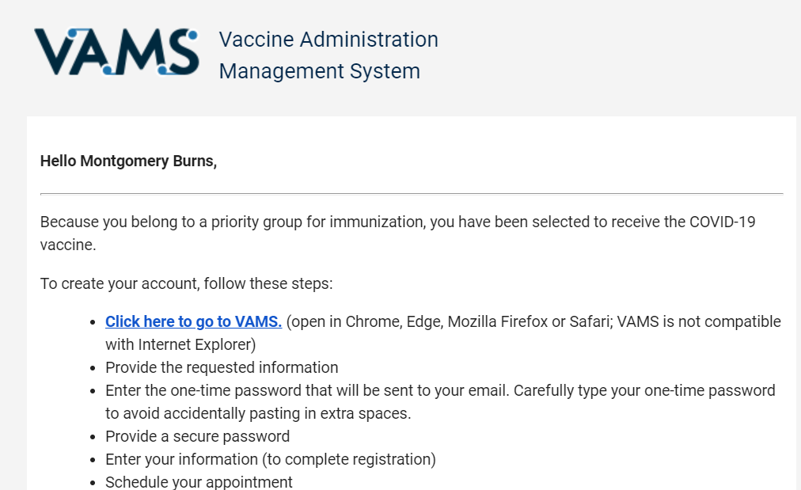
Vaccine Recipient – Online scheduling
Vaccine recipient will receive an email invitation from VAMS
Be sure to check SPAM/Junk folders (and “Promotions” tab in Gmail) for this e-mail

Slide 7
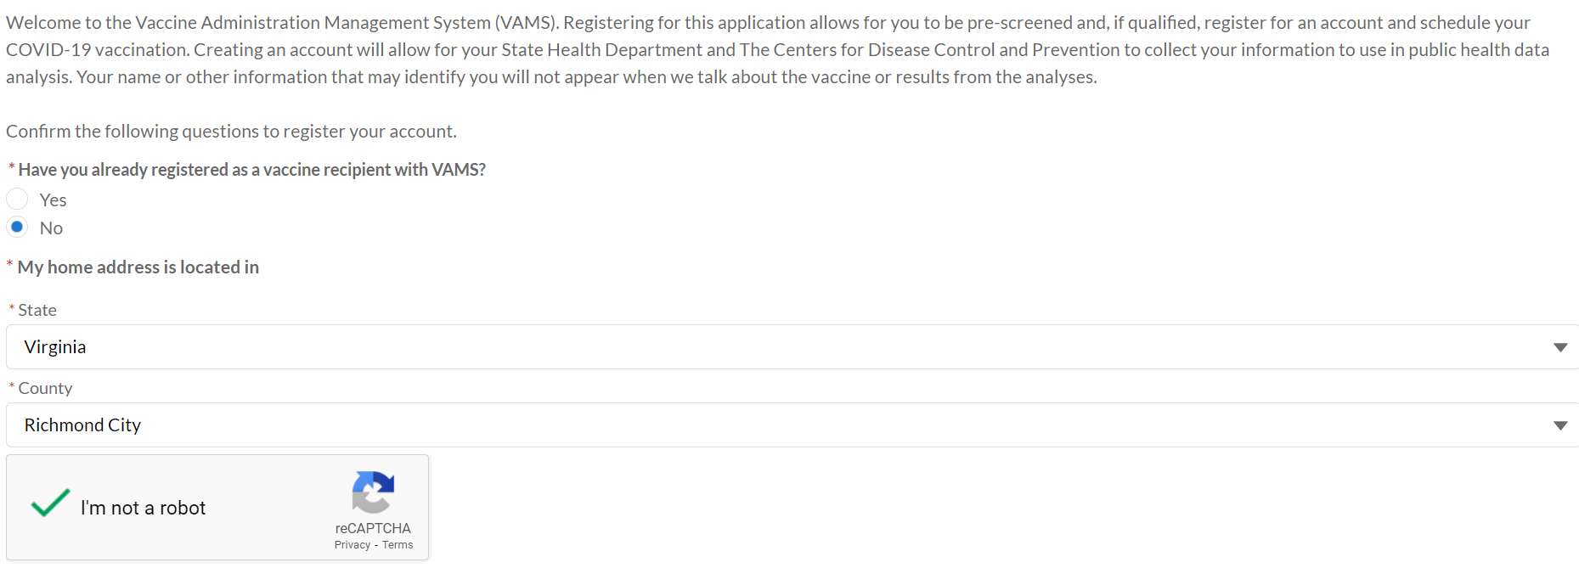
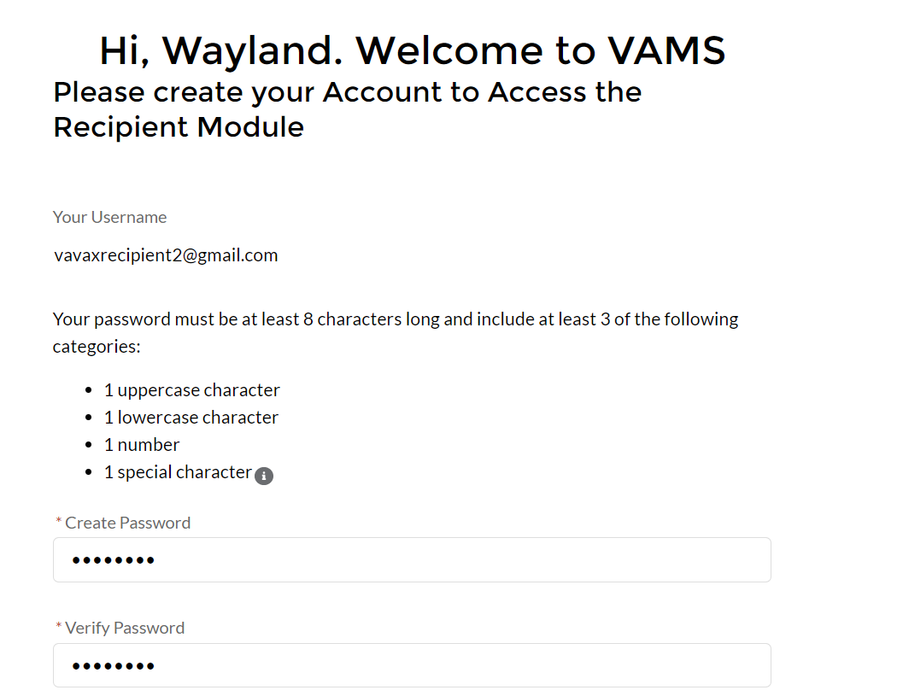
Vaccine Recipient – Online scheduling
Vaccine recipient creates VAMS account

Slide 8
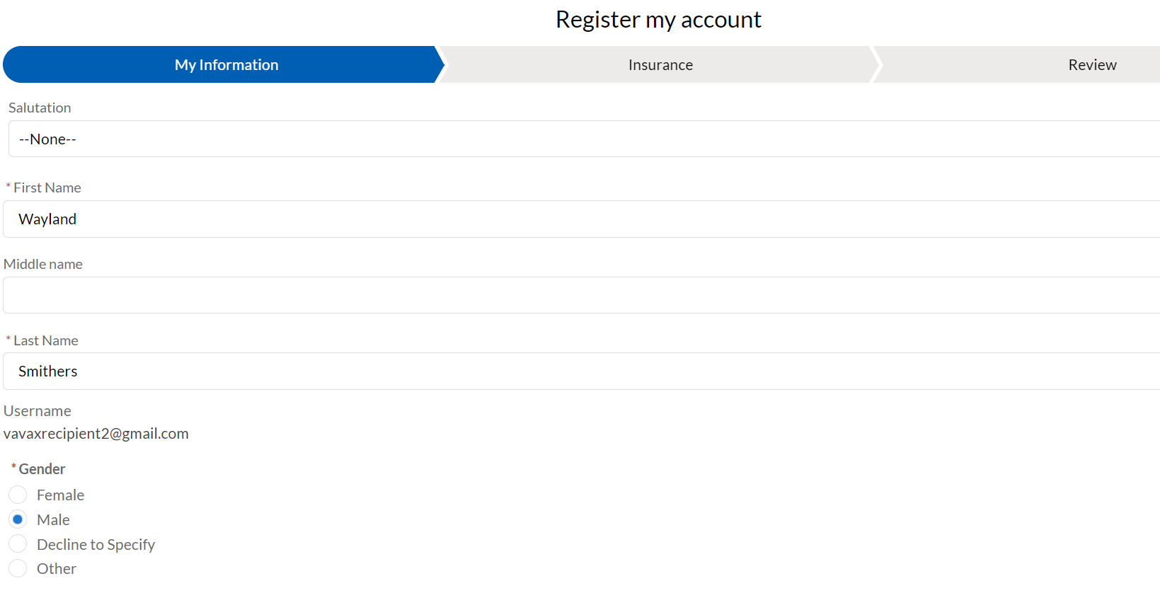
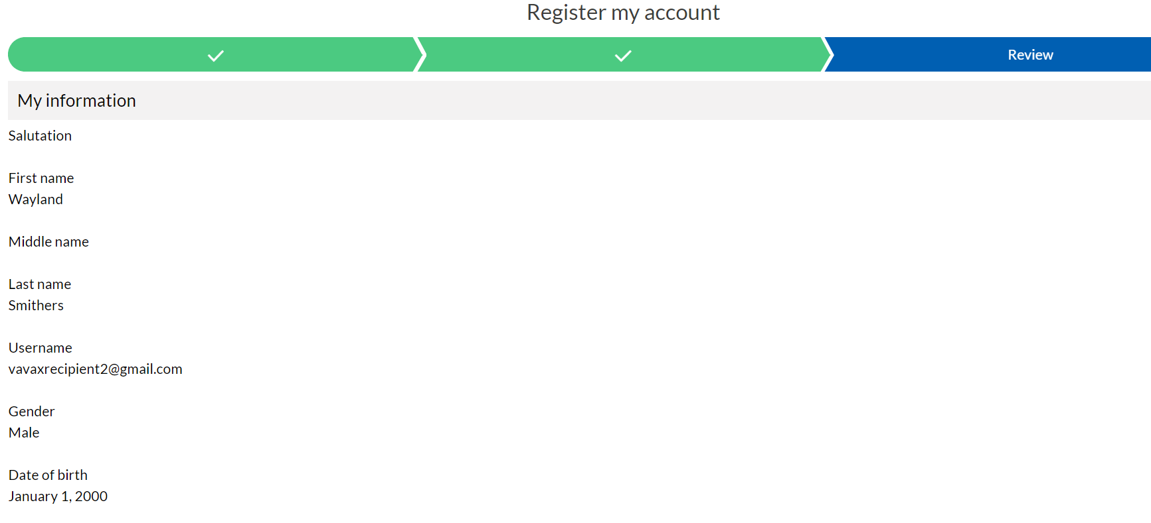
Vaccine Recipient – Online scheduling
Vaccine recipient confirms information

Slide 9
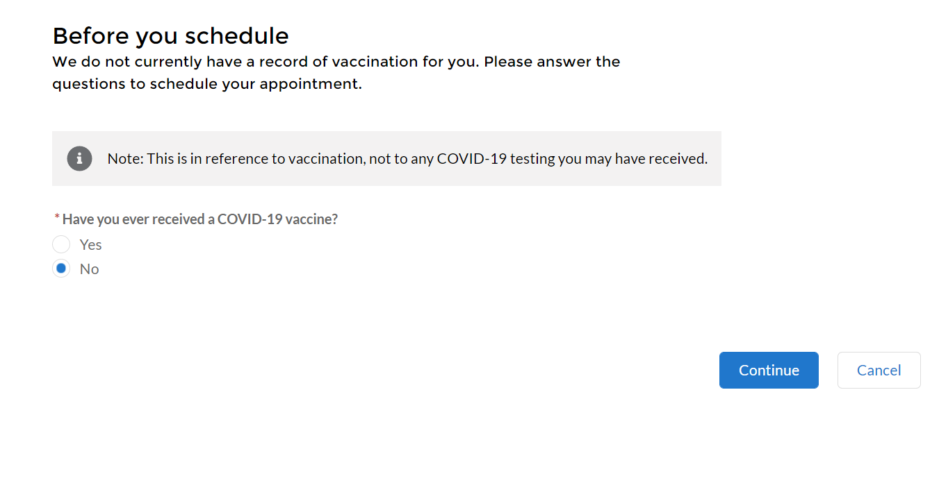
Vaccine Recipient – Online scheduling
Vaccine recipient schedules appointment, starting with initial scheduling questions

Slide 10
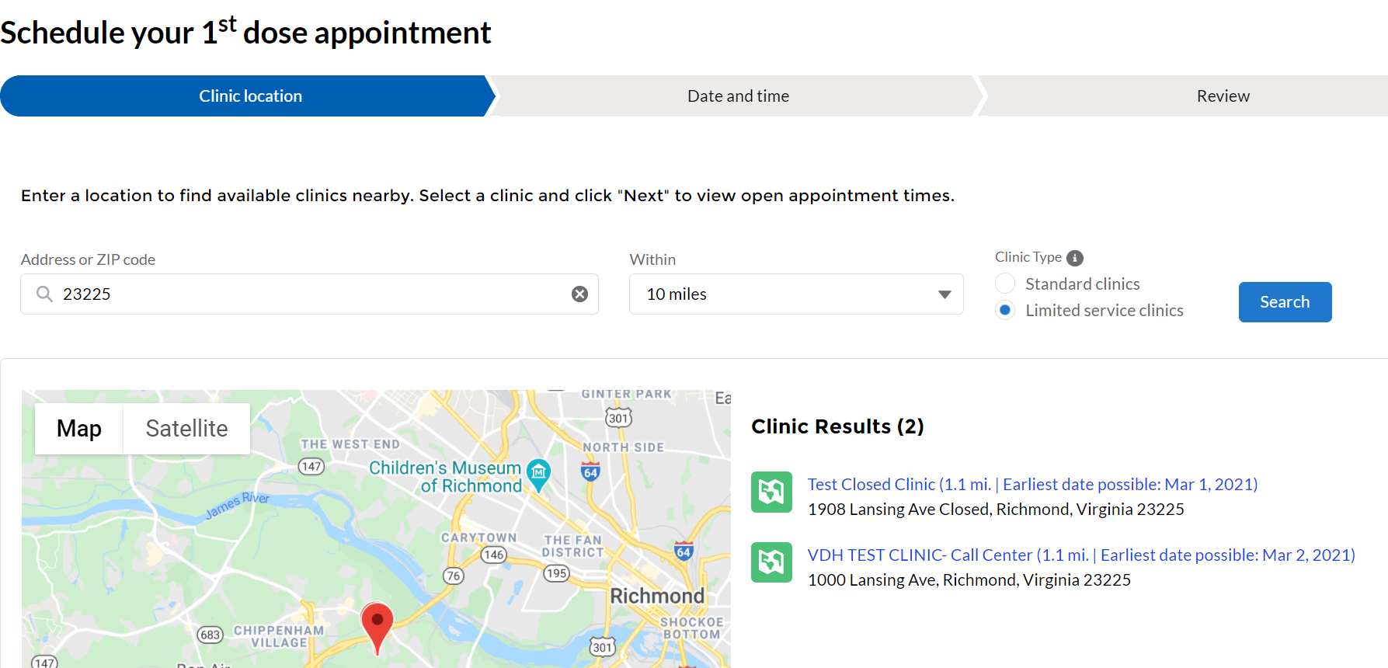
Vaccine Recipient – Online scheduling
Clinic search conducted by ZIP code and clinic type
Be sure to check “standard clinics” if no clinics appear when searching “limited service” clinics

Slide 11
Vaccine Recipient – Online scheduling
Clinic selected and appointment scheduled

Slide 12
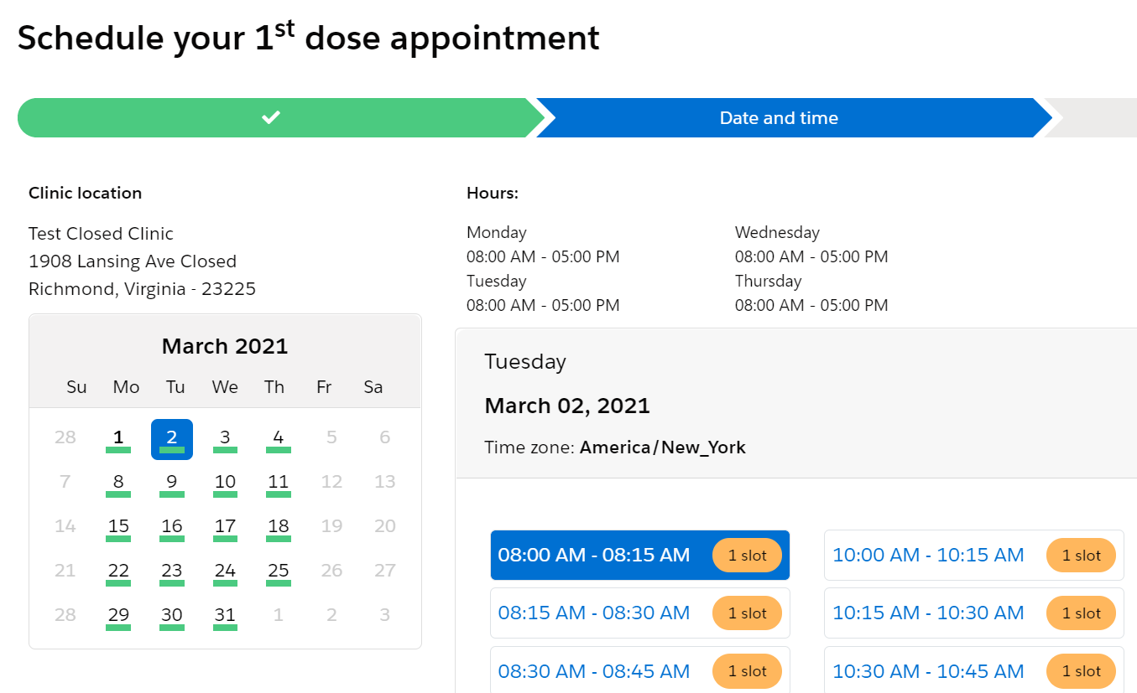
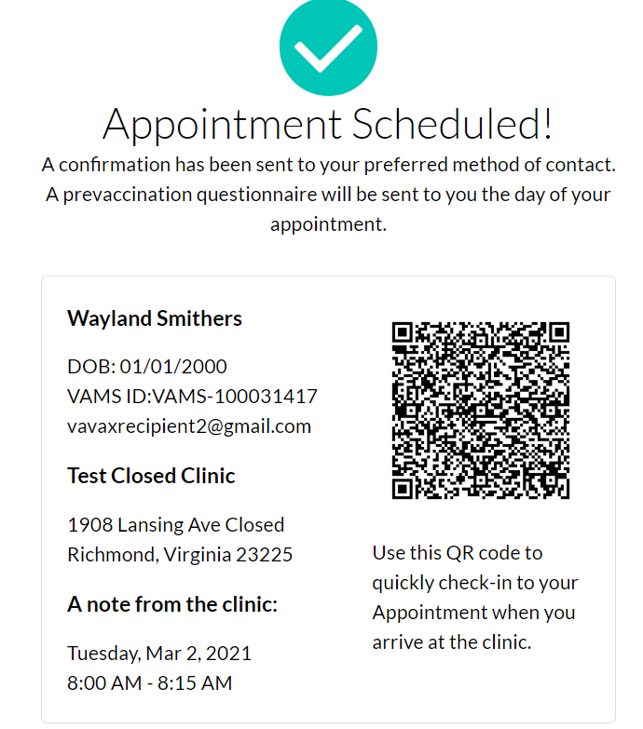
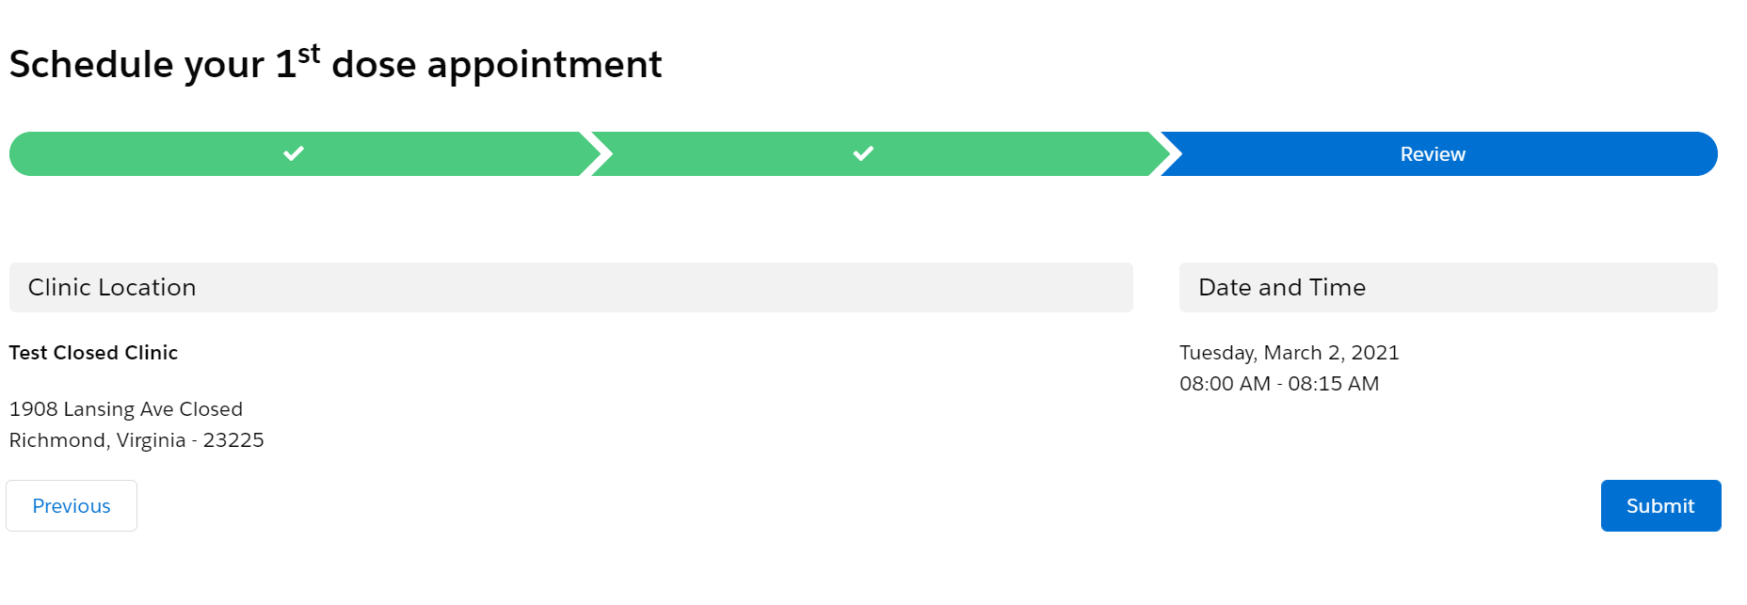
Vaccine Recipient – Online scheduling
Vaccine recipient completes appointment scheduling by selecting date/time and confirming details, receives confirmation

Slide 13
Vaccine Recipient – Scheduling by phone
Vaccine recipient will contact call center
Call center agent will use VAMS to help schedule vaccine appointment

Slide 14
Vaccine Recipient – Scheduling by phone
Step 1: Call center agent logs into VAMS to access clinic portal
Access VAMS at vams.cdc.gov
Login using username and password
Complete “CAPTCHA” if requested
Enter two-factor authentication code (received via email or SMS text message)

Slide 15
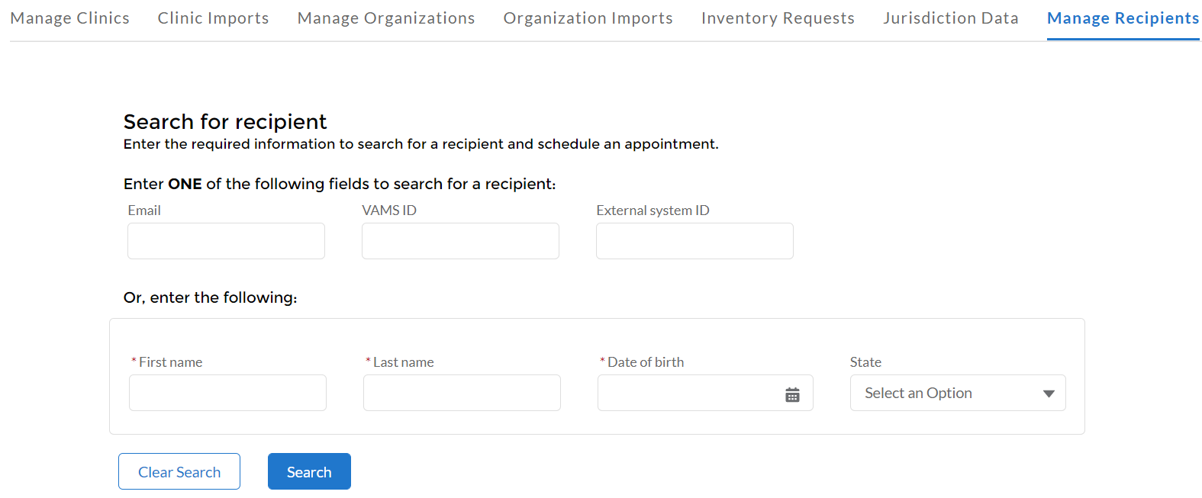
Vaccine Recipient – Scheduling by phone
Step 2: Locate recipient
Recipient will have been added by employer/organization using first name, last name, and e-mail
Click on “Manage Recipients” tab

Slide 16
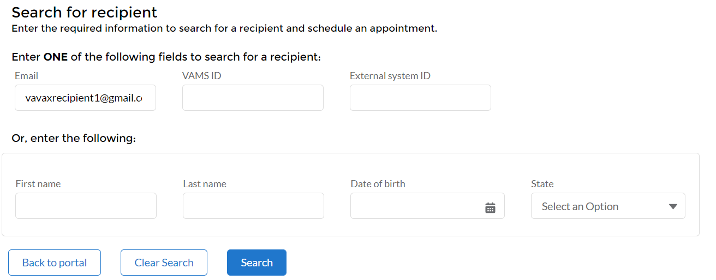
Vaccine Recipient – Scheduling by phone
Step 2: Locate recipient
Enter recipient e-mail address and click “Search”

Slide 17
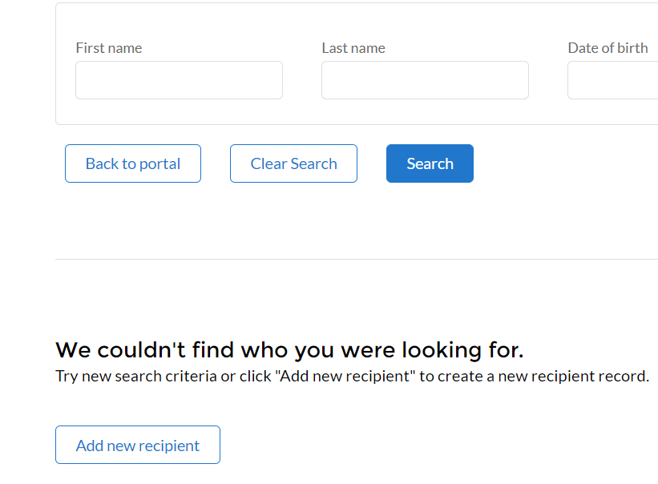
Vaccine Recipient – Scheduling by phone
Step 2: Locate recipient
If recipient has activated their account, they will appear in search results; check the box next to their name and click “Schedule future appointment” (unlikely as they are calling the call center to help them schedule!)
If recipient is not found, you can help create appointment for them

Slide 18
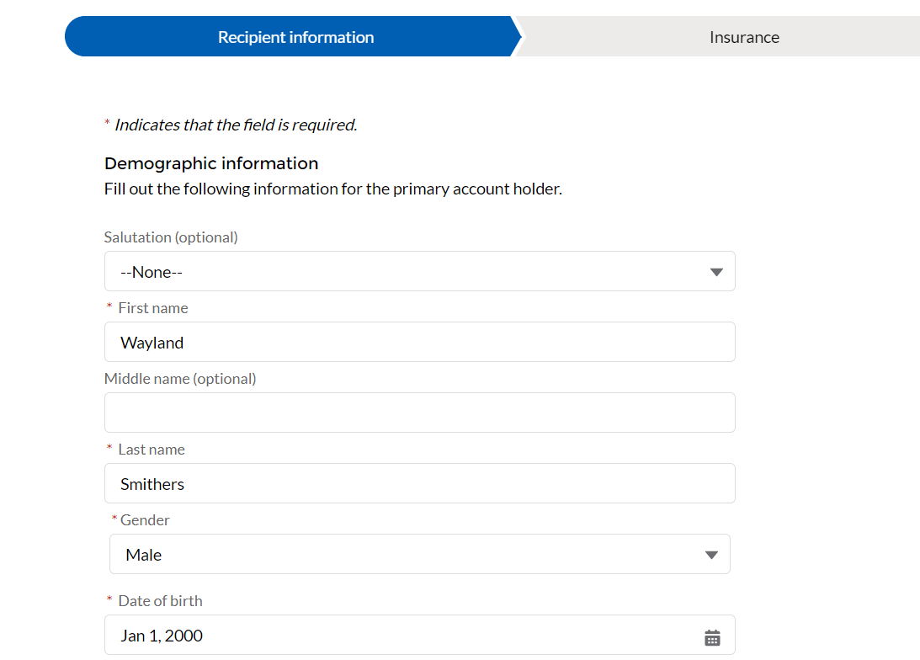
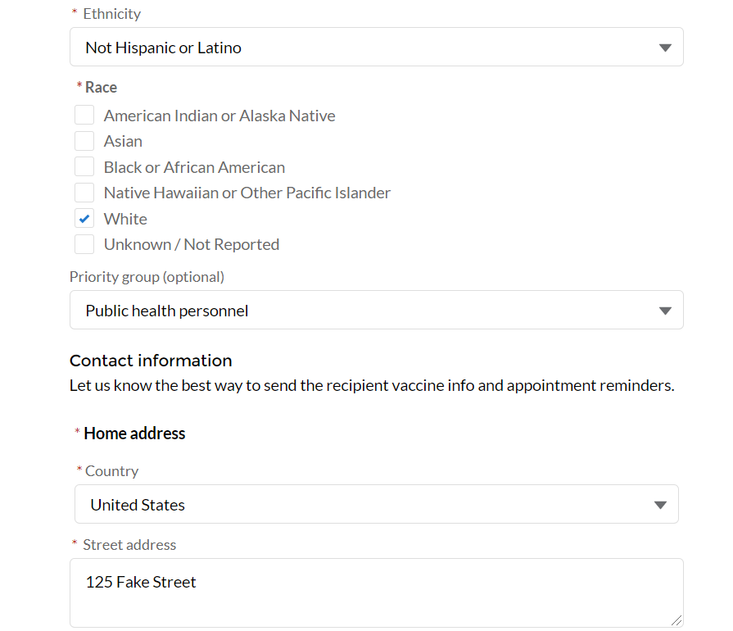
Vaccine Recipient – Scheduling by phone
Step 2: Locate recipient
If recipient does not have active account, you can help create appointment for them, but will need to enter basic demographic information first to create an account

Slide 19
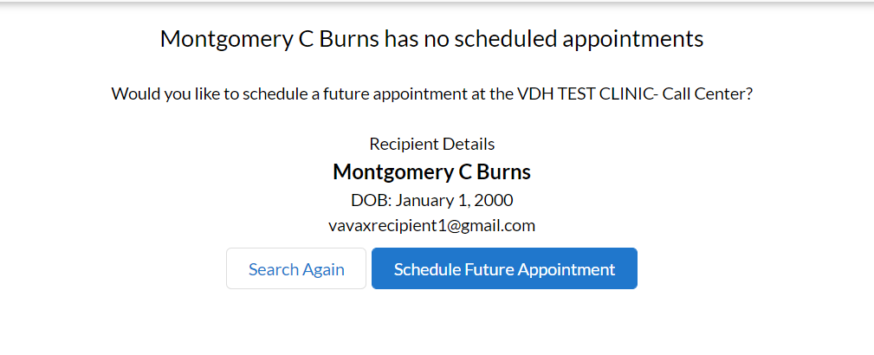
Vaccine Recipient – Scheduling by phone
Step 3: Schedule future appointment
Click “Schedule Future Appointment” box

Slide 20
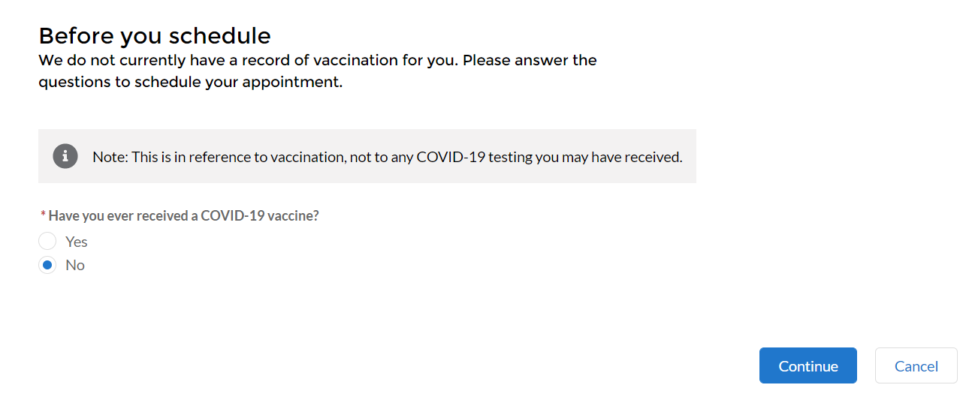
Vaccine Recipient – Scheduling by phone
Step 3: Schedule future appointment
Click through prompts

Slide 21
Vaccine Recipient – Online scheduling
Step 3: Schedule future appointment
Conduct clinic search by entering recipient’s ZIP code

Slide 22
Vaccine Recipient – Online scheduling
Step 3: Schedule future appointment
Select chosen clinic and click “Next” to schedule appointment

Slide 23
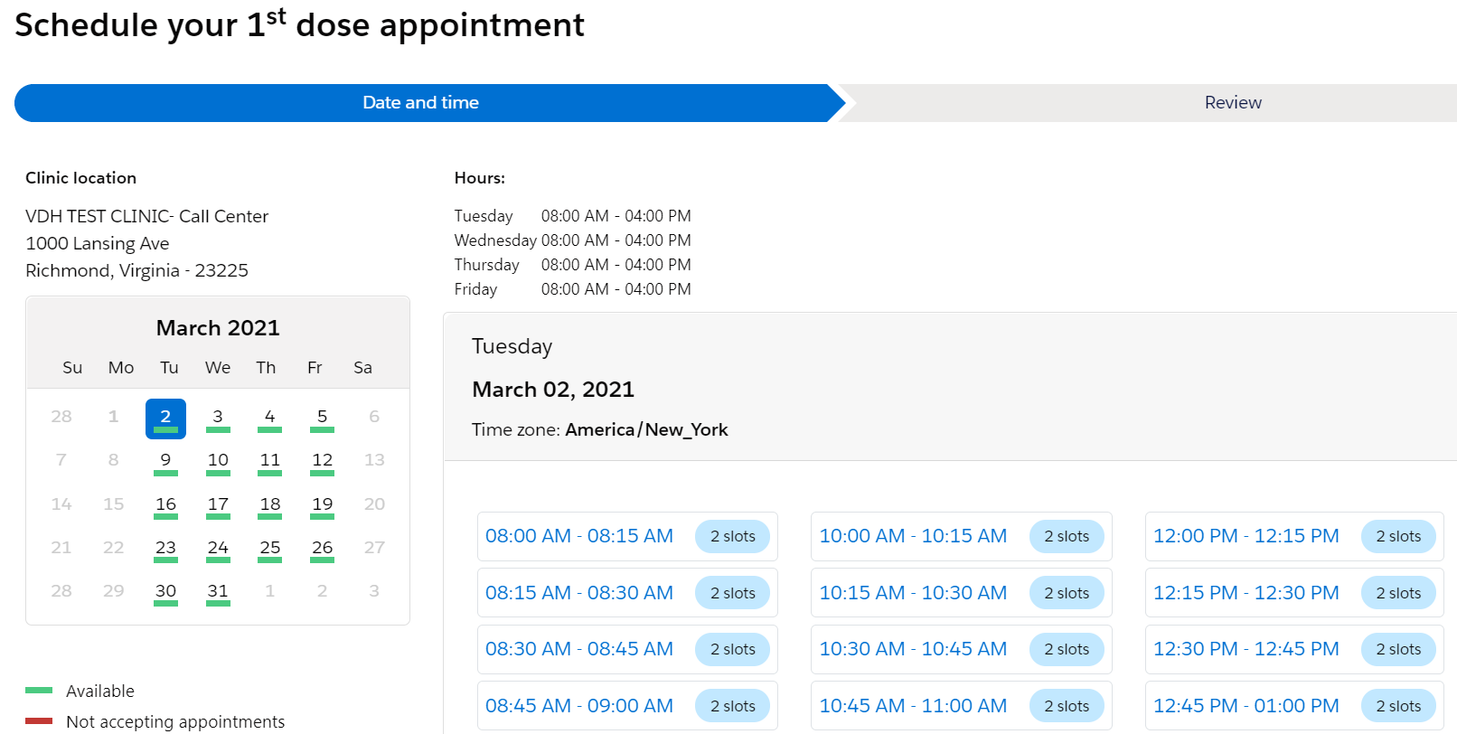
Vaccine Recipient – Scheduling by phone
Step 3: Schedule future appointment
Select a date and time for the appointment from the available dates/times, scroll down, and click “Next”

Slide 24
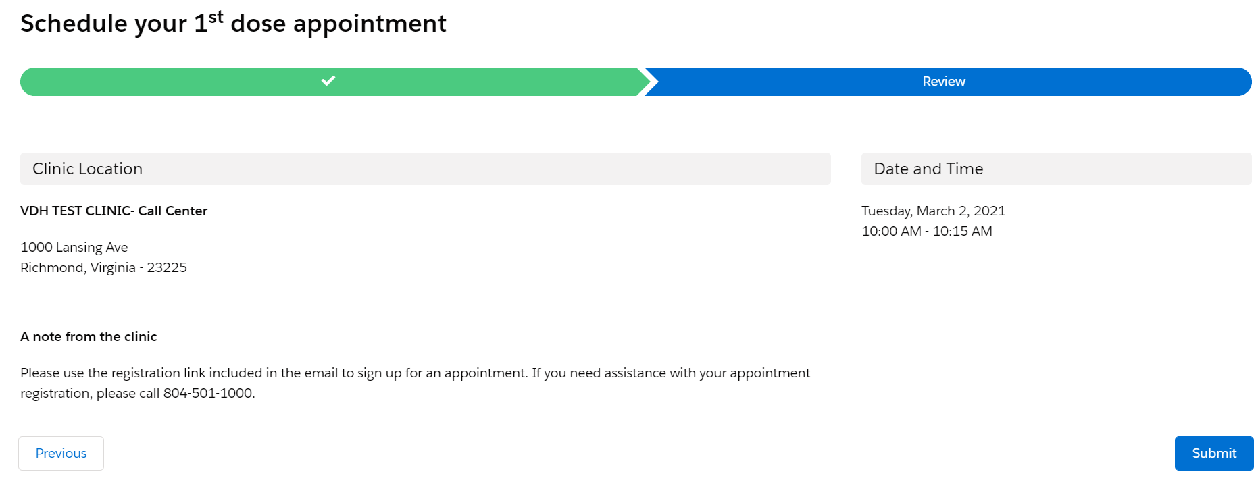
Vaccine Recipient – Scheduling by phone
Step 3: Schedule future appointment
Confirm appointment details with recipient and click “Submit”
IMPORTANT: Recipient will receive email with details, but please ensure recipient writes down details of their appointment date/time/location

Slide 25
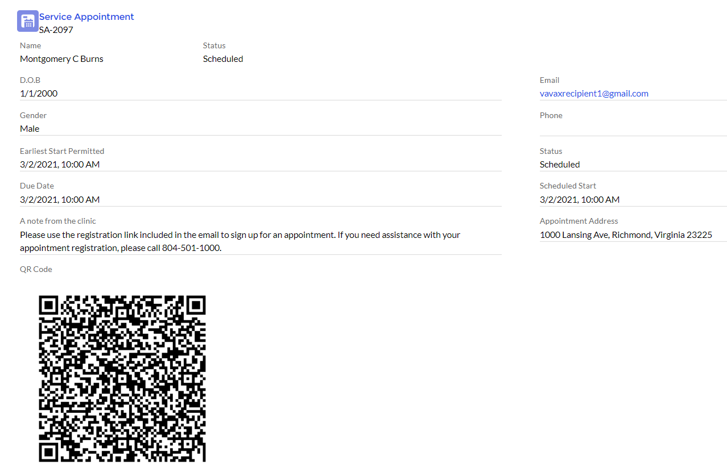
Vaccine Recipient – Scheduling by phone
Step 4: Ensure you have confirmed appointment details with recipient before disconnecting and explain next steps

Slide 26
What happens next?
Vaccine recipient has appointment!
Upon presenting to clinic, front desk staff will complete check in
Vaccine recipient will complete pre-screening on paper (with electronic attestation of completion) or provider can complete pre-screening with patient and document electronically
Vaccine administered and documented
Ideally second dose (if applicable) scheduled during post-vaccine waiting period

Slide 27
Questions?
AND...THANK YOU!

