Slide 1





The Power of Partners: Engaging the Community to Fight TB

Slide 2
Learning Objectives
Participants will:
Articulate shared TB elimination challenges across the Commonwealth
Identify steps in developing culturally competent solutions to TB elimination challenges

Slide 3

The traditional model of TB control in the United States, in which planning and execution reside almost exclusively with the public health sector, is no longer the optimal approach during a sustained drive toward the elimination of TB
–Advisory Council for the Elimination of Tuberculosis, January 1995

Slide 4
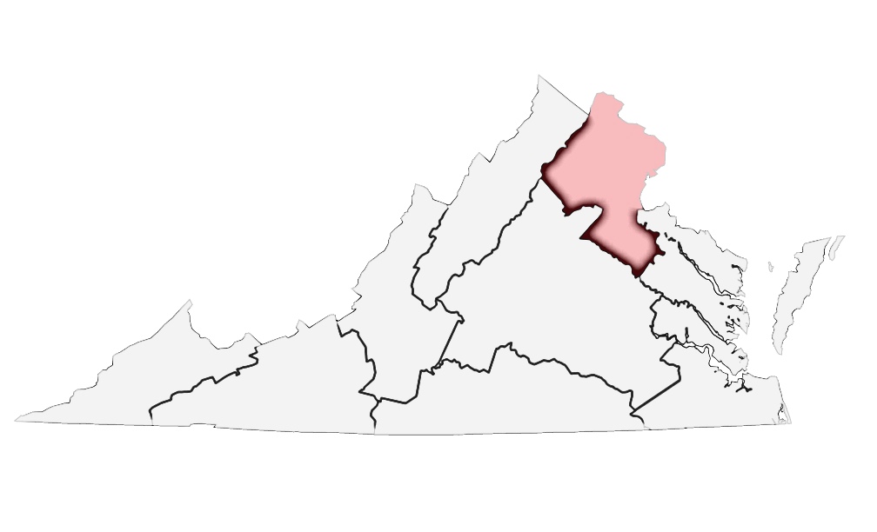
TB Control in NOVA
1/3 of VA’s population
1/4 of population is foreign-born
180 languages
At least 90% of TB cases are foreign-born

Slide 5
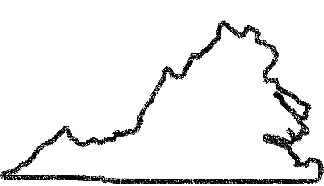
Fairfax
Arlington
Loudoun
Alexandria
Prince William
- Est -
August 2017
Identify and develop sustainable approaches to increase community capacity to advance TB elimination goals in Northern Virginia
Goal

Slide 6
Establish a Northern Virginia TB Elimination Task Force
Establish a local TB Community Advisory Council
Deliverables

Slide 7
Educational campaign
Community provider education
Interjurisdictional partnerships
Strategies

Slide 8
Challenges
Prevalence of TB among foreign-born
Delays in detection and reporting
Late entry into care
Contacts don’t want to be tested or treated
Treatment completion
BCG protection myth

Slide 10
Provide strategic direction for education campaign
Identify effective solutions for TB elimination challenges
Council’s Role

Slide 11
Identify challenges and causes
Identify core messages
Survey clients
Interview community members
Review campaign materials
Engagement Strategies

Slide 12
Shaping Campaign Materials Development
Community
member interviews
Campaign Materials
TB client surveys
Community Advisory Council feedback
TB Taskforce experience

Slide 13
Brought from out of the country
–African representative
It’s dangerous and hideous and no one talks about it
–Mongolian representative
What do you think of when you think TB?
For the impoverished and immigrants
–Muslim representative
Controlled in the US, but immigrants are coming and transmitting it
–Korean representative

Slide 14
Root Cause Analysis

Slide 15
Delays in Detection, Reporting
Lack of trust in medical community
Fear, Stigma
Don’t know signs and symptoms
Don’t feel sick
No TB in the U.S.
Providers don’t test

Slide 16
Late Entry Into Care
Lack of trust in medical community
Fear
Cost/lack of insurance
Don’t know signs and symptoms
Incorrect diagnosis
Desire to treat in other ways

Slide 17
Contacts Don’t Want Testing, Treatment
Lack of trust in medical community
Fear, Stigma
Cost/lack of insurance
Don’t feel sick
Side effects and length of treatment
Don’t understand the risk

Slide 18
Barriers to Care
Lack of trust in medical community
Stigma
Cost/lack of insurance
Side effects and length of treatment
Lack of transport–ation
Don’t feel sick

Slide 19
BCG Myth
Fear of more screening
Perception of lifetime immunity
Don’t know signs and symptoms

Slide 20
Campaign Development
Developed messages
Validated messages
Developed materials
Validated materials

Slide 21
Anyone can get TB
Even if you have gotten the TB vaccine in the past, you can still get TB
Core Messages
Many immigrants in the US were infected in their home country and don’t know that they have TB
Most people with TB do not know they are infected

Slide 22
TB can be treated and cured
A cough that won’t go away could be the first sign of TB
Core Messages
Taking medications as prescribed by your healthcare provider can cure TB
TB can be prevented

Slide 23
Message Testing/Interviews

Slide 24








Countries Represented

Slide 25
Knowledge and Awareness

Slide 26
Top Messages

Slide 27
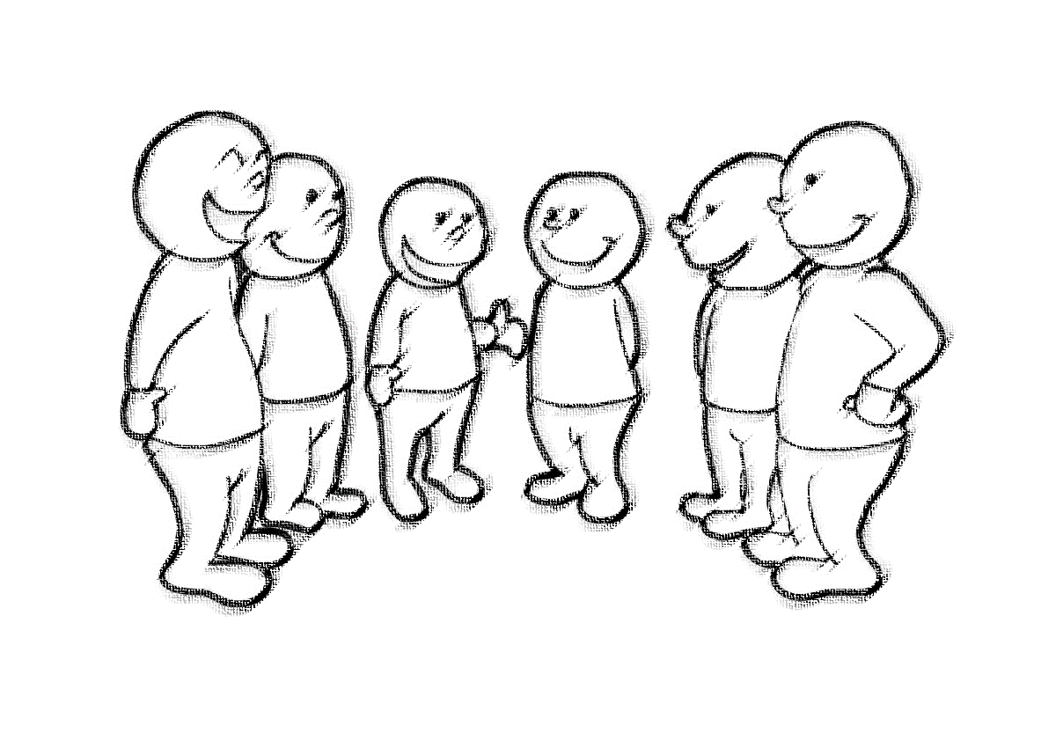
Communication Preferences Among Non-Spanish Speakers
7 preferred places of worship and cultural community centers
More than half recommended media outlets and radio

Slide 28

Communication Preferences Among Spanish Speakers
4 preferred Spanish TV daily news or other ethnic television
2 preferred Spanish-language radio
A few mentioned faith-based organizations and community centers

Slide 29
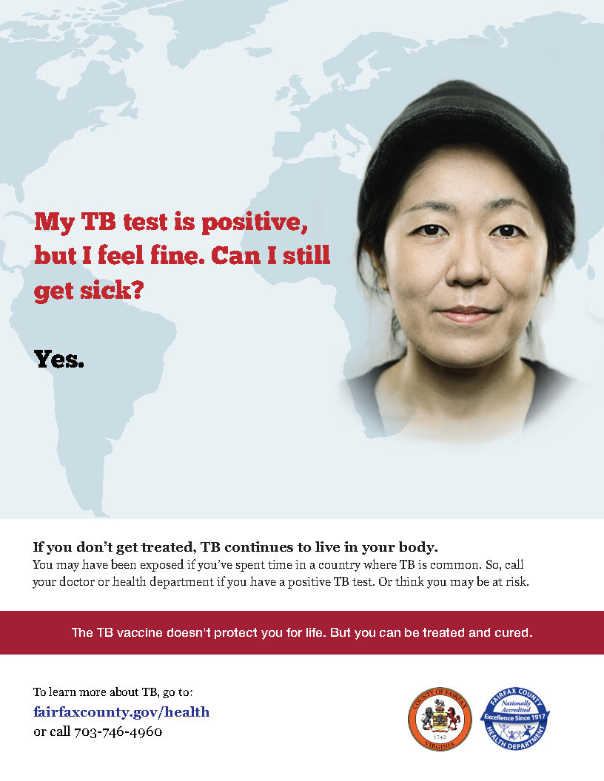
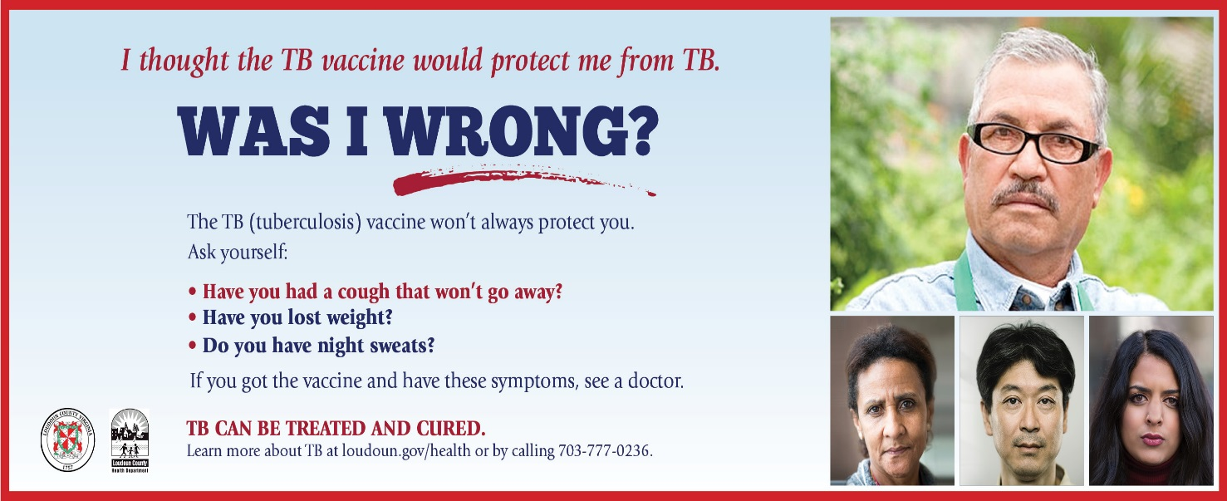
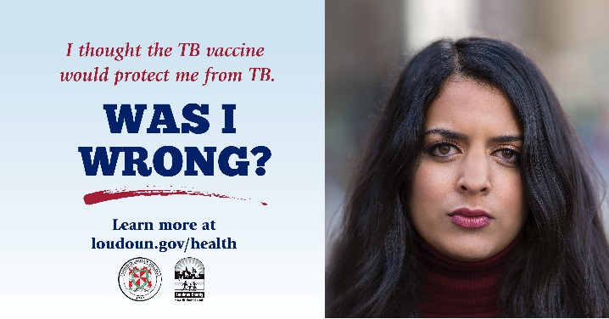
Campaign Materials

Slide 30

Outreach Strategy
Social media: Facebook, Twitter, Instagram
Metro bus ads
Print material distribution

Slide 31
Accomplishments
Formed TB Elimination Taskforce
✓
Developed education campaign
✓
✓
Identified co-chairs to ensure sustainability
Formed Community Advisory Council
✓

Slide 32



Next Steps
Develop & launch community provider education
4
Finalize materials & outreach strategy
3
Chart course for interjurisdictional work
2
1
Implement campaign

Slide 33





Lessons Learned
Engagement
We can—and should—work together!

Slide 34
Acknowledgments

Slide 35
Questions

