Slide 1
Evaluating TB Classified Individuals

Slide 2
Objectives
Describe the Electronic Disease Notification System and its uses and purpose.
Define TB classifications.
Demonstrate understanding of how to complete TB follow-up worksheets in the EDN system.
List goals of the National TB Indicators Project related to evaluation of TB classified immigrants and refugees.

Slide 3
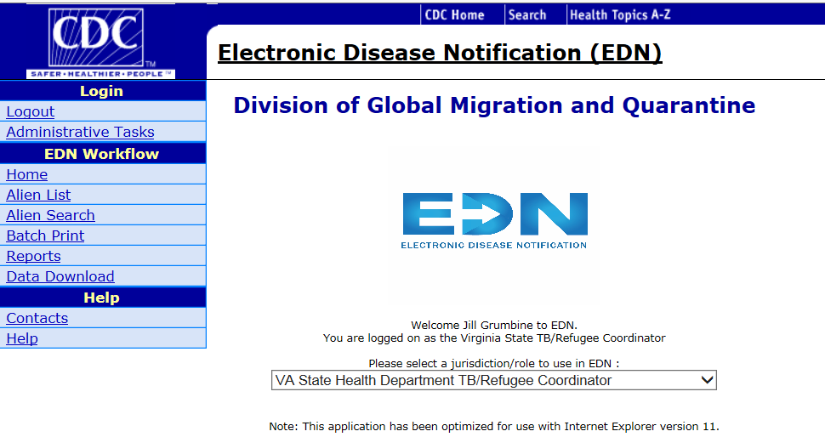
EDN
Electronic Disease Notification System
CDC database that houses overseas medical information for all refugees and any immigrant identified with TB classified condition

Slide 4
Program Evaluation Focus Area
TB Program
  National targets for performance in evaluating individuals with a TB Classification
The current data:
Indicator and time frame |  | National 2020 Goal | Virginia 2017 Performance
Exam initiation | Within 30 days of notification | 84% | 58.1%
Exam completion | Within 90 days of notification | 76% | 33.5%

Slide 5
State/Local Health Department and Clinic Responsibilities in EDN
  Submit TB follow-up worksheets on all notifications
  Submit addresses of those who move so they can receive appropriate care
*CDC COOPERATIVE AGREEMENT*

Slide 6
District EDN Access
TB and Newcomer Health Program expects:
  2 individuals for TB notifications
  1 individual for Refugee paperwork (if applicable)
Multiple people for cross coverage
No limit to the number of people who can have access

Slide 7
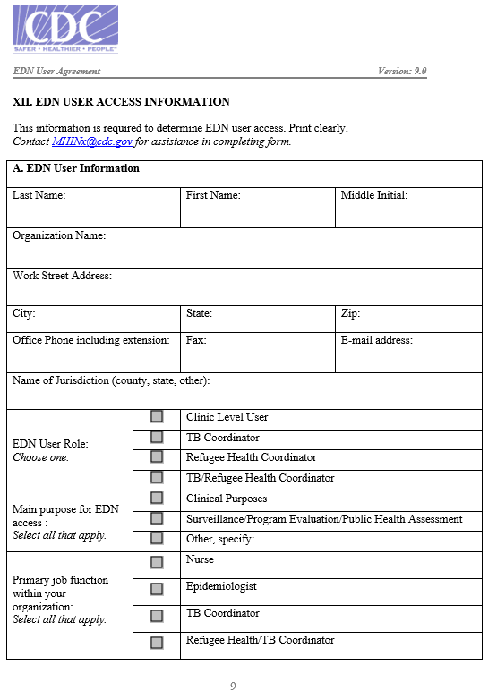
Obtaining EDN Access
To receive this form, email: Kirthi Bondugula, Kimani Burney, Jill Grumbine, or Amanda Khalil
Enter your DISTRICT under Organization Name
Enter in your own information. Choose an EDN user role; this is based on your job role.
  Do NOT select Clinic Level User
Notes:
Jill Grumbine- State Refugee Health Coordinator
Kirthi Bondugula- Newcomer Health Program Support
Amanda Khalil- Nurse Consultant
Kimani Burney- TB Program Support

Slide 8
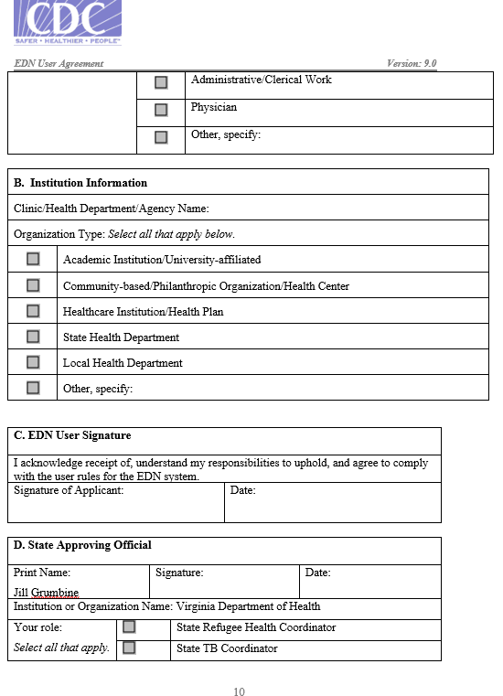
Select Institution type
  Local Health Department
Sign and date the agreement
Fax to Jill Grumbine at 804-864-7913
  Jill will sign and fax to CDC
You will then receive an email with receipt of approval and a registration login for the SAMS portal

Slide 9
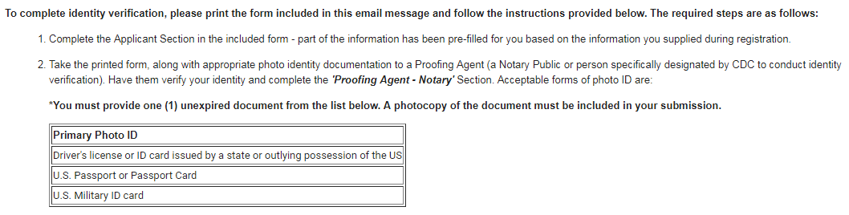
Obtaining EDN Access
You will first register using the login provided in your email
Upload completed PDF to SAMS as final step
for approval for EDN access
This is what the email will look like!

Slide 10
Recommendation
Log in monthly to avoid being kicked out of the system
    Set calendar reminder
              1st Wednesday of each month
    Avoid choosing specific dates
              May fall on a weekend

Slide 11
Departing Employees
  Notify TB/NH immediately so that access to EDN can be discontinued
  Identify additional access needs

Slide 12
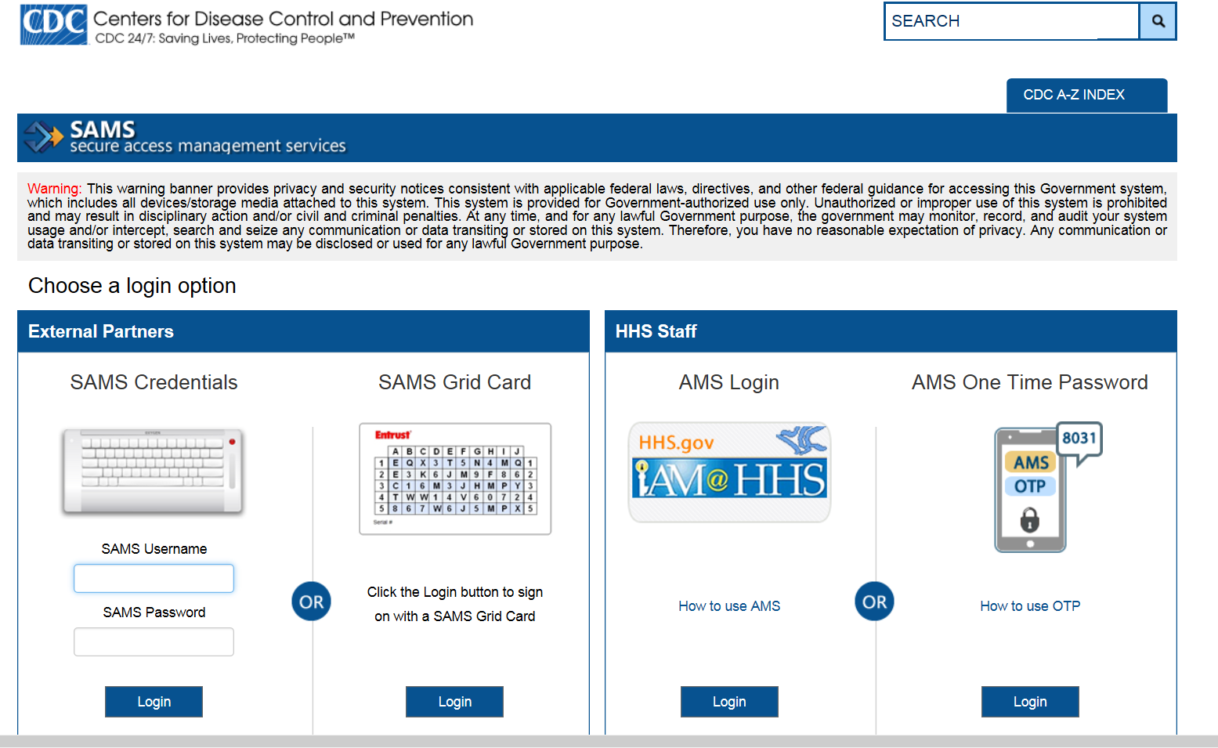
https://sams.cdc.gov

Slide 13
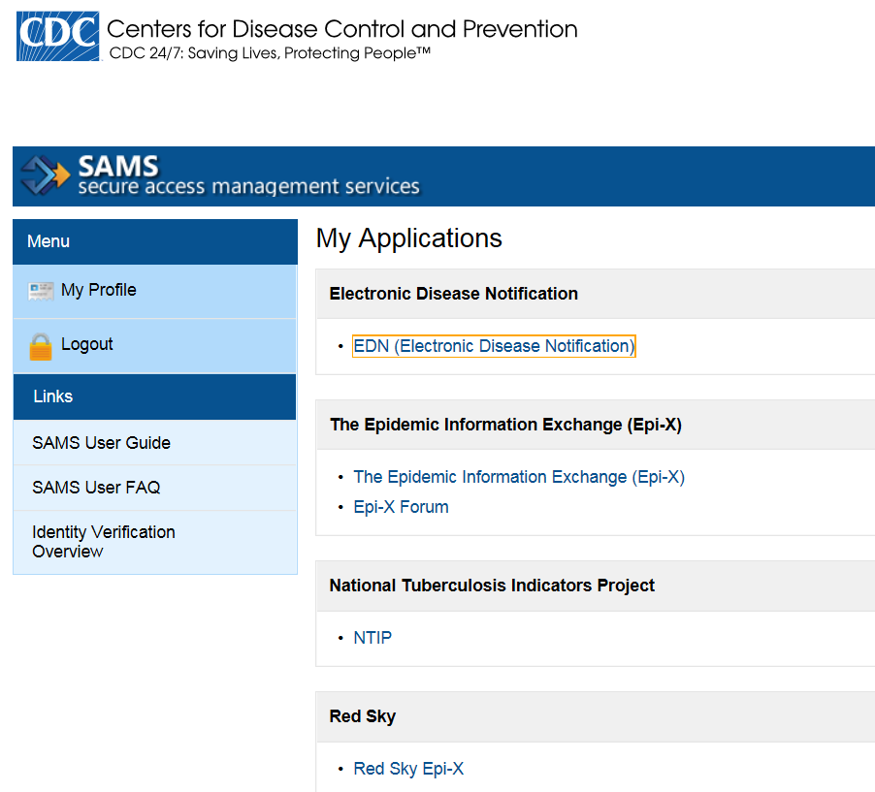

Slide 14
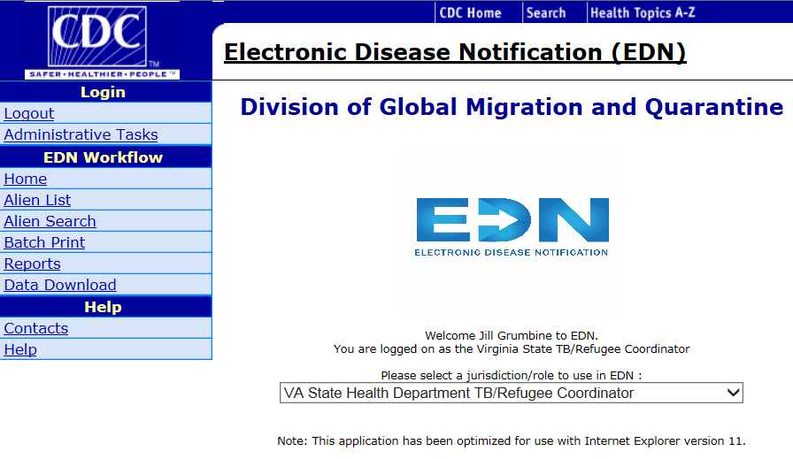
Alien Search

Slide 15
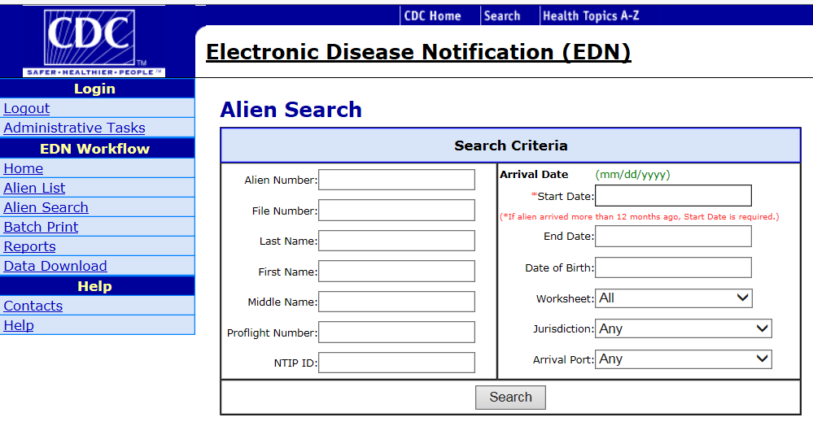
*If alien arrived more than 12 months ago, Start Date is required. Enter any date BEFORE the date of entry.

Slide 16
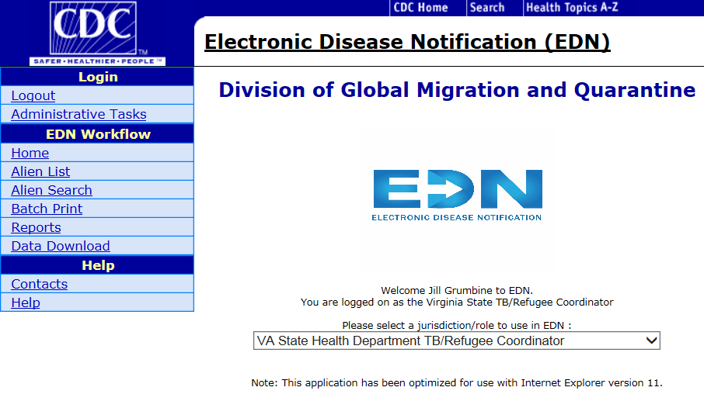

Slide 17

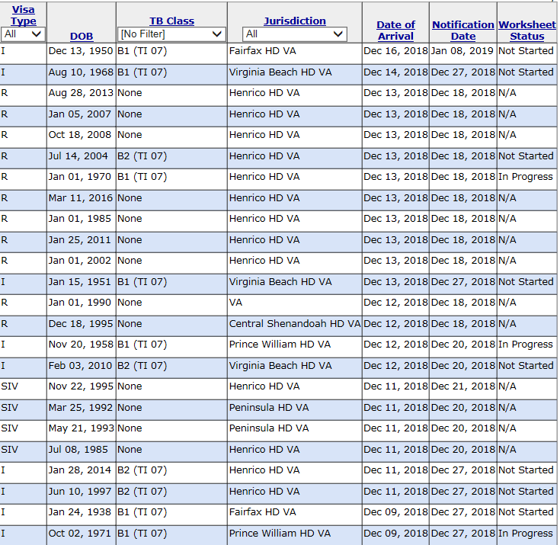

Slide 18
What is the Difference Between a Refugee and an Immigrant?
Refugee
Immigrant
Forced to leave country of homeland and can’t go back
Eligible for reimbursement through the Newcomer Health Program (NHP)
Come to United States for various reasons
  Marriage, job, school, etc
Not eligible for reimbursement through the NHP

Slide 19
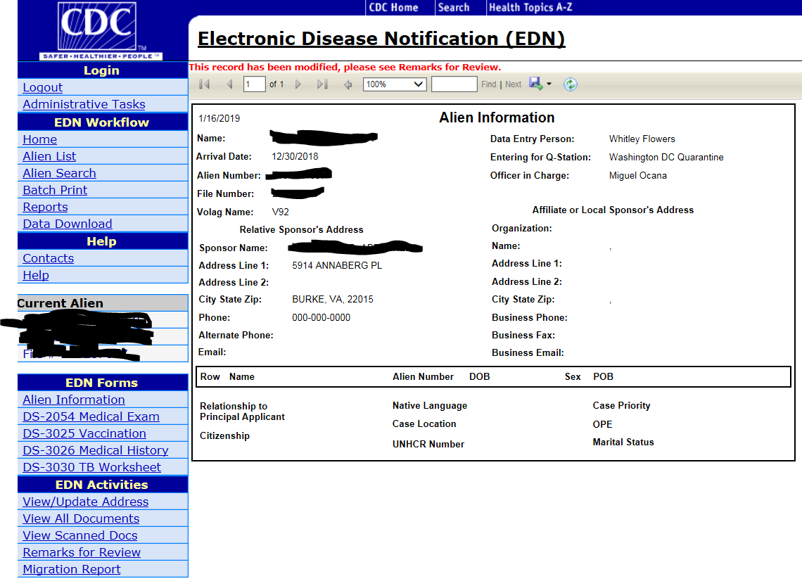
How to change an address

Slide 20
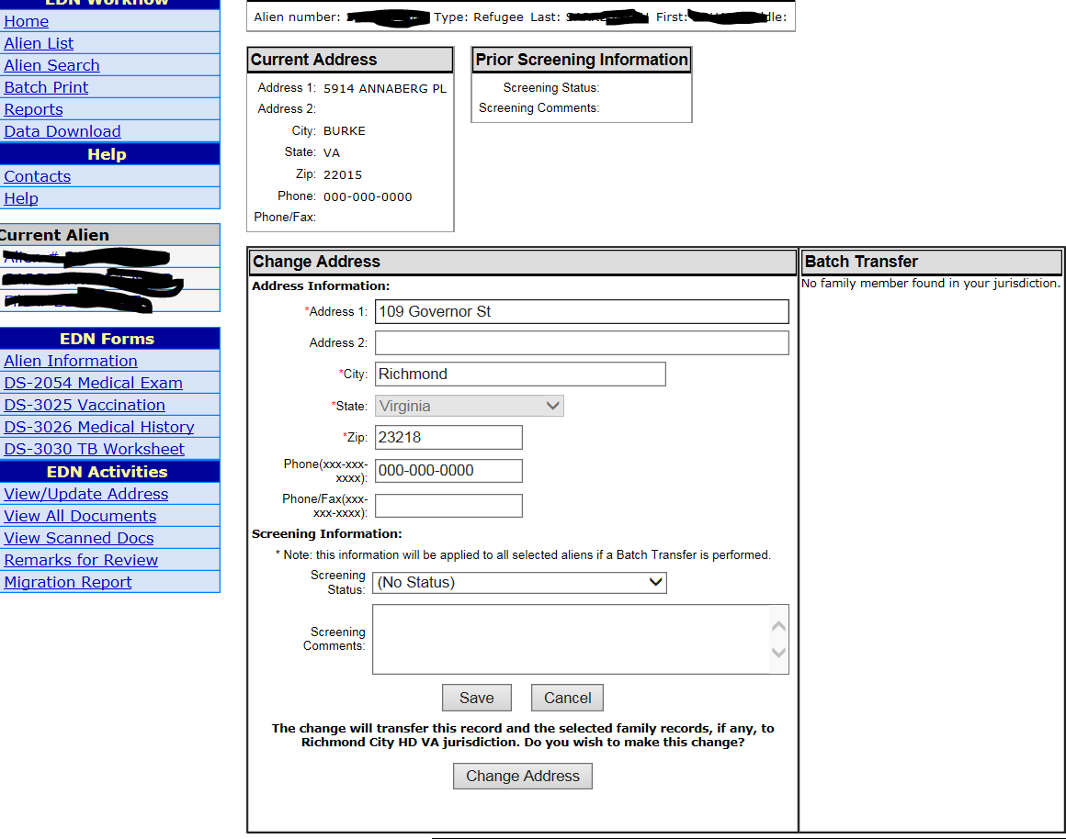
Enter new address
Once you change the address you will no longer have access to the patient.

Slide 21
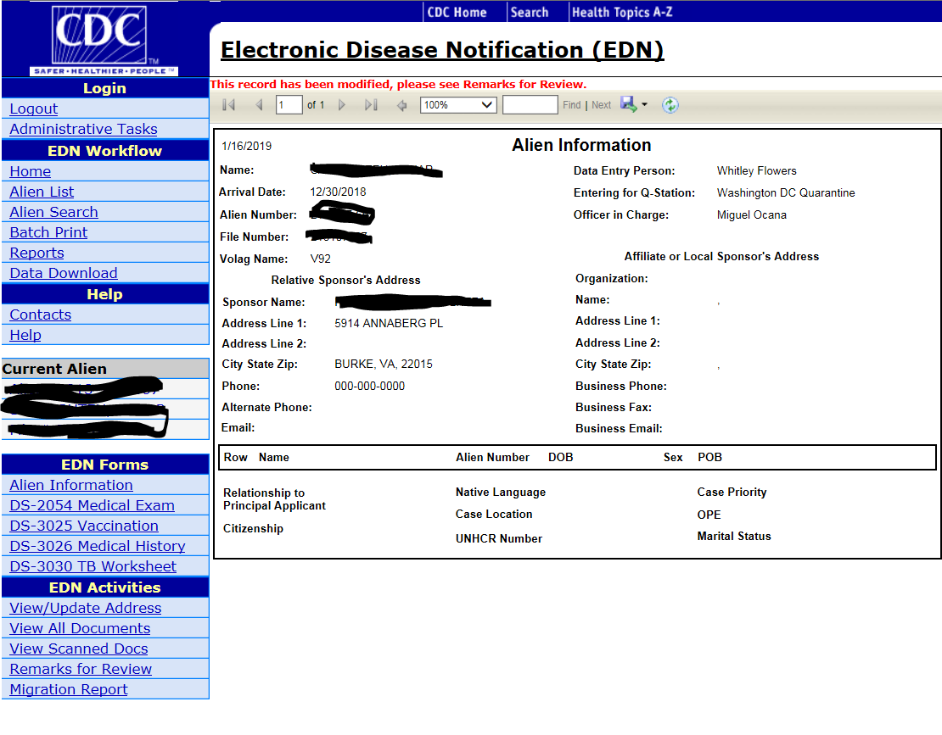
Print Overseas Documents

Slide 22
Select PDF
Screen will pop up at the bottom of the screen. Select Open. Then you can view and print the overseas documents.

Slide 23
Look at scanned documents
Follow same procedure as view all documents to view and print scanned documents

Slide 24
Live Demo
https://sams.cdc.gov

Slide 25
How do I know if someone has arrived to my district?
  Those with access will receive an email that reports are pending in EDN
  This is why it’s so important for several people in your district to have access to the system

Slide 26
TB Classifications

Slide 27
Class A TB with Waiver
All applicants who have tuberculosis disease.
This also includes applicants with extrapulmonary tuberculosis who have a chest x-ray suggestive of pulmonary tuberculosis disease, regardless of sputum smear and culture results.
These applicants are not cleared for travel until completion of treatment unless a waiver is granted.

Slide 28
Class B0 TB
Diagnosed with tuberculosis by the panel physician or presented to the panel physician while on tuberculosis treatment and successfully completed DGMQ-defined DOT under the supervision of a panel physician prior to immigration.
Travel clearance is valid for 3 months from the date final cultures are reported as negative.

Slide 29
Class B1 TB, Pulmonary
Have signs/symptoms, physical exam, or chest x-ray findings suggestive of tuberculosis disease, or have known HIV infection, but have negative AFB sputum smears and cultures and are not diagnosed with tuberculosis disease.
Classification includes applicants who were diagnosed with tuberculosis disease by the panel physician, refused DOT treatment, and are returning after treatment and completion of 1-year wait.
If all parts of the examination are complete, travel clearance is valid for 3 months from date final cultures are reported as negative.

Slide 30
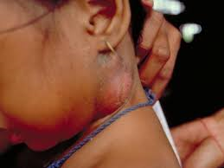
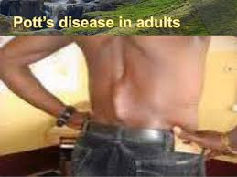
Class B1 TB, Extrapulmonary
  Diagnosis of extrapulmonary tuberculosis with a normal chest x-ray and negative sputum smears and cultures. Travel clearance valid for 3 months from date final cultures are reported as negative

Slide 31
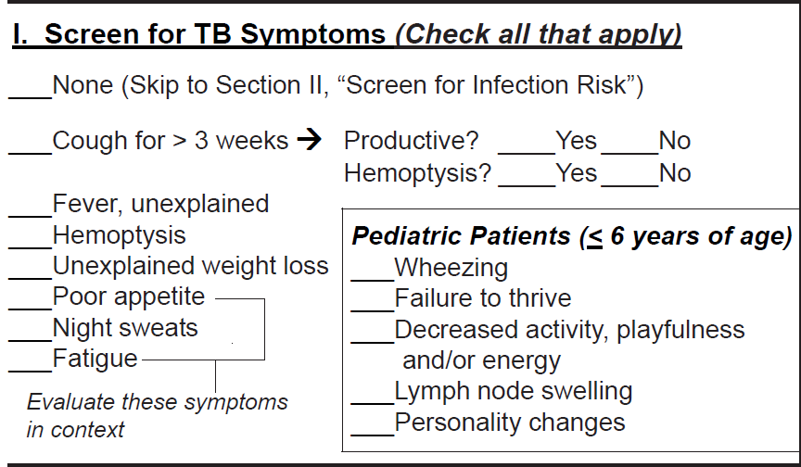
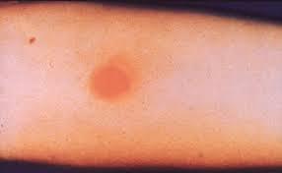
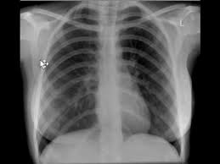
Class B2 TB, LTBI Evaluation
  Positive IGRA or TST, normal chest x-ray, no signs or symptoms of TB
  Travel clearance valid for 6 months

Slide 32
Preventing Tuberculosis Overseas Pilot Study (PTOPS)
US bound immigrants from Vietnam
Have IGRA prior to arrival
Study to treat with 3HP by DOT prior to arrival in US
  Encouraged to complete treatment prior to departure
  If do not complete treatment, will be given doses to complete by self administered therapy (SAT)
Make sure to review overseas medical records to see if client is part of study
Participations will be recorded in the remarks section of the DS-3030
Notes:
Treatment status card indicates IGRA result, cxr result, tx start and completion if applicable.

Slide 33
PTOPS - Continued
If treatment completed: given a certificate. Everyone receives a treatment status card.
If card lost, or you have questions about treatment, call 404-718-5570 or email ptops@cdc.gov
We recommend completing remaining doses by DOT in US
Since this project is part of a US study, these individuals will not need to complete the entire TB medical evaluation unless they have symptoms consistent with active TB

Slide 34
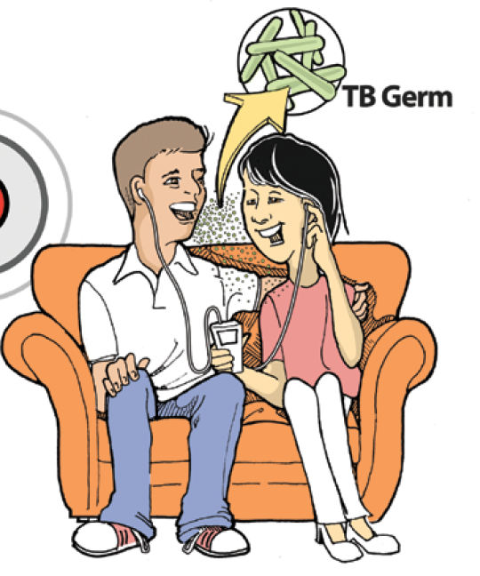
Class B3 TB, Contact Evaluation
  Recent contacts of known TB cases, regardless of IGRA or TST results
  Travel clearance is valid for 6 months

Slide 35
Evaluation

Slide 36
Challenges to initiating and completing exams
Notes:
We heard from our survey respondents at the TB and Refugee Nursing Training that the biggest challenges in initiating and completing exams was wrong or no phone numbers, and incorrect addresses
What are your district’s challenges with initiating and completing the B1 and B2 examinations?
69% (33/48) said wrong or no phone number
69% (33/48) said incorrect address
50% (24/48) said lack of patient follow through
44% (21/48) said not enough time due to other responsibilities
17% (8/48) said difficulty with clinician access
4% (2/48) said they didn’t get any B1 or B2 individuals in their district
0% (0/48) said not a priority

Slide 37
What do I do if I don’t have a phone number or address?
Reach out as soon as possible
    Contact info is most likely temporary
    Sooner you reach out, more likely it is to be correct
Attempt a home visit as soon as possible
    Leave a note if no one is home
Send a certified letter to the address on file (if any)
Check for an email address
Check scanned documents for handwritten information
Document all of your attempts (at least 3)

Slide 38
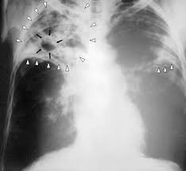
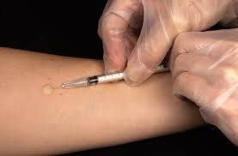
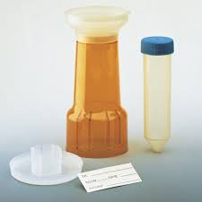
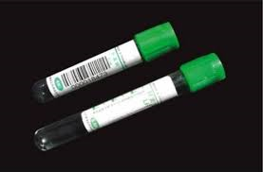
Class B0 and B1 TB
Consider every Class B0 and B1 immigrant as a presumptive case of TB
Required follow-up evaluations:
  TB Health History and TB 512
  Sputum Collection x 3
  Chest x-ray
  TB testing – see next slide
  Modified Isolation

Slide 39
Guidance for Class B0 and B1
IGRA
Modified Isolation
Needed for those with a positive or negative TST or negative IGRA
Not needed if
  documentation of a positive IGRA
  documentation of successfully completed TB treatment
Use a TST in place of an IGRA if client is <2
Place on modified isolation until you receive…
  chest x-ray report
  sputum smear results
Notes:
New TB Technical Instructions recommend IGRA testing beginning at age 2
https://www.cdc.gov/immigrantrefugeehealth/exams/ti/panel/tuberculosis-panel-technical-instructions.html

Slide 40
Do NOT begin treatment for TB Infection (LTBI) until final culture reports are received!

Slide 41
Testing your knowledge
You receive a B1 notification: What do you do?
Notes:
Contact the person, gather health history, do a TB test (TST or IGRA), chest x-ray, sputum, discuss modified isolation

Slide 42
Class B2 TB
Required follow-up evaluations:
  TB Health History and TB 512
  IGRA
        Not needed if documentation of a positive IGRA
        IGRA recommended if TST was the test used overseas
        TST for those less than 2
  Chest x-ray if IGRA or TST positive, or if symptomatic
  Sputum collection x3 if abnormal chest x-ray result or symptomatic
  Begin treatment for LTBI if IGRA or TST positive, normal x-ray and no symptoms

Slide 43
Testing your knowledge
You receive a B2 notification: What do you do?
Notes:
Contact the person, health history, TST or IGRA, additional testing as needed

Slide 44
Class B3 TB
Required follow-up evaluations:
TB Health History and TB 512
A repeat IGRA or TST (if <2) a minimum of 10 weeks after contact broken with source case
    These individuals should have documentation which includes:
            Size of the TST or IGRA response
            Information about the source case: Name, Alien ID#
            Relationship to the case
            Type of TB
Additional testing (x-ray, sputum, etc) as indicated

Slide 45
TB Follow Up Form

Slide 46
What would improve district performance?
Notes:
What would improve your district’s performance on initiating and completing B1 and B2 examinations?
46% (22/48) said training on how to submit the results of the examination
40% (19/48) said training on how to do the examination
31% (15/48) said increase clinician availability
23% (11/48) said electronic submission of the results
13% (6/48) said access to EDN
8% (4/48) said nothing, we are doing well now

Slide 47

TB Follow Up Forms
Any individual identified with a TB classification must have a TB Follow Up Form completed

Slide 48
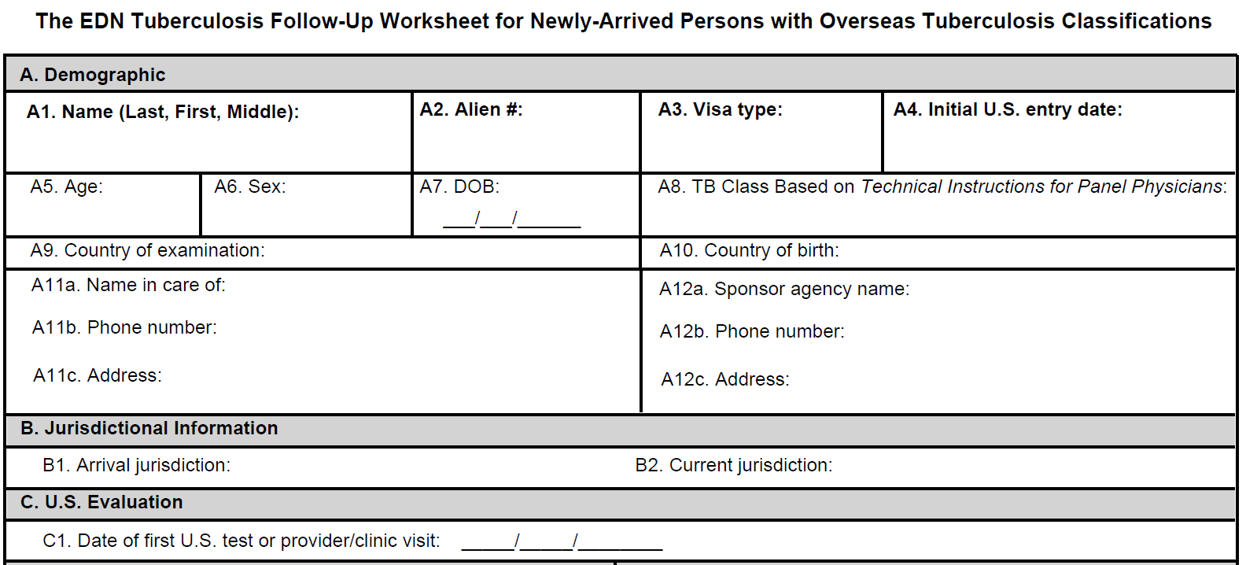
The top portion of the form will already be completed by EDN
Enter the first date of clinical activity

Slide 49
Indicator!
Percent of immigrants and refugees with abnormal chest x-rays read overseas as consistent with TB who initiated medical examination within 30 days of notification
Notes:
Indicator calculation
Date the health dept. was notified
Date of initial US medical evaluation

Slide 50
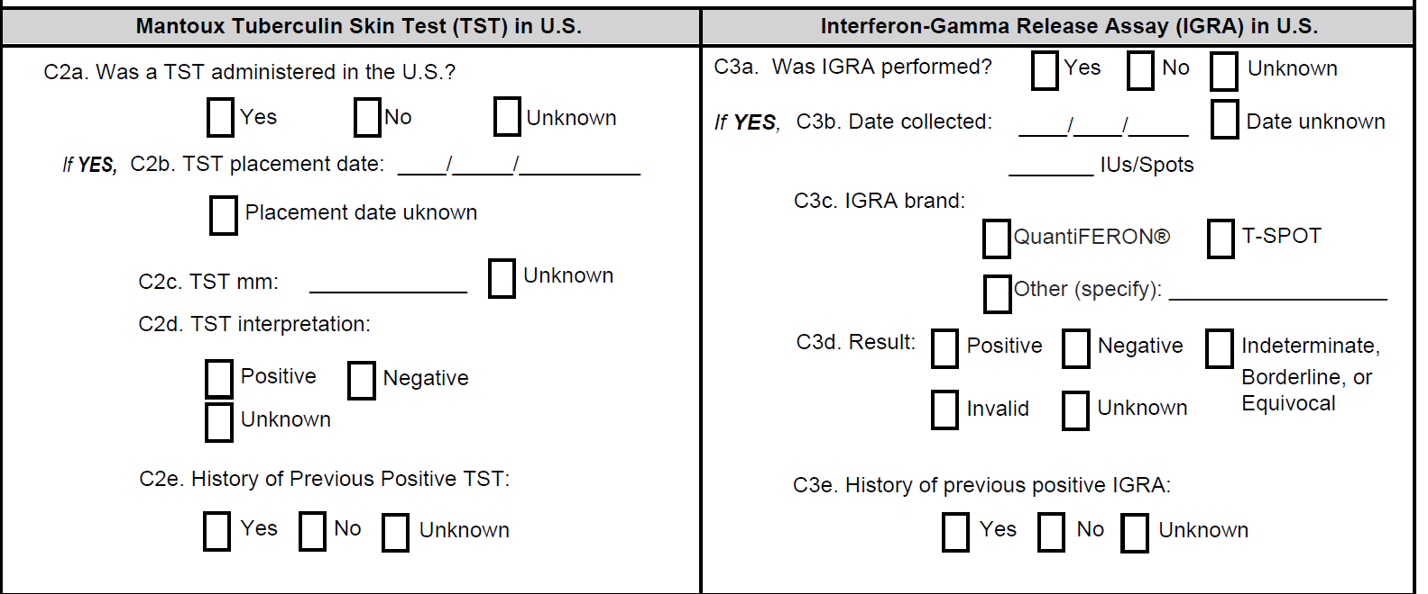
TB Testing Information
Notes:
Enter any information about US testing here. Do NOT enter information about overseas testing unless you are indicating history of a positive TST or IGRA

Slide 51
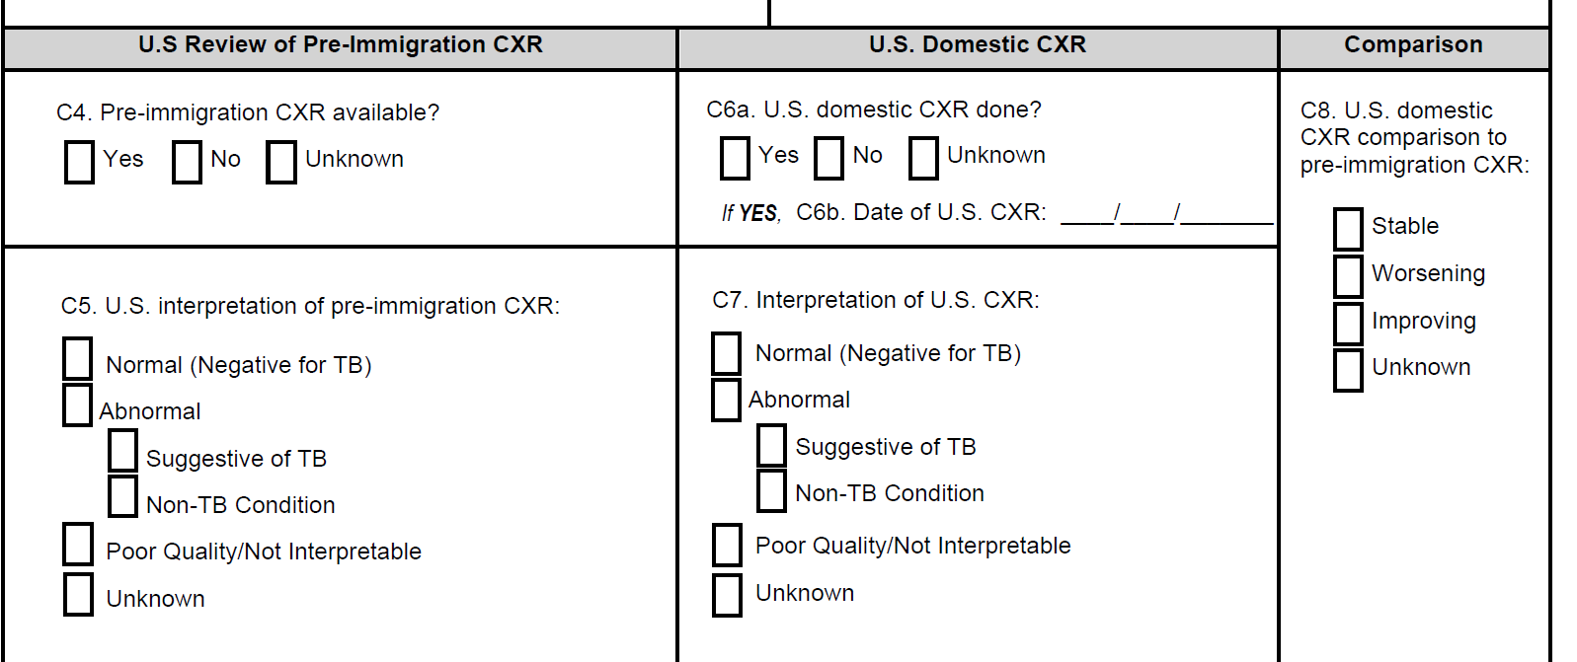
Chest X-Ray information
The US Review of Pre-Immigration CXR should not be a repeat of what is documented on the overseas medical exam. It is an evaluation of what a US doctor sees on the overseas x-rays. Unless a US doctor specifically reads the film, you should mark “Unknown”

Slide 52
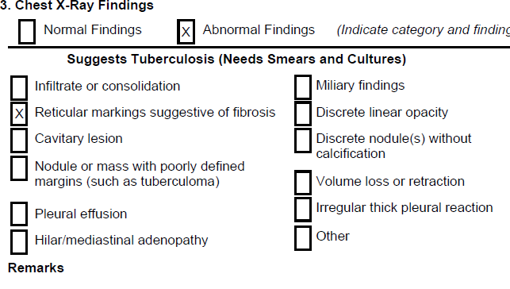
Scenario
US Report of domestic chest x-ray Date of X-ray 2/20/19
Overseas medical exam (EDN paperwork)
Comparison: 1/15/2019
Findings: View compared with prior study date of 1/15/19. Persistent reticular markings. No new consolidation or cavities.
Impression: Persistent reticular markings are unchanged from previous study. Could be related to Tuberculosis.
Date of this x-ray is 1/15/19

Slide 53
Chest X-Ray information
Scenario
Notes:
Completing this section using the scenario
C4 – mark yes if patient comes with disk or film
C5 – based on our scenario the answer is unknown because a physician in the US did not actually interpret the overseas film; a comparison does NOT qualify as an interpretation of the overseas film
C6a/b – will be yes, a date should be included
C7 – provide the interpretation of the US film (abnormal – suggestive of TB)
C8 – indicate whether or not the films are stable or not – (stable)

Slide 54
Use the comparison box to document when a comparison of the overseas x-ray and the US x-ray is requested. If you don’t have the pre-immigration x-ray, mark Unknown

Slide 55
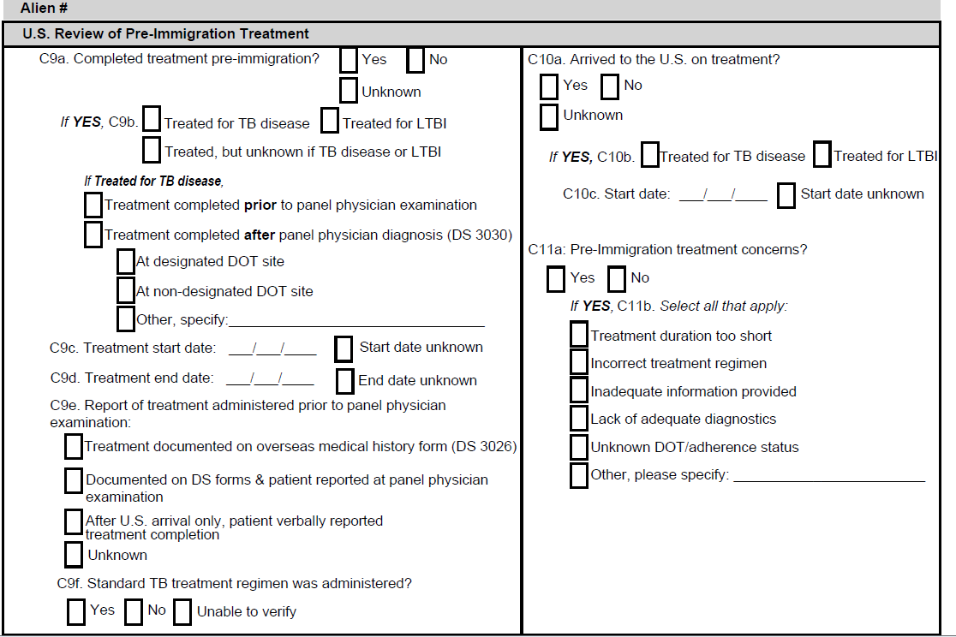
Treatment Information
Indicate if TB treatment was completed overseas prior to U.S. arrival
Indicate if treatment was for TB disease or infection
Enter treatment start and end dates, if known
Indicate how treatment was reported
Indicate whether or not a standard treatment regimen was used

Slide 56
Indicate whether or not the patient arrived on TB treatment
Indicate whether treatment is for TB disease or infection
Enter treatment start dates, if known
Indicate whether or not there are treatment concerns

Slide 57
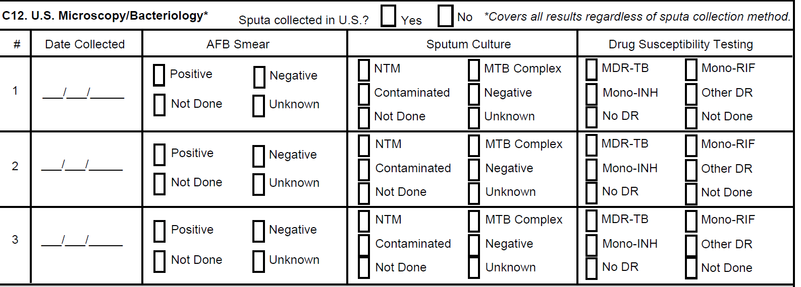
Enter information about Sputum Collection

Slide 58
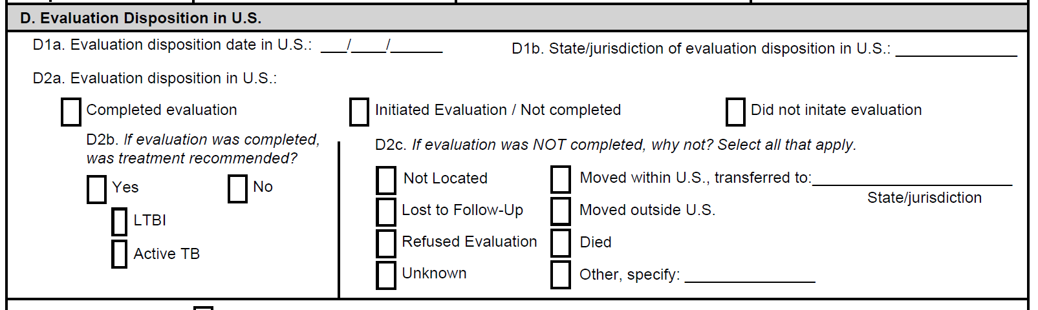
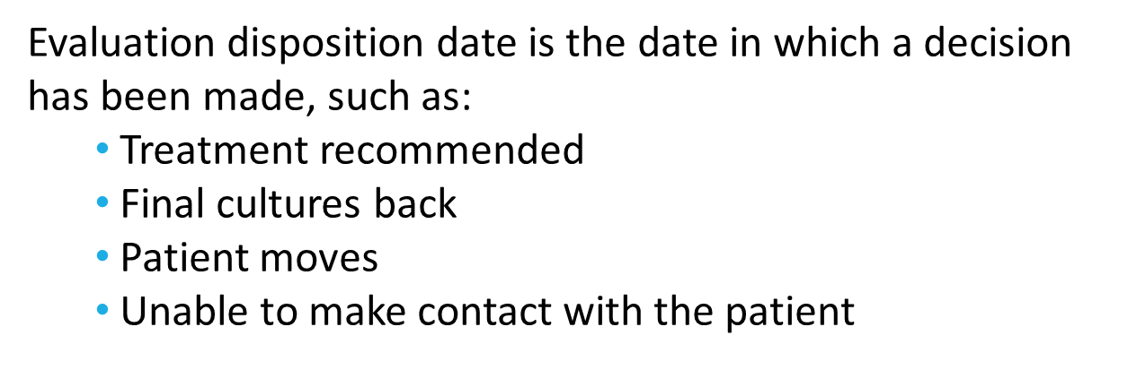
Evaluation Disposition

Slide 59
Indicator!
Percent of immigrants and refugees with abnormal chest x-rays read overseas as consistent with TB who completed medical examination within 90 days of notification
Notes:
Indicator calculation
Date the health dept. was notified
Evaluation disposition date

Slide 60
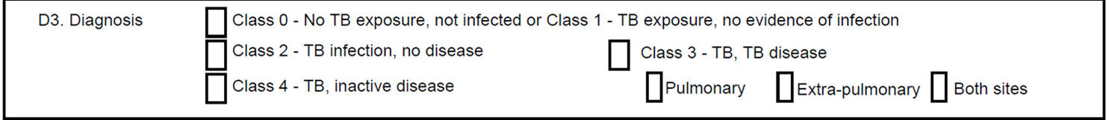
Diagnosis
Diagnosis must be indicated in order for form to be submitted in EDN

Slide 61
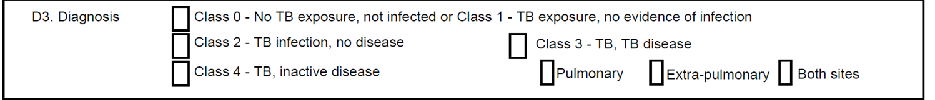
D3 – Diagnosis
TB Classes 0-1
Class 0: No TB Exposure
  Negative TST or IGRA
  No history of exposure
Class 1: TB exposure, no evidence of infection.
Exposure to TB but does not have latent TB infection
  Negative TST or IGRA
  No evidence of infection
  History of exposure to tuberculosis but negative TST
Class 0 and Class 1 are now combined as a single choice of diagnosis
Notes:
Identify TB classification

Slide 62
D3 – Diagnosis
TB Class 2
Class 2: TB infection, no disease
Latent TB Infection (LTBI)
  Positive test for TB Infection
  Negative microscopy/bacteriology results
  No clinical or radiographic evidence of tuberculosis

Slide 63
D3 – Diagnosis
TB Class 3
Class 3: TB Active TB disease
Clinically active tuberculosis
Person must have clinical and/or radiologic evidence of tuberculosis
  Established most definitively by isolation of M. tuberculosis
  In absence of a positive culture for M. tuberculosis, persons in this class must have a positive reaction to the TST or IGRA
Class 3 is further defined as pulmonary, extra-pulmonary, both sites on the follow-up form

Slide 64
D3 – Diagnosis
TB Class 4
Class 4: Tuberculosis, inactive disease
Old, healed, inactive TB disease
  History of previous episode(s) of tuberculosis or abnormal stable radiographic findings
  Positive reaction to test for TB Infection
  Negative microscopy/bacteriology
  No clinical and/or radiographic evidence of current disease

Slide 65
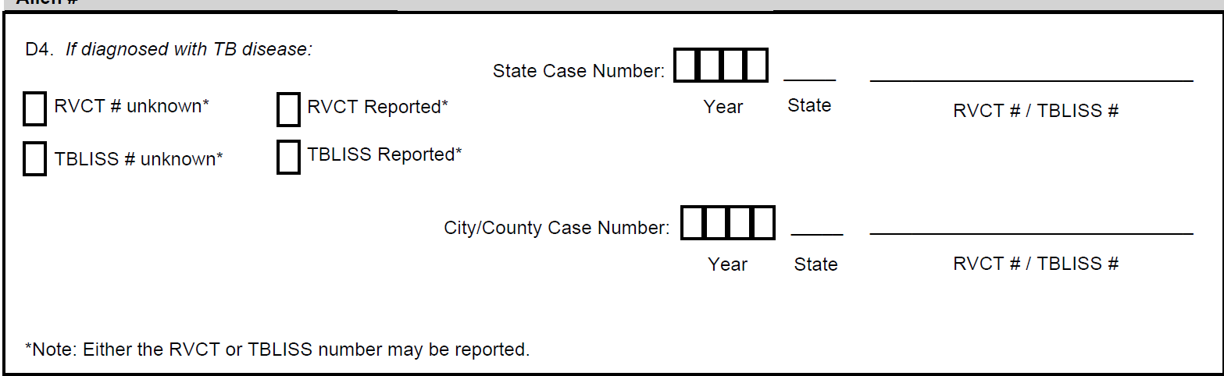
RVCT and TBLISS Information
Let TB Control know when you diagnose a case of active disease in a TB classified individual. Central office staff will need to enter RVCT information into EDN

Slide 66
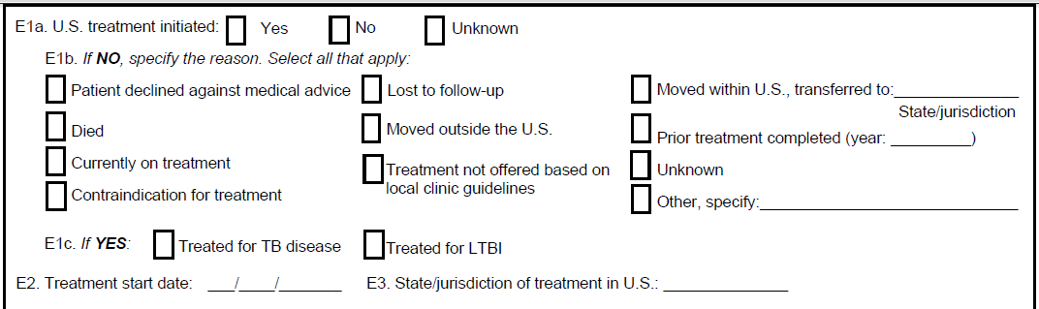
Treatment
Indicate if treatment is started
If not started indicate why not started
Indicate treatment start date and location of treatment

Slide 67
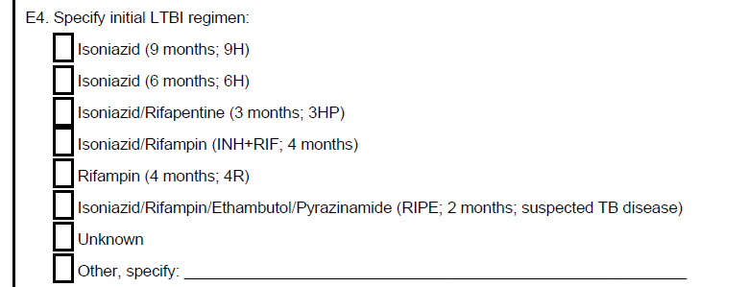
Treatment Regimen

Slide 68
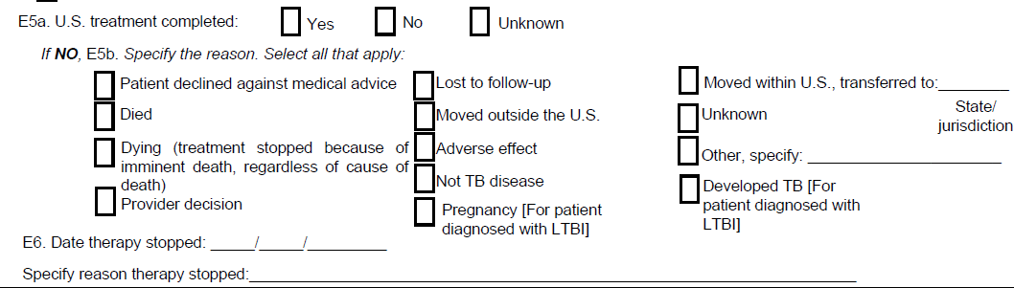
Treatment Completion
Indicate if treatment was completed
If not completed indicate reason why

Slide 69
Indicator!
Percent treatment initiation for immigrants and refugees with abnormal chest x-rays read overseas as consistent with TB who are diagnosed with latent TB infection (LTBI) or have radiographic findings consistent with prior pulmonary TB and who are recommended for treatment on the basis of examination in the US.
Notes:
Indicator calculation
US Treatment
US treatment initiated is marked Yes for either TB or LTBI
Has a treatment start date

Slide 70
Indicator!
Percent treatment completion for immigrants and refugees with abnormal chest x-rays read overseas as consistent with TB who are diagnosed with latent TB infection (LTBI) or have radiographic findings consistent with prior pulmonary TB and recommended for treatment on the basis of examination in the US, who have started treatment.
Notes:
Indicator calculation
US Treatment
US treatment completed is marked Yes

Slide 71
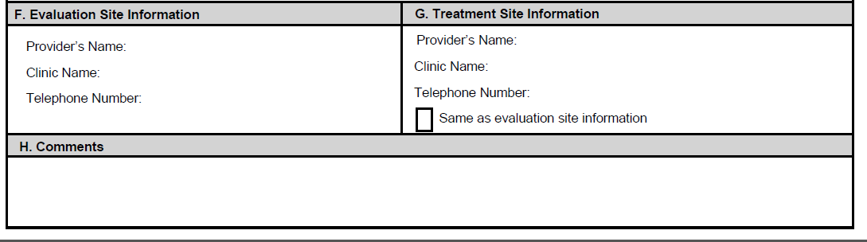
Evaluation & Treatment Site Information and Comments
Note – Provider’s Name can be PHN or clinician
Use Comments for anything not already covered by the form

Slide 72
Timeframes

Slide 73
Form Submission
As soon as possible
As soon as a decision has been made on what to do with patient
      Starting meds
      Not starting meds
It is preferable to “save” the form in EDN
      This will result in an “In Progress” status
      Update form as needed (final test results, meds completed)

Slide 74
Change Address in EDN
  Within 2 business days of learning someone has moved out of state or to another jurisdiction in Virginia – change address in EDN and save
  This will transfer the case to the new jurisdiction
  You will no longer have access to the case or be able to see the record

Slide 75
WHY?

Slide 76

Primary Reason
Identify and treat cases of TB

Slide 77
Your Evaluations matter!
Notes:
Average of 7 per year

Slide 78
National TB Indicators Project
  The National Tuberculosis Indicators Project (NTIP) is a monitoring system for tracking the progress of U.S. TB control programs toward achieving national TB program objectives
  Indicators highlighted during presentation
  CDC looks at data and compares states to National averages

Slide 79
NTIP Goals

Slide 80
Testing your knowledge
Evaluation must be initiated within how many days of notification?

Slide 81

Initial Evaluation
Evaluation should be initiated within 30 days of notification

Slide 82
Testing your knowledge
Evaluation must be completed within how many days of notification?

Slide 83

Evaluation Completion
Complete evaluation within 90 days of notification

Slide 84
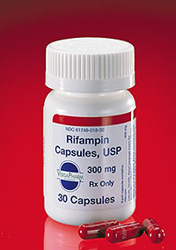
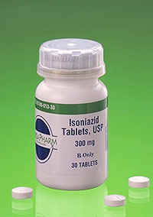
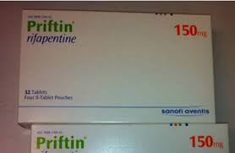
LTBI Diagnosis
For those diagnosed with LTBI initiate treatment

Slide 85

LTBI Treatment
For those who start treatment, ensure treatment is completed

Slide 86

The Message
We need all of YOU to help improve our performance!

Slide 87
Putting information to use

Slide 88
  Jane Doe has arrived from the Philippines on an immigrant visa. Her date of entry is 8/21/18.
  She is 32 years of age
  She has a B1 classification
  Your health department receives a notification from EDN on 8/24/18

Slide 89
The health department calls her on 8/24/18 but no one answers the phone. Voicemail is not set up.
A home visit is done on 8/27/18. The client says she will come to the health department tomorrow morning. She doesn’t have time right now.
Jane arrives to the health department at 9 a.m. for her evaluation. (8/28/18)
What do you do?

Slide 90
An IGRA (T-Spot) is drawn on 8/28/18
A health history is completed, including a TB screening
Patient is given a voucher to have an x-ray completed
      The health department advises the patient to take her overseas chest x-ray with her to the hospital for comparison
The first sputum of 3 is collected. Patient is given 2 additional cans with instructions to collect them the next 2 mornings.
Patient is placed on modified isolation until results of chest x-ray and sputum smears are received

Slide 91
On 8/31/18 IGRA results are reported as positive
The health history found that the patient has never been treated for TB or LTBI and did not arrive on treatment
Patient denies any symptoms of active TB
The chest x-ray with comparison report is received with a visit date of 9/1/18 and is normal. The comparison with the overseas film shows improvement
The patient submits additional sputum containers which were collected on 8/29/18 and 8/30/18

Slide 92
The smear results of all sputums are negative
Patient is removed from modified isolation
Patient will be contacted after culture results are available
…….and we wait

Slide 93
All 3 culture reports are finalized on October 15, 2018
The first specimen from 8/28/18 is negative on culture
The second specimen from 8/29/18 is identified as M. Gordonae, a non-Tuberculus mycobacteria (NTM)
The third specimen from 8/30/18 is negative
The clinician reviews the records on 10/16/18 and recommends treatment for LTBI

Slide 94
On 10/17/18 the nurse contacts the client to review the reports and discuss treatment options for LTBI
          The patient selects 3HP
          Clinician writes med orders
On 10/22/18 the patient comes to the clinic for education and initiation of 3HP

Slide 95
The patient is compliant and completes treatment within the appropriate timeframe (11 to 12 doses within 16 weeks)
Her last dose is taken on January 11, 2019
The nurse submits the TB follow-up worksheet on January 28, 2019

Slide 96
Demo –
How’d you do?

