Slide 1
2017 Community Health Assessment Fredericksburg City, Virginia
Brooke Rossheim, M.D., M.P.H.
Saba Lemma, M.P.H.
January 12, 2017

Slide 2
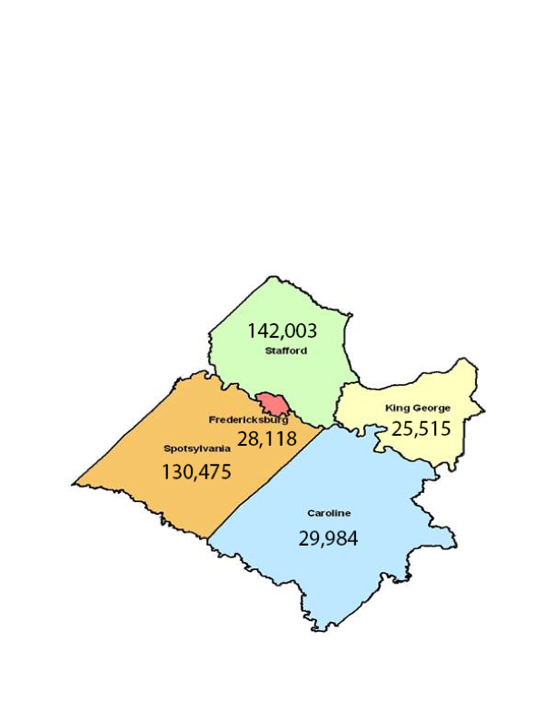
Rappahannock Area Demographics – 2015
Source: U.S. Census Bureau

Slide 3
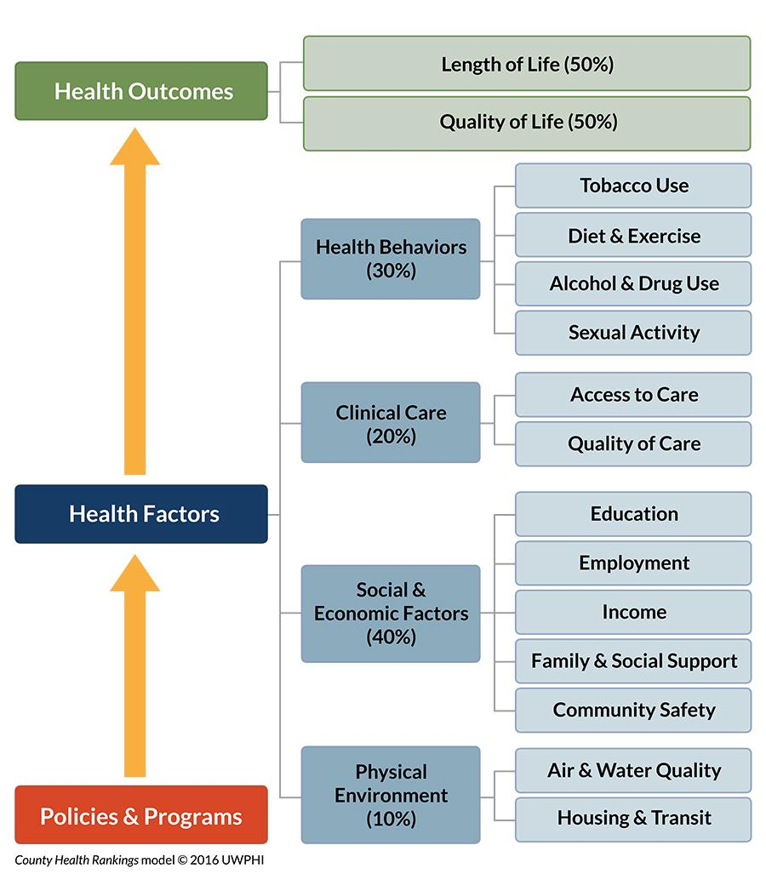
County Health Rankings
www.countyhealthrankings.org
The Rankings are based on a model of population health that emphasizes the many factors that, if improved, can help make communities healthier places to live, learn, work and play

Slide 4
Source: 2016 County Health Rankings & Roadmaps

Slide 5
Source: 2016 County Health Rankings & Roadmaps

Slide 6
Source: 2016 County Health Rankings and Roadmaps

Slide 7
$97,144
$81,688
$78,125
$59,227
Source: 2016 US Census Bureau

Slide 8
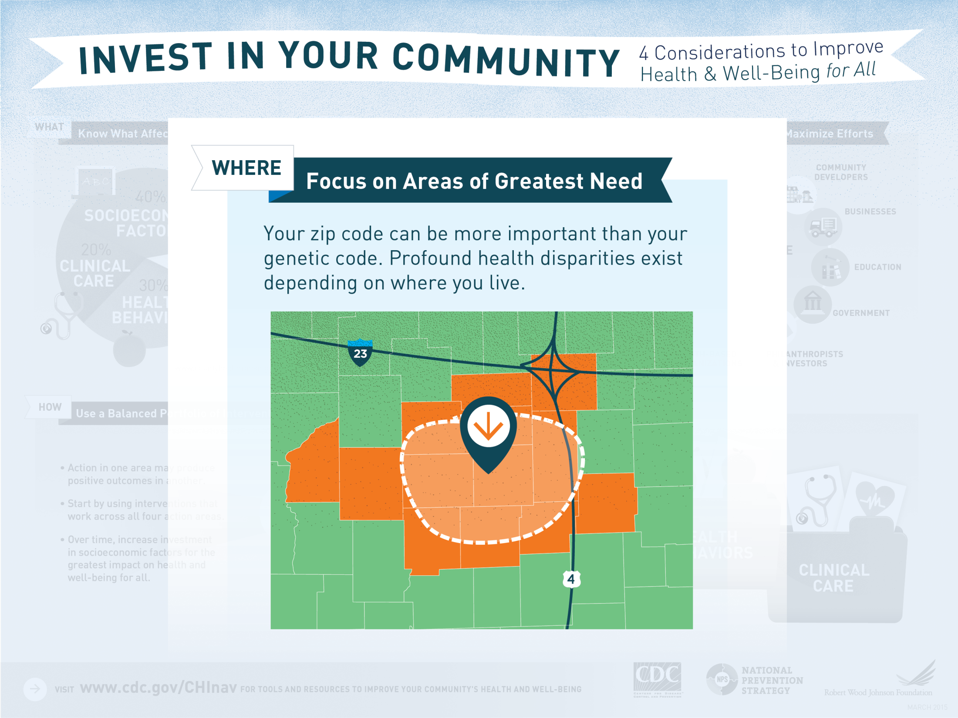
Source: Centers for Disease Control and Prevention

Slide 9
Unnatural Causes
Is inequality making us sick?
Source: www.pbs.org/unnaturalcauses

Slide 10
Health Impact Pyramid
Source: Centers for Disease Control and Prevention
Notes:
Make separate slides

Slide 11
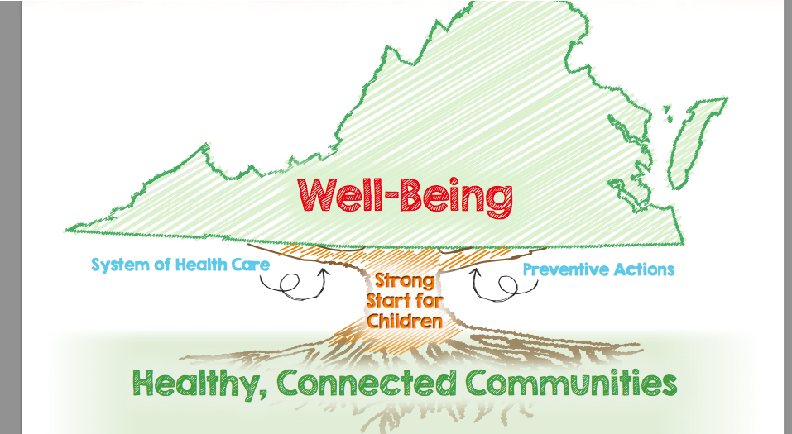
Virginia’s Plan For Well-Being 2016-2020
Source: http://virginiawellbeing.com

Slide 12
Community Health Assessment (CHA)
The CHA is a systematic examination of the health status indicators for a given population that is used to identify key problems and assets in a community.

Slide 13
Benefits of a Community Health Assessment (CHA)
Informs community decision-making
Prioritizes health problems and
Assists in development and implementation of community health improvement plans.

Slide 14
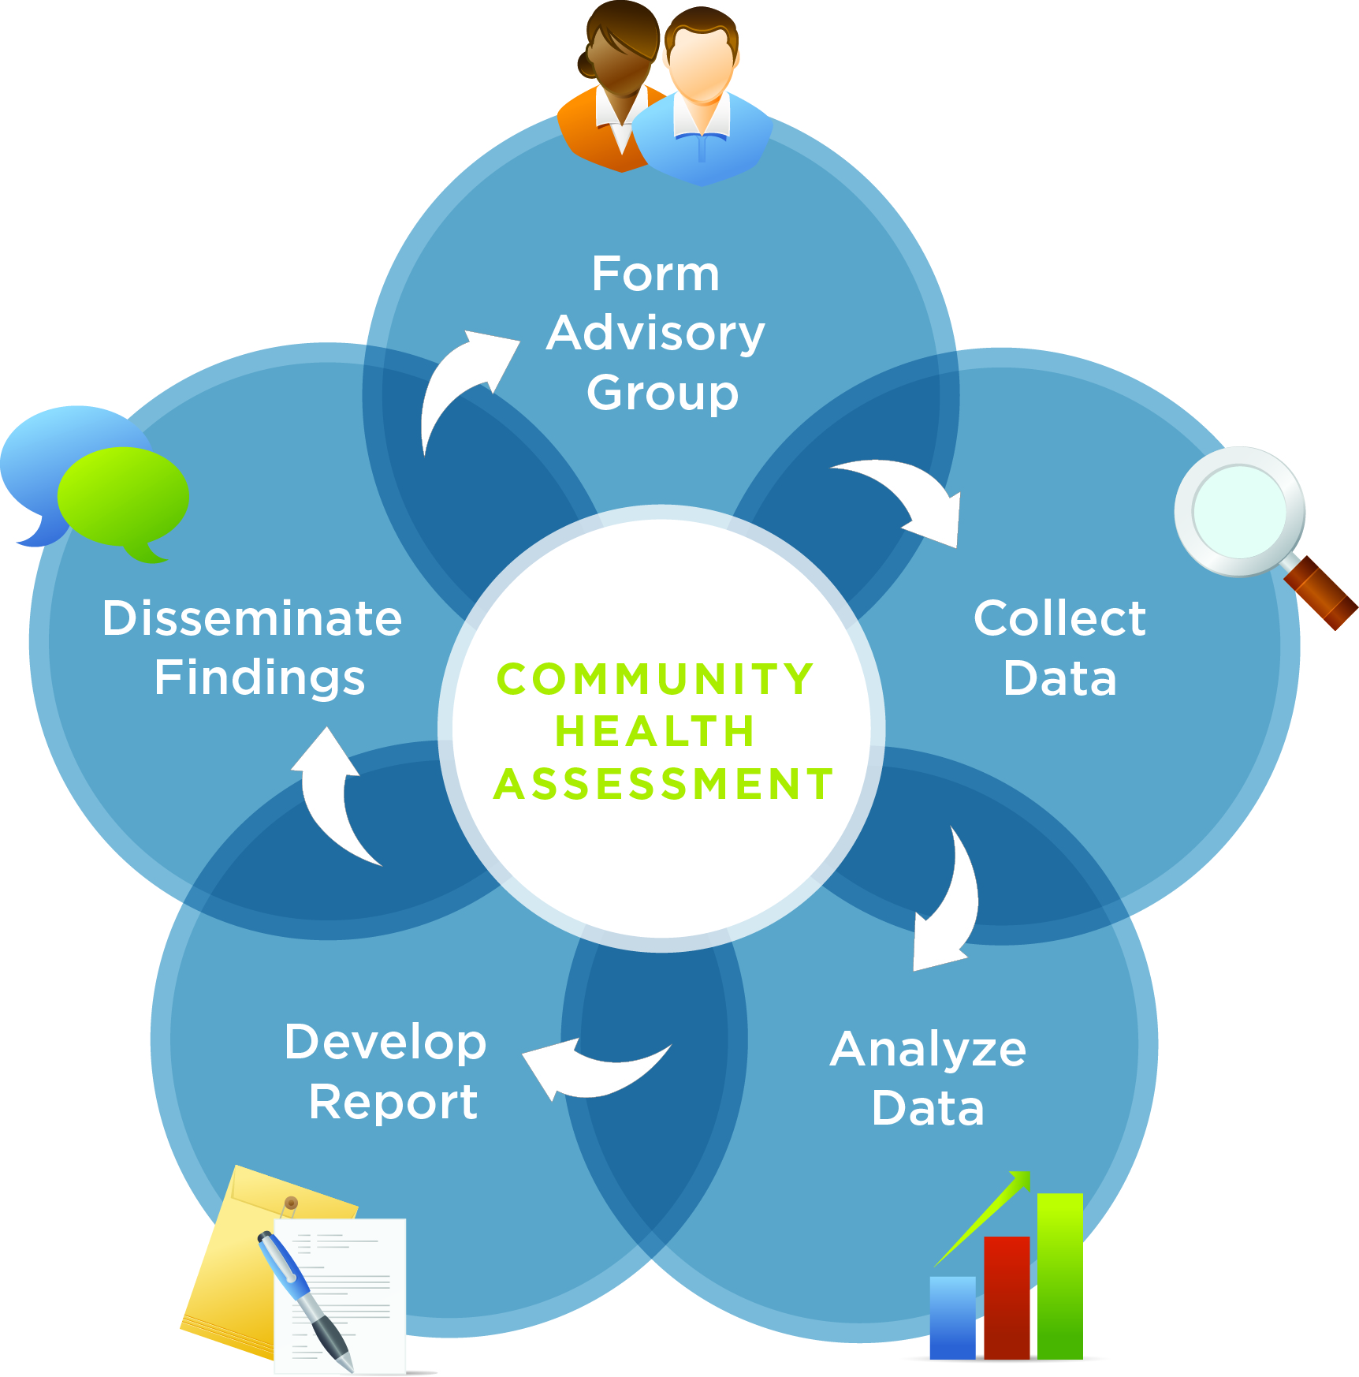
Overview of Community Health Assessment Process

Slide 15
Community Health Improvement Plan (CHIP)
Is a long-term, systematic effort to address public health problems based on the results of the community health assessment.
The CHA-CHIP process is typically done on a 3-5 year cycle.

Slide 16
Benefits of a Community Health Improvement Plan (CHIP)
Based on CHA findings
An action plan consisting of strategies to address identified problems/issues is developed
Includes built-in metrics to see what progress is being made

Slide 17
CHA/CHIP Summary
What geographic area does this cover?
Fredericksburg City
Where will the information come from?
Surveys, vital records, program and facility data, interviews and focus groups

Slide 18
CHA/CHIP Summary
Why should community members be involved?
Share lived experience and engage in the process
How will this improve health
Maximizes impact through focus on important health issues

Slide 19
CHA/CHIP Summary
Why are we doing this now?
-Rappahannock Area Health District (RAHD) recognizes that population health improvement is a central part of public health
-New effort for RAHD
How long will the project take?
CHA / CHIP process takes about 1 year

Slide 20
Community Health Assessment Team Model
Steering Committee (at least 10 members)
Work Groups (4 or more members, includes RAHD Staff)
Project Facilitator (CHA Planner)

Slide 21
Steering Committee
Agree to meet regularly for a defined period of time
Review the CHA process materials
Review data and other information
Review recommended goals and objectives

Slide 22
Work Group Roles and Responsibilities
Meet with subcommittees as needed
Perform or delegate data collection
Interpret findings
Develop community health action plans
Ensure that interventions are
implemented and evaluated

Slide 23
Project Facilitator
Keeps the process moving
Coordinates CHA meetings
Provides information and tools to complete tasks
Coordinates access to support materials
Serves as central contact person
Serves as contact person to request technical assistance

Slide 24
Next Steps
Questions?
Request for partner engagement in CHA-CHIP process
Training in community health assessment tool
Schedule next meeting

Slide 25
Thank you for your attention!!
If questions, please contact Saba Lemma, M.P.H.
Community Health Planner
Rappahannock Area Health District
Email = saba.lemma@vdh.virginia.gov
Cell Phone: 540-369-3201
OR
Brooke Rossheim, M.D., M.P.H.
District Director
Rappahannock Area Health District
Email = brooke.rossheim@vdh.virginia.gov
Main Office = 540-899-4797

