Slide 1
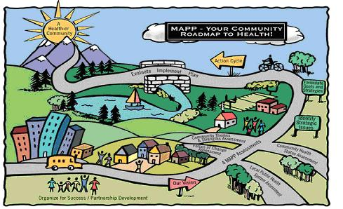
2017 Community Health Assessment Forces of Change Assessment Fredericksburg City, Virginia
Saba Lemma, M.P.H.
Brooke Rossheim, M.D., M.P.H.
June 28, 2017

Slide 2
2017 Fredericksburg Community Health Assessment Vision
An inclusive community which will work collaboratively to provide physical and mental health resources, safe and secure housing, educational opportunities, healthy food choices and space for recreational activity to all of its residents.

Slide 3
Forces of Change Assessment
Forces of change outside of your control that affect the local public health system or community.
Example of forces: Trends, factors and events
Trends: growing population
Factors: historic city
Events: natural disaster

Slide 4
Questions to answer
What is occurring or will occur over the next five years that impacts the health of Fredericksburg City?
What specific threats or opportunities are generated by these occurrences?

Slide 5
Categories for discussion
Social
Economic
Political
Technological
Environmental
Scientific
Legal
Ethical

Slide 6
Forces of Change Questions
What has occurred recently that may affect our city?
What may occur in the future?
What characteristics of the city pose an opportunity or threat?
What may occur or has occurred that may pose a barrier to achieving CHA vision?
Are there changes in your organization that may impact the community?

Slide 7
Questions?

Slide 8
Next Steps
CTSA and CHSA workgroup meetings.
Local Public Health System Assessment (LPHSA) meeting
Steering Committee meeting

Slide 9
Thank you for your attention!!
If questions, please contact Saba Lemma, M.P.H.
Community Health Assessment Planner
Rappahannock Area Health District
Email = saba.lemma@vdh.virginia.gov
Cell Phone: 540-369-3201
OR
Brooke Rossheim, M.D., M.P.H.
District Director
Rappahannock Area Health District
Email = brooke.rossheim@vdh.virginia.gov
Main Office = 540-899-4797

