Slide 1
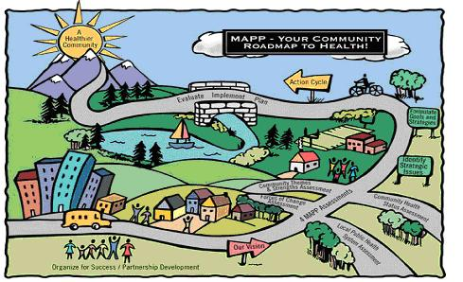
2017 Community Health Assessment
MAPP Overview
Fredericksburg City, Virginia
Saba Lemma, M.P.H.
Brooke Rossheim, M.D., M.P.H.
February 27, 2017

Slide 2
Agenda
Announce steering committee
MAPP overview
Draft vision statement
Establishing workgroups
Next steps

Slide 3
Meeting Objectives
Understand principles and phases of the MAPP tool
Draft vision statement for our Community Health Assessment (CHA)
Establish workgroups for Community Themes and Strengths Assessment and Community Health Status Assessment – to be discussed later

Slide 4
Mobilized for Action through Planning and Partnerships (MAPP)
Product of National Association of County and City Health Officials (NACCHO) and Center for Disease Control and Prevention (CDC)

Slide 5
Vision of MAPP
Communities achieving improved health and quality of life by mobilizing partnerships and taking strategic action.

Slide 6
Seven Underlying Principles of MAPP
Systems thinking
Dialogue
Shared vision
Data
Partnership
Strategic thinking
Celebration of successes

Slide 8
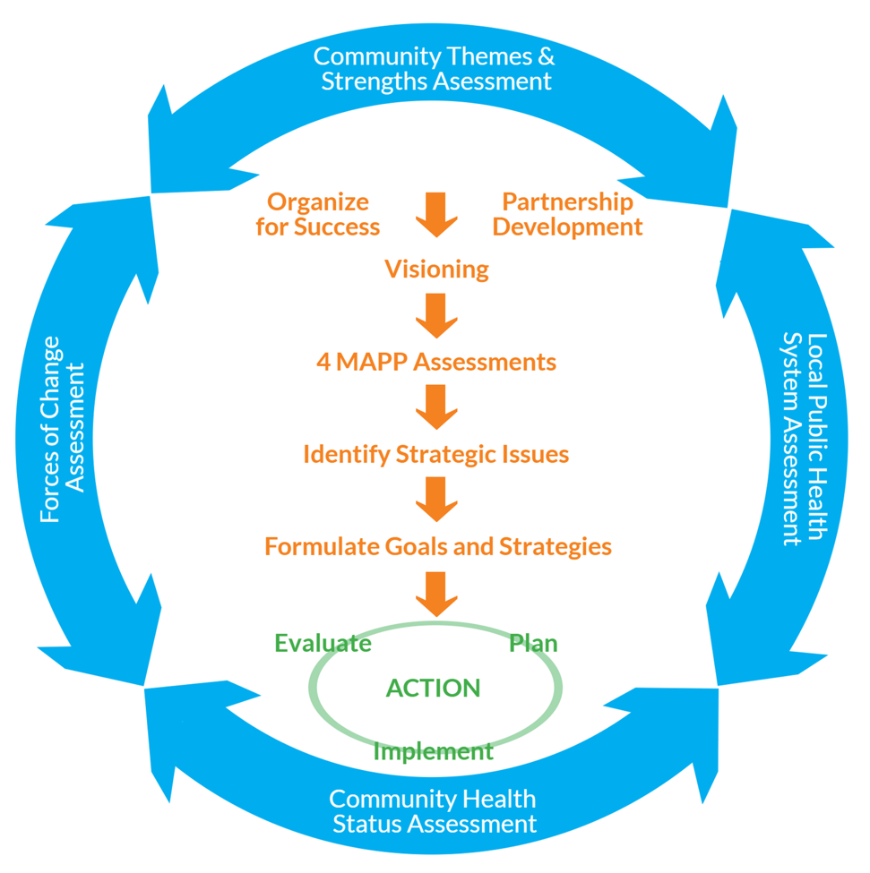

Slide 9
The Six Phases of MAPP
Organize for Success/Partnership Development
Visioning
The Assessments
Strategic Issues
Goals/Strategies
Action Cycle

Slide 10
Six Phases of MAPP
Organizing for Success/Partnership development
      Steering committee and workgroup recruited, process organized and planned out
Visioning
      Develop Shared vision of health in the community

Slide 11
Example of Vision Statement
A community where all residents have the opportunity and the means to live a physically, economically and socially healthy and satisfying life in a healthy environment.

Slide 12

What are your hopes and aspirations for Fredericksburg City?

Slide 13
Questions
What does a healthy city mean to you?
What are the important characteristics of a healthy community for all who live, work and play?
How do you envision the local public health system in the next five or 10 years?

Slide 14
Six Phases of MAPP
The Assessments
      The Community Themes and Strengths Assessment (CTSA) (qualitative data)
      The Community Health Status Assessment (CHSA)
      Local Public Health System Assessment (LPHSA)
      Force of Changes Assessments

Slide 15
The Assessments
The Community Themes and Strength Assessment (CTSA) (qualitative data)
      What health issues are important to you?
      Identify assets in your community used to address health and other issues.

Slide 16

Methods for Community Themes and Strengths Assessment
Focus Group Discussions & interviews
Survey & observations, photovoice

Slide 17
The Assessments
The Community Health Status Assessment (CHSA) (quantitative data)
      How Healthy are the residents?
      What does the health status of our community look like?

Slide 18
Community Health Status Indicators
Who are we and what do we bring to the table?
    Demographic Characteristics
    Socioeconomic Characteristics
    Health Resource Availability
What are the strengths and risks in our community that contribute to health?
    Quality of Life
    Behavioral Risk Factors
    Environmental Health Indicators
What is our health status?
    Social and Mental Health
    Maternal and Child Health
    Death, Illness and Injury
    Infectious Disease
    Sentinel Events

Slide 19

Methods
Review data, interviews, survey

Slide 20
The Assessments
The Local Public Health System Assessment (LPHSA)
    How are the 10 Essential Public Health Services being provided to our community?
    What are the components, activities, competencies and capacities of our local public health system?

Slide 21
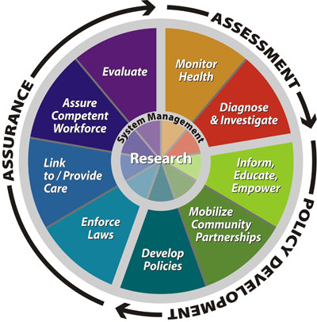
The Ten Essential Public Health Services

Slide 22
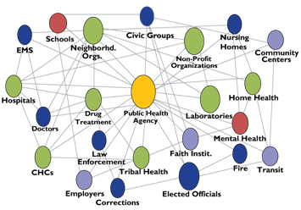
Method for Local Public Health System Assessment
National Public Health Performance Standards Program local instrument

Slide 23
The Assessments
      The Force of Change Assessment (FCA)
    What is happening or might happen in the future that will have an impact on community health?

Slide 24
Areas or Categories to Consider
Social
Economic
Political
Technological
Environmental
Scientific
Legal
Method = Brainstorm

Slide 25
Six Phases of MAPP
Strategic Issues
    Examine the data collected to identify key issues
Goals/Strategies
    Set goals for identified key issues
Action Cycle
    Planning, implementation and evaluation of the action that the group takes to achieve it goals

Slide 26
Fredericksburg City Community Health Assessment Timeline (Tentative)

Slide 27
Source
NACCHO: http://archived.naccho.org/topics/infrastructure/mapp/

Slide 28
Next Steps
Questions?
Validate vision statement
Establish two Workgroups
Validate Community Themes and Strength Assessment survey
Meeting #3

Slide 29
Thank you for your attention!!
If questions, please contact Saba Lemma, M.P.H.
Community Health Planner
Rappahannock Area Health District
Email = saba.lemma@vdh.virginia.gov
Cell Phone: 540-369-3201
OR
Brooke Rossheim, M.D., M.P.H.
District Director
Rappahannock Area Health District
Email = brooke.rossheim@vdh.virginia.gov
Main Office = 540-899-4797

