Slide 1
Findings from the Virginia Department of Health (VDH)
2010 Central Line-Associated Bloodstream Infection (CLABSI)
Data Audit Project
Andrea Alvarez, MPH
Virginia Department of Health
Healthcare-Associated Infections Program Coordinator
Mary Andrus, BA, RN, CIC
Infection Preventionist Consultant

Slide 2
Learning Objectives
1) Quantify the CLABSI case status discrepancies identified by the data validation specialists
2) Describe issues leading to the misclassification
of CLABSI events
3) Identify lessons learned regarding CLABSI
surveillance and quality assurance methods
4) Learn how the CLABSI data audit project aligns
with state and federal HAI reporting initiatives
and the VDH HAI Program

Slide 3
Outline of Today’s Webinar
Introduction
Methods
Results
Discussion
Next Steps

Slide 4
Impetus for CLABSI Audit
July 2008: Virginia state mandate to report central line-associated bloodstream infections (CLABSIs) in adult intensive care units using the National Healthcare Safety Network (NHSN)
2009: CDC HAI American Recovery and Reinvestment Act (ARRA) grant
  Goal to enhance surveillance
2010: Virginia acute care needs assessment
2010-2011: CDC publication of state-specific infection reports using standardized infection ratio (SIR)
Notes:
One of the major goals of the ARRA grant is to enhance surveillance – funds were given to states to support surveillance activities such as piloting surveillance for additional types of infections and to validate existing data. We heard of other states that were planning to use funds for validation and thought this would be a good opportunity to look at our data in a similar way.
We have also heard consistently from IPs the need for validation and standardization of publicly reported data. It was no surprise that both a few QIs and administrators made sure that they communicated the same concerns as validation is important to ensure that all facilities are identifying infections in the same way and are accurate.

Slide 5
Notes:
This graph represents CLABSI rates by the state total, by bedsize category, and by quarter in Virginia in 2009 and 2010. The y-axis represents the CLABSI rate, which is calculated per 1000 central line days, and the x-axis shows the year and quarter of the CLABSI event. The three different bedsize categories used and reported in Virginia for CLABSIs are 200 beds or fewer, 201 to 500 beds, and more than 500 beds. The state CLABSI rate over the two years remained between 1 and 1.6 CLABSI events per 1000 central line days. There has been the most variation in the 200 beds or fewer bedsize category ranging from just over 0.4 CLABSI events per 1000 central line days in the fourth quarter of 2009 to just under 1.9 CLABSI events per 1000 central line days in the second quarter of 2009. Except for the first two quarters of 2009, the largest bedsize category consistently reported the highest CLABSI rate. However, in the fourth quarter of 2010, the CLABSI rates for all 3 bedsizes were quite similar, with a state average of 1.4 CLABSI events per 1000 central line days.

Slide 6
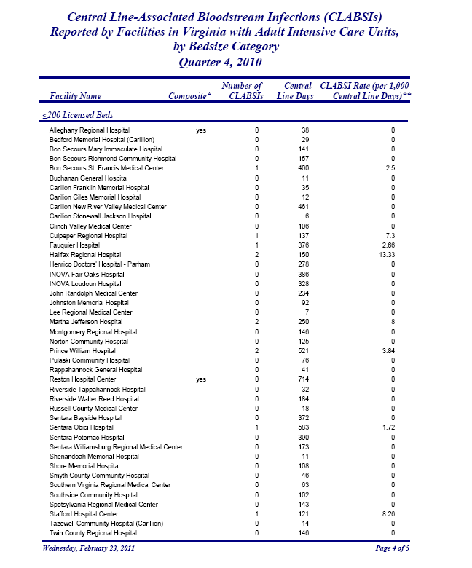
Notes:
Here is a screenshot of the quarterly CLABSI report from the 4th quarter of 2010, available to the public on the VDH website. This page displays the number of CLABSIs, the number of central line days, and the CLABSI rate (per 1000 central line days) for each hospital with an adult intensive care unit for that quarter.

Slide 7
Virginia standardized infection ratio
(SIR) = 0.83
17% fewer infections observed than expected
Statistically significant
Virginia SIR = 0.80
20% fewer infections observed than expected
Statistically significant
Notes:
CDC has now published 2 state-specific HAI data summary reports. The first one reviewed data from January through June, 2009. Virginia’s standardized infection ratio (SIR) was 0.83, meaning there were 17% fewer infections observed than expected and was statistically significant. The second reported HAI data for data from July through December 2009. In this report, Virginia’s SIR was 0.80, meaning there were 20% fewer infections observed than expected and was also statistically significant. The two SIRs (0.83 and 0.80) are not statistically different from each other, which means that prevention efforts were maintained between the two time periods.

Slide 8
Standardized Infection Ratio (SIR)
A summary measure used to track HAIs at a national, state, or local level over time
Adjusts for patients of varying risk within each facility
SIR compares the actual number of HAIs reported to the baseline U.S. experience
An SIR >1.0 indicates that more HAIs were observed than predicted
  Statistical significance testing is important!

Slide 9
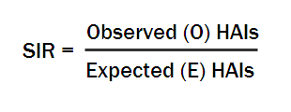
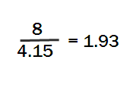
Calculation of SIR
Type of ICU | # CLABSI | # CL Days | CLABSI Rate | NHSN Rate | Expected # CLABSIs
Medical Cardiac | 2 | 380 | 5.26 | 2.0 | 0.76
Medical | 1 | 257 | 3.89 | 2.6 | 0.67
Med/Surg | 3 | 627 | 4.78 | 1.5 | 0.94
Neuro-surgical | 2 | 712 | 2.81 | 2.5 | 1.78
Total | 8 | 1976 | 4.05 |  | 4.15
Notes:
This table demonstrates how to calculate an SIR. You need to collect the following information: type of ICU, number of CLABSI events, number of central line days, and the NHSN CLABSI rate for that particular type of ICU. After calculating the CLABSI rate, you can calculate the expected number of CLABSIs for each ICU type by multiplying the number of central line days and the unit-specific NHSN rate and dividing by 1000. Add up the total number of CLABSIs in all of the ICUs and the total number of expected CLABSIs you calculated using the NHSN reference CLABSI rate. The SIR is calculated by dividing the observed number of HAIs by the expected number of HAIs. In this instance, there were 8 total infections from the medical cardiac, medical, med/surg, and neuro-surgical ICUs and an expected 4.15 CLABSIs in those same ICUs (as determined by using the unit-specific reference CLABSI rates from NHSN). 8 divided by 4.15 is 1.93. Therefore, 93% more CLABSIs were observed in this facility during this time period than were expected.

Slide 10
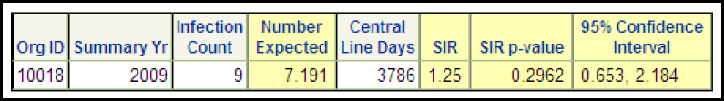
Example – Overall CLABSI SIR
During 2009, there were 9 CLABSIs identified in our facility, and we observed 3786 central line days from the locations from which the CLABSIs were reported.
Based on the NHSN 2006-2009 baseline data and the composition of locations in the facility, 7.191 CLABSIs were expected.
This result is an SIR of 1.25 (9/7.191), signifying that during this time period, our facility identified 25% more CLABSIs than expected.
The p-value and 95% confidence interval indicate that the number of observed CLABSIs is not significantly higher than the number of expected CLABSIs.
Notes:
This slide describes another example of the SIR and how to interpret a SIR report that is obtainable from NHSN.

Slide 11
Virginia Data Audit Objectives
To assess the accuracy of selected central line-associated bloodstream infections (CLABSI) reported to the National Healthcare Safety Network (NHSN) on patients in adult intensive units hospitals between January 1, 2010 and June 30, 2010
To identify issues leading to misclassification of CLABSIs
To evaluate current surveillance methods used to detect infections and associated denominators
To use the results to provide educational materials and lessons learned to infection preventionists across the Commonwealth
Notes:
The validation was designed to inform overall learning about how CLABSI definitions are being consistently applied across the state. The goal of this project was not to extrapolate results and quantify the “true” number of CLABSIs for this time period nor the number of CLABSIs that were missed by surveillance.

Slide 12
Responsibilities
Virginia Department of Health
  Development of CLABSI audit protocol
    Review protocols from other states that have done validation studies
    Collaborate with APIC-VA and Virginia Hospital and Healthcare Association (VHHA)
    Select hospitals and charts for review
VHHA
  Hire Validation Specialists and other staff

Slide 13
Responsibilities (cont’d)
Validation Specialists
  Have previous experience in infection prevention and chart review
  Coordinate and conduct site visits with participating hospital
  Conduct chart reviews and process interviews at each hospital
Consultant – Mary Andrus
  Train Validation Specialists
  Consult on difficult cases
  Coordinate training
  Present audit results to all hospitals
Notes:
Facilities were assigned to validation specialists so that the number of estimated chart reviews was approximately equal amongst the four validation specialists and the facilities were geographically clustered. Additionally, if a validation specialist had previously worked in a facility, she was not eligible to review charts in that facility.

Slide 14
Methods – Chart Selection
Time period under review: January 1, 2010 through June 30, 2010
Notes:
This is the CLABSI rate graph that we described in slide 5 that displays 2009-2010 CLABSI rates by quarter and bedsize category. The circled area shows the time period that was under review by this project, which was January 1st through June 30th, 2010.

Slide 15
Methods – Hospital Selection
Selected facilities | # records reviewed | Average # records reviewed per hospital
18 small (<200 beds) | 120 | 6.67
11 medium (201-500 beds) | 85 | 7.73
8 large (>500 beds) | 114 | 14.25
Total: 37 hospitals,
319 records
Notes:
There were 73 hospitals in the state that submitted CLABSI data to NHSN during the January – June 2010 time frame. Available funds from the 2009 American Recovery and Reinvestment Act (ARRA) provided for the review of approximately half of the hospitals.
37 hospitals were targeted for review and a total of 319 records were audited.
Priority for review was given to hospitals that reported one or more CLABSI during this time period, which equaled 26 facilities. Eleven other hospitals were randomly selected proportional to the number of remaining eligible hospitals in each bedsize category.
Ultimately, 18 hospitals in the smallest bedsize category were selected; 120 records were reviewed with an average of 6.67 records reviewed per hospital. 11 hospitals in the medium bedsize category were selected; 85 records were reviewed with an average of 7.73 records reviewed per hospital. 8 hospitals in the large bedsize category were selected; 114 records were reviewed with an average of 14.25 records reviewed per hospital.

Slide 16
Steps for Record Selection
Positive blood culture list
(from hospital)
CLABSI
line list
(from NHSN)
Line lists were deduplicated and charts were randomly selected to reach a targeted proportion of records
Target List
(average number of records reviewed per bedsize category)
Small hospitals = 6.67
Medium hospitals = 7.73
Large hospitals = 14.25
All reported CLABSIs were included (n=107)
Notes:
The method for record selection included receiving the positive blood culture list from each hospital and the CLABSI line list from NHSN for that same time period. Positive blood culture line lists were deduplicated and charts were randomly selected to reach a targeted proportion of records. All reported CLABSIs were included (n=107). The targeted number for the positive blood cultures was based on hospital bedsize: ½ of positive blood cultures in small hospitals, ¼ of positive blood cultures in medium hospitals, and 1/6 of positive blood cultures in large hospitals.
To obtain these target proportions, prior to the audit, approximately 10 hospitals were surveyed to estimate the number of positive blood cultures that would be reviewed for this time period to make sure that we would have a sample that was large enough to be reviewed and could feasibly be audited with the time restraints and existing budget. The estimates approximated that based on our ½ - ¼ - 1/6 sampling fraction, we would review approximately 10 records in small hospitals, 11 in medium hospitals and 33 records in large hospitals. Based on our line lists, we received (and thus reviewed) fewer records than anticipated (average of 6.7 records per small hospital, 7.7 per medium hospital, and 14.3 per large hospital).
In one facility, there were no positive blood cultures during the time period of interest, but this did not exclude the hospital from the project. The data validation specialist conducted a site visit to administer the survey with the infection preventionist and other staff members who were involved with CLABSI data collection.

Slide 17
Audit Training – October 12, 2010
Conducted by Mary Andrus, Surveillance Solutions Worldwide, Inc.
Auditors and VDH staff participated
Content:
  NHSN overview
  BSI definition and data collection protocol
  Audit format and directions
  Interview process
  Other CDC/NHSN definitions
  Case studies and practice
Notes:
Training for the Auditors took place on October 12th in Richmond, Virginia.

Slide 18



Hospital Visits by Validation Specialists
November 22 – January 26
Notes:
Despite working around the holidays and weather conditions, Validation Specialists were able to conduct all on-site audits in approximately two months, from November 22nd through January 26th. Thanks to all participating facilities for making time in their busy schedules!

Slide 19
Responsibilities During Chart Audit
Hospital Staff
  Give access to appropriate hospital areas and medical records including security issues
  Open and navigate electronic medical records where necessary
  Provide privacy to auditor
  Arrange interview with data collection staff at the end of the review
Validation Specialist
  Conduct chart review - blinded to reported cases
  Interview staff for determination of appropriate collection of infection and denominator data
Notes:
On the appointment date, the auditor arrived at the hospital, sat down with each patient record, and reviewed it. It should be noted also, that the auditor was blinded as to whether a case had or had not been reported to NHSN. After the chart review, a discussion was held between the auditor and the staff who collect patient days and central line days to determine the methodology that was used to collect denominator data. The cases reviewed were also discussed at this time.

Slide 20
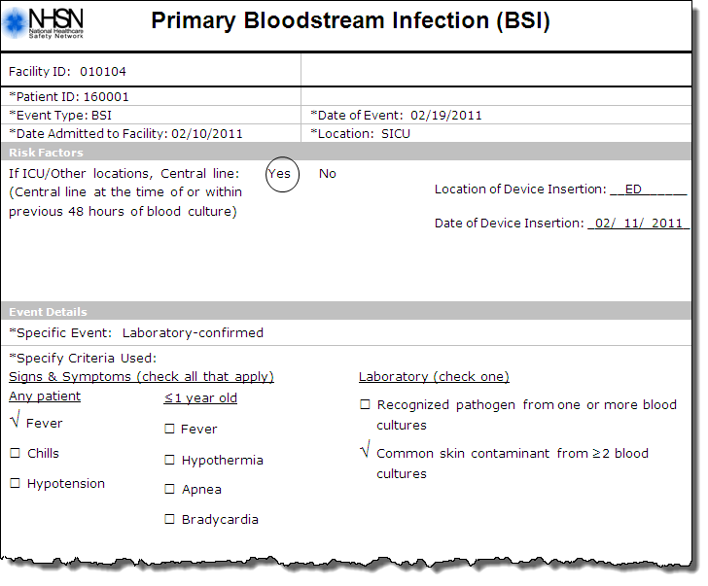
2/19 1400 BC= CNS
2/19 1430 BC = S. epi
Notes:
This slide shows a screen shot of the NHSN Primary Bloodstream Infection data collection sheet which includes basic facility and patient IDs, type of event, location, and date, CLABSI risk factors, and other event details including signs and symptoms and laboratory results.
On this sample data collection form, the patient was admitted to the facility on 2/10/11 and had a CLABSI event on 2/19/11. He/she was in the surgical intensive care unit; had a central line inserted in the ED on 2/11 and experienced fever. He/she had a common skin contaminant cultured from two or more positive blood cultures – coag negative Staphylococcus on 2/19 at 1400 and Staph epi on 2/19 at 1430.

Slide 21
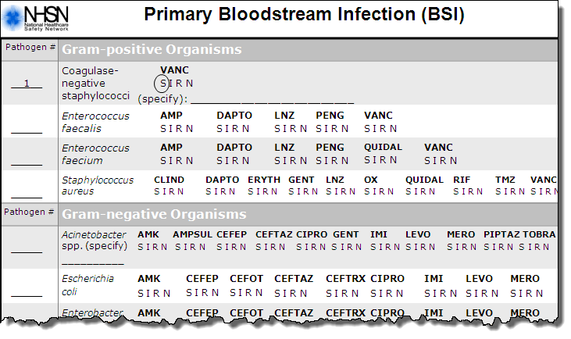
Notes:
On this backside of the primary bloodstream infection data collection sheet includes laboratory results related to antibiotic resistance specific to bacteria type and antibiotic type.
In this example, the patient’s primary pathogen was coagulase-negative staphylococci that was sensitive to vancomycin.

Slide 22
Resolution of Discrepant Cases
VDH staff compared reported CLABSIs
(from NHSN) to those identified in the audit
Letter sent to each hospital, outlining summary of findings and process of resolution for discrepancies
Validation specialist and hospital discussed disagreements
Contacted consultant (Mary Andrus) when hospital and validation specialist could not agree
Hospitals made changes to NHSN data entry as appropriate

Slide 23
Results - CLABSI Audit
Comparison of CLABSIs Identified by Hospital IP Staff Reported to NHSN and Virginia Audit
 |  | Audit CLABSI | Audit no CLABSI | Total
Hospital Reporting | Reported CLABSI | 107 | 0 | 107
 | Reported no CLABSI | 3 | 209 | 212
 | Total | 110 | 209 | 319
Notes:
Let’s look now at the results of the CLABSI audit. We’ll go through each element of the table.
Along the left of the table are the results of the hospital reporting to NHSN, indicating how many the facility reported and did not report to NHSN.
The rows at the top are the results of the audit, indicating how many CLABSIs the auditor identified as a CLABSI and how many were not identified as a CLABSI. The totals were summed up for both the rows and columns.

Slide 24
Results - CLABSI Audit
Comparison of CLABSIs Identified by Hospital IP Staff Reported to NHSN and Virginia Audit
 |  | Audit CLABSI | Audit no CLABSI | Total
Hospital Reporting | Reported CLABSI | 107 | 0 | 107
 | Reported no CLABSI | 3 | 209 | 212
 | Total | 110 | 209 | 319
A total of 319 CLABSI records were reviewed
Notes:
A total of 319 CLABSI records were reviewed.

Slide 25
Results - CLABSI Audit
Comparison of CLABSIs Identified by Hospital IP Staff Reported to NHSN and Virginia Audit
Auditors reviewed a total of 107 patients that were reported to NHSN by the hospitals as CLABSI
 |  | Audit CLABSI | Audit no CLABSI | Total
Hospital Reporting | Reported CLABSI | 107 | 0 | 107
 | Reported no CLABSI | 3 | 209 | 212
 | Total | 110 | 209 | 319
Notes:
Of those 319 total records reviewed, the auditors reviewed a total of 107 positive blood cultures that were reported to NHSN by the hospitals as a CLABSI.

Slide 26
Results - CLABSI Audit
Comparison of CLABSIs Identified by Hospital IP Staff Reported to NHSN and Virginia Audit
 |  | Audit CLABSI | Audit no CLABSI | Total
Hospital Reporting | Reported CLABSI | 107 | 0 | 107
 | Reported no CLABSI | 3 | 209 | 212
 | Total | 110 | 209 | 319
Bloodstream infections that were reported by the hospital and confirmed by the audit
Notes:
Of those 107 reported CLABSIs to NHSN, all 107 were identified as CLABSIs in the audit.

Slide 27
Results - CLABSI Audit
Comparison of CLABSIs Identified by Hospital IP Staff Reported to NHSN and Virginia Audit
 |  | Audit CLABSI | Audit no CLABSI | Total
Hospital Reporting | Reported CLABSI | 107 | 0 | 107
 | Reported no CLABSI | 3 | 209 | 212
 | Total | 110 | 209 | 319
There were no CLABSI cases that were reported to NHSN that were not confirmed by the audit
Notes:
Of the CLABSIs reported to NHSN, none of them were determined to be non-CLABSIs by the auditors.

Slide 28
Results - CLABSI Audit
Comparison of CLABSIs Identified by Hospital IP Staff Reported to NHSN and Virginia Audit
 |  | Audit CLABSI | Audit no CLABSI | Total
Hospital Reporting | Reported CLABSI | 107 | 0 | 107
 | Reported no CLABSI | 3 | 209 | 212
 | Total | 110 | 209 | 319
Total number of positive blood cultures reviewed by auditors
Notes:
Of the 319 total records reviewed, the auditors reviewed a total of 212 positive blood cultures that were not reported to NHSN by the hospitals as a CLABSI.

Slide 29
Results - CLABSI Audit
Comparison of CLABSIs Identified by Hospital IP Staff Reported to NHSN and Virginia Audit
Positive blood cultures that were identified as CLABSI by audit, but were not reported by the hospital to NHSN
 |  | Audit CLABSI | Audit no CLABSI | Total
Hospital Reporting | Reported CLABSI | 107 | 0 | 107
 | Reported no CLABSI | 3 | 209 | 212
 | Total | 110 | 209 | 319
Notes:
Of the 212 positive blood cultures not determined to be CLABSIs by the facility and therefore not entered into NHSN, three were identified as CLABSIs by the auditors and should have been entered into NHSN.

Slide 30
Results - CLABSI Audit
Comparison of CLABSIs Identified by Hospital IP Staff Reported to NHSN and Virginia Audit
 |  | Audit CLABSI | Audit no CLABSI | Total
Hospital Reporting | Reported CLABSI | 107 | 0 | 107
 | Reported no CLABSI | 3 | 209 | 212
 | Total | 110 | 209 | 319
Positive blood cultures that were not identified as CLABSI by audit, and were not reported by the hospital to NHSN
Notes:
Of the 212 positive blood cultures not determined to be CLABSIs by the facility and therefore not entered into NHSN, 209 were not identified as CLABSIs by the auditors and were correctly not entered into NHSN.

Slide 31
CLABSI Misreported Cases
Total of 3 reporting errors:
  3 under-reported
34 hospitals had no identified CLABSI reporting errors
  2 small hospitals had one error each
  1 medium hospital had one error
Misreported cases
  1 case was identified as a 2° BSI when it actually met the criteria for a CLABSI
  2 cases appear to have been overlooked
Notes:
Only three reporting errors were identified out of the total number of blood cultures reviewed (319). Therefore, the error rate was 3/319, or less than 1%.

Slide 32
Secondary BSI
A culture-confirmed BSI associated with a documented HAI at another site
If a primary infection is cultured, the secondary BSI must yield culture of same organism and exhibit the same antibiogram as the primary HAI site
Example: Mrs. Jones grows E. coli in her urine (>100,000 col/cc) and in her blood. Both organisms have the same antimicrobial susceptibility pattern. The UTI is reported with a secondary BSI.
Example: Mr. Smith grows A. baumanii in his surgical wound which is resistant to amikacin and levofloxin but sensitive to other tested antimicrobials. He is also growing A. baumanii in his blood, but it is susceptible to amikacin.
Notes:
Note that the second bullet is no longer part of the surveillance definition but was at the time of the positive blood cultures that were under review.

Slide 33
Secondary BSI (cont’d)
If an infection is identified and no culture is used to meet the infection criteria and a blood culture is positive, then the first infection is considered primary and the bloodstream infection is reported as secondary.
The organism cultured from the blood is reported as the organism for the primary site.
Example: 6 days postoperatively, Miss Green has an abdominal abscess, confirmed by CT scan. On the same day, her blood is drawn and grows Bacteroides fragilis. The infection is reported as an SSI-GIT (organ space SSI) with a secondary BSI. The organism is reported as B. fragilis

Slide 34
Positive blood culture
Does patient meet the criteria for HAI at another site? [If infection is community-acquired (CA), or if NHSN criteria for the specific site HAI has not been met, answer “No”.]
Does patient meet the criteria for HAI at another site? (If infection is CA, or if NHSN criteria for the specific site HAI has not been met, answer “No”.)
Does patient meet the criteria for HAI at another site? (If infection is CA, or if NHSN criteria for the specific site HAI has not been met, answer “No”.)
No
Yes
CA or HA
CA or HA
CA or HA
Is blood isolate a common pathogen for this site?
Is blood isolate a common pathogen for this site?
Is blood isolate a common pathogen for this site?
HA
HA
HA
CA
CA
Yes
No
This CA infection with secondary BSI is not reported through NHSN nor is the BSI.
This CA infection with secondary BSI is not reported through NHSN nor is the BSI.
Site infection with secondary BSI
Site infection with secondary BSI
Primary BSI
Primary BSI
Primary BSI
Notes:
Here is an algorithm when looking at positive blood cultures to help determine what should be reported to NHSN and if it is a primary or secondary bloodstream infection (BSI). First, ask if the patient meets the criteria for an HAI at another site. If the infection is community-acquired (CA) or if NHSN criteria for the specific HAI has not been met, answer “No”. If it is a CA infection with secondary BSI, it is not reported through NHSN nor is it a BSI. If it is healthcare-associated, and does not meet criteria for an HAI at another site, it would be considered the primary BSI.
If, on the other hand, the patient does meet the criteria for HAI at another site, you should be asking if the blood isolate is a common pathogen for this site. If Yes, it would be considered a site infection with a secondary BSI. If it is not a common pathogen for this site, it would be considered a primary BSI.

Slide 35
Results
Comparison of CLABSIs Identified by Hospital IP Staff Reported to NHSN and Virginia Audit
 |  | Audit CLABSI | Audit no CLABSI | Total
Hospital Reporting | Reported CLABSI | 107 | 0 | 107
 | Reported no CLABSI | 3 | 209 | 212
 | Total | 110 | 209 | 319
Agreement
Disagreement
Notes:
Looking at the audit data as a whole, the areas shaded in yellow are those areas where the auditors and the hospitals were in agreement with the patient records reviewed. For example, auditors and hospitals agreed that 107 were CLABSIs and 209 were not CLABSIs of the reviewed 319. The dark shaded areas are those areas where discrepancies were identified. Auditors and hospitals did not agree on three, all of which were infections that the auditors identified that were not reported to NHSN. Please note that there were no instances where a CLABSI had been reported by the hospital and was determined by the audit to not be a CLABSI. These results are outstanding!

Slide 36
Analysis - CLABSI
Sensitivity: The probability that an individual who has a true CLABSI is reported by the hospital as having a CLABSI
Specificity: The probability that an individual who does not have a CLABSI is not reported as a CLABSI
Positive Predictive Value (PPV): The probability that a person has a CLABSI given that a CLABSI is reported
Negative Predictive Value (NPV): Probability that a person does not have a CLABSI if a CLABSI is not reported
 | Estimated Value
Sensitivity | 97%
Specificity | 100%
Positive Predictive Value (PPV) | 100%
Negative Predictive Value (NPV) | 98.5%
Notes:
In analyzing these data, we found that the sensitivity was 97%, the negative predictive value was 98.5%, and both the specificity and positive predictive value were 100%

Slide 37
Notes:
Now let us review the results of the interview of the 37 hospitals.
In response to inquiring about how many ICUs were in each hospital, 62% (n=23) reported one ICU, 24% (n=9) reported 2-5 ICUs, and 14% (n=5) reported 6 ICUs.

Slide 38
Number of responding hospitals
Notes:
Eighty-one percent of the hospitals audited had a Medical/Surgical Critical Care unit (n=30), 32% had a Medical Cardiac Critical Care unit (n=12), and 30% had a Surgical Cardiothoracic Critical Care unit (n=11).

Slide 39
Size of the facility did not correlate with electronic capacity.
Notes:
Nearly half of the hospitals (46%, n= 17) used a combination of electronic and manual methods to collect denominator data.
Less than one-quarter (22%) of facilities (n=8) used only electronic methods to count both central line days and patient days.
Approximately one-third of facilities (32%, n=12) used only manual methods to count both central line days and patient days.

Slide 40
Number of hospitals
Notes:
Among those (19) hospitals that collect patient days manually, IPs are most commonly assigned to this task (47%, n=9).
It is important to emphasize that at the same time every day, the number of patients on the unit should be counted to accurately obtain this number.

Slide 41
Counting Patient Days
At the same time each day, count the number of patients on the unit
  Use denominator forms
In NICUs, patients are counted separately for each birthweight category
Do not count patients who have not yet been admitted
Do not count patients who have been discharged
Do count patients who may be off the floor for tests (e.g., radiology, surgery, etc.) at the time the count is done
The total is recorded in NHSN at the end of the month

Slide 42
Number of hospitals
Charge Nurse usually collects the information while the IPs were more often involved in tallying information or retrieving collected data
Notes:
Among those hospitals that collect central line days manually, IPs and charge nurses are most commonly assigned to this task.
Tips:
Central line days should be counted at the same time each day.
Count the number of patients with one or more central lines in place.
Be sure to plan for coverage during weekends or other staff gaps. It is important for multiple people to know how to correctly count central lines.
If a gap in data entry has occurred and there is no accurate way to determine the number of lines for the month, leave the information blank for that month. Do not approximate or take an average of past months. You may want to make the HAI epidemiologist aware that there will be denominator data missing for that month.

Slide 43
Counting Central Line Days -
(ICU) Examples
James is admitted today at 5 am and a subclavian central line is inserted. At noon today, one central line day is counted.
Gretchen was admitted 2 weeks ago. Today she has both a PICC line and a femoral central line. At noon today, one central line day is counted.

Slide 44
Number of hospitals
Notes:
When asked about the method used to collect central line days, a few hospitals indicated that they counted the total number of central lines during the day and a few did not specify the method beyond using the electronic system. The majority used the method required by NHSN (the correct method), indicated in the red square, which is counting the number of patients on the unit with one or more central lines at the same time each day.

Slide 45
If a patient has more than one central line, only one central line per patient should be counted each day. Out of 37 ICUs, 3 (8%) are incorrectly counting these days.
Notes:
If a patient has more than one central line, only one central line per patient should be counted each day according to the NHSN definition. Out of 37 ICUs, 3 (8%) hospitals are incorrectly counting these days, 89% are correctly counting these days, and 3% did not provide a clear response.

Slide 46
Notes:
If a patient had a temporary central line and a permanent central line, only one central line day should be counted according to NHSN. Most hospitals (92%) reported that they would count this scenario correctly as only one central line day. One hospital said it would count two central line days if the patient had a temporary CL and a permanent CL. 2 left the question blank.

Slide 47
Comments:
But only if it has been accessed
If within last 24 hours
Number of hospitals
Notes:
Central lines should not be counted if it was removed earlier that day before the scheduled “counting” time. Most facilities (86%, n=32) answered correctly and said they would not count the line. 14% (n=5) facilities said they would count the line.
One facility noted that it would count a line that was removed earlier in the day only if it was accessed and one said that they would count if it was removed within the last 24 hours. Both of these responses are incorrect – whether or not the line had been accessed or if it was in within the last 24 hours should not affect the counting of the line.

Slide 48
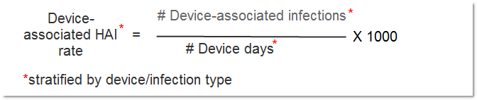
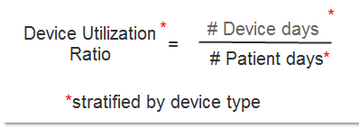
Device-associated Rates/Ratios
Notes:
Device-associated HAI rate is calculated by the number of device-associated infections divided by the number of device days multiplied by 1000 and can be stratified by device and infection type. The device utilization ratio is calculated by the number of device days divided by the number of patient days and can be stratified by device type.

Slide 49
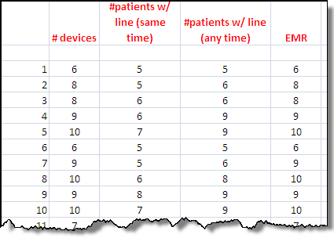




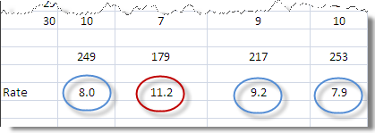
Different data collection methods will produce significantly different rates!
Collection of clabsi denominators
Notes:
It is very important to use a standardized method of data collection because different data collection methods can produce significantly different rates! For example, using different denominators methods would change the denominator number and therefore the CLABSI rate. Different methods may include collecting the number of devices, the number of patients with the central line collected at a random time throughout the day or at the same time each day. Some hospitals may even be using an electronic count of line days; these data may be incorrect if they have not been validated.
For example, for the same patient population/time period/unit, the electronic medical record may count 253 central line days, the number of patients with central lines counted at various times may be 217, the number of patients with a central line collected at the same time may be 179, and the number of devices may be 249. If the number of CLABSI events was 2, then the calculated CLABSI rate would vary: 7.9 for EMR, 9.2 for lines counted at any time, 11.2 for lines counted at the same time every day, and 8.0 for the number of devices. Clearly, if not counted in the same way, rates would not be comparable between units nor between hospitals.

Slide 50
Electronic Collection of Denominators
When denominator data are available from electronic databases (e.g., ventilator days from respiratory therapy), these sources may be used as long as the counts are not substantially different (+/- 5%) from manually collected counts.
Notes:
Electronic data are not perfect! It is important to validate electronic data also: at the very beginning of its use and periodically using manual data collection methods for comparison.

Slide 51

Are peripheral IVs counted as central lines?
No – 100% answered correctly

Slide 52
Other staff involved:
NHSN
ICU Directors
Pathologists
MedMined
DiCON consulting
Quality improvement
Physicians
Clinical nurse specialists
Number of hospitals
Notes:
Most facilities indicated that many different resources are used to make a determination about whether or not a case should be reported to NHSN. This is perfectly acceptable, as long as the final decision is made using the NHSN/CDC definition and protocol. Thirty-one hospitals (84%) reported that the IP makes the final decision, 8 reported the ID physician/department makes the final decision, 7 indicated that they consult with other facility IPs, and 5 reported the hospital epidemiologist makes the final decision.

Slide 53
Notes:
Most (86%) of the facilities audited reported that their facility applied the CLABSI definitions very consistently and 2% said they apply the definitions consistently. Approximately one in ten facilities (11%) indicated that they believed CLABSI definitions were applied very inconsistently.

Slide 54
Number of hospitals
Notes:
There were a variety of training methods for data collectors; however, 9 facilities reported not having any training for data collectors.
7 hospitals reported training data collectors at an annual competency skills review, at a staff orientation, or in ongoing staff education. 6 hospitals train data collectors with NHSN materials, 3 use corporate webinars, and 1 used APIC webinars.
Note: Education question did not differentiate between training about CLABSI definitions vs. denominator data collection.

Slide 55
Number of hospitals
Notes:
Regarding the quality control of the CLABSI data, 14 hospitals did not clearly know or could not articulate their quality control practices, 13 ensured that the same collected CLABSI data were reviewed by multiple methods, 8 collected CLABSI data using two methods, and 2 had no quality control activities.
Although using multiple people to review data could be helpful to make sure the counts are added correctly, this does not help to identify quality control issues. The best method is to collect data using two methods (i.e., having a manual and electronic comparison).

Slide 56
Discussion
Great job applying the surveillance definitions!
  Celebrate and promote your success
Areas for improvement
  Denominator data collection
  Quality assurance
  Continued education
Quarterly reporting reminders
  Monthly reporting plan essential!
  Update NHSN (and VDH) about changes to unit composition
  www.vdh.virginia.gov/Epidemiology/Surveillance/HAI/haireport.htm
Notes:
We are very proud of how well the hospitals applied the surveillance definitions and you should share this information with your administrators, infection control committees, and celebrate your success.
Suggestion to include denom data collection as part of annual skills review – people were clear on how to count peripheral lines but not everyone was clear on how to count patients with multiple lines, patients with temporary and permanent lines, and patients that had lines that were removed earlier in the day. We want to stress that lines should be counted at the same time each day and it’s important to be clear on these details regarding multiple lines.
Nearly 1/3 of hospitals did not indicate that they conducted quality assurance of their data. Reports are available in NHSN to conduct data checks. Where possible, we suggest to periodically internally validate data using multiple methods (i.e. manual and electronic).
Education is important – upon new staff hire, creating plans for cross-education so that there will be coverage when dedicated staff aren’t working or when that person changes positions. Continued education also important when NHSN definitions change, when electronic reporting systems change, or when new functionality becomes available in NHSN.
As you continue your CLABSI reporting in adult ICUs, a few reminders about why we may not be able to see your data if you’ve entered it – you may not have a reporting plan for the month or one of the units may not be in the reporting plan for that month. You may have recently had a change to one of your units or added a unit and not conferred rights. It’s important to make sure that the units are defined appropriately, especially as the data are used to calculate standardized infection ratios by various audiences – you want to make sure the right type of unit from the baseline population is compared to your data. We at VDH can help you redefine a location or make it inactive – just let us know!
The last bullet is the link to the website where quarterly reports can be accessed.

Slide 57
Discussion (cont’d)
Limitations of project
  Audited ½ hospitals, took sample of blood cultures
    Unable to quantify total number of CLABSIs in the entire state
    May have missed some under-reporting issues
How has this project impacted you?
  Increased confidence in standardization and quality of data?
  Changes to data collection, quality assurance methods, or educational strategies?
Notes:
The whole universe of potential CLABSIs was not investigated due to the decision to sample and only looking at positive blood cultures in the ICU. Therefore, it is possible that not all missed CLABSIs were captured in this audit process. Some overarching issues of under-reporting may have been missed by sampling rather than reviewing the entire list of positive blood cultures; however, we hope that reviewing records from 11 hospitals that reported no CLABSIs will be sufficient in capturing larger, more common practices.

Slide 58
Next Steps
Public reporting
  Proposed additions to state reporting regulations
  CMS – CLABSI in NICU, PICU
Publish VDH report on CLABSI audit project
Presentation of CLABSI data in quarterly reports?
  More analyses by unit?
  Transition to use of SIR?
VDH/APIC conference 11/10/11 (Richmond)
  More about quality assurance using NHSN,
  data analysis, and presentation
NHSN denominator simplification project
Notes:
Thank you for your comments about the proposed regulations, which included a measure to add CLABSI reporting in selected units outside the adult ICU.
In January of this year, those of you that have neonatal ICUs and/or pediatric ICUs began sharing data with CMS as part of the inpatient prospective payment system. Although NICU CLABSI surveillance is slightly different, familiarity with the adult CLABSI definitions has probably been helpful.
Later this year, VDH would like to focus on discussing how to present our quarterly CLABSI data in meaningful ways. We do a lot of analyses internally but do not share them with the public. So we want to open the dialogue and have discussions with APIC, our Advisory Committee, and ask you today about what you’d like to see on our website or information that you’d like fed back to the hospitals about state trends. A few other states and CDC have begun to use the SIR – what do you think about this measure?
In November, we will be having a one-day conference to tie up our ARRA grant and address some of the topics identified as educational areas of interest in the acute care needs assessment. We plan to have more discussion about how to perform quality assurance on your data using the NHSN analytic tools, how to analyze the data (including the SIR, as we mentioned earlier), and how to present the data, which has been an area of focus with our collaborative in the hospitals engaged in the surgical site infection surveillance pilot.

Slide 59
Thank You!
Participating facilities
VHHA
  Barbara Brown, PhD
Data validation specialists
  Jeanette Daniel, RN, CIC
  Bonnie Harris, RN, CIC
  Carol Jamerson, RN, BSN, CIC
  Loretta Reardon, RN, CIC
APIC-VA

Slide 60
Questions?
Contact the VDH HAI Program
Program Coordinator
Andrea.Alvarez@vdh.virginia.gov / 804-864-8097
Epidemiologist
Dana.Burshell@vdh.virginia.gov / 804-864-7550
Nurse Epidemiologist
Carol.Jamerson@vdh.virginia.gov / 804-864-7547

