Slide 1

Long-Term Care:
Infection Prevention Updates and Best Practices
Carol Jamerson, RN, BSN, CIC
Nurse Epidemiologist
Virginia Department of Health
Dottie Torrey, RN
Regional Nurse Consultant
American Healthcare

Slide 2
Objectives
By the end of the presentation the attendees will better understand:
The collaborative efforts in infection prevention with the Virginia Department of Health and long-term care facilities
Updates in infection prevention specific to Norovirus, influenza vaccine, and the Tdap vaccine
Available tools for best practices in long-term care for infection prevention addressing multidrug-resistant organisms, safe practices for blood glucose monitoring, and controlling disease outbreaks

Slide 3
Acknowledgments
Virginia Department of Health - Healthcare-Associated Infections Team
Andrea Alvarez, MPH - Coordinator
Dana Burshell, MPH, CPH, CIC - Epidemiologist
Virginia Health Care Association (VHCA)
Judy Brown, RN, LNHA, Health Education Specialist
Beverley Soble, Vice-President of Regulatory Affairs
Eastern Virginia Medical School
Robert M. Palmer, MD, MPH – John Franklin Chair of Geriatrics, Professor of Medicine and Director of the Glennan Center for Geriatrics and Geronotology
Edward C. Oldfield, III – Professor of Medicine, Microbiology and Molecular Cell Biology, Director of Infectious Disease Division
Collaborative partners from 12 nursing homes in Eastern Virginia

Slide 4
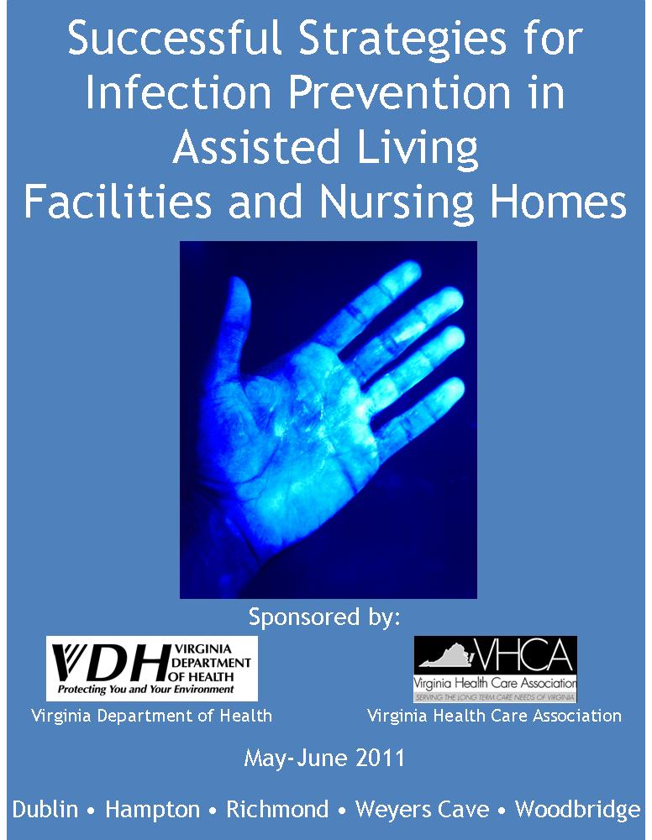

Successful Strategies for Infection Prevention in Assisted Living Facilities and Nursing Homes
Notes:
Hopefully many of you were able to attend the Long-term care educational trainings held this summer throughout Virginia. Trainings were held for nursing homes and assisted-living facilities providing specific instruction on infection prevention issues, updates, and best practices. Each facility attendee received a toolkit notebook (the cover page pictured above) and a DVD of the toolkit contents for the facility to use and customize as necessary. An additional training session was held this fall in Virginia Beach bringing the total of LTC participants trained to approximately 550.

Slide 5
Topics Covered
Routes of disease transmission and chain of infection
Standard and transmission-based precautions
  Hand hygiene and personal protective equipment
Surveillance and outbreak investigation
Environmental cleaning and disinfection
Bloodborne pathogens, safe injection practices, and blood glucose monitoring
Vaccination
Staying home when sick (staff and visitors)
Transfer of residents
Working with your health department and licensing agency
Notes:
A quick look at some of the topics covered in the trainings.

Slide 6
Hot Topics
Urinary tract infections
Isolation of residents with multidrug-resistant organisms (MDROs)
Tuberculosis
Communication of information during transfer
Environmental services

Slide 7
Nursing Homes in the News
Recent research has shown that lack of compliance with appropriate infection control practices is a major issue in nursing homes
May 2011’s American Journal of Infection Control reports infection control violations in 15% of United States nursing homes
  Data collected between 2000 and 2007 representing 96% of all nursing homes
  Based on a panel of roughly 100,000 observations
  Study examined the deficiency citation for infection control requirements (F-Tag 441)
Notes:
The timing of our training sessions coincided with the May 2011 publication in the American Journal of Infection Control (AJIC) addressing Infection Control violations in Nursing Homes. The reported study was conducted by The University of Pittsburgh’s Graduate School of Public Health.

Slide 8
Centers for Medicare and Medicaid Services (CMS)
Federal Regulation F-Tag 441 states:
  “The facility must establish and maintain an infection control program designed to provide a safe, sanitary, and comfortable environment and to help prevent the development and transmission of disease and infection.”
Notes:
A review of the 2010 F-Tag deficiencies showed F-Tag 441 to be #7 in Virginia and #2 nationally.

Slide 9
Infections: A Leading Cause of Morbidity and Mortality
Between 1.6 and 3.8 million infections occur each year in nursing homes with nearly 388,000 deaths attributed to these infections (1)
Costs associated with infections in nursing homes are significant
  Estimates range from $673 million to $2 billion (1)
Strong correlation between low staffing levels and the receipt of an infection control deficiency citation

Slide 10

CDC 12 Steps to Protect LTC Residents
The CDC advocates that 4 basic groups of actions should be taken to prevent antimicrobial resistance in long-term care:
  Prevent infection
  Diagnose and treat infection effectively
  Use antimicrobials wisely
  Prevent transmission
Most steps applicable to other healthcare settings as well
CDC 12 Steps
Notes:
One of the most difficult problem that we face in infection prevention results from antimicrobial resistance and the development of multi-drug resistant organisms (MDROs). The CDC has published a document outlining 12 steps to protect long-term care residents. The 4 basic groups of actions are listed in the slide but the full 12 steps are found in the long-term care toolkit notebook distributed during the summer training sessions.

Slide 11
A Little History About Antibiotic Use…
2000 B.C.
“Here, eat this root.”
1000 A.D.
“That root is heathen. Here, say this prayer.”
1850 A.D.
“That prayer is superstition. Here, drink this potion.”
1940 A.D.
“That potion is snake oil. Here, take this penicillin; it’s a miracle drug.”
1985 A.D.
“Penicillin is worthless. Here, take this new antibiotic; it’s bigger and better.”
2011 A.D.
“Those antibiotics don’t work anymore. Here, eat this root.”
Notes:
This slide gives a short look at where we have traveled in the history of antibiotic use. As you can see the challenges of antibiotic use and over-use have come full circle.

Slide 12
Multidrug Resistant Organisms (MDROs)
The Alphabet Soup!
Ingredients:
MRSA; VRE; Multidrug Resistant Gram-Negative Rods (MDR- GNR) includes various organisms such as E. Coli, Klebsiella pneumoniae, Acinetobacter baumannii, Stenotrophomonas maltophilia and more….
As a review:
Colonization: Presence of a microorganism in or on the body without signs of symptoms of active infection.
Active infection: Presence of microorganisms that are actively invading tissue and causing damage.

Slide 13
Important Points for MDRO Control
Know your facility’s risk based on ongoing surveillance in order to note trends in transmission or infections
  Remember an outbreak maybe indicated by a higher incidence than usual in your facility population
Work together with your microbiology laboratory and share trends with your medical director
Develop effective policies and protocols and educate staff in implementation

Slide 14
MDRO Control (cont’d)
Take action based on your findings
  Involve your key stakeholders
  Notify your local health department for advice and support
  Validate your environmental cleaning procedures and make adjustments as needed

Slide 15
Modes of Transmission
The most common mechanism of transmission is via contact.
  Person to person
  Contaminated objects
  Hand hygiene is the keystone to infection prevention and control of transmission. Ensure that you have an effective hand hygiene program in place and monitor for compliance!

Slide 16
Patient Placement
If possible, place resident in a private room
If this option is not available, the resident should be cohorted with another resident with the same organism
If neither option is possible, the resident should be placed in a room with another resident who is considered at low risk for acquistion of a MDRO. Examples include: no wounds, no invasive devices, not immunocomprised

Slide 17
Precautions
Always standard precautions!
Contact precautions may also be indicated.
Consider the individual resident’s clinical situation and incidence of MDROs in your facility to determine when to implement and discontinue contact precautions.
Practice what your facility’s policies reflect and remember to update policies based on your risk assessment!

Slide 18
Vaccinations and the Elderly
In the elderly population, pneumonia and influenza are the fifth leading cause of death in the United States
Residents who live in a long-term care facility may be at greater risk for serious infections due to age, decreased immunity, and/or underlying health conditions.
Living in close quarters and having frequent contact with other residents may increase transmission risk.

Slide 19
Successful Vaccination Strategies
Stress benefits of vaccination
Allay fears and misconceptions
  Vaccines are safe!
  Cannot “catch” the disease from the vaccine
  Minimal side effects
  Benefits outweigh the risks
Find creative ways to increase staff influenza vaccination rates
  Mobile flu carts
  Accommodate all shifts and weekdays/weekends
  Offer incentives for participation

Slide 20

Virginia Department of Health
“Community Immunity”
2011-2012 Flu Theme
Notes:
This year the Virginia Department of Health adopted “Community Immunity” as the 2011- 2012 flu theme. This picture represents a community of folks who together can help prevent the spread of influenza by receiving a vaccination and encouraging others in their community of friends and neighbors to do the same.

Slide 21
What is Community Immunity?
“When a critical portion of a community is immunized against the flu, most members of the community are protected because there is little opportunity for the virus to spread.”
  For community immunity to work, each of us who can receive flu vaccine must get vaccinated every year
  Ultimately this will help protect all of our patients and residents

Slide 22

Influenza-like Illness
2011 – 2012 Influenza Season
2010 – 2011 Influenza Season
Notes:
These slides depict a snapshot of the percent of Influenza Like Illness (ILI) visits to Virginia hospital emergency departments and urgent care centers for 8 weeks in September and October from the past two influenza seasons (2010-2011 and 2011-2012). Colored lines are used to show the percent of ILI for six different age groups (0-4 years, 5-18 years, 19-24 years, 25-49 years, 50-64 years, and 65+ years). In general the percent ILI increases with age. Patients 0 to 4 years of age have the highest percent of visits due to ILI. Comparing the two flu seasons, the percent ILI of most of the age groups (5 years and older) was similar. In the 2011-2012 influenza season, patients 0 to 4 years of age experienced a higher percentage of visits due to ILI compared to the 2010-2011 season.
ILI symptoms include: fever, cough, and/or sore throat.

Slide 23
Influenza-like Illness
Notes:
This slide shows the percent of visits due to ILI by age group (0 to 4 years, 5 to 18 years, 19 to 24 years, 25 to 49 years, 50 to 64 years, and 65+ years) for the entire 2010-2011 season (roughly October 2010 to September 2011). Of interest, we see a spike in visits after the winter holiday season beginning during mid-November through the year (weeks 47-52) and trending down as winter ends. Again, percent ILI decreases with age; the highest percent is in the 0 to 4 year old age group.

Slide 24

Changing Faces of Flu
Notes:
Our influenza surveillance coordinator notes each week where we (Virginia) are reporting levels of flu activity. There are five levels of flu activity, determined by flu outbreaks, laboratory reports, and percent ILI in each region:
No activity, sporadic, local, regional, or widespread.

Slide 25
Blood Glucose Monitoring
Best Practices
Fingerstick devices should never be used for more than one person
  Select single-use devices that permanently retract upon puncture
Dedicate blood glucose meters to a single resident, one person, if possible
  If shared, the device should be cleaned and disinfected after every use, per manufacturer’s instructions
Insulin pens and other medication cartridges and syringes are for single-use only and should never be used for more than one person
BGM In-Service
Notes:
Another tool available in the long-term care toolkit is a resource to track blood glucose monitoring practices. The graphic on this page shows an elderly woman using a fingerstick device.

Slide 26
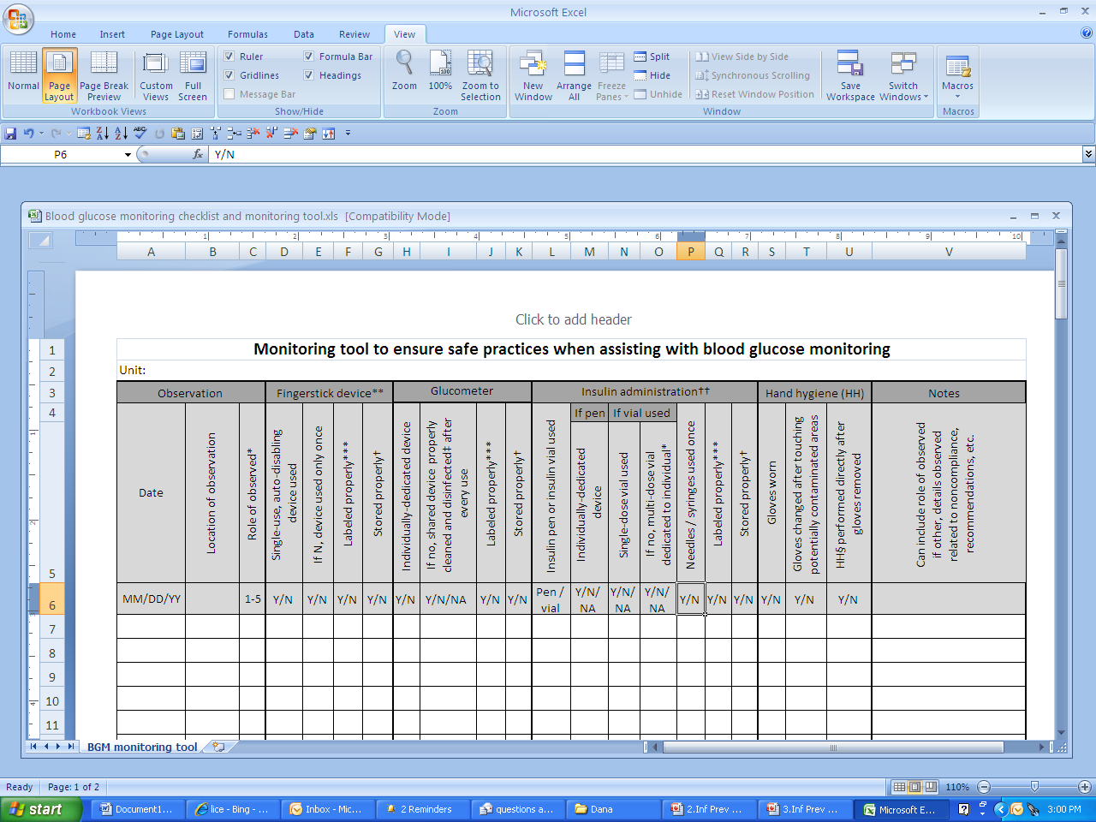
Blood Glucose Monitoring Tool
Notes:
This blood glucose monitoring tool gives an example of a log that can be used within your facility to follow and assess safe practices regarding blood glucose monitoring and hand hygiene practices.

Slide 27
Norovirus -‘Tis the Season
March 2011- Updated guidelines published in the Morbidity and Mortality Weekly Report (MMWR)
  In the United States, approximately 21 million illnesses annually attributed to Norovirus
  Transmission may be foodborne, waterborne, or by person to person
  Indirect exposure may occur via fomites, contaminated environmental surfaces, or possibly via inhalation of aerosolized droplets from vomitus
  Please contact your local health department for assistance as soon as an outbreak is suspected!
Notes:
Recent advances in norovirus epidemiology and infection prevention measures have led to updated guidance for the management of outbreaks and prevention of disease.

Slide 28
Surveillance: Outbreak/Cluster
Outbreak/cluster
  Occurs when there are more cases of a disease in a designated population than usually occur for a given period of time
    Every disease has an expected level of activity, or a “baseline” number of cases that occur over a given time period
Surveillance helps identify outbreaks!
  Establish baseline and seasonal trends
  Identify commonalities among those who are sick
    Types of symptoms, area of the facility where they reside, etc.
How to Identify an Outbreak

Slide 29
VDH Reporting Procedures
Reportable conditions required by the Code of Virginia
  http://www.vdh.virginia.gov/epidemiology/
  regulations.htm
Office of Licensure and Certification (OLC) reporting requirement
Remember to contact your local health department for any outbreak concerns and advice!
Notes:
A reminder of where to obtain an updated list of reportable conditions noted by the Code of Virginia. Also, remember if your facility is experiencing an outbreak situation please notify the Office of Licensure and Certification (OLC) as well as your local health department. This prevents OLC from visiting during an outbreak and unnecessary exposures to infectious conditions.

Slide 30
Recommended Hand Hygiene for Norovirus
Proper handwashing with soap and water - most effective way
Hand sanitizers with 70% ethyl alcohol as adjunct in between proper handwashings but should not be considered a substitute for soap and water
During suspected or confirmed outbreaks of Norovirus use soap and water!

Slide 31
Isolation Precautions and Sick Staff Members
Sick patients/residents are recommended to be isolated until 24-48 hours after symptoms resolve
Sick patient care staff, food workers, and child–care staff should be excluded from work a minimum of 48 hours after symptoms resolve.
  Upon return to work, remind staff of importance for frequent hand hygiene.

Slide 32
Environmental Cleaning
Proper cleaning and sanitizing of equipment, high traffic clinical areas, and frequently touched surfaces
After initial cleaning of surfaces to remove visible soil, use a freshly made 10% chlorine bleach solution (i.e., 5,000 ppm sodium hypochlorite = 1 cup bleach to 9 cups water) or other Environmental Protection Agency (EPA)-approved disinfectant
  Note: all cleaning products and disinfectants should be EPA-registered and have labels claims for healthcare use
  Change mop heads when a new bucket of cleaning solution is prepared, or after cleaning large spills of emesis or fecal material

Slide 33
Reminders
Norovirus is highly contagious and very hardy, so strict adherence to control measures is necessary
Successful Strategies for Infection Prevention in Assisted Living Facilities and Nursing Homes toolkit section with expanded information
Complete guidelines are available on the Virginia Department of Health website:
  http://www.vdh.virginia.gov/Epidemiology/Surveillance/norovirus.htm

Slide 34
Pertussis (Whooping Cough)
Vaccine preventable disease that causes severe coughing, vomiting, and complications possibly leading to pneumonia, and even death in infants
  Usually spread by coughing or sneezing while in close contact with others
Protection from childhood vaccination fades over time thus the need for adults to be revaccinated
On the rise throughout the United States, including Virginia
  2010: CDC reported 27,550 cases in the U.S.
Notes:
The number of cases of pertussis is most likely an underestimate due to the underreporting of cases. While adults may show only mild symptoms, they are capable of passing pertussis to infants close to them thus spreading the potential of severe disease in this age group population.

Slide 35
Tdap - What’s New for Healthcare Workers?
The Advisory Committee on Immunization Practices (ACIP) Provisional Recommendations for Healthcare Personnel (HCP) on use of Tetanus toxoid, Reduced Diphtheria Toxoid and Acellular Pertussis Vaccine (Tdap) and the use of Postexposure Antimicrobial Prophylaxis - April 2011
CDC Morbidity and Mortality Weekly Report (MMWR) scheduled date of publication of recommendations for immunization of HCP – Fall 2011
  Full pertussis-containing vaccine recommendations scheduled for 2012
Notes:
This slide describes several recent resources addressing immunization for pertussis protection.

Slide 36
Tdap in Healthcare Personnel
The ACIP recommends that all HCP, regardless of age, should receive a single dose of Tdap as soon as feasible if they have not previously received Tdap and regardless of the time since last Td dose
Expanded information is available by visiting:
  http://www.cdc.gov/vaccines/recs/provisional/ default.htm

Slide 37
VDH/VHCA Urinary Tract Infection (UTI) Prevention Collaborative
Selection of collaborative focus and region
12 participating nursing homes in the Eastern region
June - December 2011
  Monthly conference calls
  Surveillance from August – October
Partnership with Eastern Virginia Medical School – The Glennan Center for Geriatrics and Gerontology
Notes:
A recent collaborative effort between the Virginia Department of Health (VDH) Healthcare Associated Infections (HAI) Team and the Virginia Health Care Association is focused on urinary tract infection prevention in the long-term care population. This slide gives a short synopsis of the timeline and partnerships associated within the collaborative.

Slide 38
Most Frequent Infections by Facility Type
 | First | Second | Third | Fourth | Fifth
Nursing Home | UTI 90% | Pneumonia 83% | MRSA 77% | CAUTI 71% | SST 66%
Assisted Living Facility | UTI 71% | Influenza 35% | Pneumonia 33% | Norovirus 26% | SST 19%
CAUTI= catheter-associated urinary tract infection
MRSA= methicillin-resistant Staphylococcus aureus
Pneumonia: percentage does not include ventilator-associated pneumonia (VAP)
SST= skin and soft tissue infections
UTI= urinary tract infection; percentage does not include CAUTI
Notes:
The VDH HAI team conducted a needs assessment in assisted living facilities and nursing homes and noted that urinary tract infections (UTIs) are the most frequent infection noted in both assisted living facility settings and in nursing homes. Our collaborative focus supports the development of a toolkit of best practices addressing strategies for UTI prevent in this population.
The chart on the page shows the percentage of responding facilities (nursing homes or assisted living) that indicated a given type of infection was seen frequently or somewhat frequently in their facility. Pneumonia was commonly seen in both types of facilities (2nd most common in nursing homes, 3rd in assisted living), as were skin and soft tissue infections (5th most common in both types). MRSA and catheter-associated urinary tract infections were 3rd and 4th most common in nursing homes. Influenza (2nd) and norovirus (4th) rounded out the top 5 in assisted living facilities.

Slide 39
UTIs in the Long-Term Care Population
As we have noted, UTIs are the most common bacterial infections encountered in older adults
Diagnosis and treatment is often challenging as clinical manifestations are often atypical
Assessment and delivery of information to the clinician is an important tool in determining if a symptomatic UTI is present

Slide 40
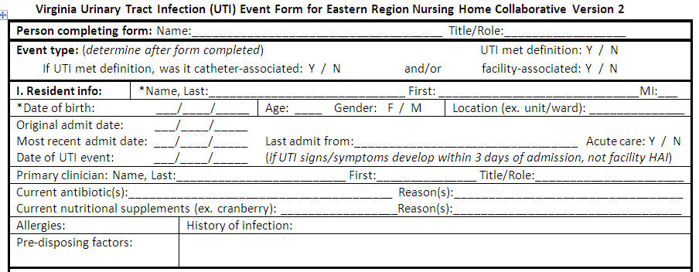
UTI Surveillance Form
Demographics
Relevant dates (admission, event)
Pre-disposing factors
Catheter use
Signs and symptoms
Lab testing
Pathogens identified & sensitivities
Treatment
Notes:
This slide shows a screenshot of a form used to conduct surveillance for urinary tract infections in long-term care facilities. Our HAI epidemiologist worked together with the collaborative group to develop this surveillance form that participating facilities used during the project period (August 2011-November 2011) to assess the form’s usefulness and suggest changes. This form is available in the UTI prevention toolkit and covers that areas identified in the bullet points of the slide.

Slide 41
Collaborative Activities and Sharing of Information
UTI panel presentation - November 2nd
Best practices for UTI prevention will be shared throughout Virginia via VDH website (currently being constructed)
Anticipate publication of updated and validated revisions to the McGeer et al. (1991) definition set used by many long-term care facilities
Notes:
The UTI panel presentation held November 2, 2011, was an education opportunity for the collaborative facilities including associated clinicians. Panelists included experts from the Eastern Virginia Medical School (EVMS) in Gerontology and Infectious Diseases and a Clinical Nurse Education in long-term care within our collaborative group addressing issues with UTIs and treatment in the long-term care population.

Slide 42
Collaborative Wrap-Up
Sharing and development of tools for best practices in UTI prevention (toolkit #2)
  Surveillance tools
  Guidelines for assessment
  Education for staff, residents, and families
Potential for sustaining/expanding project if grant funding approved

Slide 43

Thank You For All of Your Efforts in Infection Prevention !
VDH Healthcare-Associated Infections Team
  Andrea.Alvarez@vdh.virginia.gov
  Dana.Burshell@vdh.virginia.gov
  Carol.Jamerson@vdh.virginia.gov
Notes:
Our HAI team contact information at the Virginia Department of Health.

Slide 44

Questions??

