Slide 1
Virginia Syndromic Surveillance Advisory Group
Inaugural Meeting
March 31, 2017

Slide 2
Agenda
Introductions
What is syndromic surveillance?
How are syndromic surveillance data used?
Virginia Syndromic Surveillance Advisory Group
Discussion
Next steps

Slide 3
Introductions
Em Stephens
Enhanced Surveillance Analyst
Emily.Stephens@vdh.virginia.gov
Erin Austin, MPH
Enhanced Surveillance Coordinator
Erin.Austin@vdh.virginia.gov

Slide 4
What Is Syndromic surveillance?

Slide 5
Definition
Syndromic surveillance (SyS) is a method of conducting public health surveillance by monitoring health-related data sources in near real-time
Uses clinical data to categorize symptoms and diagnoses in syndromes
Emergency department (ED) and urgent care center visits are most common
Aim of improving health of a community through earlier detection of emerging public health events
“…to identify illness clusters early, before diagnoses are confirmed and reported to public health agencies, and to mobilize a rapid response, thereby reducing morbidity and mortality.”¹
What’s impacting the community’s health right now?
¹ Henning, K. (2004). What is Syndromic Surveillance? Morbidity and Mortality Weekly Report, 53, 7-11.

Slide 6
Background
SyS first used to monitor for potential bioterrorism threats after 9/11/2001 and the anthrax scare
Consisted of manual review of hospital records by local health department staff
Visits classified into syndrome types based on patient’s symptoms
Count of visits that met syndrome criteria recorded and analyzed by health department
VDH obtained an electronic SyS system in 2004 called ESSENCE
Notes:
Verbally discuss that this is where term ‘syndromic surveillance comes from’

Slide 7
Benefits and Limitations
Strengths:
Situational awareness of population health status
Surveillance for variety of public health issues
Data available in near real-time (within 24 hours)
Can be used to compliment other data sources
Limitations:
No regulations requiring reporting in VA
Difficulty detecting small scale events – “strength in numbers”
Primary use of data is not for public health surveillance but clinical use
Lack of specificity in early health data

Slide 8
Authority to Collect Data
VDH authorized to collect protected health information under HIPAA and Code of Virginia
Healthcare entities are permitted to release protected health information to VDH for purposes of public health surveillance, exempted from minimum necessary determination
Facilities licensed in Virginia are authorized to voluntarily report data to VDH without civil liability or criminal penalty
VDH authorized to examine medical records, tasked with preserving patient anonymity
Release of patient information exempt from Freedom of Information Act (FOIA)
Meaningful Use (HITECH Act) provides monetary incentive for facilities to report syndromic surveillance

Slide 9
VDH Syndromic Surveillance Program
ESSENCE is syndromic surveillance system utilized by VDH
Electronic Surveillance System for the Early Notification of Community-based Epidemics
Developed by Johns Hopkins University Applied Physics Laboratory
Allows visualization and analysis of data including statistical alerts
Provides flexibility to customize variety of public health events
Provides pre-grouped syndromes using symptoms found in chief complaint
VDH epidemiologists and communicable disease staff use ESSENCE to:
Conduct epidemiologic analyses
Monitor trends over time and geography, identify clusters or unusual health events

Slide 10
VDH Syndromic Surveillance Program
Person-level and facility-level data are protected as confidential
Access limited to VDH staff
Local health departments can view only data within their jurisdiction
More information on VDH’s SyS program can be found here: http://www.vdh.virginia.gov/surveillance-and-investigation/syndromic-surveillance/

Slide 11
What Data are Collected?
VDH receives SyS data in near-real time (no more than 24 hours after visit)
Data include information on facility, patient, and visit
Facility name
Patient demographics: date of birth, sex, race, ethnicity, 5-digit zip code, facility-specific patient identifier (often MRN)
Visit information: visit date and time, chief complaint, discharge diagnosis, discharge disposition

Slide 12
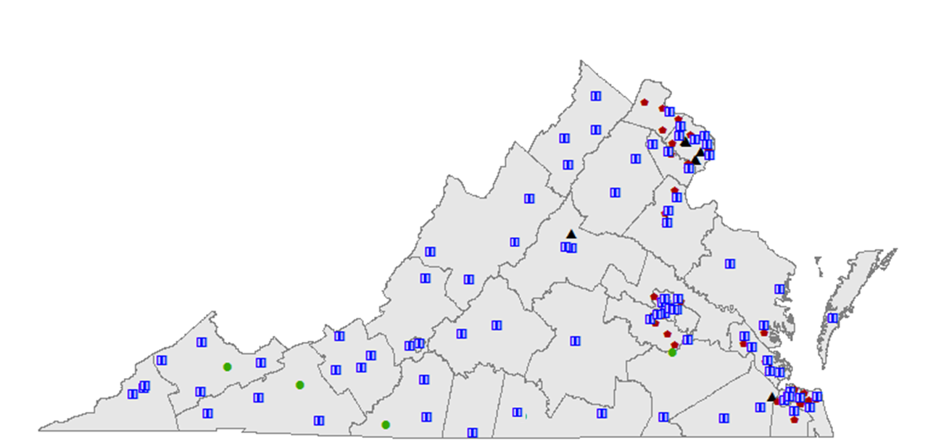
Syndromic Surveillance Coverage in VA
VDH receives data from 160 healthcare facilities
82 hospital EDs
13 free-standing EDs
65 urgent care centers

Slide 13
National Syndromic Surveillance
SyS is a public health surveillance strategy used by many other states, local jurisdictions, and CDC
CDC formed National Syndromic Surveillance Program (NSSP) in 2015
Previous version of program was called BioSense
VDH sends SyS data to NSSP
Agreements with healthcare facilities allow data submission to CDC to support national surveillance efforts
CDC provides ESSENCE version for analysis of data
VDH does not currently grant user access to data (aggregate or line level)

Slide 14
HOW Are Syndromic Surveillance data used?

Slide 15
Infectious Disease: Influenza-like Illness
SyS used during flu season to monitor influenza-like illness (ILI) as an indicator of the severity and spread of flu in the community
Defined as fever with cough or sore throat

Slide 16
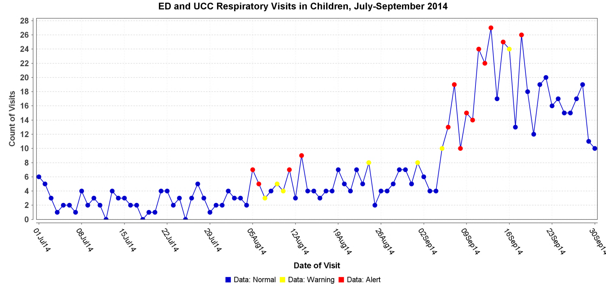
Infectious Disease: EV-D68
Enterovirus D68 is a respiratory illness that caused severe illness among children during fall 2014
Monitored respiratory complaints in children 0-17 who were admitted to inpatient acute care or transferred

Slide 17
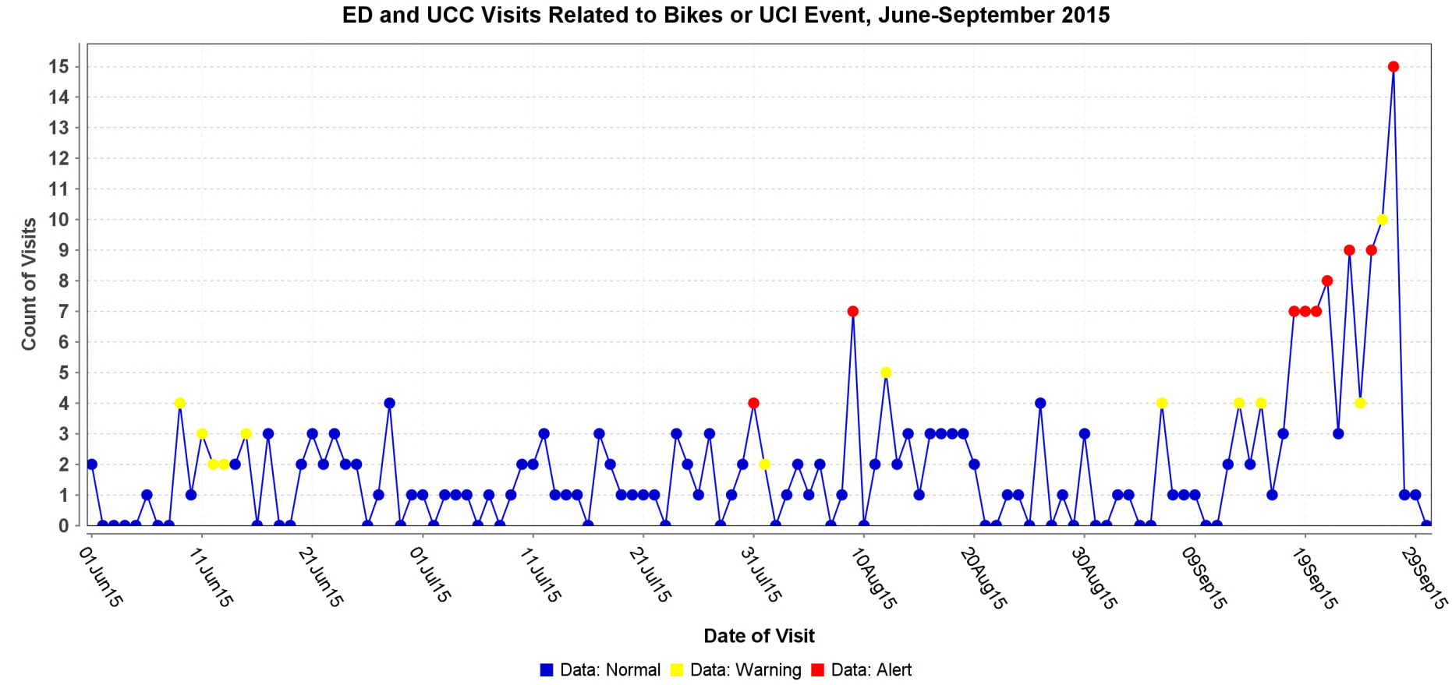
Mass Gathering: UCI Bike Race
International cycling championship held in Richmond in fall 2015
Monitored for bike crashes as well as patients mentioning attendance or participation in the event

Slide 18
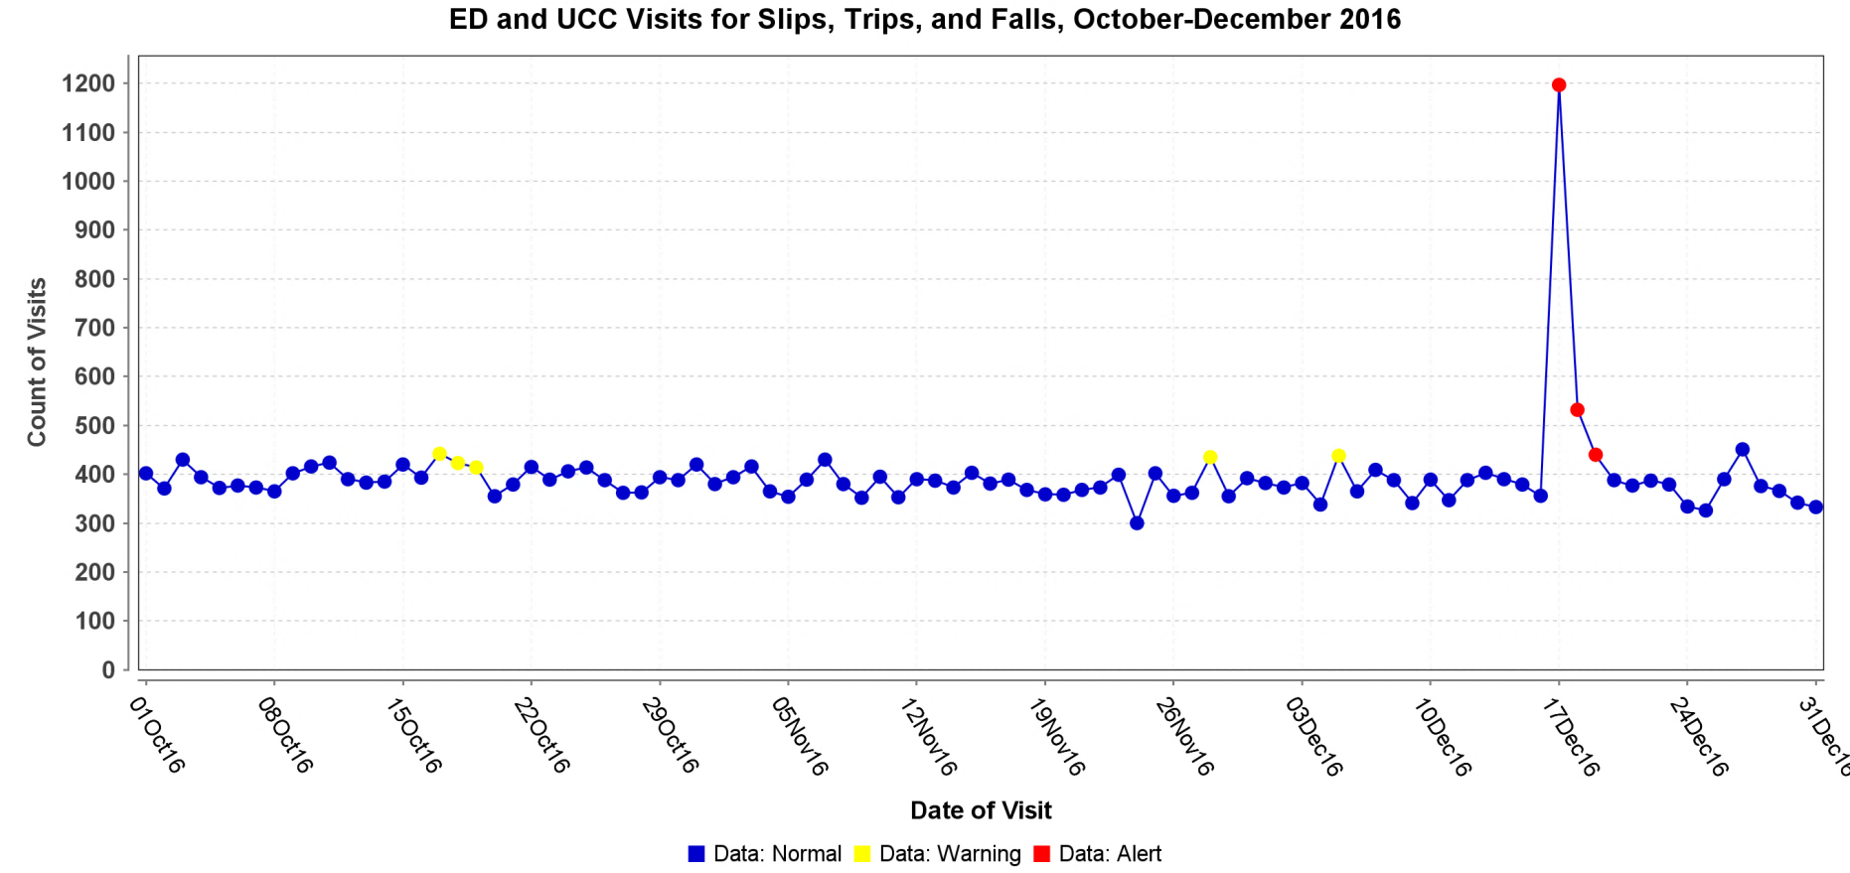
Extreme Weather: Winter Storm
Surveillance conducted for illness and injuries during extreme weather events (storms, flooding, heat waves, tornados)
Monitored visits for falls during winter weather in 2016

Slide 19
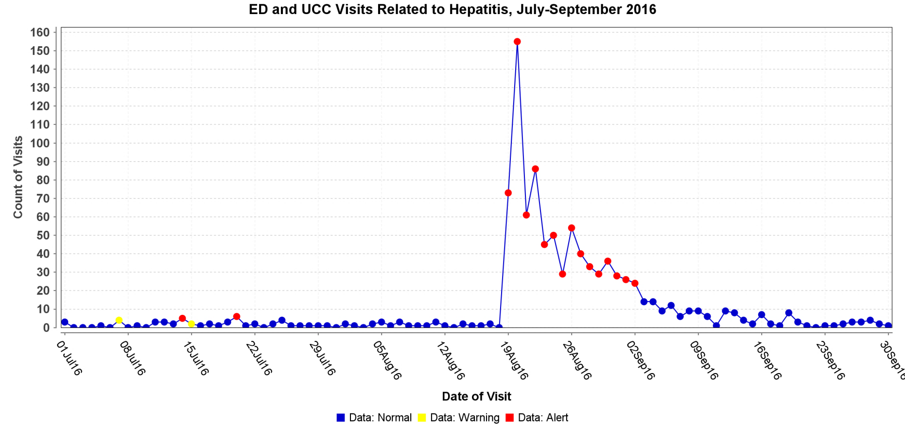
Disease Outbreak: Hepatitis A
Outbreak of hepatitis A across multiple states related to eating frozen strawberries in summer/fall 2016
Monitored number of visits indicating exposure or requesting testing after press release

Slide 20
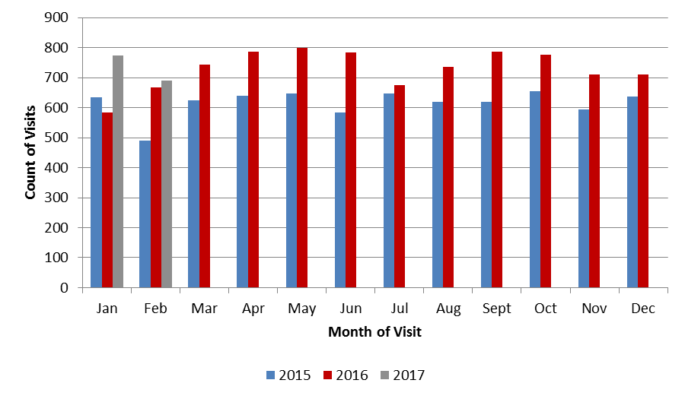
Emerging Issue: Opioid Overdose
Declared a Virginia Public Health Emergency in November 2016
Visits related to unintentional opioid/unspecified substance or heroin overdose are reported monthly

Slide 21
Public Health Response
Information sharing
Internal communication (situational awareness)
External communication (public report, media release)
Information gathering
Follow up with healthcare facility/infection preventionist for more information
Review electronic health record (where applicable)

Slide 22
Questions about syndromic surveillance or how the data are currently used?

Slide 23
Virginia syndromic surveillance advisory group (VSSAG)

Slide 24
Goal and Objectives of VSSAG
Goal is to increase understanding and use of syndromic surveillance data
Hold regular meetings to facilitate collaboration (minimum two per year)
Maintain diverse membership
Define a set of protocols for data sharing
Provide trainings to improve knowledge
Provide NSSP access to those eligible
Encourage use of SyS data to inform business practices
Obtain feedback on SyS data and reports
Evaluate success of advisory group
Notes:
Will plan to pass out hard copy of Goals and Objectives document

Slide 25
Objectives 1 and 2: Logistics
Convene regular meetings
Plan 2-4 meetings annually
Encourage attendance in person, but webinar option will be offered for all meetings
Maintain a diverse membership in VSSAG
Please let us know of other potential stakeholders who may be interested in participating

Slide 26
Objective 3: Data Sharing
Compile a set of best practices for data sharing among VSSAG members and VDH partners
Data sharing includes various formats:
Direct access to data through NSSP version of ESSENCE
Ideal for users with data science background
Summarized reports produced by VDH
Ideal for users with specific questions and limited time
Example: ED visits for drug overdose
Other formats may be identified through this group

Slide 27
Objective 4: Trainings
Trainings will be offered to VSSAG members and colleagues to improve knowledge of SyS practices and use of data
VDH will request input on format and topics for trainings
How to communicate syndromic surveillance findings and reports to organizational leadership, public
How to incorporate syndromic surveillance data with other previously utilized data sources
How to use NSSP ESSENCE for those individuals provided access

Slide 28
Objective 5: Access to SyS Data
VDH will provide access to the NSSP version of ESSENCE to VSSAG members as appropriate
Data sharing protocol and best practices will inform who receives access
Access role and level of detail may be limited by stakeholder type
Data user agreement and rules may be needed

Slide 29
Objective 6: Use of Data
Empower VSSAG members to use SyS data and reports shared by VDH in their normal business practices
Potential uses include:
Measure the health status of your local community
Compare your local community with state or other communities
Understand impact of public health issue on your organization
Capture burden placed on ED/UCC
Inform resource allocation and planning activities

Slide 30
Objective 7: Provide feedback
Feedback from VSSAG members will help improve VDH’s SyS program and strengthen its collaboration with partners
Are these data useful to you and your business practices?
How have you used these data?
How can VDH improve the reports/data it shares?
Do you have any recommendations for data quality, representativeness improvement, communication?
Do you have any innovative projects ideas using these data?

Slide 31
Objective 8: Evaluate
VDH would like to evaluate how its SyS program is doing
Will distribute “pre-assessment” survey in April to measure baseline
Evaluation surveys conducted annually to measure progress
Evaluation results will help identify:
Improvements to the VDH SyS program
Focus of future advisory group activities

Slide 32
Discussion
Notes:
See Word doc for more detailed questions to bring up during the discussion

Slide 33
Next Steps
Short pre-assessment survey will be distributed in April
Online survey - less than 10 minutes to complete
Next VSSAG meeting will be held in June
Will conduct poll to determine best dates for attendees
Please direct any questions or concerns to emily.stephens@vdh.virginia.gov or (804) 864-7254

