Slide 1
Virginia Syndromic surveillance Advisory Group
Fourth Meeting
September 11, 2018

Slide 2
Agenda
Introductions
Background
Syndromic Surveillance
VSSAG
Update on current syndromic projects
Data Quality Reports
Hurricane Florence
Influenza
Opioid Overdose
Department of Defense (DoD) data sharing pilot
Rural Health Network data sharing pilot?
Request for (non-VDH) VSSAG pilot users of NSSP ESSENCE
Next Call

Slide 3
Introductions
Arden Norfleet
Enhanced Surveillance Epidemiologist
Arden.Norfleet@vdh.virginia.gov
804-864-7264
Erin Austin
Enhanced Surveillance Coordinator
Erin.Austin@vdh.virginia.gov
804-864-7548
Em Stephens
Influenza Surveillance Coordinator
Emily.Stephens@vdh.virginia.gov
804-864-7254

Slide 4
Background - Syndromic Surveillance
Syndromic surveillance data include visits to emergency departments (EDs) and urgent care centers (UCCs)
Purpose: Improve health of a community through early detection of a public health issue
VDH epidemiologists and communicable disease staff use these data to:
Conduct epidemiologic analyses using ESSENCE tool
Monitor trends over time and geography, identify clusters in symptoms or diagnoses, and detect unusual health events

Slide 5
How are Syndromic Surveillance Data Used?
Influenza-like illness (ILI) and other seasonal illnesses
Weather-related or natural disaster events (hurricane, heat wave, earthquake)
Mass-gathering events (UCI Cycling World Championships, Presidential Inauguration, Vice Presidential Debate, Unite the Right Rally)
Conditions of public health concern (animal bites, drug overdose, injuries, meningitis, Lyme disease, vaccine preventable diseases)
Emerging health concerns (Zika virus) and outbreaks

Slide 6
What Data are Collected?
Facility Name
Visit Information:
Chief Complaint
Discharge Diagnosis
Discharge Disposition
Patient Demographics:
Date of Birth
Sex
Race and Ethnicity
Home Zip Code
Facility-specific patient identifier (often MRN)
Does NOT include direct patient identifiers such as patient name, SSN, or street level address
Notes:
Chief complaint – patient’s “reason for visit” or what symptoms they are reporting when they show up to the ER or urgent care center
Discharge diagnosis – physician assigned diagnosis
Discharge disposition – whether the patient was admitted to the hospital, transferred, or routinely discharged

Slide 7
Strengths and Limitations
Strengths:
Data available in near real-time (within 24 hours)
Situational awareness of population health status
Surveillance for a variety of public health issues
Limitations:
Difficulty detecting small scale events – “strength in numbers”
Lack of specificity in early health data
No regulations requiring reporting in VA, but federal incentive programs exist
→Proposal submitted w/in VDH
Notes:
The Enhanced Surveillance team did submit a proposal this year which would require all emergency departments in Virginia to participate in syndromic reporting. It was not accepted by the agency as a priority for this year – so no legislation is currently being pursed by VDH. We believe this is important for the sustainability of our program so we plan to continue to pursue this issue and will re-submit a proposal for consideration in 2019. We would be interested in hearing from you if you have any thoughts about this proposal.

Slide 8
Syndromic Surveillance and the CDC
CDC created the National Syndromic Surveillance Program (NSSP) to improve nationwide situational awareness using syndromic surveillance
Provide a cloud-based BioSense Platform, contains nationwide syndromic surveillance data and several analysis tools including ESSENCE
VDH participates in sending these data to NSSP
NSSP BioSense Platform exists outside the VDH firewall –> opportunity for data sharing with non-VDH partners

Slide 9
Background - VSSAG
Virginia Syndromic Surveillance Advisory Group (VSSAG)
Formed in 2017
Membership includes:
public health
state and federal partners
healthcare associations
academic stakeholders
healthcare facilities
Website: http://www.vdh.virginia.gov/surveillance-and-investigation/syndromic-surveillance/vssag/
Notes:
Formed in 2017 as part of grant activities with CDC.
Multidisciplinary group
State and local public health
State and Federal partners (state police, dbhds –dept. behavioral health, poison control, DoD)
VHHA, academics – research institutions

Slide 10
Why was VSSAG formed?
VSSAG Goal:
Increase the understanding and utilization of syndromic surveillance data among public health and healthcare partners for situational awareness of issues affecting public health and to inform their business practices.

Slide 11
VSSAG Objectives
Convene at a minimum two (2) meetings annually to facilitate information sharing and collaboration among public health and healthcare partners.
Maintain working group membership which will consist of public health, healthcare, and health data partners who could benefit from syndromic surveillance data sharing.
Define best practices and methodologies for syndromic surveillance data sharing with public health and healthcare partners by VDH.
Improve knowledge of syndromic surveillance among working group members through trainings and use cases.
Provide access to syndromic surveillance data to appropriate working group members through the National Syndromic Surveillance Platform (NSSP) ESSENCE.
Empower working group members to use syndromic surveillance data in their business practice as a situational awareness tool.
Obtain feedback from working group members on the utility and ease of use of syndromic surveillance data and reports provided by VDH.
Evaluate the success of increasing knowledge and use of syndromic surveillance data within the working group.
Notes:
Convene regular meetings
Maintain a diverse membership
Data sharing best practices
Trainings
Provide access to SyS data
Empower to use data
Provide feedback
Evaluate

Slide 12
Syndromic surveillance Project Updates

Slide 13
Project #1 - Data Quality Reports
Specific to each healthcare system
To be provided semi-annually
Quarterly visit counts for each facility
Summary Data Quality Measures:
Completeness
Validity
Timeliness
Notes:
In order to encourage engagement with our reporting facilities and indicate areas in need of data quality improvement we developed data quality reports.

Slide 14
Project #1 - Data Quality Reports

Slide 15
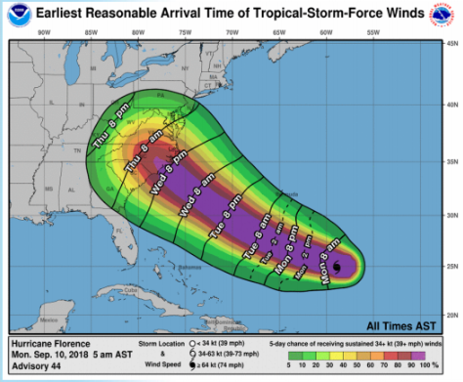
Project #2 – Hurricane Florence Prep
Provide situational awareness during emergencies
Use storm-specific dashboards and queries in ESSENCE
Assess impact of storm conditions, resulting power loss, and evacuations

Slide 16
Project #2 – Hurricane Florence Prep
Health and Safety:
Injury
Near-drowning and drowning
Hurricane-specific terms (e.g. hurricane, storm, Florence, flooding)
Power loss:
Heat-related illness
Carbon monoxide exposure
Food-borne illness
Evacuation:
“displaced” patients, dialysis, animal bites, prescription refills, and seizures
Notes:
Informed by surveillance findings during evacuations in Florida during Hurricane Irma and Texas during Hurricane Harvey.

Slide 17
Project #3 – Influenza Surveillance
Syndromic surveillance used to determine burden of influenza-like illness (ILI) during flu season
ILI defined as chief complaint containing fever with either cough or sore throat
Presented as a percentage of total visits
Statewide coverage allows for situational awareness across the state and among age groups
ILI is used in combination with other data sources to determine weekly influenza activity level
Helps determine geographic spread

Slide 18
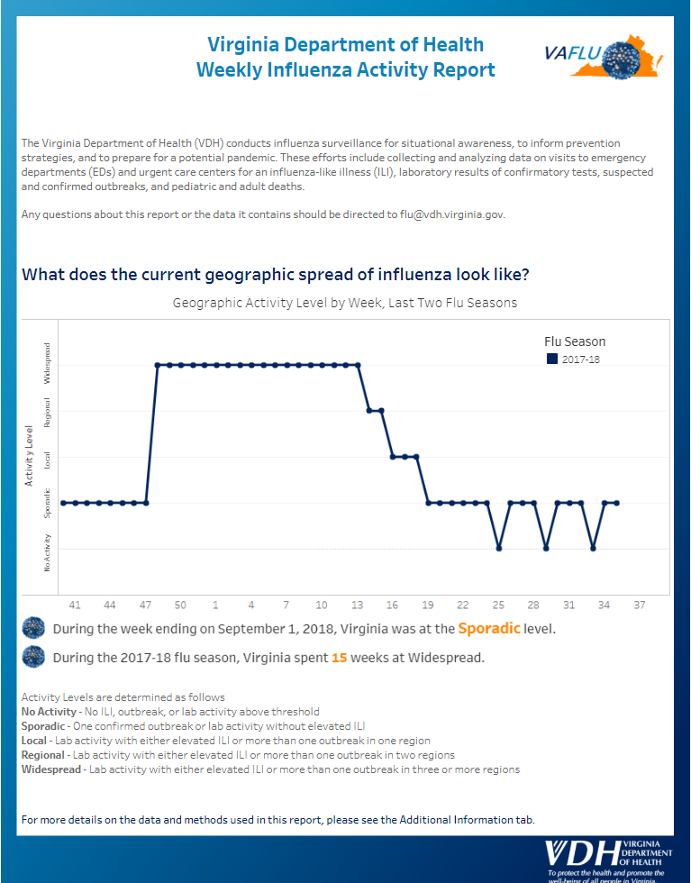
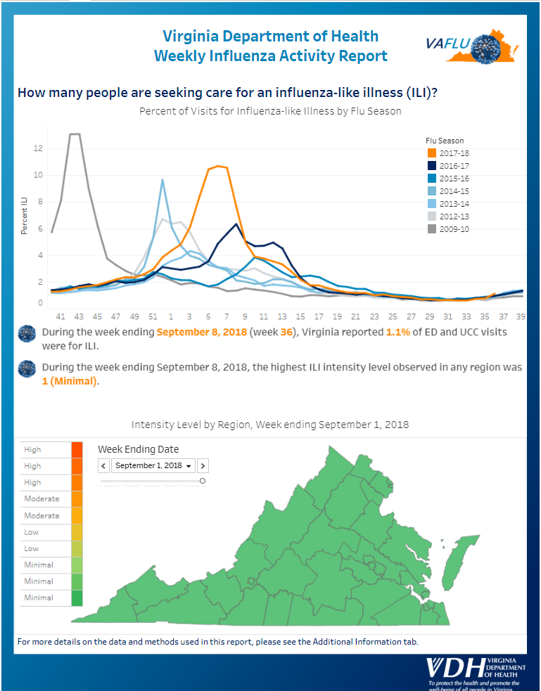
Project #3 – Influenza Surveillance

Slide 19
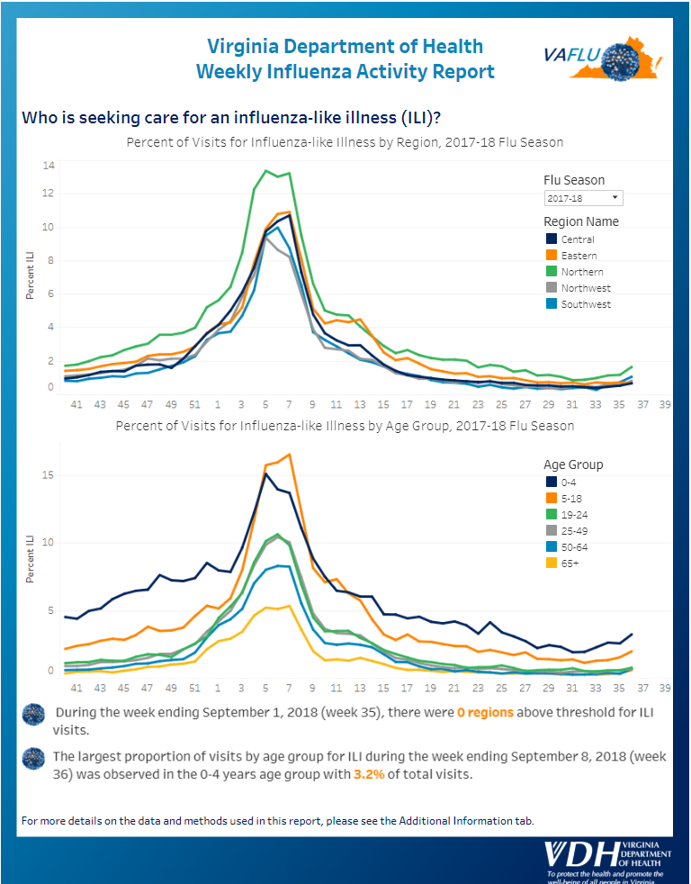
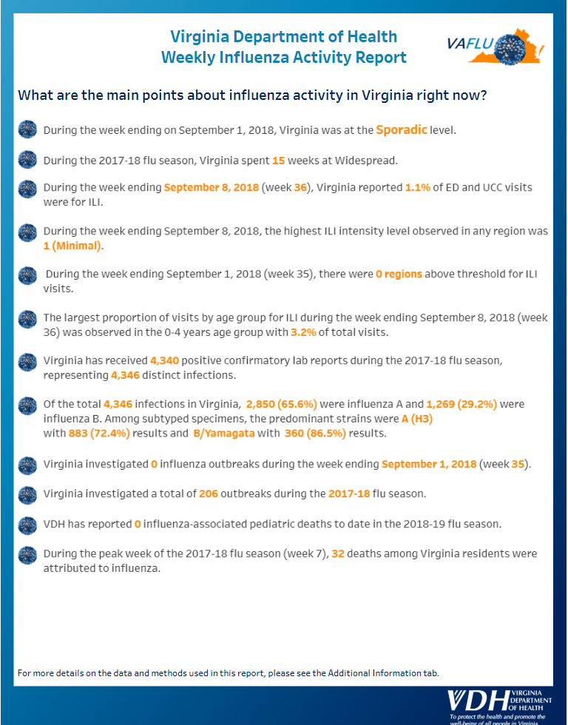
Project #3 – Influenza Surveillance

Slide 20
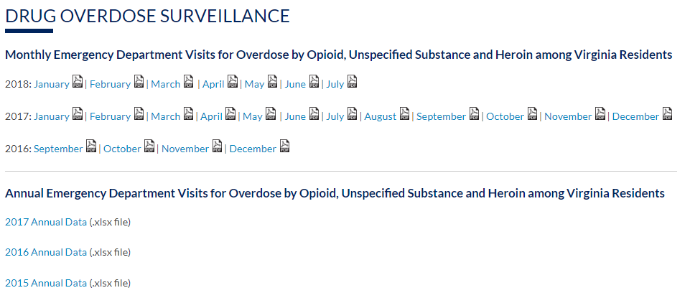
Project #4 – Opioid Overdose
Report posted monthly to VDH website:
http://www.vdh.virginia.gov/surveillance-and-investigation/syndromic-surveillance/drug-overdose-surveillance/

Slide 21
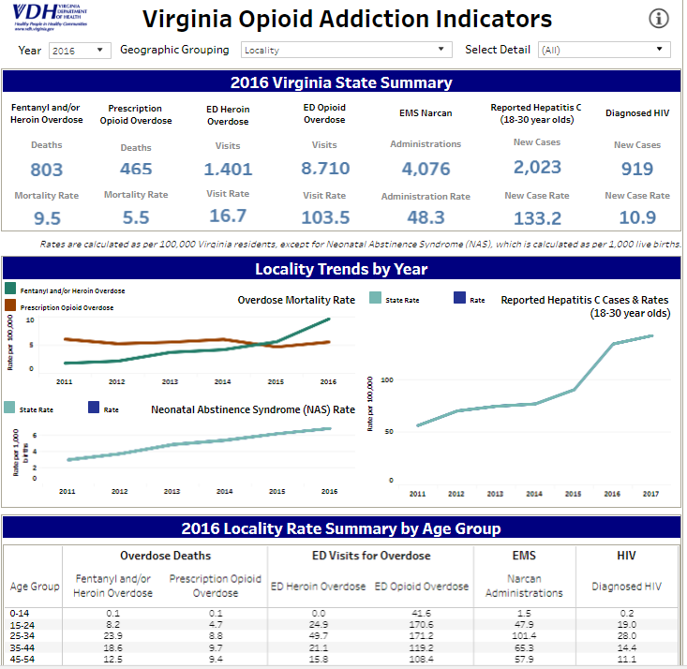
Project #4 – Opioid Overdose
Syndromic surveillance data included in VDH Opioid Addiction Dashboard: http://www.vdh.virginia.gov/data/opioid-overdose/

Slide 22
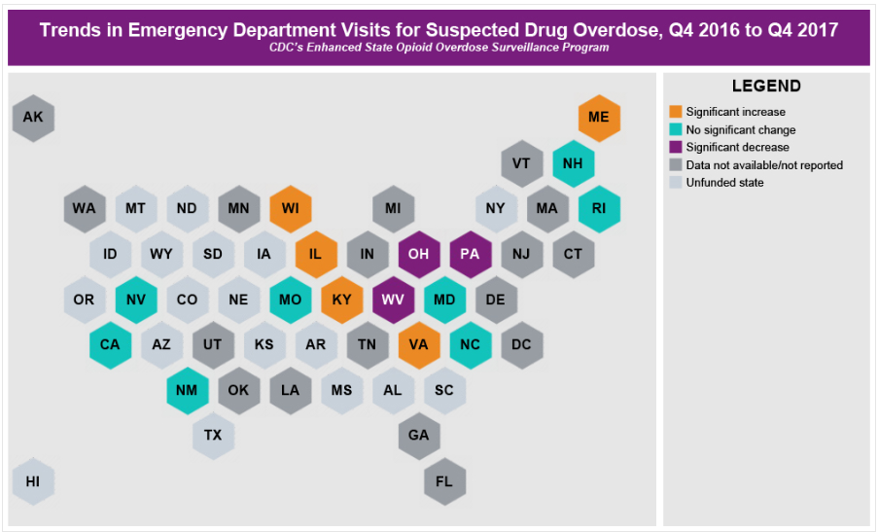
Project #4 – Opioid Overdose
VDH syndromic surveillance data sent to CDC to inform national picture: https://www.cdc.gov/drugoverdose/data/nonfatal.html
Notes:
CDC’s Enhanced State Opioid Overdose Surveillance (ESOOS) program captures different types of data for both fatal and nonfatal overdoses.

Slide 23
Project #5 – DoD Data Sharing Pilot
Department of Defense (DoD) and VDH
Aggregate level data sharing via NSSP ESSENCE
Objectives:
More comprehensive view of medical care visits in Virginia among military and civilian populations
Increase communication between DoD public health officials and VDH local health dept
Develop procedures for data sharing, data access & communication

Slide 24
Project #5 – DoD Data Sharing Pilot
18 DoD medical facilities participating
Visits include active duty and beneficiaries
7 VDH Local Health Districts (34 facilities):
Chesapeake
Hampton
Norfolk
Peninsula (contains Newport News)
Portsmouth
Prince William (contains Quantico)
Virginia Beach

Slide 25
Project #5 – DoD Data Sharing Pilot
Currently:
Notifying healthcare facilities in pilot area
Establishing communication protocol
Next steps:
Begin data sharing (late Sept)
2 month pilot - regular weekly communication b/w VDH local epis and DoD contacts
Assess challenges and lessons learned
Expand to rest of state and nationally?

Slide 26
Project #6 – Rural Health Network
Preliminary discussions around a second data sharing project through the NSSP
Virginia Rural Health Association (VRHA)
Rural Health Network Development Planning Program grant opportunity through Health Resources and Services Administration (HRSA)
Aim to strengthen rural health care network among Virginia’s critical access hospitals

Slide 27
Volunteer time!

Slide 28
Request for VSSAG NSSP Pilot Users
Objectives
Grant NSSP data access to pilot VSSAG members
Use syndromic data to inform action within organization
Help VDH finalize the NSSP Virginia User Policy (data usage expectations and data access levels)
Assess successes, challenges, and lessons learned
Looking for VSSAG pilot users to be given NSSP access
1 health care facility user
1 non-healthcare facility user
Notes:
Action can include communication or email (does not need to be formal actions)
Access levels dependent on role. According to the VSSAG user policy (on website) line level for healthcare user and aggregate for non-reporting partner.
Questions:
We want this pilot to assess trends that are actionable. Is ILI a good pilot use case or is there a different seasonal trend or health issue you would like to monitor? Is 1 month an appropriate time frame – too long? Too short?

Slide 29
Request for VSSAG NSSP Pilot Users
Expectations
Data access for 1 month (beginning mid-Oct)
Receive NSSP ESSENCE training
Perform surveillance and communication w/in organization (multiple times a week)
→ILI surveillance?
Summarize uses, challenges, and lessons learned
Notes:
Looking at October 15th as a start data for giving data access.
Want to focus on one use case to monitor. Pilot users can agree on one specific use case that works for both of them.

Slide 30
Next VSSAG Meeting
5th VSSAG meeting: early December
DoD and VSSAG data sharing pilots:
Successes
Challenges
Recommendations for future data sharing
Finalize NSSP user roles and data access rules
Notes:
Will send out poll in November to set a firm date, but looking at 1st week of December.

Slide 31
Questions?
Feel free to send questions to the VDH Enhanced Surveillance team at syndromic@vdh.virginia.gov
Notes:
Are you comfortable receiving our next update on the call in December, or would you like more frequent communication from us. Interim updates on the pilot projects or syndromic reports?

