Slide 1
Virginia Syndromic Surveillance Advisory Group (VSSAG) Pilot Kick-Off Call
January 9, 2019

Slide 2
Agenda
Pilot Goals
Pilot Expectations
Pilot Role-Based Access
NSSP ESSENCE Demo
Confirm Paperwork/NSSP Accounts/Data Access

Slide 3
Pilot Goals
Grant NSSP data access to pilot VSSAG members
Visit level access
Aggregate count level access
Use syndromic data to inform action within organization
Help VDH finalize the NSSP Virginia User Policy (data usage expectations and data access levels)
Assess successes, challenges, and lessons learned
Notes:
Security considerations
Training needs
Other information you need to make decisions
Data details?

Slide 4
Pilot Expectations
Dates: Jan 9, 2019 – Feb 6, 2019 (4 weeks)
NSSP data access and supervisor approval forms
Kick-off call: 1/9/19
Weekly:
Log into NSSP ESSENCE (at minimum once per week)
Assess ILI dashboard (5-10 minutes)
Share information internally as needed
Complete weekly online survey (5 minutes)
Wrap-up call: 2/6/19
Notes:
Around 15 minutes per week minimum
If we find there is need for a touch base call mid-way through the pilot then we can schedule as needed

Slide 5
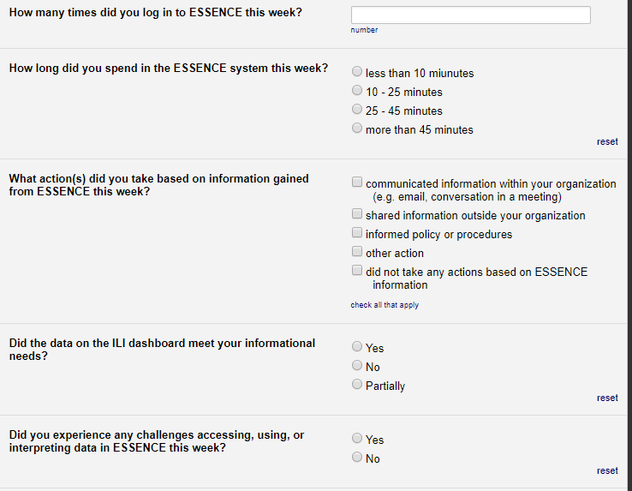
Weekly Online Survey
Online survey to be completed by Wednesday each week
Notes:
https://redcap.vdh.virginia.gov/redcap/surveys/?s=89KMLNPCM7
I will send out a reminder email each Tuesday with the link to the survey
4 times, less than 5 minutes
Gauging how often you are using ESSENCE, how long in the system, if you are taking any actions based on what you see, and any challenges you are experiencing

Slide 6
User Policy Role-Based Access
Defined by the NSSP BioSense Platform - Virginia User Policy
Public Health Epidemiologist
Healthcare/Hospital Epidemiologist/Infection Preventionist
Emergency Preparedness Coordinator
Other State or Federal Government Data Scientist
Public Health Researcher
Notes:
There are 5 access roles defined by the NSSP BioSense Platform Virginia User Policy for authorized Virginia users.
User access roles are determined by the users’ job duties and organization.
Defines the level of data access (aggregate or data details) each user may receive.

Slide 7
User Policy Role-Based Access
Name | Organization | NSSP Access Role | Access Level(s)
Julia Gohlke | Virginia Tech | Public Health Researcher | Statewide aggregate
Kelly Parker | VHHA | Emergency Preparedness Coordinator | Statewide aggregate
Morris Reece | VHHA | Emergency Preparedness Coordinator | Statewide aggregate
David Vaamonde | VHHA | Public Health Researcher | Statewide aggregate
Andrea Chapman | Sentara Martha Jefferson | Healthcare/Hospital Epidemiologist/IP | Statewide aggregate and data details for Martha Jefferson Hospital
Stuart Hutter | UVA Health System | Healthcare/Hospital Epidemiologist/IP | Statewide aggregate and data details for UVA Hospital
John Strazzullo | Patient First | Healthcare/Hospital Epidemiologist/IP | Statewide aggregate and data details for Patient First Urgent Cares
Colleen Ryan-Smith | VDH - Arlington Health District | Public Health Epidemiologist | Statewide aggregate and data details for Arlington Health District
Notes:
8 pilot volunteers:
4 statewide aggregate access only – daily visit counts aggregated at the statewide level
4 with jurisdictional data details access - daily visit counts aggregated at the statewide level + visit details for your jurisdiction

Slide 8
ESSENCE Demo

Slide 9
Logging Into ESSENCE
Access & Management Center (AMC): https://amc.syndromicsurveillance.org/NSSP_AdminTool/login
Initial account setup
Password/username help
Be sure to check spam or trash folder!
Notes:
Must log in through the Access and Management Center (AMC) when setting up your account
Emails from the system are often flagged as spam, so be sure to check your spam or trash folder if you are trying to reset your password.
The NSSP AMC allows you to reset your password or retrieve your user name if you have trouble logging in.

Slide 10
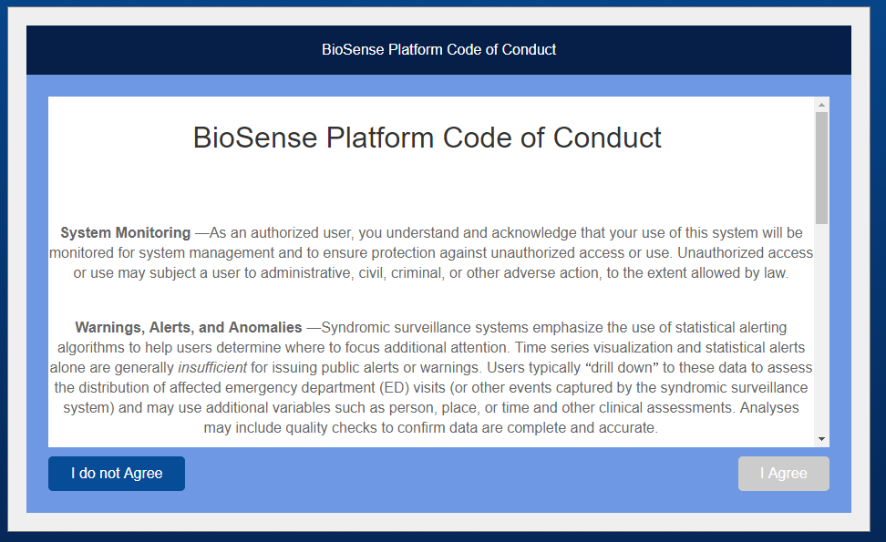
Logging Into ESSENCE
Access & Management Center (AMC):
Notes:
You will be required to agree to the BioSense Platform Code of Conduct upon first creating your account or after resetting your password.

Slide 11
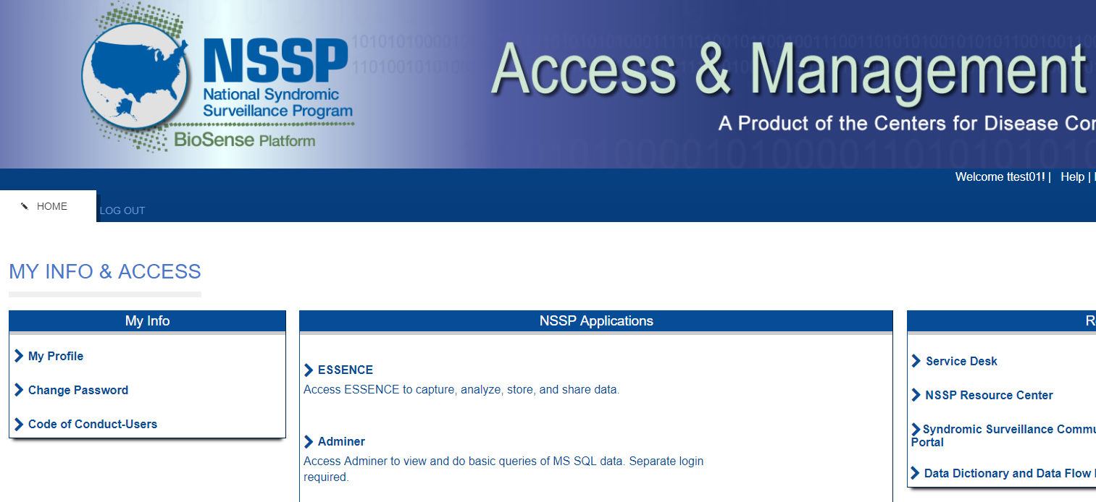
Logging Into ESSENCE
Access & Management Center (AMC):
Notes:
Within the AMC, click the ESSENCE hyperlink under “NSSP Applications” to log into ESSENCE.

Slide 12
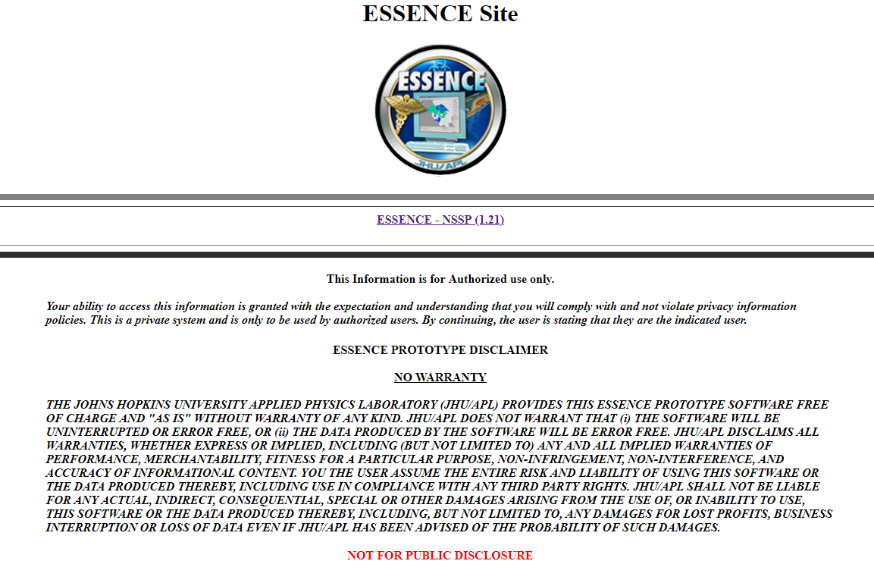
Logging Into ESSENCE
Login Page: https://essence.syndromicsurveillance.org/
Notes:
You may want to bookmark the direct link to the ESSENCE login page: https://essence.syndromicsurveillance.org/
Click on “ESSENCE – NSSP (1.21)” in the middle of the screen
Log in by using your NSSP-provided user ID and password (figure 1). These are the same credentials used for the Access & Management Center.

Slide 13
ESSENCE Home Page
Only use Google Chrome when using ESSENCE
Notes:
Be cognizant of logging out or locking your screen
Main menu in tabs at top of screen
Use Google Chrome
Because the pilot is very limited in scope, I am only going to walk you through a few key functions using ESSENCE and the MyESSENCE dashboards.
If you are interested in exploring ESSENCE further I would be happy to do one-on-one training or direct you to NSSP ESSENCE training resources.

Slide 14
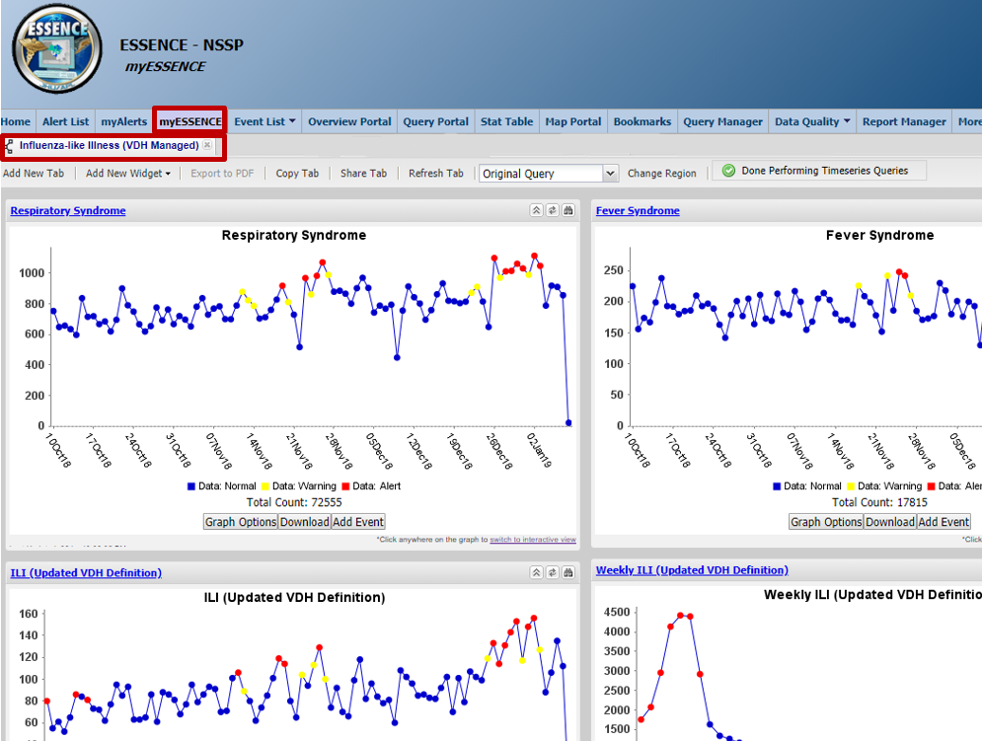
myESSENCE – ILI Dashboard
TIME SERIES GRAPHS:
Respiratory
Fever
Influenza-like Illness (ILI)
Weekly ILI
ILI stratified by age
0 – 4 years
5 – 18 years
19 – 24 years
25 – 49 years
50 – 65 years
65+ years

Slide 15
myESSENCE - Helpful Tips
By default, graphs display daily visit counts over the previous 90 days
Today’s data count will be artificially low
Red or yellow data points indicate a significant increase in visits (yellow= p-value<0.05; red= p-value<0.01).
Hovering over a data point displays:
date of visit
number of visits
expected number of visits
p-value of alert
statistical algorithm used to determine the p-value
Use the “refresh tab” button or reload the page if not loading correctly
MyESSENCE is considered one page; refreshing or navigating back will take you to the first tab
Open links you need to explore in a new tab or window
Notes:
By default the time series show the last 90 days
Today’s data count will always be lower because all the data has not yet been received (some send every two hours but others only twice a day or daily)
Red alert = significance level of 1% (p-value < 0.01)
Yellow alerts = significance level of 5% (p-value < 0.05)
Refresh tab button if not loading correctly
Open links you need to explore in a new tab or window

Slide 16
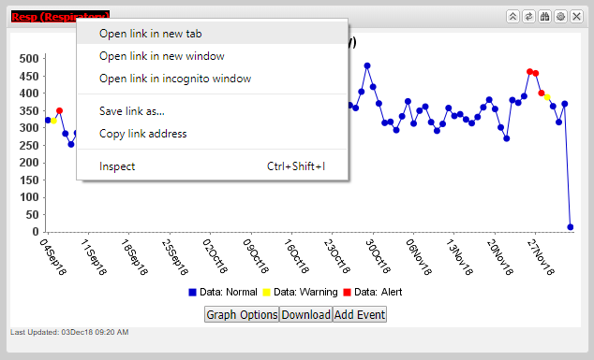
Analyze a myESSENCE Time Series
To further analyze a myESSENCE time series graph: right click on the hyperlinked name of the graph of interest and select “open link in new tab”

Slide 17
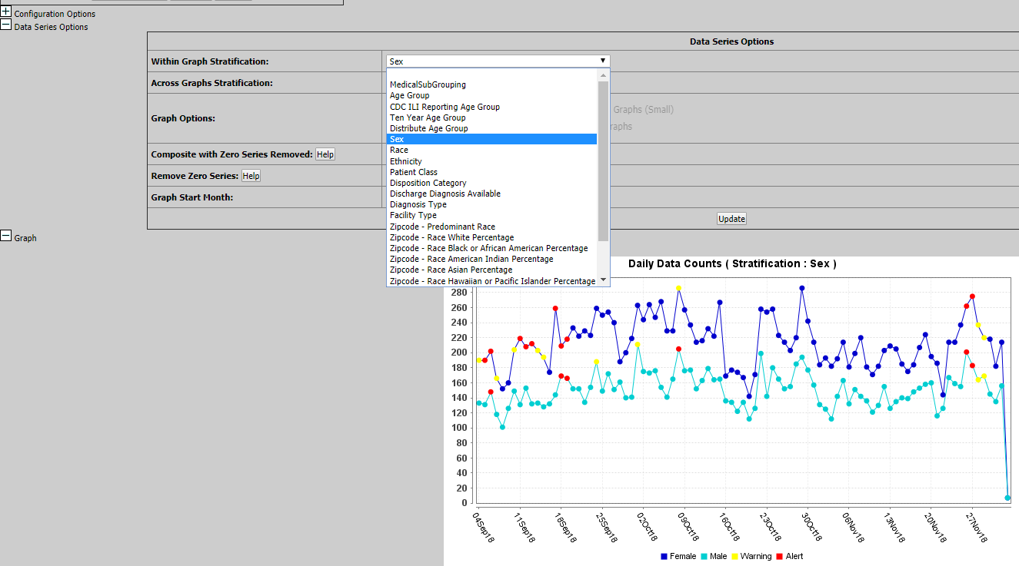
Stratify a Time Series
Select “Data Series Options”
Stratify by race, age group, sex, etc. within the same graph or as separate graphs

Slide 18
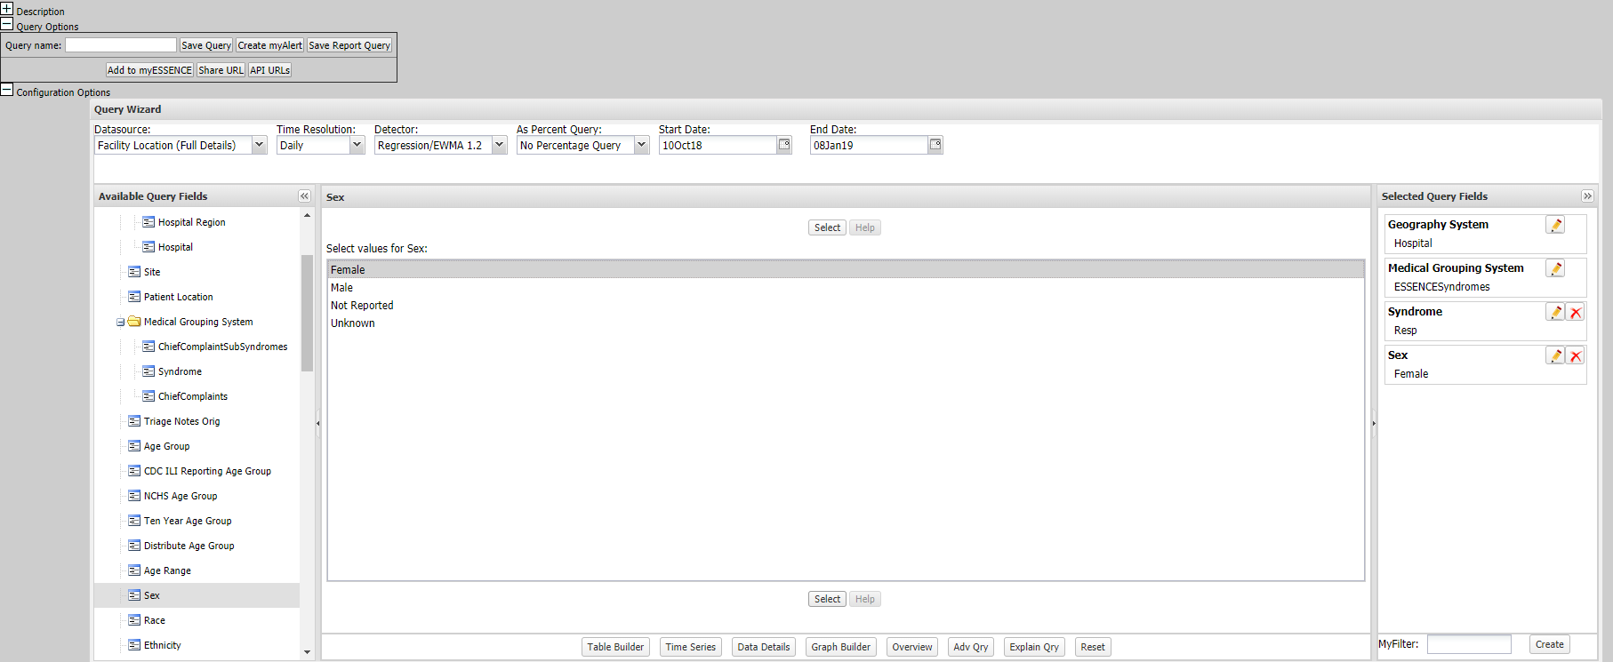
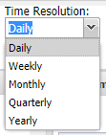
Modify a Query/Time Series
Select “Configuration Options”
Modify: time resolution, date range, age, sex, etc.
Can also change the display of query results (time series or data details)
Notes:
“Configuration Options” allows you to modify the query parameters without starting from scratch.
To modify a query or time series graph: select “Configuration Options”
Across the top of the Query Wizard you can modify the time resolution (i.e. daily, weekly, monthly) and date range
Select from “Available Query Fields” to modify any other query parameters: add age restrictions, disposition categories, select certain hospitals or patient location, etc.
You can also change the display of query results (time series or data details)

Slide 19
View Visit Details:
To view visit details: right click on the data point of interest and select “open link in new tab”
Right click the data point and select “view
Notes:
IF you have access to data details…

Slide 20
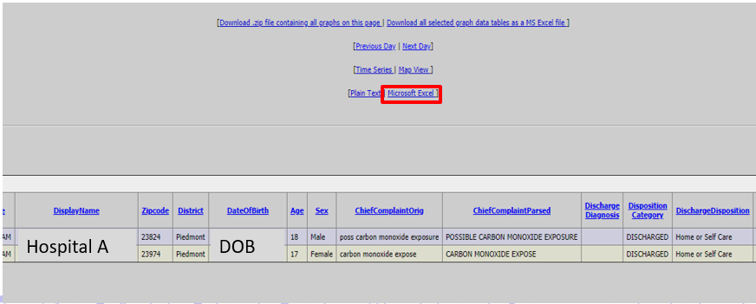
Export to Excel:
To export visit details to Excel: select the “Microsoft Excel” hyperlink

Slide 21
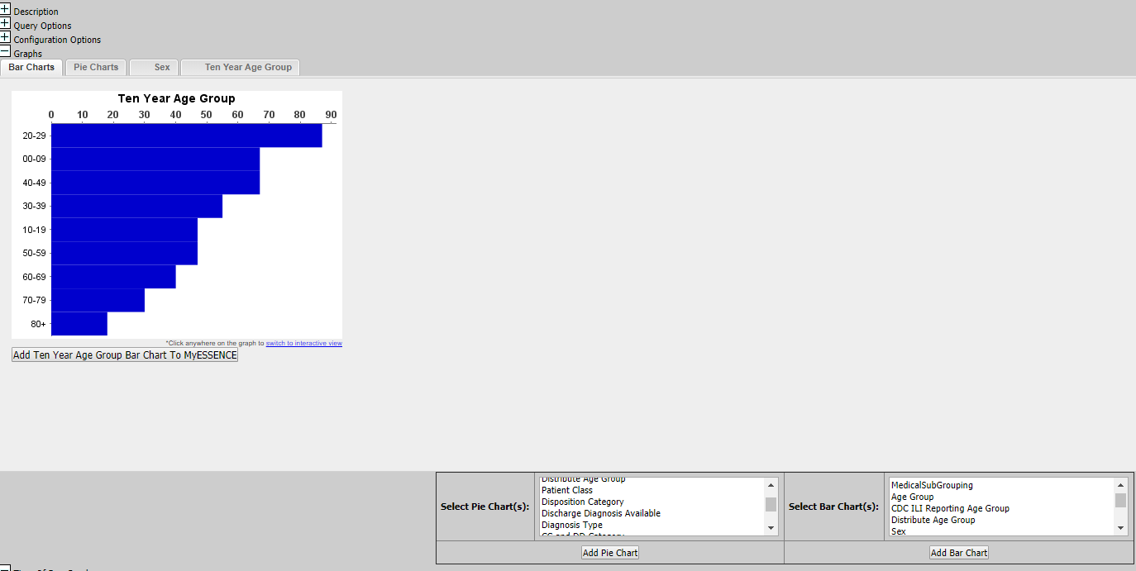
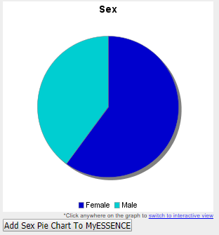
Graph Visit details
To graph visit details: select “Graph”
Select race, age group, sex, etc. as a Pie Chart or Bar Chart

Slide 22
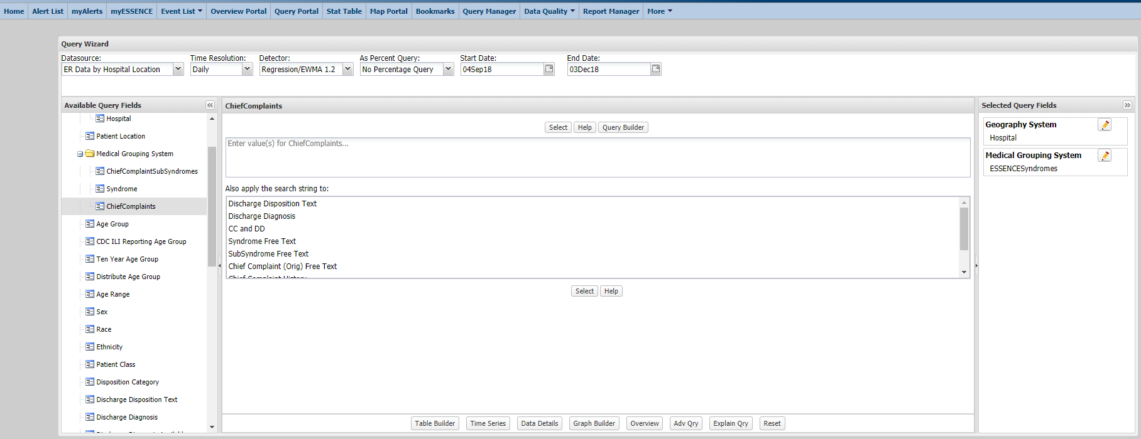
Query Portal – Building A Query
“Query Portal” allows you to build a query from scratch
Set the Data Source, Time Resolution, Date Parameter and any other Available Query Fields
ESSENCE User Page provides a list of free-text queries for your use!
Notes:
ESSENCE provides pre-built syndromes, sub-syndromes, and CC+DD categories
Free-text queries for “ChiefComplaints” or “CC and DD” are what allow the ESSENCE system to be so flexible and robust, but it does involve a more advanced skill set as it require a specific formatting
There is information on how to format free text queries in the NSSP Resources portion of the AMC
We recommend first emailing syndromic@vdh.virginia.gov to see if free-text queries for your questions already exist or for guidance writing your own free-text query.

Slide 23
VDH Influenza Surveillance Report
VDH publishes a weekly influenza activity report that includes
% ED and urgent care visits with ILI
Confirmatory lab tests for influenza
Reported outbreaks of influenza
http://www.vdh.virginia.gov/epidemiology/influenza-flu-in-virginia/influenza-surveillance/

Slide 24
Next Steps
Complete data access form
Supervisor completes confirmation step
Receive “BioSense Platform Access and Management Center Account Created” email and follow steps to activate account
Check spam folder!
Log into ESSENCE and confirm data access
Start using the data!

Slide 25
QUESTIONS?
Arden.Norfleet@vdh.virginia.gov

