Slide 1
Incidence of acute kidney injury in oncology patients receiving piperacillin-tazobactam and vancomycin
Jennifer Walters, PharmD
PGY-1 Pharmacy Practice Resident
Virginia Commonwealth University Health System

Slide 2
Disclosure
The authors and contributors of this project have no conflicts of interest to disclose.
Notes:
First, I’d like to mention that none of the authors or contributors of this projects have any conflicts of interest to disclose

Slide 3
Background
Acute Kidney Injury (AKI) defined by
Risk, Injury, Failure, Loss of Kidney Function, and End-Stage Kidney Disease (RIFLE) - 2002
Acute Kidney Injury Network (AKIN) - 2007
Kidney Disease: Improving Global Outcomes (KDIGO) - 2012
~2% prevalence in non-critically ill
1-year risk in hospitalized oncology patients ~17%
Increased morbidity and mortality
Pharmacotherapy: A Pathophysiologic Approach, 10e, McGraw-Hill Education
Kidney Intl Supplements. 2012;2(1): 1-138
Notes:
To start off with a little background, AKI is typically defined by 1 of 3 major criteria used, either
RIFLE, 2002: looked at SCr, GFR, and UOP acutely as well as longer term, but did not take RRT into consideration
AKIN, 2007: only diagnosed AKI after adequate hydration and did not rely on changes in GFR changes (only SCr and UOP); but did take into account RRT
KDIGO, 2012: combines aspects of RIFLE and AKIN
AKI is an important issue to discuss, because of the frequency of occurrence in the hospital setting
~20% prevalence of AKI in all hospitalized pts, but when look at noncritically ill patients, it’s about ~2% —KDIGO AKI guidelines
-1 yr risk of AKI in hospitalized oncology patients has been reported to be ~17%
-There is an increased risk of morbidity and mortality associated with AKI
-Patients who survive and recover from an episode of severe AKI are at an increased risk of later developing CKD and end-stage renal disease and there is even evidence of CKD mortality associated with AKI occurrence
**NEXT**
requiring dialysis are at increased risk for the later development of dialysis-requiring end-stage kidney disease. –harrisons
Per KDIGO guidelines→ evidence of long-term risk of subsequent development of CVD or CKD mortality, even after apparent resolution of AKI
[Multiple studies have demonstrated an increase in the risk of chronic kidney disease (CKD) and end-stage renal disease (ESRD) among patients who recover from AKI (UTD) ]
RIFLE, 2002: looked at SCr, GFR, and UOP acutely as well as longer term (L->4 weeks, E->3mo); limitations: requires baseline SCr (may not be known, can est with MDRD—but MDRD in pts with stable renal function, not AKI), requirement for RRT not considered
AKIN, 2007: AKI dx only after adequate hydration and excl urinary obstruction; only relies on SCr and UOP, not GFR changes; baseline SCr not necessary, but requires 2 SCr values within 48hrs, takes into account RRT in stage 3, but removes the L/E; limitations: limited to 48 hr window of identification

Slide 4
Risk Factors
Chronic Comorbidities
Diabetes mellitus
Renal Dysfunction
Chronic kidney disease
Albuminuria
Heart or liver disease
Acute Dysfunction
Acute decompensated heart failure
Sepsis
Hypotension
Dehydration
Non-Modifiable
Males
Advanced age
African American
Cancer-specific
Multiple myeloma
Other
Major surgery
Renal infiltration
Urinary obstruction
Neoplasia-associated glomerulopathies
Nephrotoxic medications
Induction chemotherapy
Pharmacotherapy: A Pathophysiologic Approach, 10e, McGraw-Hill Education
Clin J Am Soc Nephrol. 2012;7:1713-1721.
Notes:
You can read the many RF for developing an AKI here, but I’d like to highlight those associated with Cancer specifically, such as…..induction chemotherapy for ALL/AML
And of course *CLICK* concomitant nephrotoxic medications in general, such as piperacillin-tazobactam and vancomycin put patients at an increased risk
-These 2 medications are commonly used as empiric therapy in the hospital setting to treat a variety of infections because of its wide spectrum of activity (anaerobes, MRSA, pseudomonas, etc)
**NEXT**

Slide 5
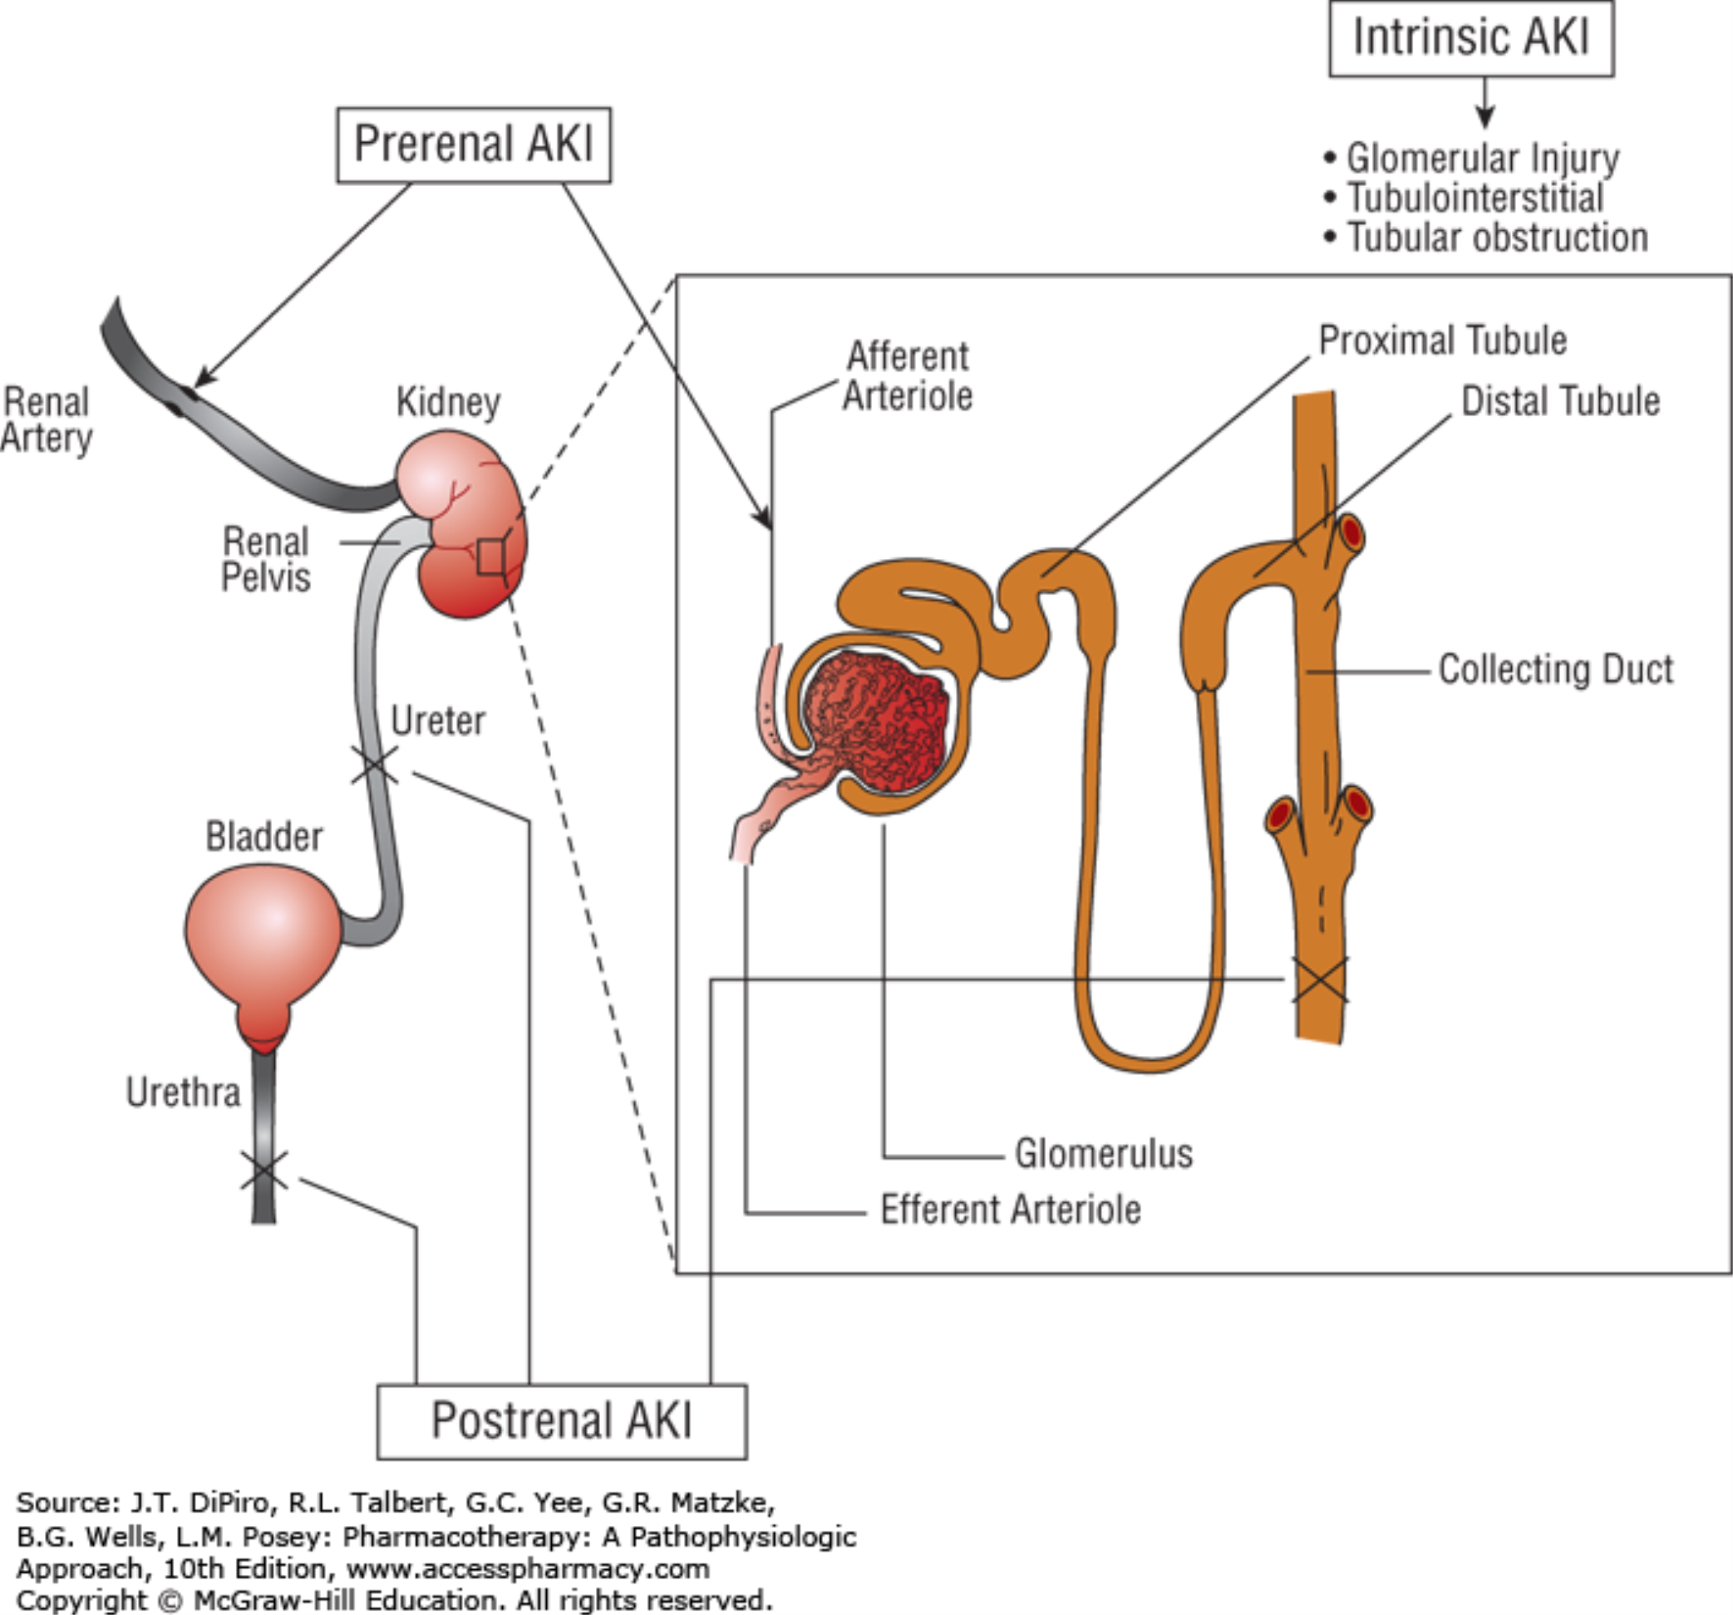
Risk Factors
Piperacillin-tazobactam
Vancomycin
Pharmacotherapy: A Pathophysiologic Approach, 10e, McGraw-Hill Education
Clin J Am Soc Nephrol. 2012;7:1713-1721.
Notes:
Physiology of AKI categorized into: Prerenal (CO, volume), Intrinsic (glomerulonephritis, tubular injury, AIN, vascular damage), and postrenal (urinary obstruction)
-Both vancomycin and an PTZ’s mechanism of AKI thought to be through an intrinsice AKI
-zosyn→ acute interstitial nephritis = which essentially is an inflammatory process in the kidney interstitium that cause renal lesions leading to a decline in renal function
-vanc’s exact MOA unknown, thought to be through AIN or Acute tubular necrosis (ATN) that is dose-related due to accumulation in the proximal tubule leading to cellular necrosis and glomerular destruction
-This is important because it is estimated that anywhere between 30% and 70% of patients may not recover their baseline renal function if they develop an AKI due to AIN
*Next slide*
-Mechanism of AKI for Combo therapy is unknown, but thought an additive effect from AIN and direct cellular necrosis with concomitant use
Patients who are at higher risk for permanent damage include elderly or those who develop more severe disease including azotemia, oliguria, or need for dialysis.
Major surgery-esp cardiac
-volume depletion- N/V/dehydration

Slide 6
Literature
 | Study Design | Population | Study Groups | Results [95% CI]
Meaney et al, 2014¹ | Retrospective, chart review | N=125 Non-critically ill patients | Vanc vs. VPT | VPT vs. Vanc : aOR 5.36 [1.41-20.5], p=0.014
Kim et al, 2015² | Retrospective, chart review | N=228 Non-critically ill patients | Vanc or PT vs. VPT | Vanc vs. VPT: OR 0.14 [0.04-0.52], p=0.004 PT vs. VPT: OR 0.15 [0.03-0.83], p=0.03
Anderson et al, 2017³ | Retrospective, chart review | N=455 Non-critically ill patients | Vanc vs. VPT | VPT vs. Vanc: 24% vs. 11%, p<0.001
VPT = Vancomycin + piperacillin/tazobactam
PT = piperacillin/tazobactam
Vanc = vancomycin
1. Pharmacotherapy. 2014;34(7):653-3661.
2. BMC Res Notes. 2015;8:579.
3. Military Medicine. 2017;182:e1773-1778.
Notes:
When reviewing the published literature over the last several years, I found many studies looking at AKI rates with concomitant use in the non-critically ill populations…as you can see from the 3 listed here, all were retrospective reviews in hospitalized non-critically ill patients and all 3 studies found significantly higher rates or odds of developing an AKI with combination vanc + pip/tazo therapy compared to either abx alone
-There have been many other studies published looking at AKI rates with combo therapy in the critically ill populations as well, but none specifically in the oncology population
*NEXT*
Average of 4 studies in noncritically ill around 24% incidence
I found a few studies that specifically looked at the non-critically ill population
-In this first study by Balci and colleagues, it was a single, center, retrospective cohort study at a tertiary care hospital from Jan 2012-Dec 2013 that was investigating the Rate of AKI defined by the AKIN criteria; looked at Vanc monotherapy vs. PT monotherapy vs. VPT combo vs. VM combo
-They found the Highest rate of AKI to be in the VPT group = 41.3%, [followed by PT alone (16%), then Vanc (15.7%), and VM (10%)] which was statistically significant when compared to PT alone, vanc alone, or VM
-~50% oncology pts, median CCI:3
[-saw no difference in time to the development of AKI between the groups though]
The next study by Kim and colleagues also performed a retrospective chart review at an urban academic medical center in Atlanta
-Study groups were similar in that they included Vanc mono vs. PT mono vs. VPT (but no vanc meropenem combination)….with the primary outcome was also the difference in incidence of AKI between the groups
-In each of the 3 study groups they saw an increased odds of AKI occurring with VPT compared to monotherapy (though PT vs VPT non statisticaly sig) as well as PT compared to vanc, showing a higher overall incidence with PT monotherapy over vanc monotherapy [use though the authors did note that most of their patients on vanc or PT monotherapy had less comorbidities]
-~7% oncology pts
Lastly, Anderson and colleagues, again, performed a retrospective chart review at a tertiary care military treatment facility from 2012-2014,
-They also compared monotherapy to combo therapy, but this time only with vanc alone
-Primary outcome was again the incidence of AKI in patients, but only looked at patients with a normal baseline renal function and found over a 2.5x risk of AKI with VPT vs vanc alone
-most pts CCI around 4

Slide 7
Study Objective
To evaluate the incidence of AKI with concomitant piperacillin-tazobactam and vancomycin use in patients admitted to the medicine-oncology service
Notes:
Which leads me to our study purpose…our objective was:
-the medicine-oncology service includes mostly patients with solid tumors, admitted for complications of their cancer or cancer treatment

Slide 8
Study Outcomes
Primary outcome
Secondary outcomes
Incidence of AKI defined by the KDIGO criteria
Time to onset of AKI
Stage of AKI
Duration of AKI
Resolution of AKI by discharge
Identification of risk factors for AKI
Notes:
Stage 1: SCr increase ≥ 0.3 mg/dL or 1.5-1.9x baseline
Stage 2: SCr increase 2-2.9 x baseline
Stage 3: SCr increase 3 x baseline or SCr ≥ 4 mg/dL or need for RRT
-onset: counted from first day of concomitant use of meds to first date met any 1 of the KDIGO criteria

Slide 9
Definitions
KDIGO | Increase in SCr ≥0.3 mg/dL within 48 hours -or- Increase in SCr ≥1.5 times baseline Stage 1: 1.5-1.9 times baseline or ≥ 0.3 mg/dL increase Stage 2: 2.0-2.9 times baseline Stage 3: 3.0 times baseline or increase in SCr ≥4.0 mg/dL or initiation of renal replacement therapy
Baseline SCr | First SCr measurement within 24 h of hospitalization
Time to Onset of AKI | Begins day one of combination VPT therapy
Resolution of AKI | Return to <0.3 mg/dL of baseline SCr
SCr = Serum creatinine
VPT = Vancomycin + piperacillin/tazobactam
Notes:
*NO NOTES*
Not RIFLE bc: etiology of AKI and the requirement for RRT are not considered in the RIFLE classification (adv is takes into acct UO and SCr and GFR changes)
Not AKIN bc: dx of AKI only considered after achieving an adequate status of hydration and after excluding urinary obstruction; only relies on SCr and no GFR changes, baseline SCr not necessary, requires 2 values of SCr within a period of 48 hrs→was an attempt to make RIFLE more sensitive and reliable, takes into acct RRT, adv: not using baseline SCr
*D/t to limitations with the restrspective nature of this study, we are not looking at SCr 1.5x baseline in prior 7 days or UOP to determine AKI
Initiation of combination VPT therapy through ≤72 hours of discontinuation during current admission
https://www.uptodate.com/contents/obesity-in-adults-prevalence-screening-and-evaluation?search=obese%20scale&source=search_result&selectedTitle=1~150&usage_type=default&display_rank=1

Slide 10
Methods
VCU Institutional Review Board and Massey Cancer Center Protocol Review and Monitoring Committee approved
Retrospective medical record review
July 1, 2016 – June 30, 2018
Data collection via Cerner Information Systems

Slide 11
Patient Population
Inclusion Criteria
≥18 years old
Exclusion Criteria
Prisoners
Admitted to inpatient medicine oncology
Receiving piperacillin-tazobactam AND vancomycin ≥48 h
SCr within 24 h of admission
Pregnant women
Dialysis on admission
Prior kidney transplant
Duplicate patient
AKI prior to VPT initiation

Slide 12
Statistical Analysis
Demographics
Descriptive statistics
Primary Outcome
Descriptive statistics
Secondary Outcomes
Descriptive statistics
χ2 test/Fisher’s exact test
Student t-test
Odds ratio
Logistic regression
Notes:
-run stats using JMP
Descriptive statistics: chi square for nominal data, student t-test for continuous data
Linear regression = outcome (dependent variable) is continuous
Logistic regression = outcome has limited # of possible values
UTD: Multivariable logistic regression analysis revealed that the following characteristics were predictive of mortality at 60 days:
●Age (odds ratio [OR] 1.13 per decade)
●Sepsis (OR 1.50)
●Adult respiratory distress syndrome (OR 1.79)
●Liver failure (OR 1.62)
●Thrombocytopenia (OR 1.66)
●Blood urea nitrogen (BUN; OR 1.09 per 10 mg/dL [3.6 mmol/L])
●Serum creatinine <2.0 mg/dL (OR 1.99 [177 micromol/L])

Slide 13
Results
270 patients identified
Reason for exclusion | N=132 (%)
Combo therapy <48 h | 115 (87)
Duplicate patient | 7 (5)
Prisoner | 4 (3)
Dialysis on admission | 2 (2)
Prior kidney transplant | 2 (2)
No SCr ≤ 24 hrs | 1 (0.8)
AKI prior to study drugs initiation | 1 (0.8)
138 patients included
Notes:
We identified 270 patients who received concomitant abx within the study window, but only included 138 pts
-the most common reason for exclusion was not receiving combo therapy for at least 48 hrs
No pregnant pts

Slide 14
Baseline Characteristics
Characteristic | All Patients (N=138)
Age (years), mean ± SD | 58.3 ± 12.35
Male, no. (%) | 69 (50)
Race, no. (%) Caucasian African American Other | 73 (53) 52 (38) 13 (9)
Baseline SCr (mg/dL), mean ± SD | 1.1 ± 0.75
Weight (kg), mean ± SD | 75.5 ± 52.15
Charlson comorbidity index, mean ± SD | 6.4 ± 2.54
ICU admission, no. (%) | 28 (20)
Hospital LOS, mean ± SD | 11.2 ± 9.55
Malignancy, no. (%) Solid tumor Hematologic | 111 (80) 27 (20)
Site of infection, no. (%) Respiratory Blood Skin and soft tissue Genitourinary Intra-abdominal Unknown origin | 74 (54) 23 (17) 17 (12) 13 (9) 10 (7) 26 (19)
Notes:
The average age of all patients was arounf 58 yrs old, with half of the population being male and over half being white
-The mean CCI score was 6.36 in comparison to most of the published literature being around 2-3
-the predominant form of malignancy were solid tumors, which is no unexpected since we have a different hematology in-patient service that would mostly see those patients
-Lastly, most predominant type of infection was a respiratory infection at about 54% of pts…also to point out, patients may have had more than 1 infection type, may be counted more than once
*NEXT*
Average age was younger in pts who developed AKI vs those who didn’t which was found to be SS
-about ½ pts were male
-majority white or AA
-baseline SCr values higher to begin with in the no AKI group, which I’ll discuss more of in my limitations
-Peak SCr was significantly higher in the AKI, which is not unexpected
-No sig differences in weight, CCI, ICU admission, or hospital LOS
(CCI median for both groups = 7)
-Majoriy of pts had solid tumors, though not SS between groups
-primary site of infection was respiratory in nature

Slide 15
Primary Endpoint
Historical Comparison
Non-critically ill: 22%
Critically ill: 30%

Slide 16
Secondary Endpoints
Characteristic | Patients (N=38)
Time to onset of AKI, mean days ± SD | 5.1 ± 3.12
Stage of AKI, no. (%) 1 2 3 | 23 (61) 8 (21) 7 (18)
Duration of AKI (days), mean ± SD | 6.6 ± 7.71
Resolution of AKI before discharge, no. (%) | 15 (39)
Notes:
Average time to onset of AKI was around 5 days, with the majority of pts having a stage 1 AKI, lasting around 6 days with about 39% resolving by discharge
*NEXT*
In few studies I reviewed who looked at this outcome, 1 in HCT pts saw similar resolution at discharge (15, 39%) in all txplt pts, but in a study in noncrticially ill pop abroad, almost 90% resolved by discharge

Slide 17
Secondary Endpoints
 | Acute Kidney Injury
Characteristic | Yes (N=38) | No (N=100) | P value
Age (years), mean ± SD* | 55.2 ± 11.13 | 60.1 ± 12.07 | <0.05
Male, no. (%)⁺ | 20 (53) | 49 (49) | 0.70
Race, no. (%) ⁺ Caucasian African American Other | 16 (42) 18 (47) 4 (11) | 57 (57) 34 (34) 9 (9) | 0.06
Baseline SCr (mg/dL), mean ± SD* | 0.9 ± 0.30 | 1.1 ± 0.86 | 0.10
Peak SCr (mg/dL), mean ± SD* | 2.1 ± 1.43 | 1.2 ± 0.84 | <0.05
Weight (kg), mean ± SD | 74 ± 17.09 | 70.8 ± 17.73 | 0.36
Charlson comorbidity index, mean ± SD* | 6.7 ± 2.05 | 6.2 ± 2.71 | 0.29
ICU admission, no. (%) ⁺ | 7 (18) | 21 (21) | 0.73
Hospital LOS, mean ± SD* | 14.9 ± 9.69 | 10.4 ± 9.61 | <0.05
Malignancy, no. (%) ⁺ Solid tumor Hematologic | 33 (87) 5 (13) | 78 (78) 22 (22) | 0.34 0.34
Site of infection, no. (%) ⁺ Respiratory Blood Intra-abdominal Skin and soft tissue Genitourinary Unknown origin | 21 (55) 6 (16) 6 (16) 3 (8) 3 (8) 5 (13) | 53 (53) 17 (17) 4 (4) 14 (14) 10 (10) 21 (21) | 0.81 0.86 <0.05 0.40 1.00 0.34
* Student’s t-test
+ χ2 test/Fisher’s exact test
Notes:
To highlight a few of the significant differences in our baseline demographics *CLICK*
Average age was younger in pts who developed AKI vs those who didn’t which was found to be SS
-*CLICK*Peak SCr was significantly higher in the AKI, which is not unexpected, since this is more of a result of the AKI, not a true baseline characteristic
-No sig differences in weight, CCI, or ICU admission, (CCI median for both groups = 7)
-*CLICK* pts who developed AKI had a significantly longer hospital LOS compared to those who didn’t
-Majoriy of pts had solid tumors, though not SS between groups
*CLICK* Pts with intra-abdominal infections developed significantly more AKIs
*NEXT*
CCI: age, DM, liver dz, malignancy, AIDS, mod-severe CKD, MI, COPD, PVD, CVA/TIA, dementia, hemiplegia, connective tissue dz, peptic ulcer dz

Slide 18
Secondary Endpoints
 | Acute Kidney Injury
Characteristic | Yes (N=38) | No (N=100) | P value
Nephrotoxic medications, no. (%) IV contrast Loop diuretics Acyclovir NSAIDs ACEi Amphotericin B ARB Cisplatin | 33 (87) 25 (66) 19 (50) 3 (8) 3 (8) 3 (8) 1 (3) 1 (3) 0 (0) | 68 (68) 46 (46) 30 (30) 19 (19) 10 (10) 5 (5) 1 (1) 1 (1) 1 (1) | 0.29 <0.05 <0.05 0.13 1.00 0.68 0.48 0.48 1.00
Fluids, no. (%) Hypotension* Dehydration ⁺ Other | 36 (95) 28 (74) 15 (39) 4 (11) | 89 (89) 50 (50) 29 (29) 18 (18) | 0.51 0.10 0.24 0.43
Chemotherapy regimen, no. (%) Cisplatin-containing Methotrexate Ifosfamide-containing | 2 (5) 1 (3) 1 (3) 0 (0) | 14 (14) 8 (8) 4 (4) 2 (2) | 0.44 1.00 1.00
Days of vancomycin therapy, mean ± SD | 6.4 ± 0.61 | 4.0 ± 0.37 | <0.05
Days of piperacillin-tazobactam therapy, mean ± SD | 7.1 ± 0.72 | 4.9 ± 0.44 | <0.05
* BP <90/60 mmHg
+ BUN:SCr ≥20
Notes:
-87% pts who developed AKI received at least 1 nephrotoxic medication, whereas 68% who did not develop an AKI received at least 1 nephrotoxic med
-Of those, 49 ppl in total received >1 nephrotoxic med, 37% (14/38) ultimately developed an AKI
-administration of IV contrast and loop diuretics were statistically significant predictors of developing an AKI
-there were no statistically sig differences in pts receiving fluids and developing an AKI -
-looking at chemo in the last 6 weeks bc this is the time course nephrotoxicity most commonly seen
*CLICK* Lastly, Patients who developed an AKI were treated significantly longer with vanc and PTZ compared to those who didn’t develop AKI

Slide 19
Secondary Endpoints
p<0.05
Notes:
Avg duratio of therapy for combo therapy was 5 days vs 3, which was found to be statistically significant

Slide 20
Secondary Endpoints
p<0.05
N=98
Notes:
63% of pts who developed AKI had a peak vanc trough >20 compared to only 15% of those who didn’t develop an AKI…this was found to be statistically significant
-40 pts missing vanc troughs→ 7 who developed AKI, 33 who didn’t

Slide 21
Secondary Endpoints
Variable | Odds Ratio [95% CI]
Vancomycin trough >20 µg/mL | 9.71 [4.12 – 22.91]
Loop diuretics | 2.33 [1.08 – 5.02]
IV contrast | 2.26 [1.04 - 4.91]
Age <65 years | 2.08 [0.83 – 5.24]
Notes:
Over 9x odds of developing an AKI if vanc trough >20
-and over 2x odds of developing AKI if administer loop and/or IV contrast independently, both SS
-Age >65 known RF for AKI in oncology pts, but we saw younger patients developing AKI more than older…2x odds of developing if <65, but not SS

Slide 22
Limitations
Retrospective
Nephrotoxic medications
“Baseline” SCr
Continuity of therapy
Missing vancomycin levels
Notes:
-all other agents to be equal: meaning aren’t stratifying our meds based on “high risk” vs. “mod” vs “low” to assess, even though would expect for increased nephrotoxicity with cisplatin than Ibuprofen prn
-timing: since we aren’t looking back in their chart beyond the current admission, other than chemo in the last 6 weeks, we won’t know if they had a recent hospitalization and received nephrotoxic medications within that 7 day window the KDIGO guidelines use in their definition;
-Baseline SCr→may not be patients true baseline, could include pts in AKI in comparator group if further elevation of SCr doesn’t meet our definition
-While collecting data, instances where patients received 2 courses of abx→ included total duration of therapy

Slide 23
Conclusions
Incidence of AKI higher than previously reported in non-critically ill
No difference in AKI rates in hematologic vs. solid tumor malignancies
Risk factors for AKI included:
IV contrast
Loop diuretics
Younger population
Intraabdominal infection
Highest vancomycin trough >20 µg/mL
Days of combination therapy
Hospital LOS
Notes:
Incidence AKI higher than expected (1-year risk ~17% in oncology pts) and when compared to non-critically ill patients (majority of whom did not have cancer) reported from previously published studies→ ~20% incidence in non-critically ill
-no diff in AKI rates in heme vs solid tumors, but this may have been because we had such a low number of heme malignancies included
-IV contrast and loop diuretics 2 concomitant nephrotoxic meds most associated with AKI development in this population
-increased AKI rates in younger population, though age<65 or age<60 not statistically sig as cutoff points
-More pts with intraabdominal infections significantly developed AKI, but this is questionable, since such a small number of patients in total had an IA infection
-Those with supratherapeutic vanc troughs also significantly assoc with AKI development
-sweet spot to discontinuing therapy <5 days, likely 3-4 days
-Lastly, pts who developed an AKI had increased lengths of stay, but this is just an association, unclear if pts stayed longer bc they developed an AKI or developed an AKI because they were hospitalized longer
Next steps: diligent about peeling off vancomycin first→ sig difference in # days treated in those who developed AKI vs. those who didn’t

Slide 24
Future Directions
Present to hematology/oncology faculty group
Risk stratify patients
De-escalate antibiotics
Notes:
Next steps: Plan to present to our hematology/oncology faculty group for discussion
-Be diligent about risk stratifying patients for continued use or use at all of van + pip/tazo
-Consider alternative antibiotic choices for coverage
combination treatment sig difference in # days treated in those who developed AKI vs. those who didn’t

Slide 25
Acknowledgements
Mandy Gatesman, PharmD, BCOP
Payal Kakadiya, PharmD, BCPS
Teresa Potter, PharmD, MPH, BCPS
Physician Champion – Vikrant Brar, MD

Slide 26
Incidence of acute kidney injury in oncology patients receiving piperacillin-tazobactam and vancomycin
Jennifer Walters, PharmD
PGY-1 Pharmacy Practice Resident
Virginia Commonwealth University Health System

