Slide 1
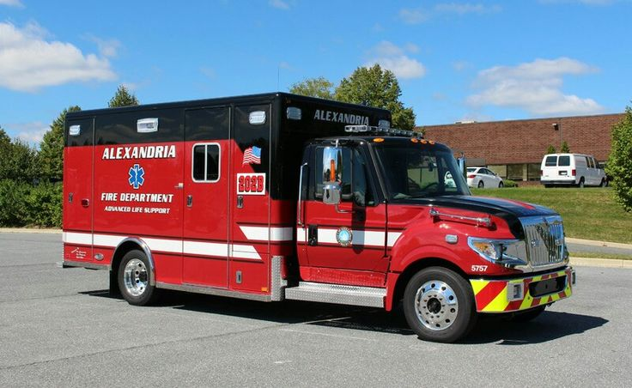
Stroke Smart Alexandria

Slide 2
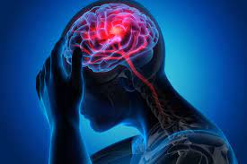
Materials
1. Dry erase board
(or scratch paper)
2. Dry erase marker
(a pencil/pen)
3. Paper towel or tissue
Objectives
1. Be able to identify all four stroke symptoms
2. Be able to explain what can happen after a stroke

Slide 3
Do You Know the Warning
Signs of a Stroke?
1. Please jot two things (on your white board or scratch sheet of paper) someone may do if they are having a stroke.
2. Pair Share
3. Share as a whole class

Slide 4
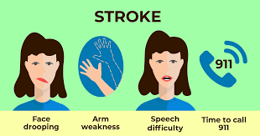
Symptoms Checklist of a Stroke - F.A.S.T.
F: Face Dropping
A: Arm Weakness
S: Speech difficulties
T: Time to call 911

Slide 5
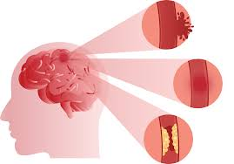
So What is a Stroke?
It is also known as a “Brain Attack”.
Something blocks blood supply to part of the brain OR a blood vessel (artery) in the brain bursts.

Slide 6

Let’s Test Your Knowledge So Far!
Please get our white boards or a piece of paper for this activity!
ANSWER BOX
Face Drooping
1. What does “F” stand for in the symptoms checklist?
Notes:
Move the “answer box” to reveal the answer or click the cursor when in slideshow mode.

Slide 7

Knowledge Check!
Arm Weakness
ANSWER BOX
2. What does “A” stand for in the symptoms checklist?
Notes:
Move the “answer box” to reveal the answer or click the cursor when in slideshow mode.

Slide 8

Knowledge Check!
Speech Difficulties
ANSWER BOX
3. What does S stand for in the symptoms checklist?
Notes:
Move the “answer box” to reveal the answer or click the cursor when in slideshow mode.

Slide 9

Knowledge Check!
Time to call 911
ANSWER BOX
4. What does “T” stand for in the symptoms checklist?
Notes:
Move the “answer box” to reveal the answer or click the cursor when in slideshow mode.

Slide 10
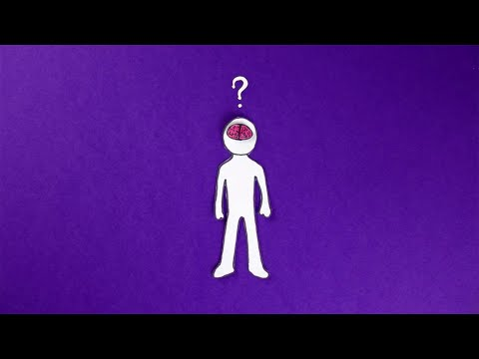
Quick Video Review!
Notes:
https://www.youtube.com/watch?v=byw6we_lSiU&t=2s

Slide 11
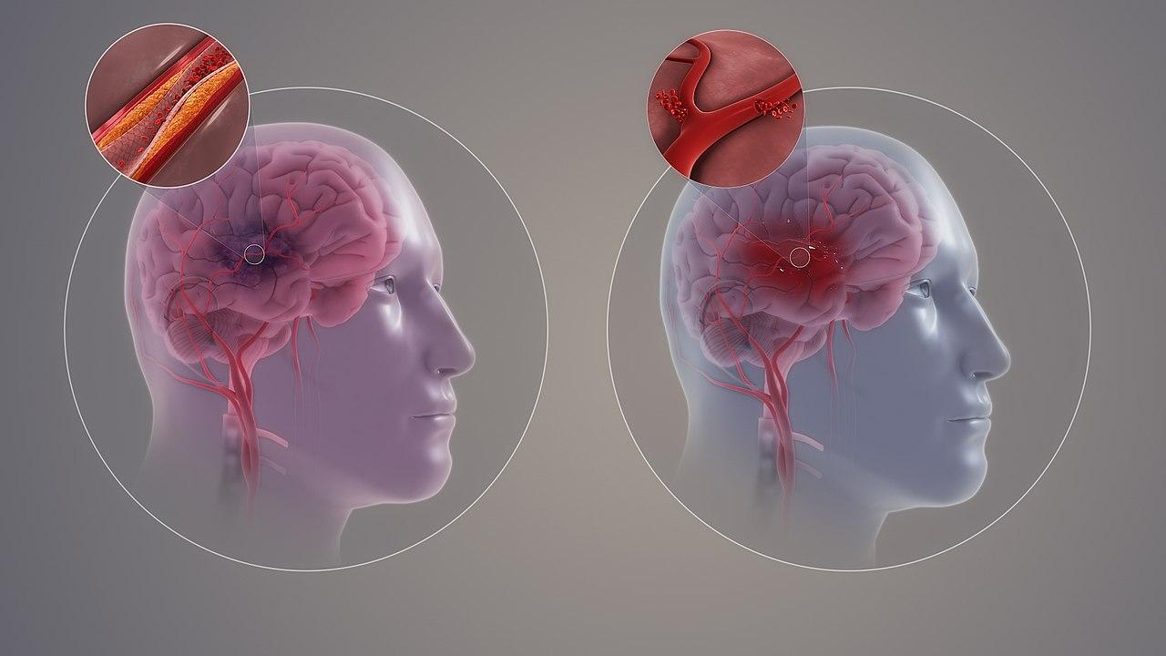
NOW YOU ARE BECOMING PROS!
Now you know what a stroke is and what to look for!
Let’s find out what can happen after a stroke!

Slide 12
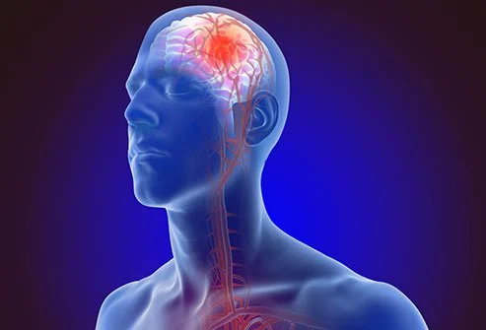
What can happen after a STROKE?
Long lasting brain damage
Paralysis in center parts of your body
Difficulty swallowing
Memory loss

Slide 13
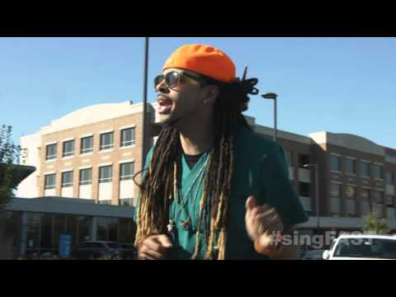
LET’S PUT IT ALL TOGETHER!
EXAMPLE
Notes:
https://www.youtube.com/watch?v=oyzwfsdd4AE

Slide 14


LET’S PUT IT ALL TOGETHER ACTIVITY!
DIRECTIONS
1. WORK AT YOUR TABLE TO COME UP WITH A RAP ABOUT STROKES.
2. THE RAP HAS TO HAVE AT LEAST 10 LINES.
3. EACH PERSON HAS TO SAY AT LEAST ONE LINE DURING THE PRESENTATION.
4. ONCE YOU ARE DONE, YOU NEED TO PRACTICE.
5. RAISE YOUR HANDS WHEN YOU ARE DONE SO THAT YOU CAN PRESENT TO YOUR TEACHER.
NOW IT IS YOUR TURN!

Slide 15
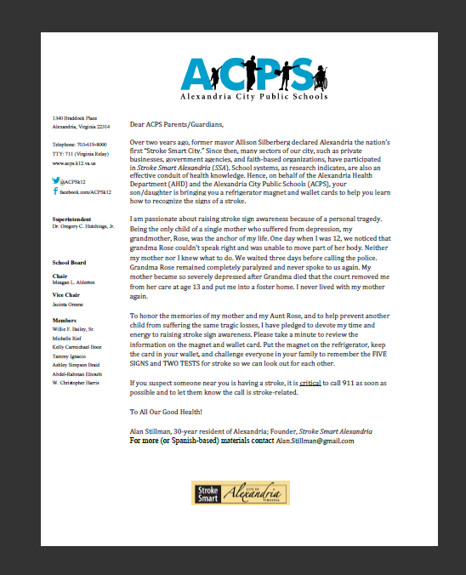
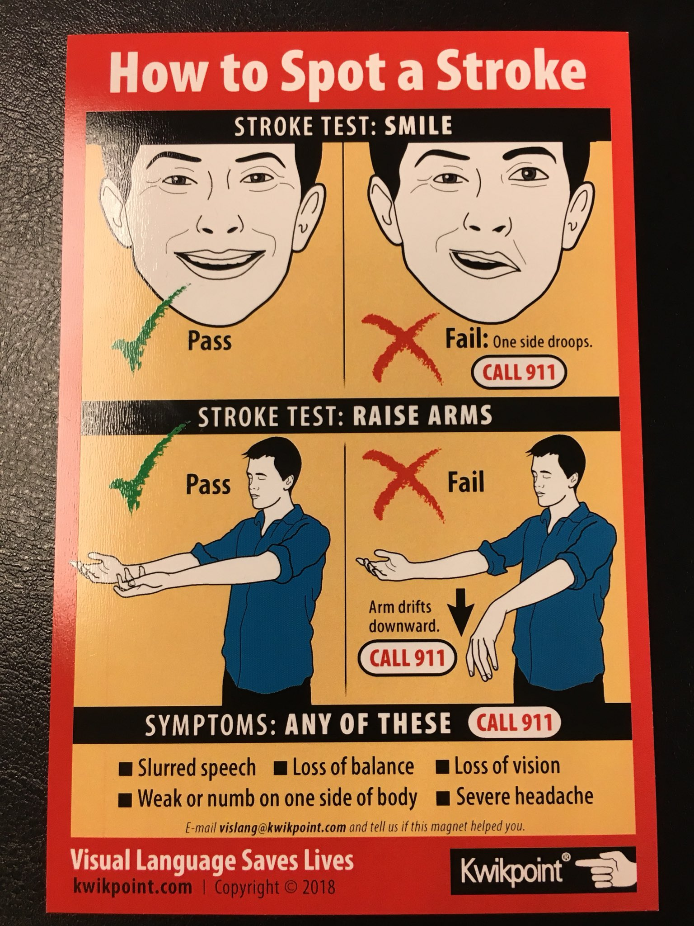
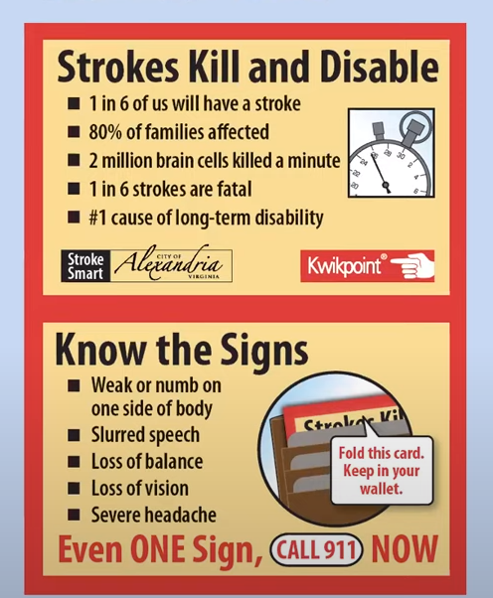
Homework
Take home this letter, magnets, and wallet cards to share with your family.
Notes:
Hand out magnets and Family Letter
This letter/article that you hand them will explain to their families what you are giving them.
Ask if any questions or anyone would like extra magnets or wallet cards for extended family.
** Suggest they put the magnet, wallet cards and letter in their backpacks immediately so they do not get lost in transition.**

Slide 16

You are now STROKE SMART and
can STAY STROKE SMART!
KNOWLEDGE IS POWER! SHARE WITH FRIENDS & FAMILY!
YOU KNOW:
WHAT A STROKE IS
WHAT SIGNS TO LOOK FOR
HOW TO HELP

