Slide 1
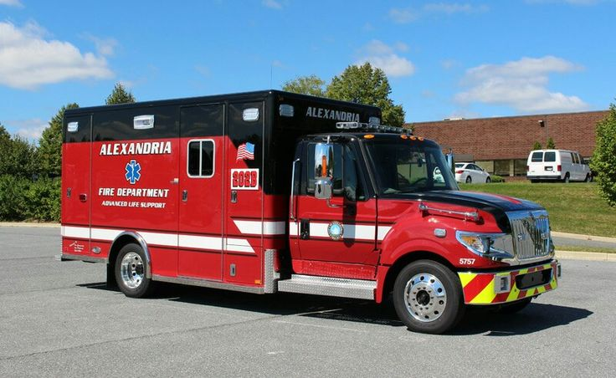
Stroke Smart Alexandria

Slide 2
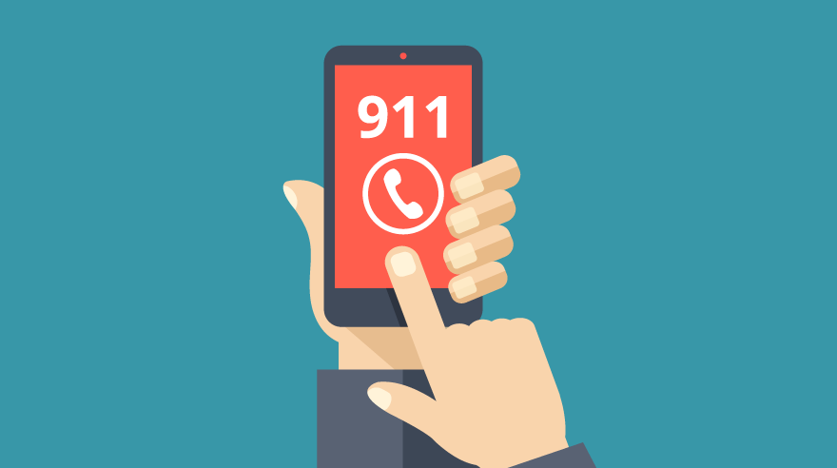
Do you know how to call 911?

Slide 3
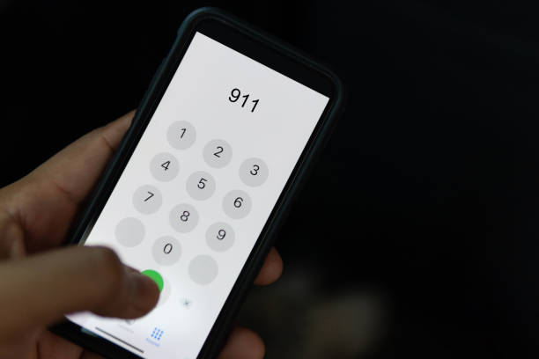
This is an important life skill to know.
911 is an emergency phone number.
This is a universal number that anyone may call in case of an emergency to reach police, fire, and ambulance.

Slide 4
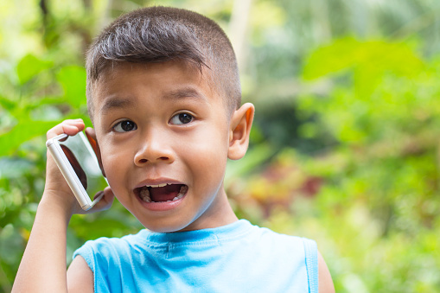
What happens when you call 911?
Do you know your address?
You will be asked questions about your emergency.
They will tell you to stay calm and talk you through helping if needed.
They will ask your address so they can send help.
An ambulance will come to take the adult to the hospital to see a doctor.
Notes:
Remind students we never call 911 as a prank, only when there is a true emergency.

Slide 5
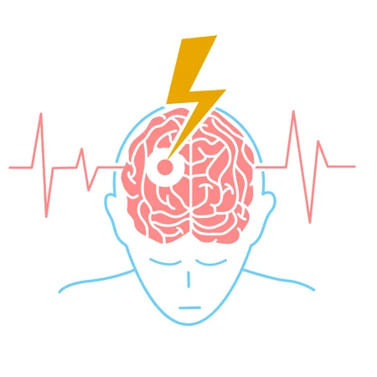
There is another disease called Stroke where you also need to call 911 to get help.
How many of you have heard of the disease called Stroke?
How many of you know someone who has had a Stroke?

Slide 6
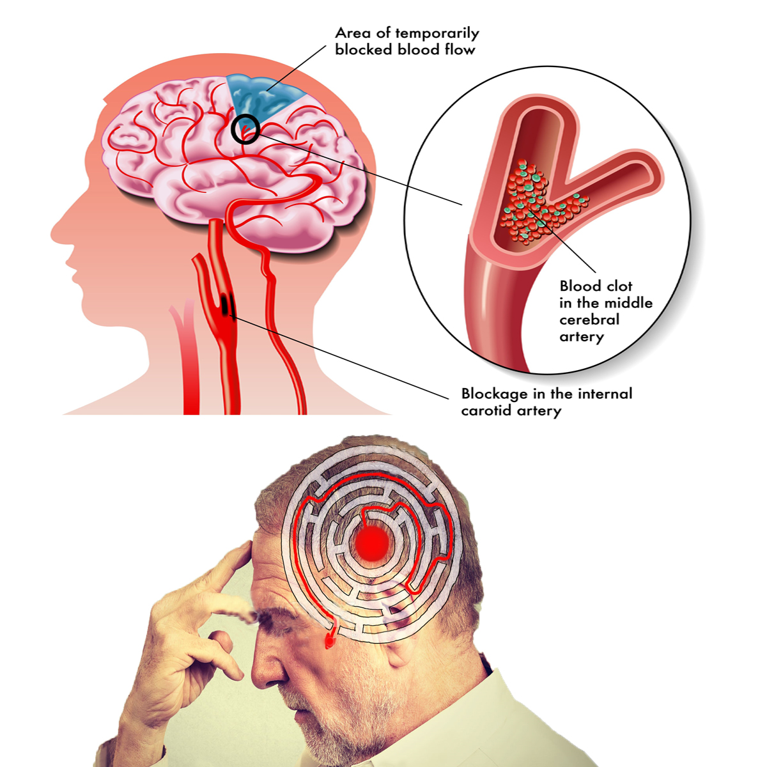
A stroke is when the brain is not
getting enough oxygen and needs help.

Slide 7

What you will learn in the next few minutes might help a sick person and make you STROKE SMART.
It’s very important to call 911 immediately if you spot a Stroke.

Slide 8
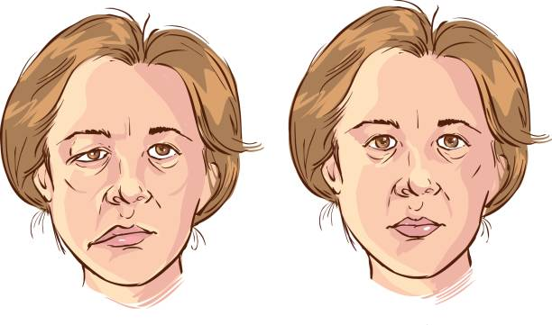
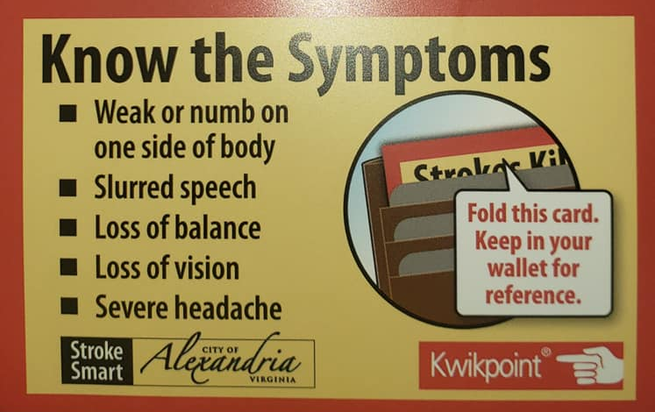
If someone seems like they’re not well or they don’t look quite right, look for these 5 SIGNS.
Notes:
Hand out wallet card and walk through 5 signs and 2 tests.

Slide 9
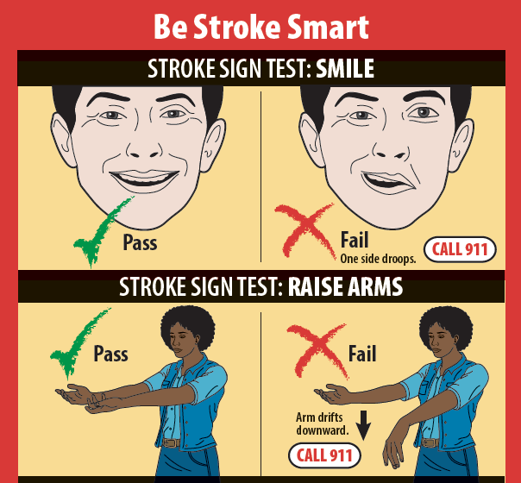
If someone seems like they’re not well or they don’t look quite right, do these 2 TESTS.
Notes:
Hand out wallet card and walk through 5 signs and 2 tests.

Slide 10
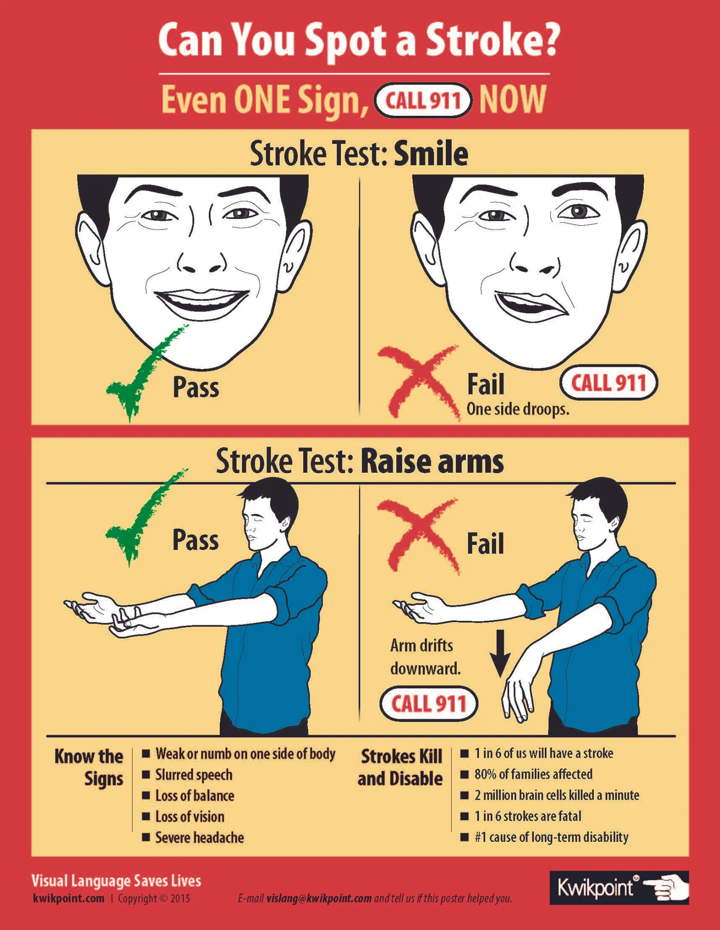
Practice and Demonstration
In partners practice the following:
1 student acts out several of the signs and their partner will try to identify them.
Then after they identify the signs, do the two tests.
Then practice what you would say to 911.
Switch roles.
Notes:
Have students partner and practice. Ask one student to act out several of the signs and the other student to identify them. Then after they identify the signs, do the two tests. Then practice what they would say to 911. Then switch roles.

Slide 11
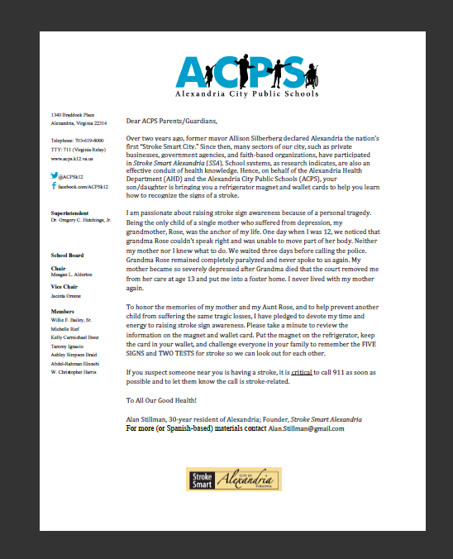
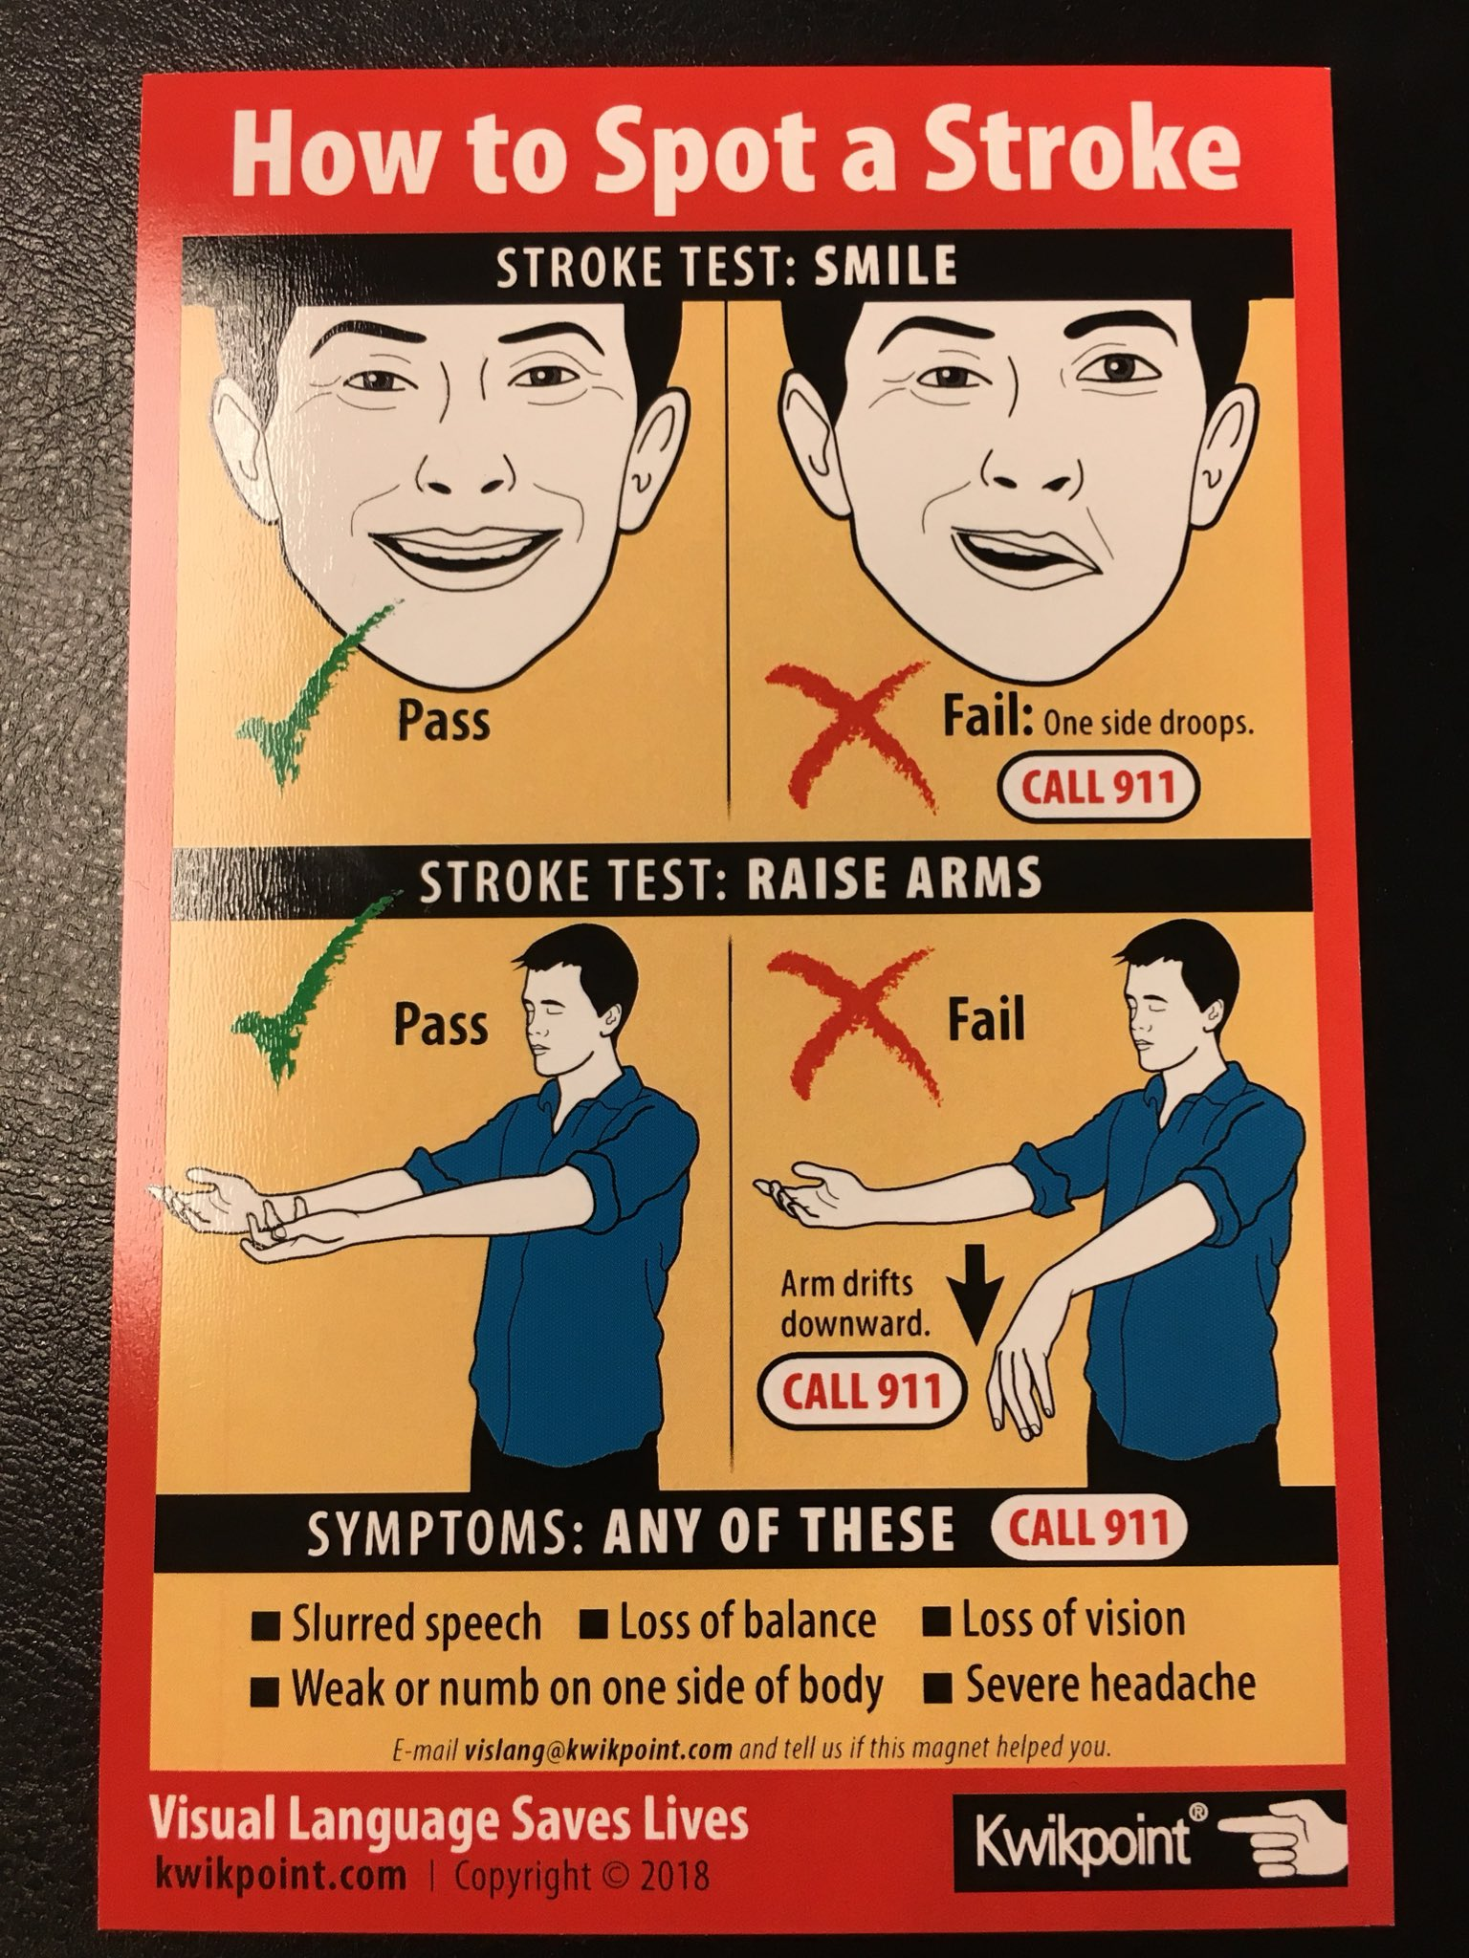
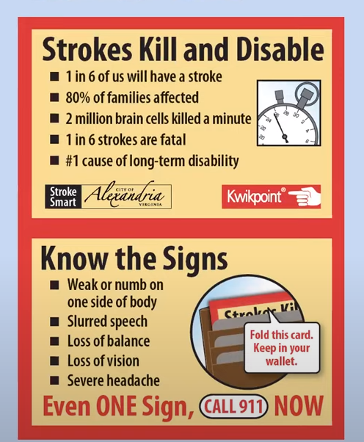
Homework
Take home this letter, magnets, and wallet cards to share with your family.
Notes:
Hand out magnets and Family Letter
This letter/article that you hand them will explain to their families what you are giving them.
Ask if any questions or anyone would like extra magnets or wallet cards for extended family.
** Suggest they put the magnet, wallet cards and letter in their Lunch Box so parents see them **

Slide 12

You are now STROKE SMART!
Now spread the word to your family and friends!
You know what to do.
You know how to stay calm.
You know what to look for.
You know how to test.
You know how to address.

