Slide 1

Maryland
Spot a Stroke
Stop a Stroke
Save a Life
A Public Health Education Initiative to Reduce
Pre-Hospital Delay in “your locality”

Slide 2
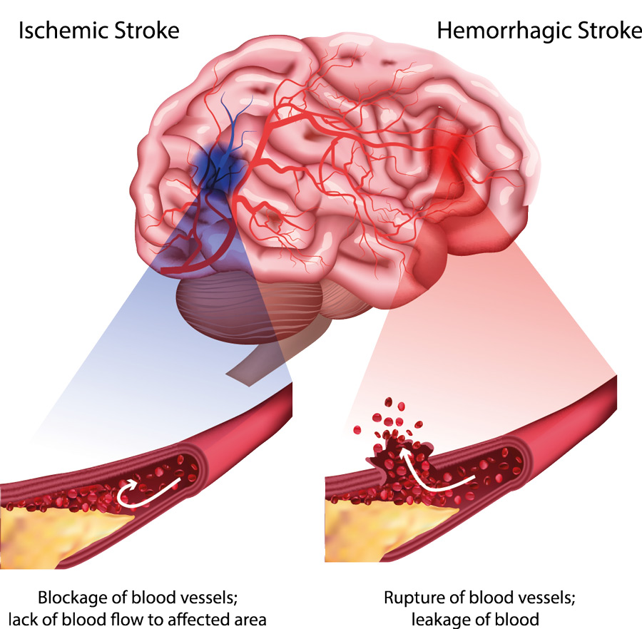
Maryland
What is a Stroke?
Ischemic stroke (87%): lack of blood supply due to a blockage
Hemorrhagic stroke (13%): lack of blood supply due to a bleed
A stroke can cause lasting brain damage, long-term disability, or even death.

Slide 3
Maryland
What is the problem?
Stroke is Prevalent:
1 in 6 lifetime
1 in 4 for 25+ years old
80% of families affected
Stroke is Devastating:
leading cause of long-term disability
# 5 cause of death in USA (3rd in MD)
# 2 cause of death worldwide

Slide 4
Maryland
Good News:
Ischemic strokes (~90% of all strokes) can be effectively treated with clot busters or surgery

Slide 5
The Predicament
While effective treatments are available, under-treatment of stroke patients persists. __% (Insert your hospital’s GWTG statistics) of stroke patients get acute treatment. __% (Insert your hospital’s GWTG statistics) of patient arrive within an acute treatment window.
Much improvement has been made with door-to-needle time in recent years. However, little to no progress has been made with onset-to-911 time for the last 25+ years!

Slide 6
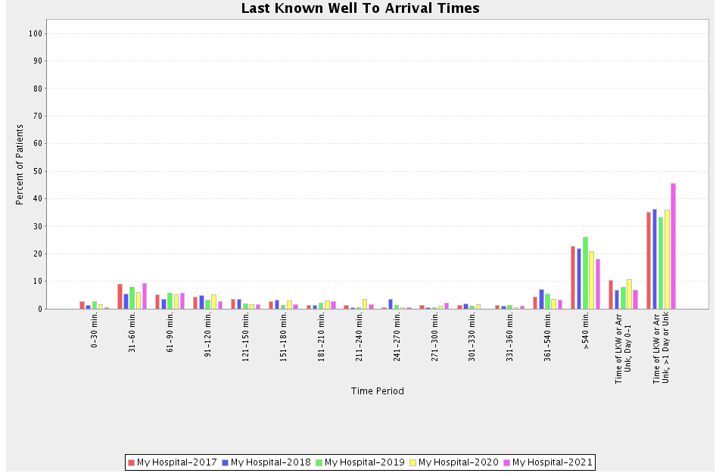
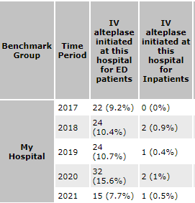
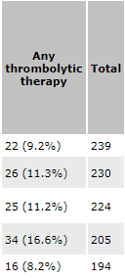
Your local hospital Stroke Statistics
In the last 5 years your local hospital has cared for ?? stroke patients
Only 123/1092 (11%) (replace with your data/graphs) received Alteplase (tPA)
The #1 reason tPA was not offered is due to pre-hospital delay
> 4.5 hours

Slide 7
Maryland
What is the solution?
Become a Stroke Smart City or County
What does this mean?
Educate the community to:
Be Stroke Smart
Stay Stroke Smart
Be a Stroke Champion

Slide 8
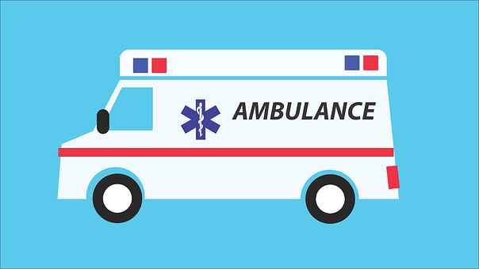
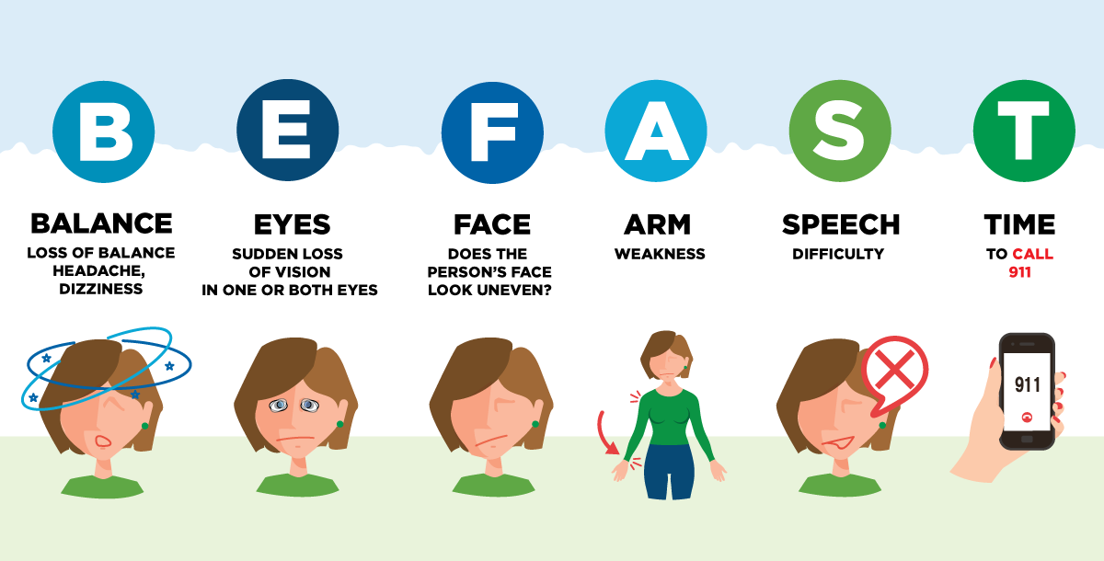
Be Stroke Smart
Learn what a stroke is: interrupted blood supply, damage
Learn how to “Spot A Stroke”-BEFAST
Learn a stroke is a medical emergency-call 911 right away!

Slide 9
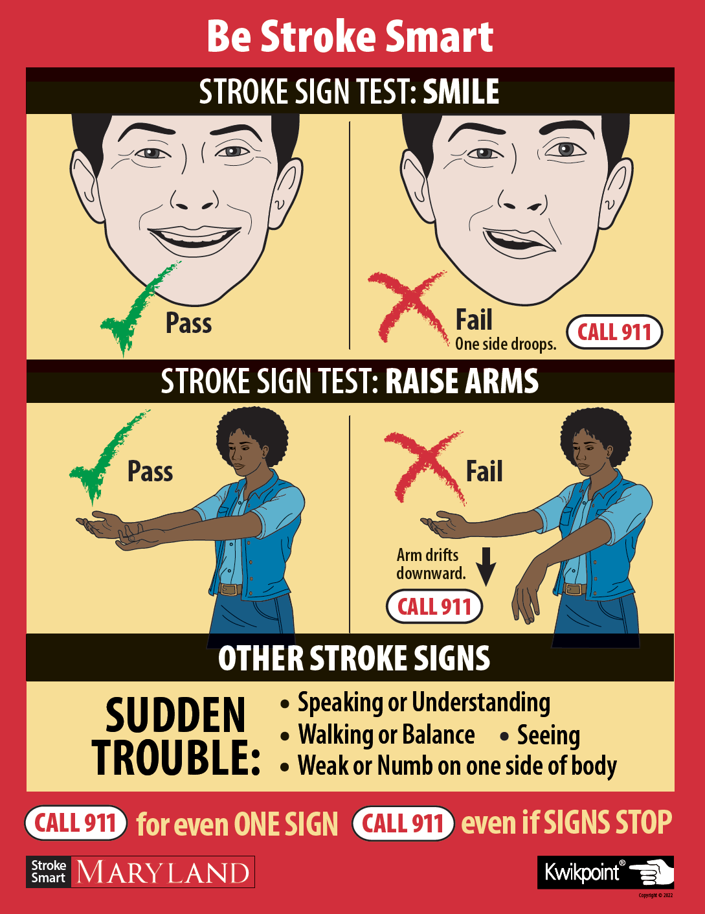
Stay Stroke Smart
Retention
Repetition
Access
Memory aides
Wallet cards
Magnets
Posters

Slide 10
Be a Stroke Champion
Improve stroke literacy
A community effort by active community members
Sharing knowledge
With a goal to educate everyone in your locality
How to “Spot A Stroke”
How to “Stop A Stroke”

Slide 11
Maryland
What are the next steps?
Make a proclamation
Introductions to key agencies:
Your local Bureau of Aging and Disabilities
Your local Public School District

Slide 12
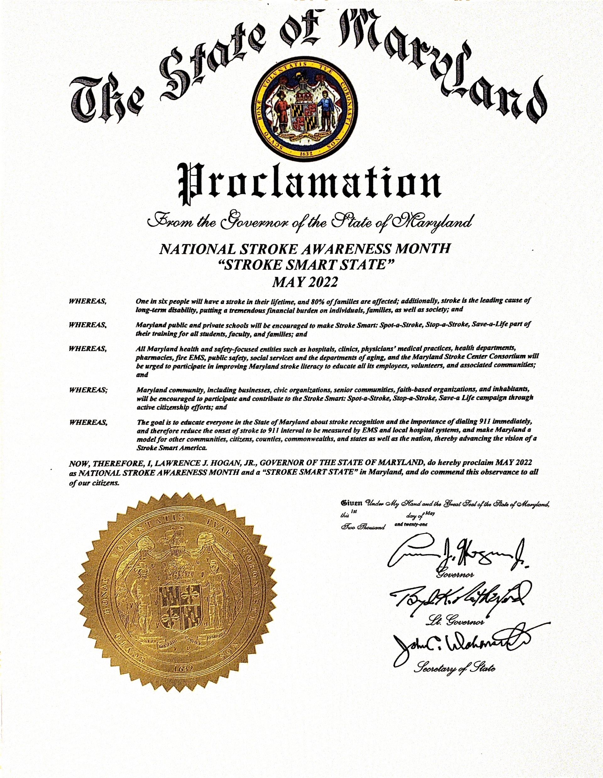

Slide 13
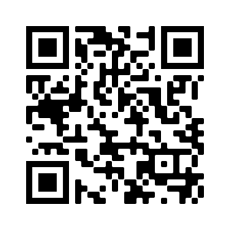
Maryland
MIEMSS Stroke-Smart-Resources
Stroke Smart Resource Center (miemss.org)

Slide 14
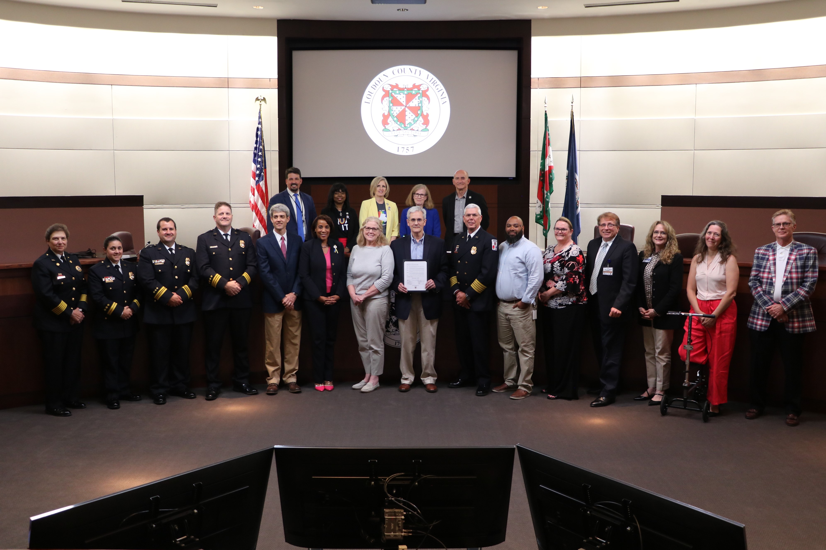
Loudon County, VA Stroke Smart Proclamation
This picture used a reference

Slide 15
Maryland
Questions?
Your contact information

Slide 16
References
Centers for Disease Control and Prevention, 2022. Stroke Facts | cdc.gov
World Health Organization, 2020. The top 10 causes of death (who.int)

