Slide 1

Stroke Smart Training and Champion Pledge Certificates
Alan Stillman
CEO Kwikpoint, Founder Stroke Smart

Slide 2
The purpose of this presentation is to provide Stroke Smart training and offer the opportunity to take the Stroke Smart Champion Pledge.
Audience: Anybody!
Duration: 10-15 minutes

Slide 3

People Who Take the Stroke Smart Champion Pledge Multiply the Power of Stroke Smart

Slide 4

Gather Materials in Advance
Access Stroke Smart materials at: https://www.vdh.virginia.gov/stroke/stroke-smart-virginia/
  Order wallet cards, magnets, posters and yard signs in advance
    Allow 7-10 business days for shipping
  Print posters in color from the website
  Videos
Have technology needed to show the 3-minute “How to Spot a Stroke” 3-minute video.
  This could include a laptop, Internet access, projector and blank screen/wall.
Print Stroke Smart Champion Pledge certificates in color, enough for each participant.
Pens or Markers

Slide 5
Step 1. Provide Simple Stroke Smart Education
Open: Did you know, you can spot a stroke, stop a stroke and save a life? And you can teach others!
Emphasize key messages:
  It’s usually bystanders who call 911. That’s you!
  Educating others protects you and the community.
Watch the “How to Spot a Stroke” 3-minute video.
Review the acronym BEFAST as a group.
  BEFAST: Balance, Eyes, Facial droop, Arm weakness, Speech problems, Time to call 9-1-1.
  Reference the Stroke Smart materials (wallet card, poster, etc.) that you will be giving out.

Slide 6
Step 2. Offer the Stroke Champion Pledge
“Would you like to take the Stroke Champion Pledge?”
Are you committed to teaching others to be Stroke Smart?
Think about:
  Who can you teach about Stroke Smart?
  Where will you teach them?
  How will you teach them?
Count it out: How many people can you teach?

Slide 7
Step 3. Fill out the Stroke Smart Champion Pledge Forms!
Pass out certificates printed in color.
Give people time to fill it out.

Slide 8
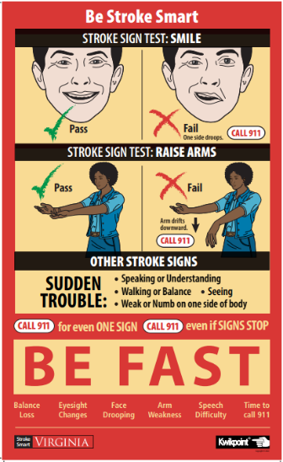
Step 4 (Final step). Distribute memory aids !
Give out enough to each Pledge Champion to reach the number on their certificate:
  Wallet cards, Magnets and/or Posters
Take a group photo (if appropriate).
  You may need a photo release!

Slide 9
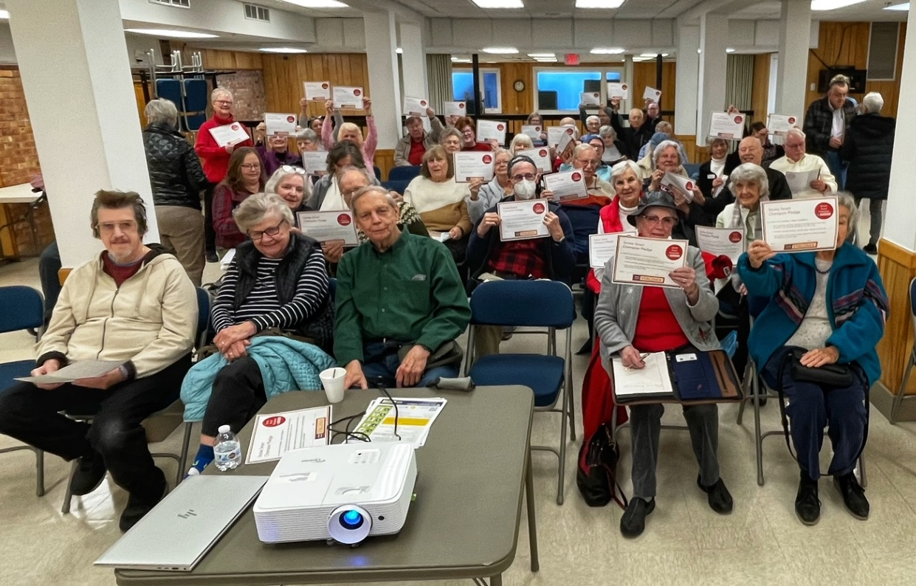
20 Stroke Champions become 100 – or more!

Slide 10
For more information about Stroke Smart, email stroke@vdh.virginia.gov

