Slide 1
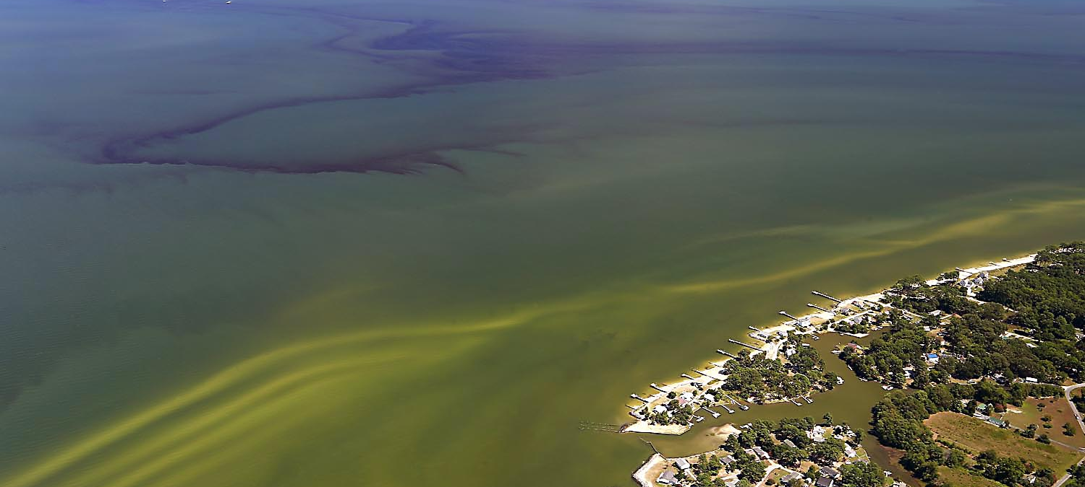
Harmful Algae Blooms
Photo Credit: VIMS; Wolfgang Vogelbein
By Aaron Moses,
Source Water Programs Manager
Division of Technical Services
Office of Drinking Water
Future of Drinking Water Seminar
March 23, 2017

Slide 2
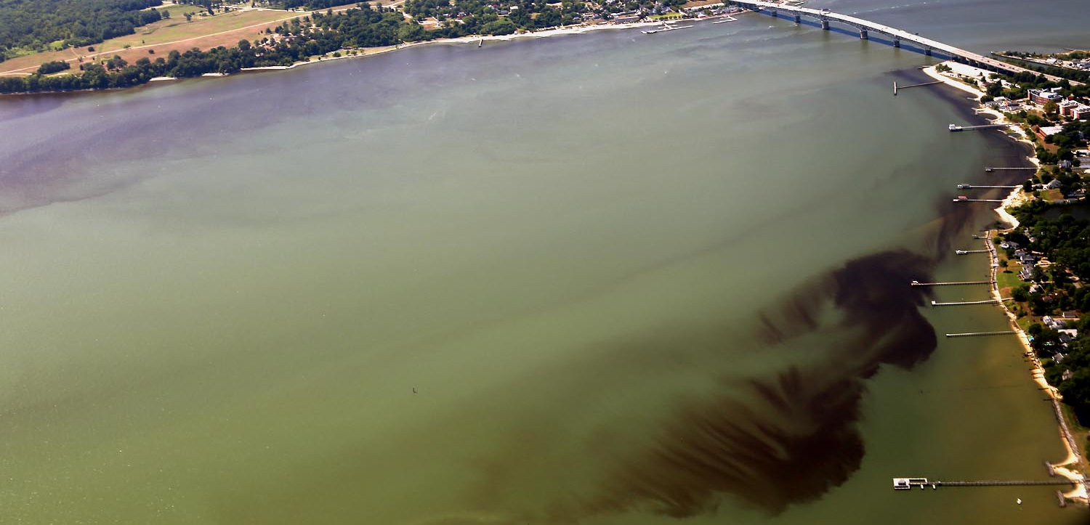
What are Harmful Algae Blooms (HABs)?
Found in marine, brackish, and freshwater
Major source of food and oxygen for aquatic life
Produce toxins
Fresh water HABs = Cyanobacteria
Photo Credit: VIMS; Wolfgang Vogelbein

Slide 3
Cyanotoxins
Intracellular vs. Extracellular
Modes of transmission
Consumption
Absorption
Respiration
More dangerous to children
Notes:
Cyanotoxins can exist within a cell, which we call “intracellular toxins”, or outside of a cell, which we call “extracellular toxins”. Some species release extracellular toxins as part of their normal life cycle, and others only release extracellular toxins if their cell membranes are weakened or ruptured. This has significant implications on waterworks treatment strategies because water plants are very effective at removing bacteria, but are much less effective at removing extracellular toxins.

Slide 4
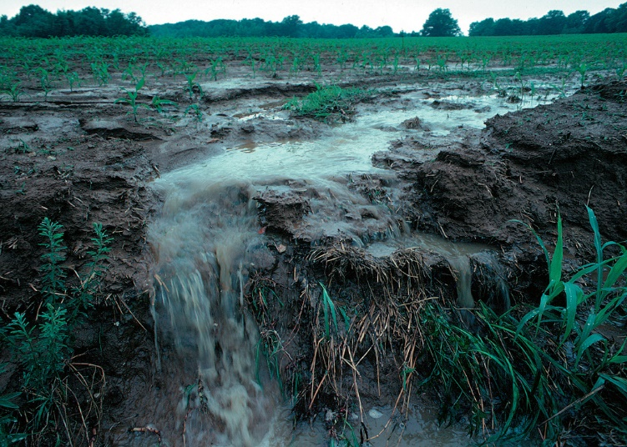
Bloom Formation
Nutrients
Sunlight
Temperature
Calm Water
Notes:
There are 4 primary factors that promote bloom formation. The first is nutrients, including nitrogen and phosphorus. Wastewater and fertilizer runoff are significant sources of nutrients to our waters. The second is sunlight, which serves as an energy source for cyanobacteria. The third is temperature. HABs typically thrive at temperatures greater than 25 degrees Celsius, but blooms can occur in much colder water. The fourth factor is calm water.
Major blooms often occur during warm dry periods following large storms. This is because of increased fertilizer runoff, like you can see in this picture, and then the following sunlight, calm water, and increased temperatures allow the bloom to grow.

Slide 5
Toledo, OH – 2014 HAB
Placed HABs in the national spotlight
3 day “Do Not Drink” advisory for nearly 500,000 people
Governor declared state of emergency for 3 Counties

Slide 6
Virginia HABs Taskforce
Virginia Interagency group
Formed in late 90’s to address Pfiesteria
Monitors public water bodies
Monitors HAB Hotline - 888-238-6154
Coordinates interagency HAB responses
Revising HAB Response Plan – to include drinking water
For more information visit: www.HarmfulAlgaeVA.com
Notes:
The primary members of this group are the Department of Health, the Department of Environmental Quality, the Old Dominion University, and The Virginia Institute of Marine Sciences. Many other members also play a role in the group.

Slide 7
Freshwater HABs in Virginia
DEE and ODU annually monitor public lakes* during summer
* not public drinking water supplies
Six potential toxin-producing cyanobacteria are commonly observed in VA’s lakes.
Year | # of Lakes/Reservoirs | # Potentially toxic
2010 | 17 | 9
2011 | 8 | 0
2012 | 39 | 15
2013 | 25 | 8
2014 | 20 | 12
2015 | 10 | 4
2016 | 12 | 10
Notes:
As one of the Taskforce’s monitoring activities, the VDH Division of Environmental Epidemiology and ODU monitor public lakes during the summer. The middle column indicates the number of lakes sampled, and the right column indicates the number of lakes in which HAB species were identified. Potentially toxic species were found in roughly half of the lakes.

Slide 8
Recent EPA HAB Activities
Cyanotoxin Health Advisory Levels, June 2015
Recommendations for Waterworks, June 2015
HB212 – Drinking Water Protection Act, August 2015
EPA’s Regulatory Process:
Fourth Contaminant Candidate List (CCL4), November 2016
Fourth Unregulated Contaminant Monitoring Rule (UCMR4), December 2016

Slide 9
EPA Cyanotoxin Health Advisory Levels
Recommended Drinking Water Health Advisory Levels for 2 cyanotoxins based on 10-day exposure
Some states have developed Drinking Water Health Advisory Levels for other cyanotoxins
Toxin | HA for Children (<6 years old) | HA for Adults (≥6 years old)
Microcystins | 0.3 µg/L | 0.7 µg/L
Cylindrospermopsin | 1.6 µg/L | 3.0 µg/L

Slide 10
EPA Recommendations for Waterworks
“Recommendations for Public Water Systems to Manage Cyanotoxins in Drinking Water” EPA, June 2015
Provides recommendations for
Algae monitoring
Cyanotoxin sampling and analysis
HAB response
Link: https://www.epa.gov/sites/production/files/2015-06/documents/cyanotoxin-management-drinking-water.pdf

Slide 11
HB212 – Drinking Water Protection Act
Requires EPA to:
List and evaluate cyanotoxins
Determine whether to publish Health Advisories and analytical methods
Establish monitoring frequency guidance
Recommend feasible treatment options
Enter into agreements with and provide technical assistance to states

Slide 12
Cyanotoxin SDWA Regulatory Consideration
Fourth Contaminant Candidate List (CCL 4)
Cyanotoxins included:
Anatoxin-a
Cylindrospermopsin
Microcystins
Saxitoxin
Notes:
The Contaminate Candidate List is a list of contaminants not currently regulated, but believed to occur in drinking water.
CCL4 includes 12 microbial contaminants and 97 chemicals including anatoxin-a, cylindrospermopsin, microcystins, and saxitoxin.

Slide 13
Cyanotoxin SDWA Regulatory Consideration
Fourth Unregulated Contaminant Monitoring Rule (UCMR 4)
30 Contaminants
Cyanotoxins included : anatoxin-a, cylindrospermopsin, microcystins, and nodularins
Administered directly by EPA (not states)
Sample twice/month, 4 consecutive months
Monitoring: 2018-2020
Notes:
The Unregulated Contaminant Monitoring Rule is used to determine the occurrence of contaminants in drinking water.

Slide 14
General Flow of SDWA Regulatory Process
Contaminate Candidate List
Regulatory Determinations
If standard is needed
If revisions are required
Unregulated Contaminants Monitoring Rule
Regulation Development
6-Year Review

Slide 15
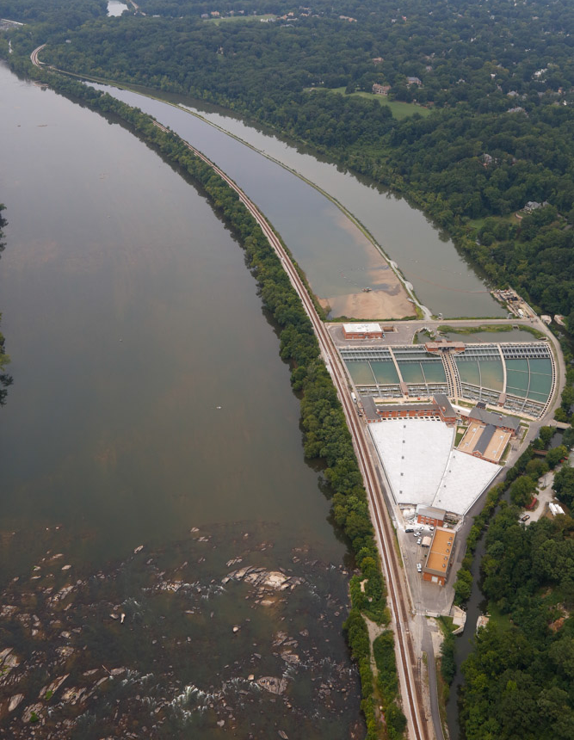
HAB Prevention and Treatment
Alternative Sources
Source Water Protection
Source Water Treatment
Water Treatment Plant Optimization
Long Term Treatment Changes

Slide 16
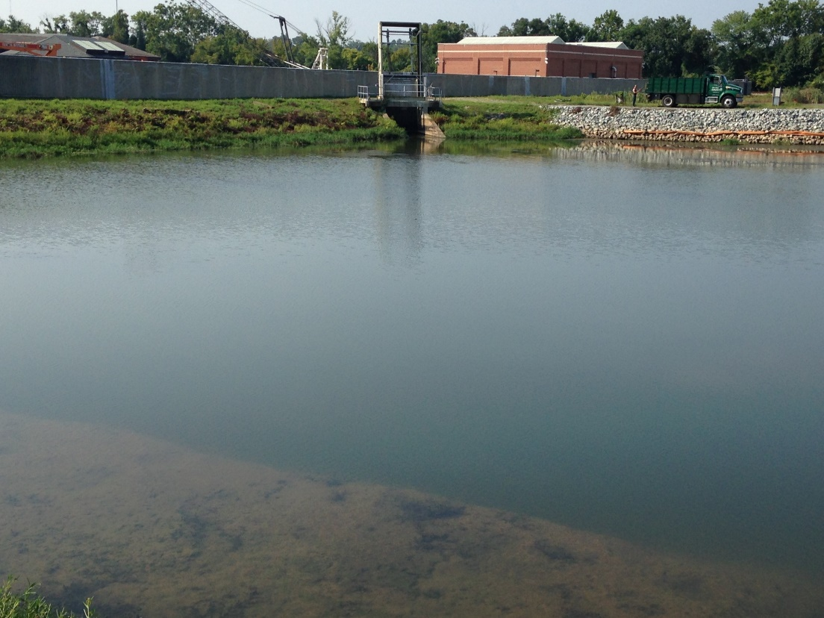
Alternative Sources
Purchase water
Utilize alternative intake
Alter intake depth – deeper
Alter hours of operation
Notes:
Among the choices for alternative sources that may be available are to purchase water, or to utilize an alternative intake that is not impacted by the HAB. If a reservoir can be isolated, a waterworks can consider using an algaecide after isolation to be able to put the reservoir back into service sooner.
Many cyanobacteria rise to the surface at night and spread throughout the water column during the day. If a waterworks has the ability, it can use a deeper intake and operate mostly at night to reduce the toxin content of the raw water. This strategy is less effective for Planktothrix and Cylindrospermopsis, which typically remain distributed.

Slide 17
Source Water Protection
Source Water Protection Plan
<50,000 pop. – ODW SWPP contractors
>50,000 pop. – ODW direct technical assistance
Reduce nutrients in watershed
Public education
Agricultural/ Stormwater BMPs
Wastewater improvements
Notes:
-The first step to protect a source water is to develop a Source Water Protection Plan. ODW has 2 ways that it helps waterworks to develop and implement source water protection plans. The first is through contracts with 3 contractors. Under our upcoming contracts, the contractors will be able to work with waterworks serving up to a population of 50,000. For larger waterworks, ODW offers direct technical assistance including plan templates and mapping.
-To reduce the risk of HABs, source water protection measures should reduce nutrients in the watershed.
One way of doing this is through public education, informing residents of the need for good practices such as proper fertilize utilization and cleaning up after pets.
Another way is through agricultural and stormwater best management practices. These can include things such as detention and retention ponds to settle out nutrients, and conservation buffers. Conservation buffers are areas of vegetation along stream banks to remove nutrients before they reach the water.
And a third way is wastewater improvements to prevent sewer overflows or to remove more nutrients in treatment plants.
-There are a wide variety of funding opportunities available to help implement these measures, please contact me for more information.

Slide 18
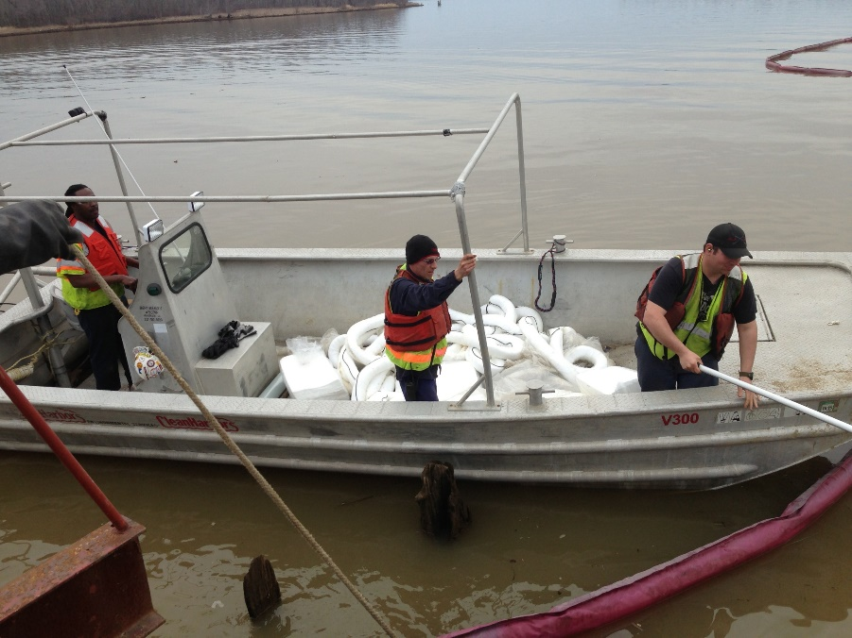
Source Water Treatment
Algaecide – prevention only
Ultrasound – prevention only
Barley Straw – prevention only
Aeration/Mixing
Scum removal
Flocculant addition
Biomanipulation
Notes:
Algaecides, such as copper, lyme, or oxidants can be used to kill algae, but these should only be used prior to a bloom because they can cause the release of toxins from the cells. Copper can also be a problem for wastewater treatment.
Ultrasound devices can kill algae by rupturing the cells and can be effective in small reservoirs, but again should not be used once a HAB has formed due to the potential release of toxins from cells.
Barley straw when place in water breaks down to release a chemical that does not kill the algae, but prevents its growth. Barley straw typically requires 2-8 weeks to be effective and is a fairly economical option, but a waterworks may need to consider its potential to kill fish through deoxygenation.
Aeration and mixing both break up the calm stratified water preferred by cyanobacteria, but they are only effective for a limited area.
Algae scum can be removed in the morning, when algae are at the surface. Oil-spill skimmers are used to remove surface scums.
Flocculants such as clay or drinking water coagulants can be added to the water to remove phosphorus through adsorption and sedimentation.
Biomanipulation involves organisms being added to or removed from the ecosystem to increase the predation of HAB species, or increase competition for recourses.

Slide 19
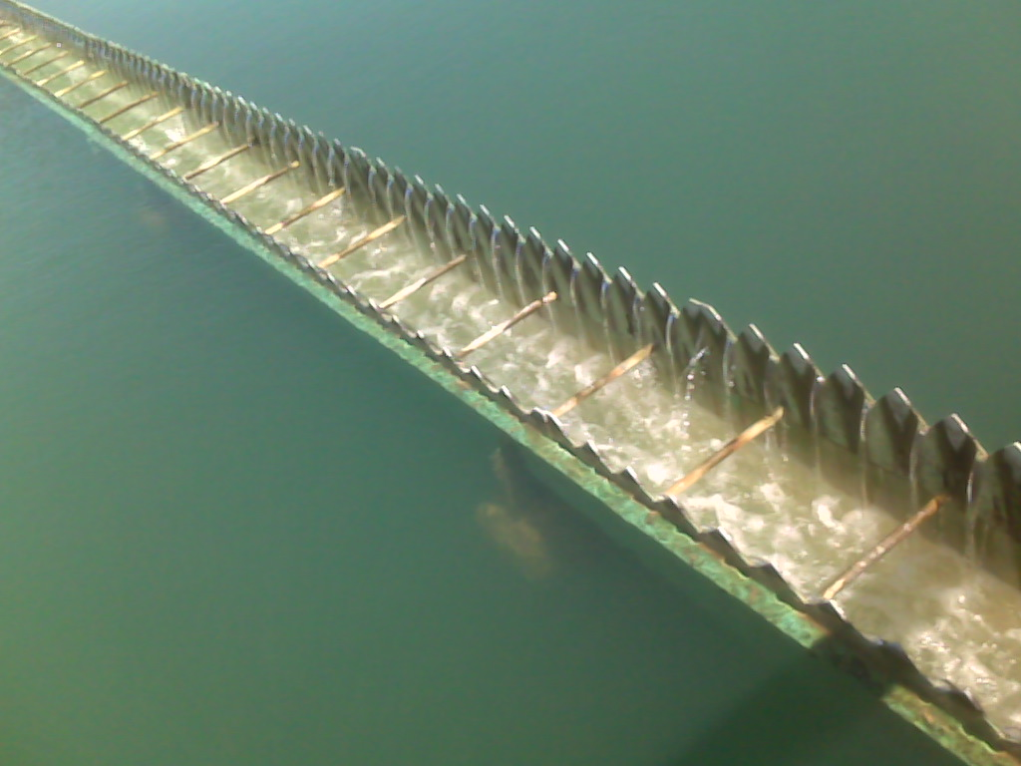
Water Treatment Plant Optimization
Stop/reduce pre-oxidation
Optimize conventional treatment for cell removal
Optimize oxidation following filtration
Powdered Activated Carbon
Notes:
Conventional treatment = coagulation, flocculation, sedimentation, and filtration

Slide 20
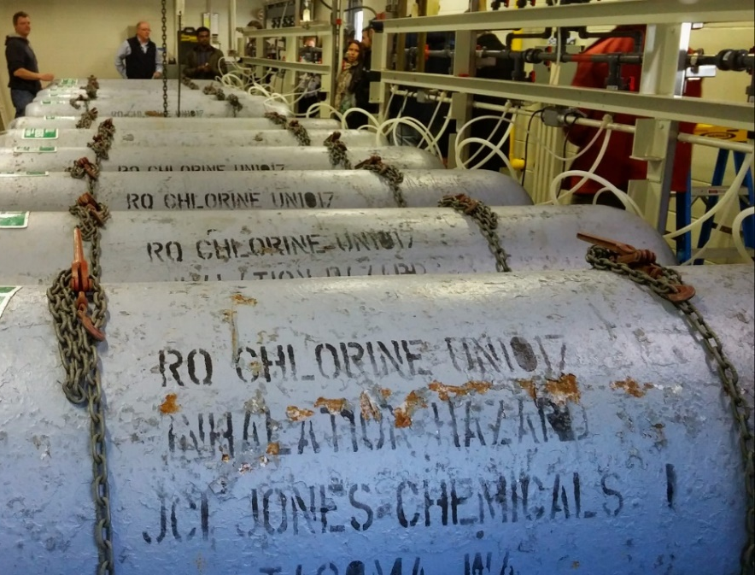
Stop/Reduce Pre-Oxidation
Pre-oxidation (before filtration)
Increases extracellular toxins by rupturing cells
Will reduce PAC effectiveness
Need to consider other factors:
Extra/intracellular toxin ratio
Giardia inactivation req’s
Manganese removal
Zebra Mussel control
Notes:
Pre-oxidation typically refers to chlorine, permanganate, or chlorine dioxide added prior to filtration. Pre-oxidation should be stopped or reduced because it increases extracellular toxins by rupturing cells and will reduce the effectiveness of Powdered Activated Carbon.
There are several factors that need to be considered before stopping or reducing pre-oxidants. The first is the extra/intracellular toxin ratio. If the toxins in the raw water are almost entirely in the extracellular form, it may be beneficial to maintain pre-oxidation to maximize toxin oxidation.
The second is giardia inactivation requirements. In some plants, pre-oxidation may be required to meet the Surface Water Treatment Rule.
Other factors to keep in mind are manganese removal and zebra mussel control.

Slide 21
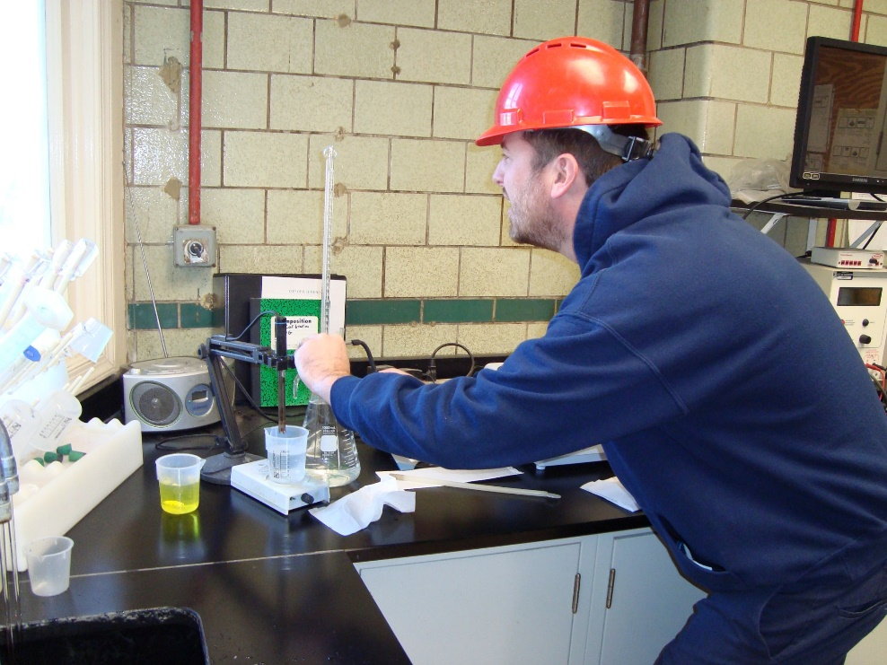
Optimize Conventional Treatment for Cell Removal
Jar test – evaluate using
UV254
Particle count
Zeta potential
Color
Pigment –
chlorophyll-a
Notes:
The first step of optimizing conventional treatment for cyanobacteria cell removal is jar testing. Turbidity has been found to not be a good indicator of cyanobacteria cell or toxin removal. It is recommended that waterworks evaluate jar tests using methods such as UV254, particle counts, zeta potential, color, or pigments such as chloraphyll-a.

Slide 22
Optimize Conventional Treatment for Cell Removal
Adjust based on jar test:
Coagulant dose
Polymer dose
Coagulation pH (>6)
Consider filter aid polymer
Increase sludge removal frequency
Increase filter backwash frequency
Do not recycle filter backwash
Notes:
Note that the coagulation pH should be maintained above 6 to prevent the rupturing of cells.
Waterworks should consider increasing sedimentation basin sludge removal and filter backwash frequency. This is because accumulated cells can rupture and release toxins.
Filter backwash water should not be recycled during a HAB due to the high toxin content of the backwash water.

Slide 23
Oxidant Effectiveness for Cyanotoxins
Oxidant | Microcystins | Cylindrospermopsin | Anatoxin-a | Saxitoxin
Chlorine | Effective* | Effective (at low pH) | Not effective | Somewhat Effective
Chloramine | Not effective at normal doses | Not effective | Not effective | Inadequate information
Chlorine dioxide | Not effective at normal doses | Not effective | Not effective at normal doses | Inadequate information
Potassium Permanganate | Effective* | Data ranges from not effective to possibly effective | Not effective at normal doses | Not effective
Ozone | Very Effective | Effective | Effective | Not effective
UV / advanced oxidation | Effective at high UV doses* | Effective | Effective | Inadequate information
*Dependent on initial cyanotoxin concentration, pH, temperature, and presence of NOM.
Water Treatment Optimization for Cyanotoxins (EPA, 2016)

Slide 24
Optimize Post-Oxidation
Evaluate Clearwell CT
Consider:
Increasing oxidant dose
Increasing detention time
AWWA CyanoTOX*
*link: https://www.awwa.org/Portals/0/files/resources/water%20knowledge/
rc%20cyanotoxins/CyanoTOX-Calculator-Ver1-7-29-15.xlsx
Notes:
The AWWA has made a tool available called “CyanoTOX”. This tool has a spreadsheet that predicts the oxidation of 3 major cyanotoxins using 5 oxidants. It is available from the link at the bottom of this slide.

Slide 25
Powdered Activated Carbon
10 mg/L minimum, >40mg/L may be needed
>45 min contact time
PAC type important
Microcystin – wood based
Saxitoxin – coconut or coal based
AWWA Cyanotox – PAC Calculator
Notes:
Powdered Activated Carbon can be effective at absorbing extracellular toxins. One drawback of PAC for removal of cyanotoxins is high doses are typically needed. 10 mg/L is considered a minimum dose and greater than 40 mg/L may be needed. In some plants, these doses can cause decreased filter run times and increased breakthrough.
A contact time of greater than 45 minutes is recommended. Some waterworks may want to consider multiple feed points to maximize contact time.
The type of PAC also impacts its effectiveness. A wood based PAC is often recommended because it is the most effective for microcystins, but a coconut or coal based PAC is more effective for the treatment of saxitoxin.
The AWWA Cyanotox also includes a tool to calculate required PAC doses.

Slide 26
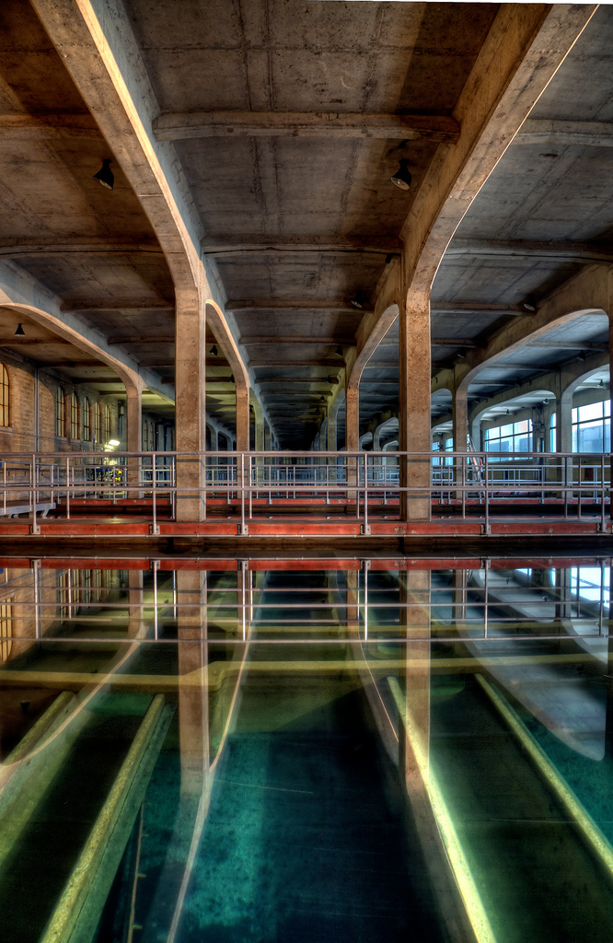
Long Term Treatment Changes
Granular Activated Carbon
Ozone
Biological Filtration
Reverse Osmosis
Notes:
I would note that these are typically costly options, and would likely only be considered if they would aid in meeting other treatment objectives.

Slide 27
Granular Activated Carbon
Rapid small-scale column tests (RSSCTs) or accelerated column tests (ACTs)
5-15 min EBCT
Consider type
Can be biologically active for 2 removal mechanisms
Notes:
Granular activated carbon can have a lower long term cost than PAC if activated carbon is routinely required because it uses material more efficiently and does not produce extra sludge.
Rapid small-scale column tests (RSSCTs) or accelerated column tests (ACTs) are recommended to evaluate the effectiveness of a GAC filter. A 5 to 15 minute contact time is recommended.
Similar to PAC, the carbon type impacts the effectiveness of the treatment, but changing the carbon type is much more difficult with GAC and one carbon type may not be effective for all treatment goals.
A GAC filter can be biologically active for a second removal mechanism.

Slide 28
Ozone
Generally effective for most cyanotoxins
Effectiveness impacted by pH, Temperature, and NOM
Consider disinfection byproducts (i.e. bromate)

Slide 29
Biofiltration
Biodegrades most cyanotoxins, depending on:
Concentration of cyanotoxins
Presence of organic matter
Absence of metals
Biodegredation of cyanotoxins may require a significant lag time
Biodegradation products of saxitoxin may actually result in more toxic forms
Notes:
Biologically active filters can biodegrate most cyanotoxins depending on the concentration of cyanotoxins, the presence of organic matter, and the absence of metals.
Even after a biofilm has developed on a filter, a significant lag time may be required for organisms to produce the enzymes responsible for degradation of the cyanotoxins. Seeding the filter with cyanotoxin degrading organisms may speed up this process.
Longer contact time and slower hydraulic loading rates may increase biodegradation of cyanotoxins.

Slide 30
Reverse Osmosis/Nanofiltration
Capable of removing extracellular toxins through:
Size exclusion
Charge effects
Issues:
Toxic waste stream
Expensive – rarely used for surface water

Slide 31
Other Resources
Cyanotoxin Management Plan Template and Example Plans (EPA, 2016)
Control and Treatment Webpage - EPA
Water Treatment Optimization for Cyanotoxins (EPA, 2016)
Generalized Cyanotoxin Treatment Optimization Recommendations (Ohio EPA, 2016)
Algae: Source to Treatment, AWWA Manual M57 (AWWA, 2010)

Slide 32
Questions?
For further questions or information on source water protection assistance, contact:
Aaron Moses, PE
(804)864-7492
Aaron.Moses@vdh.Virginia.gov

