Slide 1
Water Management Program
Dwayne Roadcap, REHS, AOSE, LPSS
Director, Office of Drinking Water
Dwayne.Roadcap@vdh.virginia.gov
(804) 338-0371
September 24, 2021
Notes:
Much thanks to Patsy Root, Regulatory Affairs Manager, IDEXX Water, One IDEXX Drive, Westbrook, Maine 04092, idexx.com/water for help with this presentation. Also, much thanks to Jenny Crain, MS, MPH, CPH, Respiratory Epidemiologist, Virginia Department of Health, (804) 864-7485, jenny.crain@vdh.virginia.gov

Slide 2
Learning Objectives
Legionnaire’s Disease – causes & prevention
Code of Virginia Requirements & Expectations
The Elements of a Water Management Program
Resources available to help

Slide 3

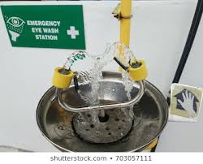

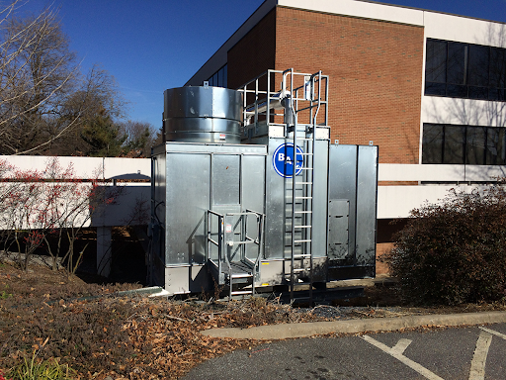
Legionnaires’ disease
L. pneumophila is a waterborne pathogen…
…that can grow in building water systems…
…and cause Legionnaires’ disease.

Slide 4
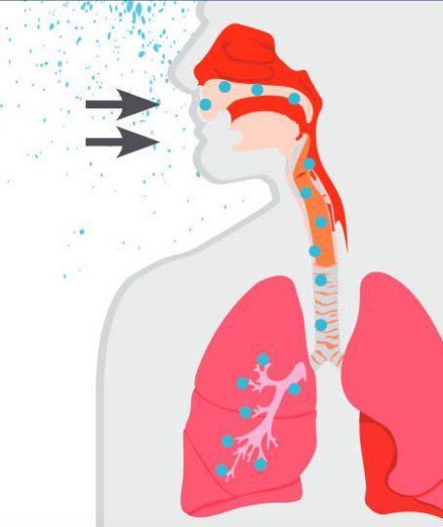
Legionnaires’ Disease is a Public Health Risk
Severe form of pneumonia
Fatal in 10-33% of cases
Contracted from inhaling contaminated water droplets
Not transmitted person to person
Increasing case count
600% increase since 2000 across the US
Sources: CDC, NASEM, VDH

Slide 5
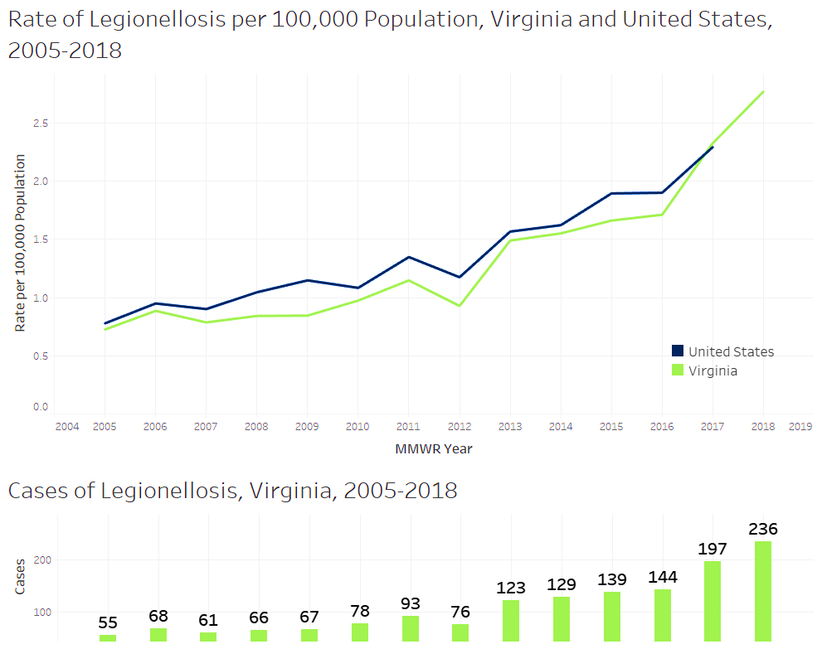
Notes:
This graph shows how cases of legionellosis in Virginia do not differ from national trends in regards to age or seasonality of cases.
Between 2005-2018, there were 1,532 confirmed or Probable cases of legionellosis reported in VA.
There were 2 suspect legionnaires’ disease outbreaks in Virginia in 2019; however, no common source was identified in those investigations.
VA LD case counts in 2019 & 2020 were lower than 2018; however, surveillance #'s remained constant during the pandemic (~same #'s as 2017).

Slide 6
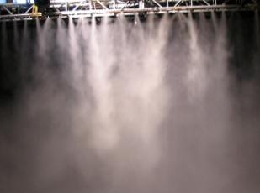
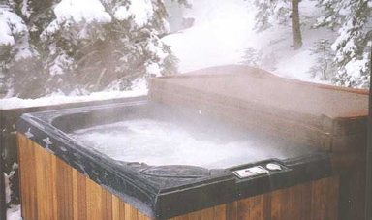
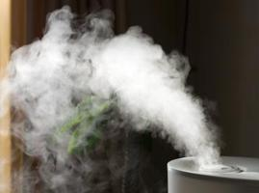
Transmission via Aerosolization (Inhalation or Aspiration)
Water droplets inhaled reach lung alveoli
Aspiration when gag reflex is bypassed
Invisible, <5 microns in size
Manmade sources of aerosols can be contaminated with Legionella
Notes:
Legionellosis is an infection caused by the inhalation or aspiration of water contaminated with Legionella bacteria; it is not transmitted from person to person.
Legionellae are generally spread through the air by aerosolized water.
(Water droplets must be inhaled deep into the lung and reach the alveoli)
A crucial aspect for transmission of Legionnaires’ disease is the number of organisms inhaled or aspirated into the lungs, which are then available for subsequent uptake and replication in alveolar macrophages. (Remember the 2-phase lifecyle?)
Additionally, the size (5um in diameter) of the aerosolized particles is critical to how deeply they become deposited within the respiratory tract, particularly on the surface of alveoli and terminal bronchioles.
Droplets of this size are invisible and have the physical properties of gas. Many different types of manmade water systems can serve as Legionella amplifiers and (aerosol) disseminators.
(Infection of surgical wounds has also occurred from potable water contaminated with Legionella.)

Slide 7
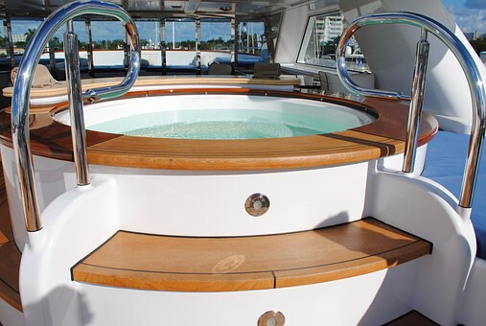
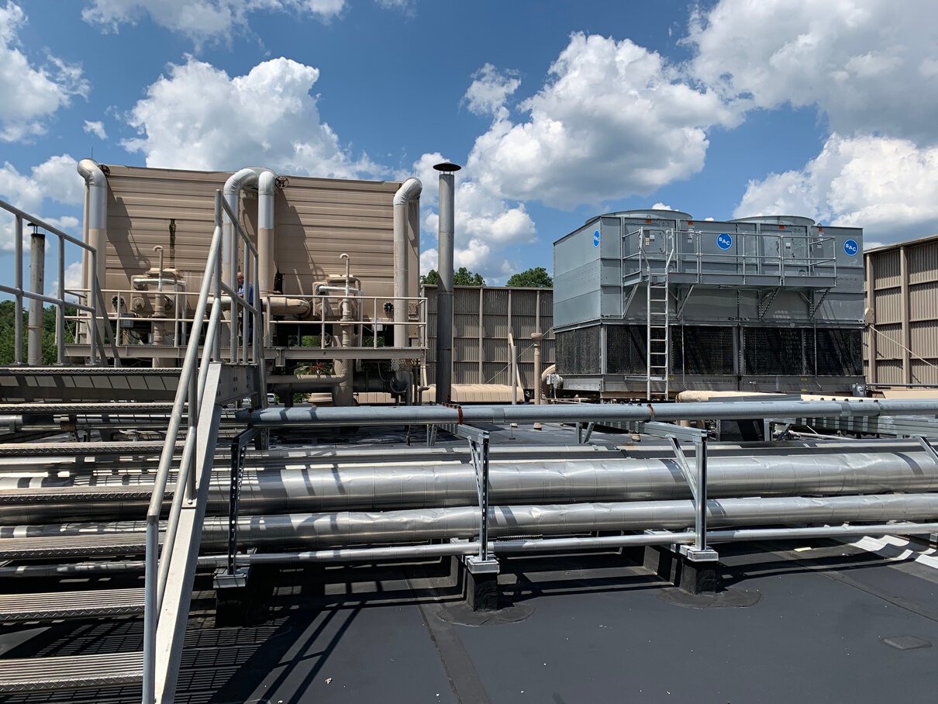
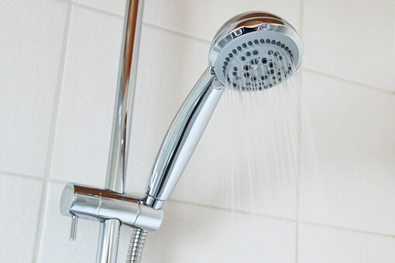
Water Sources & Settings
Possible Sources
Building plumbing
Air-Conditioning evap. condensers
Cooling towers
Spas, hot tubs
Decorative fountains
Mister devices
Common Settings
Hospitals
Health care facilities (ALF, long-term, etc)
Apts, residential bldg
Hotels/Motels
Prisons/Jails
Private homes
Notes:
Now, let’s talk about some of these manmade sources of aerosolization.
On the left side are the possible sources, and the right side shows where these sources might be found.
Assisted Living Facilities, long-term care or rehabilitation centers, etc.
Common places of exposure or previously implicated places include:
group residences, meeting rooms, dormitories, hotels, hospitals, and other mass gathering facilities.

Slide 8
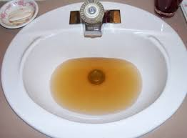
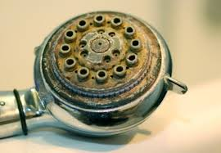
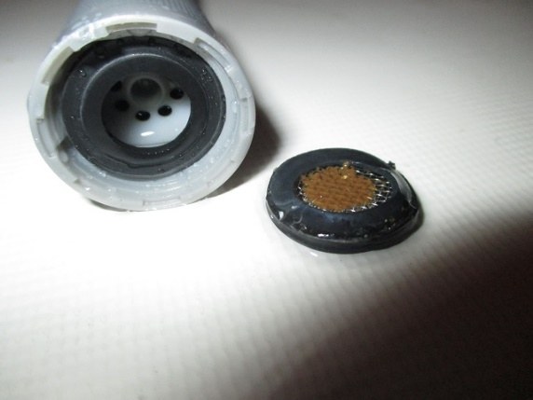
Building Plumbing
Temperature
Disinfectant
pH
Biofilm forms at dead legs
Showers and faucets design/maintenance
Notes:
Other key considerations when evaluating building water systems:
Water temperature in the premise plumbing of a building is important to preventing bacterial growth.
All ‘city’ water has been treated with some type of disinfectant, but this degrades over time and with increased distance from the water treatment source….so measuring the residual levels of chlorine throughout a building’s water system is key.
Biofilm forms at dead legs in plumbing design and basically any place where build of scum/biomass up can occur if it is not properly maintained.
Showers with detachable nozzles with the long hose, faucets with aerators that have not been cleaned or maintained

Slide 9
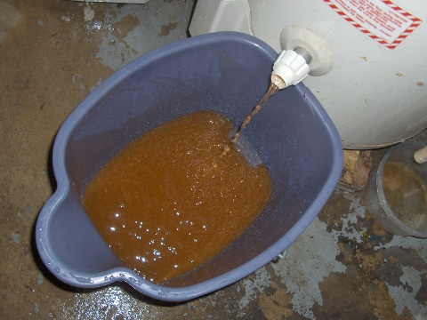
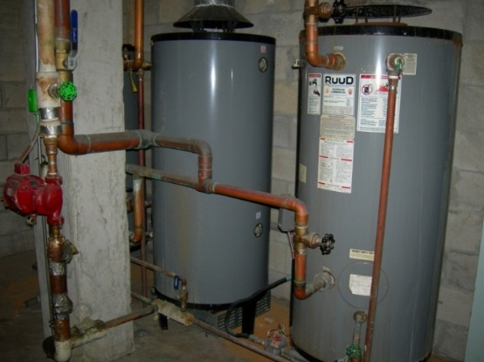
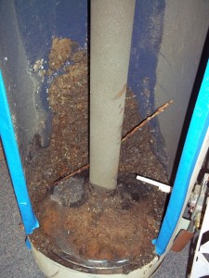
Education & PREVENTION is the KEY!
Hot water recirculates
Biofilm layer forms easily in storage tanks
Maintenance is essential
Notes:
Hot water recirculates throughout a building’s water system. This sounds good because we hear ‘recirculate’ and think that this means that there is water flow….but not necessarily. It basically means the opposite because we like ‘hot water’ at the ready….so this means that we hot store water. But just how hot is the water in your hot water heater? (Most people/facilities don’t routinely monitor this temperature.)
Biofilm layers form easily in storage tanks because the temperature is not consistent throughout the tank and sediment and debris settle to the bottom where there are usually cooler temps…remember Legionella like warm water, not too hot, but not cold.
Maintenance is essential to preventing a hot bed for Legionella proliferation!

Slide 10
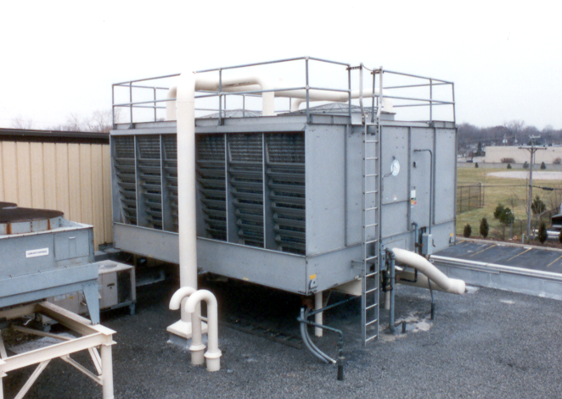
Cooling Towers
The smaller the water droplets, the more efficient the cooling
Maintenance
Location
Disinfectant
Water temperature

Slide 11
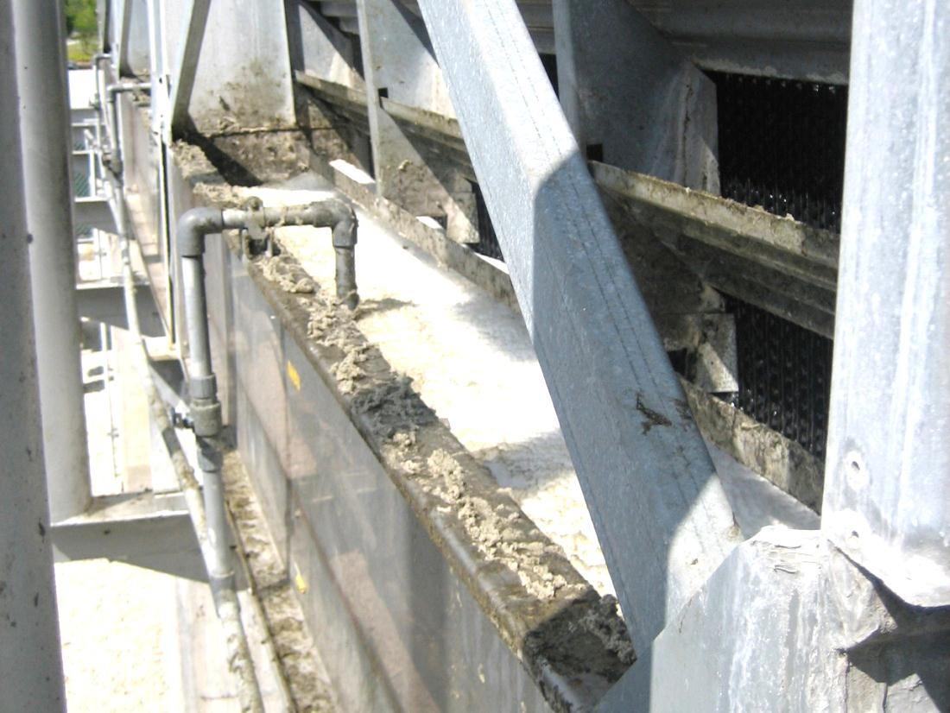
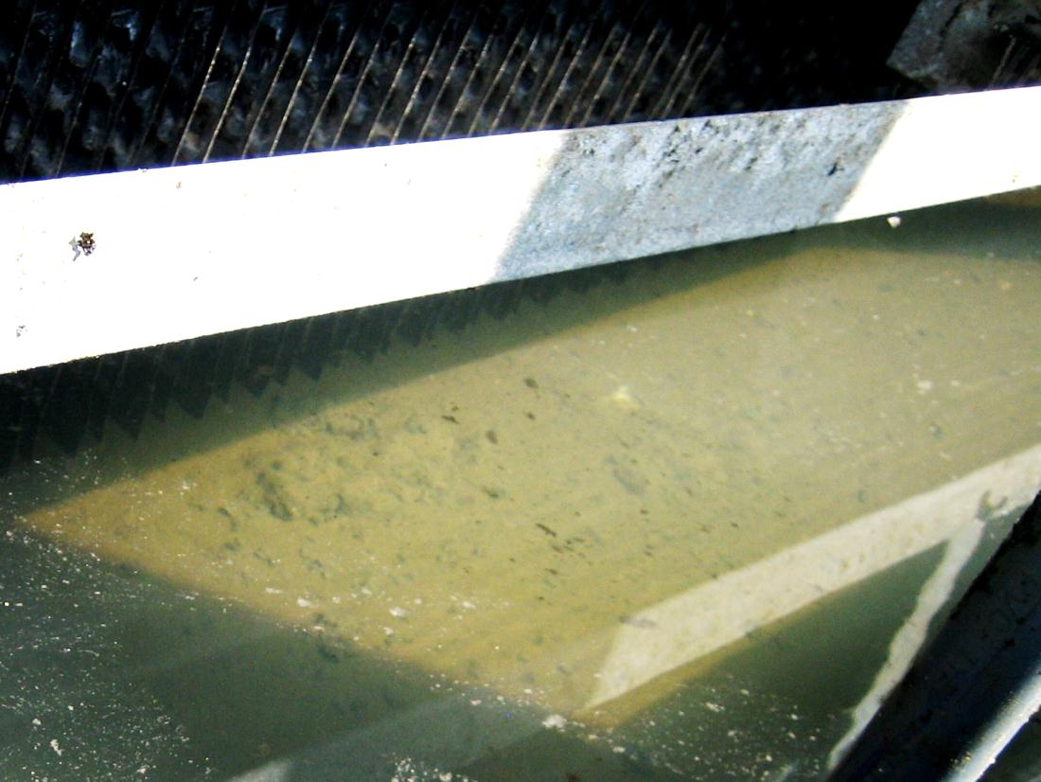
Cooling Towers

Slide 12
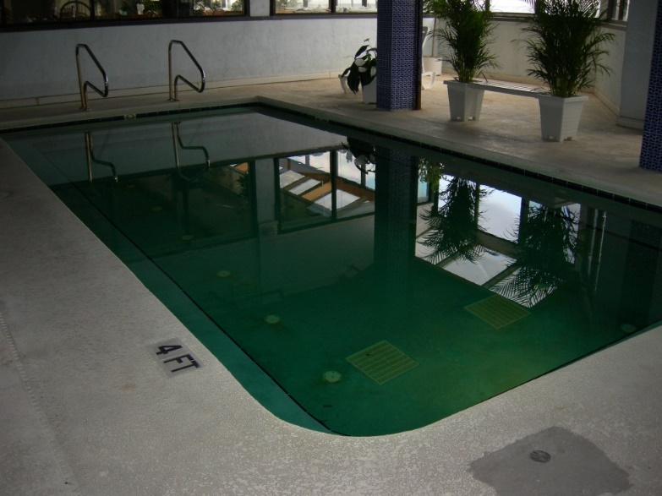
Spa/Whirlpool/Hot tub
Jets aerosolize water droplets
Temperature
Disinfectant
pH
Maintenance
Notes:
Pools are very low risk – no way to aerosolize water droplets
Splashing doesn’t create small enough droplets

Slide 13
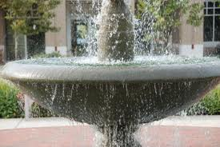
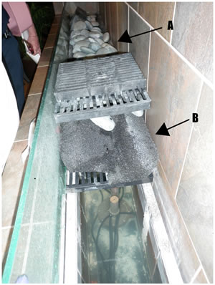
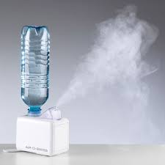
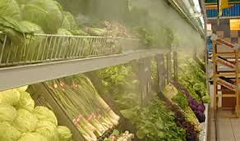
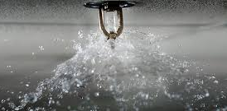
Decorative Fountains & Other Possible Sources

Slide 14
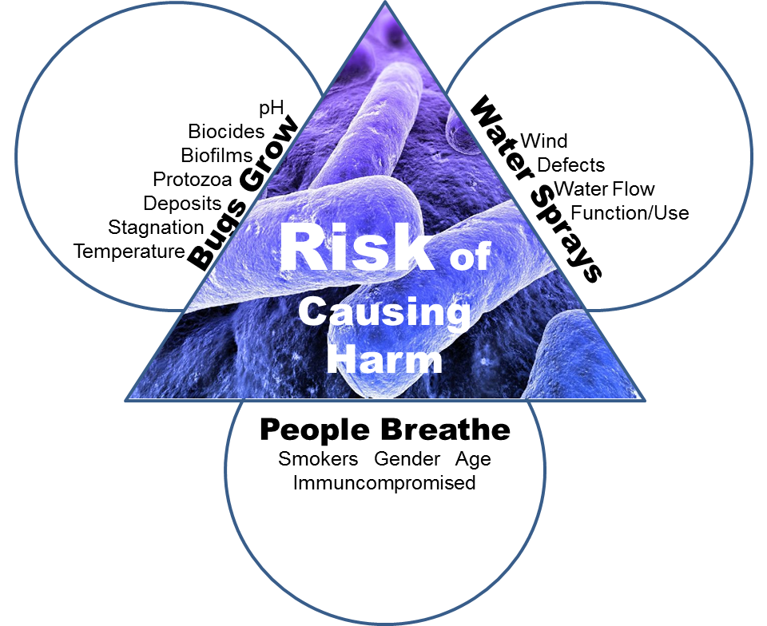
Notes:
The risk of illness after exposure to a water source depends on several factors:
Pathogen proliferation:
-the way the bacteria multiply within amoebae
-presence of biofilms
-bacterial load & strain virulence
Aerosol exposure:
-the source’s ability to form aerosols
-droplet size
-effectiveness of dissemination/distance
Susceptible population:
There is no known difference in risk factors for developing LD vs. PF
Host susceptibility risk factors may include:
-Males
> 65 years of age (Not common in people <50, very rare in <20)
-Smoking
-Alcoholism (Hepatic or renal failure)
-Diabetes
-COPD
-Congestive heart failure
-Malignant cancers
-Immune system disorders
(Recent travel with overnight stay away from home - Whirlpool spa exposure)

Slide 15
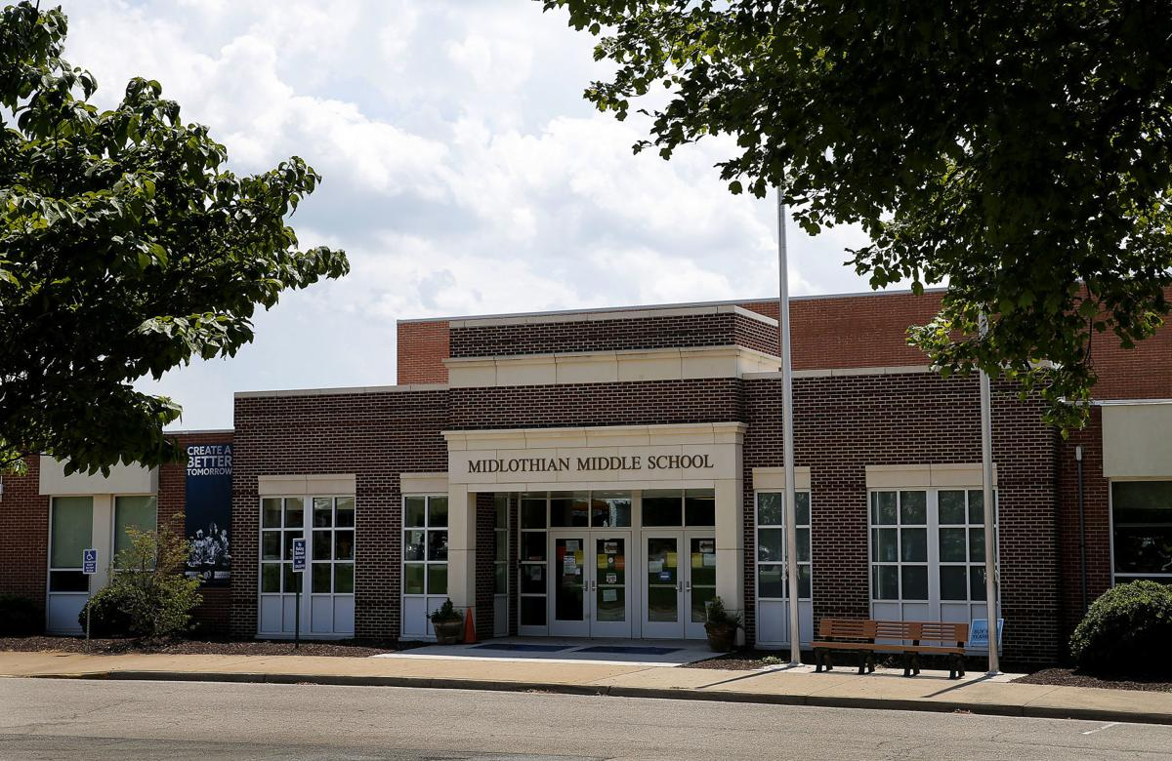
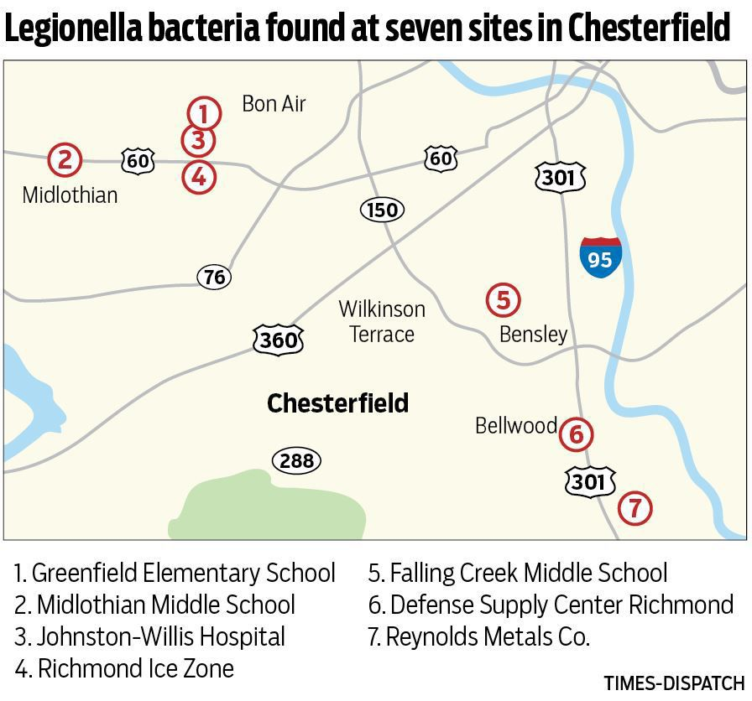
Legionnaire’s Disease in the News
August 7, 2019
Legionella bacteria found at seven Chesterfield locations — including a hospital and three schools
By SEAN GORMAN Richmond Times-Dispatch
Notes:
“Health officials have been scouring sites in Chesterfield following 10 confirmed cases of Legionnaires’ disease, a type of pneumonia, among residents in the northeast part of the county over the past couple of months, but they acknowledge they may never know exactly where any of the patients contracted it. Health officials said they normally expect to see an average of three cases over the course of a summer.
The bacteria, which occurs naturally in lakes and streams, was found in cooling towers at the seven locations, Samuel said. Cooling towers are a major source of the disease because they contain warm water for the bacteria to grow, and water droplets from the towers can spread it through the air. “
“When you test for something, you’re going to find it. Really, this bacteria is fairly common,” Samuel said. “The greater issue, of course, is whether the sites that have tested positive were the source of bacteria that caused the Legionnaires’ in the cases. That has not yet been determined.”
Officials may never know the answer to that question, Samuel said, adding it’s a complicated task to definitively link the cases to the sites.
“We have the 10 cases, which could simply be an increase over normal [levels] that we might never be able to explain,” Samuel said. “We simply want to go through an investigation to rule out potential sources.”
Chesterfield school officials have been sending emails to parents in the three schools in recent days and weeks, noting that no school or staff members at the three schools have reported becoming sick as result of the bacteria, which was found in outside cooling towers.
The school system sent messages to parents in the two middle schools on Tuesday saying that the facilities would be closed on Wednesday “out of an abundance of caution” and that the cooling towers at the schools were being cleaned.

Slide 16

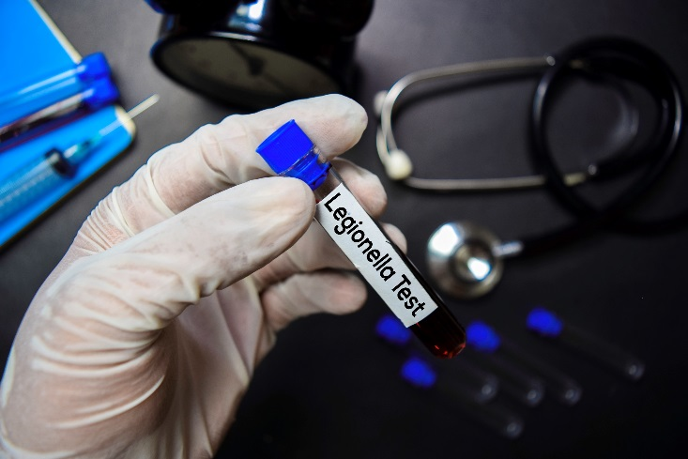
Legionnaire’s Disease in the News
Contractor warned school officials of uncleaned HVAC units
By managingeditor@localnewsllc.com on August 21, 2019
BY JIM McCONNELL AND RICH GRISET STAFF WRITERS
Notes:
Months before the Virginia Department of Health began investigating an increase in cases of Legionnaires’ disease in Chesterfield, the contractor hired to service HVAC units at county schools repeatedly alerted school officials about significant maintenance problems and recommended testing for Legionella bacteria, documents show.
The school system has come under fire in recent weeks after cooling towers at three Chesterfield schools – Greenfield Elementary, Midlothian Middle and Falling Creek Middle – tested positive for Legionella, a strain of bacteria known to cause Legionnaires’ disease, a severe form of pneumonia.
Following confirmation of the positive test at Greenfield, the Observer obtained monthly reports submitted by Water Chemistry Inc., the Roanoke-based company that performs routine service of HVAC units for the county and school system, through a Freedom of Information Act request.
The reports, which go back to June 2018, include testing data (pH, alkalinity, conductivity, etc.), observations and remarks about the condition of each unit, as well as service recommendations. Taken together, the documents describe a school system beset by poorly maintained, malfunctioning and at times inoperable HVAC components, including many cooling towers that hadn’t been cleaned for two or more years.
“We had no idea [school officials] weren’t doing basic [HVAC] maintenance,” Board of Supervisors Chairwoman Leslie Haley said in an interview Sunday. “This is much more than a 2019 problem. This goes back multiple years and has likely led to increased major maintenance costs.”
In its June 2018 report, Water Chemistry Inc. noted it “highly recommends physical cleaning of [cooling tower] equipment and additional disinfection procedures” in accordance with federal Occupational Safety and Health Administration guidelines.

Slide 17
Va. Code § 22.1-138. Minimum standards Public School Buildings
Maintain a water management program at each public school building in the school division
Validate at least annually
Maintain files for the water management program
Include results of all validation and remediation
Make files available for review
Notes:
There were two enactment clauses –
2. That the Department of Education shall make recommendations for the establishment, maintenance, and validation of water management programs to prevent Legionella pneumophila growth in public school buildings and shall notify each local school board of its recommendations no later than July 1, 2021.
3. That the provisions of the first enactment of this act shall become effective on July 1, 2021.
C. Each school board shall maintain a water management program for the prevention of Legionnaires' disease at each public school building in the local school division. Each school board shall validate each water management program on at least an annual basis to maintain the health and decency of such buildings. Each public school shall maintain files related to its water management program, including the results of all validation and remediation activities, and make such files available for review.

Slide 18
Dept of Education Policy Guidance
Center for Disease Control and Prevention (CDC) has a toolkit
https://www.cdc.gov/legionella/wmp/toolkit/index.html
Va. Dept. of Health has a website to help
https://www.vdh.virginia.gov/drinking-water/implementing-sb-410-in-school-buildingstartup/
ANSI/ASHRAE Standard 188-2021
https://www.ashrae.org/news/esociety/newly-updated-standard-188
Notes:
VDH’s website references the other materials with CDC and ASHRAE. VDH also has an example template for creating a water management program, as well as a link for consultants who have told VDH that they provide water management program services. Obviously, VDH does not endorse or promote a consultant and the list is populated as consultants let us know that they provide the services. There are also some FAQs related to water management programs that you can review. The Center for Disease Control and Prevention (CDC) has a toolkit for developing a water management program at this link: https://www.cdc.gov/legionella/wmp/toolkit/index.html. The Virginia Department of Health established a specific website to help school boards better understand requirements of the legislation and to implement it. This information is found at this link: https://www.vdh.virginia.gov/drinking-water/implementing-sb-410-in-school-buildingstartup/. Additional information on the American National Standards Institute (ANSI)/ American Society of Heating, Refrigerating and Air-Conditioning Engineers (ASHRAE) Standard 188-2018 can be found at Legionellosis: Risk Management for Building Water Systems. The above resources describe the process for creating a water management program as follows: A water management program identifies hazardous conditions and takes steps to minimize the growth and spread of Legionella and other waterborne pathogens in building water systems. Developing and maintaining a water management program is a multi-step process that requires continuous review. Seven key activities are routinely performed in a Legionella water management program:

Slide 19
A Water Management Program is a Multi-step Process
Set of procedures to reduce the occurrence of Legionnaires’ disease
Typically provided by consultants
Requires building administration and operations/maintenance collaboration
ASHRAE* Standard 188
Accredited standard for water management programs in North America
Result of a 7+year multi-stakeholder process
Basis for the CDC’s Toolkit
Notes:
CDC's recommendations in their publication, 'Developing a Water Management Program to Reduce Legionella Growth and Spread in Buildings,' include an approach similar to a food safety HAACP plan.
https://www.cdc.gov/legionella/downloads/toolkit.pdf
- Identify critical control points
- Define control measures and establish limits for each control point
- Monitor to ensure control measures are performing as designed – i.e. regular log of temperatures and chlorine residuals
- Control limits (quantifiable, measurable, physical/chemical parameter) should include a minimum and a maximum value – i.e. temperature or chlorine
- Identify corrective actions for when control limits are deviated from.

Slide 20







7 key steps – Water Management Program
IDENTIFY THE TEAM
DESCRIBE THE SYSTEM
IDENTIFY RISK AREAS
DETERMINE CONTROLS
MONITORING & CORRECTIVE ACTIONS
VERIFY & VALIDATE THE PROGRAM
DOCUMENT!
Sources: ASHRAE

Slide 21
Effective Water Management Programs require broad involvement
Required Skills
Ability to oversee the program
Knowledge of water systems
Ability to identify control locations and limits
Ability to identify and take corrective actions
Ability to monitor and document program performance
Ability to confirm program performance
Ability to communicate regularly about the program
Potential Members
Principal or Superintendent
Director of operations or facilities
Maintenance or engineering employees
Equipment or chemical suppliers
Contractors or consultants
Certified industrial hygienists
Microbiologists
Environmental health specialists
State & local health officials
Sources: ASHRAE

Slide 22
IDENTIFY THE TEAM
DESCRIBE THE SYSTEM
IDENTIFY RISK AREAS
DETERMINE CONTROLS
MONITORING & CORRECTIVE ACTIONS
VERIFY & VALIDATE THE PROGRAM
School buildings differ -
Structure, age, location, past remodels
Each one needs a tailored plan.
Use flow diagrams and a written description -
Where does the building connect to the water supply?
How is water distributed?
Where are the water heaters or boilers?
Where are the cooling towers and eye-wash stations?
Notes:
Does your building have a centralized hot-water system
* Does your building have more than ten stories?
* Does your building have a cooling tower?
* Does your building have a hot tub?
* Does your building have a decorative fountain?
* Does your building have a mister, air washer, or humidifier?

Slide 23
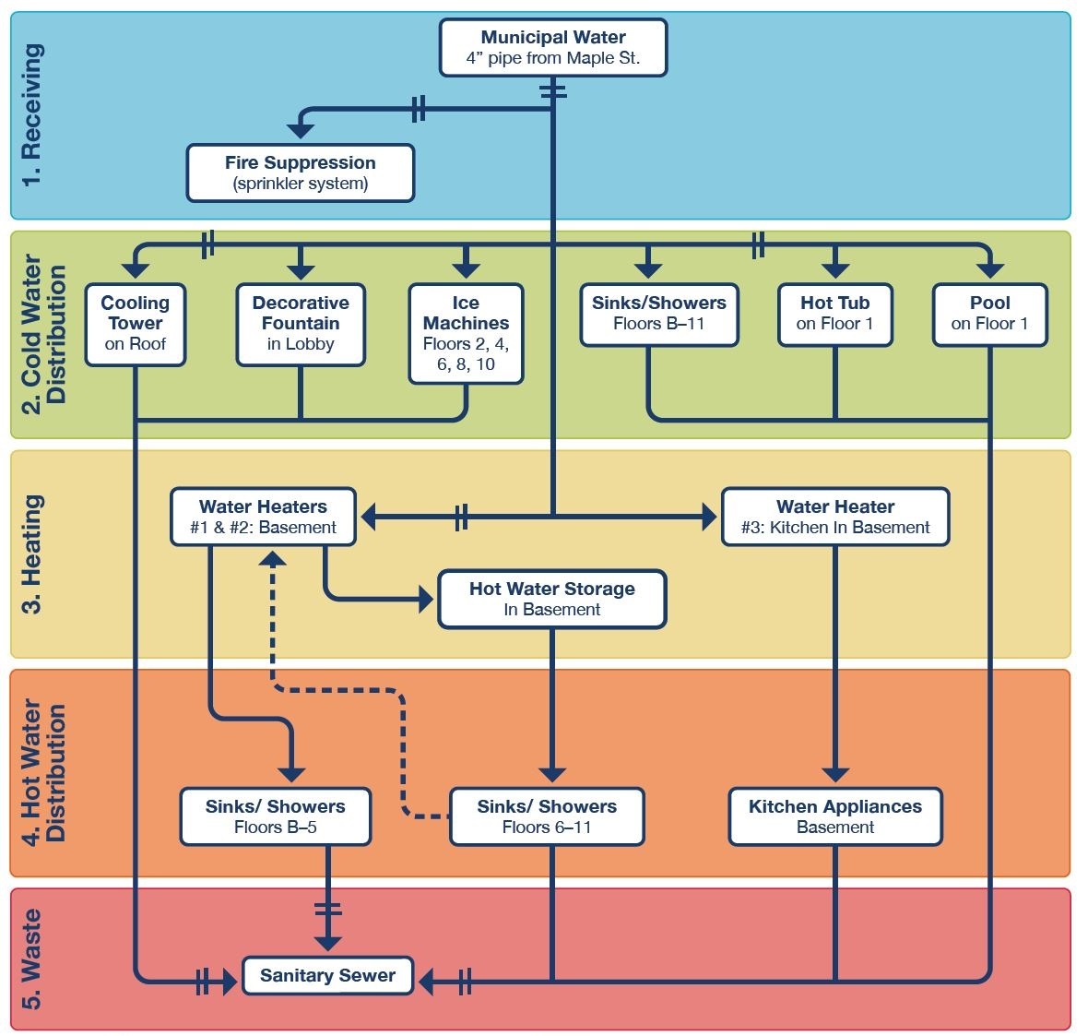



Describe building system: Process Flow Diagram
CDC 188 Toolkit
Sources: ASHRAE, CDC
Notes:
High level documents that help everyone understand how water flows rather than highly detailed plumbing schematics.

Slide 24
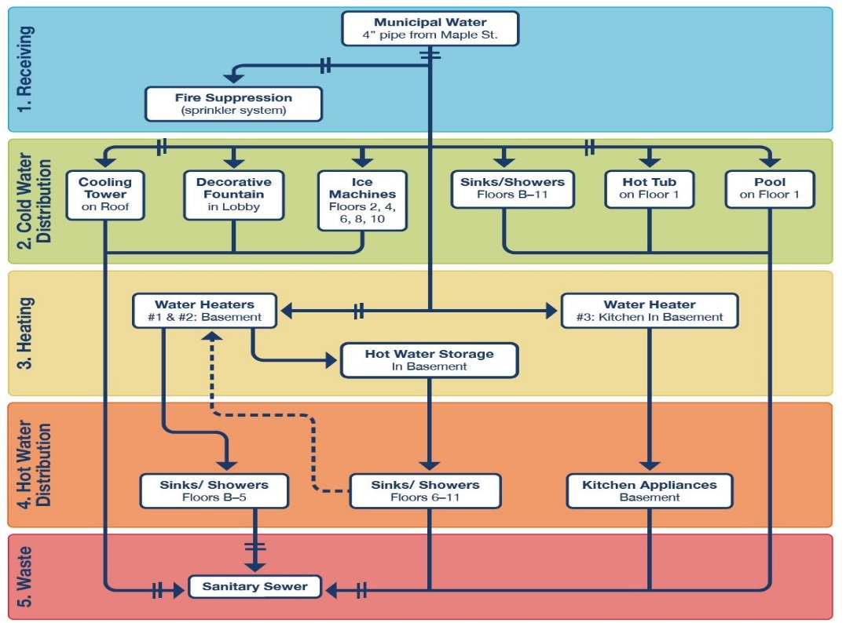
IDENTIFY THE TEAM
DESCRIBE THE SYSTEM
IDENTIFY RISK AREAS
DETERMINE CONTROLS
MONITORING & CORRECTIVE ACTIONS
VERIFY & VALIDATE THE pROGRAM
Dead legs
Pipes that go nowhere
Low-flow areas
Slow water movement
Water conservation faucets
Faucets and shower heads
Sprinklers
Eye-wash stations
Ice machines
Cooling towers
Decorative fountains
Sources: ASHRAE, CDC

Slide 25

IDENTIFY THE TEAM
DESCRIBE THE SYSTEM
IDENTIFY RISK AREAS
DETERMINE CONTROLS
MONITORING & CORRECTIVE ACTIONS
VERIFY & VALIDATE THE pROGRAM
Maintain water temperature
Hot water stays hot
Cold water stays cold
Prevent stagnation
Ensure disinfection
Prevent biofilm and scale
Stop corrosion
1. Set Control Limits
for each point where control is applied
2. Determine Monitoring
Method
for each point where control is applied
3. Set Monitoring
Frequency
for each point where control is applied
4. PRE-determine Corrective
Actions
for when control measures are Outside of Limits

Slide 26
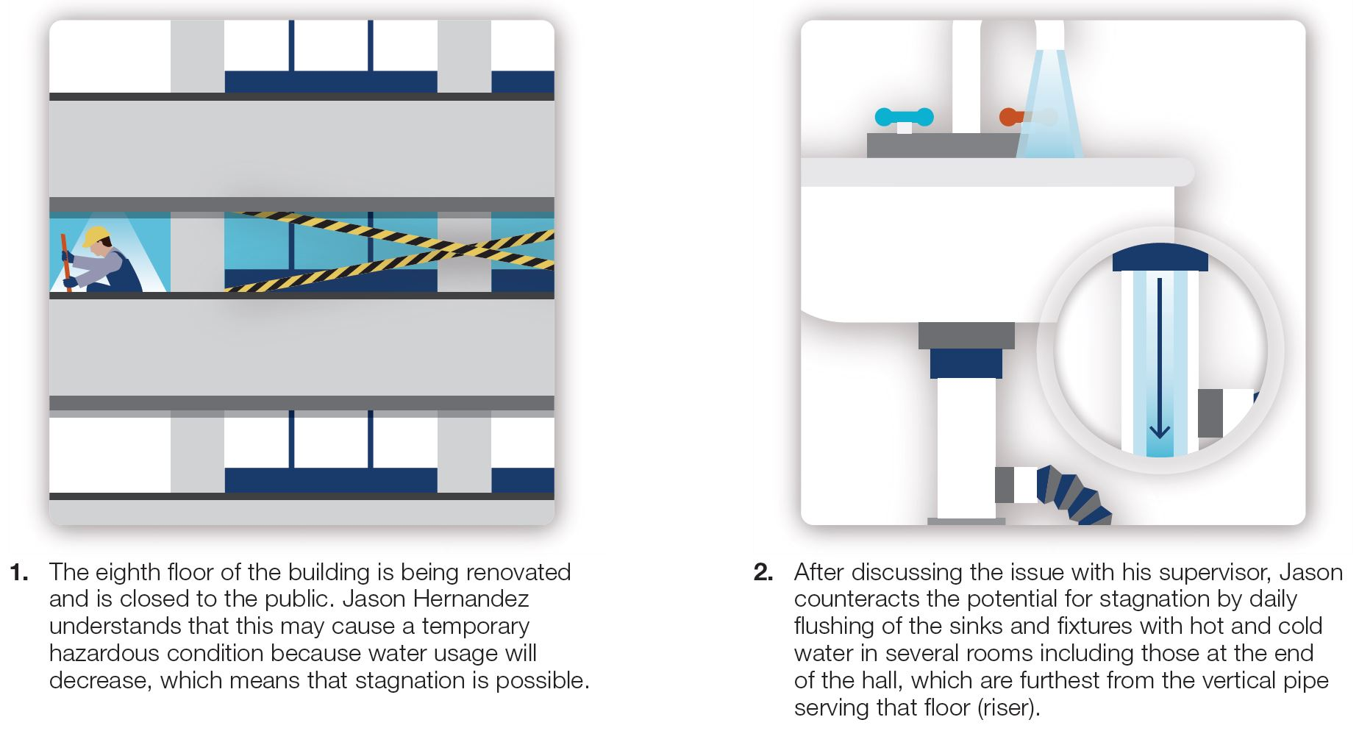
IDENTIFY THE TEAM
DESCRIBE THE SYSTEM
IDENTIFY RISK AREAS
DETERMINE CONTROLS
MONITORING & CORRECTIVE ACTIONS
VERIFY & VALIDATE THE PROGRAM
Example 1: Unoccupied Area - flushing
CDC Toolkit example

Slide 27
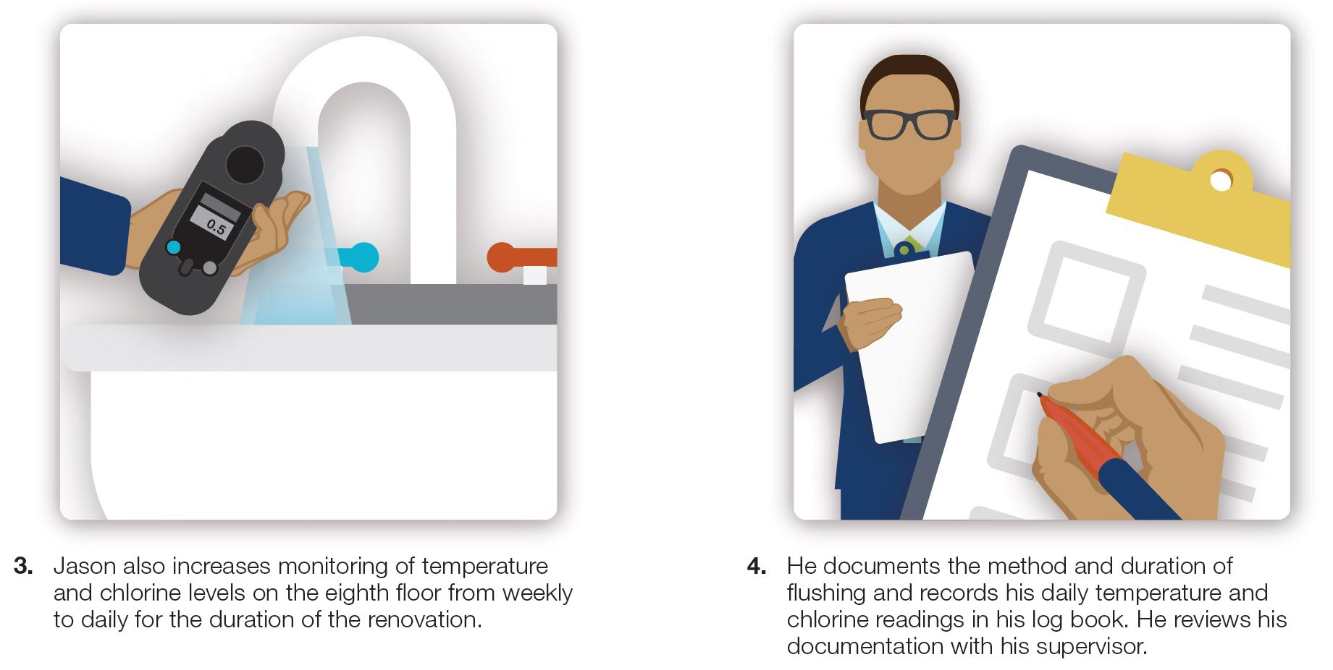
IDENTIFY THE TEAM
DESCRIBE THE SYSTEM
IDENTIFY RISK AREAS
DETERMINE CONTROLS
MONITORING & CORRECTIVE ACTIONS
VERIFY & VALIDATE THE PROGRAM
Example 2: Unoccupied Area – increased monitoring
CDC Toolkit example

Slide 28
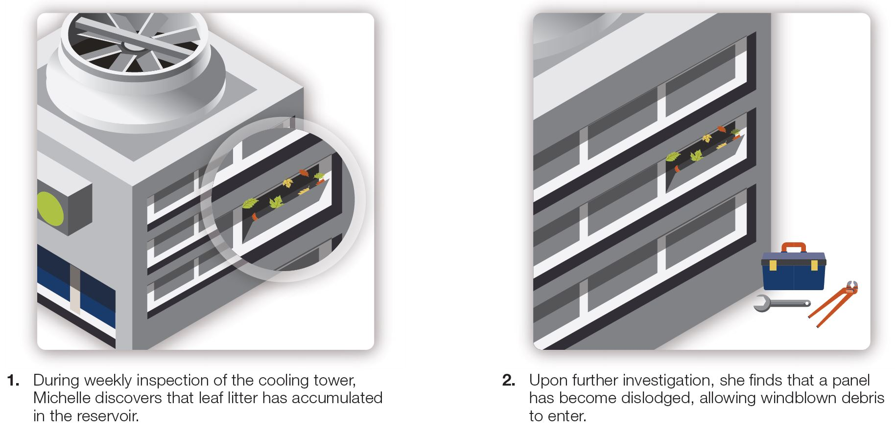
IDENTIFY THE TEAM
DESCRIBE THE SYSTEM
IDENTIFY RISK AREAS
DETERMINE CONTROLS
MONITORING & CORRECTIVE ACTIONS
VERIFY & VALIDATE THE PROGRAM
Example 3: Debris in the Cooling Tower
CDC Toolkit example

Slide 29
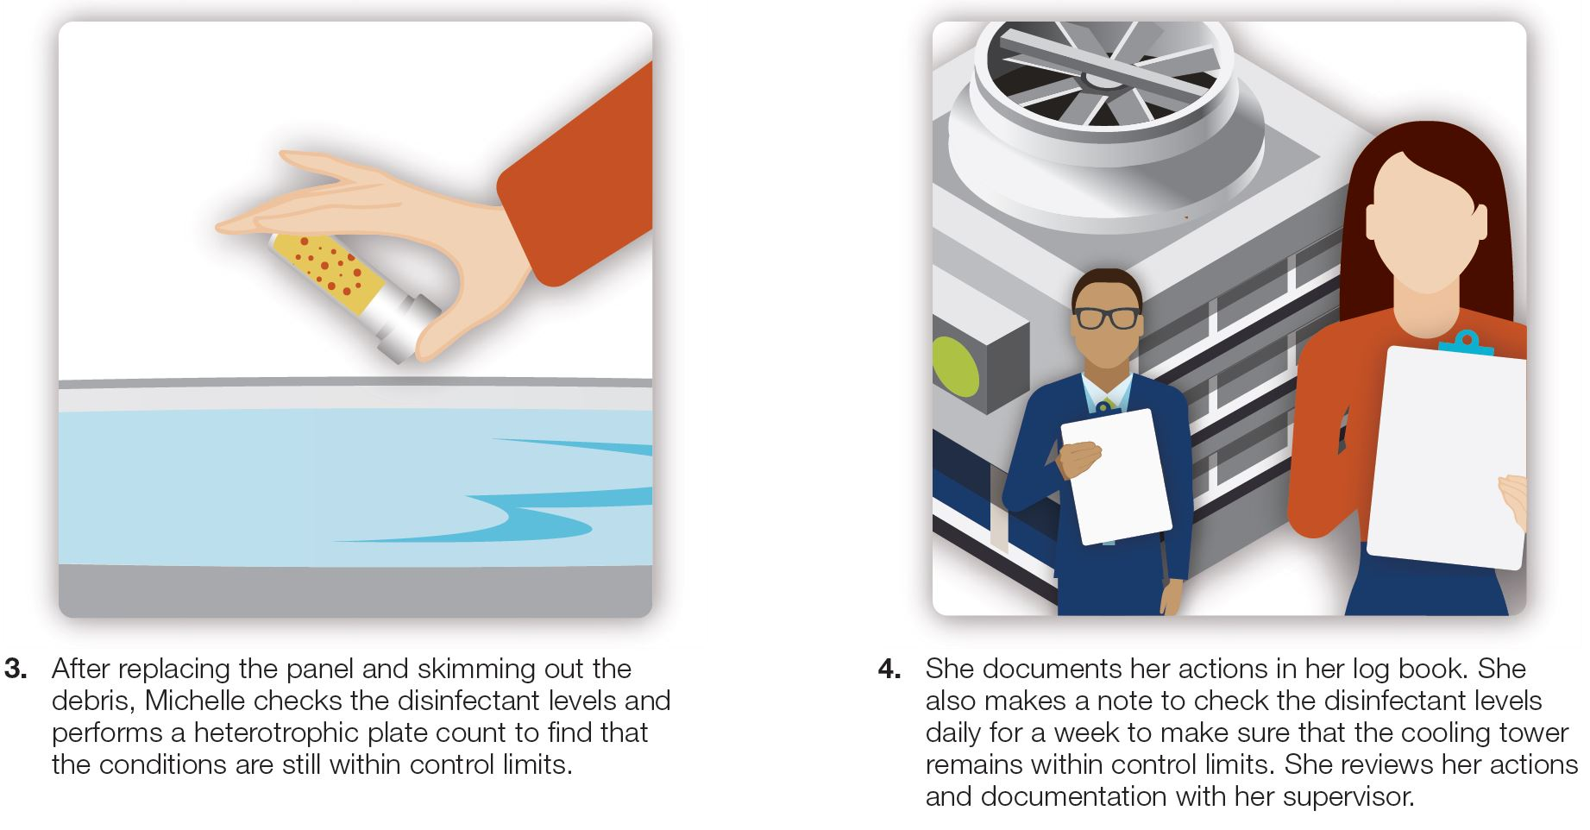
IDENTIFY THE TEAM
DESCRIBE THE SYSTEM
IDENTIFY RISK AREAS
DETERMINE CONTROLS
MONITORING & CORRECTIVE ACTIONS
VERIFY & VALIDATE THE PROGRAM
Example 3: Debris in the Cooling Tower
CDC Toolkit example

Slide 30


IDENTIFY THE TEAM
DESCRIBE THE SYSTEM
IDENTIFY RISK AREAS
DETERMINE CONTROLS
MONITORING & CORRECTIVE ACTIONS
VERIFY & VALIDATE THE PROGRAM
Verification:
Confirms Water Management Program activities are completed
For example:
Checking temperatures
Checking disinfectant
Verifying cleaning done properly
Ensuring documentation
Validation:
Confirms the Water Management Program is effective at reducing risk even as conditions change (and they will)
TESTING for bacteria is best practice and the most common form of validation, used by industry experts and consultants
Sources: ASHRAE
Notes:
What Oepi at VDH has found during environmental health assessments at long-term care facilities with a confirmed case (who spent their entire 14-day incubation period there), and later had an additional case within the same year even AFTER conducting remediation of some sort, is that documentation is absolutely key to identifying trends in legionella test results & water quality parameters. Looking at monthly testing results and logs allowed staff to pinpoint equipment failures or human errors that led to reseeding (& amplification) of legionella bacteria in premise plumbing systems.

Slide 31
validation: initial and ongoing confirmation that the water management program controls hazardous conditions throughout the building.
ASHRAE Standard 188 recommends
using accredited laboratories
Accreditation includes:
Quality Management System
Regular 3rd party audits
Contract procedures, including Chain of Custody
Quality Assurance
Relevant laboratory accreditations include:
ISO 17025
AIHA/EMLAP
TNI Standard
Source: ASHRAE, Association of Public Health Laboratories Bridges Newsletter
Notes:
Per the CDC, CDC ELITE “laboratories should be considered for environmental testing conducted as part of an investigation into cases of disease.”
An Accredited Laboratory should be considered for routine environmental monitoring, such as is done as part of a Water Management Program (Per ASHRAE 188 and CDC)
Some laboratories have both designations

Slide 32
Two types of Validation - ASHRAE 188
Reactive: Epidemiological surveillance; Legionnaires’ disease outbreak
Advantage: Less initial cost
Risk: Cases of disease that could have prevented, costly investigations and/or emergency mitigation services ($$$)
Proactive: Routine water testing for Legionella pneumophila
Advantage: Data available to confirm/improve program effectiveness, prevent disease and answer questions if needed
Risk: Routine testing cost ($, see following slides); can lead to changing procedures if risk is identified
Which is used most?
Routine water testing is used by the vast majority of consultants and building managers to maintain low risk of disease
Avoid emergency expenses

Slide 33
Routine testing & Program costs
From a prominent national water safety planning group:
“As a leader in water treatment and water management planning, Garratt-Callahan supports, recommends, and uses routine Validation testing as an integral part of an effective water management plan to prevent Legionnaires’ disease.
……
Routine Validation testing is the tool that can provide an alert that changes may be needed to the plan; seeing changes early in bacterial testing can allow for a measured, pre-planned response by the team versus an acute response to an illness or outbreak.”
David Crow
Garratt-Callahan Co.; Water Safety Group, Since 1904 ASSE 12080 Certified - Legionella Water Safety & Management Water Treatment Specialist Class III, State of Texas

Slide 34
Routine testing Costs
Routine testing costs
Test 5 – 10 samples per quarter at $45 - $125/sample; cost range $900-$5000 per year for quarterly testing
May lower insurance premiums
Having data may lower litigation probability
Potential costs using epidemiological monitoring
Emergency disinfection: $2,500 – 10,000+ per event
Potential litigation cost for a case/outbreak
Damage to public opinion
Notes:
Quarterly testing is recommended, but even semi-annual or annual testing provides information that a water management program team can use. An ounce of prevention is worth a pound of cure. Benjamin Franklin
Routine water testing is a common practice used by Federal Regulators such as US EPA for drinking water and by FDA for bottled water; there are strict disinfection protocols to ensure water is safe, but testing is used to Validate these processes.
Clinically, routine testing is also used; if one has diabetes, takes medication, eats well and sees the doctor; the doctor is still going to ask you to test your blood at least daily to assess for incremental changes.
Routine Testing keeps overall cost down; addressing issues early (and with a pre-determined plan!) illnesses and deaths can be prevented.

Slide 35
Questions?
Legionnaire’s Disease – causes & prevention
Code of Virginia Requirements & Expectations
The Elements of a Water Management Program
Resources available to help

