Slide 1
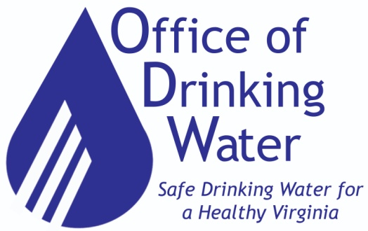
Financial & Construction Assistance and Capacity Development Programs January 2022

Slide 2
Contacts
VDH Richmond Central Office – FCAP Contacts
Kelly Ward, Division Director
Email: Kelly.Ward@vdh.virginia.gov (804) 864-7201
2. May Fornari, Project Manager
Email: May.Fornari@vdh.virginia.gov (804) 584-8412
3. Howard Eckstein, VCCO, Project Officer
Email: Howard.Eckstein@vdh.virginia.gov (804) 864-7507
VDH Richmond Central Office – Capacity Development
Barry Matthews, CPG, Director – Division of Training, Capacity Development and Outreach
Email: Barry.Matthews@vdh.virginia.gov (804) 864-7515
As of February 14, 2019

Slide 3
FCAP Project Contacts
Lexington Field Office
Keith Kornegay, P.E., Project Team Leader
Email: Keith.Kornegay@vdh.virginia.gov (540) 463-0420
Anthony Hess, MBA, Project Manager
Email: Anthony.Hess@vdh.virginia.gov (540) 463-0419
Matt Beyer, Program Support Technician
Email: Matt.Beyer@vdh.virginia.gov (540) 463-0406
Abingdon Field Office
4. Jack Hinshelwood, P.E., Project Engineer
Email: Jack.Hinshelwood@vdh.virginia.gov (276) 525-6167
5. Brad Humphrey, Project Manager
Email: Brad.Humphrey@vdh.virginia.gov (276) 525-6152
As of February 4, 2022

Slide 4
FCAP Project Contacts
Danville Field Office
Tamara Anderson, Project Manager
Email: Tamara.anderson@vdh.virginia.gov (804) 370-2439

Slide 5
Webcast Agenda
Overview - Office of Drinking Water (ODW) and Financial & Construction Assistance Program (FCAP)
What’s New for FY23 Construction Funds?
What’s Continued from Previous Years?
FCAP Funding Eligibility and Program Details
FCAP Applications – Refinance, Construction, and Source Water Protection
Funding Through Capacity Development

Slide 6
Office of Drinking Water
Mission
Protect public health by ensuring that all people in Virginia have access to an adequate supply of clean, safe drinking water that meets federal and state drinking water standards.
http://www.vdh.virginia.gov/drinking-water/

Slide 7
FCAP Funding Sources
FCAP manages the following two funding sources:
Drinking Water State Revolving Fund (DWSRF) Program = federal funds + state match
Expected Funding - Bipartisan Infrastructure Law
Note: For all proposed construction projects, regardless of the funding source, please use our Construction Application.

Slide 8
Drinking Water State Revolving Loan Fund (DWSRF) Goal
Provide a comprehensive and integrated technical and financial assistance program to waterworks through a balanced approach of using set-asides and construction funds.

Slide 9
Drinking Water State Revolving Loan Fund
Construction/Project Funds:
Correcting public health problems and ensuring compliance with the Safe Drinking Water Act and state regulations
Replacing Aging Infrastructure & Critical Assets
Other
Set-asides Funds (non-construction):
Enhance the long term capacity to produce safe drinking water
Program admin, courses, scholarships, planning & design funds, direct technical assistance, & more!

Slide 10
Construction Funding History
Since 1997 the DWSRF program has funded 440
projects for a total amount of $494,309,168.
Notes:
Data includes projects through 2020.

Slide 11
What’s New for FY 23 Construction Funding?

Slide 12
What’s New for FY 23 Construction Funding?
DWSRF Annual Capitalization Grant
$18 M (approx.) to be available in 2023
The grant is part of the $36 M total construction funding available.
Bipartisan Infrastructure Law
$88 M (approx.) for Emerging Contaminants, Lead Service Line replacement, and DWSRF Supplemental.
Other Items of Interest
FCAP is able to fund large capital improvement projects (upwards of $10 M). Phased approach for these projects.
Typical interest rates range from 1.5% to 2.5% for a 20 year loan term, and 2.0% to 3.0% for a 30 year term (30 year term is for disadvantaged waterworks).

Slide 13
What’s New for FY 23 Construction Funding?
The application deadline for Infrastructure Investment and Job Acts (BIL) funding (Lead Service Line, Emerging Contaminants, SRF Supplemental) is April 8th
The application deadline for standard DWSRF funding (construction, refinance, source water protection) is May 6th

Slide 14
What’s New for FY 23 Construction Funding?
There are new check boxes at the top of the application so applicants indicate whether they want to be considered under Infrastructure Funding, DWSRF Funding, or Both.
There is a new separate application for the Lead Elimination Assistance Program (LEAP).

Slide 15
What’s New for FY 23 Construction Funding?
We modified the Construction Application scoresheet to Award 10 Public Health Points for the following: Taking over, or providing water service to customers of an abandoned waterworks.
We added a new Environmental Justice (EJ) section to the Construction application and scoresheet. EJ communities can qualify for “Disadvantaged” status. See the Program Design Manual Section VII, D for detailed information.

Slide 16
What’s Continuing From Previous Years?

Slide 17
What’s Continued From Previous Years?
The Construction funds Application has been updated and reorganized.
The number of Attachments has been reduced.
The list of Attachments is now the last page of the Application.

Slide 18
What’s Continued From Previous Years?
The pre-application meeting with the Field Office is now called the "Funding Application Discussion."
The applicant should bring a detailed project description and cost estimate to discuss with the Field Office.
Applicants are advised to have the Funding Application Discussion with the appropriate ODW Field Office at least 30 days prior to the deadline for the type of funding the recipient is applying for. Please submit the meeting minutes with the Construction Application.

Slide 19
What’s Continued From Previous Years?
Lead Service Line Replacement (LSLR) Program has been revamped and the Lead Elimination Assistance Program (LEAP) has taken it’s place.
LEAP contains a new scoring system, developed just for LSLR projects.
Marketing material have been developed and can be personalized for your project.
Each year $2,000,000 is dedicated to fund these projects, with a maximum Principal Forgiveness grant award of $500,000 per funding cycle. If larger amounts are needed, we can talk.
FCAP has funded 8 LSL replacement projects since 2018.

Slide 20
What’s Continued From Previous Years?
Readiness to Proceed
Funding offers may not be made to waterworks owners that have more than two open DWSRF funded projects.
FCAP reserves the right to determine this on a case by case basis and will consider many factors including acute and/or chronic health issues.
Owners should focus their efforts on completing open DWSRF projects that have already been awarded.
Applicants can withdraw from consideration any open project that they believe are of lesser priority to reduce the number of open DWSRF projects.

Slide 21
What’s Continued From Previous Years?
Readiness to Proceed and Timely Use of Funds
To promote readiness to proceed and timely use of funds, FCAP offers reduced interest rates (of up to 20 bps) for recipients that can close loans within 12 months of the award date under the Expedited Closing Program.
Time is of the essence!

Slide 22
What’s Continued From Previous Years?
Asset Management Plans (AMP)
Approximately 50% of the applicants have them, however,
Since 2018 all applicants:
Are required to have an AMP.
May receive extra points during scoring.
The FCAP and Cap Dev Divisions:
Will provide up to $15,000 as grant funds for those that do not have an AMP.
Follow DWSRF procurement guidelines.
Will provide a template upon request.
Will provide other assistance.
Will review and track AMP submissions.

Slide 23
What’s Continued From Previous Years?
Disadvantaged Criteria
To better accommodate waterworks addressing aging infrastructure.
Disadvantaged waterworks qualifying for 30 year loans and/or principal forgiveness --- must have or will have monthly user rates that equal or exceed the target rates.
Waterworks may receive disadvantaged designation if taking over another waterworks which would be determined to be disadvantaged under this criteria, is considered failing, under performing, or providing drinking water service to existing unserved areas with public health challenges.

Slide 24
What’s Continued From Previous Years?
Disadvantaged Criteria
The monthly target user rate is defined as 1% of the Median Household Income (MHI) from the project area that benefits from the project.
Use FCAP’s template located on our website to calculate the average monthly residential water user rate. This template asks for actual billing data to determine the average monthly residential water user rate.

Slide 25
What’s Continued From Previous Years?
Reminders regarding Median Household Income (MHI)
Use MHI from area that benefits from the project.
Use US Census Website to obtain MHI. Print and submit with application.
If US Census Website Data does not appear to be representative of the project area - Income Survey an option.
Use FCAP’s Income Survey Template (on website) or use your own if the form is materially the same as FCAPs.

Slide 26
What’s Continued From Previous Years?
Consolidation/Regionalization
FCAP encourages the consolidation of ownership of small (or failing) systems to better leverage economies of scale and the capacity of the existing/larger system.
FCAP reserves the right to require regionalization for small (or failing) systems to improve financial capacity as a condition of the funding.
Loans to consolidate (acquire ownership by transfer of assets and liabilities) waterworks may receive special funding if the waterworks to be acquired is considered failing, at-risk of failure, or has inadequate technical, managerial, and financial (TMF) capacity.

Slide 27
What’s Continued From Previous Years?
Water Line Extension to Serve Failing Private Wells
FCAP will consider providing principal forgiveness (PF) for projects that qualify as disadvantaged.
Others may be eligible for low interest loans.
Documentation to support private well issues.
No funding for private service lines.

Slide 28
What’s Continued From Previous Years?
More details later in the presentation:
Lead Service Line Replacement Program.
Funding Application Discussion (FAD) Requirement. Contact the appropriate ODW Field Office to schedule this ASAP – prior to submitting the VDH Construction Application.
Preliminary Engineering Report (PER) – can be funded as part of the construction project.
Design-Build and other alternative project delivery methods can be funded.

Slide 29
What’s Continued From Previous Years?
Projects in the Eastern Virginia Groundwater Management Area (EVGMA) Only:
To conserve water in the EVGMA, FCAP reserves the right to give precedence to water projects that do not involve withdrawal of groundwater from the coastal plain aquifer over those projects that do withdraw groundwater in the EVGMA.
FCAP will only apply this evaluation to equally ranked projects when both are located in the EVGMA.

Slide 30
DWSRF Funding Eligibility and Program Details

Slide 31
Construction Loan Eligibility Criteria
Applicants:
Current or Future waterworks owners
Community type waterworks
Non-Profit Non-Community type waterworks
Political Subdivisions (towns, cities, counties) &
Public Service Authorities
Private/investor owned waterworks
Any sized waterworks that meets the above criteria is eligible to apply.
Not for state, tribal, or federally-owned waterworks.

Slide 32
Construction Loan Eligibility Criteria
Project priorities:
Correct/prevent public health compliance problems,
Improve the Technical, Managerial, and Financial (TMF) Capacity of the waterworks, and/or
Improve reliability, sustainability or resiliency
Not meant for:
Growth or economic development
Fire protection
Reservoirs
Emergency projects

Slide 33
Construction Loan Eligibility Criteria
Not meant for (continued from previous slide):
Per EPA requirements:
Water systems that lack adequate technical, managerial, and financial (TMF) capacity or that cannot achieve adequate TMF capacity are ineligible for financial assistance from DWSRF funds.

Slide 34
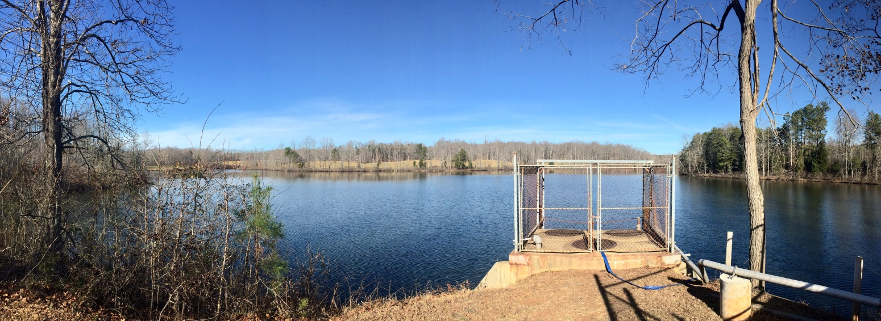
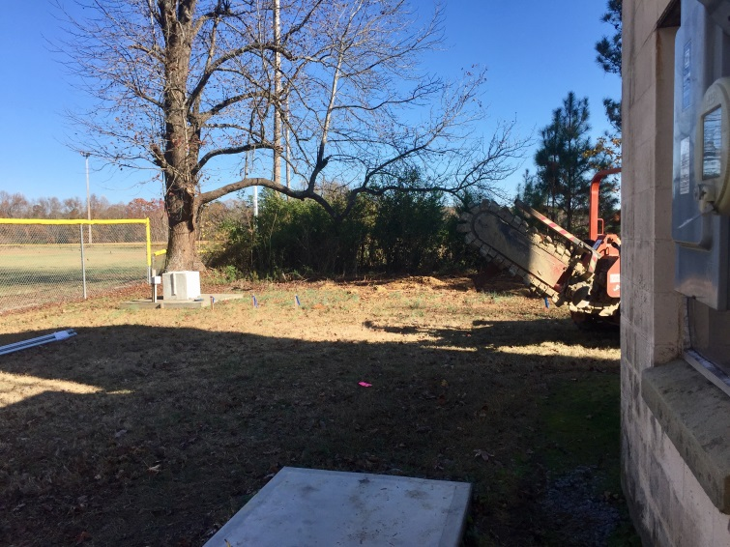
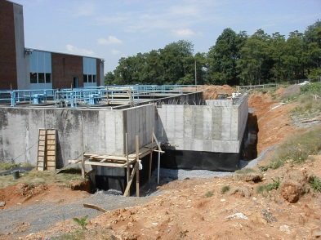
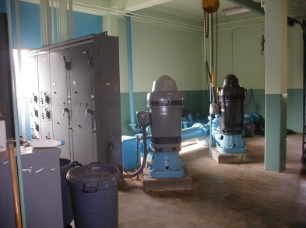
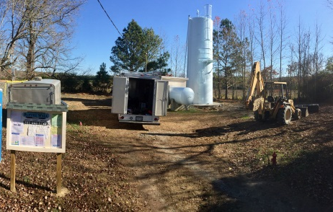
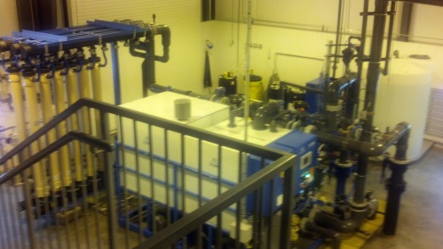
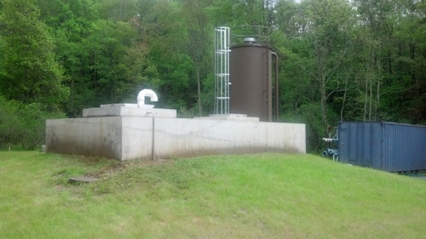
Construction Loan Eligible Projects
New Construction, repair, replacement or improvement of:
Source, Treatment…

Slide 35
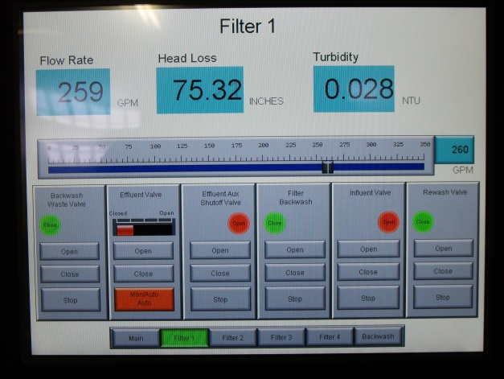
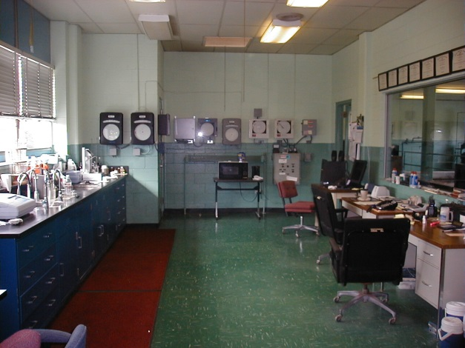
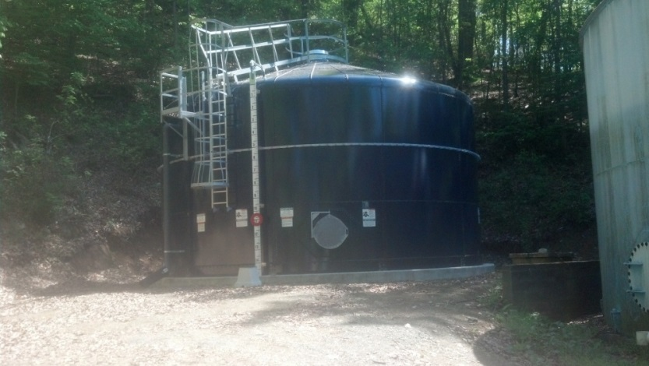
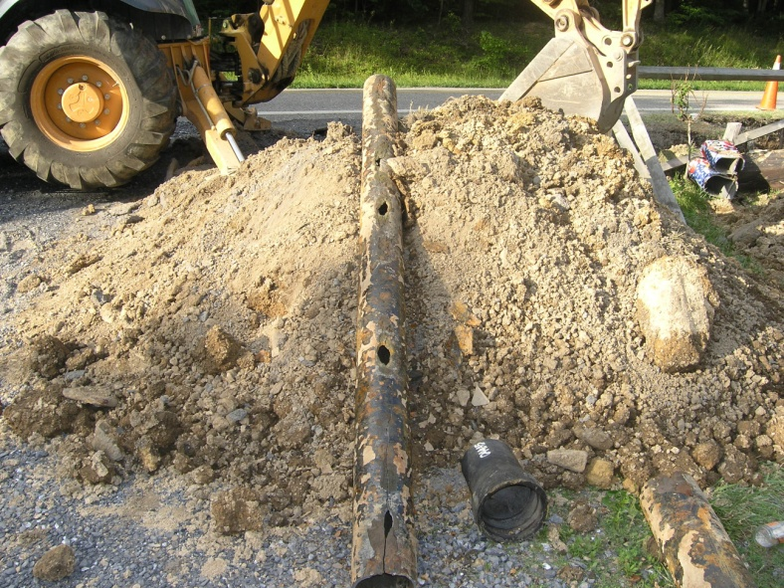
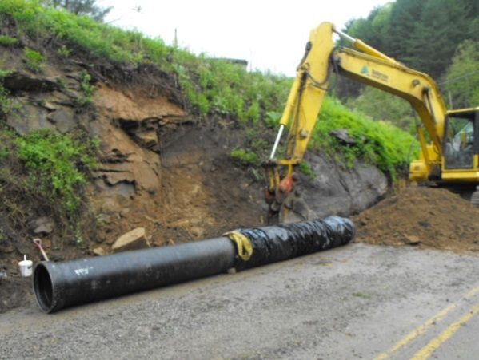
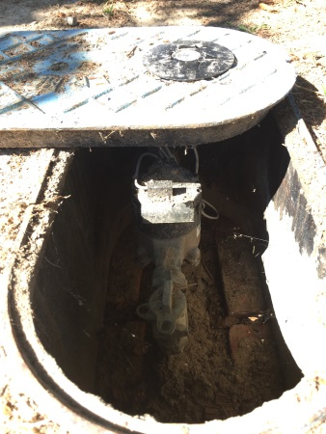
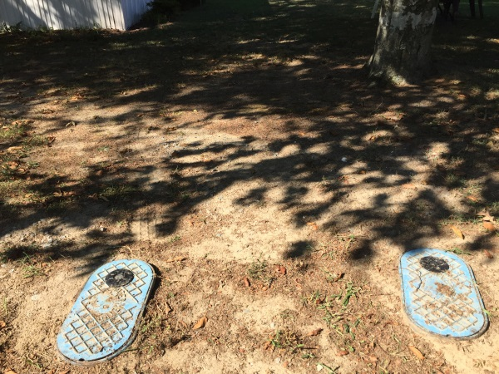
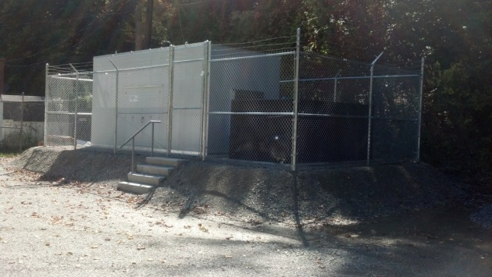
Construction Loan Eligible Projects
Monitoring/Control, Distribution, Emergency Power, Security…

Slide 36
Construction Loan Eligible Activities
Projects Can Include:
Preparation of Preliminary Engineering Reports
Development of Plans and Specifications
Leak Detection Studies and Water Audits
Asset Management Plans
Well Drilling and Development
Land Acquisition/Conservation Easements for Source Water Protection/Development
These eligible activities can be included as part of the overall Construction Project!

Slide 37
Drinking Water Funding Program Details
Design-Build and Construction Management at Risk
Design-Build, Construction Management at Risk (CMAR) and other alternative project delivery methods can be funded.
Locality needs ordinance to authorize alternative project delivery method.
Early Field Office involvement is critical with this type of project.
VDH’s first design build funded project ($5.6 M in VDH FY 17 funding). Construction complete.
Notes:
FCAP had historically only funded Design-Bid-Build projects. Starting with the FY17 funding cycle, FCAP opened the door for Design-Build, Construction Management at Risk, and other alternative delivery methods to be funded through the program.

Slide 38
Lead Elimination Assistance Program (LEAP) – Revamped LSLR Program
VDH has renamed and expanded the original LSLR program to LEAP
LEAP is more inclusive – funds are available for LSL Replacement and building LSL Inventories
LSL projects are evaluated separately from other construction projects
New: Up to $250,000 is available for building an LSL Inventory
New: Please use the LEAP Application to apply for funding
Notes:
The Lead Elimination Assistance Program is more inclusive – funds are available for LSL Replacement and building LSL Inventories.

Slide 39
Lead Service Line (LSL) Replacement Program
Eligibility = Community waterworks or non-profit non-transient waterworks owners who have confirmed or suspected lead service lines (includes utility and/or customer portion of the service line).
Grant rebates are the lesser of the actual cost of replacement or $5,000 per lead service line replaced for the private portion of the lead service line replaced.
Up to $500 of the $5,000 may be used for administrative/investigative work.
VDH reserves the right to limit the grant to a total of $500,000 per applicant per funding year, and the administrative costs to $25,000.

Slide 40
Lead Service Line Replacement Program
Lead Service Line (LSL) replacement must be a complete replacement (public and private side of the service line).
Partial replacements are only eligible if the action completes the entire replacement.
Includes pipe entry at or into the structure – up to and including a shut off valve.
Excludes premise plumbing.

Slide 41
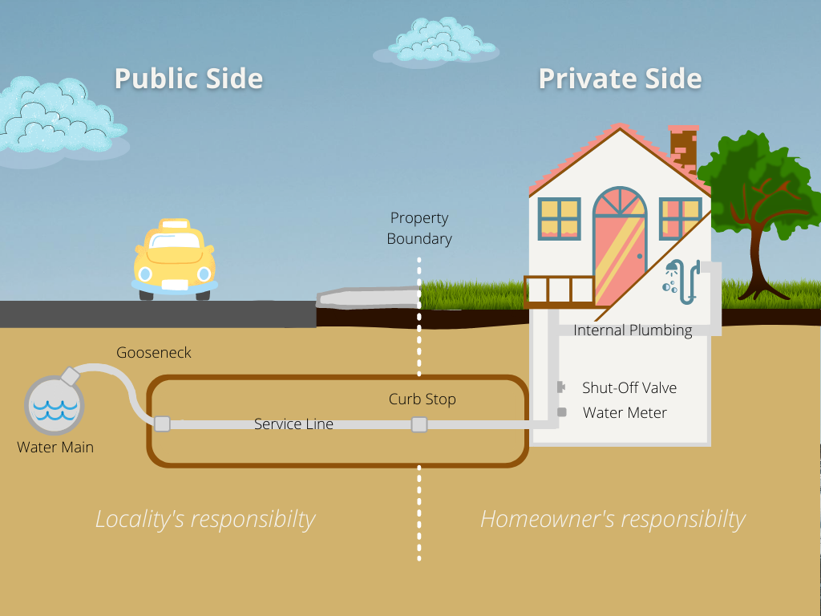
Lead Service Line Replacement Schematic

Slide 42
Water Debt - Refinancing
FCAP’s Program allows for refinancing local public debt obligations related to drinking water infrastructure.
Criteria:
Construction started and such debt was incurred after July 1, 1993.
Davis-Bacon wage requirements met when construction initiated on or after October 30, 2009.
American Iron and Steel requirements met when plans and specifications approved on or after January 17, 2014.
Privately-owned systems are not eligible for refinancing.

Slide 43
Applications
Typical Annual Cycle:
January FCAP website updated
March 8th /April 6th Funding Application Discussion with Field Offices must be complete
April 8th Application deadline (Infrastructure, LSL, Emerging Contaminants, SRF Supplemental)
May 6th Application deadline (construction, refinance, source water protection)
July/Aug. Funding offers made
Sept./Oct. Award letters
Oct./Nov. Initial meetings
*No Application Fee!
*No Local Match for Most Applications!
*Funding Application Discussions must be scheduled at least 30 days prior to the deadline for the type of funding the recipient is applying for.
On line at: http://www.vdh.virginia.gov/drinking-water/fcap/

Slide 44
Priority Ranking
As a condition of each EPA capitalization grant FCAP must develop a Project Priority List (PPL)
Evaluate projects based on an EPA-approved criteria
Rank projects in priority order
Offer funding in strict priority order
Make the PPL available to the public
Establish a public comment period/meeting
Address public comments
Allow for EPA review/approval
Allowed to by-pass projects
Unfunded projects are welcomed in subsequent years

Slide 45
Priority Ranking
Priority is based on:
Acute Health issues (e.g. enforcement, BWN, SWTR/TCR violations, GUDI)
Chronic Health issues (e.g. PMCL violations, lead/copper, ETT>10, disinfection byproducts)
Public Health (e.g. imp. pressure, reduce leakage, inadequate individual home water supplies, SMCLs, ETT 5 to10)
Compliance with Regulations
Other Factors:
Rates as related to Median Household Income
Regionalization
Readiness
Availability of other funds
Projected cost per connection
Sustainability/reliability/GPR

Slide 46
However!
While priority is based on Acute, Chronic, Public Health – FCAP has funded many types of projects.
Do you need funding assistance for the following? How may we assist you with:
Aging Water System Infrastructure
Replacing Critical Water System Assets
In general – “taking care of what you currently have”
We highly encourage all waterworks owners with eligible projects to apply!

Slide 47
Financial Assistance Packages
Construction Projects and Refinance Loans
Funding about 20 – 25 projects annually
Average project size is about $1-3 M.
Largest Leveraged project = $37 M
Largest Non-Leveraged project = $14.5 M
Core program:
20 year loan term
Interest rate is 1% below the 20 year AA municipal bond market. (Currently 1.5% to 2.5%)
VDH disadvantaged designation:
30 year term, typical interest rate = 2% to 3%
Principal forgiveness (grant) funds available if criteria met
Notes:
$36,928,000 New River Valley

Slide 48
Financial Assistance Packages
Small Construction Grants
Must be designated as disadvantaged
FCAP reserves the right to limit these 100 percent principal forgiveness offers for small projects that have documented acute health issues.
Construction Loans
Core term offer (20 year term)
Loan with 30 year term – if designated as disadvantaged
Construction Grant and Loan/Grant Blends
Must be designated as disadvantaged
Notes:
(1) Length of loan won’t exceed life of asset being funded
(2) All expenditure reimbursement
Notes:
As I mentioned, to be eligible for construction grants a waterworks must be designated as disadvantaged. I will provided details on that in the next slide.
Approximately one third of our funds are provided as grants, with a majority of the offers being a grant/loan blend or core term loans.
The objective of the program is to balance the long term viability of the fund to stretch available dollars and to provide the financial assistance needed to resolve public health problems.
A special feature of Virginia’s DWSRF Program is the Planning an Design Grants. These small grants are available to assist waterworks in completing all of the technical preparations needed to get the project to a point where you will have plans and specifications ready to be bid.

Slide 49
Other Items to Note
FCAP Program:
Typical timeline is 3.5 yrs from application to completion.
Many repeat applicants
Larger projects – we have partnered with other sources
Other:
Credit review by Virginia Resources Authority (VRA) required on all loans
Expenditure reimbursement – 5 business days
Payments to VRA start 6 months after project completion
No prepayment penalty – only borrow what’s needed.
Bond Counsel is required for Public Entities
Letter of Credit is required for Private Entities

Slide 50
Drinking Water Funding Program Requirements
Once our water system is in the DWSRF program what are some of the program requirements?

Slide 51
Drinking Water Funding Program Requirements
Procurement
All applicants must abide by the Virginia Public Procurement Act (VPPA) for all FCAP funded activities.
All applicants must abide by the EPA’s requirement for Minority and Women’s Business Enterprises (MBE/WBE) Good Faith Efforts.
All procurement for FCAP funded activities (Bond Counsel, Legal, Engineering, Construction) must be reviewed and approved prior to signing contracts.

Slide 52
Drinking Water Funding Program Requirements
Preliminary Engineering Report (PER) and Plans/Specifications
If required by the ODW Field Office:
PER – ODW Field Office and funding agency must review/approve.
Plans/specifications – ODW Field Office and funding agency must review/approve.
Environmental Review
An environmental review is required for every FCAP funded project.
Environmental Assessment or Categorical Exclusion.

Slide 53
Drinking Water Funding Program Requirements
Davis-Bacon Wage Requirement
Applies for SRF construction projects. The Davis-Bacon Act has been added to the list of Federal cross-cutter requirements.
American Iron and Steel Requirements
Applies to SRF construction loan projects with plans and specifications approved on or after 1/17/2014. Funding recipients and contractors certify compliance.
FCAP reviews the information above during on-site construction project evaluations.

Slide 54
Resources on our Webpages – Manuals, Applications, Instructions, Factsheets, Forms, and More!
https://www.vdh.virginia.gov/drinking-water/fcap/drinking-water-funding-program/

Slide 55
ODW Applications – On Our Website

Slide 56
Refinance Loan Application

Slide 57
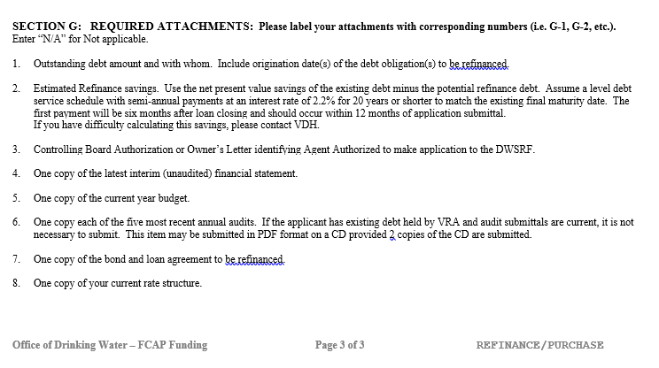
Refinance Loan Application – Required Attachments

Slide 58
Construction Funding - Instructions

Slide 59
Construction Funds Application

Slide 60
Construction Funds Application – Required Attachments

Slide 61
Construction Funds Application – Required Attachments (Cont.)

Slide 62
1452 K Source Water Protection Initiative Application

Slide 63
Other Factsheets/Forms

Slide 64
User Rate Analysis Spreadsheet

Slide 65
All Applications – Friendly Reminders
Federal DUNS and CCR numbers – if you don’t have these numbers when you apply, please note this. These will be required if you receive/accept a VDH funding offer.
Remember to sign/date the application.
Please submit all required attachments. If an item is not applicable, then note “N/A”. Most items will be applicable.
Fill out the complete application – no blanks please.
Please submit two complete sets of the application and two complete sets of all required attachments.

Slide 66
What Happens After the Applications Are Submitted?
May 1 (or thereabouts) – Applications are due every year. Applications can be hand delivered by 5:00 on the due date or postmarked for mail delivery.
Submit all applications to address listed on first page – Richmond Central Office (where they are logged in).
Within 2 weeks, the applications will be reviewed.
If application lacks an attachment/further clarification is needed - you and your consultant (if consultant listed on application) will be contacted during this timeframe via e-mail.
Deadline provided for needed information.

Slide 67
What Happens After the Applications Are Submitted?
If application is woefully incomplete or the activity applied for isn’t eligible, then it will not be scored/ranked.
After the Program review period, the appropriate ODW Field Office will also review the applications.
Capacity Development Review (TMF, Waterworks Business Operations Plan required?).
Scoring/ranking of all applications finalized.
Approx. July/August – funding offers made.

Slide 68
How May ODW and FCAP Assist You?
How may the Office of Drinking Water assist you in funding your proposed capital improvement project?
Addressing Health Issues
Regionalization/Consolidation
Replacing Aging Water System Infrastructure
Replacing Critical Water System Assets
And, all other eligible activities
Please contact us to discuss your proposed project!
https://www.vdh.virginia.gov/drinking-water/fcap/drinking-water-funding-program/

Slide 69
Funding through the
Capacity Development Program
Julie M. Floyd
Capacity Development Supervisor
Julie.Floyd@vdh.Virginia.gov
Notes:
Hi, My name is Julie Floyd and I and the Capacity Development Supervisor here in the Office of Drinking Water. I am going to provide an overview of funding and assistance that we provide to waterworks here in Virginia.

Slide 70
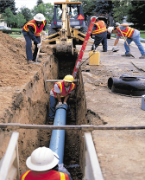
Ensuring Adequate Capacity
Strong, Effective State Programs
Technical, Managerial, & Financial Capacity of Systems
Clean & Safe Drinking Water
Source
Treatment
Distribution
Notes:
The Office of Drinking Water is at its core a regulatory body. It is our purpose to deploy a strong, effective state program that will increase the capacity of waterworks across the state. We break down the concept of “capacity” into three key areas: Technical, Managerial, and Financial.
Our Capacity Development team, of which I am a part, works closely with waterworks as well as the field offices and the FCAP team you’ve just heard from. Our team’s goal is to not just assist with regulating waterworks, but to work to improve the capacity of waterworks across the state. We do this by deploying technical assistance and funding.
To tie this in with the previous presentation, our team reviews final construction applications to ensure that they have, or can have, sufficient technical, managerial, and financial capacity to sustainably run the waterworks. For those systems that struggle with some or all of these, we may require a Waterworks Business Operations Plan be completed as a condition of funding. Another tool that is often included in construction awards is a rate study and or a rate adjustment. We want to make sure that the investment of time and money is well spent.
---------

Slide 71
Funding through Capacity Development
Planning and Design Grants
Small Project Engineering Services
“Set-aside” Suggestions
Notes:
Capacity Development has three main areas of funding that are available to waterworks. Those include Planning and Design Grants, Small Project Engineering Services, and the Set-Aside Suggestions.

Slide 72
Planning and Design Grants
Application and Instructions available online at:
https://www.vdh.virginia.gov/drinking-water/capacity-development/planning-and-design-fund/
Notes:
We will start by looking at Planning and Design Grants
The application and instructions are available online at the link above.

Slide 73
Planning and Design Grants
Maximum grant amount of $35,000.
For planning and design only, not construction
Only for Community and non-profit Nontransient Noncommunity waterworks (Not state or federally owned) with population <10,001
Project must address non-compliance with State or Federal Regulations
Applications accepted year-round
Applications not funded in immediately will be reviewed in September for possible funding
Virginia Procurement Act requirements apply
Notes:
I am going to hit the highlights of the Planning and Design Grant program. More information can be found in the instructions. First, the maximum award is $35,000. There is no local match required. Planning and design grant funds can only be used for planning type activities, not construction. I’ll be providing more detail on types of projects later. Only community and nontransient noncommunity waterworks that are not state or federally owned with populations of10,000 or fewer. For a project to be considered, it must address an issue of non-compliance with state or federal regulations. And there must be sufficient supporting documentation of that compliance issue. There is no application deadline, you may submit them year round. If you send in an application early in the year, if it is not selected at that time for funding, we will hold it until later in the year, typically September, for consideration. And lastly, Virginia Procurement Act requirements apply to work performed under this program.

Slide 74
Application Process is Competitive
Refer to the Instructions for scoring
Primary points awarded for acute, chronic and public health issues
Additional points (used as tie-breakers) will be given for:
Amount of documented water loss
Size of Waterworks (Small waterworks have priority)
Documentation of other funding
Household MHI (Affordability)
Consolidation / Regionalization
Notes:
The application process is competitive. Each year we have a limited amount of money we can award and so we go through all of the complete applications and score them based on the scoring criteria you will find in the instructions. We first score proposed projects on whether they have demonstrated that they address an acute, chronic, or public health issue. Then, if we have projects that score equally, we will go further with scoring for additional items or “tie breakers” shown here. So, for example if we have two projects that score the same for addressing a chronic health problem, we will then look at the size of the waterworks or the median household income, for example, as tie breakers since size and income can affect the ability of a waterworks to otherwise afford the work needed.

Slide 75
Planning and Design Grants: Eligible Projects
Must address an acute, chronic, or public health need (new for 2021) and must provide documentation
Up to 3 applications/year per waterworks
Only 2 can be funded per waterworks per year
Must be discrete projects, not overlapping one another. (Ex: source, treatment, distribution)
Must be stand-alone projects
Must be completed within 15 months of final award
Notes:
Beginning in 2021, in order for a project to be eligible, it must address an acute, chronic, or public health issue and MUST include documentation. That documentation can include notices of violation from the office of drinking water, letters from VDH, special orders, lab results and so on.
Each waterworks can submit up to three applications per year but we will only fund the top two scoring projects for any waterworks in any funding cycle year. The projects in the three applications must be discrete, not overlapping with one another. For example, if a waterworks submits three applications for projects addressing source, treatment, and distribution, we are allowed to fund two of the three, but they can not overlap. They also must be stand-alone, not requiring one project to be completed before the second can begin.
This last item is important. Planning and design grants must be completed within 15 months of the final signing of the award. That includes procurement, project work, and requests for reimbursement.

Slide 76
Example Planning & Design Projects
Preliminary Engineering Reports
Treatment System Evaluations due to MCL exceedances
Hydraulic Evaluation - Distribution System Improvements related to excessive water loss
Drilling, testing & sampling of test wells to determine source feasibility related to source capacity
Source water quality/quantity studies were violations have been on-going
NOT for environmental review
NOT for construction
Notes:
So what kinds of projects are we talking about? Preliminary engineering reports of just about any type would be covered by planning and design grants. Treatment system evaluations due to documented water quality issues can also be covered. Planning and design funds can pay for Hydraulic evaluations and distribution system evaluations and design. If a waterworks needs a new well, we also cover drilling, testing, and sampling of test wells to determine source feasibility. This only includes the drilling, initial testing and development of those wells, not any construction to connect it to the waterworks. We can fund source water quality and quantity studies for ongoing issues.
Note that we do not fund environmental assessments because we find that the timeframe for an environmental assessment doesn’t work well with the time frame for planning and design grants. And as mentioned earlier, these funds can not be used for construction. If you have a question about if your project would be eligible, just ask and we’ll be glad to discuss it with you.

Slide 77
Planning and Design Grants: Procurement
Virginia Procurement Act procedures must be followed
You will not be reimbursed for expenses incurred before properly procuring services
Minority Business Enterprise (MBE) and Women Business Enterprise (WBE) solicitation requirements apply
Failure to properly procure will jeopardize your funding
We will help walk you through the procurement steps
Notes:
Procurement. Again you have to follow the Virginia Procurement Act. You will not be reimbursed for expenses incurred before you properly procure the services. MBE and WBE do apply to p&d grants. Any failure to properly procure your engineer or other services can jeopardize your funding. And we can definitely help you walk through those procurement hurdles.

Slide 78
Planning and Design Grants: Payment of Funds
Reimbursement for Expenses- documentation required
For Preliminary Engineering Reports (PER)
First half may be paid when Engineer submits PER to ODW Field Office
Second Half is paid after final Field Office approval
Turnaround reasonable (and folks in the business know what to expect)
Notes:
If you are awarded a planning grant you should understand that we reimburse for expenses. So, when you submit for reimbursement you will have to include copies of invoices and we must have some verification that the work covered in the invoices has been done. One of the most common types of planning grant projects is a PER. With PERs, we will reimburse up to half of the total award when the PER has been submitted to the ODW field office for review. We expect there will be some back and forth between the field office and the engineer to address any concerns, so once the PER has been approved by the field office, then you can request the remaining balance. We try to turn around any requests for reimbursement very quickly as long as all the paperwork and documentation accompanies the pay request.

Slide 79
Small Project Engineering Services
Designed to deliver engineering services to waterworks which may not be able to otherwise afford these services or handle administrative challenges of other funding sources.
Internal (VDH Only) Referral Program
Waterworks should contact their Field Office for assistance through this program
Notes:
The next form of funding through Capacity Development is what we call “Small Project Engineering Services”.
The Small Projects Engineering program is designed to help small waterworks that don’t have staff or a board that is able to handle the administrative challenges that Planning and Design Funding would require. It’s also for those systems that also otherwise might not be able to afford engineering services even though they need them.
This is an internal-referral program, so waterworks should work through their Field Office if this seems like it could be helpful.

Slide 80
Small Project Engineering Services
Internal (ODW) referral only
Engineering contracts already procured by VDH
Small community and non-profit NTNC waterworks (< 10,000 population)
Typically for financially distressed waterworks
Small engineering needs (<$15,000)
First come, first served
Uses Task Order process
No cost to the waterworks:
But they are expected to be active participants in the process and use the results of the project.
Notes:
As I mentioned, this program operates through referrals from within the Office of Drinking Water. The way it works is that the Office of Drinking Water has already procured engineering services, typically with 3 firms that handle specific regions of the state. Small community and non-profit non-transient non-community waterworks (not state or federally owned) can use this program, especially those that are financially distressed. It is for small engineering needs which typically means a total project cost of $15,000 or less. This program is on a first-come-first served basis. Once we use up the allocation for the year, that’s it. We use a Task Order Process where our staff works with the field office and the engineering firm to agree on a Task Order for the project, and then we will issue a notice to proceed. At that point the firm can start work on the project.
Note that there is no cost to the waterworks. They will not be billed. However we expect them to be an active participant in the process and to use the results of the work.

Slide 81
Small Project Engineering Services
The types of engineering projects are small design, or documentation of as-built, and in the past have included:
• As-built drawing and specifications (VDH-Required)
• Small chemical feed design documents for upgrades
• Design documents for sampling or injection points
• Lead and copper evaluation and treatment recommendations
• Asset Management Plans
Notes:
As mentioned, this program is for small projects. Here are some examples of the types of projects we have completed.
The first are as-built drawings and specifications for modifications to a waterworks to document what is there.

Slide 82
Set-Aside Suggestions
Interested parties may submit to ODW suggestions for state-wide programs to further the promotion of the drinking water industry. Typically this refers to operator training.
https://www.vdh.virginia.gov/content/uploads/sites/14/2021/03/A.1-Program-Comment-and-Set-Aside-Suggestion-1.docx
Notes:
The last funding source is what we call Set-Aside Suggestions.
Set-aside suggestions are suggestions that impact waterworks across the commonwealth. An organization that submits a set-aside suggestion typically will be asking for funding for something state-wide like training events for the operators or owners of waterworks. We’ve also had requests for leak detection equipment to be used at no cost at waterworks across the state. Since these are not construction activities they are run through the Capacity Development program. If you have any questions about what kinds of set-aside suggestions can be submitted, you can give me or Barry Matthews, the division director, a call.

Slide 83
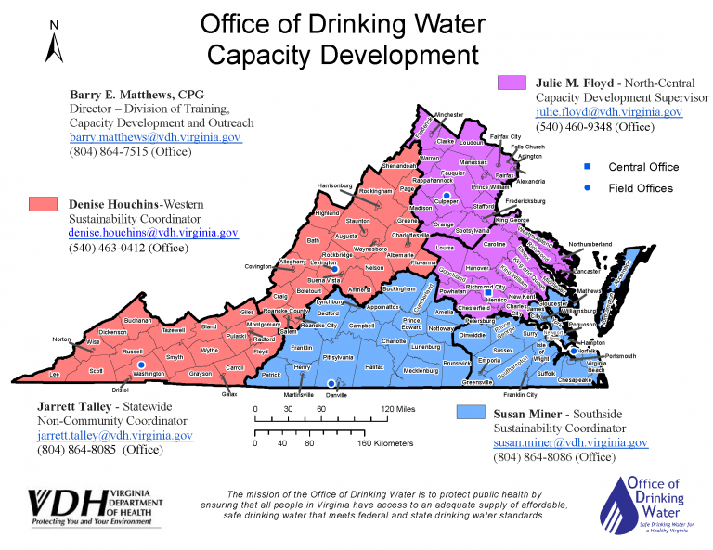
Notes:
Capacity Development staff are assigned territories. On the western side of the state, the pink-orange area, Denise Houchins serves as Sustainability Coordinator. Susan Miner covers the blue area which is Southside Virginia Beach and the Eastern Shore. I cover the purple area which is North Central. We also have a Non-community coordinator, Jarrett Talley, who works primarily with transient non-community systems across the state. Barry Matthews, whose information is in the top left, is the Director of the Training, Capacity Development, and Outreach division. If you have any questions about our programs, please reach out to any one of us. We also work with other funding partners and can help you figure out what other places you can look for funding and assistance.

Slide 84
Questions?
FCAP Related Questions? Contact:
Kelly Ward, FCAP Director
Email: Kelly.Ward@vdh.virginia.gov (804) 864-7201
Keith Kornegay, P.E., Project Team Leader
Email: Keith.Kornegay@vdh.virginia.gov (540) 463-0420
Capacity Development Related Questions? Contact:
Barry Matthews, CPG, TCDO Director
Email: Barry.Matthews@vdh.virginia.gov (804) 864-7515
Julie Floyd, Capacity Development Supervisor
Email: Julie.Floyd@vdh.virginia.gov (540) 460-9348
*Other FCAP and Capacity Development Team Members are available to assist with questions. Contact information is located on our website.

Slide 85
Thank You for Participating in the Webcast!
More information at:
http://www.vdh.virginia.gov/drinking-water/

