Slide 1
VA MRC
Volunteer Orientation
Welcome to the VA MRC Team!

Slide 2
What will you learn today?
Understand MRC purpose and mission
Overview of public health and emergency response
Understand volunteer roles, responsibilities, and protocols
Understand volunteer & training systems
Next steps

Slide 3
MRC History & Role

Slide 4

MRC History & Facts
We are MRC because of 9/11
Emergency System of the Advance Registration of Health Care Professionals = Virginia Volunteer Health System
MRC National program of Department of Health and Human Services
VA MRC is the volunteer program of VDH
Volunteers Protecting Virginia’s Health
Notes:
4

Slide 5
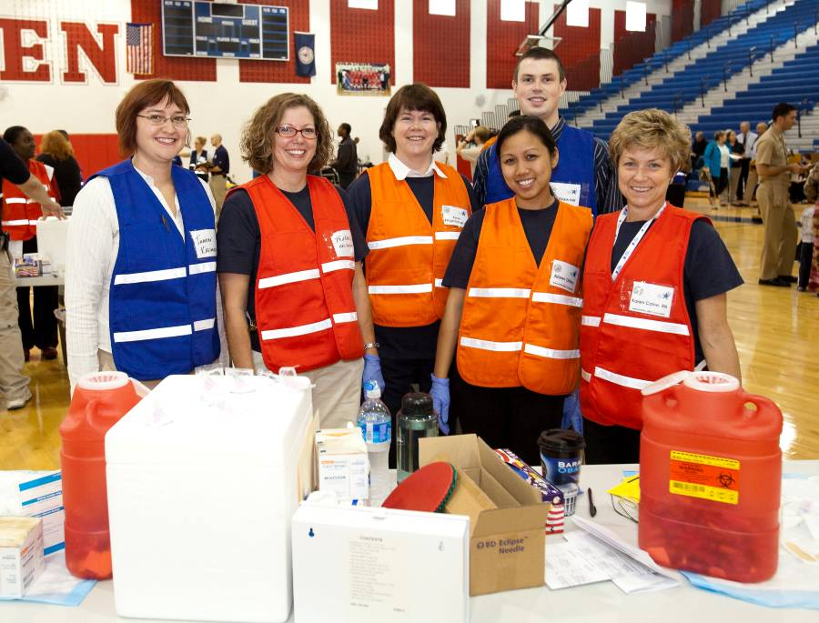
VA MRC Mission
Community volunteers prepared to support ongoing public health initiatives and emergencies in localities throughout Virginia.
Volunteers Protecting
Virginia’s Health

Slide 6
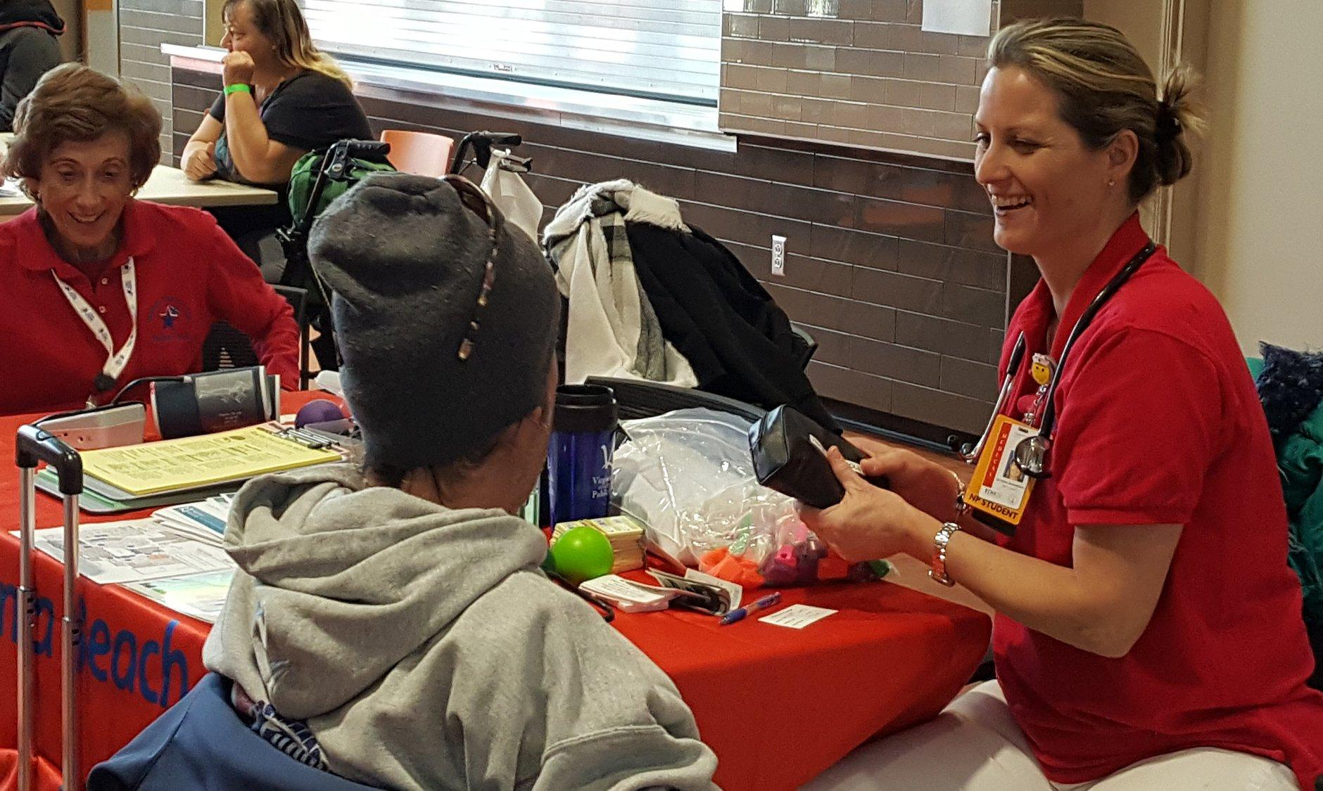
Public Health

Slide 7
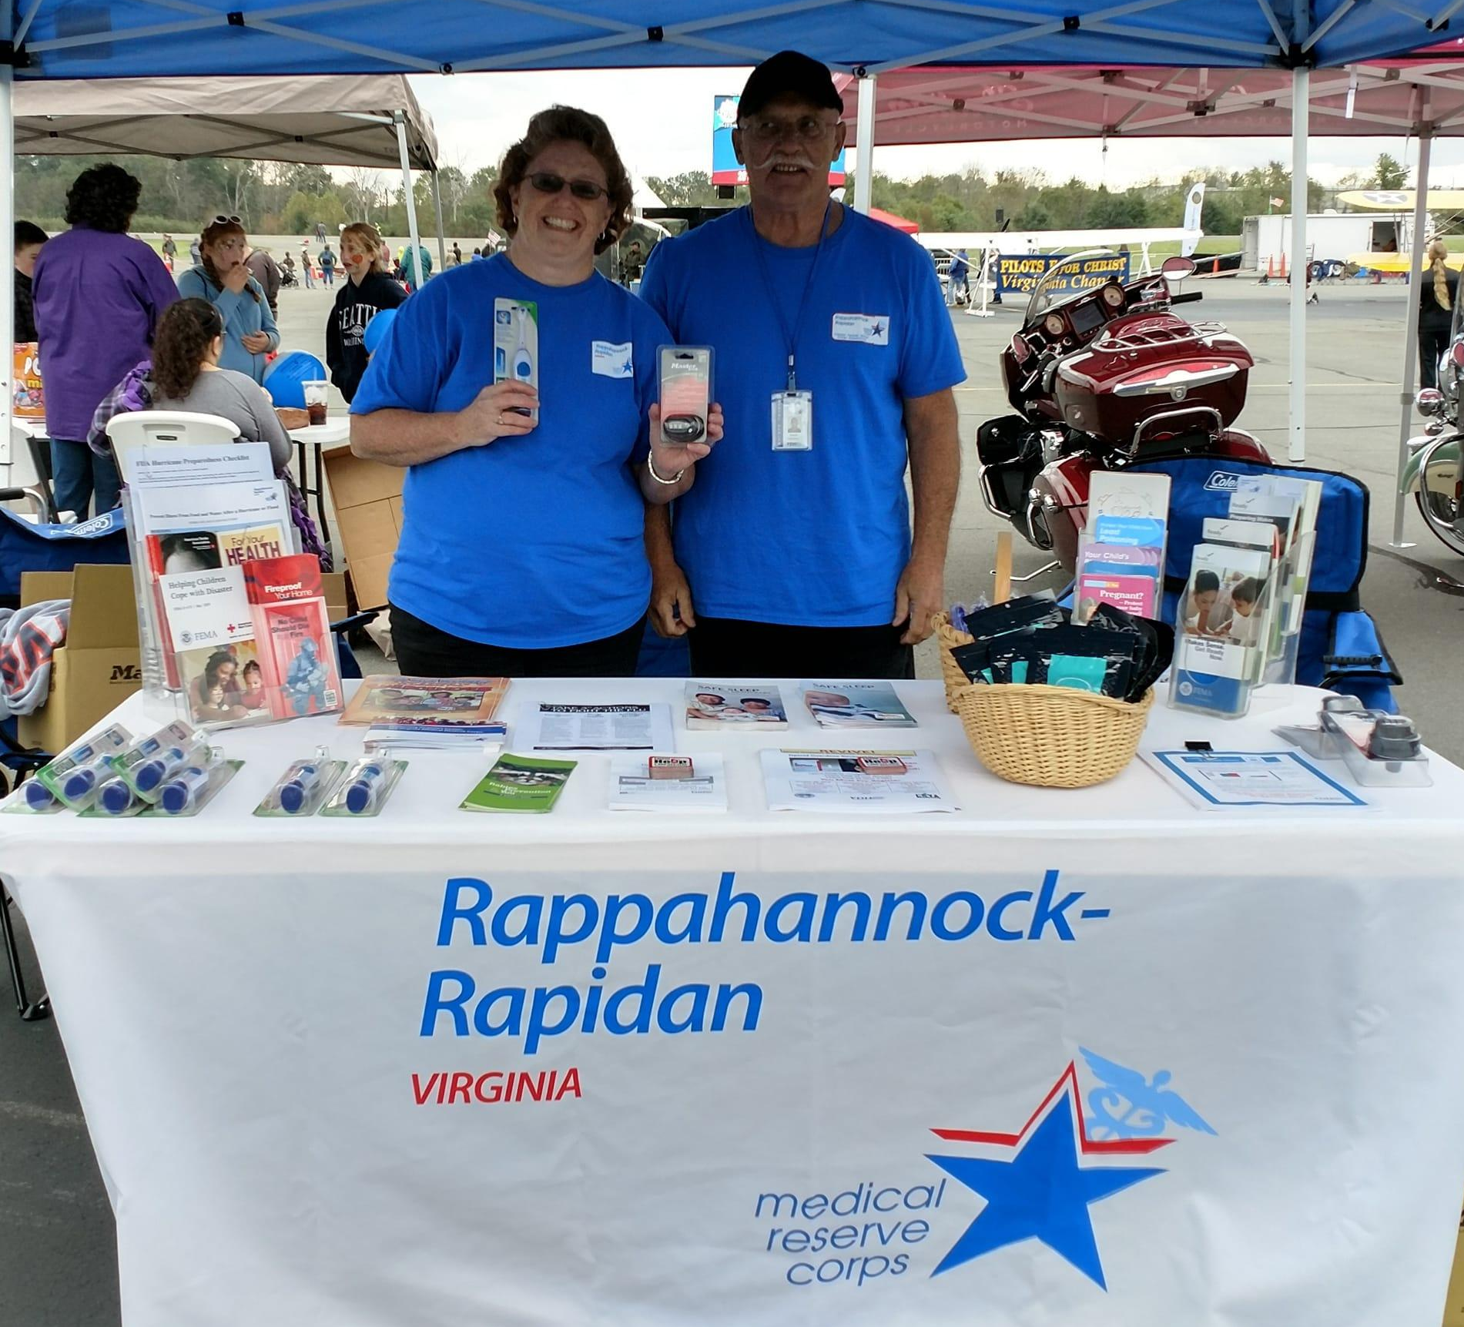
Public Health

Slide 8
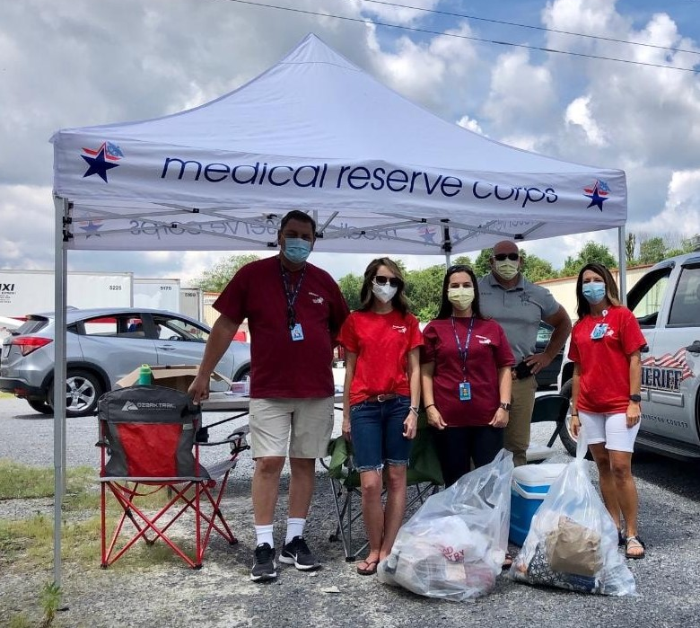
Public Health

Slide 9
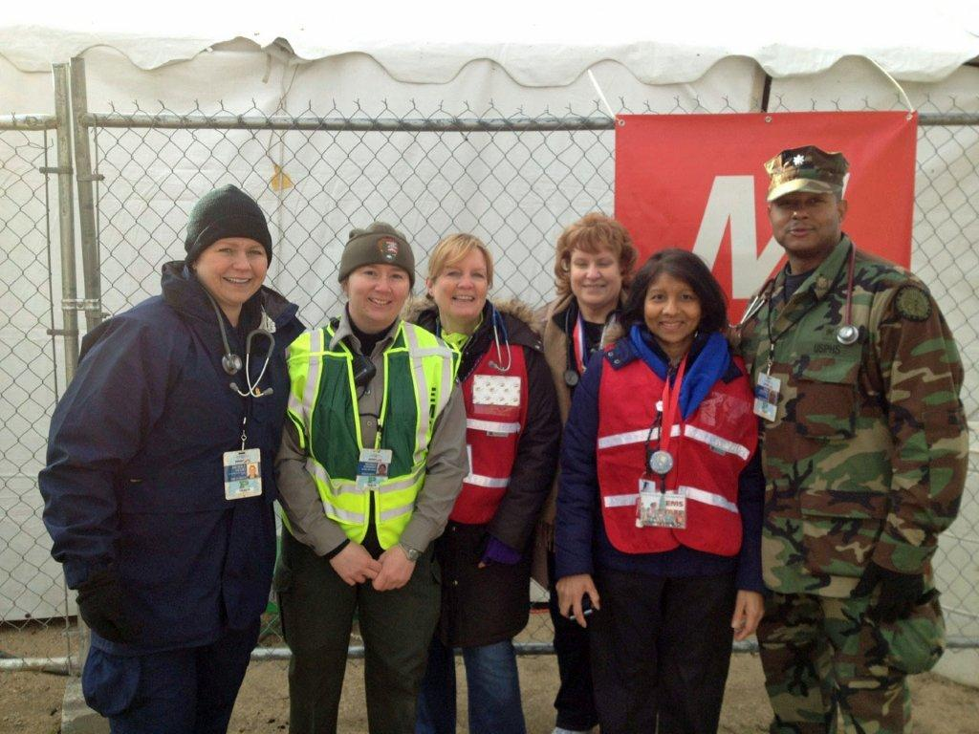
First Aid

Slide 10
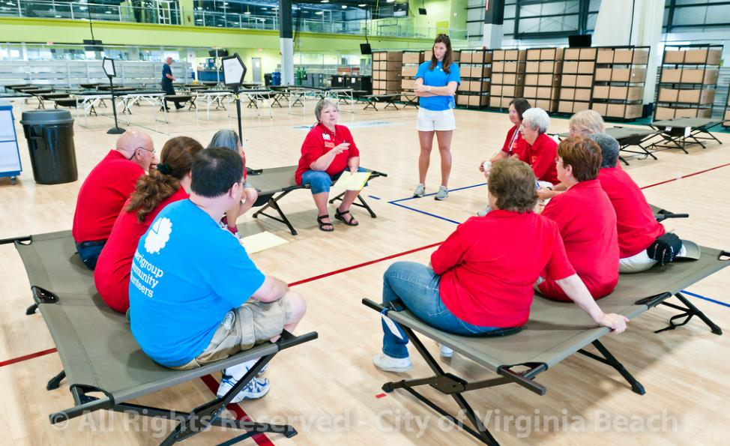
Emergency Shelters

Slide 11
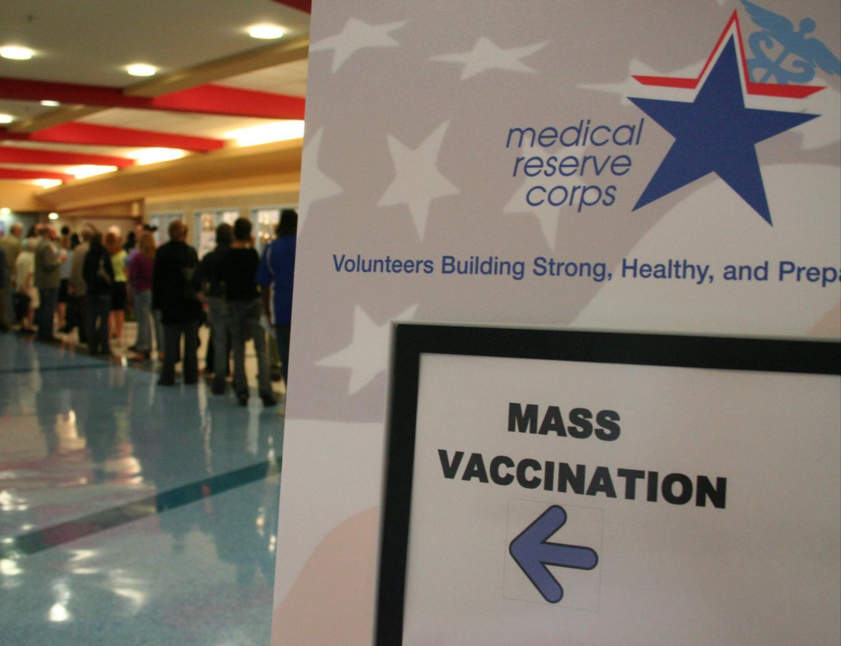
Mass Vaccination & Points of Dispensing

Slide 12


Declared Public Health Emergencies
Pandemic (H1N1) 2009-10
Ebola Virus (2014-2016)
Zika Virus (2016–2017)
Opioid / Addiction (2016-today)
Volunteers Protecting Virginia’s Health
12

Slide 13
Public Health in Emergencies
Coordinates medical, public health, mental health, and emergency medical services
Conducts active disease surveillance and investigations
Establishes procedures for mass or mobile clinics for prophylaxis, vaccination and pharmaceuticals
The MRC are NOT first responders!
Volunteers Protecting Virginia’s Health
13
Notes:
13

Slide 14
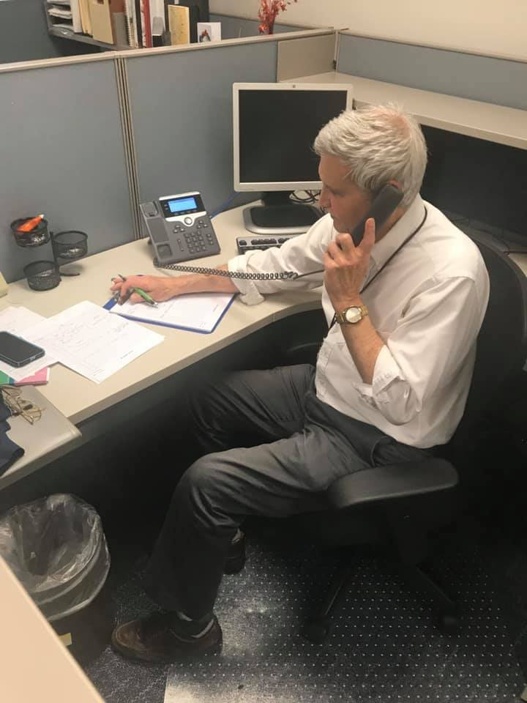
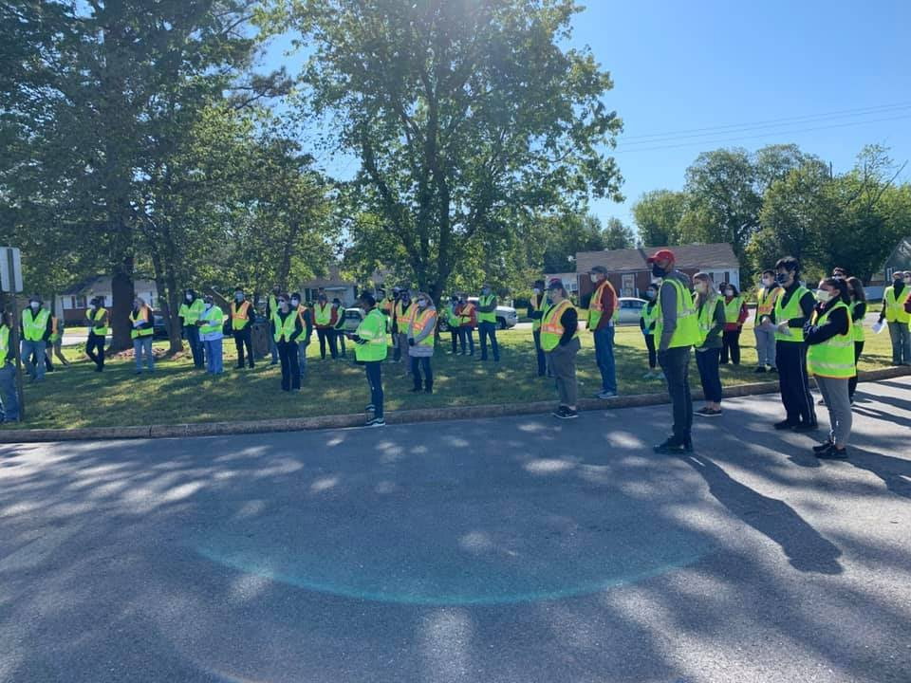
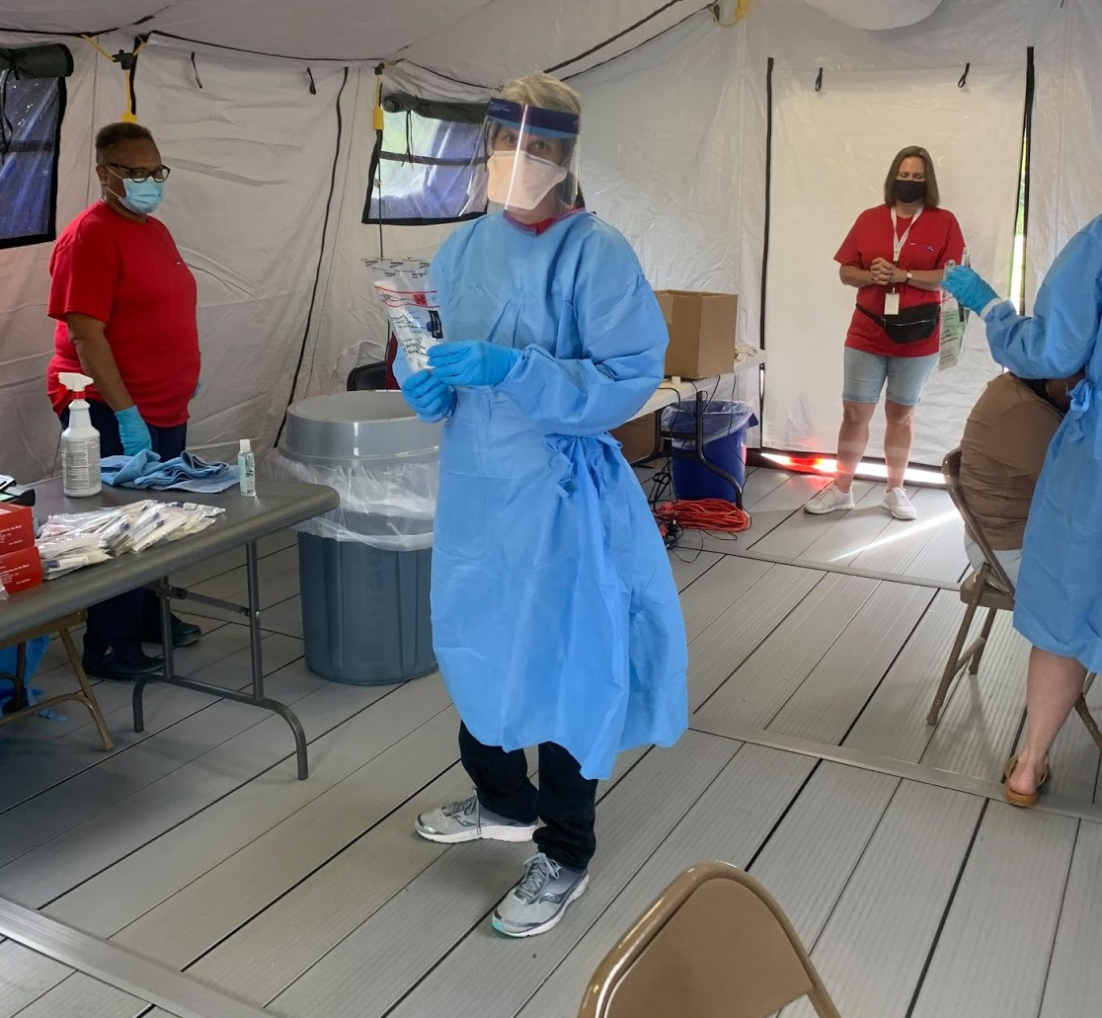
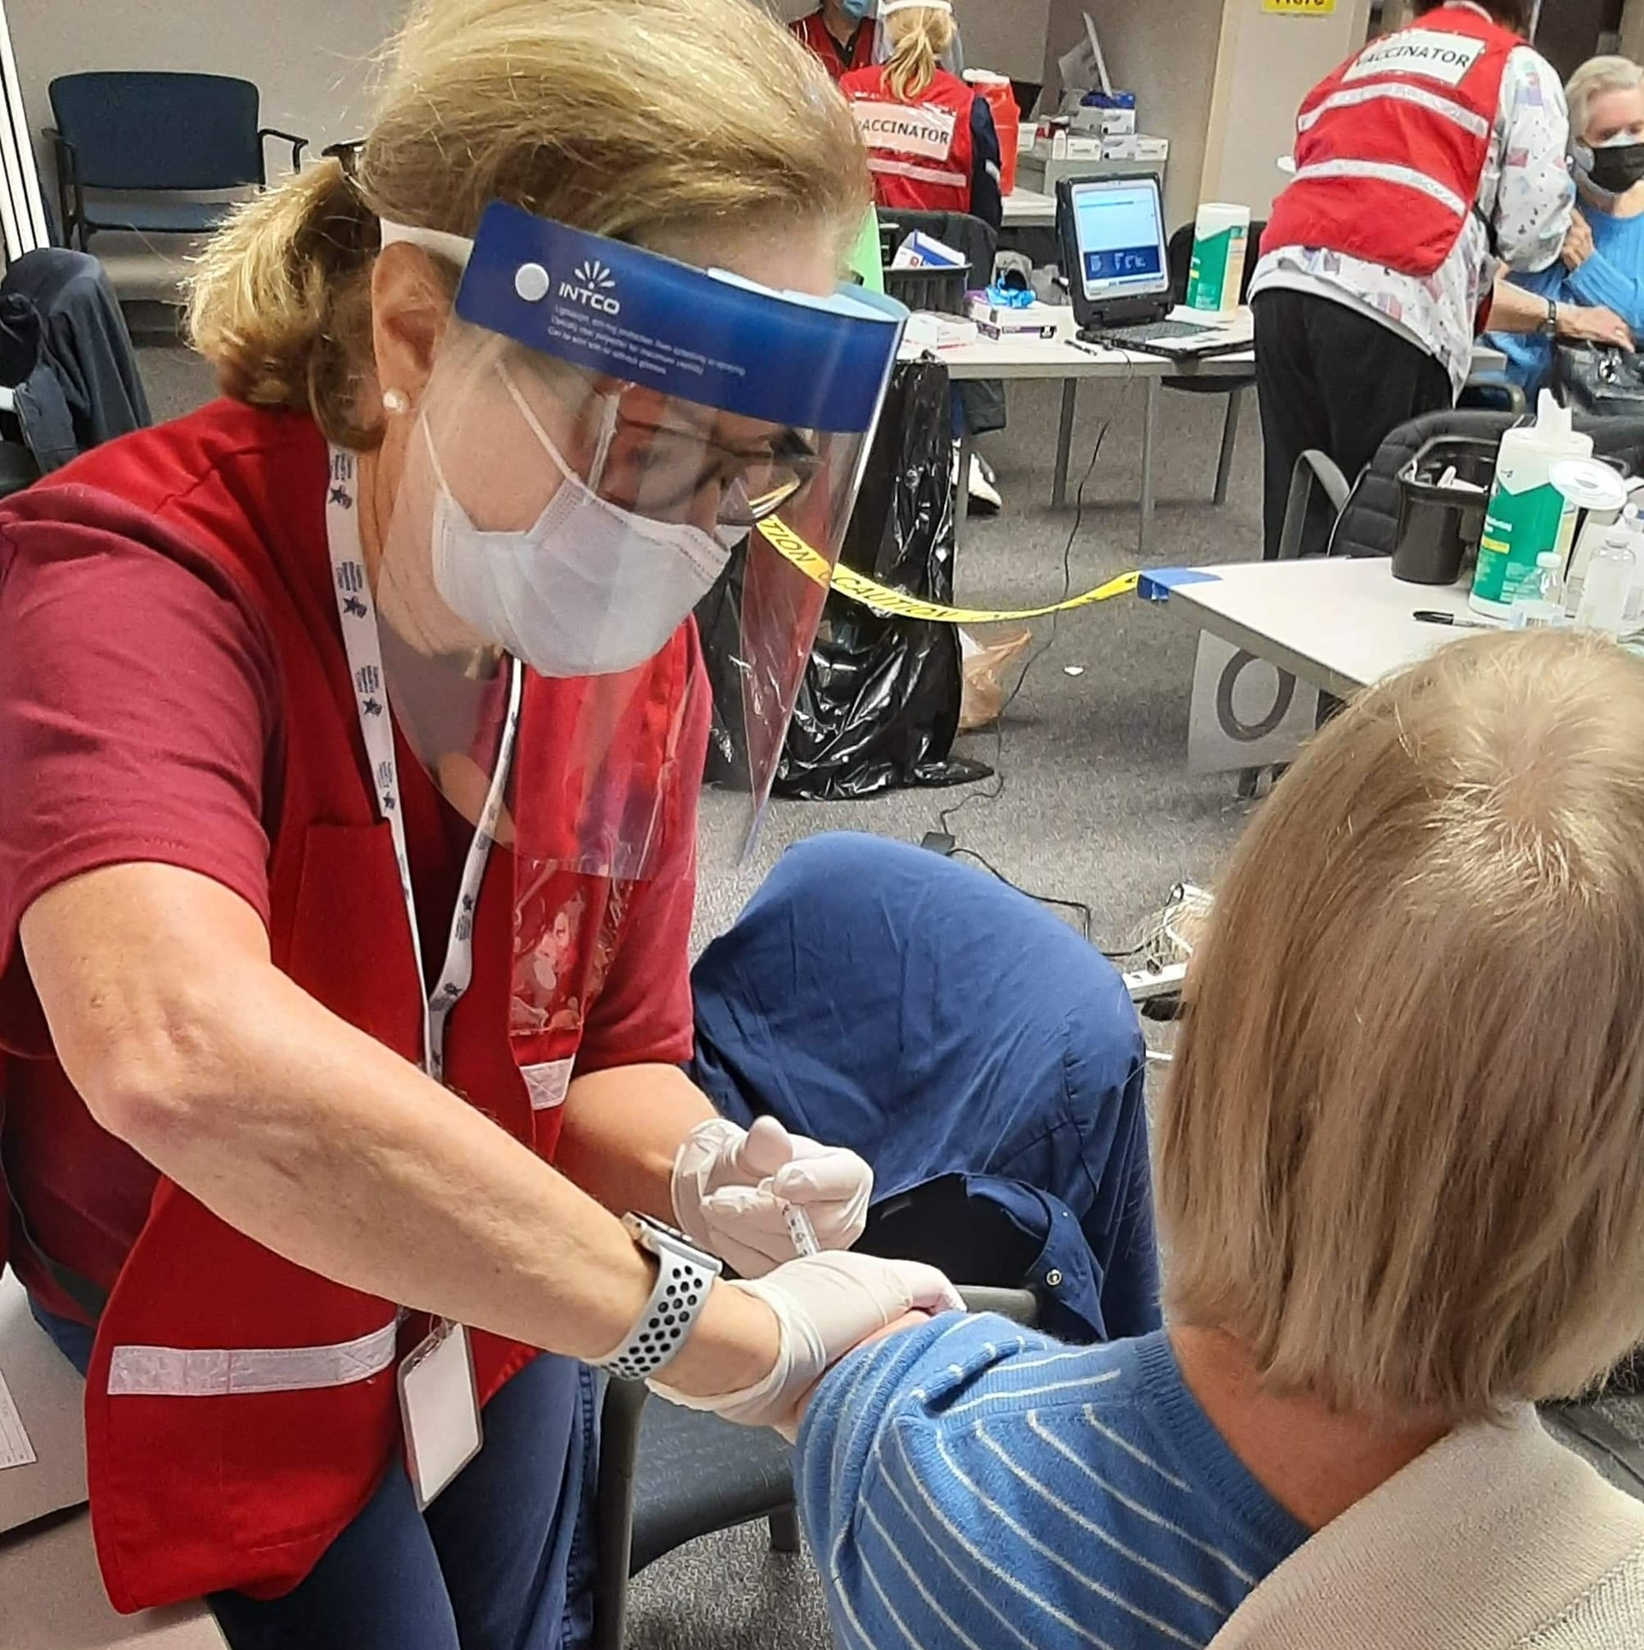
VA MRC COVID-19 Response
Contact Tracing & Epidemiology
Public Information
Outreach & Mask Distribution
Infection Prevention
Community Testing
Vaccination

Slide 15
Knowledge Check
Q. Declared Public Health Emergencies include what events?

Slide 16
Why Volunteer?

Slide 17
Why Volunteers?
For VDH:
Expand workforce
Help meet local medical and public health needs during emergencies
Augment existing public health efforts
For You:
Learn new skills
Use and improve existing skills
Meet other people who are committed to the health of our community
Flexible commitment
It’s good for you!

Slide 18
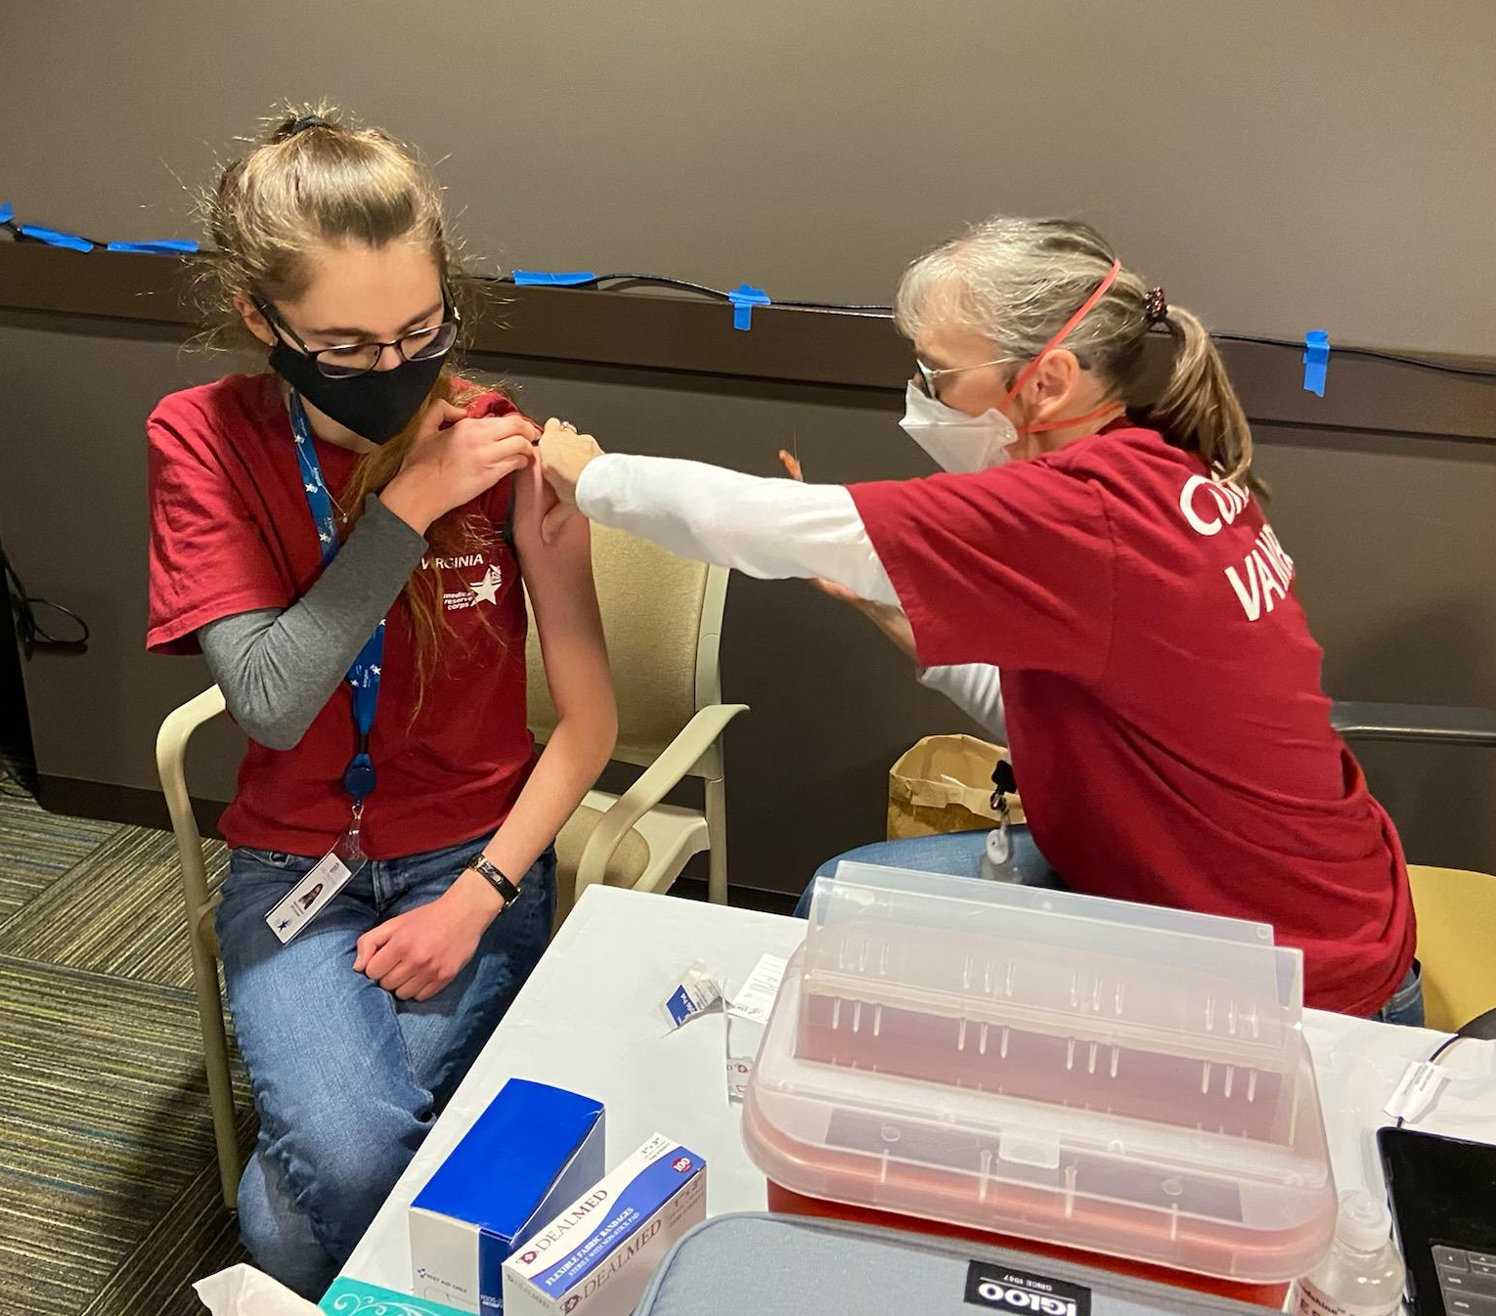
Healthcare Professionals
Physicians
Physician Assistants
Nurse Practitioners
RNs & LPNs
Nurses Aides
Pharmacists
Mental Health Professionals
Dentists, Dental Hygienist
Veterinarians
Vet. Techs, and Assistants
EMTs
Volunteers Protecting Virginia’s Health
Notes:
18

Slide 19
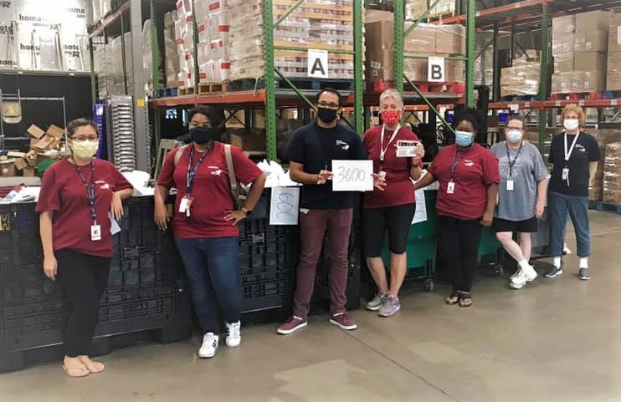
General Support
Teachers
Clergy
Social Workers
Interpreters
Office & IT
Telecommunications
Everyone has something they can offer to the MRC!
Volunteers Protecting Virginia’s Health
Notes:
19

Slide 20
Who will you be working with?
MRC Unit Coordinator
Assistant MRC Coordinators
Public Health Coordinators
Deployment Coordinators
Vaccination Liaisons
VDH and LHD staff
City or county employees
Contractors
VAMRC OEP Team
Federal Partners: USPHS & DHHS

Slide 21
MRC Member Expectations
DO NOT self-deploy
Complete training
Respond to alert notifications
Be dependable
Maintain current information
Requirement - Commitment
Represent the MRC
21
Notes:
21

Slide 22
Do NOT respond to any emergency unless requested and officially deployed by MRC.
If you self-deploy, you will be removed from the Corps and be held liable for any actions.
Volunteers Protecting Virginia’s Health
22

Slide 23
Knowledge Check
True or False
Healthcare Professionals can NOT be MRC Volunteers

Slide 24
Knowledge Check
True or False
It’s OK to self-deploy if you know there is a need?

Slide 25
Additional Expectations

Slide 26
Public Communication
As a representative of VDH,
DO NOT talk to the press without notifying the Public Information Officer(PIO) on site or your MRC Unit Coordinator.
When in doubt ASK!
Notes:
26

Slide 27
HIPAA
As a volunteer performing duties for VDH, you will have access to the protected health information (PHI) of our patients/clients. The fact that an individual is or was a patient/client of VDH is PHI.​
All MRC Volunteers are required to complete Cybersecurity and HIPAA Training before they are considered deployable. This course is available in TRAIN as a self-study course or as an instructor-led course. ​
You should receive separate communications from your local unit coordinator regarding this requirement
27
Notes:
27

Slide 28
Liability Coverage
While they are acting under the direction of VDH, and within the course and scope of their assigned emergency and disaster response activities, MRC volunteers are eligible for the same liability protection available to state employees. MRC and CERT volunteers “shall enjoy the protection of the Commonwealth’s sovereign immunity to the same extent as paid staff.”
http://www.vdh.virginia.gov/mrc/legal/
28
Notes:
28

Slide 29
Workers Compensation
As volunteers are not paid employees, you are not eligible for any worker’s compensation benefits. We take safety seriously; if you spot unsafe conditions or situations, please alert your supervisor immediately.
As a volunteer, you have the right to
refuse to serve in unsafe conditions.

Slide 30
Knowledge Check
Q. MRC Volunteers can communicate with the media:
A-In any situation
B-Only after checking with the PIO or their supervisor

Slide 31
Deployments

Slide 32
Activation
LHD receives request for volunteer support
Volunteers are contacted through VVHS Alert system and requested to sign up for a role and/or shift
Additional information/instructions may be sent to approved volunteers via an additional alert or email
32
Notes:
32

Slide 33
Alert Classifications
COMMUNICATION – Newsletter
AWARENESS – Heads Up
READINESS – Available IF needed
ACTIVATION – You Are Needed
EMERGENCY – Declared Emergency
DEACTIVATION – Stand Down

Slide 34
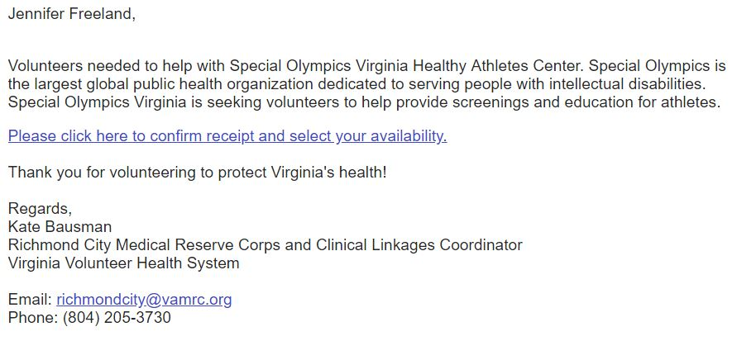
Responding to an Email Alert
Notes:
34

Slide 35
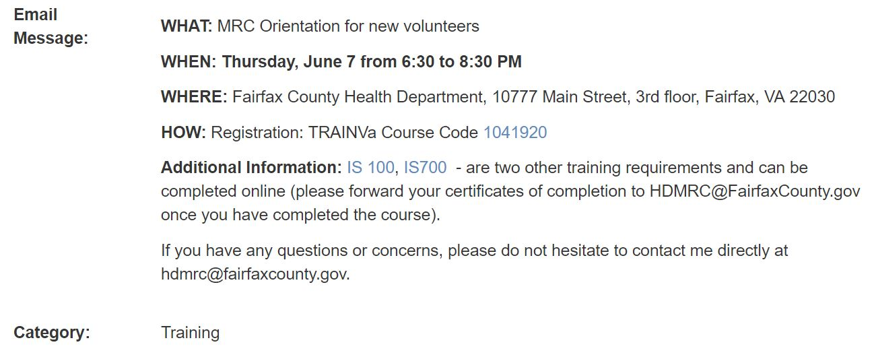

Responding to an Email Alert
35
Notes:
35

Slide 36
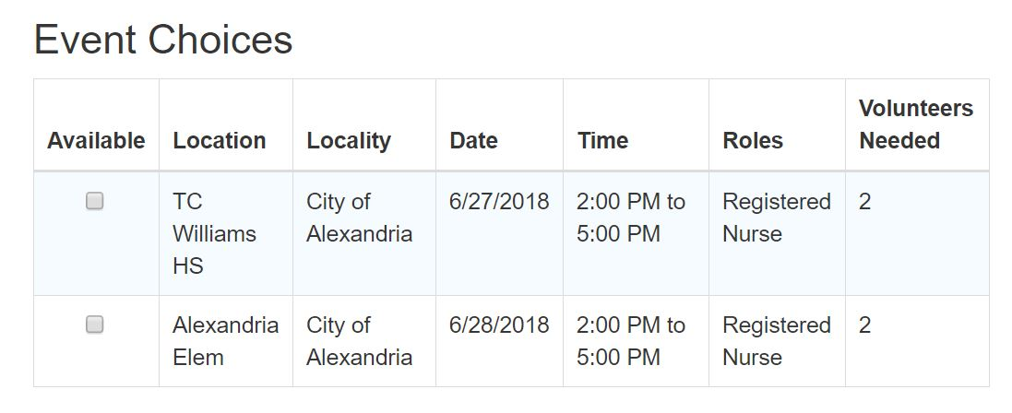

Responding to an Email Alert
36
Notes:
36

Slide 37
Email Tips
Save no-reply@vamrc.org in your contacts as VVHS Alerts which will notify your email provider you would like to receive these emails.
If you find an alert email in your SPAM or JUNK folder, with most email providers, you can click "Not Spam/Junk" and this should change the delivery location of these emails.

Slide 38
Phone & Text Messaging
If you answer the phone, you can choose 1 for available and 2 for unavailable.
You can NOT respond availability via text, so please be sure to check your email.
You will always receive VVHS MRC phone messages from the same phone
#804-864-7200.
Save it in your contacts.
38
Notes:
38

Slide 39
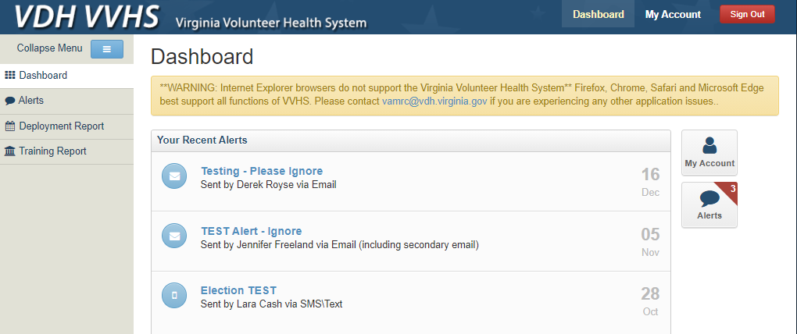
Check Alerts in VVHS

Slide 40

I’m AVAILABLE
Qualified
Personally, Physically, & Emotionally READY
Can make the commitment

Slide 41

Right for the Request
Understand nature of the request
Best practice standards and within your training and expertise
Notes:
41

Slide 42
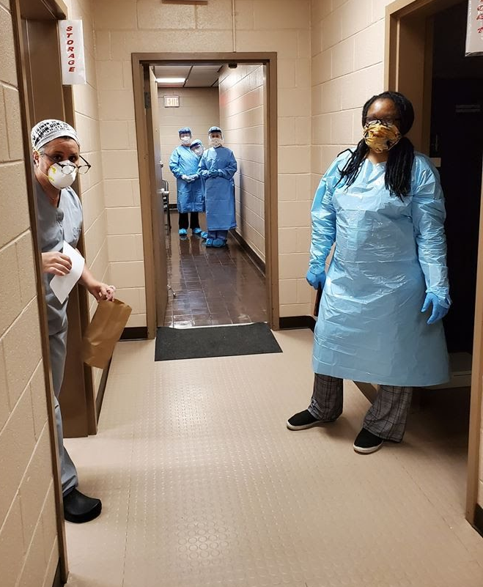
Volunteer Risks
Are you high risk?
Wear PPE
Serve in lower risk positions
Notes:
42

Slide 43
It’s
OK to Say NO!
Notes:
43

Slide 44
When you go…
Voluntary
Represent the MRC, always wear ID badge and MRC shirt or vest
Follow directions/instructions provided
Sign in and sign out to document hours
Job Action Sheets & Just-In-Time training
Wear appropriate and fit-tested PPE
44
Notes:
44

Slide 45

Best Laid Plans…
Change constantly
Flexible
Rewarding work, but stressful and tiring

Slide 46
Don’t Forget
You represent the VDH and MRC
You will be ACTIVATED when needed
RESPOND to alerts
Only talk to the media IF it’s coordinated with your MRC Coordinator or PIO
You will have a TRAIN account created
Standby for deployment

Slide 47
Knowledge Check
Q. What is NOT a type of alert that you might get?
A: Awareness
B: Communication
C: Re-activation

Slide 48
VVHS

Slide 49
Who has access to your info?
Managed by MRC Coordinators, Emergency Coordinators, VA MRC Administrators
Health department staff on need to know
When you registered, you agreed to allow us to share your information as necessary for volunteer deployment
49
Notes:
49

Slide 50
Virginia Volunteer Health System
www.vamrc.org/vvhs
50
Notes:
50

Slide 51
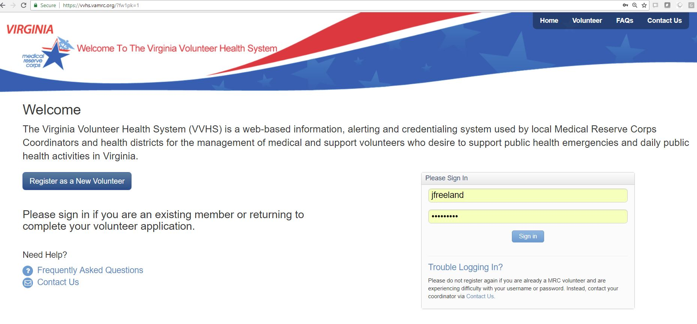
VVHS: www.vamrc.org/vvhs
51
Notes:
51

Slide 52
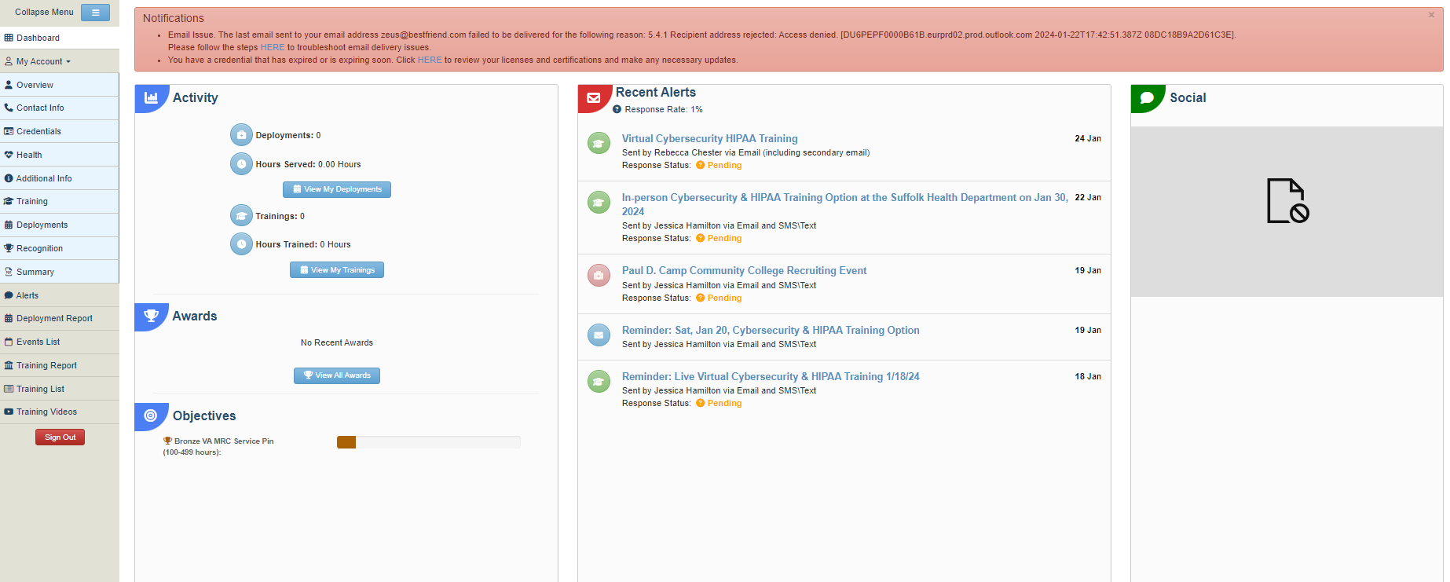
You in the Virginia Volunteer Health System
52
Notes:
52

Slide 53
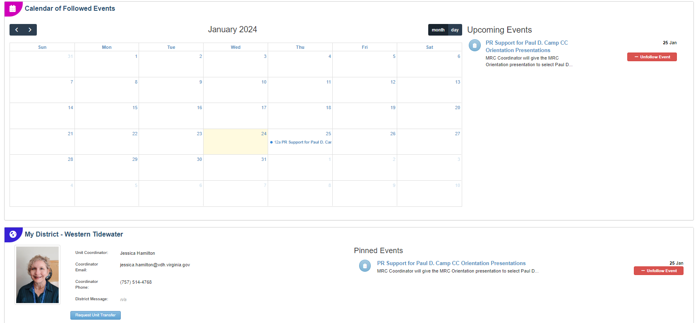
VVHS Dashboard (cont.)

Slide 54
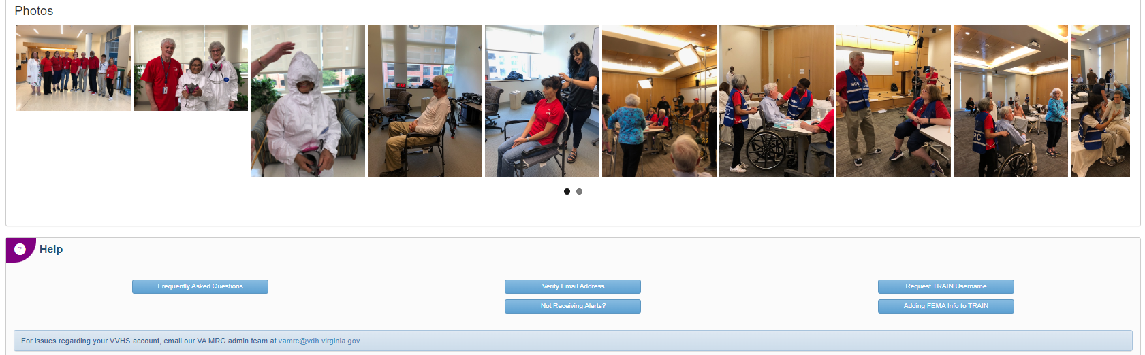
VVHS Dashboard (cont.)

Slide 55
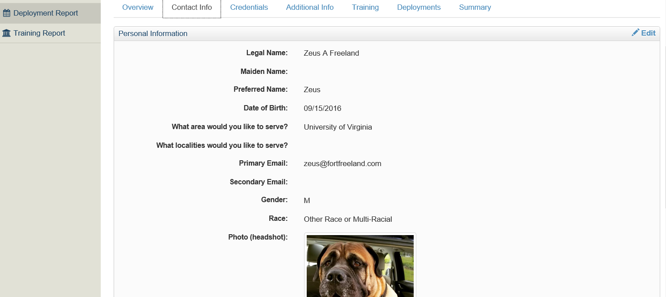
Change Your Information

Slide 56
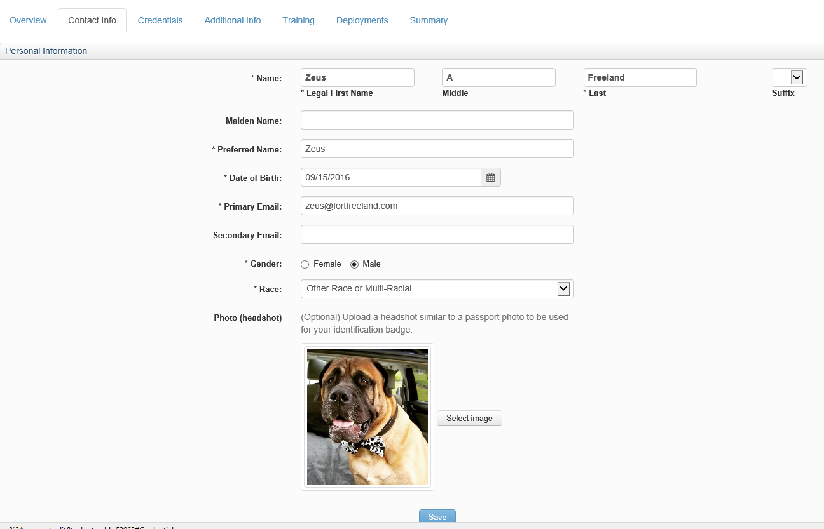
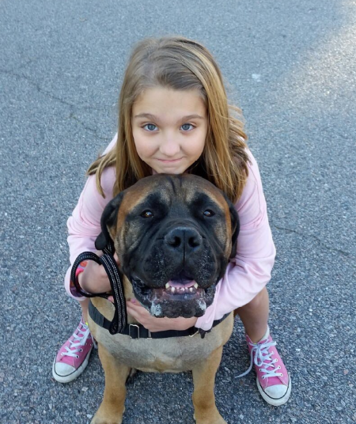
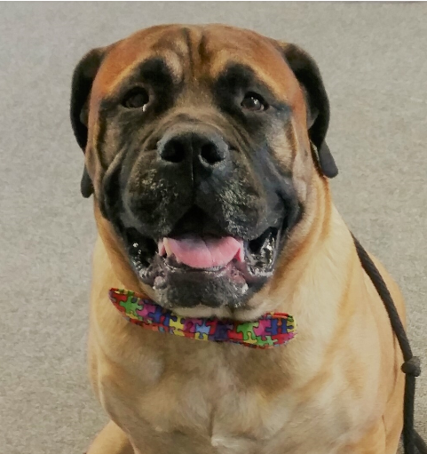

Slide 57
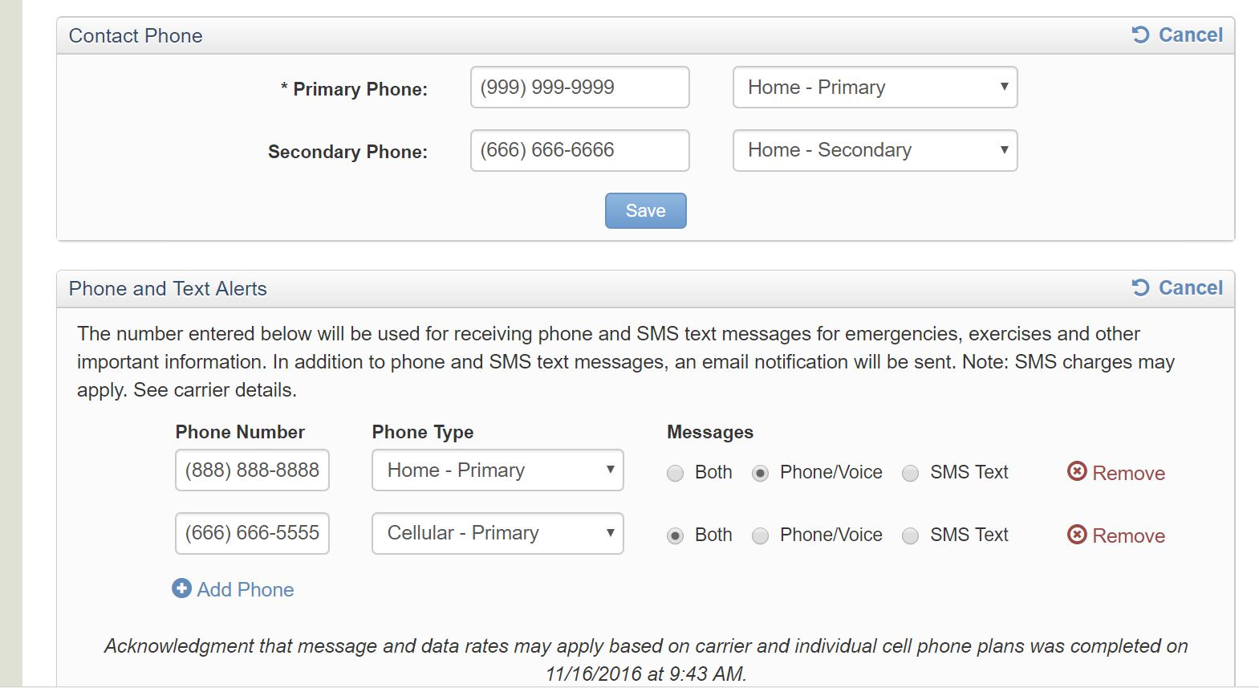
Change your info cont’d

Slide 58
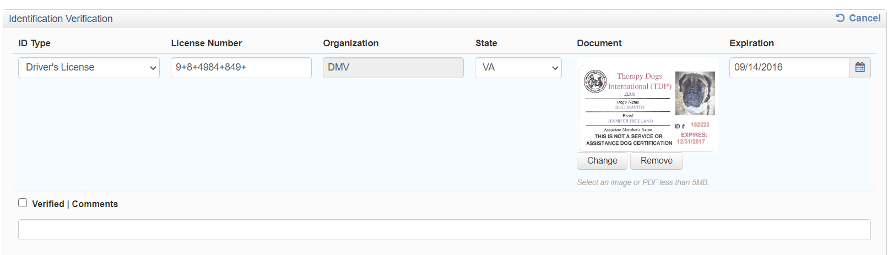
Credentials – Government ID

Slide 59
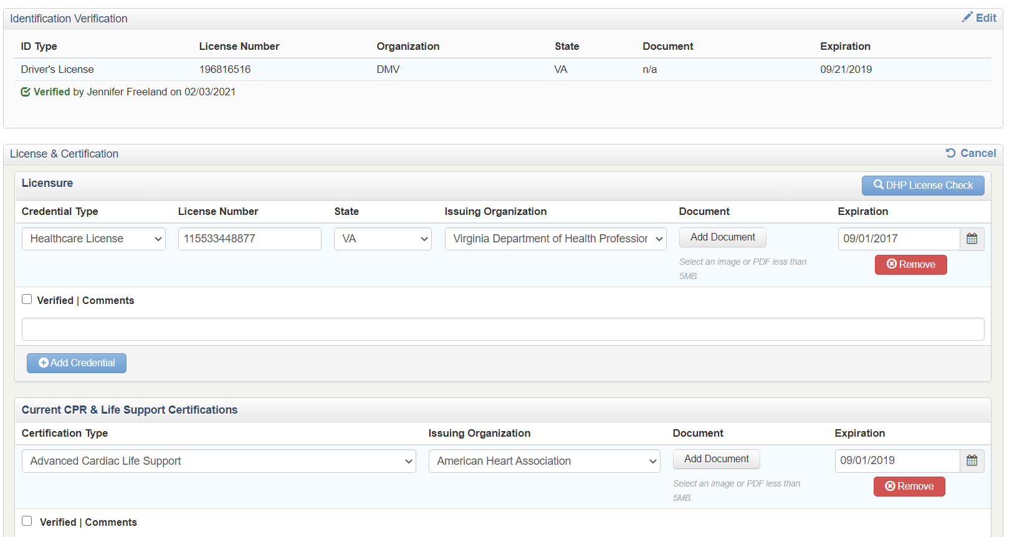
Credentials – License & Certification

Slide 60
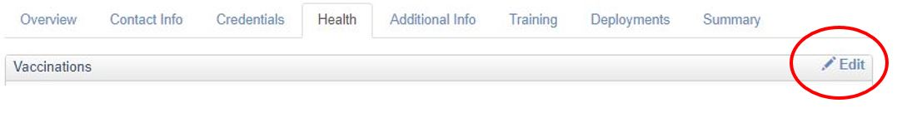
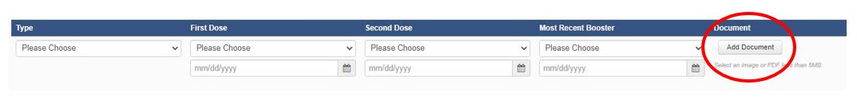
Vaccination Documentation

Slide 61
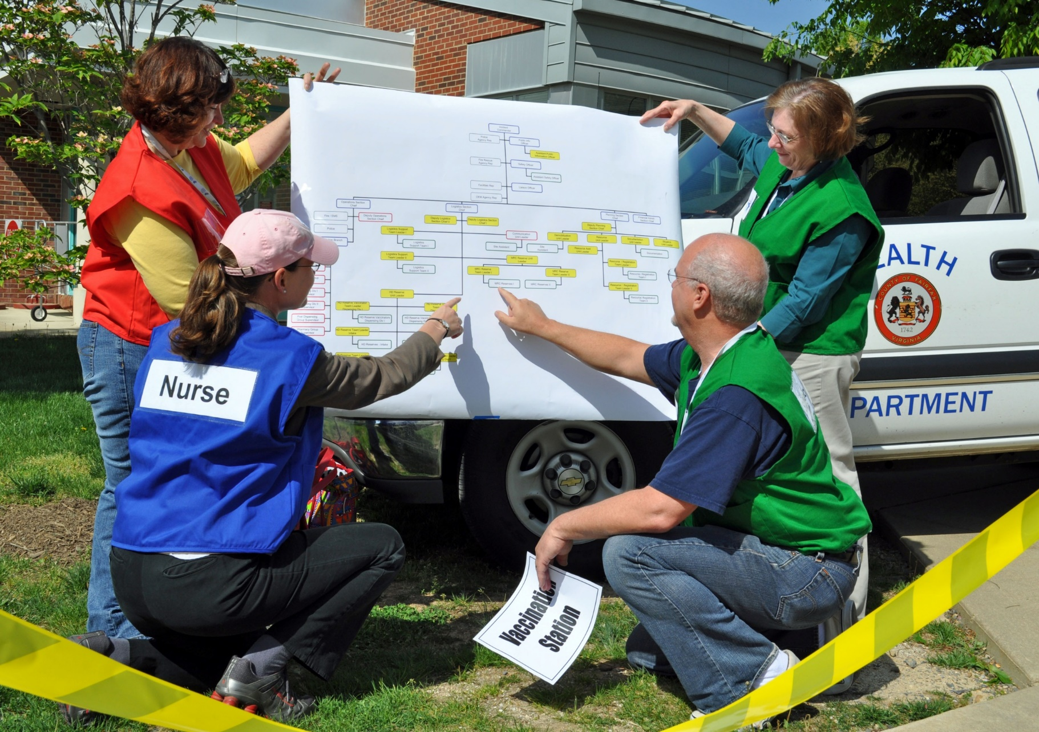
Preparing to Respond

Slide 62
Knowledge Check
True or False:
You should upload a headshot to your VVHS profile?

Slide 63
TRAINING

Slide 64
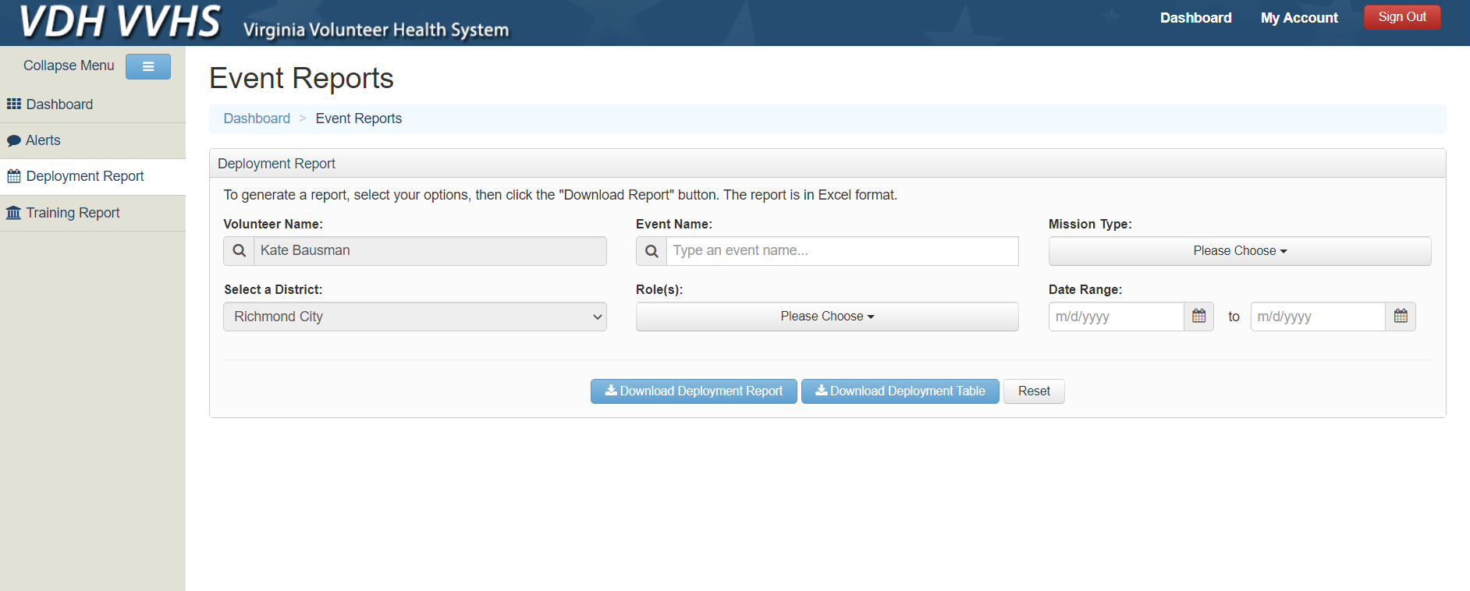
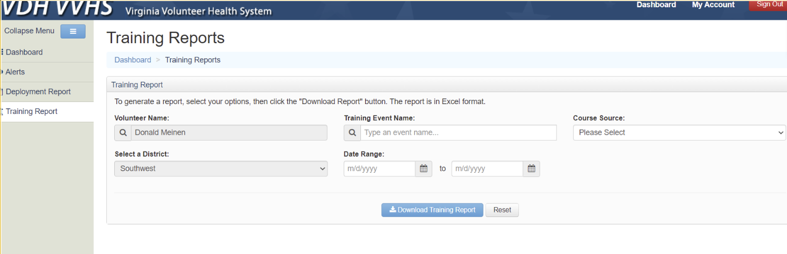
Deployment & Training Records

Slide 65
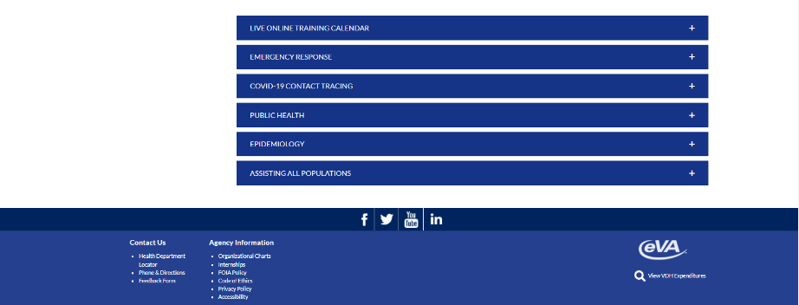
Training for MRC
https://www.vdh.virginia.gov/mrc/training/

Slide 66
Upcoming Online Training Calendar
https://www.vdh.virginia.gov/mrc
/trainingcalendar/
66
Notes:
66

Slide 67
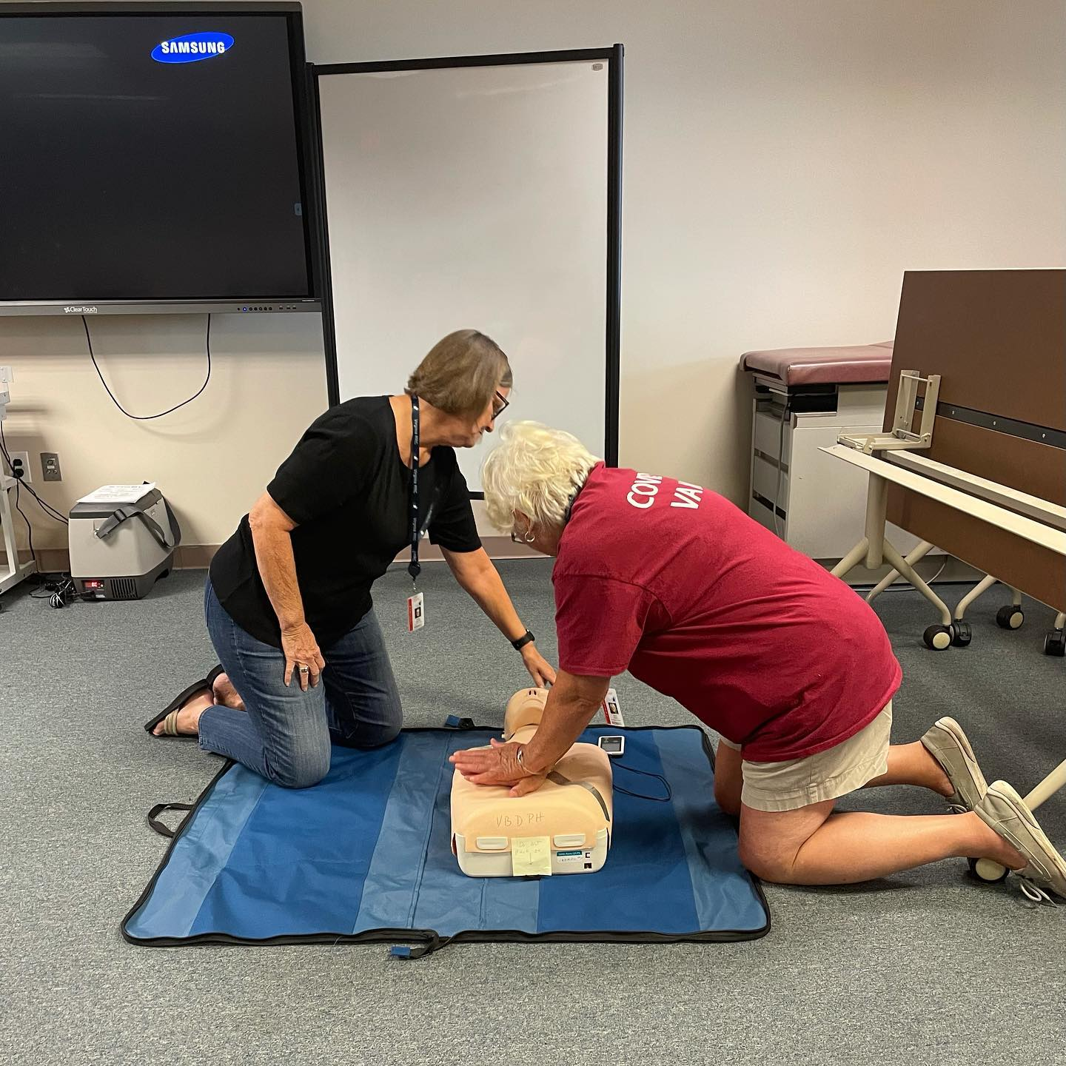
Life Support Training

Slide 68

TRAINVA - www.train.org/virginia
The TRAIN Virginia learning management system is designed to improve public health workforce and MRC volunteer competencies and to provide access to Virginia and national public health educational sources.
www.train.org/virginia
Volunteers Protecting Virginia’s Health
68

Slide 69
TRAINVA - www.train.org/virginia
Pursue the training needed to be confident in the field.
Take training that interests you when you are available.
Complete training plans for specific teams
CEUs are provided for some courses
You have access to your training records
Go to TRAIN via your VVHS account
Do NOT create a TRAIN account
Volunteers Protecting Virginia’s Health
69

Slide 70
TRAINVA - www.train.org/virginia
Once your volunteer application is approved, a TRAIN account is created for you within 24 hours.
DO NOT CREATE ANOTHER ACCOUNT!!!
If you have trouble with TRAIN, please contact the TRAIN administrator at va_admin@train.org.
Volunteers Protecting Virginia’s Health
70

Slide 71
Knowledge Check
True or False:
You should create your own TRAIN account

Slide 72
What’s Next?
Approved Application
Background Investigation
Cybersecurity & HIPAA Training
Identification - Shirts & Badges
Online training
Mobilization
Demobilization

Slide 73
Thank you!!

