Slide 1
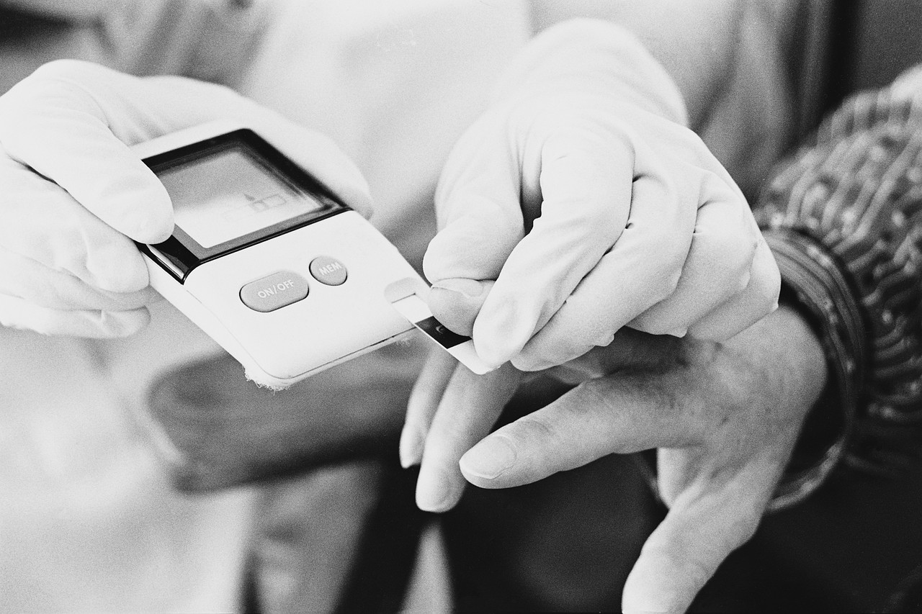
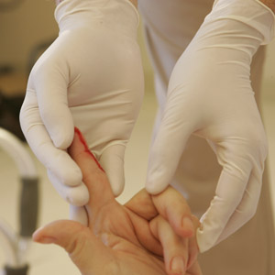
Protecting Employees from Bloodborne Pathogens:
Module 1
Notes:
The two modules of this training course address how to protect staff members in assisted living facilities from getting bloodborne pathogens, or germs that can be found in blood or body fluids.
The Occupational Safety and Health Administration (OSHA) published the Bloodborne Pathogens Standard in 1991 to outline measures that employers must follow to protect their employees from bloodborne diseases. The standard applies to employees who have the potential for exposure to blood and body fluids while performing their regular job duties. In 2001, it was revised to include the Needlestick Safety and Prevention Act, requiring employers to select safer needle devices and allow employees to identify and choose these devices.

Slide 2
Course Objectives
After completion of Module 1 of this course, attendees should be able to:
Describe three bloodborne diseases: HIV, hepatitis B, and hepatitis C
Review occupational risks for exposure to bloodborne diseases
Discuss how germs can enter the body
Describe the risk of getting an infection if exposed to a bloodborne disease
Notes:
This course is designed to give participants an overview of the Bloodborne Pathogens Standard and to describe the major components of the regulation which are designed to reduce the risk of expose to bloodborne pathogens. This presentation will include information about the human immunodeficiency virus (HIV), hepatitis B (HBV) and hepatitis C (HCV) , a review of occupational risks in the workplace, engineering and work practice controls such as safety devices. Standard precautions and personal protective equipment will also be described. Attendees will learn how to define an occupational exposure and discuss the steps to take if you are exposed. The hepatitis B vaccine and requirements for training and recordkeeping will also be discussed.

Slide 3

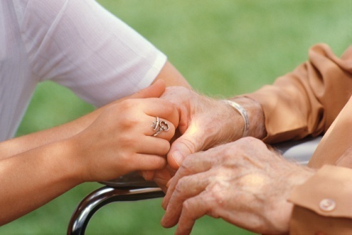
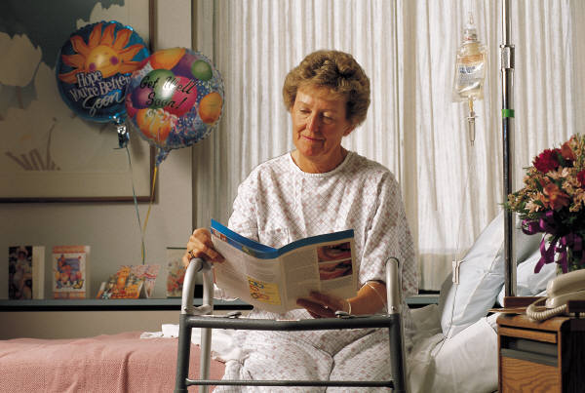
The Facts
Anyone, regardless of age, race, or socioeconomic status, can carry a disease in his or her blood or body fluids. Often, without knowing it.
However, the risk of getting a disease can be decreased with a few basic steps that will be discussed in this training.
Notes:
By looking at someone, you can’t necessarily tell what diseases they may have. Some diseases, including some that are carried in the blood or body fluids, don’t always have symptoms. This means that an ill person may not even know he or she has the disease.
There are certain steps that can be taken to prevent the spread of disease. In this training, we will discuss what can and should be done to reduce the risk of getting a disease that is carried in the blood or body fluids.

Slide 4
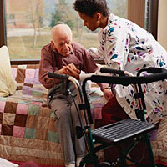
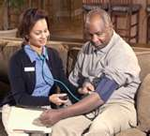
Assisted Living Facilities (ALFs)
By definition, ALFs are non-medical facilities that provide assistance with activities of daily living.
By design, ALFs provide unique services to residents who want to live as independently as possible for as long as possible.
Some of these services may involve contact with blood or body fluids that have the ability to spread disease.
Notes:
Assisted living facilities in Virginia are considered non-medical facilities designed to meet the social needs of individuals and provide assistance with activities of daily living. Due to the increase in the average life span, the number of assisted living facilities has increased as well as the medical needs of the residents they serve. Some of the services provided in ALFs may have the potential for exposure to blood and other body fluids, which can transmit disease.

Slide 5
Daily Tasks May Contain Some Risk
Daily tasks in the healthcare or residential setting pose some risk of exposure to germs.
Assisting with bathing or oral care
Handling incontinence pads, linens, and contaminated trash
Cleaning rooms, common areas, and equipment
Occasionally, these tasks may involve exposure to germs found in the blood or body fluids (bloodborne pathogens).
Notes:
Staff in assisted living facilities may be at risk for contact with blood and body fluids due to certain tasks that they perform. Some of these tasks may put the staff at risk for exposure to germs found in the blood, also known as bloodborne pathogens. Some of the activities that may be encountered on a daily basis that may pose lower risk for exposure to germs in the blood or body fluids include assisting with bathing or oral care; handing incontinence pads, dirty linens, and contaminated trash; cleaning rooms, common areas, and equipment.

Slide 6
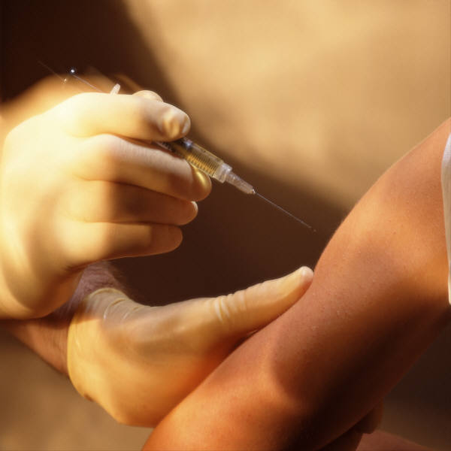
Tasks Related to Direct Resident Care That Pose More Risk for Exposure to Germs Found in Blood or Body Fluids
Assisting with wound care
Monitoring blood glucose
Giving an injection of medication
Cleaning blood/body fluid spills
Helping with nail or skin care
Providing first aid such as managing nose bleeds or abrasions
Notes:
Some tasks related to direct resident care pose risk for exposure to germs that can be found in blood or body fluids (bloodborne pathogens). These include assisting with wound care; monitoring blood glucose; performing an injection of medication such as insulin or blood thinner; cleaning blood or body fluid spills; helping with nail or skin care; or performing first aid, such as managing nose bleeds or abrasions.

Slide 7

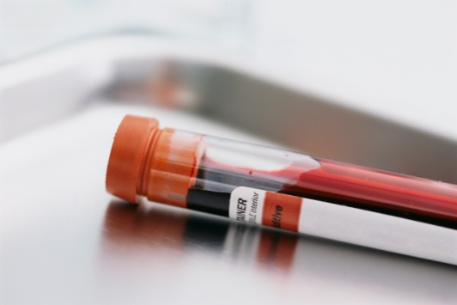
Bloodborne Pathogens
Germs that are carried in the blood and can be transmitted by contact with infected blood or body fluids are called bloodborne pathogens. The most common types include the following viruses:
Hepatitis B
Hepatitis C
HIV
Notes:
Bloodborne pathogens are gerns that are present in the blood that are capable of causing illness and disease. They can be passed to others through contact or indirect contact with contaminated blood or body fluids. The bloodborne pathogens that pose the greatest risk to workers in assisted living facilities include the hepatitis B virus, hepatitis C virus, and human immunodeficiency virus (HIV).

Slide 8
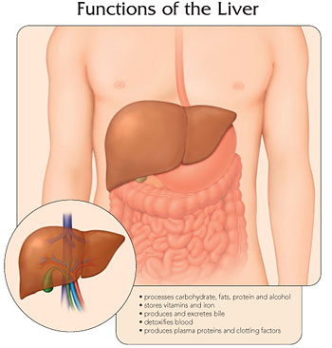
Hepatitis B
Serious liver disease that can cause cirrhosis or cancer
18,800 new infections in US in 2011 (estimated)
Most cases resolve
  ~10% of adult cases can be chronic
800,000 - 1.4 million chronically infected
  Testing recommendations to identify persons with chronic HBV infection: http://www.cdc.gov/hepatitis/HBV/TestingChronic.htm
30% of people infected don’t have symptoms
Notes:
Hepatitis B is a serious liver disease. Approximately 19,000 new cases of hepatitis B occur each year. Nearly one in three people infected don’t have any symptoms of the disease. Even without experiencing symptoms, the virus can still be found in the blood and body fluids, and person can still transmit the virus to others.
Most cases of hepatitis B resolve completely, however 10% percent of adults who contract the virus will have chronic infection, which means the infection stays with you forever.
Testing recommendations: http://www.cdc.gov/mmwr/preview/mmwrhtml/rr5708a1.htm
Synopsis: http://www.cdc.gov/hepatitis/HBV/TestingChronic.htm
Sources: http://www.cdc.gov/hepatitis/Statistics/index.htm
http://www.cdc.gov/hepatitis/B/bFAQ.htm

Slide 9
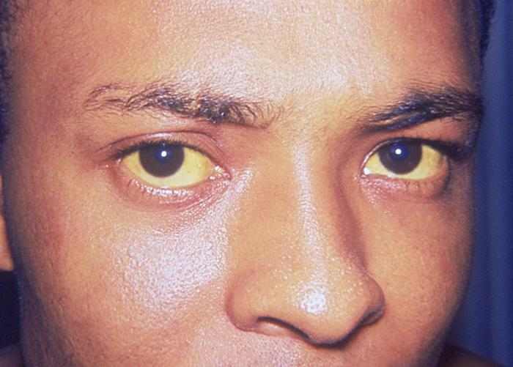
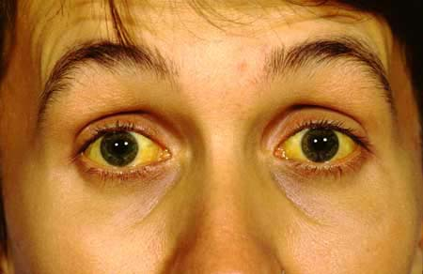
Hepatitis B
Symptoms include loss of appetite, fatigue, jaundice (yellowing of the skin), abdominal pain, and nausea
Can be prevented by vaccination
Workers in healthcare and residential settings are at increased risk
Treatment available to keep the virus under control
Notes:
The hepatitis B virus may not cause symptoms in some people. If symptoms of hepatitis B are present, they generally include loss of appetite, fatigue, jaundice (yellowing of the eyes, skin, dark urine) abdominal pain, and nausea. A vaccine for hepatitis B is available.
Prior to the introduction of its vaccine, hepatitis B was the most common disease found in blood or body fluids that was contracted by healthcare workers on the job. The transmission of hepatitis B in the healthcare setting has declined significantly since the hepatitis B vaccine, but workers in healthcare and residential settings are still at increased risk for contracting the disease. There is no specific treatment to cure hepatitis B, although there are medications called antivirals that can control the virus.

Slide 10
Hepatitis C
Serious liver disease that can lead to cirrhosis or liver failure
16,500 new infections in 2011 (estimated)
Chronic infection: 75-85% of cases
  2.7-3.9 million chronically infected (estimated)
70-80% of people do not have any symptoms.
  Many people do not have symptoms for 20 years after first infected.
  When symptoms do occur, they are similar to those of hepatitis B virus.
Notes:
Hepatitis C is a serious liver disease that affects millions of people in the US. Most people do not have symptoms early in the disease and they often do not know they are infected. The majority of people who contract hepatitis C will develop chronic infection.
Like with hepatitis B, even without experiencing symptoms, the hepatitis C virus can still be found in the blood and body fluids, and person can still transmit the virus to others. Many people do not have symptoms for 20 years after first infected
Source: http://www.cdc.gov/hepatitis/Statistics/index.htm

Slide 11
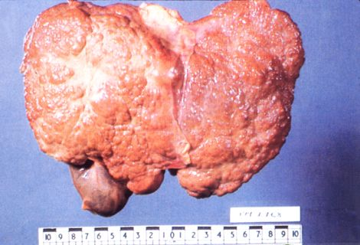
Hepatitis C
Increased risk for liver cancer
60-70% of cases develop chronic liver disease
Treatment available to keep the virus under control
No vaccine available
Testing recommended for persons born from 1945 through 1965
  Other CDC testing recommendations: http://www.cdc.gov/hepatitis/HCV/GuidelinesC.htm
Notes:
Chronic hepatitis C infection often leads to liver failure and liver cancer. Antiviral medications are available to treat certain types of the virus. There is no vaccine currently available.
Who should be tested for HCV infection? http://www.cdc.gov/hepatitis/HCV/GuidelinesC.htm
HCV testing is recommended for anyone at increased risk for HCV infection, including:
Persons born from 1945 through 1965
Persons who have ever injected illegal drugs, including those who injected only once many years ago
Recipients of clotting factor concentrates made before 1987
Recipients of blood transfusions or solid organ transplants before July 1992
Patients who have ever received long-term hemodialysis treatment
Persons with known exposures to HCV, such as
health care workers after needlesticks involving HCV-positive blood
recipients of blood or organs from a donor who later tested HCV-positive
All persons with HIV infection
Patients with signs or symptoms of liver disease (e.g., abnormal liver enzyme tests)
Children born to HCV-positive mothers (to avoid detecting maternal antibody, these children should not be tested before age 18 months)

Slide 12

HIV
Disease that causes the immune system to lose its ability to fight infection
1.15 million infected (~18% undiagnosed)
Some people progress to Acquired Immunodeficiency Syndrome (AIDS)
Symptoms vary; initial infection may cause flu-like illness
Medications available to treat illness, but there is no cure or vaccine
Testing recommendations: http://www.cdc.gov/hiv/basics/testing.html
Notes:
HIV or the human immunodeficiency virus is a virus that causes the body’s immune system to lose its ability to fight infection effectively. At the end of 2009, approximately 1.15 million people were living with HIV infection, with 18% undiagnosed. (reference: http://www.cdc.gov/hiv/statistics/basics/index.html)
Once the virus enters the body it does not leave. The symptoms of HIV vary. Initial infection often causes “flu-like” symptoms including low-grade fever, body aches and swollen lymph nodes. Medications called antivirals are available to treat HIV/AIDS and are often effective in controlling the virus. Currently there is no cure or vaccine.
As HIV progresses and the immune system becomes weaker, some people develop more serious infections. Acquired Immunodeficiency Syndrome (AIDS) is a syndrome associated with HIV that is characterized by the development of opportunistic infections and a very low T-helper cell count in the blood. The number of people who develop AIDS and die from HIV has decreased due to anti-viral medications.
CDC recommends that health care providers test everyone between the ages of 13 and 64 at least once as part of routine health care. One in six people in the United States who have HIV do not know they are infected. For more information on testing recommendations, go to: http://www.cdc.gov/hiv/basics/testing.html

Slide 13
Transmission (How Diseases are Spread)
Bloodborne pathogens are spread by contact with blood or other potential infectious materials such as:
Saliva
Semen and vaginal fluids
Normally sterile fluids (body sites)
  Cerebrospinal fluid (spinal cord)
  Synovial (joint) and pleural fluid (lung)
  Peritoneal (abdominal), pericardial (heart), and amniotic fluid (uterus)
Notes:
HIV, HBV, and HCV can be spread by contact (or touching) blood or other body fluids including saliva (such as when someone bites another person), semen, and vaginal fluids.
Certain sites within the body are normally sterile and contain body fluids that may contain bloodborne pathogens. These fluids include cerebrospinal (spinal) fluids, synovial (joint) fluid, pleural (lung) fluid, peritoneal (abdominal fluid) fluid, pericardial (heart) fluid, or amniotic (uterine) fluid.

Slide 14

In Other Words…
Blood can be present with nearly any human bodily fluid.
If it’s warm, wet, and not yours,
DON’T TOUCH IT without wearing gloves and any other appropriate types of personal protective equipment!

Slide 15
How Bloodborne Pathogens Are NOT Spread
Bloodborne pathogens such as HBV, HCV, and HIV are not spread by many common behaviors that may occur in the assisted living setting, including:
  Hugging
  Holding or shaking hands
  Coughing
  Sneezing
  Using the same toilet seat
Notes:
Other behaviors such as kissing or sharing utensils are generally low risk. However, they could pose a greater risk if a person’s mouth could be bleeding (such as after oral surgery or when someone has mouth trauma).

Slide 16
How Germs Can Enter Your Body
Needles
Broken glass (broken blood tubes)
Non-intact skin exposure through cuts, skin abrasions, and mucous membranes of mouth, eyes and nose
  Includes human bites, splashes or sprays of blood/body fluids
Touching your mouth, eyes, nose or open skin after touching surfaces or equipment contaminated with blood or contaminated body fluids
Notes:
Germs found in the blood or body fluids can enter the body in a variety of ways, including:
-needles
-contaminated broken glass
-contaminated blood/body fluids that touch non-intact areas of the skin or mucous membranes. This could include human bites, or a splash or spray, or splatter of blood or body fluids.
-touching your mouth, eyes, nose, or open skin after touching surfaces or equipment that have blood or body fluids on them.
In Virginia, we have seen outbreaks in ALFs where the disease has been spread due to equipment (such as devices associated with blood glucose monitoring) and other surfaces contaminated with hepatitis B virus.

Slide 17
Your Risk For Getting An Infection from Blood or Body Fluids
Depends on:
The germ involved
How you are exposed
The amount of germ in the infected blood/body fluid at the time of exposure
The amount of infected blood/body fluid involved in the exposure
Your immune response
Your vaccination status (if vaccine is available)
Whether you get treatment after exposure and how quickly you get treatment
Notes:
Risk of infection after being exposed to a bloodborne pathogen depends on many things: the pathogen itself, the type (or route) of exposure (needlestick vs. eye/nose/mouth vs. non-intact skin), the amount of virus in the blood at the time of the exposure, the amount of body fluid or blood involved in the exposure, the exposed individual’s immune response, the exposed individual’s vaccination status, and post-exposure treatment. Timely post-exposure treatment is able to decrease the risk of infection.

Slide 18
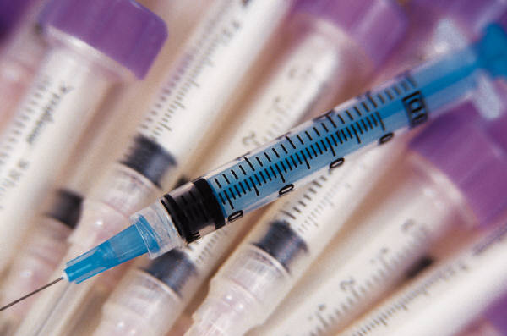
If I’m Exposed, What’s My Risk?
Risk of infection following an occupational needlestick or cut from a known positive source:
HBV: 6% - 31%
HCV: 1.8%
HIV: 0.3%
Notes:
Following a needlestick or cut from a known positive source, risks of infection range by type of pathogen. Risk of transmission of hepatitis B is highest, with an range from 6-31%, followed by hepatitis C (1.8%), and HIV (0.3% or 3 in 1000).
The risk after exposure of the eye, nose, or mouth to HIV-infected blood is estimated to be, on average, 0.1% (1 in 1,000). The risk after exposure of non-intact skin to HlV-infected blood is estimated to be less than 0.1%.

Slide 19

Another Way to Think About Risk
Or, out of every 1,000 people exposed via a needlestick or cut from a known positive source:
60 – 310 people could get HBV
18 could get HCV
3 could get HIV

Slide 20
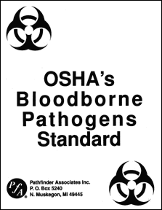
Bloodborne Pathogens Standard (BBP)
Written by the Occupational Safety and Health Administration (OSHA)
  Title 29 of the Code of Federal Regulations (29 CFR 1910.1030)
Purpose: To protect you and reduce your risks for occupational exposure to disease
Describes policies and practices that employers must establish to protect employees who have contact with blood/body fluids in their job
Notes:
The Bloodborne Pathogens Standard is a document written to protect employees from bloodborne diseases. It describes specific policies and practices that employers must follow to protect their employees. The standard is enforceable by federal law.

Slide 21
Module 1: Summary
Certain job duties can put employees at risk for coming into contact with blood or body fluids
Sometimes people have germs in their blood and don’t know it
Germs can be spread by coming into contact with blood or body fluids
Employers are responsible for protecting their employees from exposure to disease on the job

Slide 22
Protecting Employees from Bloodborne Pathogens:
Module 2
Notes:
The two modules of this training course address how to protect staff members from getting bloodborne pathogens, or germs that can be found in blood or body fluids.
The Occupational Safety and Health Administration (OSHA) published the Bloodborne Pathogens Standard in 1991 to outline measures that employers must follow to protect their employees from bloodborne diseases. The standard applies to employees who have the potential for exposure to blood and body fluids while performing their regular job duties. In 2001, it was revised to include the Needlestick Safety and Prevention Act, requiring employers to select safer needle devices and allow employees to identify and choose these devices.

Slide 23
Course Objectives
After completion of Module 2 of this course, attendees should be able to:
Discuss the components of Occupational Health and Safety Administration (OSHA) Bloodborne Pathogens Standard
Define engineering and work practice controls
Describe appropriate personal protective equipment
Define an occupational exposure and discuss the steps to take if you are exposed
Notes:
This module is designed to give participants an overview of the Bloodborne Pathogens Standard and to describe the major components of the regulation that are designed to reduce the risk of expose to bloodborne pathogens. This presentation will include information about engineering and work practice controls such as safety devices. Standard precautions and personal protective equipment will also be described. Attendees will learn how to define an occupational exposure and discuss the steps to take if you are exposed. The hepatitis B vaccine and requirements for training and recordkeeping will also be discussed.

Slide 24
A Recap of Module 1
Certain job duties can put employees at risk for coming into contact with blood or body fluids
Sometimes people have germs in their blood and don’t know it
Germs can be spread by coming into contact with blood or body fluids
Employers are responsible for protecting their employees from exposure to disease on the job

Slide 25
Bloodborne Pathogens Standard (BBP)
Written by the Occupational Safety and Health Administration (OSHA)
  Title 29 of the Code of Federal Regulations (29 CFR 1910.1030)
Purpose: To protect you and reduce your risks for occupational exposure to disease
Describes policies and practices that employers must establish to protect employees who have contact with blood/body fluids in their job
Notes:
The Bloodborne Pathogens Standard is a document written to protect employees from bloodborne diseases. It describes specific policies and practices that employers must follow to protect their employees. The standard is enforceable by federal law.

Slide 26
Bloodborne Pathogens (BBP) Standard
The Bloodborne Pathogens Standard describes important strategies that can reduce the risk of infection on the job. These include:
Exposure Control Plan
Engineering Controls
Work Practice Controls
Standard Precautions/Personal Protective Equipment
Housekeeping
Hepatitis B Vaccine
Occupational Exposure Follow-up
Notes:
The Bloodborne Pathogens Standard is divided in sections that address the following topics; the exposure control plan, engineering controls, work practice controls, standard precautions and personal protective equipment, housekeeping, hepatitis B vaccine, occupational exposures, education, and recordkeeping. A copy should be located in your facility and made available to you.

Slide 27
Exposure Control Plan
The Plan is a document that describes how
your employer will address the components
of the Bloodborne Pathogens Standard. It
includes:
Who is covered under the standard
Ways to reduce the risk of exposure
What to do if there is an occupational exposure
Example: www.vdh.virginia.gov/epidemiology/surveillance/hai/documents/word/BloodbornePathogensExposureControlPlanTEMPLATE.doc
Notes:
**If this training is targeted to administrators, the first sentence should say: …that describes how you, as an employer, will address the components…”**
The exposure control plan is the written document that describes how the Bloodborne Pathogen Standard is addressed by your facility. The exposure control plan should include who is covered under the standard, risks present in your workplace, ways to reduce your risks of exposure, and the procedures to follow if you have an occupational exposure.
Include a pop-up or link to see a copy of a model Exposure Control Plan

Slide 28
Writing the Plan
Determine exposures
  Employer prepares lists of job classifications
    Classifications in which all workers have occupational exposure
    Classifications in which some workers have occupational exposure
    Includes a list of the tasks and procedures performed by those workers that result in their exposure
Describe methods of protecting employees against exposures
Make written plan available to employees
Update the plan annually
Notes:
**for administrators only**
Remember that in the facility, one person may be filling many roles. If any of the roles or job responsibilities of a person involves exposure to blood or other potentially infectious body fluid, the OSHA Bloodborne Pathogens Standard applies to him or her.
• Establish an exposure control plan. This is a written plan to eliminate or minimize occupational exposures. The employer must prepare an exposure determination that contains a list of job classifications in which all workers have occupational exposure and a list of job classifications
in which some workers have occupational exposure, along with a list of the tasks and procedures performed by those workers that result in their exposure.
• Employers must update the plan annually to reflect changes in tasks, procedures, and positions that affect occupational exposure, and also technological changes that eliminate or reduce occupational exposure. In addition, employers must annually document in the plan
that they have considered and begun using appropriate, commercially-available effective safer medical devices designed to eliminate or minimize occupational exposure. Employers must also document that they have solicited input from frontline workers in identifying, evaluating,
and selecting effective engineering and work practice controls.

Slide 29
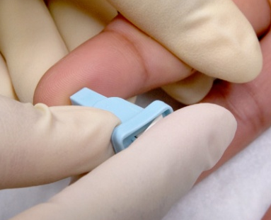
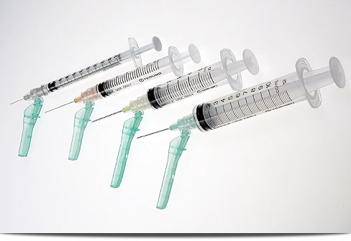
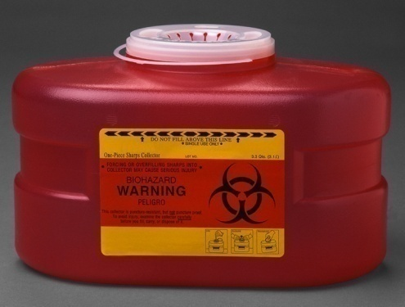
Engineering Controls
Systems or mechanical devices that minimize hazards in the workplace.
Examples:
Self-sheathing or retractable needles
Sharps disposal containers
Single-use fingerstick devices
Notes:
Engineering controls are systems or mechanical devices designed to minimize or reduce your risk of exposure to hazards in the workplace. Examples of such devices include self-sheathing or retractable needles, sharps containers, and single-use fingerstick devices.
The OSHA BBP Standard states that an employer’s Exposure Control Plan must:
1910.1030(c)(1)(iv)(A) Reflect changes in technology that eliminate or reduce exposure to bloodborne pathogens; and1910.1030(c)(1)(iv)(B) Document annually consideration and implementation of appropriate commercially available and effective safer medical devices designed to eliminate or minimize occupational exposure.

Slide 30
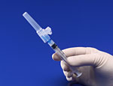
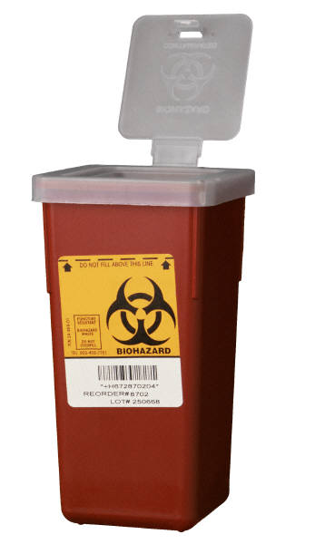
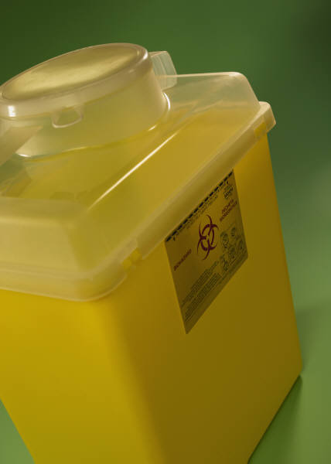
Sharps Safety Rules
Use needles with safety devices
Never recap, break or bend needles
Never leave needles unattended
Never reuse disposable sharps
Dispose of all needles in a regulated, color-coded, labeled sharps container
Sharps containers should be changed when ½ - ¾ full.
Notes:
Engineering controls (part of OSHA BBP Standard) include certain safety rules that should be followed when handling sharps. Safe practices include never reusing disposable needles, syringes, lancets or sharps of any kind and never breaking bending or recapping needles. If recapping is necessary, those situations should be described in the exposure control plan. The single handed “scoop technique” should always be used (see next slide). Used needles should be disposed of in a regulated, color-coded, labeled sharps container as described in Virginia Regulated Medical Waste regulation. Sharps containers should be puncture proof with a lid that prevents retrieval of the disposed medical waste.
The sharps container should be changed when it is ½ - ¾ full to avoid contact with discarded sharps. Sharps containers should be placed in locations accessible to staff but not to residents.
Resources on sharps:
Do’s and don’ts of safe disposal of needles and sharps (FDA):
http://www.fda.gov/downloads/MedicalDevices/ProductsandMedicalProcedures/HomeHealthandConsumer/ConsumerProducts/Sharps/UCM278775.pdf
Home generated medical waste:
http://www.fairfaxcounty.gov/dpwes/trash/dispsharps.htm

Slide 31

Work Practice Controls
Practices in the workplace that protect you from disease and prevent transmission to your residents and coworkers.
These include:
Hand hygiene
Personal hygiene
Personal protective equipment
Notes:
Work practice controls are practices that prevent transmission for bloodborne pathogens to your patients/residents and coworkers. These are practices that reduce the possibility of exposure by changing the way a task is performed, and such as appropriate practices for hand hygiene, personal hygiene and the use of personal protective equipment.
Also includes appropriate practices for handling and disposing of contaminated sharps, handling specimens, handling laundry, and cleaning contaminated surfaces and items.
**For Administrators: Work practice controls cannot be implemented appropriately without adequate supplies. It is essential that your facility and staff have the enough supplies and the correct kinds of supplies to conduct hand hygiene, practice personal hygiene, and wear personal protective equipment.**

Slide 32
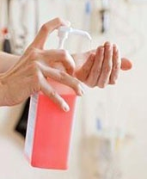
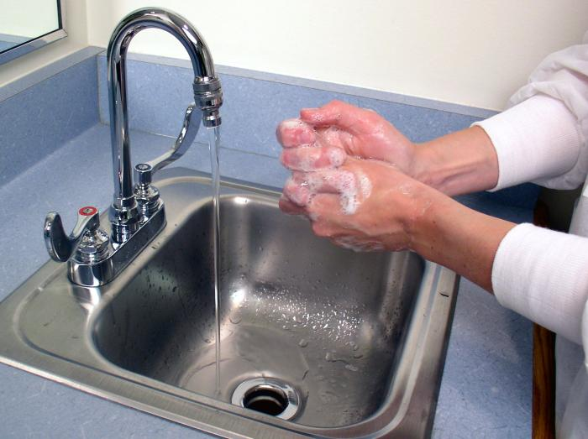
What is Hand Hygiene?
Hand hygiene involves the following:
Hand washing:
Washing hands with soap and water. Includes applying friction and drying hands thoroughly.
Alcohol-based hand rub:
Rubbing hands with an alcohol-containing preparation.
Notes:
Hand hygiene is a general term that applies to either handwashing, using an alcohol-based handrub, or using antiseptic handwash.
Handwashing refers to washing hands with soap and water. Handwashing with soap and water remains a good strategy for hand hygiene in non-healthcare settings and is recommended by CDC and other experts.
Alcohol-based hand rub (also known as hand sanitizer or hand gel) refers to the alcohol-containing preparation applied to the hands to reduce the number of microorganisms on the skin. Alcohol-based hand rubs should have a concentration of at least 60% alcohol, although >70% is best because some organisms may require a higher concentration of alcohol.

Slide 33
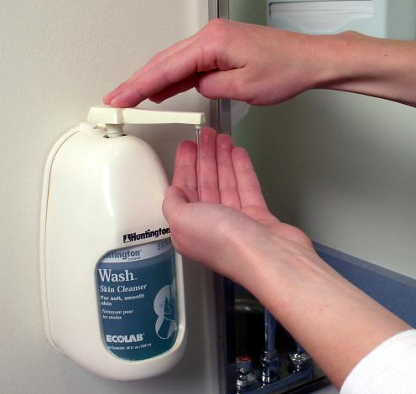
Recommended Hand Hygiene Techniques
Hand rubs
  Apply to palm of one hand, rub hands together covering all surfaces until dry.
  Manufacturer will instruct how much to use.
Hand washing
  Wet hands with water, apply soap, rub hands together for at least 15 seconds.
  Rinse and dry with disposable towel.
  Use towel to turn off faucet.
Notes:
When decontaminating hands with an alcohol-based handrub, apply product to palm of one hand and rub hands together, covering all surfaces of hands and fingers, until hands are dry.
When washing hands with soap and water, wet hands first with water, apply the amount of soap recommended by the manufacturer, and rub hands together for at least 15 seconds, covering all surfaces of the hands and fingers. Rinse hands with water, dry thoroughly with a disposable towel, and use the towel to turn off the faucet.

Slide 34
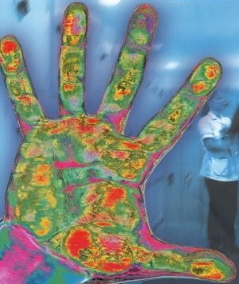
Hand Hygiene: When
If hands are visibly dirty, contaminated, or soiled, wash with soap and water.
  After using the restroom
  Before eating or preparing food
If hands are not visibly soiled,
you may choose to use an alcohol-based hand rub for routinely decontaminating hands.
Notes:
When hands are visibly dirty, contaminated, or soiled, wash with soap and water. This includes after using the restroom and before eating or preparing food.
If hands are not visibly soiled, use an alcohol-based handrub for routinely decontaminating hands.

Slide 35
When to Perform Hand Hygiene
Before and after:
  Contact with a resident
    Be sure to perform hand hygiene between residents
  Treating a cut or wound
  (e.g., changing dressings or bandages)
Before:
  Preparing or eating food
  Touching your eyes, nose, or mouth
  Putting on gloves
  Handling/administering medication
  Insertion of invasive devices (e.g., urinary catheters)
Notes:
Hand hygiene is indicated before and after: contact with a resident and changing wound dressings or bandages (treating a cut or wound)
Gloves should be used when potential for contact with blood or other body fluids occurs. This is in accordance with standard precautions.
Be sure to perform hand hygiene before preparing or eating food, touching one’s eyes, nose, or mouth, administering medication, or inserting invasive devices such as catheters (regardless of glove use)

Slide 36
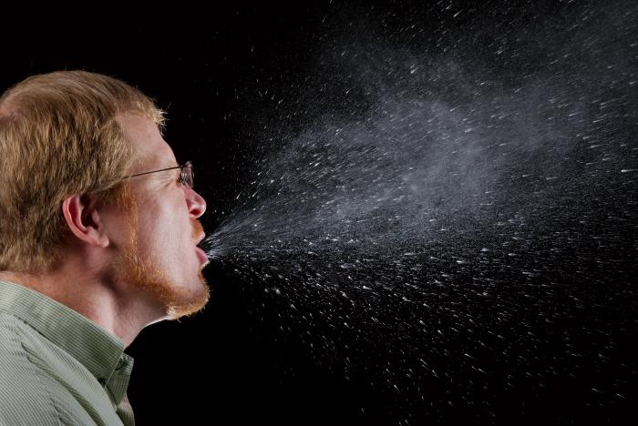
When to Perform Hand Hygiene
After:
  Contact with blood, body fluids, mucous membranes, secretions, excretions, or non-intact skin
  Removing gloves
  Touching surfaces or objects in the environment that may be contaminated with blood or body fluids
  Handling garbage
  Using the restroom
  Blowing your nose, coughing, or sneezing
Notes:
After contact with a patient/resident’s blood, body fluids, mucous membranes, secretions (except sweat), excretions, or non-intact skin, wash hands immediately.
Hand hygiene should also be performed after removing gloves, after touching surfaces or objects in the environment that may be contaminated with blood or body fluids, and after handling garbage.
All persons should always perform hand hygiene after using the rest room and blowing their nose, coughing, or sneezing.

Slide 37
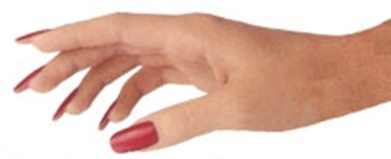
Work Practice Controls:
Hand Hygiene and Nails
Keep fingernails short, clean, and healthy
Artificial nails should not be worn; natural nails should be no longer than ¼ inch
  Long fingernails require extra effort when washing hands – harder to remove all germs
  Long fingernails may tear gloves
Notes:
Artificial and natural nails can harbor germs that can be transmitted to other people. Artificial nails should not be worn by staff caring for residents or those working in their environment such as housekeeping personnel. Natural nails should be worn no longer than ¼ inch long.
It’s harder to clean long fingernails – germs can get stuck under the nails. Also, having long fingernails can be dangerous because the fingernails may tear the gloves, which may put the care provider at risk

Slide 38
Work Practice Controls:
Personal Hygiene
Things that you can do to protect yourself from disease:
Do not leave food or drinks on countertops where blood or potentially infectious materials can be present (e.g., nurses station)
Do not keep food or drinks in refrigerators or freezers used to hold medications or potentially infectious materials
Do not use petroleum-based lubricants with latex gloves – these weaken the protective glove barrier
Do not eat, drink, apply cosmetics, or handle lip balm in an area where you might be exposed to blood or body fluids
Notes:
Personal hygiene practices should be maintained on the job. Do not place food or drinks in refrigerators, freezers or countertops that store potentially infectious materials. You should never eat, drink, apply cosmetics or handle lip balm in areas where you might be exposed to blood or body fluids.
Some bloodborne pathogens can survive outside the body for days (ex. HBV can live for up to 7 days). The Hepatitis C virus can survive outside the body at room temperature, on environmental surfaces, for at least 16 hours but no longer than 4 days. HIV cannot survive outside the body for very long.
Petroleum-based lubricants should not be used with latex gloves as they can interfere with the integrity of the glove.

Slide 39
Standard Precautions
A set of precautions designed to protect staff and residents from exposure to disease
Use for ALL residents, ALL body fluids, ALWAYS
Includes:
  Hand hygiene
  Personal protective equipment (PPE), including resuscitation devices
  Safe injection practices
  Sharps injury prevention
  Care of environment
  Cleaning of care equipment
  Respiratory hygiene/cough etiquette
  Handling of linen and regulated medical waste
  Special lumbar puncture procedures
  Patient/resident placement
Notes:
Standard precautions, previously called Universal Precautions, is a set of precautions designed to protect staff and patients/residents from exposure to diseases, including bloodborne diseases. You should use them when caring for all residents regardless of diagnosis and when handling all body fluids.
Hand hygiene before and after contact with the resident and /or objects/surfaces around the resident that may be contaminated with bacteria or viruses
PPE - Use gloves when care provider anticipates contact with blood, feces, urine or other body fluids
Wear a gown to prevent soiling of providers clothing
Additional PPE such as mask, face shield, or eye protection/goggles when splashing or spraying of blood/body fluids may occur
During resuscitation, use mouthpiece, resuscitation bag, other ventilation devices to prevent contact with mouth and oral secretions
Safe injection practices: Use aseptic technique to prevent contamination of sterile injection equipment
-Do not administer medications from a single syringe to multiple residents. Changing the needle is not sufficient.
-Use fluid infusion and administration sets (i.e., intravenous bags, tubing, and connectors) for one resident only, and discard immediately after use
-Use single-dose vials for injectible medications whenever possible
-If multi-dose vials must be used, use and store them in accordance with the manufacturer’s instructions
Care of environment - Develop procedures for routine care, cleaning, and disinfection of environmental surfaces, especially frequently touched surfaces in patient-care areas.
Respiratory hygiene/cough etiquette - used to decrease the transmission of respiratory illness such as influenza & colds by:
Education regarding how respiratory illnesses spread and prevention practices including how to “cover your cough” and proper hand hygiene methods
Availability and use of tissues and hand hygiene products
Use of mask for person who is coughing
Spatial separation of the person with a respiratory illness
Clean equipment between residents - handle in a manner that prevents transfer of microorganisms to others and to the environment
Handling of linen and regulated medical waste - Handle in a manner that prevents transfer of microorganisms to others and to the environment.
Sharps injury prevention - Do not recap, bend, break, or hand-manipulate used needles; if recapping is required, use a one-handed scoop technique only; use safety features when available; place used sharps in puncture-resistant container
Special Lumbar Puncture Procedures - use of masks for insertion of catheters or injection of material into spinal or epidural spaces via lumbar puncture procedures (e.g., myelogram, spinal or epidural anesthesia).
Patient/resident placement - Prioritize for single-patient room if patient is at increased risk of transmission, is likely to contaminate the environment, does not maintain appropriate hygiene, or is at increased risk of acquiring infection or developing adverse outcome following infection.

Slide 40
For More Information…
Virginia Department of Health webpage on Standard Precautions:
www.vdh.virginia.gov/Epidemiology/Surveillance/HAI/StandardPrecautions.htm
2007 Guideline of Isolation Precautions: Preventing Transmission of Infectious Agents in Healthcare Settings
www.cdc.gov/hicpac/2007IP/2007isolationPrecautions.html

Slide 41
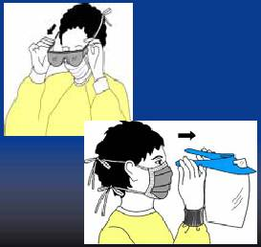
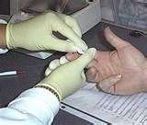
Personal Protective Equipment
Protective wear that serves as a barrier between you and blood/body fluids:
Gloves
Gowns
Masks
Goggles/Face shields
Resuscitation devices
Notes:
Personal protective equipment are barriers worn to protect you from exposure to blood and body fluids. PPE includes gloves, gowns, masks, goggles, face shields, and resuscitation devices.

Slide 42
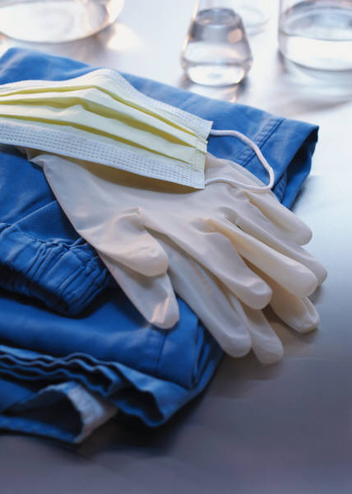

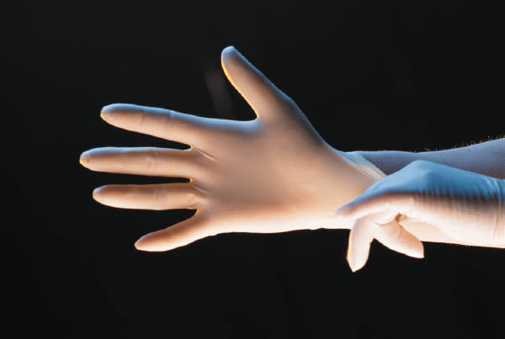
Protective Equipment
Type varies with task
Adequate supplies maintained, replaced, and disposed of by facility
Fits properly and is free of flaws
Supplied at no cost to employee
Facility must offer training on use
If re-usable, must be cleaned carefully and as soon as possible to prevent contamination
Notes:
PPE is supplied to you, the employee, at no cost. You should be trained on hire as to the location, selection and disposal of PPE. The selection of PPE should be based on the task that you will be performing. Contaminated PPE should be disposed of carefully and in accordance with Virginia Regulated Medical Waste regulations. Heavy duty utility gloves used for certain housekeeping and cleaning procedures may be reused if not damaged. If you have a latex allergy, non-latex gloves must be made available to you.

Slide 43
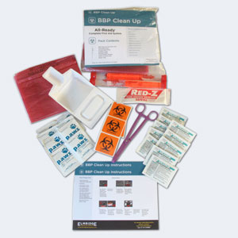
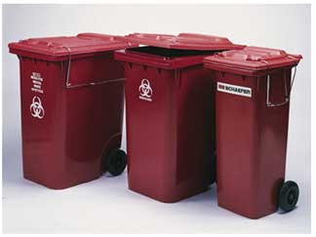
Housekeeping
Facility cleaning schedule
Procedure for cleaning up blood/body fluid spills – clean up spills promptly and appropriately
Follow product instructions for use
  Use enough product
  Use for appropriate kill time
Use standard precautions when handling all linen (including sheets, clothes)
Regulated medical waste policy/procedure
Notes:
All facilities must have a regular cleaning schedule in their exposure control plan. Procedures for cleaning and disinfecting all areas of the facility should be included as well as how to manage blood spills. A 1:10 bleach solution is often used (1 part bleach to 9 parts water, if using regular concentration (5.25-6%) household bleach).
Assure that cleaning and disinfecting products are used according to manufacturer’s recommendations. It is important to use enough product for the job, and to use the product for a sufficient amount of time needed to kill germs. For example, a person may need to wipe a surface so that it stays wet for one minute.
Standard precautions should be followed whenever you are handling contaminated linen and trash. Linen contaminated with blood and body fluids does not need to be separated from non-contaminated linen prior to washing or transport if it is handled using standard precautions and it is placed in an impervious linen bag. Regulated medical waste should be separated from regular trash and handled per the Virginia Regulated Medical Waste regulation.

Slide 44
Hepatitis B Vaccine
Single most important factor in preventing hepatitis B infection in healthcare workers
Must be offered by the employer to all employees who may have exposure to blood or body fluids on the job
  Must be provided at no cost to the employee
  Must be offered within 10 days of initial assignment to a job where there may be occupational exposure to blood or body fluids
Safe, effective
Series of three shots over a 6-month period
Long-term immunity
Notes:
The hepatitis B vaccine must be offered to any employee who is covered under the Bloodborne Pathogens Standard.
The vaccination must be offered after the worker is trained about the OSHA Bloodborne Pathogens Standard and within 10 days of initial assignment to a job where there is occupational exposure risk, unless the worker has previously received the vaccine series, antibody testing has revealed that the worker is immune, or the vaccine is contraindicated for medical reasons.
It is safe and effective and provides long-term immunity. Vaccination requires 3 separate injections given at separate intervals over a period of 6 months in the upper arm A blood test should be done following the final injection to determine if the vaccine was effective.
If you choose not to receive the vaccine, you will be asked to sign a declination form. If you decline the vaccine initially, you can change your mind at any time.

Slide 45
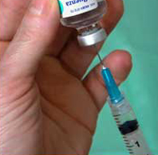
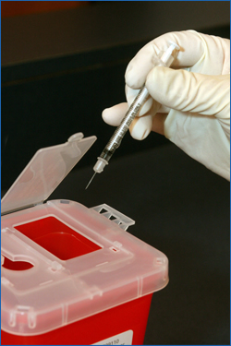
Occupational Exposure:
Immediate Response
If you should get stuck by a needle or if you have direct skin or mucous membrane contact with blood or other body fluids:
  Don’t panic
  Wash the area with soap and water
  Flush eyes or mucous membranes with water
  Report the incident immediately (within two hours) to your supervisor and record date and time of incident
    This is important so that you can get the necessary follow-up care
Notes:
Occupational exposures can cause fear and anxiety. There are certain steps that you can take at the time of the exposure that can reduce your risk. Remember not to panic. First, wash the area with soap and water. If mucous membranes were exposed, flush them with water.
If you suspect that you have had an occupational exposure, report it immediately to your supervisor to document the incident. A referral for a post-exposure evaluation should be initiated as soon as possible to assess the need for follow-up and prophylaxis.
The facility’s Bloodborne Pathogens Exposure Control Plan should include details on how employees are to report occupational exposures and how they should seek follow-up care after an exposure has occurred.

Slide 46

Occupational Exposure: Post-Exposure Counseling and Follow-up
After an occupational exposure, you must be provided with counseling and follow-up care
  Trained medical staff will help determine your risk of acquiring a bloodborne disease
  If there is a risk, appropriate testing and follow-up of the employee (and resident(s) involved) will be initiated
Remember to keep all follow-up appointments
Notes:
An occupational exposure is any mucous membrane or percutaneous exposure that has the risk of transmitting a bloodborne infection.
Face-to-face counseling should be offered to you at the time of the exposure to assess your risk and the need to received follow-up testing. If there is any risk associated with your exposure, you will be offered appropriate testing, prophylaxis, and follow-up counseling. It is very important that you keep all of your appointments.

Slide 47
Education
Training on the BBP Standard is required upon hire and annually thereafter for staff members who are covered under the OSHA BBP Standard
Training must be conducted by a person who is knowledgeable in the subject
Training must be offered at a convenient location and on company time
Training records must be kept at least 3 years
Notes:
OSHA requires employers to train everyone who is covered under the Bloodborne Pathogens Standard upon hire and annually thereafter. Training is also required whenever there are changes in policies, procedures, or safety devices and equipment. You will be paid for the time you attend training and it should be offered at a time and place that is convenient.
Training records must be maintained for 3 years. See the BBP Standard for more information on what is required to be kept in the training record.
This training is one form of training that can meet this requirement

Slide 48
Recordkeeping
Training records
Medical records
  Maintained for each employee with an occupational exposure
  Includes vaccination status and post-exposure evaluations
Sharps injury log
  Maintained for 5 years from the date of exposure
  Type and brand of device involved
  Department or area of incident
  Description of incident
Notes:
Medical records, including vaccines and post-exposure evaluations, should be maintained for each employee with an occupational exposure. All medical records are stored in a separate file from personnel records. See the BBP Standard for more information on what is required to be kept in the employee’s medical record.
Unless the employer falls under an exemption (Part 1904 --Recording and Reporting Occupational Injuries and Illnesses, in Title 29 of the Code of Federal Regulations), a sharps injury log should be maintained as part of the BBP standard. The log will be maintained confidentially. Sharps injuries that occur must be noted in the log and maintained for 5 years from the date of the exposure. The log includes type and brand of device involved (if known), the department or area of the incident, and a description of the incident.

Slide 49
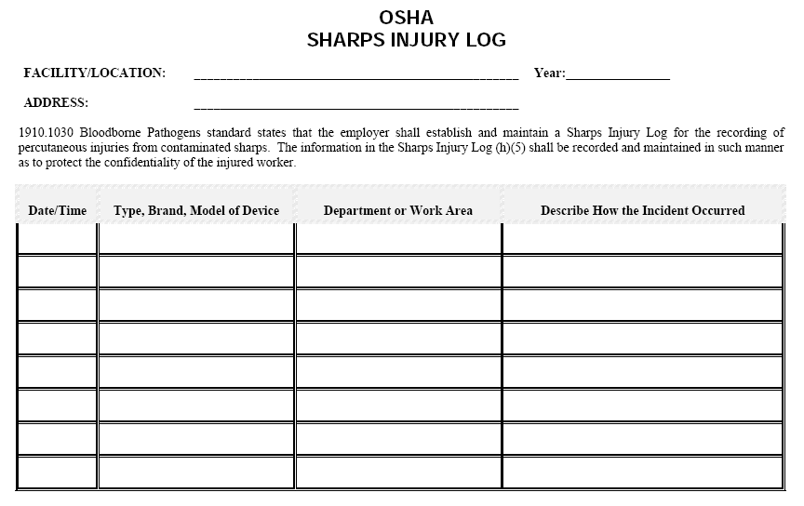
Example of Sharps Injury Log

Slide 50
Module 2: Summary
The OSHA BBP Standard describes policies and practices that employers must establish to protect employees who have contact with blood/body fluids in their job.
If an occupational exposure does occur, report the incident and receive follow-up care promptly.
Training upon hire and annually is important to assure that employees understand their risks and follow the appropriate policies and practices.
Notes:
Domains of the BBP Standard: (1) Exposure Control Plan; (2) Engineering Controls; (3) Work Practice Controls; (4) Standard Precautions/Personal Protective Equipment; (5) Housekeeping; (6) Hepatitis B Vaccine; and (7) Occupational Exposure Follow-up

Slide 51
Self Test (True or False)
1. The OSHA Bloodborne Pathogens Standard applies to anyone who may have exposure to blood/body fluids while performing job duties.
2. HIV, HBV, and HCV may cause no obvious symptoms.
3. Standard Precautions should only be used with residents who have infectious diseases.
4. Used needles and syringes should always be placed in a regulated sharps container.
Notes:
1.T
2.T
3.F. Standard precautions should be used for all residents
4. T.

Slide 52
Self Test (True or False)
5. Employers must help prevent occupational exposure by providing access to work practice controls (such as personal protective equipment) and engineering controls (such as sharps containers).
6. It is safe to store medications and employee food/drinks in the same refrigerator.
7. There is no time limit to reporting occupational exposures to your supervisor as long as follow-up testing is initiated eventually.
Notes:
5.T
6. F. It is not safe to store food or drinks in the same refrigerator or freezer used to hold medications, blood, or other potentially infectious materials.
7. F. Occupational exposures should be reported to your supervisor at the time of exposure to ensure appropriate and effective follow-up. Written documentation of the incident should include the date, time type of exposure, device and follow-up care received.

Slide 53
Self Test (True or False)
8. Employees are responsible for following the policies and procedures written by their employer and for using the safety measures available to them to reduce their risk of exposure to bloodborne diseases.
9. Employers must offer hepatitis B vaccine at no cost to employees with occupational exposure to blood/body fluids.
10. Training in the OSHA BBP Standard is only required for new employees.
Notes:
8. T.
9. T.
10. F. Training is required upon hire, annually, and as needed.

Slide 54
Resources
Centers for Disease Control and Prevention
  HIV/AIDS (http://www.cdc.gov/hiv/)
  Viral Hepatitis (http://www.cdc.gov/hepatitis/index.htm)
Occupational Safety and Health Administration
  www.osha.gov/SLTC/bloodbornepathogens/index.html
Virginia Department of Environmental Quality
  Hazardous waste disposal (http://www.deq.virginia.gov/Programs/LandProtectionRevitalization/SolidHazardousWasteRegulatoryPrograms/HazardousWaste.aspx)
Virginia Department of Health
  Contact your local health department (www.vdh.virginia.gov/lhd/)
  Healthcare-Associated Infections Program (www.vdh.virginia.gov/epidemiology/surveillance/hai)
  Division of Immunization (www.vdh.virginia.gov/epidemiology/Immunization/)
Virginia Department of Labor and Industry
  Virginia Occupational Safety and Health Compliance Program (www.doli.virginia.gov/vosh_enforcement/vosh_enforcement_intro.html)
Notes:
Other resources:
Do’s and don’ts of safe disposal of needles and sharps (FDA):
http://www.fda.gov/downloads/MedicalDevices/ProductsandMedicalProcedures/HomeHealthandConsumer/ConsumerProducts/Sharps/UCM278775.pdf
Home generated medical waste:
http://www.fairfaxcounty.gov/dpwes/trash/dispsharps.htm
Virginia Department of Health webpage on Standard Precautions:
www.vdh.virginia.gov/Epidemiology/Surveillance/HAI/StandardPrecautions.htm
2007 Guideline of Isolation Precautions: Preventing Transmission of Infectious Agents in Healthcare Settings
www.cdc.gov/hicpac/2007IP/2007isolationPrecautions.html

