Slide 1

Characterizing the change between intravenous piggyback and intravenous push antibiotic administration in the emergency department
Stephanie Gore, PharmD
PGY1 Pharmacy Practice Resident
VCU Health System

Slide 2
Disclosure
The authors and contributors of this project have no conflicts of interest to disclose

Slide 3
Current Literature
 | Study Design | Outcome
Kumar et al (2006) | Retrospective cohort study of 14 intensive care units (ICU) and 10 hospitals | Adjusted mortality odds ratio (OR) 1.119 per hour delay (95%CI 1.103-1.136, p<0.001)
Gaieski et al (2010) | Single center cohort study | Significant association with time from triage to appropriate antibiotics of <60 minutes and mortality (19.5% vs. 33.2%; OR 0.30 [95% CI, 0.11– 0.83])
Ferrer et al (2014) | Retrospective analysis of 165 ICUs in Europe, United States, and South America | Adjusted hospital mortality OR increased from 1 to 1.52 as time to antibiotic administration increased from 0 to >6 hours
Kumar et al. 2006. Crit Care Med. 34 (6):1589-1596.
Gaieski et al. 2010. Crit Care Med. 38 (4):1045-1053.
Ferrer et al. 2014. Crit Care Med. 42 (8): 1749-1755.

Slide 4
Antibiotic Timing
2016 Surviving Sepsis Campaign guidelines recommend administration of antibiotics within one hour after recognition of sepsis (grade 1B)
Current literature has associated quicker, appropriate empiric antibiotic administration with reduced mortality
Kumar et al. 2006. Crit Care Med. 34 (6):1589-1596.
Gaieski et al. 2010. Crit Care Med. 38 (4):1045-1053.
Ferrer et al. 2014. Crit Care Med. 42 (8): 1749-1755.
Rhodes A, et al. 2017.Crit Care Med.45(3):486-552

Slide 5
Drug Shortage
September 2017
  Hurricane Maria devastated Puerto Rico
  Pharmaceutical products made in Puerto Rico account for about 10% of all drugs consumed in United States
November 2017
  Critical antibiotic shortages force VCUHS to change from IVPB to IVP antibiotics
    Cefazolin
    Cefepime
    Ceftriaxone
IVPB: intravenous piggyback
IVP: intravenous push

Slide 6
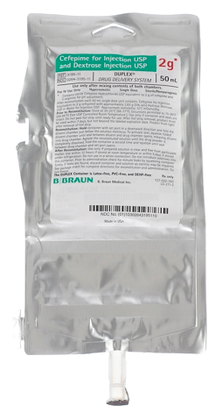
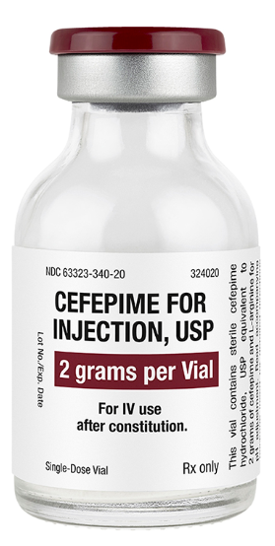
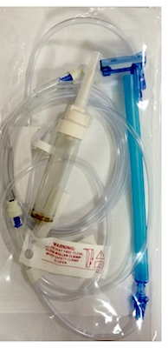
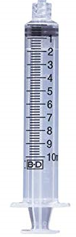
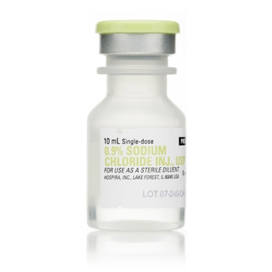
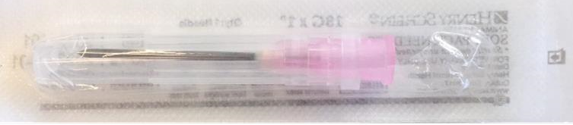
Intravenous Piggyback vs Intravenous Push
ED medication distribution
IVPB cefepime 2017 Administration: 30-60 mins
IVP cefepime 2018 Administration: 3-5 mins
Materials:
IV tubing
Alaris™ pump
Materials:
10 mL syringe
18 gauge needle
10 mL NaCl 0.9%
Is there a difference between IVPB and IVP cefepime administration?
IV: Intravenous
ED: Emergency department
Images retrieved from: http://products.fresenius-kabi.us/product-184.html
https://www.bbraunusa.com/en/products/b0/2g-cefepime-for-injectionuspanddextroseinjectionusp.html
https://www.allivet.com/p-2997-18g-x-1-inch-needle
https://www.amazon.com/BD-302995-Box-Syringe-Only-Luer-Lok
https://www.aaawholesalecompany.com/hos-488820-pk.html
Notes:
http://products.fresenius-kabi.us/product-184.html
https://www.bbraunusa.com/en/products/b0/2g-cefepime-for-injectionuspanddextroseinjectionusp.html
https://www.allivet.com/p-2997-18g-x-1-inch-needle.aspx?sku=25211-2&gclid=CjwKCAjwqqrmBRAAEiwAdpDXtFaSNdFpewtHkGIqq467nbCcK486R5bzmdYAOTy85msPr4s2Iec7KxoCo-QQAvD_BwE
https://www.amazon.com/BD-302995-Box-Syringe-Only-Luer-Lok/dp/B072KMPB9B
https://www.aaawholesalecompany.com/hos-488820-pk.html?utm_source=googleshopping&utm_medium=cse&gclid=CjwKCAjwqqrmBRAAEiwAdpDXtMoQaM67hV3lJZlQ0kOV_Q9ip3qmiSHPPIEmnpGlC6ZYVKvP5H9IixoCZYkQAvD_BwE

Slide 7
Outcomes
Primary
Secondary
Safety
Time from order to administration of first empiric antibiotic
Time from order to administration of second empiric antibiotic (if applicable)
Duration of treatment
Mortality
Direct cost differences
Newly documented adverse event

Slide 8
Methods
Approved by VCU Institutional Review Board
Retrospective, observational cohort study
  IVPB: January 2017 through June 2017
  IVP: January 2018 through June 2018
Data collected from Cerner Information Systems
Quality improvement project
  To help determine if the switch to IVP antibiotics should be continued once medication shortages resolve

Slide 9
Statistical Analysis
IBM SPSS Statistics 25
Baseline characteristics: Descriptive statistics
Continuous variables: Mann-Whitney U test
Categorical variables: Chi-Square

Slide 10
Patient Population
Inclusion
Age > 18 years old
Received cefepime from January-June 2017 and January-June 2018 in the ED
Exclusion
Pregnancy
Prisoners
Did not receive cefepime in the ED

Slide 11
Patient Flow Diagram
Charts assessed for eligibility (n=499)
Excluded:
prisoners (n=17)
Eligible patients (n=482)
IVPB cefepime 2017 reviewed (n=165)
IVP cefepime 2018 reviewed (n=317)
Excluded:
not received in the ED (n=6)
Excluded:
not received in the ED (n=13)
IVPB cefepime 2017 included in analysis (N=159)
IVP cefepime 2018 included in analysis (N=304)

Slide 12
Patient Demographics
Baseline Characteristics | IVPB (n=159) | IVP (n=304)
Age (mean, years, std. dev) | 54.6 (+16.5) | 54.4 (+ 15.2)
Sex, no. (%) Male | 82 (51.2) | 138 (45.4)
Race, no. (%) Caucasian African American Hispanic Asian | 83 (51.9) 74 (46.3) 2 (1.3) 1 (0.6) | 146 (48) 147 (48.4) 4 (1.3) 3 (1)
Admitting unit, no. (%) General ICU Not admitted, ED Step-down | 132 (82.5) 23 (14.4) 4 (2.5) 1 (0.6) | 238 (78.3) 46 (15.1) 14 (4.6) 6 (2)
Std dev: Standard deviation

Slide 13
Patient Demographics
Baseline Characteristics | IVPB (n=159) | IVP (n=304)
Type of infection, no. (%) Febrile neutropenia Pulmonary Bloodstream infection Unknown Genitourinary Cellulitis Osteomyelitis CNS Intraabdominal Cardiac Prophylaxis | 38 (23.8) 31 (19.4) 28 (17.5) 25 (15.6) 16 (10) 10 (6.3) 4 (2.5) 4 (2.5) 3 (1.9) 1 (0.6) 0 (0) | 34 (11.2) 48 (15.8) 63 (20.7) 81 (26.6) 29 (9.5) 31 (10.2) 5 (1.6) 4 (1.3) 7 (2.3) 1 (0.3) 1 (0.3)
Initial antibiotic, no. (%) Cefepime Other | 133 (83.1) 27 (16.9) | 285 (93.8) 19 (6.3)

Slide 14
Primary and Secondary Outcomes
Primary/Secondary Outcomes | IVPB (n=159) | IVP (n=304) | P-value
Time from order to first antibiotic administration (mins, median, IQR range) | 58 (28-108.3) | 42.5 (23-67.5) | <0.001
Time from order to second antibiotic administration (mins, median, IQR range) | 74 (47.5-112) | 61 (33-91) | 0.006
Duration of antibiotic treatment (days, median) | 3 | 3 | 0.954
Reason for cefepime treatment discontinuation, no. (%) De-escalation/narrowing Broadening coverage Completion of treatment Therapy not indicated Other | 75 (46.9) 15 (24) 12.5 (20) 28 (17.5) 8.1 (13) | 154 (50.7) 35 (11.5) 43 (14.1) 52 (17.1) 20 (6.6) | 0.758
Mortality (during admission) no. (%) | 11 (6.9) | 23 (7.6) | 0.933
New documented adverse event to cefepime, no. (%) | 1 (0.6) | 6 (2) | 0.464
Mins: Minutes
IQR: Interquartile range

Slide 15
Characteristics of Adverse Events
Adverse Events | IVPB (n=159) | IVP (n=304)
Throat swelling | 1
Itching |  | 1
Hives |  | 2
Flushing/hives |  | 1
Tongue swelling |  | 1
Unknown |  | 1
Total no. (%) | 1 (0.6%) | 6 (2%)

Slide 16
Direct Cost Savings
Characteristic | IVPB | IVP
Doses | 159 | 304
Medication wholesale acquisition (WAC) | 1 g = $11.72/Piggyback 2 g = $17.69/Piggyback | 1 g = $5.83/vial 2 g = $9.34/vial
Material cost | $9.50/primary set | $0.10/needle $0.18/syringe $0.35/NaCl 0.9% vial
Total cost per dose | 1 g = $21.22 2 g = $27.19 | 1 g =$6.46 2 g =$9.97
Estimated cost savings per dose | 1 g =$14.76 2 g =$17.22
* Includes price for primary set infusion tubing
**Includes price for 10mL syringe, 18G needle, 10 mL NaCl 0.9% vial
NaCl = Sodium chloride
Pricing retrieved from:
https://www.meadowsmedical.com/online-store/iv-pharmacy/iv-tubing/alaris-71-72-series-primary-set-detail
http://shop.gohcl.com/default.aspx?page=item%20detail&itemcode=19837
Notes:
IVP
17-1g
287- 2g
IVPB
9-1g
151-2g
Single dose cost
6.46=IVP1g
2gIVP-9.97
Single dose cost
1givpb= 21.22
2gIVPB=27.19
1gIVPB= 190.98
2gIVPB= 4105.69
1gIVP=109.82
2gIVP=2861.39

Slide 17
Limitations
Retrospective study
Single institution
Limited time period
Documentation bias
Restriction of meropenem

Slide 18
Conclusion
The utilization of IVP antibiotics resulted in faster treatment times compared to IVPB antibiotics with median time savings of 16 minutes
Duration of antibiotic therapy, reason for cefepime treatment discontinuation, and mortality were not significantly different between the two groups
Adverse events were slightly higher in the IVP group, but not statistically significant
There was direct cost savings with IVP compared to IVPB
IVPB: intravenous piggyback
IVP: intravenous push

Slide 19
Future Directions
Recommend to pharmacy leadership to continue the use of IVP antibiotics even after the drug shortage resolves due to time savings and cost savings
Examine the utilization of other IVP antibiotics beyond cefepime
Nursing time and satisfaction survey

Slide 20
Acknowledgements
Tammy Nguyen, PharmD, BCPS
Stephen Miller, DO

Slide 21
Characterizing the change between intravenous piggyback and intravenous push antibiotic administration in the emergency department
Stephanie Gore, PharmD
PGY1 Pharmacy Practice Resident
VCU Health System

