Slide 1
Evaluation of the Management of Skin and Soft Tissue Infections in the Inpatient Setting
Jennifer Emberger MD, MPH
Khine Sann MBBS
SIGoVA Virtual Research Symposium
June 14, 2019

Slide 2
BACKGROUND
Skin and soft tissue infections (SSTIs) accounted for 10% of all infectious diseases related hospitalizations in the US from 1998-2006
2.5% of total hospitalization across Veterans Affairs Medical Centers from 2007 to 2009
Treatment of SSTIs is widely variable and antimicrobial management is often inappropriate
The Infectious Disease Society of America (IDSA) published practice guidelines for the management of SSTIs in 2014
Compliance with treatment guidelines is an important outcome measure for Antimicrobial Stewardship Programs (ASP)
Christensen et al. Clin Infect Dis.2009; 49(7):1025-1035.
Jenkins et al. Clin Infect Dis.2010; 51(8):895-903.
Hurley et al. Am J Med. 2013; 126(12):1099-1106.
Walsh et al. BMC Infect Dis. 2016; 16(1):71
Stevens et al. Clin Infect Dis. 2014; 59(2):147-159.

Slide 3
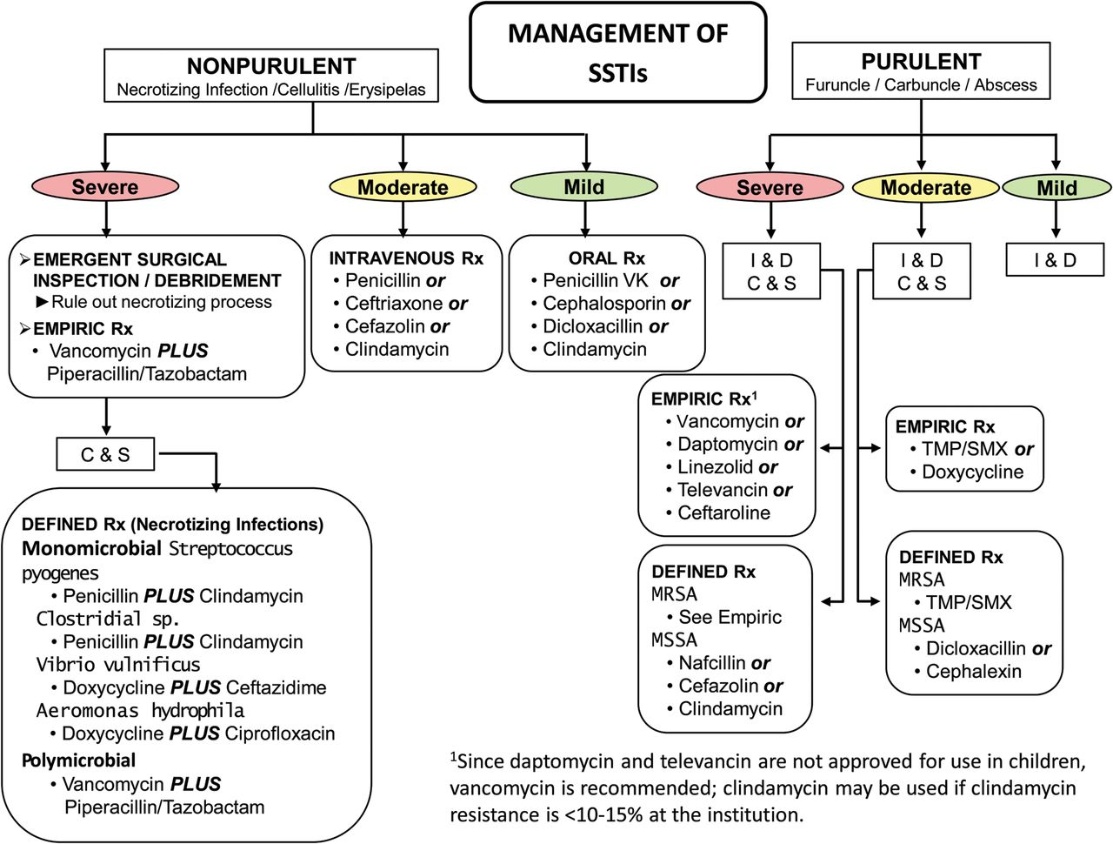
Stevens et al. Clin Infect Dis. 2014; 59(2):147-159.

Slide 4
STUDY OBJECTIVE
To evaluate the appropriateness of antibiotics for the treatment of purulent and non-purulent SSTIs at the Richmond VAMC

Slide 5
METHODS
Study Site: The Richmond VAMC (399-bed tertiary care center)
Multi-site study in collaboration with the Antimicrobial Stewardship Taskforce, Salt Lake City IDEAS Group and VA Pharmacy Benefits Management/VA Center for Medication Safety
Study Design: Retrospective chart review of patients admitted between June 1, 2016 to May 31, 2017

Slide 6
RICHMOND VAMC

Slide 7
METHODS
Inclusion Criteria:
Patients aged ≥18 years
Received inpatient care in an acute care unit
First hospital visit in the study period with at least one of two ICD-10 codes present on admission:
L02 (cutaneous abscess, furuncle or carbuncle)
L03 (cellulitis and lymphangitis)
Received systemic antibacterial treatment >2 total calendar days (including during & after hospitalization)

Slide 8
METHODS
Exclusion Criteria:
Admission for SSTI within past 28 days prior to current hospital visit
Systemic antibacterial therapy for non-SSTI indications
Expiration within 5 days of hospital admission date
Transfer to another inpatient facility within 5 days of current hospitalization
Direct transfer from another facility where inpatient hospitalization occurred
Severe immunosuppression
Systemic antibiotic treatment for the following SSTIs:
Surgical site infection, chronic ulcers or wounds, SSTI involving the face, eye, mouth, ear or nose, peri-rectal or peri-genital SSTI, human or animal bite SSTI, SSTI related to retained foreign body, necrotizing SSTI, deep tissue infection

Slide 9
METHODS
Data Collection: (Patient characteristics)
Demographics (age, gender)
Comorbidities (eg. diabetes, heart failure, ischemic heart disease, peripheral vascular impairment, chronic kidney disease, end-stage renal disease on hemodialysis, cirrhosis)
Baseline characteristics (BMI, I&D for SSTI or receipt of abx 14 days prior to visit, current or past MRSA surveillance screen)
Documented antibiotic allergy

Slide 10
METHODS
Data Collection: (Hospitalization details)
Length of stay
SSTI classification (non-purulent vs. purulent)
Site of SSTI
Vital signs & laboratory values (WBC, ESR, CRP, lactate)
Patients who meet ≥ 2 quick SOFA criteria within 1 calendar day of first antibacterial
Patients on vasopressors within 1 calendar day of the first antibacterial
Use of imaging
Incision and drainage
Choice and duration of antimicrobials
Blood and cutaneous culture results
Retreatment for SSTI within 28 days of discharge
Evidence of C .diff infection during hospitalization or within 28 days of discharge

Slide 11
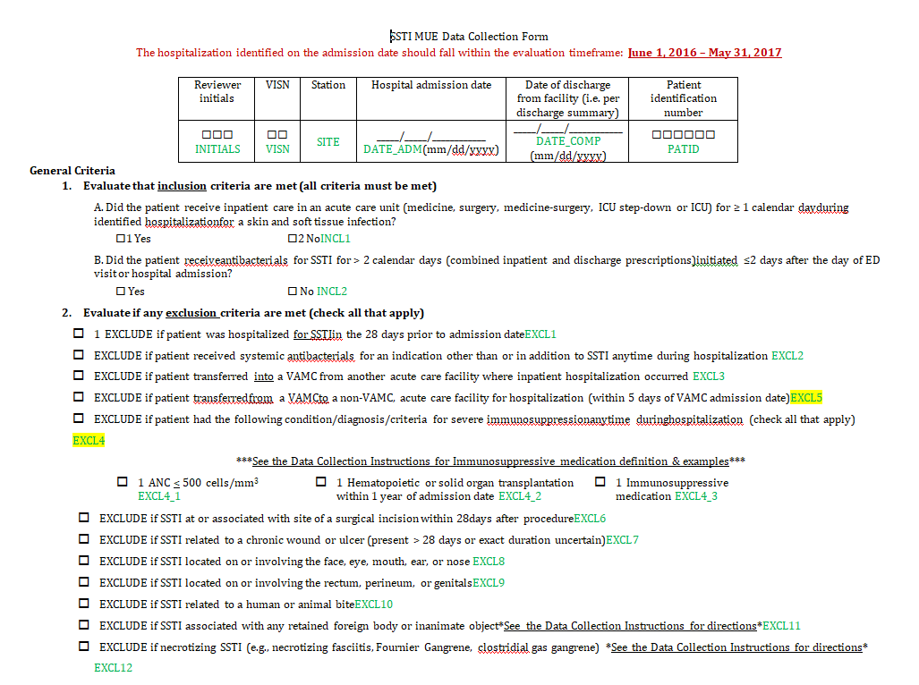

Slide 12
METHODS
Infections were classified as a purulent SSTI based on chart review documenting
Abscess
Nodule
Boil
Carbuncle
Furuncle
Felon
Purulence
Purulent cellulitis/drainage/exudate/SSTI
Fluctuance
Fluid accumulation/collection or pus/pustule

Slide 13
METHODS
Descriptive analysis:
Frequencies of:
Non-purulent vs purulent cases
Dual antibiotic therapy
Antibiotic allergies
Quick SOFA criteria
I&D
CDI
MRSA positive screens
Location of SSTI
Average:
Age
BMI
Duration of antibiotics
Days of therapy (DOT) of antibiotics
Distribution of choice of antibiotics used
Distribution of culture results
Statistical analysis:
SAS version 9.4 (Cary, NC) was used for all analyses
Associations were assessed using:
Spearman outcomes relevant to management of SSTIs
Spearman rank correlations
Wilcoxon rank test
Logistic regression
Fischer’s exact test

Slide 14
RESULTS
114 patients charts were reviewed for our study
43 patients met inclusion criteria
11 purulent SSTI, 32 non-purulent SSTI
Average age of patients in the study was 69.2 years
Average BMI (kg/m2) was 31.4
24 patients (56%) were found to have a documented antibiotic allergy
The majority (72%) of SSTIs were located in the lower extremities
No patients met ≥ 2 quick SOFA criteria within 1 calendar day of the first antibacterial administration
No patients developed C. diff within 28 days of antimicrobial administration

Slide 15
RESULTS
Distribution of Comorbidities | Number (N) | Percentage (out of a total of 43 patients)
Heart failure | 14 | 33 %
Chronic kidney disease | 17 | 40 %
Peripheral vascular disease | 19 | 44 %
Ischemic heart disease | 22 | 51 %
Cirrhosis | 2 | 5 %
Diabetes mellitus | 26 | 61 %
Injection drug use | 0 | 0 %

Slide 16
RESULTS
There were NO significant differences between patients with purulent and non-purulent SSTI in terms of:
Inappropriate antibiotic choices (82% vs. 97%, p-value = 0.1560)
Inappropriate length of therapy (45% vs. 63%, p-value = 0.4805)
Length of stay was significantly associated with BMI (r = -0.31, 95% CI: -0.56, 0.00, p-value = 0.0491)
Minocycline, Cephalexin and Vancomycin had the highest total DOT among all patients
Total DOT were higher in patients with non-purulent SSTIs

Slide 17
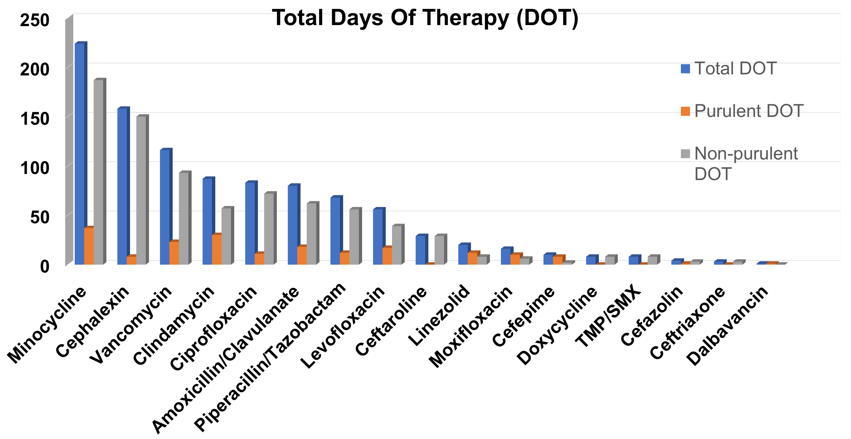

Slide 18
RESULTS
40/43 (93%) patients received IDSA guideline discordant choice of antibiotic therapy
25/43 (58%) patients received IDSA guideline discordant duration of therapy
25/43 (58%) patients received IDSA guideline discordant choice and duration of therapy

Slide 19
Data Summaries for Continuous and Categorical Outcomes
 | Purulent SSTI |  |  |  | Non-Purulent SSTI
 | N | Median | Min/Max |  | N | Median | Min/Max | p value
Total length of antibiotic therapy | 11 | 9 | 1 ,16 |  | 32 | 10 | 5, 65 | 0.1978
Days of therapy for all antibiotics | 11 | 21 | 5, 26 |  | 32 | 20.5 | 6, 134 | 0.4105
Length of hospital stay (in days) | 10 | 3 | 2, 3 |  | 31 | 3 | 1, 12 | 0.3476
 | N | Frequency | % |  | N | Frequency | %
Inappropriate Antibiotic Choice | 11 | 9 | 82% |  | 32 | 31 | 97% | 0.1560
Inappropriate Length of Therapy | 11 | 5 | 45% |  | 32 | 20 | 63% | 0.4805
Inappropriate Antibiotic Choice AND Length of Therapy | 11 | 5 | 45% |  | 32 | 20 | 63% | 0.4805

Slide 20
CONCLUSIONS
Most patients at our VAMC receive guideline discordant choice and/or duration of antibiotic therapy for SSTIs
Despite guidelines emphasizing a distinction between treatment of purulent vs non-purulent SSTIs, providers at our facility do not seem to use these categories to guide antibiotic therapy
Optimization of treatment of SSTIs represents a key opportunity for Antibiotic Stewardship Programs

Slide 21
FUTURE DIRECTIONS
Create an SBAR (Situation, Background, Assessment, Recommendation) summarizing our findings and recommendations from this study
Distribute SBAR at VAMC
Educate frontline providers
Develop clinical pathway for treatment of SSTI
Repeat our study

Slide 22
ACKNOWLEDGEMENTS
J. Daniel Markley DO, MPH
Leroy Vaughan MD
Daniel Tassone PharmD
Roy Sabo PhD
Michael P. Stevens MD, MPH

Slide 23
REFERENCES
Christensen KL, Holman RC, Steiner CA, Sejvar JJ, Stoll BJ, Schonberger LB. Infectious disease hospitalizations in the United States. Clin Infect Dis. 2009;49(7):1025-1035.
Jenkins TC, Sabel AL, Sarcone EE, Price CS, Mehler PS, Burman WJ. Skin and soft-tissue infections requiring hospitalization at an academic medical center: opportunities for antimicrobial stewardship. Clin Infect Dis. 2010;51(8):895-903.
Hurley HJ, Knepper BC, Price CS, Mehler PS, Burman WJ, Jenkins TC. Avoidable antibiotic exposure for uncomplicated skin and soft tissue infections in the ambulatory care setting. Am J Med. 2013;126(12):1099-1106.
Walsh TL, Chan L, Konopka CI, et al. Appropriateness of antibiotic management of uncomplicated skin and soft tissue infections in hospitalized adult patients. BMC Infect Dis. 2016;16(1):721.
Stevens DL, Bisno AL, Chambers HF, Dellinger EP, Goldstein EJC et al. Executive Summary: Practice Guidelines for the Diagnosis and Management of Skin and Soft Tissue Infections: 2014 Update by the Infectious Diseases Society of America. Clin Infect Dis. 2014; 59(2):147-159.

