Slide 1

Implementation and Impact of Real-time Audit and Feedback on All Positive Blood Cultures in the Inpatient and Outpatient Setting at an Academic Veterans Affairs Medical Center
Pamela Bailey, DO
Representing: Barry Rittmann MD, MPH, Roy Sabo PhD, Leroy Vaughan MD, Daniel Tassone PharmD, Amy Pakyz, PharmD, PhD, Michael P. Stevens MD, MPH, and J. Daniel Markley DO, MPH

Slide 2
background
Bloodstream infection is a major cause of morbidity and mortality worldwide and in the United States.
Gram-negative sepsis with shock has a mortality rate of 12 to 38 percent.
The most common Gram-positive bacteremia, Staphylococcus aureus, has a mortality rate ranging from 20 to 40 percent, not to mention significant morbidity (endocarditis, etc.).
It is well known that time to appropriate antibiotics in sepsis is critical to saving lives.
Kang et al. Antimicrob Agents Chemother 2005; 49:760.
Mylotte JM et al. Rev Infect Dis 1987; 9:891.
Kumar A et al. Crit Care Med 2006; 34:1589.

Slide 3
background
ID consultation has been linked to improved outcomes in cases involving Staph aureus bacteremia.
Forsblom et al:
A retrospective study comparing bedside consultation with telephone consultation for management of 342 patients with S. aureus bacteremia revealed that bedside consultation was associated with a significantly lower 90-day mortality (9 versus 29 percent; odds ratio 0.25; 95% CI 0.13-0.51).
Among patients treated with an appropriate duration of therapy, significantly fewer relapses were observed among those who received bedside consultation (6 vs. 18 percent).
Fowler VG et al. Clin Infect Dis 1998; 27:478.
Forsblom E et al. Clin Infect Dis 2013; 56:527.
Schmitt S et al. Clin Infect Dis 2014; (58): 22-28
Notes:
1. Kang CI, Kim SH, Park WB, et al. Bloodstream infections caused by antibiotic-resistant gram-negative bacilli: risk factors for mortality and impact of inappropriate initial antimicrobial therapy on outcome. Antimicrob Agents Chemother 2005; 49:760.
2. Mylotte JM, McDermott C, Spooner JA. Prospective study of 114 consecutive episodes of Staphylococcus aureus bacteremia. Rev Infect Dis 1987; 9:891.
3. Kumar A, Roberts D, Wood KE, et al. Duration of hypotension before initiation of effective antimicrobial therapy is the critical determinant of survival in human septic shock. Crit Care Med 2006; 34:1589.
4. Fowler VG Jr, Sanders LL, Sexton DJ, et al. Outcome of Staphylococcus aureus bacteremia according to compliance with recommendations of infectious diseases specialists: experience with 244 patients. Clin Infect Dis 1998; 27:478.
5. Forsblom E, Ruotsalainen E, Ollgren J, Järvinen A. Telephone consultation cannot replace bedside infectious disease consultation in the management of Staphylococcus aureus Bacteremia. Clin Infect Dis 2013; 56:527.

Slide 4

Intervention
Since 2007, ALL positive blood cultures at the Richmond VAMC undergo prospective audit and feedback
>3000 culture notes written since 2007
Micro lab generates a “blood culture alert” as soon as Gram stain is performed
Alert goes to desktop of on-call ID fellow, attending, and ordering provider
ASP performs a chart review
ASP responds in the form of E-consult note as soon as feasible
Limited by chart access, most responses are during office hours (no nights or weekends)
Template imports Gram stain and culture results if available; field for antibiotics; field for recommendations, and disclaimer
Individual note content varies by provider
10-15 minutes on average/culture note
Focuses on the initial management of bloodstream infections
empiric antibiotic therapy
initial workup and further management
Notes:
Would show a screenshot of a blank template
This notification is the result of a brief chart review and does not constitute a formal consultation. If any questions arise regarding the significance of these results, please consult Infectious Diseases

Slide 5

Screenshot of blood culture alert note

Slide 6
Study objectiveS
To determine the impact of real-time audit and feedback for all positive blood cultures in the inpatient and outpatient setting and describe the implementation of this intervention
To determine if ASP reaction time (to e consult note completion) was associated with:
Time to clearance of blood cultures
Day of the week the alert was generated
Mortality
LOS
C. diff infections
Describe the characteristics of the stewardship interventions being performed and their impact on ID consultation

Slide 7
Methods
Study Design: Retrospective Cohort Study
Chart review performed by 2 ID fellows, questions adjudicated by 2 ID attendings
Inclusion criteria:
All adult inpatients or outpatients with positive blood culture alert note performed February 2016-October 2017 (18 months)
Exclusion criteria
Formal ID consultation on the same day as ID Blood Culture Note
>1 distinct episodes of bacteremia during the hospital stay
LOS > 150 days
Death prior to ASP review
Notes:
Clearly defined characteristics ie immunosuppression, using the same timestamps, etc

Slide 8
Methods – Data Collection
Demographics | Health Factors | ASP Interventions | Infection Characteristics | Outcomes
Age | Immunosuppresion | Initiation of abx | Organisms ID | Mortality at 30 and 90 days
Sex | ICU stay anytime during hospitalization | Escalation of abx | Contaminant status as deemed by ASP | LOS
Location at time of alert (inpt vs outpt) |  | De-escalation of abx | Day of the week alert generated | C diff infection events
 |  | IV to PO
 |  | Additional workup recommended (lab/imaging)
 |  | Reaction Time by ASP
 |  | Day of the week note written
 |  | Subsequent formal ID consultation performed

Slide 9
OutcomEs
Primary Outcomes
Time to sustained blood culture clearance
30 and 90 day mortality
Secondary Outcomes
LOS
C. diff infections
Subsequent ID consultation

Slide 10
Statistical analysis
Differences in ASP reaction time are compared between days in which the blood culture alert was generated using Poisson regression
Differences in the rates of ASP reaction time lasting longer than 24 hours are compared between alert dates using binary logistic regression.
Associations between ASP reaction time and categorical outcomes (ID consultation, C-Diff performed, day 30 mortality, day 60 mortality) are examined using binary logistic regression,
Associations between ASP reaction time and continuous outcomes (time to blood culture clearance, length of hospital stay) are examined using Poisson regression.
Adjusted models incorporate continuous ASP reaction time as well as patient age, sex and day of the week blood culture alerts were sent (weekday or weekend), whether patient was immunosuppressed, and whether patient was admitted to ICU.
Associations between species identification are examined between the categorical outcomes with binary logistic regression and between continuous outcomes with Poisson regression.
The GLIMMIX procedure in the SAS statistical software (version 9.4, Cary, NC, USA) was used for analyses.

Slide 11
Results
302 patients were included in the study
The mean age was 69 years, and 96% male
Most common organisms:
Coagulase negative Staphylococcus aureus (104/302, 34%)
Escherichia coli (47/302, 15%)
Staphylococcus aureus (33/302, 11%)
Organisms were analyzed in 4 main groups
Notes:
Recommended a unique intervention in 208 (69%) patients
371 interventions; mean of 1.22 interventions per patient
39 (13%) patients were outpatient; 19 (50%) were recommended for admission.
216 (72%) of alert notes were written ≤ 24 hours from blood culture positivity.
Mean reaction time for the ASP was 20.8 hours
Varied depending on day of the week that the blood culture became positive (range 0.25 – 122 hours, p < 0.001)

Slide 12
Group 3: GNRs (99, 32.8%)
GNR unspecified (7)
Aeromonas hydrophila (1)
Bacteroides (eggerthii, fragilis, sp, thetaiotaomicron) (4)
Capnocytophaga canimorsus (1)
Citrobacter koseri (2)
Escherichia coli (48)
Enterobacter sp. (aerogenes, cloacae, sp) (6)
Haemophilus influenza (1)
Klebsiella sp. (oxytoca, ozaenae, pneumoniae, sp) (25)
Moraxella oslonesnsis (1)
Morganella morganii (2)
Parabacteroidies distasonis (1)
Pasturella multocida (2)
Proteus mirabilis (7)
Providencia stuartii (1)
Pseduomonas sp. (aeruginosa, putida) (8)
Salmonella sp. (non-typhi/paratyphi, enteritidis) (2)
Serratia maracescens (4)
Sphinogomonas paucimobilis (1)
Group 1: Staphylococcus aureus (30, 9.9%)
Methicillin resistant | 8
Methicillin susceptible | 15
Susceptibility not specified | 10
Group 2: Coagulase-negative Staphylococci and other GPC (135, 44.7%)
Staph Epidermidis | 11
Staph hominis | 2
coagulase-negative, not otherwise specified | 91
Enterococcus faecalis and faecium. (19)
GPC not specified (1)
Kocuria rosea (1)
Micrococcus sp. (3)
Streptococcus sp. (agalactiae, anginosus, bovis, constellatus, dysgalactiae, equinus, gallolyticus spp pasturianus, pneumoniae, pyogenes, salivarius, sanguinis, alpha-hemolytic, intermedius) (38)
Group 4: Polymicrobial and other species (38, 12.6%)
Diptheroids/GPR no speciation (11)
Bacillus sp. (5)
Candida parapsilosis (1)
Clostridium sp. (clostridiforme, perfringes, sp) (4)
Propionibacterium avium (1)

Slide 13
ASP Interventions
A total of 371 interventions were performed
mean of 1.22 interventions per patient
Recommended a unique intervention in 208 (69%) patients
39 (13%) patients were outpatient; of those, 19 (50%) were recommended for admission
216 (72%) of alert notes were written ≤ 24 hours from blood culture positivity
Mean reaction time for the ASP was 20.8 hours
Varied depending on day of the week that the blood culture became positive (range 0.25 – 122 hours, p < 0.001)

Slide 14
“Additional workup” included imaging (n=18, 6%), labs (n=115, 37%), both labs and imaging (n=16, 5%), removal of central lines and bladder catheters (n=6, 2%), joint aspiration (n=1, 0.3%), and surgical consultation (n=1, 0.3%).
Notes:
Recommended a unique intervention in 208 (69%) patients
371 interventions; mean of 1.22 interventions per patient
39 (13%) patients were outpatient; 19 (50%) were recommended for admission.

Slide 15
Mean reaction time for the ASP was 20.8 hours and varied significantly depending on day of the week that the blood culture was generated (range 0.25 – 122 hours, p < 0.05)
Notes:
216 (72%) of alert notes were written ≤ 24 hours from blood culture positivity.
Mean reaction time for the ASP was 20.8 hours
Varied depending on day of the week that the blood culture became positive (range 0.25 – 122 hours, p < 0.001)

Slide 16
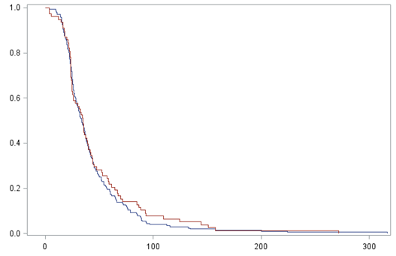
Blue line: ASP reaction time < 24 hours
Red line: ASP reaction time > 24 hours
Shorter reaction times were associated with faster time to clearance (p < 0.05)
proportion of patients with positive blood cultures
time to clearance
Notes:
Blue line represents ASP reaction time < 24 hours
Red line represents ASP reaction time > 24 hours
X axis is time to clearances
Y axis is proportion of patients that cleared
As you can see, faster reaction times were associated with faster time to clearance

Slide 17
Regression analysis of Differences in Outcomes by Organism Grouping
Bacterial Species | N, % | Rate of ID Consult | p-value | Mean Time to Blood Culture Clearance (hr) | p-value | LOS (days) | p-value
Staphylococcus aureus | 30, 9.9% | 73% | < .05 | 49.4 | < .05 | 12.3 | < .05
Coagulase-negative Staph and other GPCs | 135, 44.7% | 36% | < .05 | 46.7 | < .05 | 11.7 | < .05
GNRs | 99, 32.8% | 40% | < .05 | 33.6 | < .05 | 10.7 | < .05
Polymicrobial and Other species | 38, 12.6% | 39% | < .05 | 62.7 | < .05 | 19.6 | < .05
Rate of ID consultation, time to blood culture clearance, and LOS varied by organism identification (all p values < 0.05)
Notes:
Rate of ID consultation, Time to blood culture clearance, and LOS varied by organism identification (a p values < 0.05)

Slide 18
Time to blood culture clearance
Mean time to clearance was 44 hours (3.45—316.6 hours)
Reaction times > 24 hours were associated with significantly longer time to clearance (p-value = 0.0002, RR = 1.08, 95% CI: 1.04, 1.12)
Day of the week was also associated with time to clearance, with weekdays more likely to clear than weekends (p = 0.0023, RR = 1.08, 95% CI: 1.03, 1.13).
Time to clearance was different between identified species types (p < 0.0001, Table 2).

Slide 19
ID consultation
Subsequent to the ASP blood culture alert note being documented, official ID consults were eventually placed on 42% (n = 130) of patients.
ASP reaction time was negatively associated with the occurrence of ID consultation (p = 0.0059)
Reaction times > 24 hours associated with a 52% lower odds of consultation (OR = 0.48, 95% CI: 0.28, 0.82).
Shorter ASP reaction time more likely to prompt a formal ID consultation

Slide 20
mortality
Mean 30 and 90 day mortality were 9% (n=29) and 18% (n=53) respectively
ASP Reaction time was not associated with day-30 mortality (p = 0.93) or day-90 mortality (p = 0.56)

Slide 21
Length of stay
Mean LOS was 12 days
ASP reaction time was not associated with length of hospital stay (p = 0.45)
Blood culture alerts that were generated on weekends were associated with longer LOS compared to weekdays (RR = 1.10, 95% CI: 1.01, 1.20)
Hospital LOS significantly differed between identified species types (p < 0.0001)

Slide 22
C. diff
ASP reaction time not associated with C. diff infections

Slide 23
Conclusions
Real-time audit and feedback of all positive blood cultures by the ASP results in a high frequency of stewardship interventions (~70% of patients)
Reaction time < 24 hours improves time to blood culture clearance
Faster ASP reaction times are more likely to prompt formal ID consultations
Blood cultures positivity on weekends associated with longer LOS
Absence of weekend coverage significantly impacts ASP reaction time and more resources are needed to optimize implementation
Audit and feedback of all positive blood cultures provides a means to enhance patient safety by rapidly identifying patients with bacteremia in the outpatient setting that may require prompt hospitalization

Slide 24
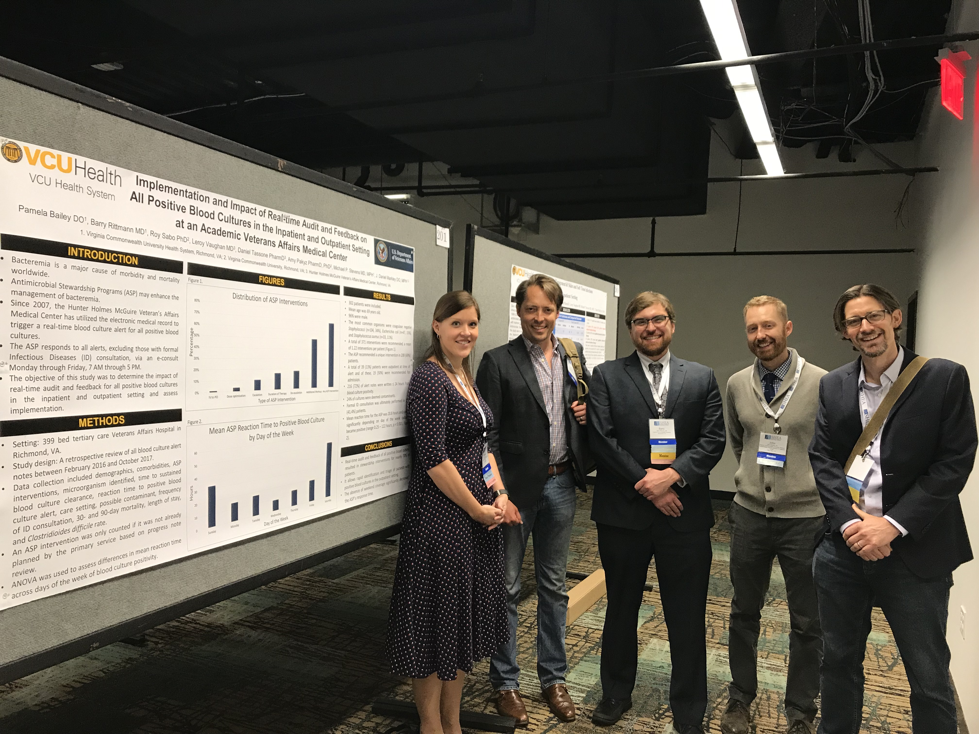
Contributors
Barry Rittmann MD, MPH
Roy Sabo PhD
Amy Pakyz, PharmD, PhD
Daniel Tassone PharmD
Leroy Vaughan MD
Michael P. Stevens MD, MPH
J. Daniel Markley DO, MPH

Slide 25
Questions?

