Slide 1

Implementation of an Antibiotic Timeout Process
SIGOVA Antimicrobial Stewardship
Research Symposium
Ashlee Hamel, PharmD, BCPS
System Coordinator, Pharmacy Clinical Programs
Sentara Healthcare - Norfolk, VA
agsommer@sentara.com

Slide 2

Sentara Healthcare
Not-for-profit system serving Virginia and northeastern North Carolina
12 hospitals (2,727 beds)
Advanced imaging centers
Nursing and assisted-living facilities
Rehabilitation services
Home health/hospice programs
Outpatient medical clinics
Integrated health insurance partner
~180,000 inpatient visits annually
76,000 ED admissions
~700,000 outpatient visits each year
*Location of Sentara hospitals
Sentara Healthcare, 2019

Slide 3

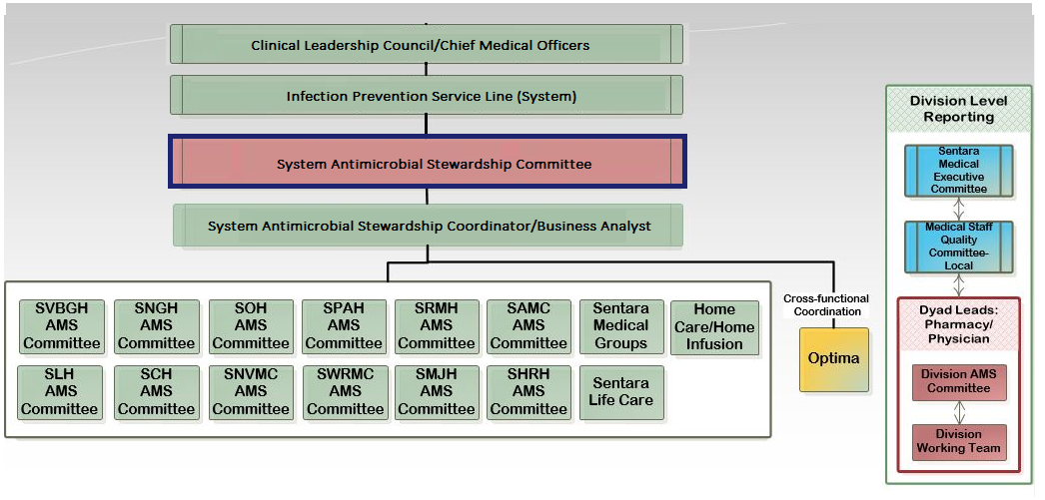
Sentara’s Antimicrobial Stewardship Program (ASP)
Notes:
.

Slide 4
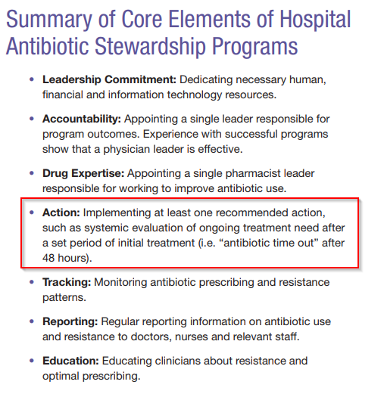
Antibiotic Timeout (ATO)
CDC, 2014

Slide 5
Phases of Antibiotic Timeout Project
Educate and Implement
Share, Review, and Gather Feedback – Test, Test, Test!
Project Proposal
Gap Analysis/Impact Effort Matrix
Review and Revise
Collect Data and Validate Impact

Slide 6
Phases of Antibiotic Timeout Project
Educate and Implement
Share, Review, and Gather Feedback – Test, Test, Test!
Project Proposal
Gap Analysis/Impact Effort Matrix
Review and Revise
Collect Data and Validate Impact

Slide 7
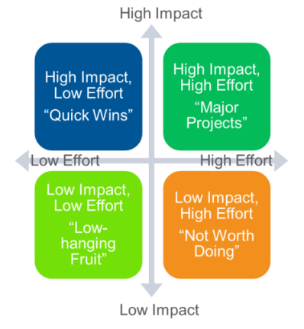
Project Selection – Impact Effort Matrix
Perform gap analysis and plot possible projects
Value
Ease of implementation
Global project comparison
Consider organization’s priorities
Know your bandwidth
American Society for Quality - Quality in Healthcare, 2019

Slide 8
Phases of Antibiotic Timeout Project
Educate and Implement
Share, Review, and Gather Feedback – Test, Test, Test!
Project Proposal
Gap Analysis/Impact Effort Matrix
Review and Revise
Collect Data and Validate Impact

Slide 9

Provide Rationale
According to CDC, 20-50% of all antibiotics prescribed in acute care settings are unnecessary and inappropriate.
Antibiotics are often started empirically in hospitalized patients while diagnostic information is being obtained.
The initial selection of antibiotics and duration of treatment are often not optimal
There was no process in place to ensure a review of the selection of antibiotics after more clinical and laboratory data (including culture results) became available
CDC, 2014

Slide 10
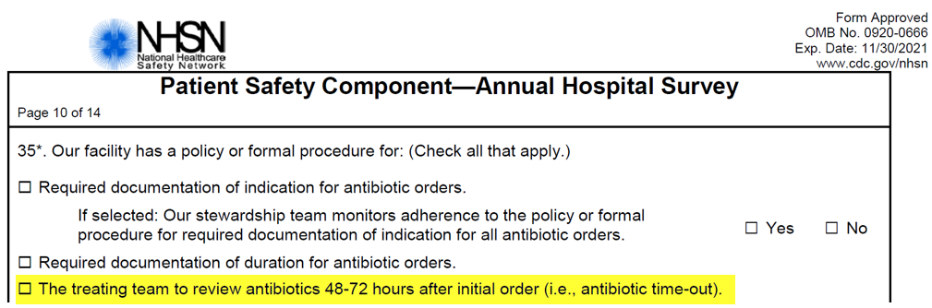
External Support
A number of state/federal agencies and professional societies have developed standards that affect hospital accreditation, reimbursement, and quality metrics.
Antibiotic timeout is one of the measured best practices and is proposed by CMS to be a regulatory mandate in the near future
This metric is currently part of the NHSN/Leapfrog patient safety surveys
CDC, 2014
NHSN, 2018

Slide 11

ATO Overview
Goal:
Optimize clinical outcomes and prevent continuation of unnecessary antibiotics in the acute care setting
Assess all antibiotic regimens on day 3
Key Items:
Encourage prospective reviews > “blanket” alert
Be specific; streamline white noise
Make it actionable
Evidence:
The documentation of antibiotic assessments in the EMR is inconsistent and often incomplete
If an assessment is documented, it is often not in a discrete, reportable, and/or actionable format

Slide 12
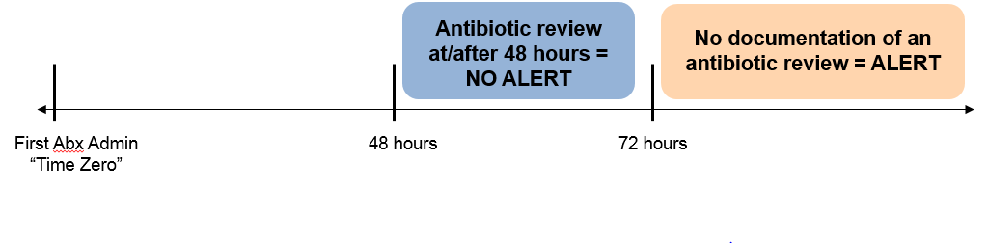
Create an Integrated Workflow
Give providers the opportunity to prospectively assess antibiotics as a part of their daily workflow
Implement an alert to prompt an assessment if a timeout is not recorded
Note Documented or Change in ABX Orders
Alert Suppressed

Slide 13
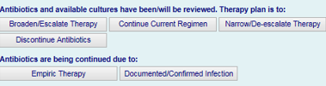

ATO Documentation
Progress Notes | Antibiotic Modification | Best Practice Alert
PROS -Non-invasive workflow -Defined questions and responses that file discretely | PROS -Non-invasive workflow | PROS -Prompts assessment for patients without a recorded ATO -Acts as reminder of best practice -Specific
CONS -Requires provider use of specific EMR functionality -No real-time audit to validate accuracy | CONS: -Potential that antibiotics are adjusted without thought of timeout | CONS -Invasive workflow

Slide 14



ATO Documentation
Progress Notes | Antibiotic Modification | Best Practice Alert
PROS -Non-invasive workflow -Defined questions and responses that file discretely | PROS -Non-invasive workflow | PROS -Prompts assessment for patients without a recorded ATO -Acts as reminder of best practice -Specific
CONS -Requires provider use of specific EMR functionality -No real-time audit to validate accuracy | CONS: -Potential that antibiotics are adjusted without thought of timeout | CONS -Invasive workflow

Slide 15

ATO Documentation
Progress Notes | Antibiotic Modification | Best Practice Alert (BPA)
PROS -Non-invasive workflow -Defined questions and responses that file discretely | PROS -Non-invasive workflow | PROS -Prompts assessment for patients without a recorded ATO -Acts as reminder of best practice -Specific
CONS -Requires provider use of specific EMR functionality -No real-time audit to validate accuracy | CONS: -Potential that antibiotics are adjusted without thought of timeout | CONS -Invasive workflow

Slide 16
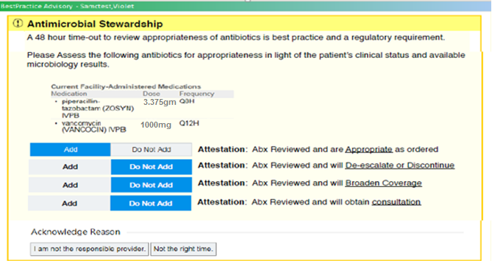
Alert Design
Alert Logic:
Exclude chronic/prophylactic therapy
Selective – displays to responsible provider
Timing of alert – once a day between 0600-1800

Slide 17
Phases of Antibiotic Timeout Project
Educate and Implement
Share, Review, and Gather Feedback – Test, Test, Test!
Project Proposal
Gap Analysis/Impact Effort Matrix
Review and Revise
Collect Data and Validate Impact

Slide 18
Vetting/Approval Pathway
Subject Matter . Experts
Reviewed literature
Proposed solutions
Project Team
Provided feedback
Proposed solutions
Informatics Support
Guidance on EMR build and design
Reaction Panels
Provider Groups
IT Physician Groups
VPMAs
Chief Officers/ Leadership Council
Final approval of project plan

Slide 19
Phases of Antibiotic Timeout Project
Educate and Implement
Share, Review, and Gather Feedback – Test, Test, Test!
Project Proposal
Gap Analysis/Impact Effort Matrix
Review and Revise
Collect Data and Validate Impact

Slide 20

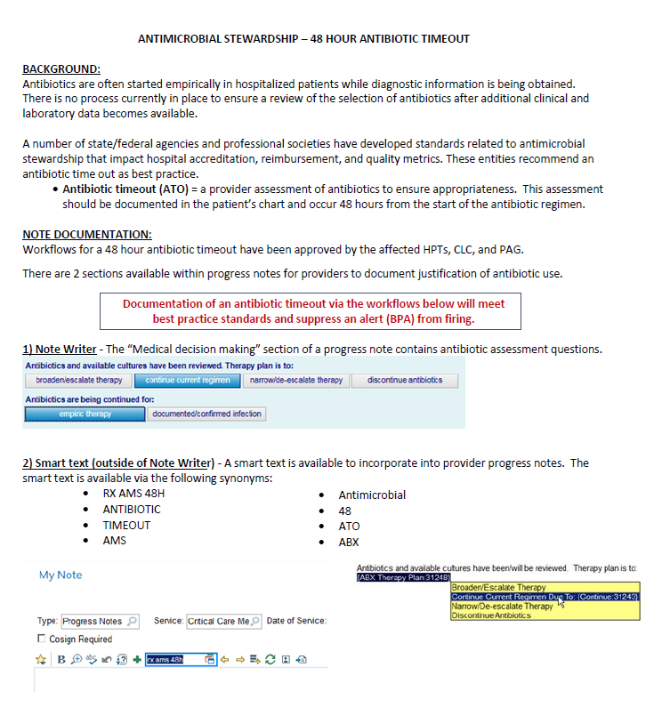
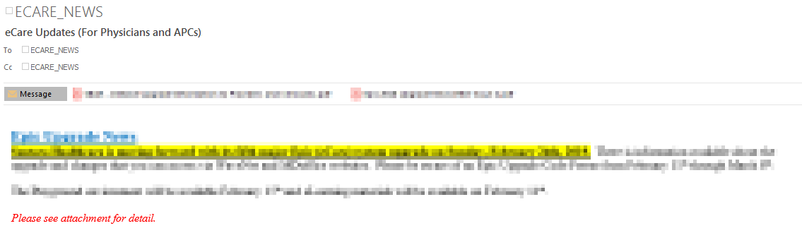
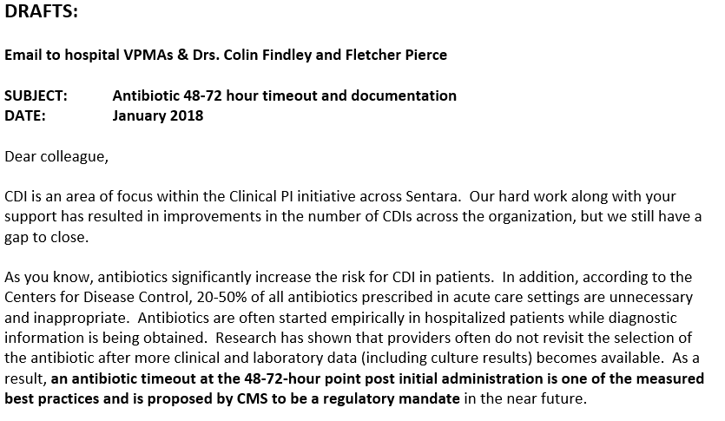
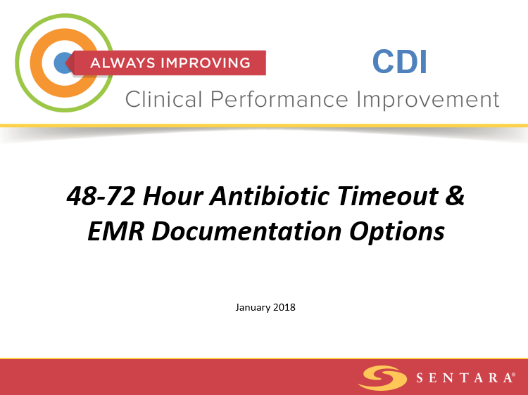
Education
Emphasize the value behind the change
Communicate in several ways/forums

Slide 21
Phases of Antibiotic Timeout Project
Educate and Implement
Share, Review, and Gather Feedback – Test, Test, Test!
Project Proposal
Gap Analysis/Impact Effort Matrix
Review and Revise
Collect Data and Validate Impact

Slide 22
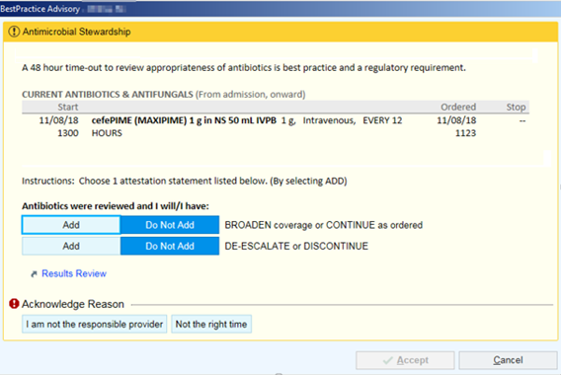
ATO Revisions
Updated triggers
Simplified verbiage
Streamlined responses

Slide 23
Phases of Antibiotic Timeout Project
Educate and Implement
Share, Review, and Gather Feedback – Test, Test, Test!
Project Proposal
Gap Analysis/Impact Effort Matrix
Review and Revise
Collect Data and Validate Impact

Slide 24
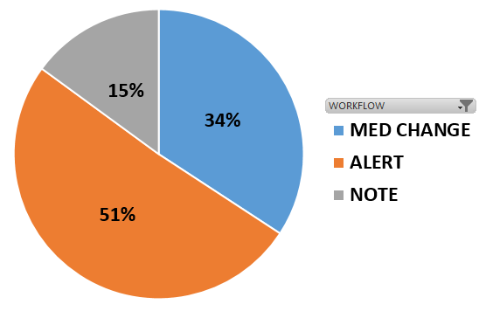
Evaluate ATO Impact
*Historic utilization of Note Writer
templates is between 15-30%
Adoption Metrics:
Increase in patients who had an antibiotic assessment recorded or antibiotic orders adjusted during the “timeout” window
Decrease in patients requiring an antibiotic timeout alert to fire due to missed documentation during the “timeout” window

Slide 25
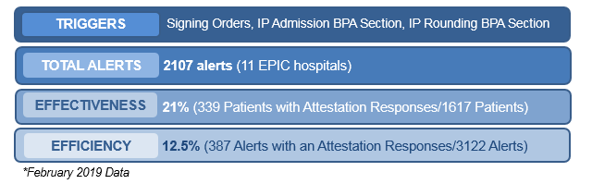
ATO Alert Evaluation
Effectiveness = # Pts with Desired Actions / Total # of Pts
Example: 20 patients w/ alert action taken = 40% effective
50 patients for whom alert(s) fired
Efficiency = # Alerts with Desired Actions / Total # of Alerts Fired
Example: 20 alerts w/ alert action taken = 10% efficient
200 alerts fired

Slide 26
Validity of ATO Documentation
83% Accuracy
Not Accurate
Notes:
.

Slide 27
Days of Therapy/1000 Patient Days
ANTIBIOTIC TIMEOUT – MID 2017

Slide 28

Our Experience: Lessons Learned
Get right people on the team initially
Get executive support
Clinicians relate to graphs and visuals
Don’t be afraid of revisions
Educate and re-educate
Small victories are still a win

Slide 29
Acknowledgments
Sentara Antibiotic Timeout Team Members
Dennis Szurkus, MD, MBA, CPE, FACOG
Mark Beck, MSM, RN, NE-BC
Chris Tagliente, PharmD, BCPS
Ashlee Hamel, PharmD, BCPS
Bogdan Neughebauer, MD, PhD, MBA, CPE, FACP, FIDSA
Karen Streett
Wilma Tagliente, MS, PharmD
Elsbeth Thurston, PharmD, MBA, MHA
Neil Davis, PharmD
Nikki Foster, PharmD
Jeremy Rose, PharmD, BCPS

Slide 30
Implementation of an Antibiotic Timeout Process
SIGOVA Antimicrobial Stewardship
Research Symposium
Ashlee Hamel, PharmD, BCPS
System Coordinator, Pharmacy Clinical Programs
Sentara Healthcare - Norfolk, VA
agsommer@sentara.com

